Slide 1



Radware Application Solution

Slide 2
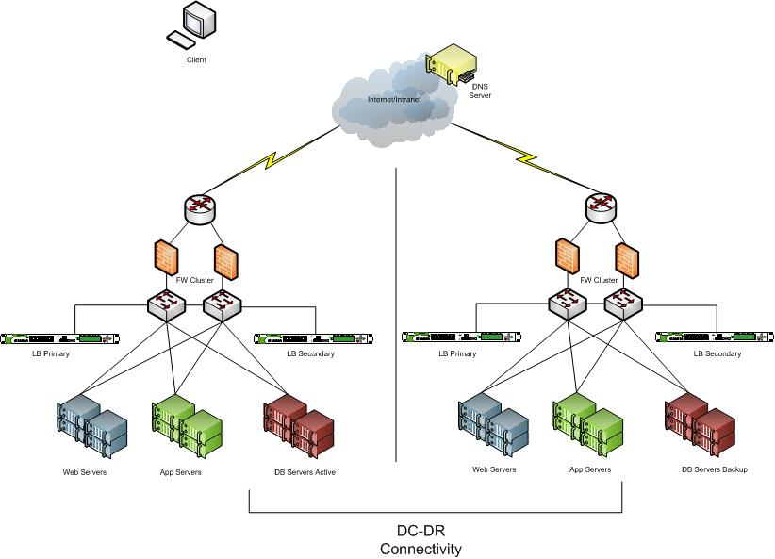
Application request using FQDN
DNS Request for abc.com
DNS Request for abc.com
abc.com is VIP-A
Web Request on VIP-A
abc.com is VIP-A
App Request
DB Request

Slide 3
Application Response Using FQDN
Web Response
App Response
DB Response

Slide 4
Application request using FQDN Secondary Site
DNS Request for abc.com
DNS Request for abc.com
Application Request on VIP-B
abc.com is VIP-B
abc.com is VIP-B
App Request
DB Request
Slide 4

Slide 5
Application response using FQDN Secondary Site
Web Response
App Response
DB Response
Slide 5

Slide 6
Application request using IP Address
Web Request on VIP-A
App Request
DB Request

Slide 7
Application Response Using IP
Web Response
App Response
DB Response

Slide 8
Application request using IP Address
http redirect to VIP B ( code 302 )
Application Request on VIP-B
Web Request on VIP-A
App Request
DB Request

Slide 9
Application response using IP Secondary Site
Web Response
App Response
DB Response
Slide 9

Slide 10
DNS Redirection
Pros | Cons
Solution will provide Full redundancy even if full primary site is down there is no need to change anything on client site | Client must support Application access through FQDN
Less Dependency on client after solution has gone live | Dependancy on DNS Server
 | Applicatio has to be accessed through FQDN
 | If client is able to Cache DNS Response Load-balancing will not be equal
 | Although negligible but some latency will be introduce for DNS resolution in first request
Http-Redirection
Almost no dependency on Client as solution work on pure http protocol | Solution does not provide full redundancy as in case whole Primary Site goes down some mecanism will be required to make request to Site B.
Application can be accessed through IP address | Although negligible but some latency will be introduce for Http-redirected sessions
Fine control on Load-balancing

Slide 11
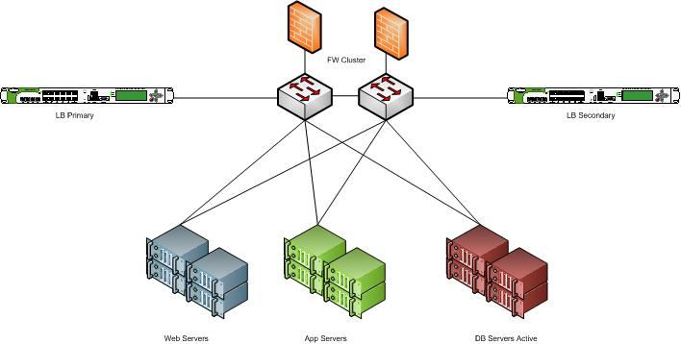
Low Level Flow - Request
Firewall Policy Check
Load-balancing for web server ( Change the destination IP from VIP to web server IP
Load-balancing for App server ( Change the destination IP from VIP to app server IP
Web Request
App Request
DB Request

Slide 12
Low Level Flow - Response
Session table Matching
Client table matching ( Change the source IP from web server IP to VIP
Client table matching ( Change the source IP from app server IP to VIP
Web Response
App Response
DB Response

Slide 13
Thanks You

