Slide 1
BIG-IP Application Security Manager (ASM)
F5 Partner Technical Boot Camp
Written for TMOS v13.0

Slide 2
Lesson 1: Application Security Manager (ASM) Overview
Lesson 2: Allowing Specific File Types / Using Attack Signatures

Slide 3

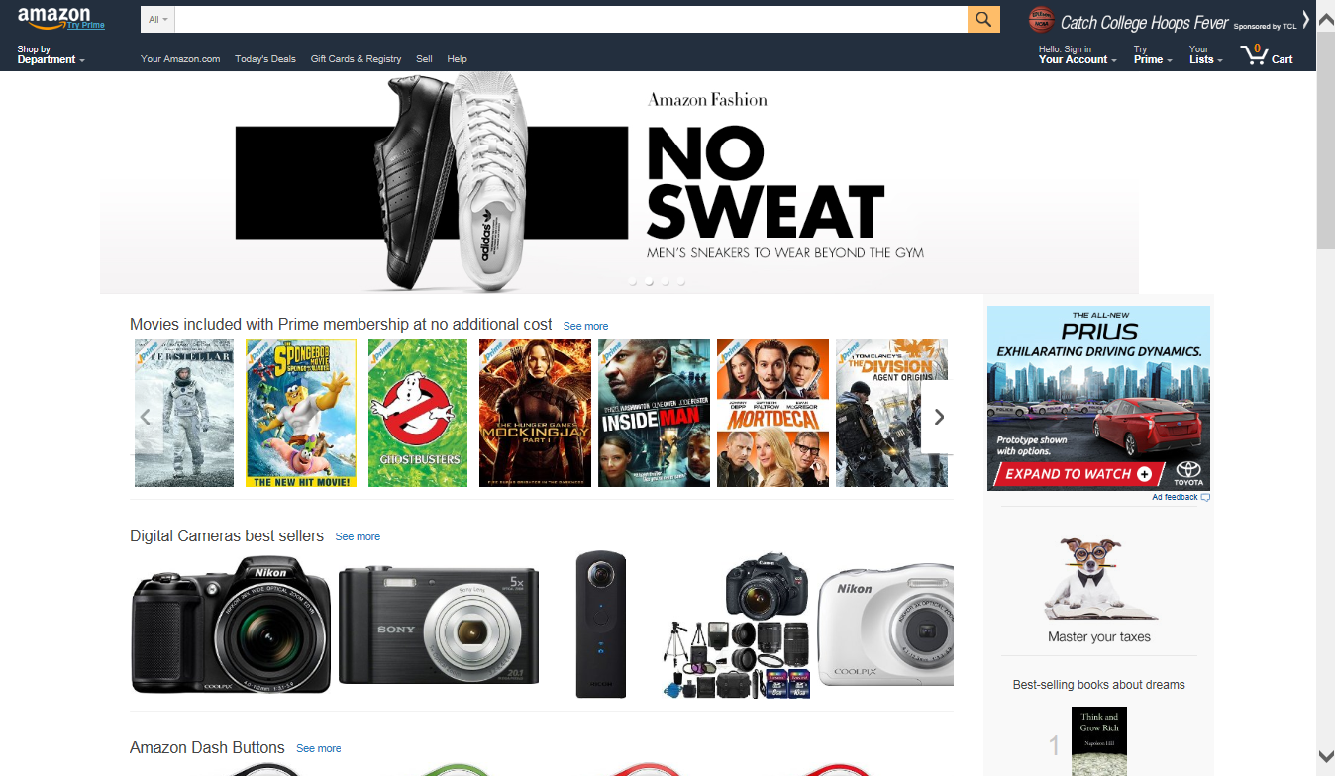
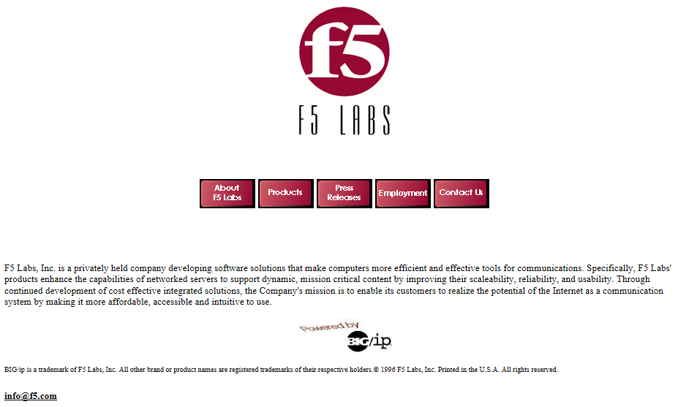

Anatomy of Web Application
HTTP request
In the early days of the Internet…
Today’s web applications are much more sophisticated
HTTP response
Web server
CGI/JavaScript
App server
Database server
Data
Notes:
Let’s take a step back in time. In the early days of the Internet the main use of the Internet was accessing a company web site with limited details, hours of operation, pictures, company details, but not much else.
Today’s web applications are much more sophisticated with scripts, application servers, databases. This provides today’s Internet users a much more robust web application experience. The problems is for companies, they have threats at multiple levels that must be addressed, otherwise they can be attacked with severe consequences.

Slide 4




Common Application Security Measures
Network firewalls are used at the datacenter perimeter
SSL encryption is used to protect data in transit
SSL encryption is used to protect data in transit
Developers add security into the applications
Server patching is routinely maintained
Server hardening practices are applied
Web server
CGI/JavaScript
App server
Database server
Data
Application developers
Notes:
Organizations have several methods to deal with these threats. Many rely on a network firewall to block incoming traffic. They also use SSL for their web applications. They also apply server hardening practices. They also have patch management and updates. They also ensure the application developers write the applications with secure code to be protected against application threats.

Slide 5
Limitations with Common Application Security Measures
Application attacks take place at layer 7
SSL only protects confidentiality and integrity of data in transit
L7
L6
L5
L4
L3
L2
L1
L6
L5
L4
L3
L2
L1
L5
L4
L3
L2
L1
L4
L3
L2
L1
L3
L2
L1
Network firewalls are “blind” to SSL traffic
L2
L1
Network firewalls only protect through layer 4
L1
Hardening, patching, and secure coding does not protect against zero-day attacks
SSL actually helps to ensure malicious requests make to the web server
Web server
CGI/JavaScript
App server
Database server
Data
Application developers
Notes:
There are several issues with relying on these for attack mitigation. We now have a malicious user attempting to attack our web application. SSL protects requests while in transit to the web application. SSL doesn’t help to protect from malicious content within the request. Network firewalls only protect up through layer 4. Even using AFM and its network DoS protection only goes up to layer 4. The application threats we’re talking about take place at layer 7. Network firewalls are blind to all application layer traffic. The network firewall will see that all attack requests are going to the correct web server on the correct port, and it will allow the attack traffic through. Network firewalls are also blind to SSL traffic and will allow it all through. SSL actually helps to ensure that an application attack is delivered safely to the web server. Hardening and patch management, although very important, will not address against zero-day attacks. We have to wait for new updates or security patches to be released.

Slide 6
Let’s review the benefit of a BIG-IP system
Notes:
WHITEBOARD
Let’s review why the F5 BIG-IP is so valuable. We have a BIG-IP for web applications. We can do several things, such as SSL offload. Why is SSL offload valuable? It offloads the decryption and encryption from the web servers. We also can do HTTP compression in hardware on the BIG-IP. Why is that valuable. Again, we’re offloading the CPU task from the web server. Why do we have the web servers in the network? Their job is to receive HTTP requests and send responses. We don’t want to fill their CPU with unnecessary tasks. Now, let’s talk about application attacks. Even if the web servers are hardened and patched, and the applications are coded securely, do we want application attacks to arrive at the web servers and have the servers play traffic cop, identifying good traffic versus bad traffic. Or would it be better to have all bad requests blocked at the BIG-IP, and allow the web servers to do their job of serving up web content. Not only is this good for the servers, ASM will protect the web applications much better than the servers could themselves. Also, if there is a new attack that has been identified, we can add a custom signature on the BIG-IP and block all the new attack traffic from hitting the servers. If we’d relied on the server security, we’d have to wait for a security patch for the new attack string.

Slide 7


Application Attack Threats
Application attacks can access sensitive user data
Application attacks can expose confidential server files
These attacks must be prevented from reaching the web application
Application attacks can delete database data and entire databases
Application attacks can take servers offline
password
Web server
CGI/JavaScript
App server
App server
Database server
Data
Notes:
If an application attack makes it to the web server, many things can happen. It may trick the web server into doing something or sending something to the hacker. It can easily take web servers down. It can access the database and send database data to the hacker, such as credit card numbers or usernames and passwords. They can also delete data from the database. We have ensure that no application attack traffic ever arrive at the web server.

Slide 8
Using BIG-IP ASM to Protect Web Applications
Buffer overflow
OWASP top 10
Cross site scripting
SQL Injection
Cross site request forgery
Layer 7 DoS
Web scraping
Parameter tampering
Forceful browsing
Geolocation enforcement
Cookie poisoning
Brute force attacks
Botnet detection
Proactive web bot identification
HTTP request
ASM verifies request against a security policy
Full layer 3 through layer 7 protection
AFM
ASM
ASM
ASM verifies response against a security policy
HTTP response
Web server
CGI/JavaScript
App server
Database server
Data
Notes:
We are going to use BIG-IP ASM for full web application security, in front of all of our web applications. An ASM security policy will examine every request and identify if it’s malicious. If it’s not malicious, it will send the request to the web server. ASM will also check server responses for something dangerous before sending the response to the user. We also recommend having both ASM and AFM on the same BIG-IP which will provide full layer 3 through 7 protection.
Here is a list of several security features of using an ASM security policy. We won’t have time to go through all of the features of this list today, but it’s good to know how comprehensive ASM security policies are. One example is layer 7 DoS is different than an application attack, which is malicious request to a web server. Another scenario, the malicious user is accessing the logo on the home page. This isn’t a malicious request, it’s a legal request. However, if hundreds of thousands of computers in a botnet are flooding the wed server with requests for the logo. This may take the web server offline. This can be difficult to identify because they are all valid requests. ASM can protect web applications against this using layer 7 DoS protection.

Slide 9
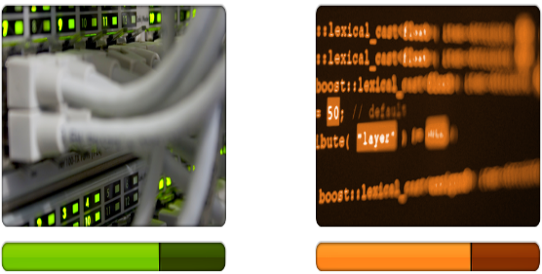
Network Threats vs. Application Threats
NETWORK THREATS
APPLICATION THREATS
MAJORITY of security investment goes here
MAJORITY of attacks are focused here
Attack Vectors
TCP SYN Flood
TCP Conn Flood
DNS Flood
HTTP GET Flood
Attack Vectors
HTTP Slowloris
SQL Injection
Cross Site Scripting
DNS Cache Poison
Notes:
We’ve seen a trend where a lot of the money for security is going to network attack protection. Not as much money is spent on application attack protection. However the threats from application attacks are much more dangerous, there is more loss, such as customer confidence, customer data loss, etc. We need to change the trend so that organization make more of a security investment in application attack protection.

Slide 10





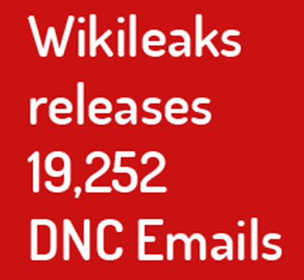


What’s Driving Web Application Firewall Sales
LONG history of high profile breaches and exploits
Compliance requirements
PCI DSS
SOX
OWASP
Notes:
What is driving web application firewall sales? First is the long list of organizations that have been affected by application layer attacks. The more this list continues to grow, the more organizations are likely to invest in a WAF. Also, organizations with compliance requirements may need a WAF, such as PCI compliance. What types of organizations require PCI compliance? Any organization that uses credit cards on their web application requires PCI compliance, and they need a product like ASM. Finally, keeping up with OWASP activities like the current top ten web application threats can help you target organizations that need a WAF.

Slide 11
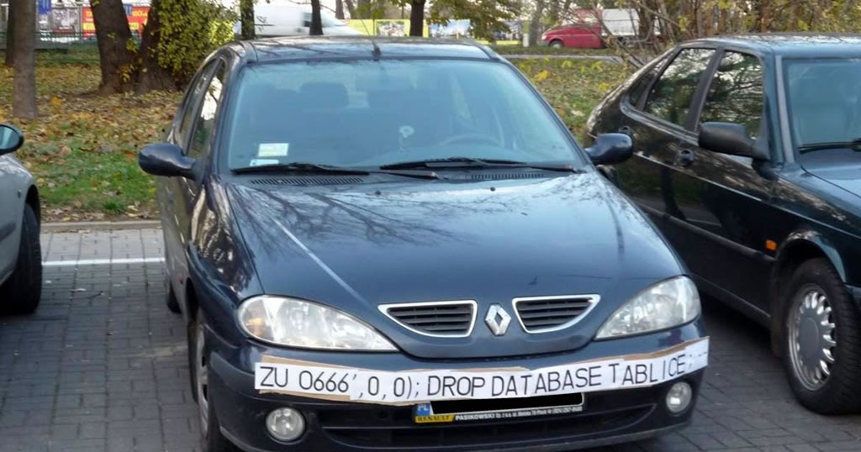
Notes:
Can anyone see what’s happening here? There are traffic cameras to take pictures of license plates. When the system that processes this license plate adds this to its database, it can fool the application into doing something it’s not supposed to do. This is an example of SQL injection.

Slide 12
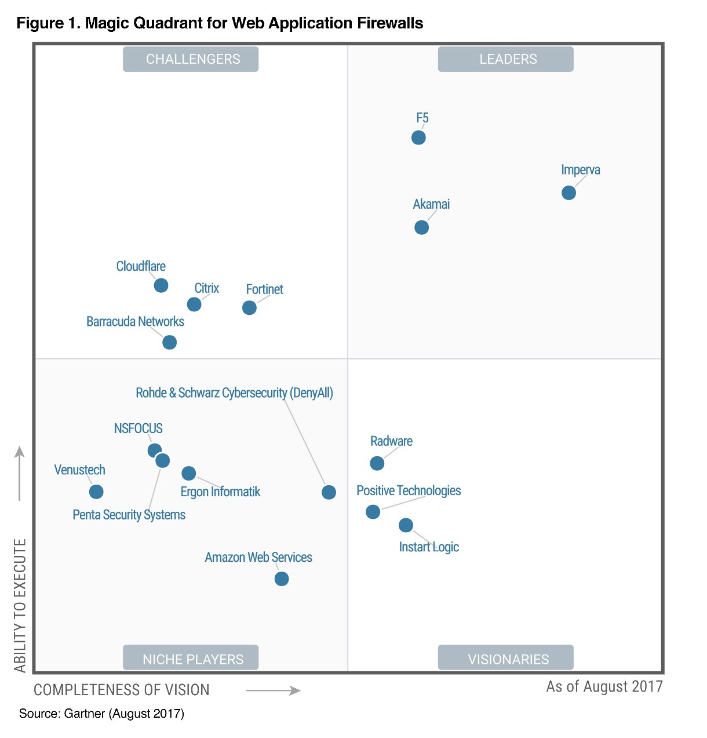

F5 Networks Positioned as a Leader in 2017 Gartner Magic Quadrant for Web Application Firewalls*
F5 is highest in execution within the Leaders Quadrant.
* Gartner, Magic Quadrant for Web Application Firewalls, Jeremy D’Hoinne, Adam Hils, Claudio Neiva, 7 August 2017
This graphic was published by Gartner, Inc. as part of a larger research document and should be evaluated in the context of the entire document. The Gartner document is available upon request from F5 Networks. Gartner does not endorse any vendor, product or service depicted in its research publications, and does not advise technology users to select only those vendors with the highest ratings or other designation. Gartner research publications consist of the opinions of Gartner's research organization and should not be construed as statements of fact. Gartner disclaims all warranties, expressed or implied, with respect to this research, including any warranties of merchantability or fitness for a particular purpose.
Notes:
F5 is now positioned as a leader in the 2017 Gartner Magic Quadrant for Web Application Firewalls.

Slide 13

OWASP Top 10
Which can be mitigated with BIG-IP ASM?
1: Injection
2: Broken Authentication and Session Management
3: Cross-Site Scripting (XSS)
4: Insecure Direct Object References
5: Security Misconfiguration
6: Sensitive Data Exposure
7: Missing Function Level Access Control
8: Cross-Site Request Forgery (CSRF)
9: Using Components with Known Vulnerabilities
10: Unvalidated Requests and Forwards
Notes:
Here is the list of the current OWASP top ten. Can anyone guess how many of these are mitigated with an ASM security policy. All ten can be mitigated by ASM. This is a very important concept to share with your customers.

Slide 14
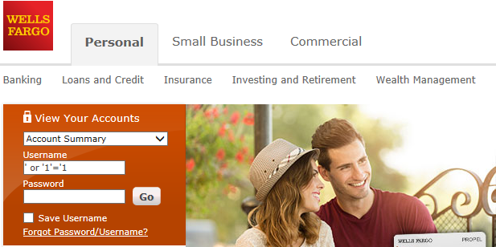
Injection
Retrieves database records
SQL injection
Exploits a security vulnerability in a website's software
Deletes database records
SQL injection
Deletes entire databases
Web server
CGI/JavaScript
App server
Database server
Data
Notes:
How do users interact with web applications? They use input fields, also known as parameters, such as a username and password field. SQL injection attacks are submitted within these input fields, like the soldiers hiding inside the trojan horse. If this is an unprotected web application, once the request reaches the web server, it will send a command to the database. The database command can send data to the hacker, such as credit card numbers, usernames and passwords, medical records. It can delete data from the database. It can also delete an entire database. Think about the loss of customer confidence when the organization loses their customer data. Here is an example of a SQL injection request being sent in the username input field. This request is going to fool the server into always sending some sort of a positive response, because 1 does equal 1. This can make the database server send something back to the hacker.

Slide 15
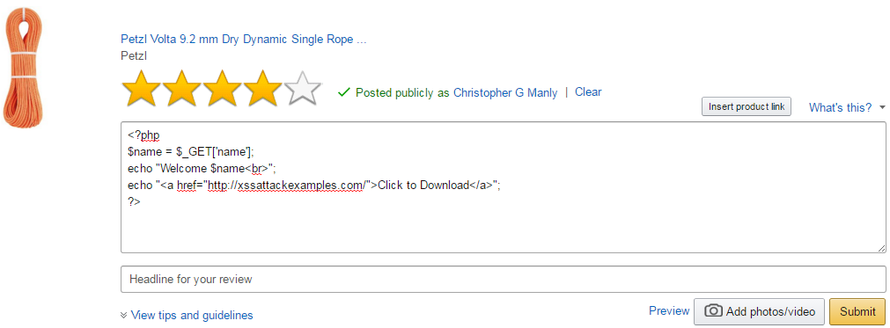

Cross-Site Scripting (XSS)
Accounts for roughly 84% of all security vulnerabilities
Cross-site script
Non-persistent: Can expose web server files
Enables hackers to inject client-side script into requests
Persistent: Insert script into the database
Cross site script
Cross site script
password
Non-persistent: Can cause a server to go offline
Web server
Web server
CGI/JavaScript
App server
Database server
Data
Notes:
Cross site scripting uses scripts written in any scripting language. Imagine a user input field where we can enter a lot of data, like a comment, a review, or a Facebook post. The hacker can enter into this field a script that starts with <script>, and then they can write any type of script that does whatever they can make the script do. If the script makes it to the server, the server will process the request, and when it does that it will process the script. The script can do something like having the server send confidential data to the hacker. It could also take a server offline. These are examples of non-persistent scripts. A non-persistent script is a one and done script, it is run once and does what it’s written to do. There is also a persistent script. A persistent script is one that’s added to the database, such as a comment or a user review. Now, if another internet user looks for all of the reviews of a product, the response will include the hacker’s script, and the victim’s browser will run the script and do whatever it’s written to do. Cross-site scripting accounts for 84% of vulnerabilities that organizations are dealing with. The good news is that ASM can protect against these attacks very easily. Here is an example of a php script being sent in a user review field.

Slide 16
Examine an HTTP Request
Request line
Headers
Body data (optional)
Parameters
Values
POST http://www.vlab.f5demo.com/index.php HTTP/1.1
HTTP version supported by the client’s browser
Accept: text/html, application/xhtml+xml, */*
Accept-Encoding: gzip, deflate
Accept-Language: en-US
Connection: Keep-Alive
Cookie: JSESSIONID=rhnjej8nodk1e1bvf8k64ato61; security=low
Host: www.vlab.f5demo.com
Referer: https://dvwa.vlab.f5demo.com/
User-Agent: Mozilla/5.0 (Windows NT 6.1; WOW64; Trident/7.0; rv:11.0) like Gecko
HTTP method, i.e. GET, HEAD, POST, PUT, and DELETE
URI (universal resource identifier)
username=bob&password=smith&login=Login
Notes:
How many of you would consider yourself an HTTP pro? Good news is that ASM is an HTTP pro, it knows everything about HTTP. Let’s discuss ASM versus an IPS/IDS. IPS/IDS can examine requests for many application types and offer some basic protections. It’s hard to configure and the security it can provide for all of these applications is minimal. Think about military soldier using an 18th century suit of armor. When he’s blasted with today’s weapons, that suit of armor won’t offer a lot of protection, even though it’s providing head to toe protection. ASM is a WEB application firewall, it’s all HTTP based. It doesn’t help with FTP, email, SIP. It can protect every aspect of HTTP. So we now have our soldier wearing today’s protection. They may loose a hand or a leg, but the important areas like the head and heart, are very well protected.
Let’s examine an HTTP request because all of this can be protected by an ASM security policy. First is the request line. This includes the method, which is usually either GET or POST. GET is used to retrieve a page, POST is used to send a request with input fields that were submit by the user. Next is the full URL, and finally the HTTP version supported by the user’s web browser. Then are the request headers, which tell the web server information about the browser. Request headers will change depending on the web browser being used. Finally, if the request includes input fields, there would also be a body, which includes both the input fields, as well as the values supplied by the user.

Slide 17
ASM Checks RFC Compliance
POST /login.php HTTP/1.1
Host: dvwa.vlab.f5demo.com\r\n
Connection: keep-alive\r\n
Content-Length: 44\r\n
Cache-Control: max-age=0\r\n
Accept: text/html,application/xhtml+xml,application/xml;q=0.9\r\n
Origin: https://dvwa.vlab.f5demo.com\r\n
Upgrade-Insecure-Requests: 1\r\n
User-Agent: Mozilla/5.0 (Windows NT 6.1; WOW64) AppleWebKit/537.36 (KHTML, like Gecko) Chrome/47.0.2526.106 Safari/537.36\r\n
Content-Type: application/x-www-form-urlencoded\r\n
Referer: https://dvwa.vlab.f5demo.com/login.php\r\n
Accept-Encoding: gzip, deflate\r\n
Accept-Language: en-US,en;q=0.8\r\n
username=admin&password=P@ssw0rd!&Login=Login
POST /login.php HTTP/1.1
Host: dvwa.vlab.f5demo.com\r\n
Connection: keep-alive\r\n
Content-Length: 44\r\n
Cache-Control: max-age=0\r\n
Accept: text/html,application/xhtml+xml,application/xml;q=0.9\r\n
Origin: https://dvwa.vlab.f5demo.com\r\n
Upgrade-Insecure-Requests: 1\r\n
User-Agent: Mozilla/5.0 (Windows NT 6.1; WOW64) AppleWebKit/537.36 (KHTML, like Gecko) Chrome/47.0.2526.106 Safari/537.36\r\n
Content-Type: application/x-www-form-urlencoded\r\n
Referer: https://dvwa.vlab.f5demo.com/login.php\r\n
Accept-Encoding: gzip, deflate\r\n
Accept-Language: en-US,en;q=0.8\r\n
username=admin&password=P@ssw0rd!&Login=Login
Notes:
Let’s discuss the parts of the HTTP request that an ASM security policy can protect. First is RFC compliance. This includes things like a valid method, such as GET or POST, a valid HTTP version, and correct end of line marks. All security policies will include RFC compliance.

Slide 18
ASM Checks for Length Limits
POST /login.php HTTP/1.1
Host: dvwa.vlab.f5demo.com\r\n
Connection: keep-alive\r\n
Content-Length: 44\r\n
Cache-Control: max-age=0\r\n
Accept: text/html,application/xhtml+xml,application/xml;q=0.9\r\n
Origin: https://dvwa.vlab.f5demo.com\r\n
Upgrade-Insecure-Requests: 1\r\n
User-Agent: Mozilla/5.0 (Windows NT 6.1; WOW64) AppleWebKit/537.36 (KHTML, like Gecko) Chrome/47.0.2526.106 Safari/537.36\r\n
Content-Type: application/x-www-form-urlencoded\r\n
Referer: https://dvwa.vlab.f5demo.com/login.php\r\n
Accept-Encoding: gzip, deflate\r\n
Accept-Language: en-US,en;q=0.8\r\n
username=admin&password=P@ssw0rd!&Login=Login
POST /login.php HTTP/1.1
Host: dvwa.vlab.f5demo.com\r\n
Connection: keep-alive\r\n
Content-Length: 44\r\n
Cache-Control: max-age=0\r\n
Accept: text/html,application/xhtml+xml,application/xml;q=0.9\r\n
Origin: https://dvwa.vlab.f5demo.com\r\n
Upgrade-Insecure-Requests: 1\r\n
User-Agent: Mozilla/5.0 (Windows NT 6.1; WOW64) AppleWebKit/537.36 (KHTML, like Gecko) Chrome/47.0.2526.106 Safari/537.36\r\n
Content-Type: application/x-www-form-urlencoded\r\n
Referer: https://dvwa.vlab.f5demo.com/login.php\r\n
Accept-Encoding: gzip, deflate\r\n
Accept-Language: en-US,en;q=0.8\r\n
username=admin&password=P@ssw0rd!&Login=Login
POST /login.php HTTP/1.1
Host: dvwa.vlab.f5demo.com\r\n
Connection: keep-alive\r\n
Content-Length: 44\r\n
Cache-Control: max-age=0\r\n
Accept: text/html,application/xhtml+xml,application/xml;q=0.9\r\n
Origin: https://dvwa.vlab.f5demo.com\r\n
Upgrade-Insecure-Requests: 1\r\n
User-Agent: Mozilla/5.0 (Windows NT 6.1; WOW64) AppleWebKit/537.36 (KHTML, like Gecko) Chrome/47.0.2526.106 Safari/537.36\r\n
Content-Type: application/x-www-form-urlencoded\r\n
Referer: https://dvwa.vlab.f5demo.com/login.php\r\n
Accept-Encoding: gzip, deflate\r\n
Accept-Language: en-US,en;q=0.8\r\n
username=admin&password=P@ssw0rd!&Login=Login
POST /login.php HTTP/1.1
Host: dvwa.vlab.f5demo.com\r\n
Connection: keep-alive\r\n
Content-Length: 44\r\n
Cache-Control: max-age=0\r\n
Accept: text/html,application/xhtml+xml,application/xml;q=0.9\r\n
Origin: https://dvwa.vlab.f5demo.com\r\n
Upgrade-Insecure-Requests: 1\r\n
User-Agent: Mozilla/5.0 (Windows NT 6.1; WOW64) AppleWebKit/537.36 (KHTML, like Gecko) Chrome/47.0.2526.106 Safari/537.36\r\n
Content-Type: application/x-www-form-urlencoded\r\n
Referer: https://dvwa.vlab.f5demo.com/login.php\r\n
Accept-Encoding: gzip, deflate\r\n
Accept-Language: en-US,en;q=0.8\r\n
username=admin&password=P@ssw0rd!&Login=Login
Notes:
ASM can also check for various length limits. What if this request was 100,000 characters long? It would slow down the web server. ASM can check the length of the URI or query string, it can check the length of the data that was input by users for the different input fields, it can also check for the full HTTP message length and ensure a request isn’t for 100,000 bytes.

Slide 19
ASM Can Enforce Specific File Types
GET /dvwa/images/logo.png HTTP/1.1 Host: dvwa.vlab.f5demo.com\r\n
Connection: keep-alive\r\n
Content-Length: 44\r\n
Cache-Control: max-age=0\r\n
Accept: text/html,application/xhtml+xml,application/xml;q=0.9\r\n
Origin: https://dvwa.vlab.f5demo.com\r\n
Upgrade-Insecure-Requests: 1\r\n
User-Agent: Mozilla/5.0 (Windows NT 6.1; WOW64) AppleWebKit/537.36 (KHTML, like Gecko) Chrome/47.0.2526.106 Safari/537.36\r\n
Content-Type: application/x-www-form-urlencoded\r\n
Referer: https://dvwa.vlab.f5demo.com/login.php\r\n
Accept-Encoding: gzip, deflate\r\n
Accept-Language: en-US,en;q=0.8\r\n
GET /dvwa/js/dvwaPage.js HTTP/1.1 Host: dvwa.vlab.f5demo.com\r\n
Connection: keep-alive\r\n
Content-Length: 44\r\n
Cache-Control: max-age=0\r\n
Accept: text/html,application/xhtml+xml,application/xml;q=0.9\r\n
Origin: https://dvwa.vlab.f5demo.com\r\n
Upgrade-Insecure-Requests: 1\r\n
User-Agent: Mozilla/5.0 (Windows NT 6.1; WOW64) AppleWebKit/537.36 (KHTML, like Gecko) Chrome/47.0.2526.106 Safari/537.36\r\n
Content-Type: application/x-www-form-urlencoded\r\n
Referer: https://dvwa.vlab.f5demo.com/login.php\r\n
Accept-Encoding: gzip, deflate\r\n
Accept-Language: en-US,en;q=0.8\r\n
GET / HTTP/1.1 Host: dvwa.vlab.f5demo.com\r\n
Connection: keep-alive\r\n
Content-Length: 44\r\n
Cache-Control: max-age=0\r\n
Accept: text/html,application/xhtml+xml,application/xml;q=0.9\r\n
Origin: https://dvwa.vlab.f5demo.com\r\n
Upgrade-Insecure-Requests: 1\r\n
User-Agent: Mozilla/5.0 (Windows NT 6.1; WOW64) AppleWebKit/537.36 (KHTML, like Gecko) Chrome/47.0.2526.106 Safari/537.36\r\n
Content-Type: application/x-www-form-urlencoded\r\n
Referer: https://dvwa.vlab.f5demo.com/login.php\r\n
Accept-Encoding: gzip, deflate\r\n
Accept-Language: en-US,en;q=0.8\r\n
GET /index.php HTTP/1.1 Host: dvwa.vlab.f5demo.com\r\n
Connection: keep-alive\r\n
Content-Length: 44\r\n
Cache-Control: max-age=0\r\n
Accept: text/html,application/xhtml+xml,application/xml;q=0.9\r\n
Origin: https://dvwa.vlab.f5demo.com\r\n
Upgrade-Insecure-Requests: 1\r\n
User-Agent: Mozilla/5.0 (Windows NT 6.1; WOW64) AppleWebKit/537.36 (KHTML, like Gecko) Chrome/47.0.2526.106 Safari/537.36\r\n
Content-Type: application/x-www-form-urlencoded\r\n
Referer: https://dvwa.vlab.f5demo.com/login.php\r\n
Accept-Encoding: gzip, deflate\r\n
Accept-Language: en-US,en;q=0.8\r\n
Notes:
ASM can also check for valid file types that are needed for the web application. Most web applications don’t require a very large list of file types. For example this web application only allows php, png, and pdf. We’ll also want to keep in mind if a user submits a request for something like www.amazon.com and there is no file type in the request. We’ll cover this in lesson 2.

Slide 20
ASM Can Enforce Specific URLs
GET /index.php HTTP/1.1 Host: dvwa.vlab.f5demo.com\r\n
Connection: keep-alive\r\n
Content-Length: 44\r\n
Cache-Control: max-age=0\r\n
Accept: text/html,application/xhtml+xml,application/xml;q=0.9\r\n
Origin: https://dvwa.vlab.f5demo.com\r\n
Upgrade-Insecure-Requests: 1\r\n
User-Agent: Mozilla/5.0 (Windows NT 6.1; WOW64) AppleWebKit/537.36 (KHTML, like Gecko) Chrome/47.0.2526.106 Safari/537.36\r\n
Content-Type: application/x-www-form-urlencoded\r\n
Referer: https://dvwa.vlab.f5demo.com/login.php\r\n
Accept-Encoding: gzip, deflate\r\n
Accept-Language: en-US,en;q=0.8\r\n
GET /instructions.php HTTP/1.1 Host: dvwa.vlab.f5demo.com\r\n
Connection: keep-alive\r\n
Content-Length: 44\r\n
Cache-Control: max-age=0\r\n
Accept: text/html,application/xhtml+xml,application/xml;q=0.9\r\n
Origin: https://dvwa.vlab.f5demo.com\r\n
Upgrade-Insecure-Requests: 1\r\n
User-Agent: Mozilla/5.0 (Windows NT 6.1; WOW64) AppleWebKit/537.36 (KHTML, like Gecko) Chrome/47.0.2526.106 Safari/537.36\r\n
Content-Type: application/x-www-form-urlencoded\r\n
Referer: https://dvwa.vlab.f5demo.com/login.php\r\n
Accept-Encoding: gzip, deflate\r\n
Accept-Language: en-US,en;q=0.8\r\n
GET /dvwa/sqli/sqlform.php HTTP/1.1 Host: dvwa.vlab.f5demo.com\r\n
Connection: keep-alive\r\n
Content-Length: 44\r\n
Cache-Control: max-age=0\r\n
Accept: text/html,application/xhtml+xml,application/xml;q=0.9\r\n
Origin: https://dvwa.vlab.f5demo.com\r\n
Upgrade-Insecure-Requests: 1\r\n
User-Agent: Mozilla/5.0 (Windows NT 6.1; WOW64) AppleWebKit/537.36 (KHTML, like Gecko) Chrome/47.0.2526.106 Safari/537.36\r\n
Content-Type: application/x-www-form-urlencoded\r\n
Referer: https://dvwa.vlab.f5demo.com/login.php\r\n
Accept-Encoding: gzip, deflate\r\n
Accept-Language: en-US,en;q=0.8\r\n
GET /login.php HTTP/1.1 Host: dvwa.vlab.f5demo.com\r\n
Connection: keep-alive\r\n
Content-Length: 44\r\n
Cache-Control: max-age=0\r\n
Accept: text/html,application/xhtml+xml,application/xml;q=0.9\r\n
Origin: https://dvwa.vlab.f5demo.com\r\n
Upgrade-Insecure-Requests: 1\r\n
User-Agent: Mozilla/5.0 (Windows NT 6.1; WOW64) AppleWebKit/537.36 (KHTML, like Gecko) Chrome/47.0.2526.106 Safari/537.36\r\n
Content-Type: application/x-www-form-urlencoded\r\n
Referer: https://dvwa.vlab.f5demo.com/login.php\r\n
Accept-Encoding: gzip, deflate\r\n
Accept-Language: en-US,en;q=0.8\r\n
Notes:
ASM can go one step further. In addition to the valid file types, we can also specify the valid URLs. We can create a white list of every valid URL. So not just php, but login.php, index.php, instructions.php. We can create full paths to the URLs that are allowed.

Slide 21
ASM Can Allow Only Specific Parameters
POST /login.php HTTP/1.1
Host: dvwa.vlab.f5demo.com\r\n
Connection: keep-alive\r\n
Content-Length: 44\r\n
Cache-Control: max-age=0\r\n
Accept: text/html,application/xhtml+xml,application/xml;q=0.9\r\n
Origin: https://dvwa.vlab.f5demo.com\r\n
Upgrade-Insecure-Requests: 1\r\n
User-Agent: Mozilla/5.0 (Windows NT 6.1; WOW64) AppleWebKit/537.36 (KHTML, like Gecko) Chrome/47.0.2526.106 Safari/537.36\r\n
Content-Type: application/x-www-form-urlencoded\r\n
Referer: https://dvwa.vlab.f5demo.com/login.php\r\n
Accept-Encoding: gzip, deflate\r\n
Accept-Language: en-US,en;q=0.8\r\n
username=admin&password=P@ssw0rd!&Login=Login
Notes:
We can go one step further. We can specify every valid parameter, or user input field, that is allowed for the web application. Only parameters named username, password, Login.

Slide 22
ASM Can Check Each Parameter for Specific Criteria
POST /login.php HTTP/1.1
Host: dvwa.vlab.f5demo.com\r\n
Connection: keep-alive\r\n
Content-Length: 44\r\n
Cache-Control: max-age=0\r\n
Accept: text/html,application/xhtml+xml,application/xml;q=0.9\r\n
Origin: https://dvwa.vlab.f5demo.com\r\n
Upgrade-Insecure-Requests: 1\r\n
User-Agent: Mozilla/5.0 (Windows NT 6.1; WOW64) AppleWebKit/537.36 (KHTML, like Gecko) Chrome/47.0.2526.106 Safari/537.36\r\n
Content-Type: application/x-www-form-urlencoded\r\n
Referer: https://dvwa.vlab.f5demo.com/login.php\r\n
Accept-Encoding: gzip, deflate\r\n
Accept-Language: en-US,en;q=0.8\r\n
username=admin&password=P@ssw0rd!&Login=Login
Notes:
Once again, we can one step further, not only can we specify the TYPE of data that can be input into each parameter. For example for the username, the maximum should be no more than 40 characters. For the password the maximum should be no more than 15 characters. The username shouldn’t include characters like #, @, !, etc. We can specify every keyboard character that a user can type into every input field in the web application.

Slide 23
ASM Can Scan For Attack Signatures
POST /login.php HTTP/1.1
Host: dvwa.vlab.f5demo.com\r\n
Connection: keep-alive\r\n
Content-Length: 44\r\n
Cache-Control: max-age=0\r\n
Accept: text/html,application/xhtml+xml,application/xml;q=0.9\r\n
Origin: https://dvwa.vlab.f5demo.com\r\n
Upgrade-Insecure-Requests: 1\r\n
User-Agent: Mozilla/5.0 (Windows NT 6.1; WOW64) AppleWebKit/537.36 (KHTML, like Gecko) Chrome/47.0.2526.106 Safari/537.36\r\n
Content-Type: application/x-www-form-urlencoded\r\n
Referer: https://dvwa.vlab.f5demo.com/login.php\r\n
Accept-Encoding: gzip, deflate\r\n
Accept-Language: en-US,en;q=0.8\r\n
username=admin&password=P@ssw0rd!&Login=Login
Notes:
ASM can also check for attack signatures. ASM includes thousands of attack signatures. ASM will check every part of the HTTP request to see if it recognizes an attack signature string. It checks in the request line, all HTTP headers, and within the parameter values. If it recognizes a signature somewhere in the request, ASM knows it’s a malicious request.

Slide 24
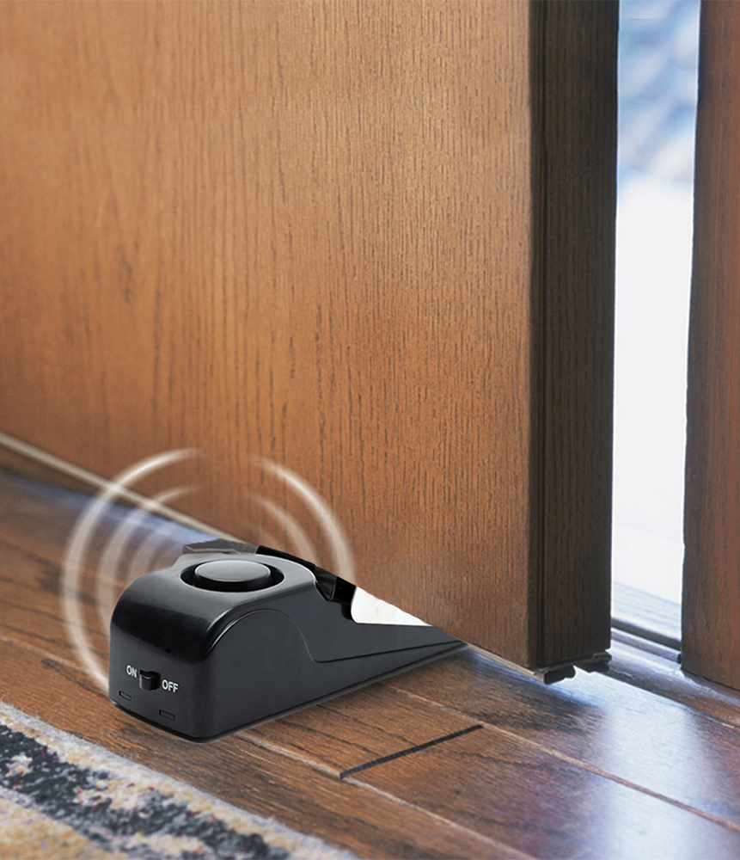
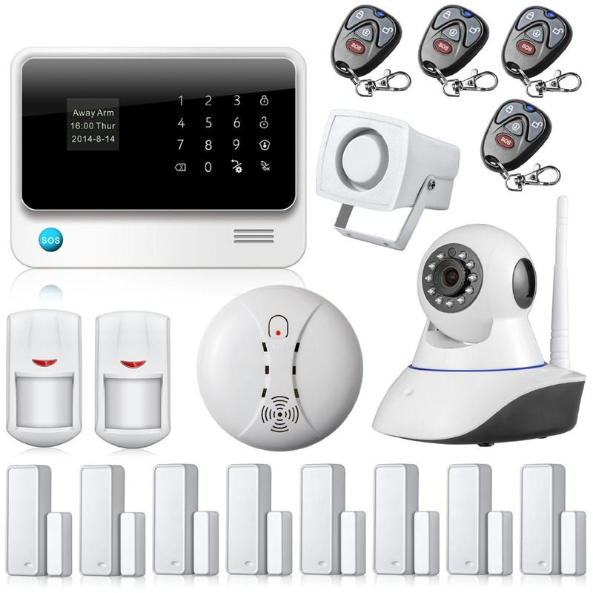
Notes:
ANALOGY
This sounds like a lot of options. One of the things that scares potential ASM customers is that there are simply too many options, and it’s too overwhelming. Imagine if you’re looking into installing a home security system due to break-ins in your neighborhood. You schedule a couple of companies to give you bids. The first company offers you an alarm that will sound when someone busts through the front door. Once the alarm goes off, it’s up to you, with a baseball bat or a frying pan, to confront the prowler. This security system is very affordable. The next company offers you a much more sophisticated. The can check every egress and ingress point in the house. They will wire every one of these points with touch and motion sensors, and if someone so much as brushes against the window, you have a guaranteed police car in the driveway in ten minutes. This system is considerable more expensive. I’m thinking that the first option isn’t nearly enough security for me, but the second option sounds like too much security. What if I brushed up along the window myself? I don’t want to trigger a false positive and get a visit from the police. Most people are probably going to pick a security option somewhere in between these two options. This is similar to building an ASM security policy. Question, when we create an ASM security policy, what do you suppose we’ll attach that security policy to in the Configuration Utility. ANSWER, a virtual server. Therefore we will have different security policies for each VIP, or each web application. We can have a policy with minimal security, such as just RFC compliance and attack signatures. This might be appropriate for our public web site. We can also have a policy with most security options enabled. This might be appropriate for our online banking web site. The level of security depends on how much security we need, and how much time we’re willing to devote to building the security policy.

Slide 25

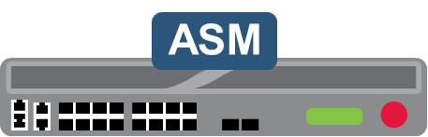

ASM Verifies the Server Response
Checks for malicious patterns in the response
Verifies valid response codes
Hides the server header
Performs content scrubbing
Notes:
One more thing, as we said earlier, ASM can also check the HTTP response from the web server. One of the things it will check for is data leakage, such as credit card numbers being sent out in the response. ASM can either mask the credit card numbers, or it can simply block the response. ASM can also check for malicious patterns in the response. This implies that there is something in the response that matches an attack signature. QUESTION: assuming we don’t have a malicious employee in the web development team, how would our web application send a malicious response to a user? ANSWER: if a persistent cross-site script was inserted into the database.

Slide 26
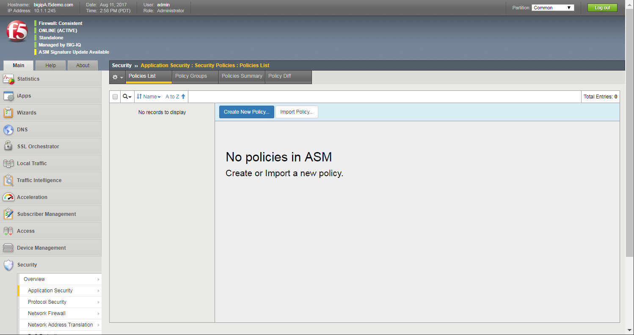
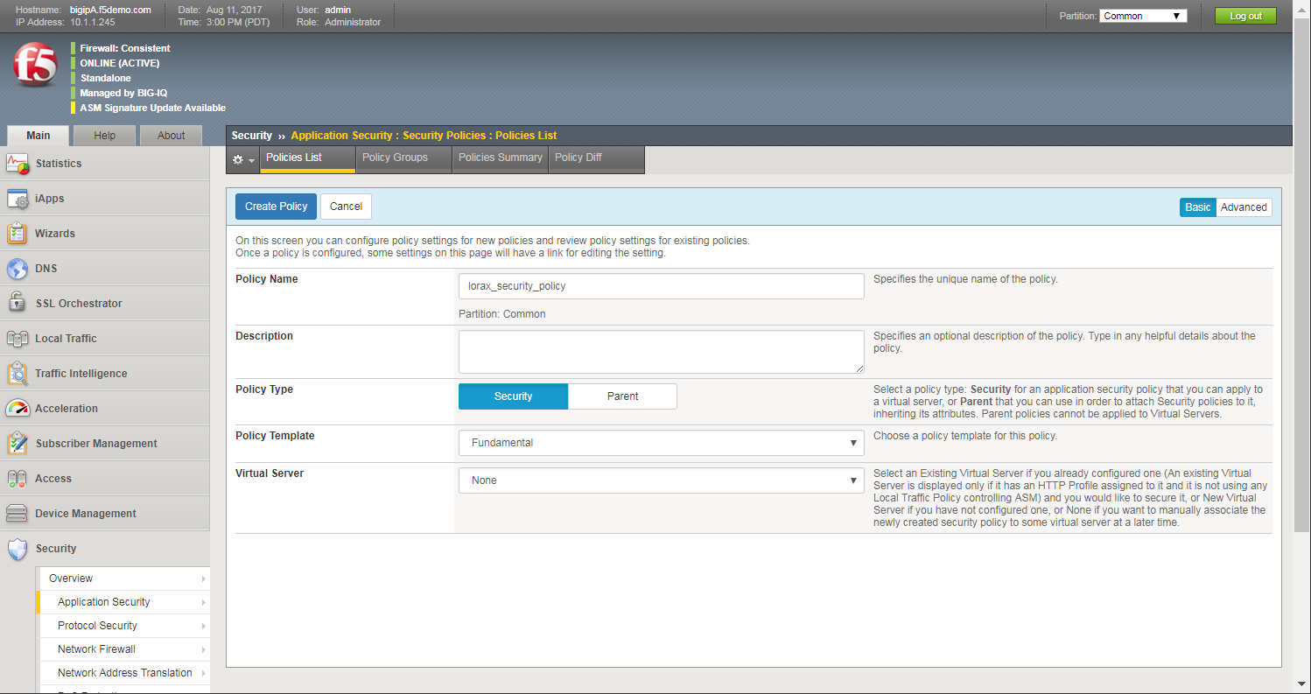
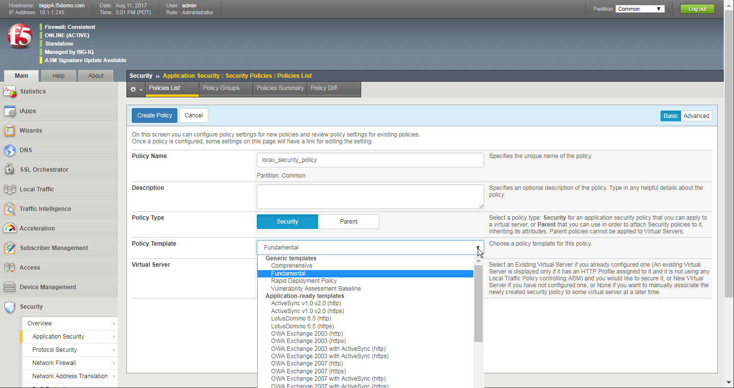
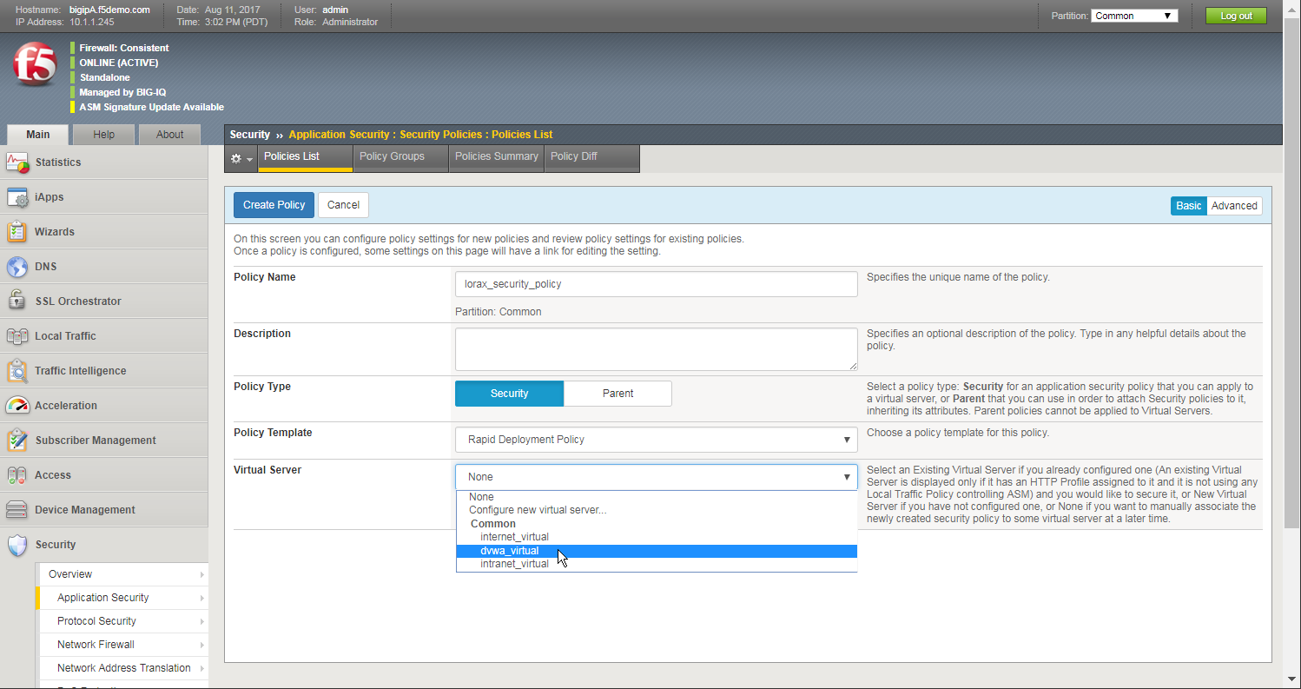
Create a New Security Policy
Minimizes false positives
Decreases time from Transparent to Blocking
Protects against OWASP attacks
Includes thousands of detection signatures
Includes all required policy items, URLs, parameters, cookies, etc.
Notes:
In the last part of this lesson we’ll cover how to create an ASM security policy. QUESTION: how long do you suppose it takes to create an ASM security policy? ANSWER: it can take less than one minute to create an ASM security policy. Now that’s how long it takes to CREATE the security policy. Tuning the security policy will take more time, especially depending on the scope of the web application. The create a security policy we’ll use the BIG-IP Security menu, which will be enabled once we have ASM, AFM, or WebSafe provisioned, then we’ll use the Application Security, Security Polices, Policies List page. This page is new for ASM 13, all of the options are now on one page. There are only three things that must be selected. First we’ll give the security policy a name. Next we’ll select the policy template. One of the challenges of using a WAF is that in order to properly protect a web application, ASM needs to know all about the web application. It needs to know all the file types, all the URLs, all the parameters, which URLs the parameters are expected on. Depending on the scope of the web application, this process can take some time. ASM includes some common out-of-the-box web application, such as OWA. The nice thing about these policy templates is that ASM already knows a lot of the aspects of the web application. It knows the URLs and parameters needed for Outlook Web Access. These policy templates can be a good starting point for creating a security policy, however they still will probably be just the starting point. Any custom web application will use one of these three policy templates, Comprehensive, Fundamental, or Rapid Deployment. We’re going to discuss Rapid Deployment. If you are able to take the F5 Advanced Security boot camp, you’ll learn about using the Fundamental and Comprehensive policy templates. Rapid Deployment has several benefits. It will minimize the number of false positives. QUESTION: what’s a false positive. ANSWER: blocking a non-malicious request. QUESTION: do you suppose it’s important to minimize the number of false positives? ANSWER: definitely, most organizations don’t want to block any valid users. QUESTION: what’s the trade off then of minimizing false positives? ANSWER: more false negatives, which is allowing bad traffic into the web application. It’s always a trade off, organizations have to decide the level of false positives versus false negatives. Next, Rapid Deployment decrease the time from transparent to blocking mode. Every ASM security policy has one of two modes. It’s either in transparent mode or its in blocking mode. When a security policy is in transparent mode, we’re typically still building the security policy, putting all the pieces into place. This is what I like to call introducing ASM to the web application. While in transparent mode, absolutely nothing is blocked by ASM. Once we have all the policy tuned and tested, we can move the entire policy to blocking mode. Now, ASM will block any requests that match a configured security violation. Each security policy must be moved completely from one mode to the next, it can’t be partially switched. However, remember that we may have several security policies for several web applications. Each security policy can be in either transparent or blocking mode. One other thing to consider, remember the two home security systems we discussed earlier? The first solution can likely be installed very quickly. However, when the second company comes out to my ten bedroom house, I tell them I need the security system installed by 5pm. They explain that it takes at least two weeks to inspect the entire house, especially a house my size, then they have to design the security system, and then they have to install it. This takes time. This is just like a security policy, if I have a large web application and I want to utilize several ASM security features, it will take some time to build the security policy. Rapid Deployment will protect the web application from OWASP attacks, such as cross-site scripting and SQL injection. And finally it will include thousands of attack signatures. A security policy using Rapid Deployment might be similar to the front door alarm, maybe a little better than the door alarm. It adds security, it’s a good starting point, but we’ll probably tune it more to add more security. Finally, we identify the virtual server that we’re attaching the security policy to. That’s it, give the policy a name, select the policy template, select the virtual server, and then click Create Policy.

Slide 27
ASM Exercise 1 – Create an ASM Security Policy
In this exercise:
Use the DVWA application to identify security vulnerabilities
Configure a new security policy using Rapid Deployment
Examine the ASM log file
Estimated completion time: 30 minutes
Notes:
We’ll now do our first exercise. In this exercise, be sure to use the copy/paste guide on the desktop because there are several long commands that will take a long time to type. You’re going to start by seeing what it’s like to be a hacker, attacking a web site with SQL injection, cross-site scripting, and forceful browsing attacks. You’ll then create a security policy using Rapid Deployment. Finally you’ll use the web application, and then view the requests in the very comprehensive ASM event log. You have 40 minutes to complete this exercise.

Slide 28
Lesson 1: Application Security Manager (ASM) Overview
Lesson 2: Allowing Specific File Types / Using Attack Signatures

Slide 29
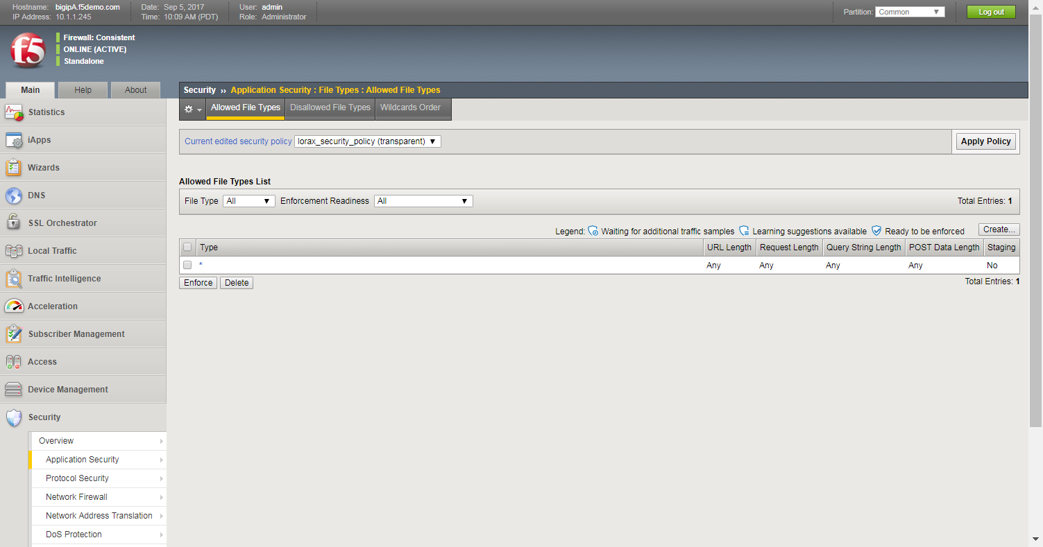
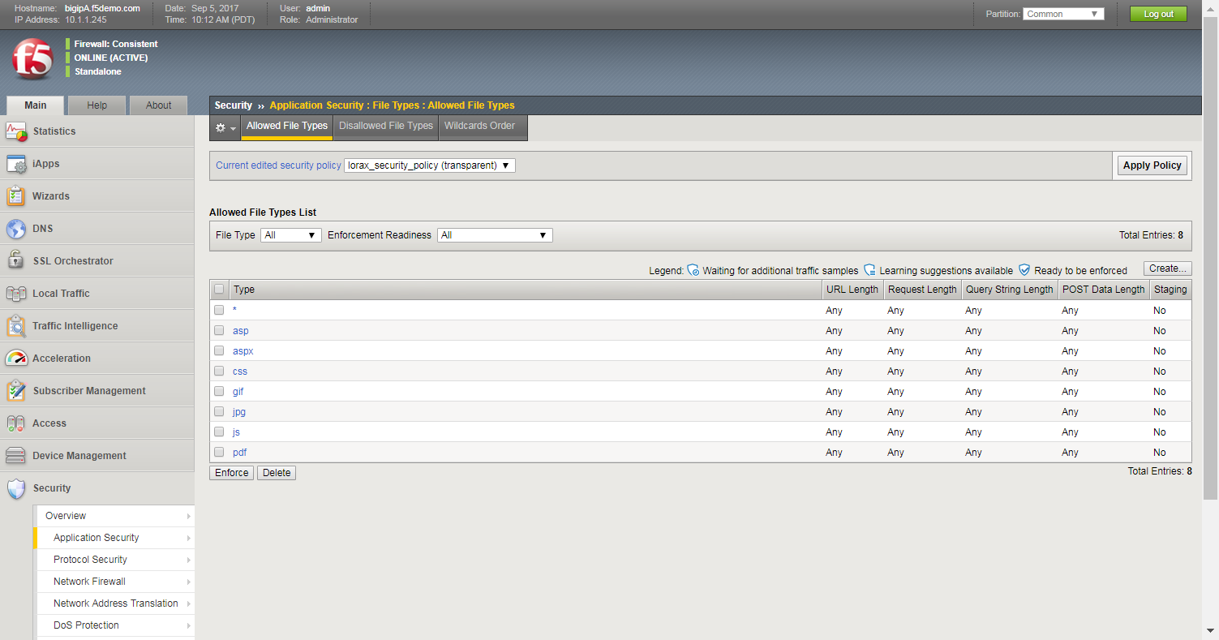
File Type Enforcement
Wildcard entry must be deleted to complete the policy
Most .NET applications use a small list of file types
Default “Allowed File Types” after Rapid Deployment
Defined list of file types blocks many application attacks (code red made request for default.ida)
Notes:
We’ll start by discussing file type enforcement. Here is our allowed file types page. Notice that the current allowed file type is an asterisk. QUESTION: what does that mean? ANSWER: it’s a wildcard, it means that currently any and all file types are allowed, ini, exe, etc. What we want to do is define the list of file types for this web application, such as asp, css, js, and pdf. On average, a web application typically needs about ten file types. That’s one benefit of using file type enforcement, we don’t need to come up with a complicated list, just a short list of the required file types. Another nice thing, is as a web application evolves and the web developers are adding more pages and functionality, rarely do they need to add NEW file types. Therefore file type enforcement doesn’t require a lot of ongoing maintenance. Finally, it adds great additional security, especially considering how quick and easy it is to configure. For example, this would have protected a web application against the code red attack. It also protects against forceful browsing, which you did in your last exercise. I feel that every security policy should include file type enforcement. Now once we have our defined list of file types, we’ll need to address the wildcard, because if we leave it here ASM will enforce our list of file types, and still allow all other file types. We’ll select the asterisk checkbox and delete it. We now have a completed file types white list.

Slide 30
Let’s discuss a huge ASM benefit
Notes:
WHITEBOARD
Most security products like ASM provide two types of security. They offer negative security, which are things that they KNOW are bad, and they also offer positive security, which are things that they KNOW are good. QUESTION: When it comes to negative security, how do most security products identify if a request is bad or malicious? ANSWER: attack signatures, most security products use attack signatures to identify malicious requests. Positive security can be things like whitelists. Such as, as we’re discussing, a whitelist of file types. If something is in a whitelist, then ASM knows it’s a good request. We can also add whitelists for other items, such as URLs, parameters, and one other thing. Anyone have a guess? It’s cookies. Each of these can have a whitelist of items that we know are good. What is great about ASM is that it combines all of the negative security and positive security together. As long as the request matches our positive security, than ASM knows the request is good, AS LONG as it doesn’t match something in the negative security, in which case the request is bad. So only if the request fits in the positive list, and it DOESN’T fit in the negative list, will the request be considered valid. For this lesson, we are going to focus on creating a whitelist of file types.

Slide 31
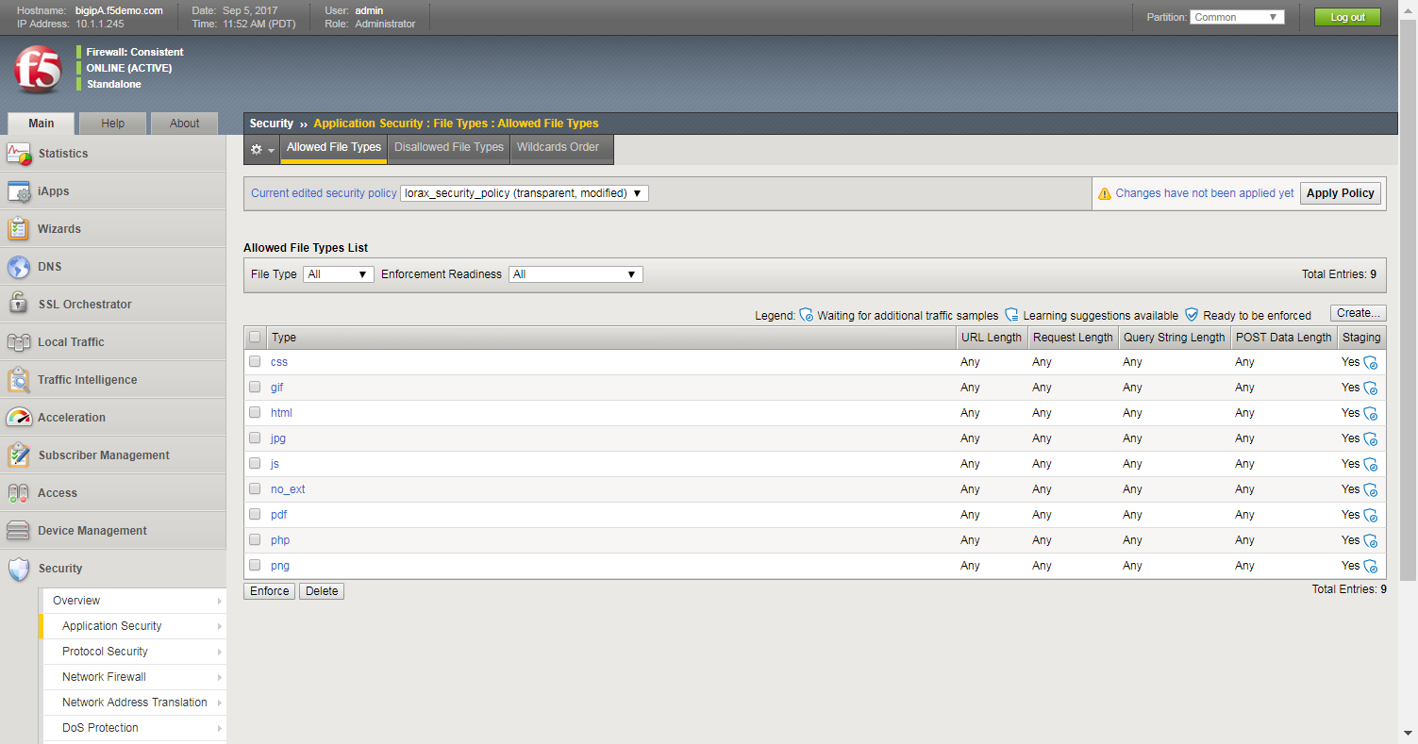
File Type Enforcement
Notes:
So coming back to our whitelist of file types, how can we create this list? There are two ways we can create this list. First, we go to the customer, please bring in your web application team and they can give me the small list of file types, and I can use the Create button and we can create this list in a matter of minutes. The second scenario is where we go to the customer and ask them to bring in their web application team, and then tell us that the web application team for this application is long gone, or it was outsourced, and they have no internal intelligence about the web application. In this scenario, we need to have ASM identify this list for us. Like I said earlier, we need to introduce ASM to the web application. In the next few slides we’ll discuss the process of have ASM build this list for us.

Slide 32
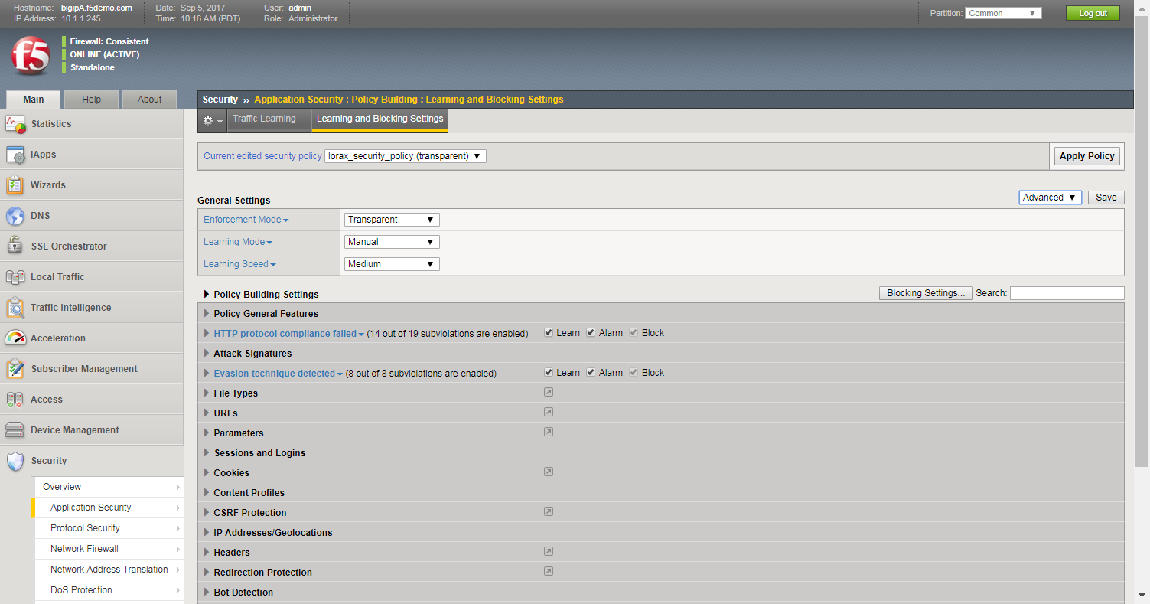
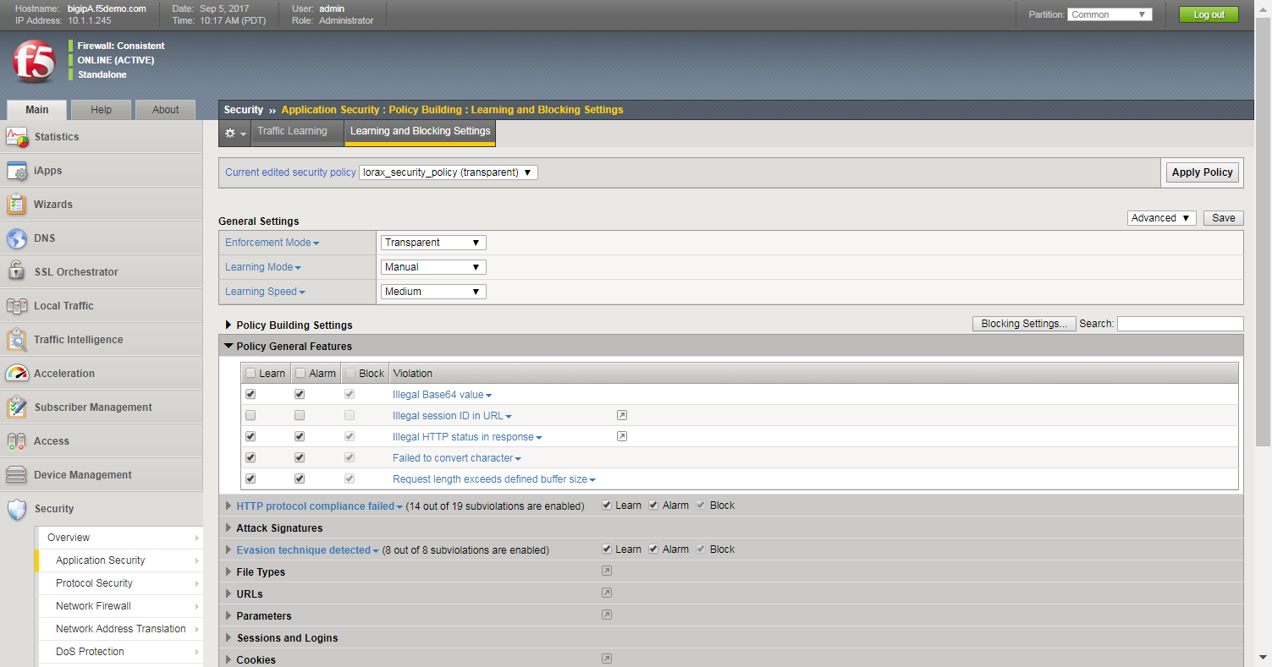
Use the Learning and Blocking Settings Page
Options enabled using the Rapid Deployment Security Policy
Notes:
Here is the most important page for ASM administrators to get to know. It’s the learning and blocking settings page. This is where almost all security policy configurations are configured. First off, top level fields. Remember that each security policy has two modes. This is where we switch from transparent to blocking mode. We also have three learning mode options ASM uses to build a security policy: manual, automatic, and disabled. Finally, there are three different learning speeds, which control how quickly ASM learns about a web application. Then there are several categories of security violations. For each category we can view specific violation types. There are several that are already selected. This is because we used the Rapid Deployment policy template. Each of these violations can identify a malicious or illegal request. You can use the little triangle at the end of each violation type to view more details of the violation, although it’s not important to get to know every violation. What’s important is to understand the three columns: Learn, Alarm, and Block. First the Learn option. In a few minutes we’ll look at another page, the Traffic Learning page. On that page we will see everything that ASM has learned about the web application. For each violation on this page with the Learn checkbox, ASM will show us every time a user request triggers the violation. We can use that information to help us determine valid versus malicious requests. Not all requests that match a violation are malicious. They could be triggering false positives. Then we have the Alarm checkbox. Once we have a violation type configured and a request arrives that triggers the violation, AND the security policy is in transparent mode, ASM will create an illegal event log entry. These log entries will let us know which requests will be blocked once we move the security policy to blocking mode. Finally is the Block checkbox. Once we are in blocking mode, this checkbox ensures that any requests that trigger this violation will be blocked, and SAM will create a blocking event log entry.

Slide 33
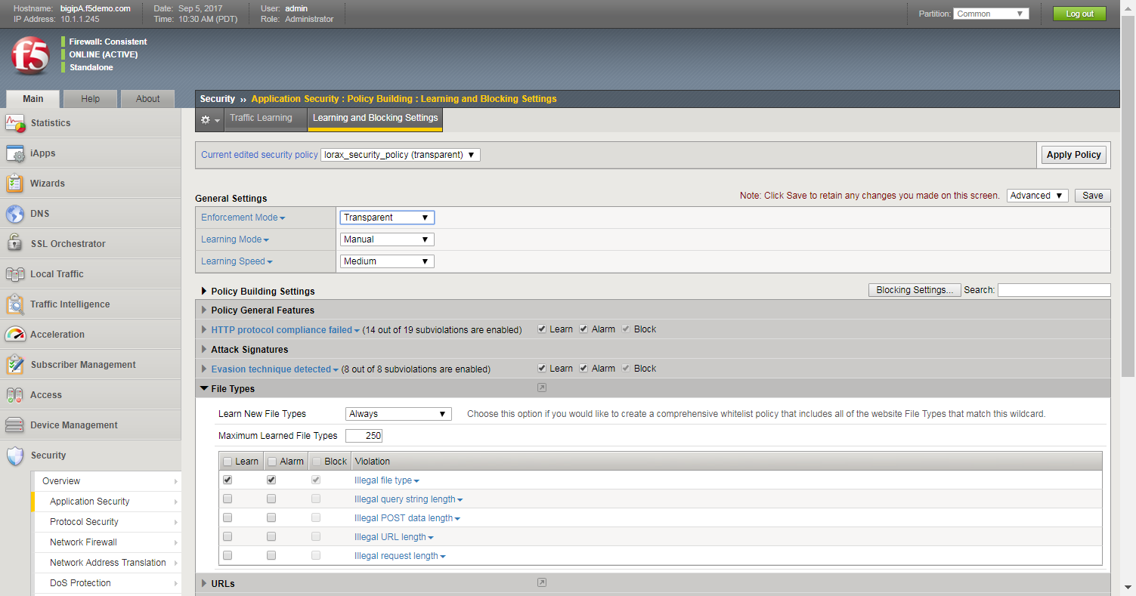
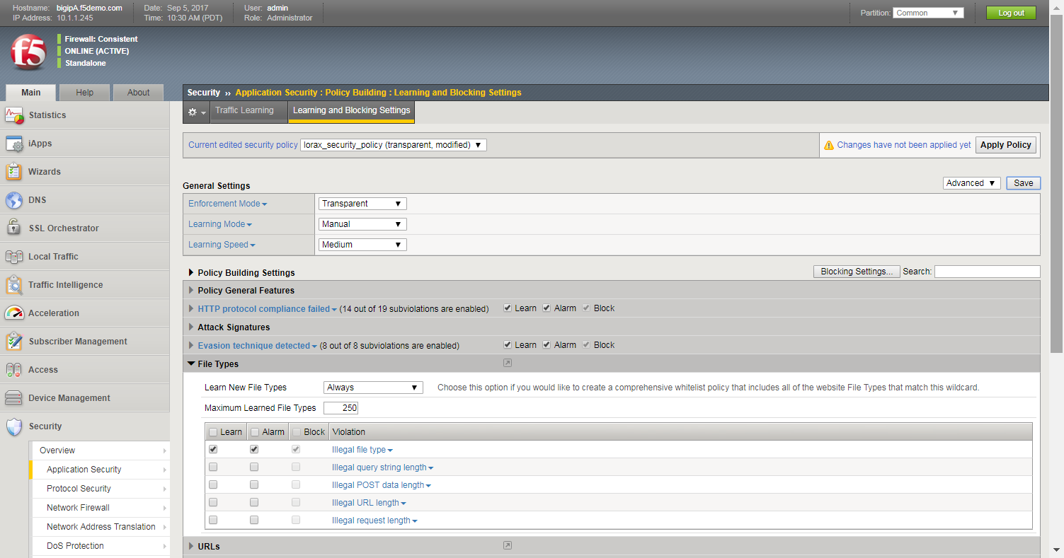
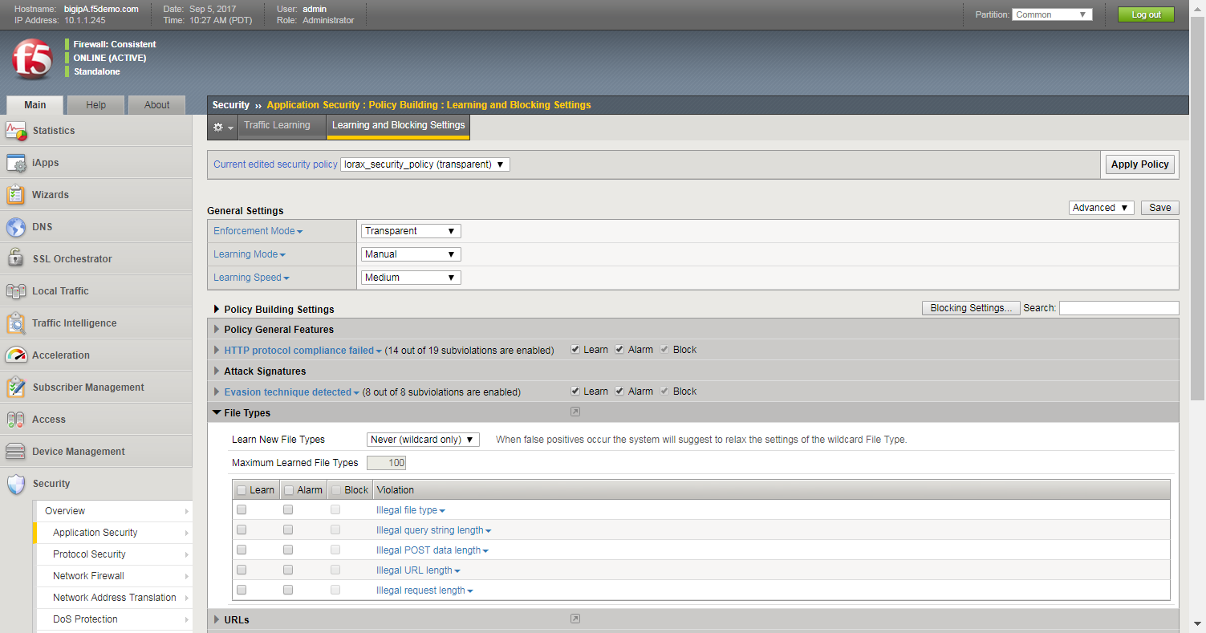
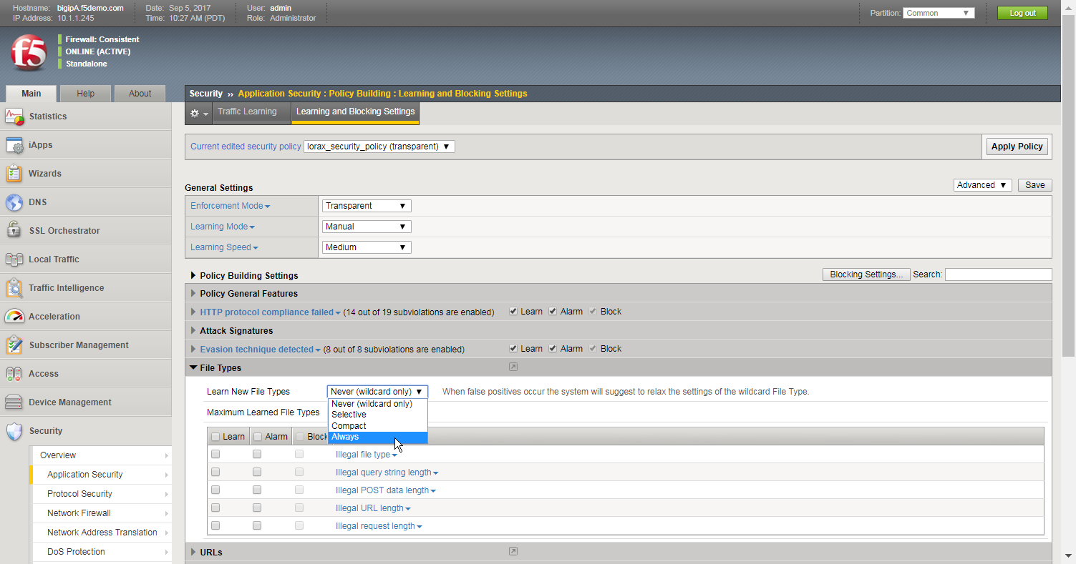
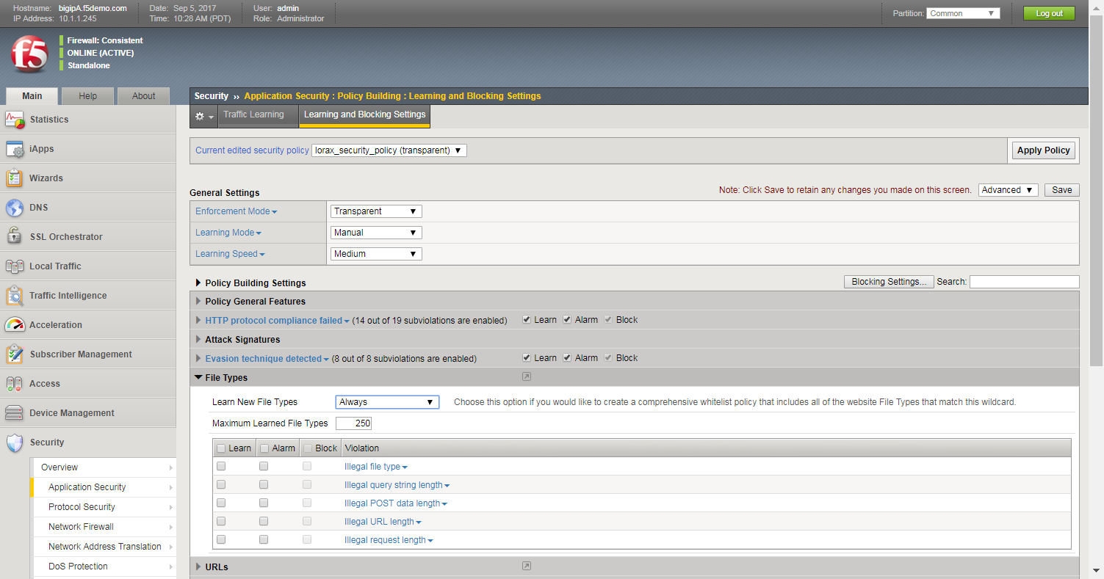

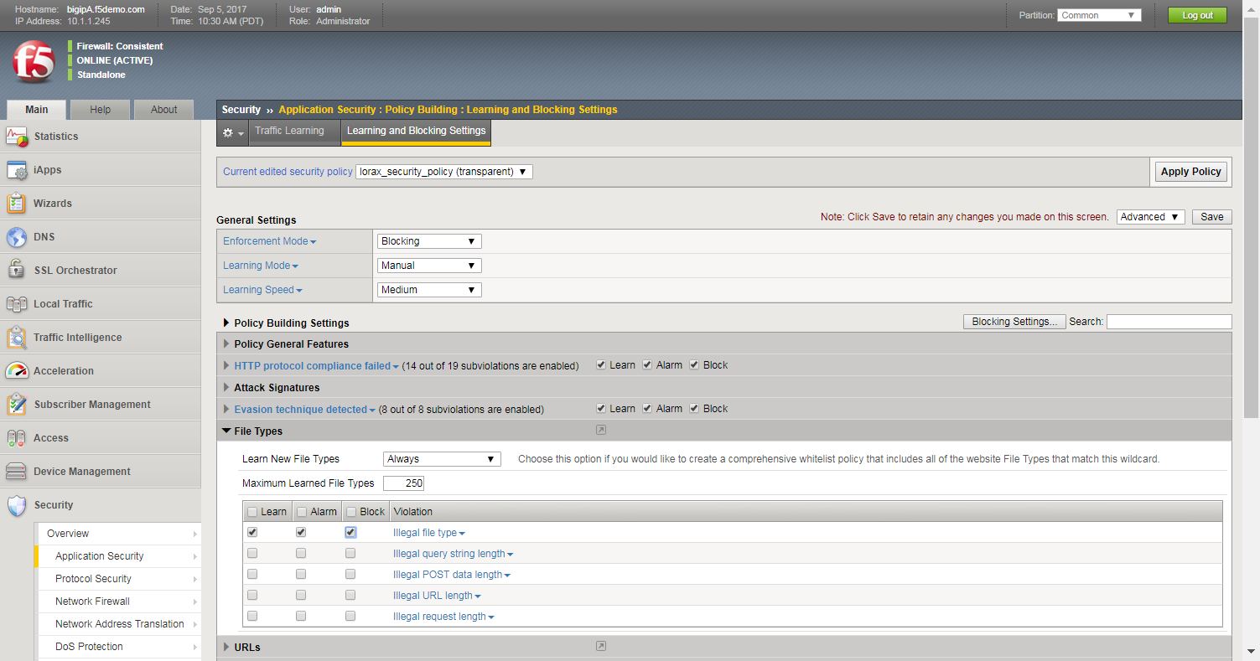
Step 1: Adjust Learning and Blocking Settings
Switch to Blocking mode
You can now switch back to Transparent mode
The Block can now be selected
With the policy in Transparent mode, the Block option is greyed out
Notes:
We will use the learning and blocking settings page to enable learning for new file types. First, notice that all of the block checkboxes are greyed out and I can’t select them. QUESTION: anyone know why they’re greyed out? ANSWER: because we’re in transparent mode. We can easily do this be switching from transparent to blocking mode, but don’t yet save the page. Notice that we can now enable the block checkboxes. First though we’ll change the learn new file types option from never to always. This will enable ASM to create a comprehensive whitelist of file types. Next we’ll need to select the checkboxes for the Illegal File Type violation. This enables ASM to show us new file types on the traffic learning page, alert us if a file type is requested that’s not on the whitelist in transparent mode, and block a request if a file type is requested that’s not on the whitelist in blocking mode. We can now switch back to transparent mode, and then save the page. Notice at the top of the page we’re notified that changes have been made to the security policy that haven’t yet been applied. With ASM we need to click Apply Policy in order to see the new settings in the web application.

Slide 34
Define Specific File Types Step 2: Generate Learning Suggestions
Remember, blocking may not be taking place
Valid file types (2xx response codes) are added to the list of suggestions
www.lorax.com/schedule.asp
www.lorax.com/images/icon.jpg
www.lorax.com/style.css
www.lorax.com/default.asp
www.lorax.com/images/logo.gif
www.lorax.com/instructions.pdf
www.lorax.com/config.conf
ASM
.asp
(2)
.gif
.pdf
Some suggestions may be malicious requests that should not be added to the security policy
Learning suggestions can be generated in production or a development environment
.jpg
.css
.conf
Web server
Notes:
34
The next step is to generate learning suggestions for file types. QUESTION: how do you suppose we’ll identify potential file types? ANSWER: have users generate traffic. When users request different file types that receive successful responses from the web server, ASM adds the file types to the SUGGESTION list. It’s important to remember that this is only a list of suggestions; it’s possible and likely that not all will be added to the file type whitelist. As different users access the same file types, ASM keeps track of the number of requests for each file type. This will help us identify valid file types. If a malicious user requests a file type using forceful browsing, that file type will be added to the suggestion list. We can do this in a production or development environment, but it’s important to remember that we’re in transparent mode, and nothing gets blocked in transparent mode.

Slide 35
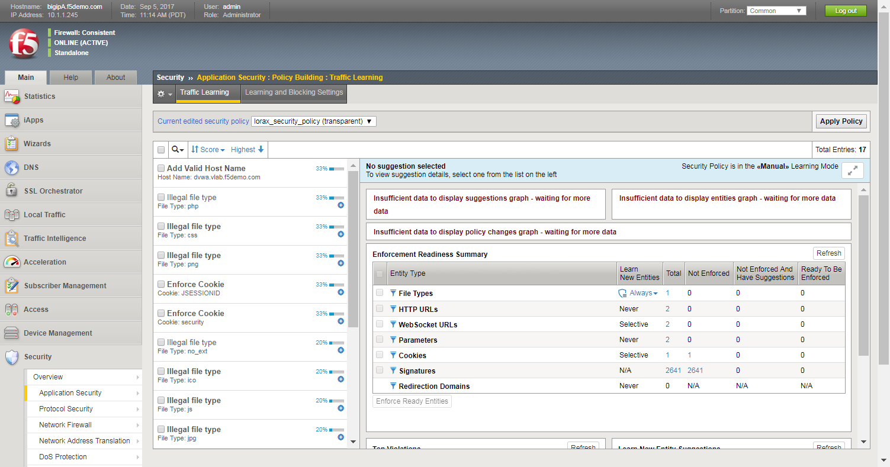
View Traffic Learning Suggestions
These are all of the generated suggestions
Notes:
After a period of time has passed, we can now examine all of the details that ASM has learned about this web application, and we’ll do that on another very important ASM page, the traffic learning page. Remember on the learning and blocking settings page there were all of those violations with the learn checkbox selected. This page will show us every time a user request triggered one of those violations. First is the list of what are called learning suggestions. Some of these are valid and should be added to the security policy as acceptable, others are not valid or malicious and should not be added to the security policy.

Slide 36
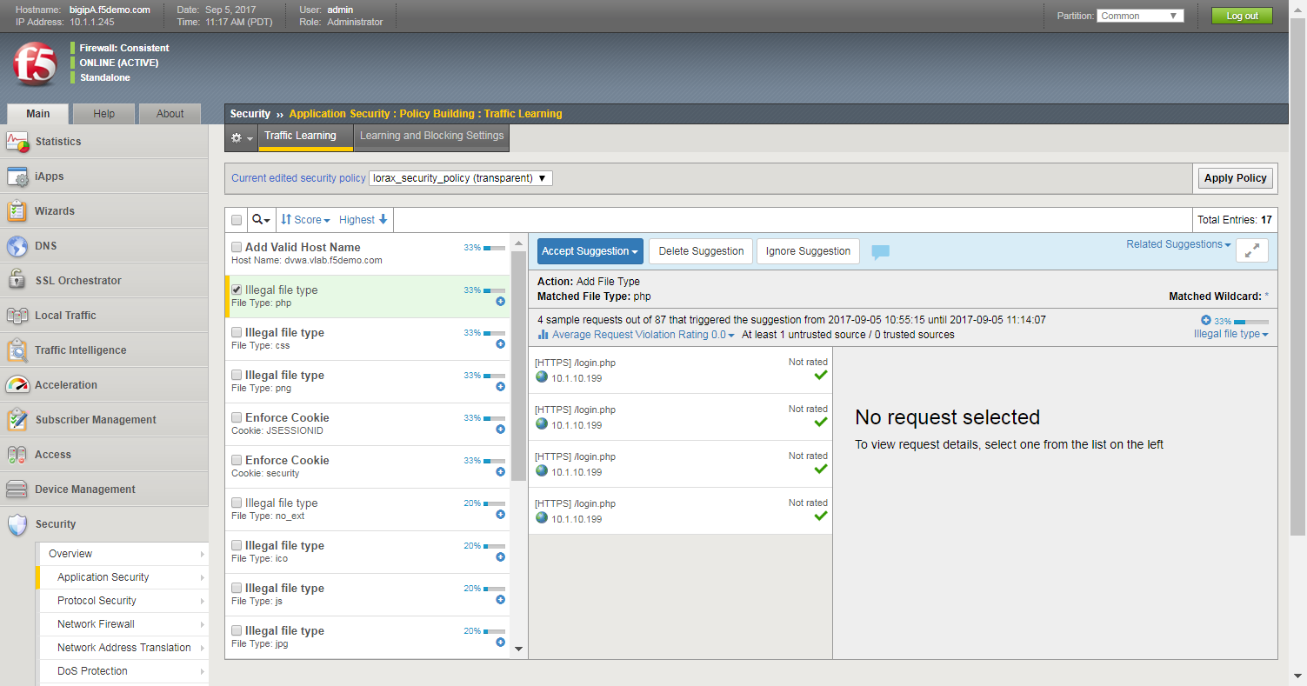
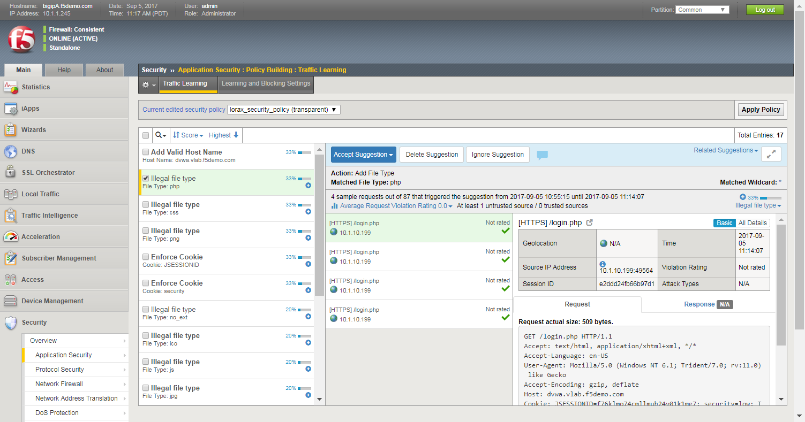
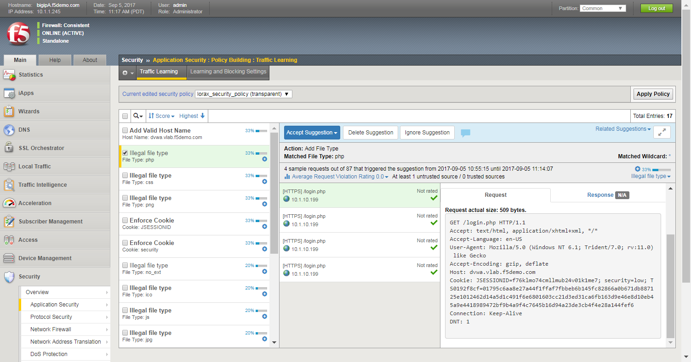
View a Specific Traffic Suggestion
You can view general details of the request, in addition to the entire HTTP request
Notes:
Next we’ll look at a specific traffic suggestion Notice that this suggestion has a score, this is called the learning suggestion score. The idea is that as more requests come in from different users using different sessions over a period of time for this same file type, ASM will slowly increase the suggestion score. We can also see many suggestions have come in for this file type, for example there were 87 requests for the php file type. You can also see the exact URLs that were requested for this file type. And when you select one of the URLs you can see the full HTTP request submitted by the user. This is a lot of detail for the ASM administrator, which they can use to determine if they should add this file type to the whitelist.

Slide 37
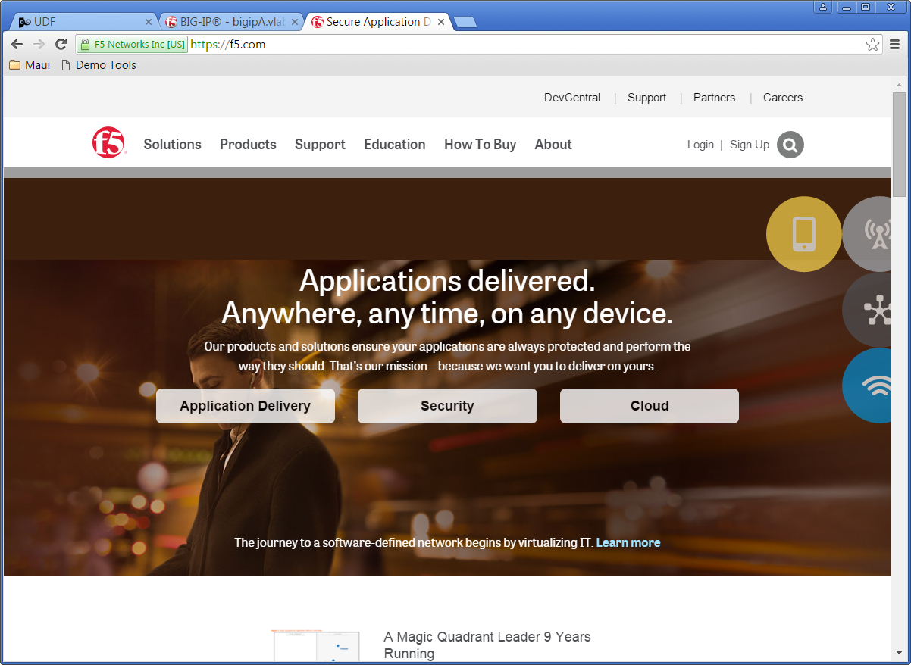

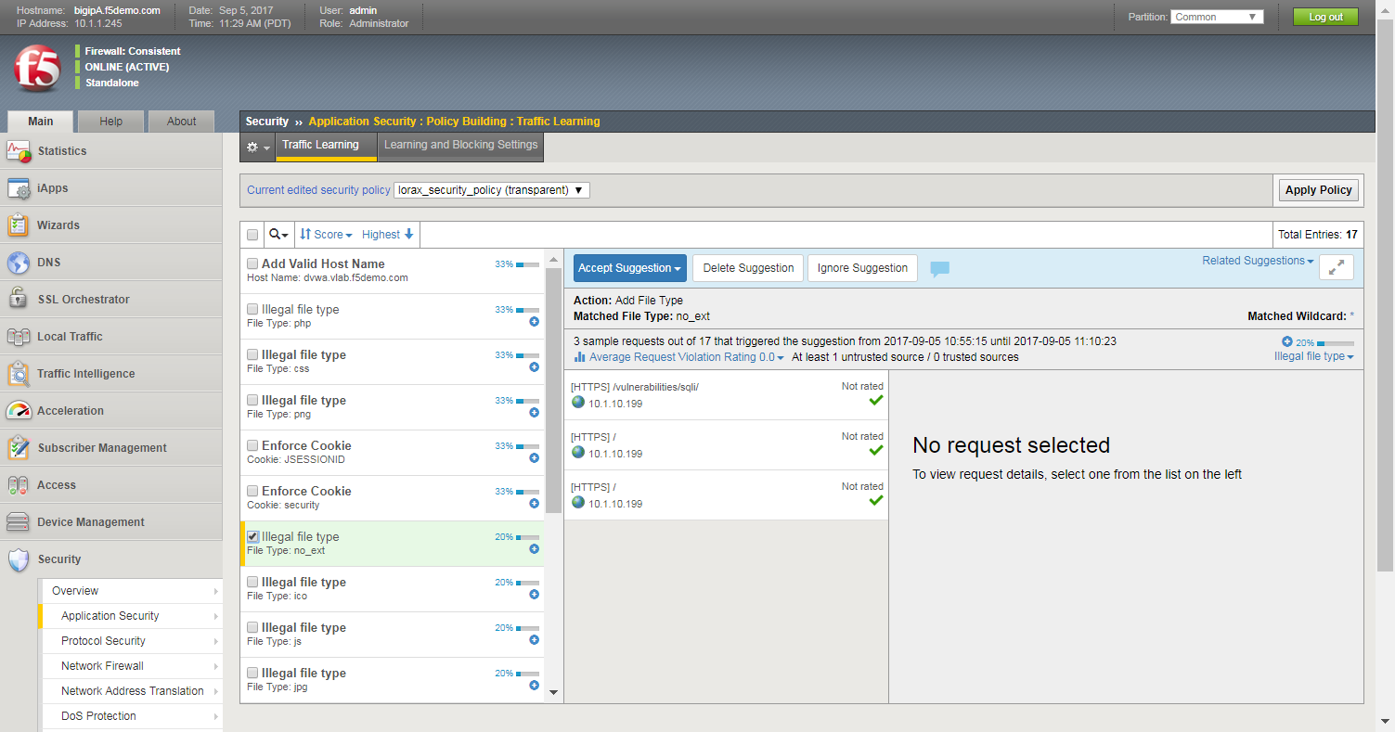
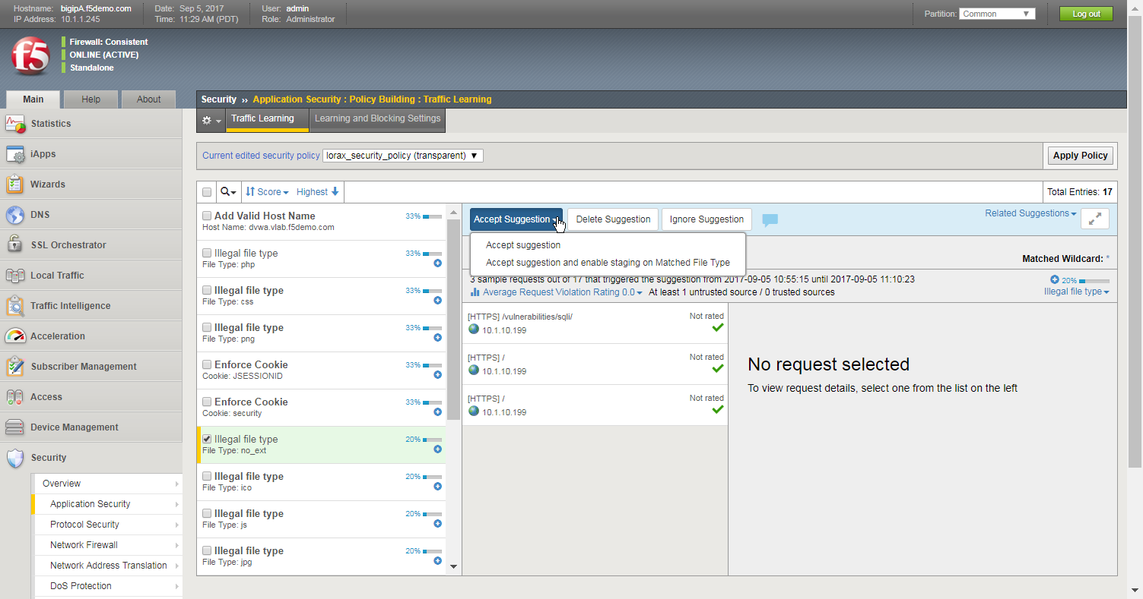
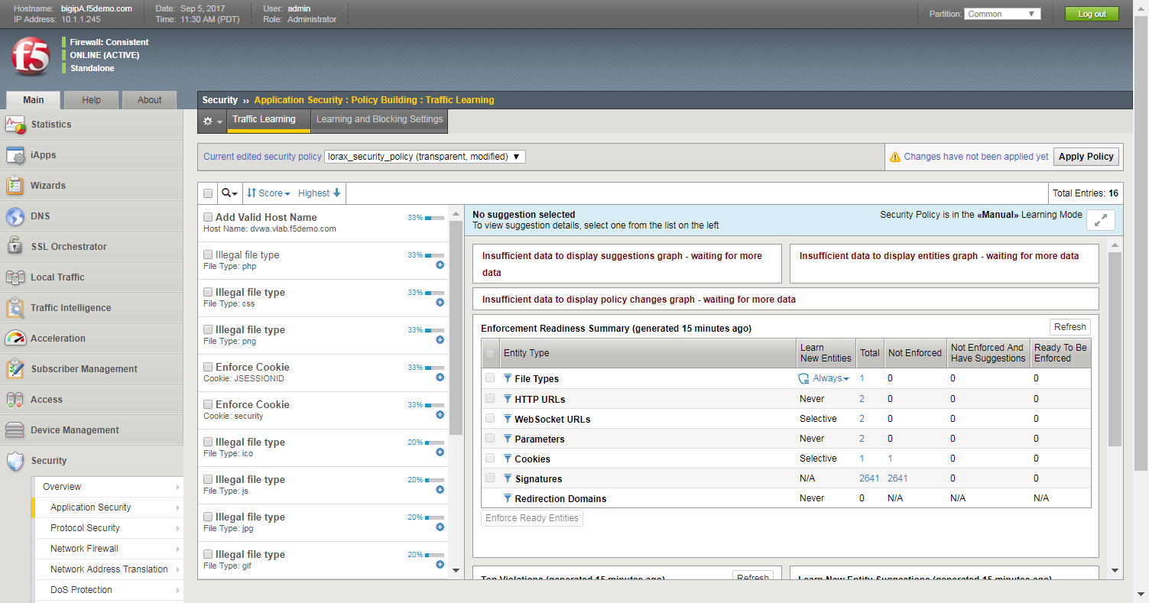
Step 3: Add a File Type to the Security Policy
What type of file did the user request?
Add the file type to the policy and remove it from staging
The Action is Add File Type
Add the file type to the policy and leave it in staging
The file type is no longer in the list (and will no longer appear as a new suggestion)
What type of file is “no_ext”?
Notes:
The last step for creating our file types whitelist is to add the correct file types from the suggestion list. First, notice there is a file type called no_ext. QUESTION: what do you suppose this refers to? ANSWER: it stand for “no extension”, it’s whenever a user submits a request like this, for f5.com, without specifying a file type. QUESTION: do we want to add this file type to our whitelist? ANSWER: definitely, unless we want to force our users to access our home page by going to www.lorax.com/default.XXX. Now we have the suggestion selected. By the way, just because the violation is illegal file type doesn’t mean that this is actually an illegal file type, it’s just an illegal file type NOW because it’s not on the whitelist. To add it to the whitelist we’ll use that blue button. It’s important to understand that the blue button will add any of the suggestions to the positive security model for the policy. In this case you can see that the blue button will add php to the list of valid file types. When I click the button there are two options, for now we’ll select the second option and keep the file types in staging. Once we do that the suggestion is removed from the suggestion list, and it will never appear on the suggestion list again because php is no longer illegal.

Slide 38
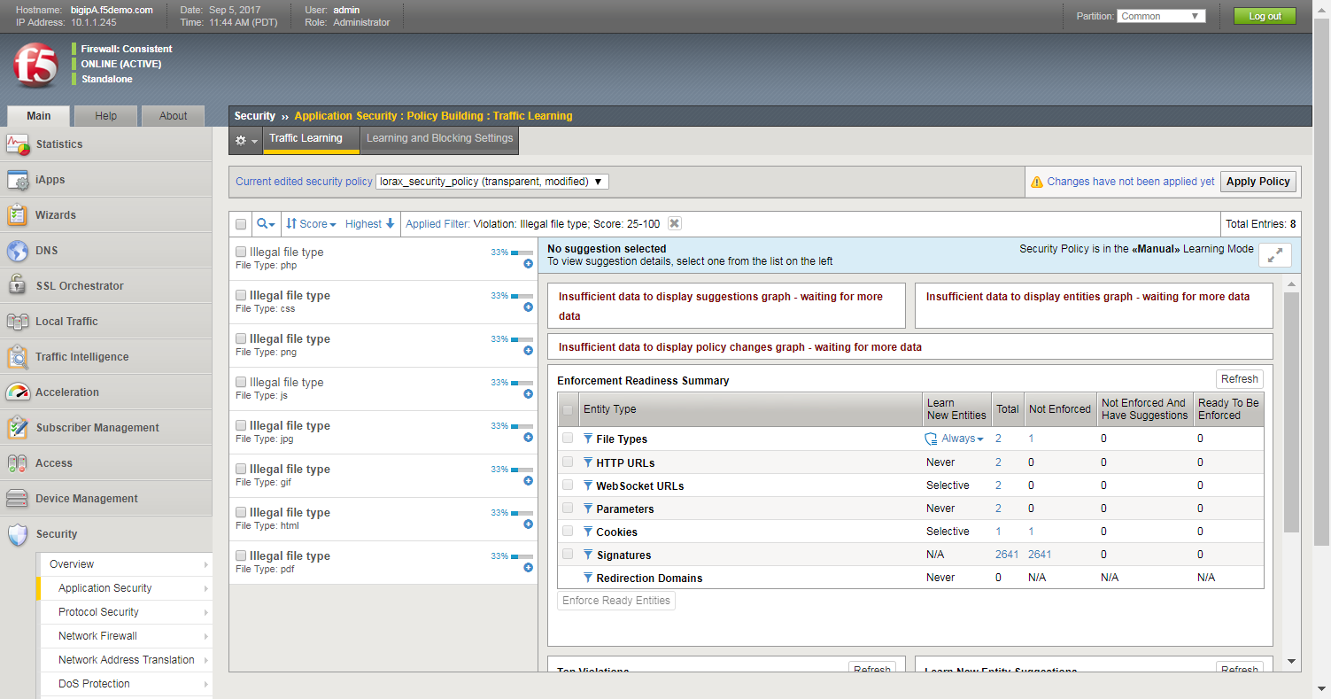
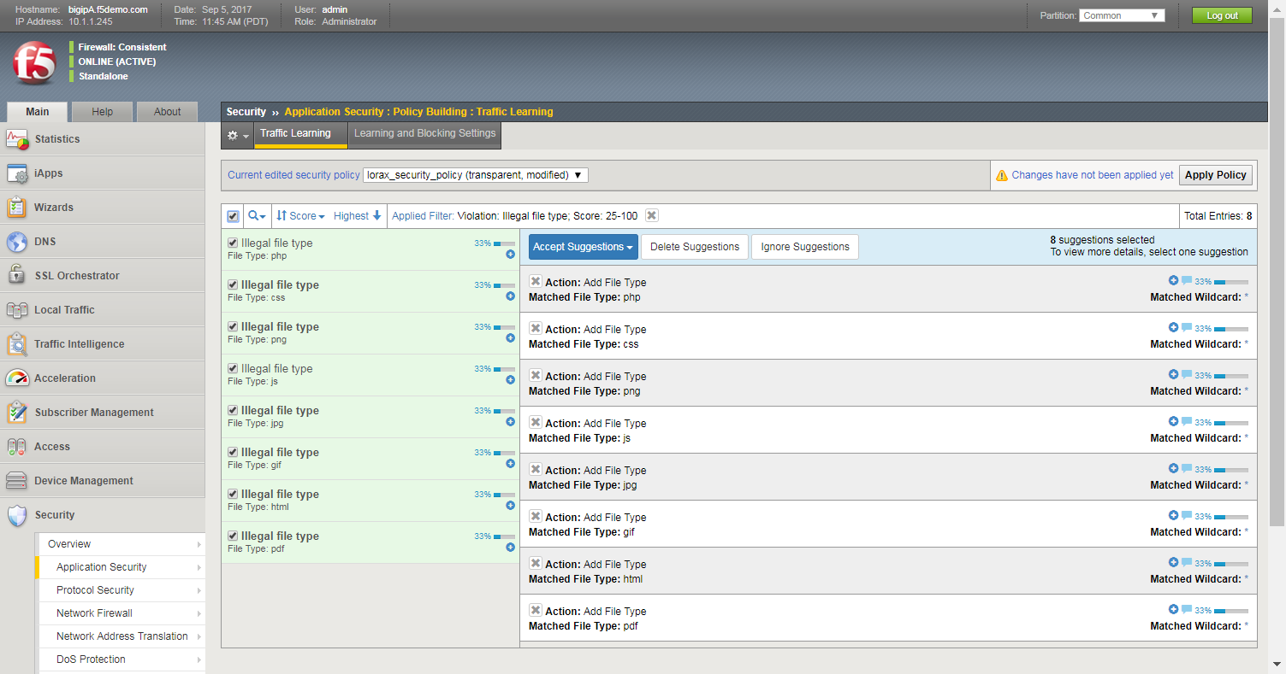
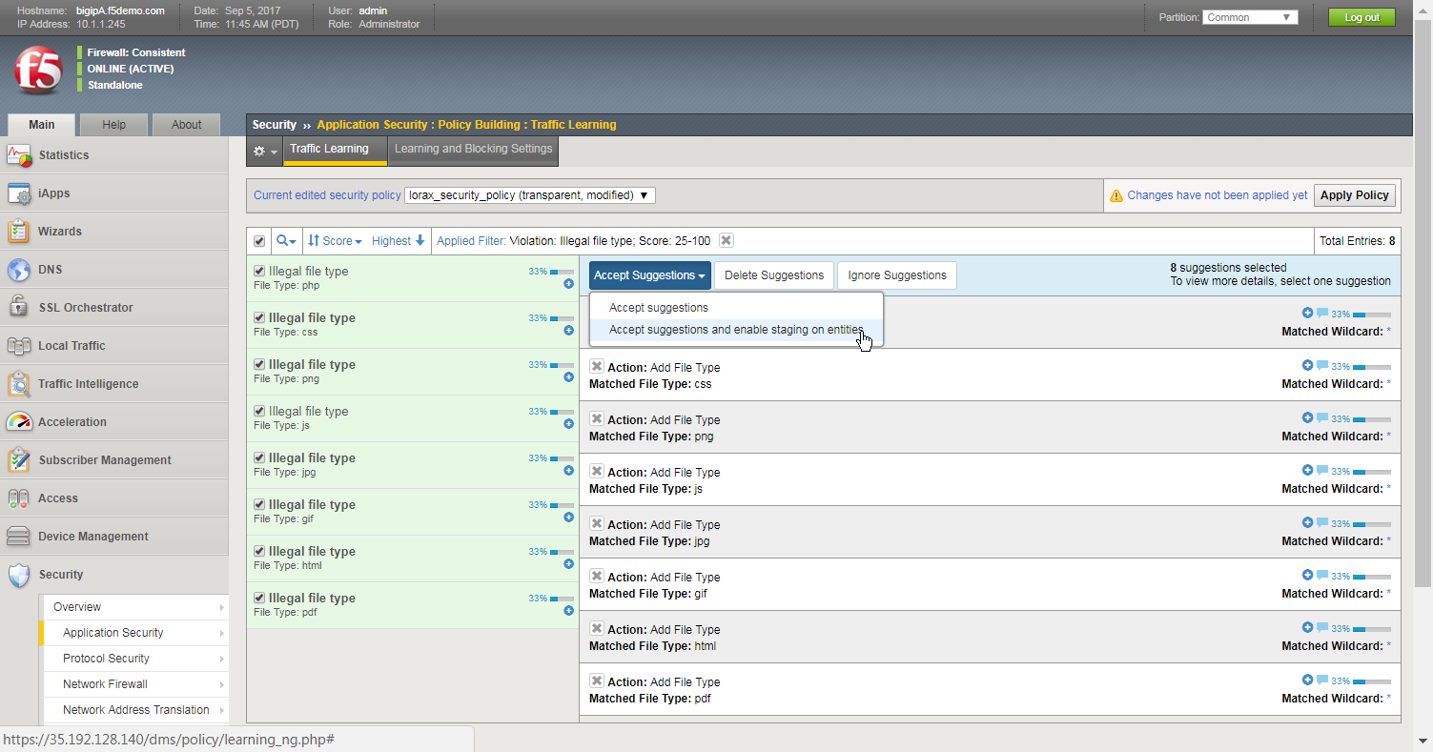
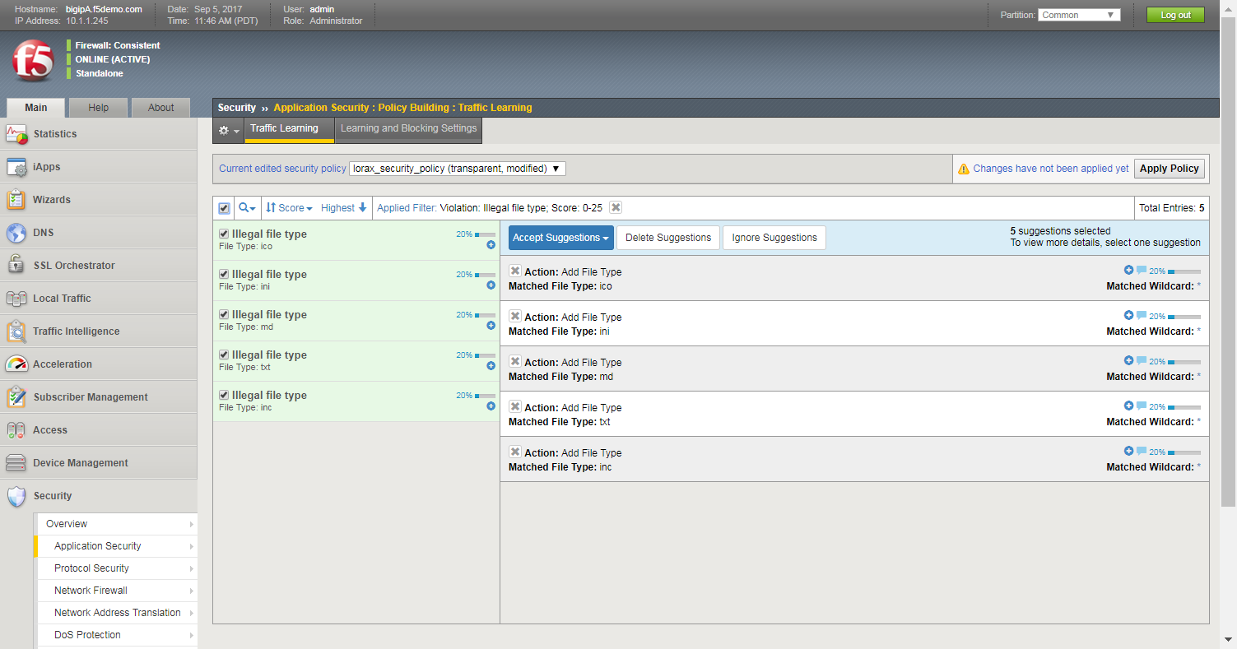
Adding Multiple File Types to the Security Policy
Filtering can be used to limit the suggestion list
The remaining file types can remain in the list, or can be deleted or ignored
Notes:
This process may be time consuming going one by one, so we can use the magnifying glass to create a filter of just illegal file types with a high learning score. I can quickly see that these are all valid file types and select them all together with the select all checkbox. Notice you can see that all the file types that will be added. We’ll then add them all and keep them in staging. We can then adjust the filter to see all file types with a low learning score. We can choose to keep them in this list, delete them, or ignore them. If we keep them in the list it will clutter up the suggestion list. If we click on delete suggestions it will remove them from the list, but the suggestions may re-appear in the list again if they are requested again. If we click on ignore suggestions it will remove them from the list and they will never again appear in the list.

Slide 39
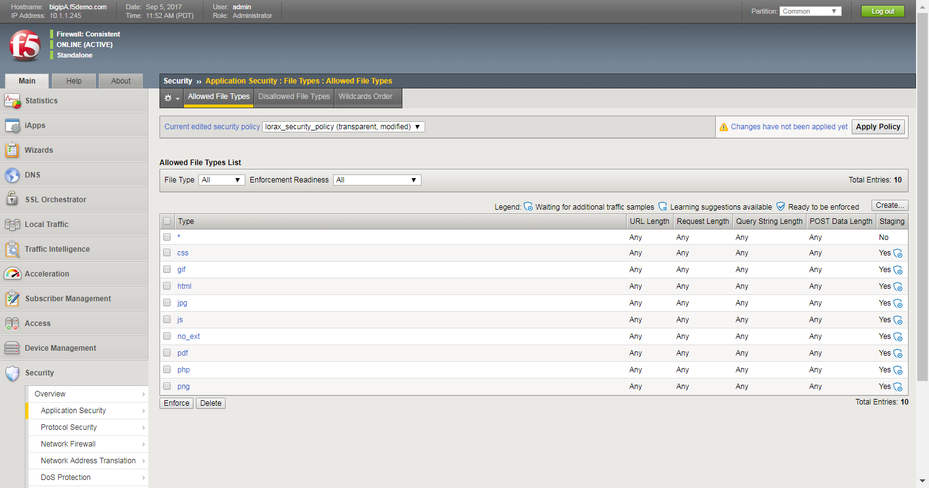

Define Specific File Types Step 4: Remove the Wildcard Entry
As long as the wildcard character is on the Allowed File List page, BIG-IP ASM allows all file types
Without the wildcard, these are the only file types that BIG-IP ASM will allow
Note that all file types are in staging
Notes:
39
We can now view the allowed file types page, which is our whitelist. Remember, as long as the wildcard is on this list ASM will continue to allow all file types. Once we are confident that this list is complete, we can then select the wildcard checkbox and click Delete. Now, without the wildcard, ASM will ensure that all requested file types match one of the items in the whitelist. QUESTION: if someone now requests an ini file type, will it be allowed or blocked? ANSWER: it will be allowed because we’re in transparent mode. However ASM will create an illegal event log entry. One last thing, note that all file types are in staging. If you get a chance to take the advanced security boot camp you’ll learn about staging.

Slide 40
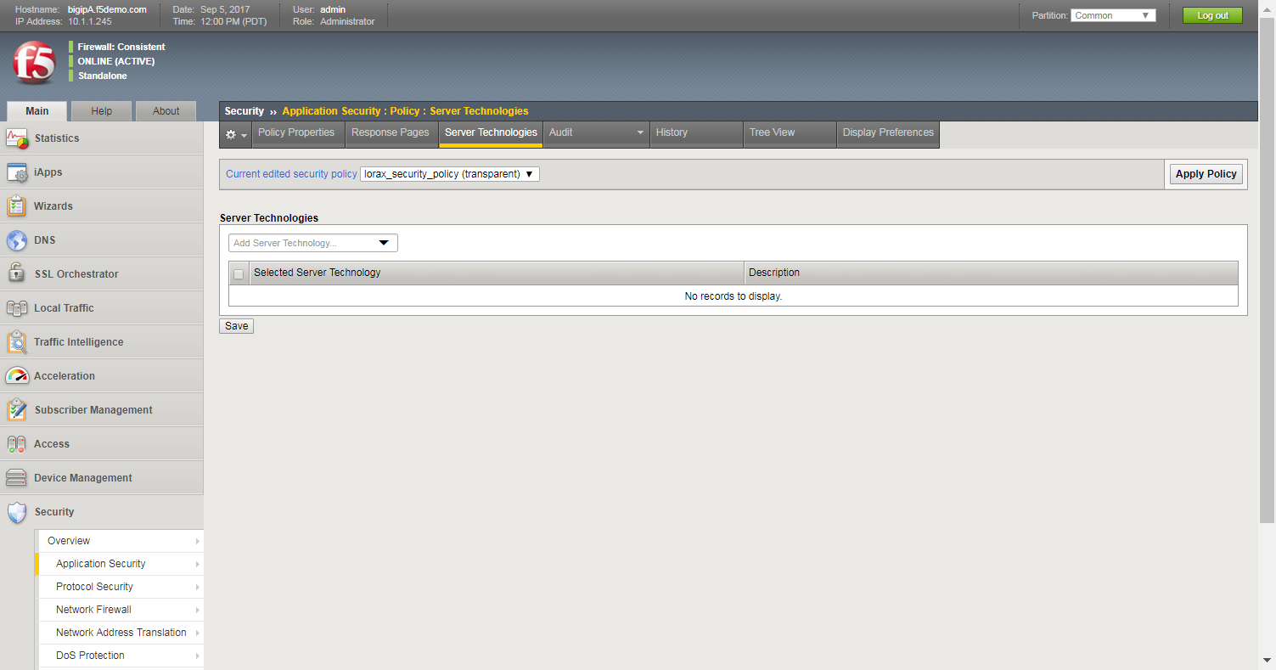
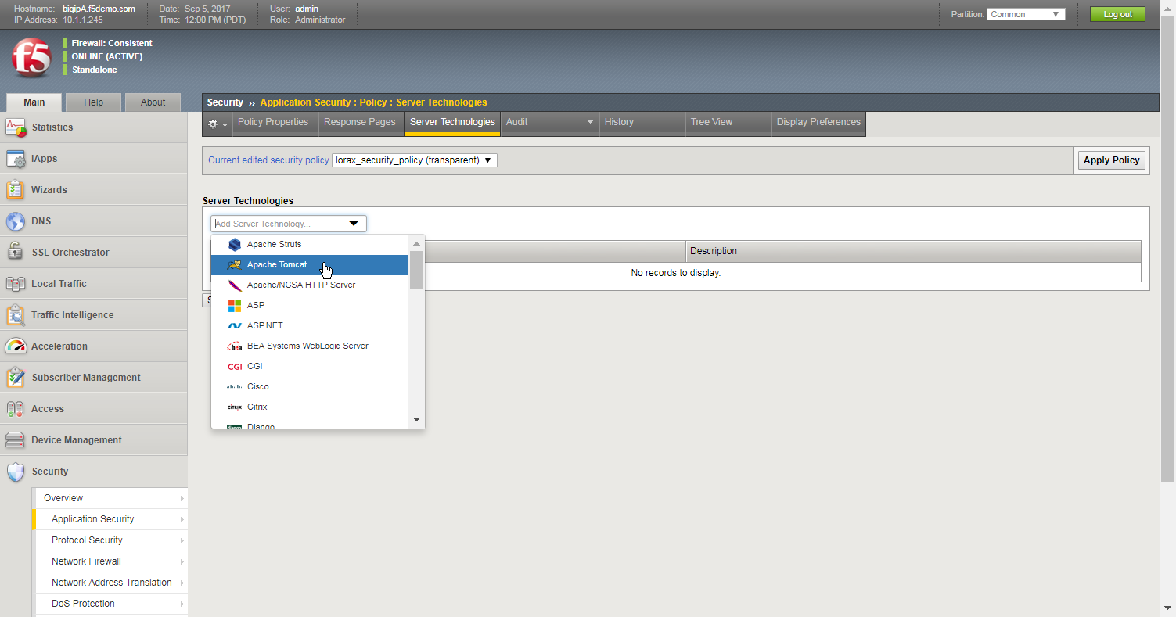
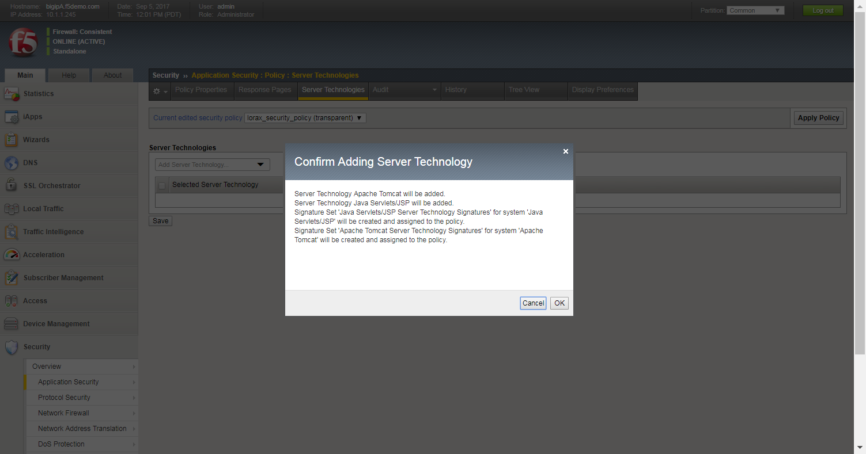
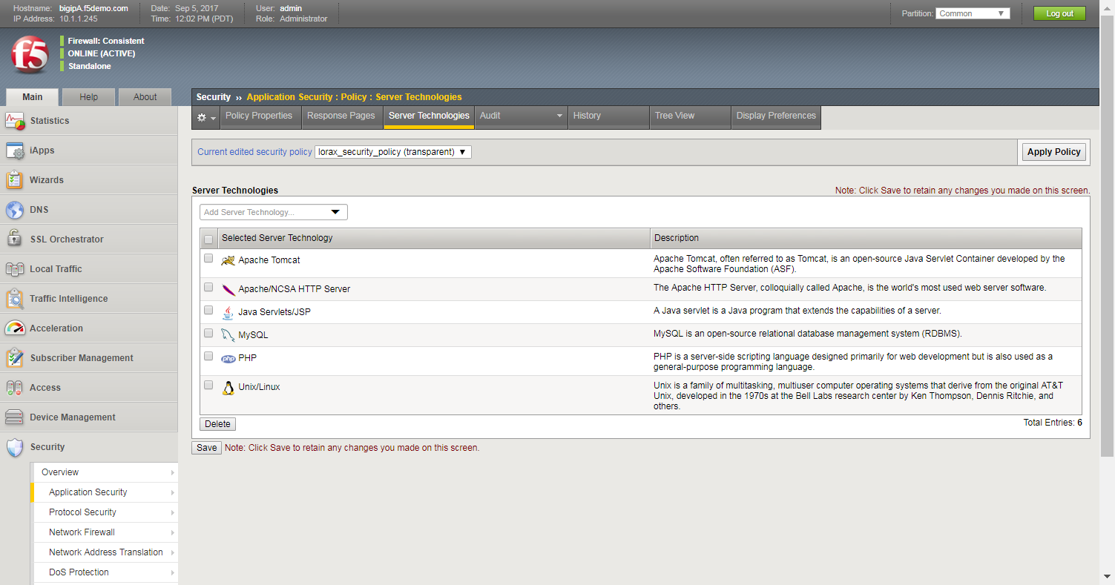
Add Server Technologies
Notes:
Next we’ll talk about attack signatures. The first thing we’ll discuss is the server technologies page. We use this page to define aspects about the web application, such as the web server type such as IIS or Apache, the web page types such as asp or php, the database type such as SQL or mySQL. For each item we add, ASM will add additional attack signatures that ONLY apply to these technologies. Therefore this page is used to add custom signatures for this security policy.

Slide 41
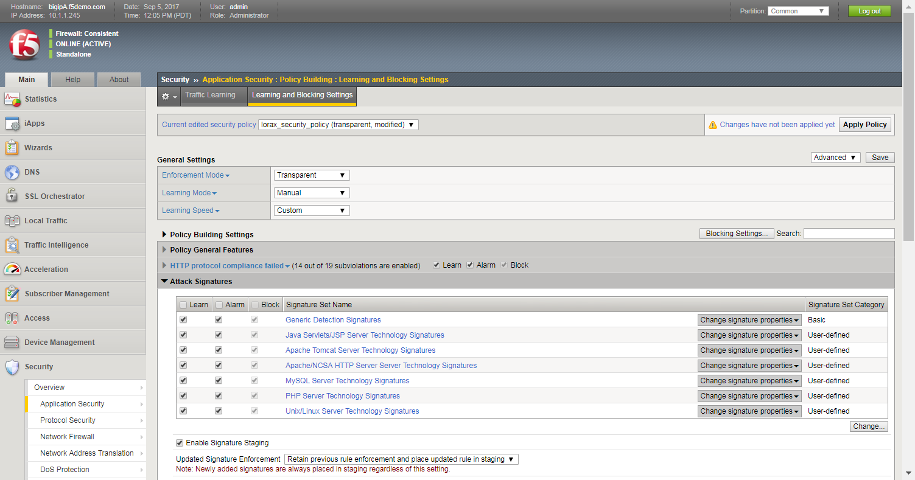
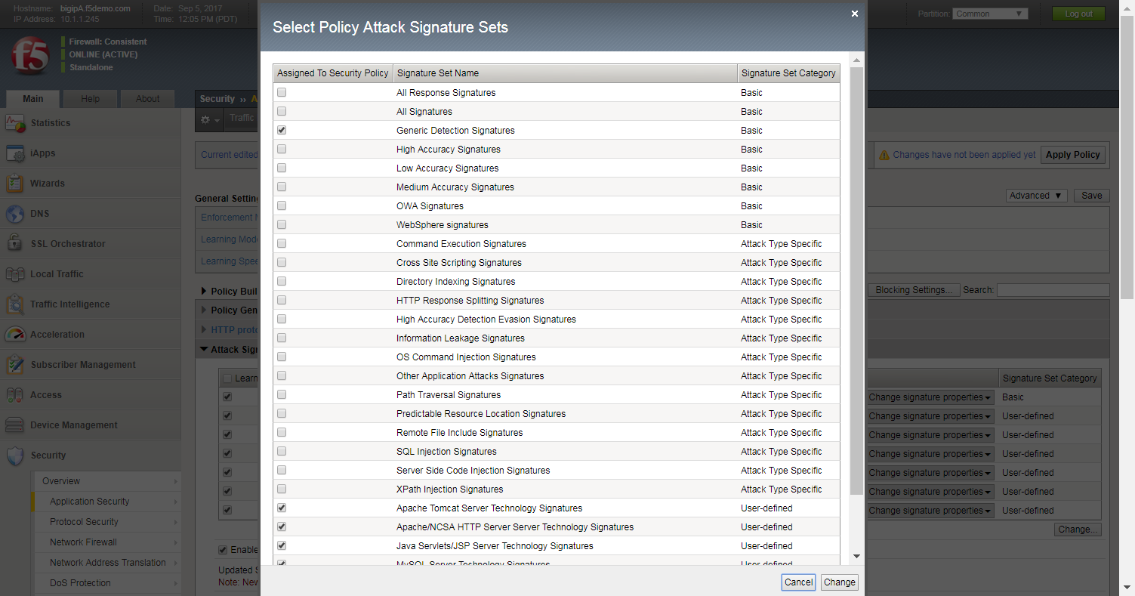

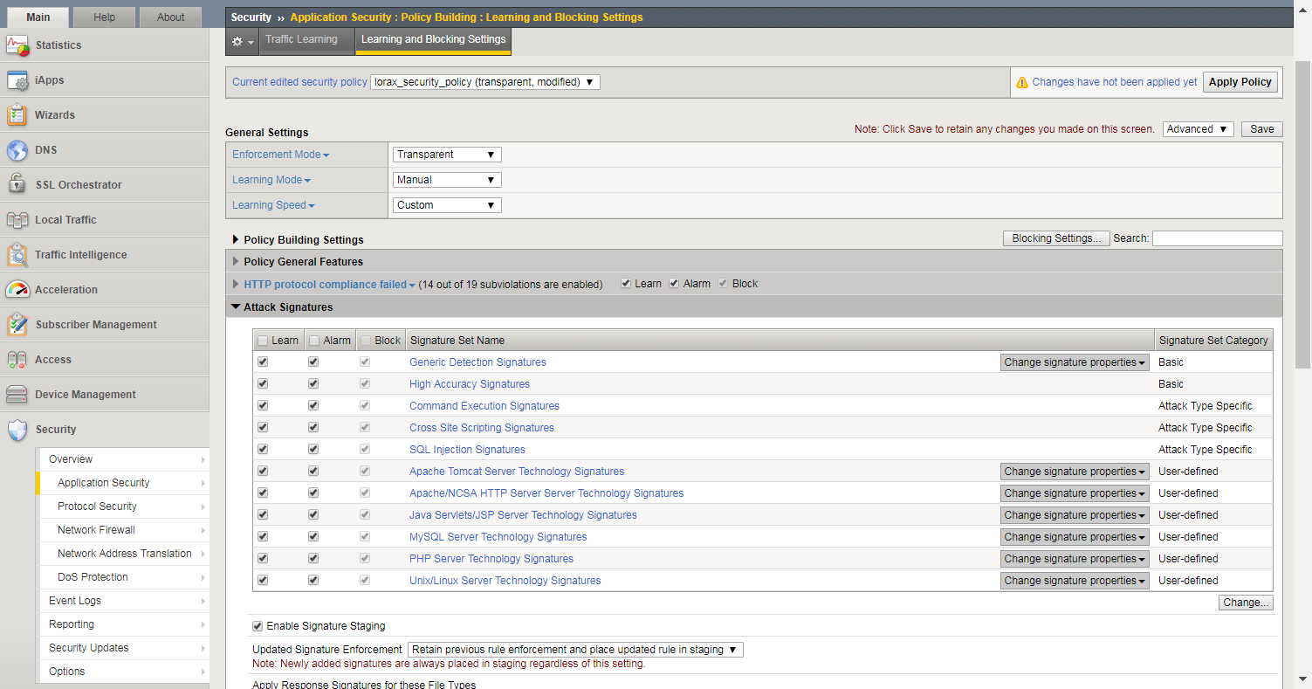
Adding Attack Signatures to a Security Policy
Signatures adding while creating the policy and adding server technologies
Notes:
Another place where we can add signatures to the security policy is the learning and blocking settings page. Notice there is an Attack Signatures section. When we expand it you can see all of the signature sets that are currently added to the security policy, including the server technologies signature sets we just added. We can click on the Change button to see additional signature sets. A signature set contains any number of different attack signatures. QUESTION: why not just add all signature sets to the security policy? ANSWER: two reasons, it adds unnecessary overhead, plus it can trigger unwanted false positives. Therefore I only want to add the signature sets that are required. High accuracy will have less false positives, low accuracy may have more false positives. I can now see all of the new signature sets and I can save the page and apply the policy.

Slide 42
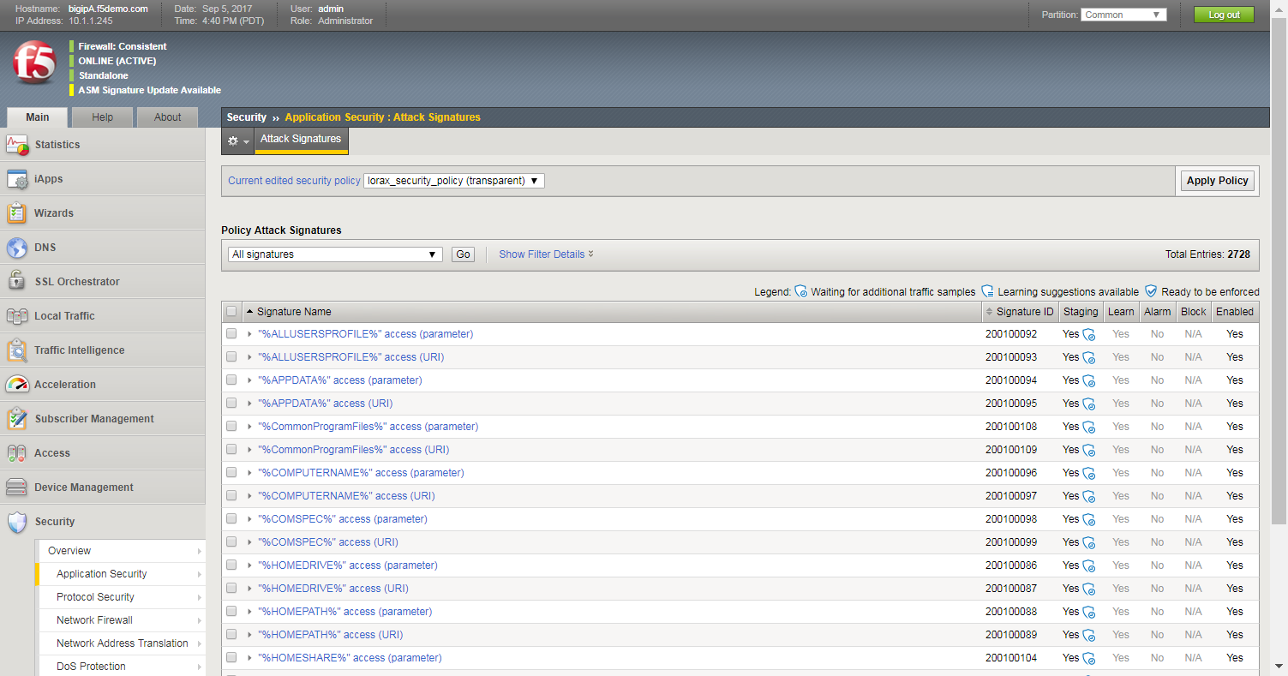
Viewing Attack Signatures Per Security Policy
Note that all signatures are in staging
Notes:
We can also use the attack signatures page to view all of the attack signatures for this security policy. One important thing to note is that the top of nearly every ASM page has the current policy list. You should always ensure that you’re looking at the correct security policy before doing any editing. On this page we can see the exact number of signatures, in this case over 2700. Once again, note that all signatures are currently in staging. If you take the advanced security course you will learn about staging.

Slide 43
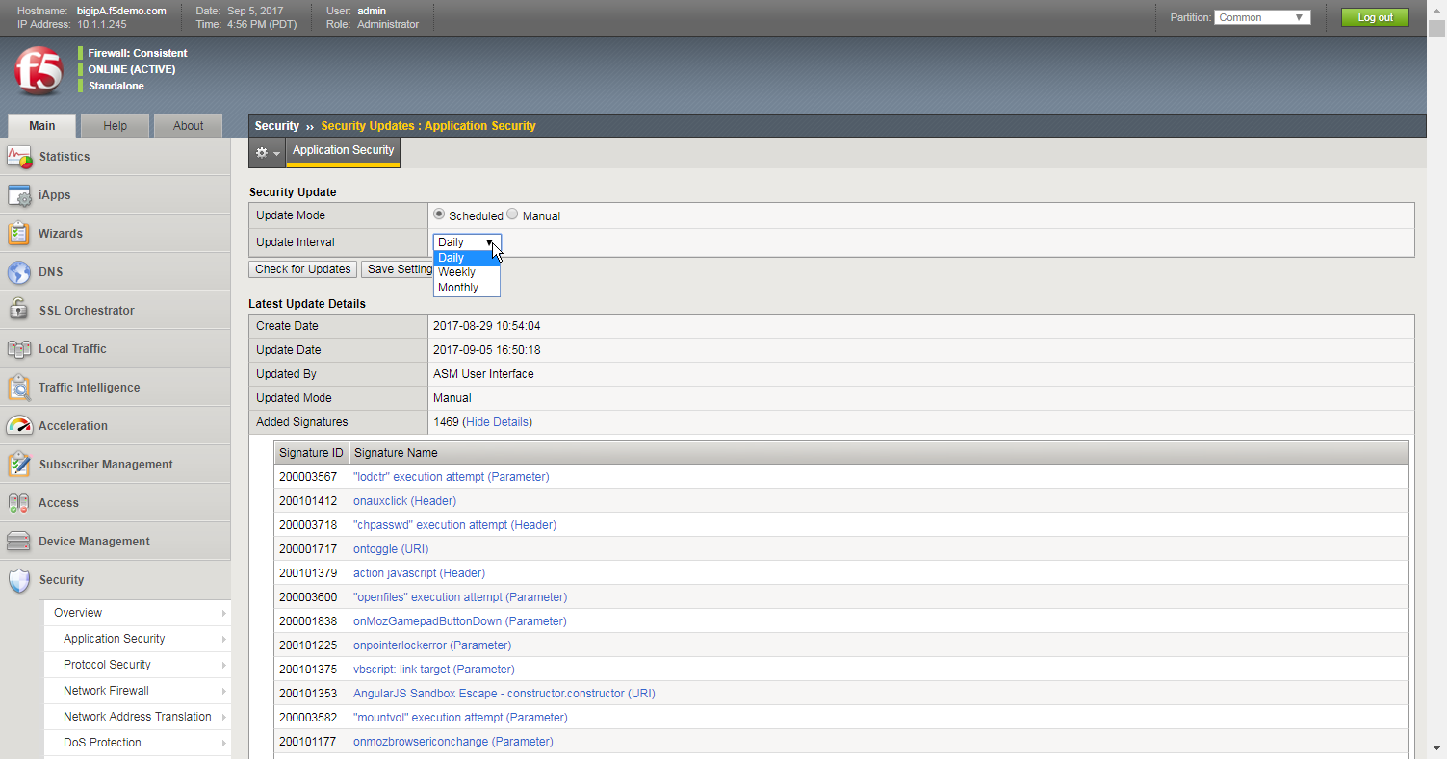
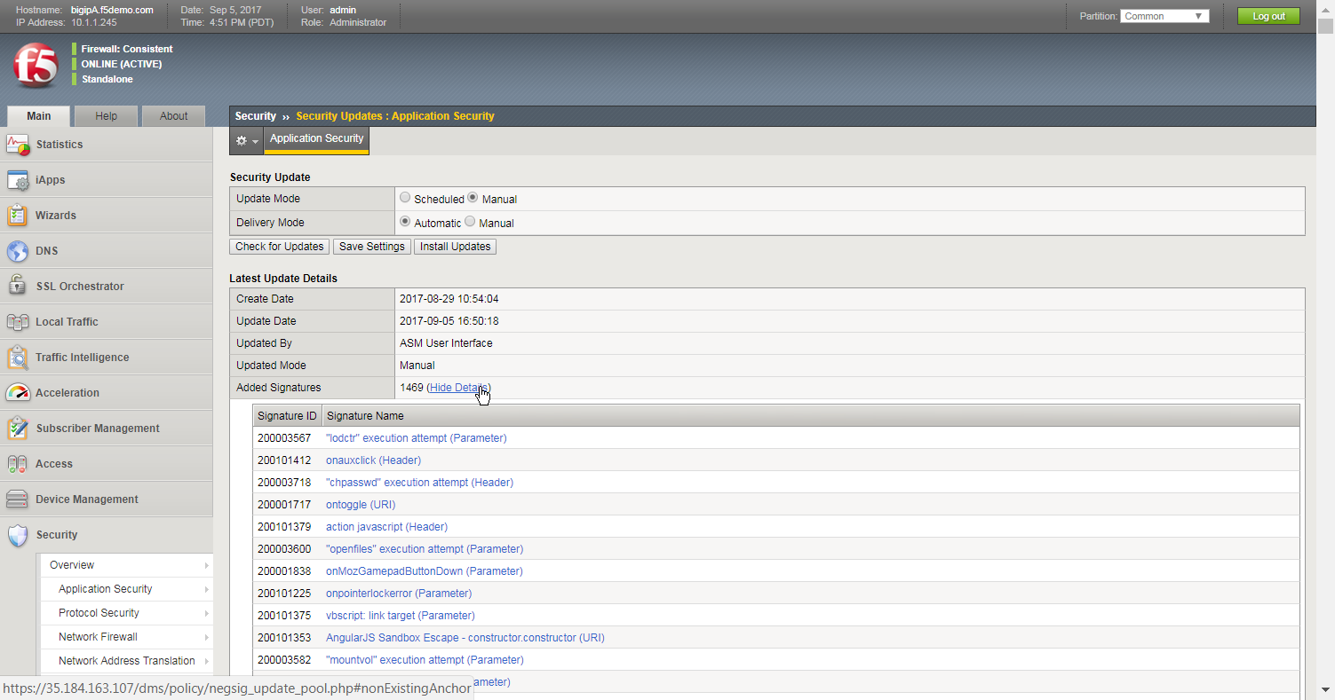
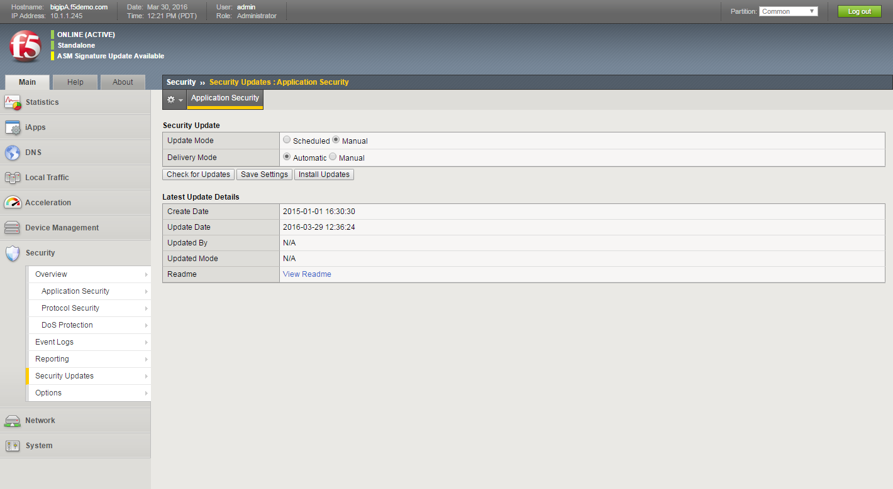



Attack Signature Updates
Updates due to zero day attacks are typically released 12 – 48 hours after a pervasive attack
F5 releases signatures roughly every six weeks
Notes:
Notice that up in the to left corner of the page there’s a notification about new ASM signatures. This link brings us to the Security Updates page. The F5 ASM team in Tel Aviv watches all application attack trends and adds new signatures, modifies existing signatures, and even deletes signatures. They release signature updates roughly every six weeks. There are a couple different ways we can apply signature updates to ASM. By default it’s manual, where we click the Check for Updates button. We’re then notified that there are updates available, and then we can install the updates. Notice we are informed of exactly how many attack signatures, bot signatures, and server technology signatures were added, modified, or deleted. Once the install is complete you can view details about the specific signatures that were affected. You can also change from manual signature update to automatic signature update, where we specify how often ASM should check for updates. For zero day, the research team is releasing emergency updates ASAP, they typically take 12-48 hours after a pervasive zero day is published.

Slide 44
ASM Exercise 2 – Use File Type Enforcement
In this exercise:
Configure the security policy to learn about file types
Generate traffic to create learning suggestions
Accept valid suggestions to the security policy
Modify the security policy enforcement mode
Add additional signatures to the security policy
Estimated completion time: 40 minutes

