Slide 1
Web Application Firewall (WAF) - Demo
Yasir Liaqatullah

Slide 2
WAF Demo - Introduction
Demo Objective
To demonstrate some of the common security problems and mitigation strategies using A10-Web Application Firewall
Required Hardware and Software
VMware ESXi, Workstation or Fusion
BadStore Bootable CD
Windows Client running Firefox

Slide 3
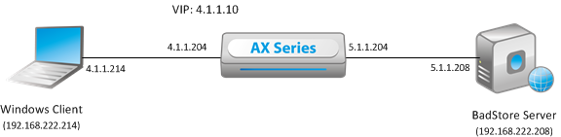
WAF Demo - Introduction
Setup
The setup is entirely on a HyperVisor (ESXi in this case)
FireFox + Add-ons
- Cookie Manager +
- TemperData
- Live HTTP Headers
- User Agent Switcher
Download from:
sharefile -> SE-Folder -> Yasir-Liaqat

Slide 4
Demonstrated Vulnerabilities
Vulnerabilities
SQL Injection Attack
XSS (Cross Site Scripting) Attack
Data Exposure
Form Field Inconsistencies
Privileged URL’s
Sensitive Data Leaks (Credit Card, SSN)
Credit Card Numbers
US Social Security Numbers
Generic Maskable Content (PCRE)
Response Sniffing
Buffer Overflows
Bot Checking

Slide 5
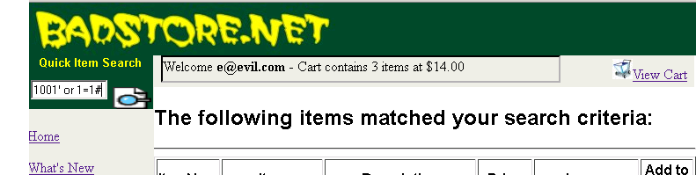
SQL Injection Attack
Problem:
Modify the input such that it becomes an SQL command
Example:
Expected: 1001 (select 1001)
Received: 1001’ or 1=1# (select 1001’ or 1=1) (Always True)

Slide 6
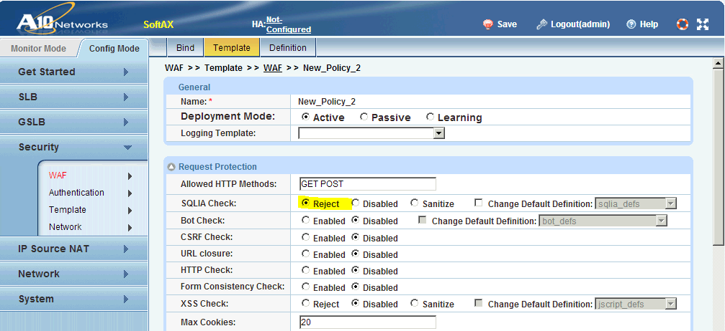
SQL Injection Attack Mitigation
Mitigation
Enable SQLIA Check

Slide 7
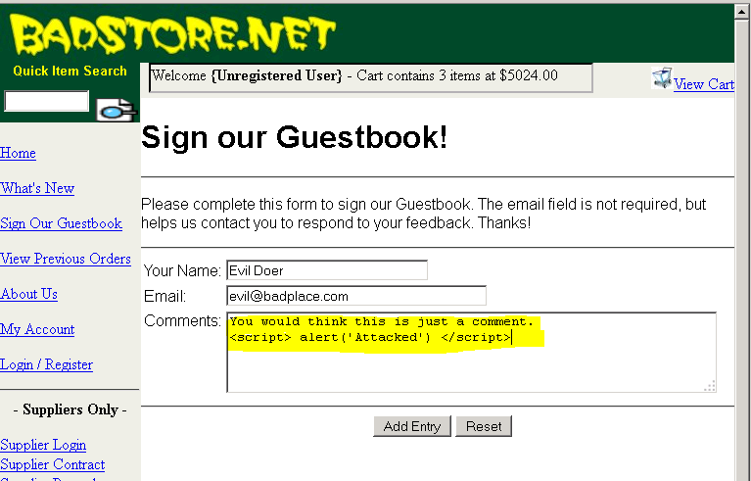
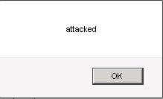
XSS Attack
Problem:
A script is embedded in a page or a link by a hacker. When an unsuspecting user access the page, the script is executed on her machine
Example:
<script> alert (‘Attacked’) </script>

Slide 8
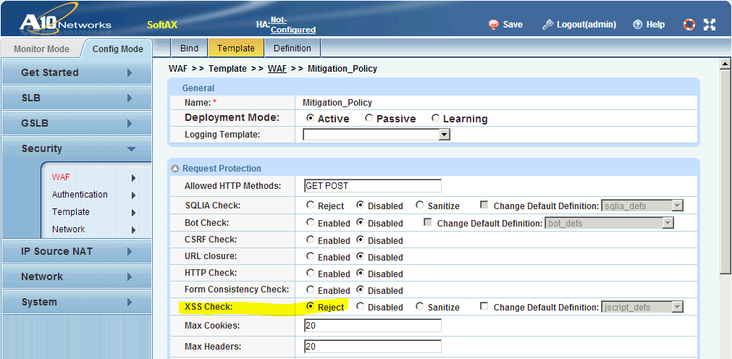
XSS Attack Mitigation
Mitigation
Enable XSS Check

Slide 9
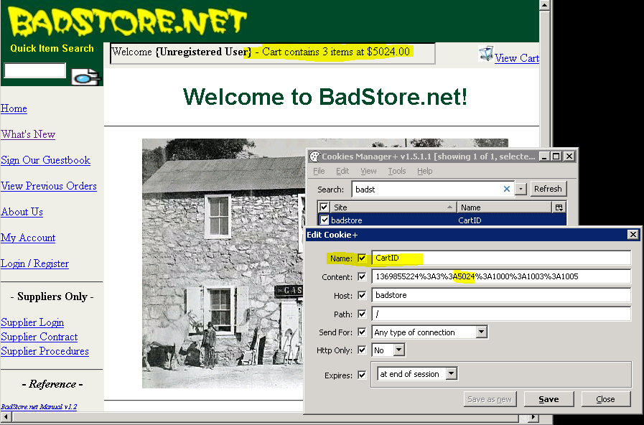
Data Exposure
Problem:
Data is exposed in clear text and it can be tweaked to manipulate the functionality of the site
Example:
Cookie Values

Slide 10
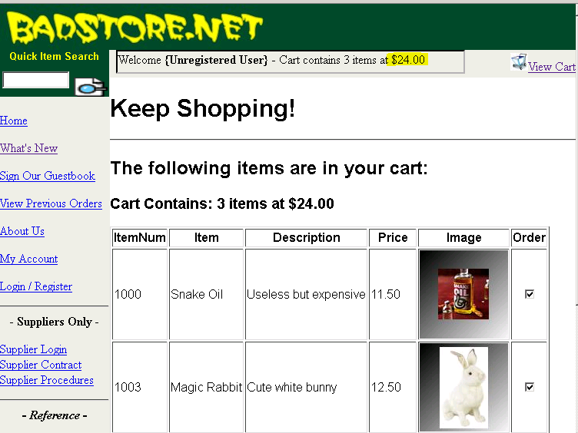
Data Exposure
Problem:
Data is exposed in clear text and it can be tweaked to manipulate the functionality of the site
Example:
Cookie Values

Slide 11
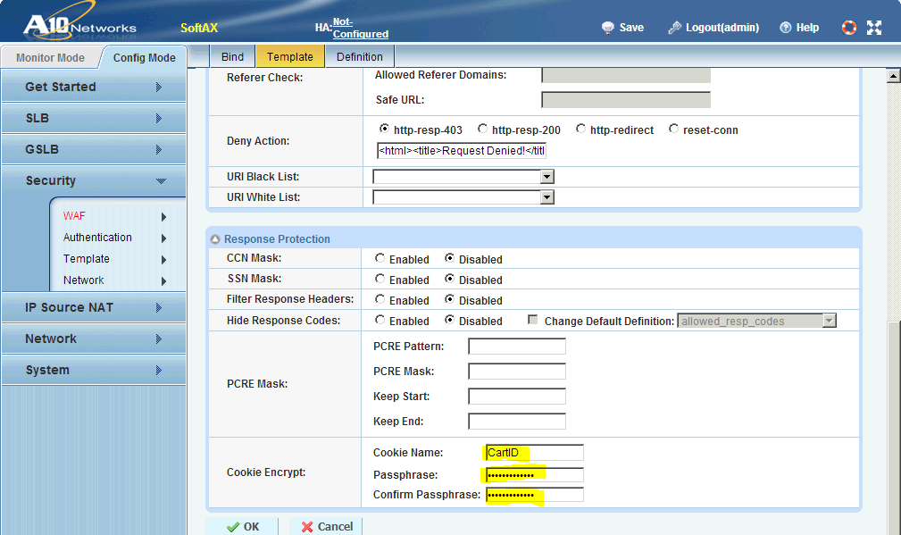
Data Exposure – Mitigation
Mitigation
Encrypt Cookies

Slide 12
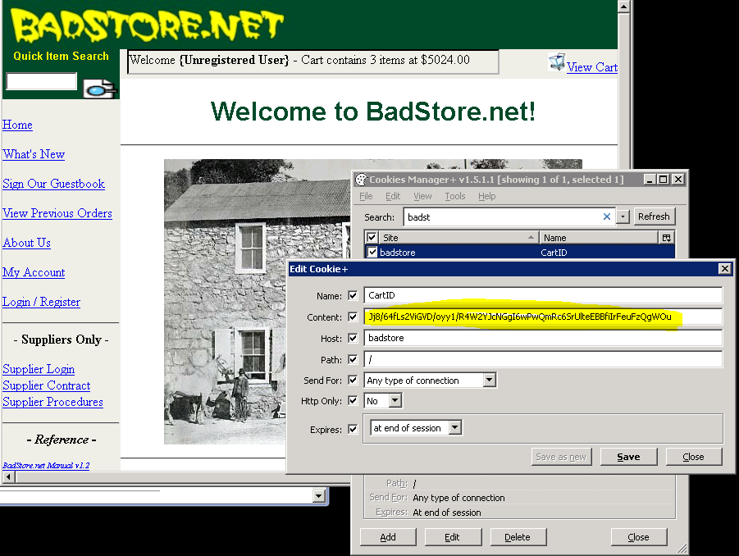
Data Exposure – Mitigation
Mitigation
Encrypt Cookies

Slide 13
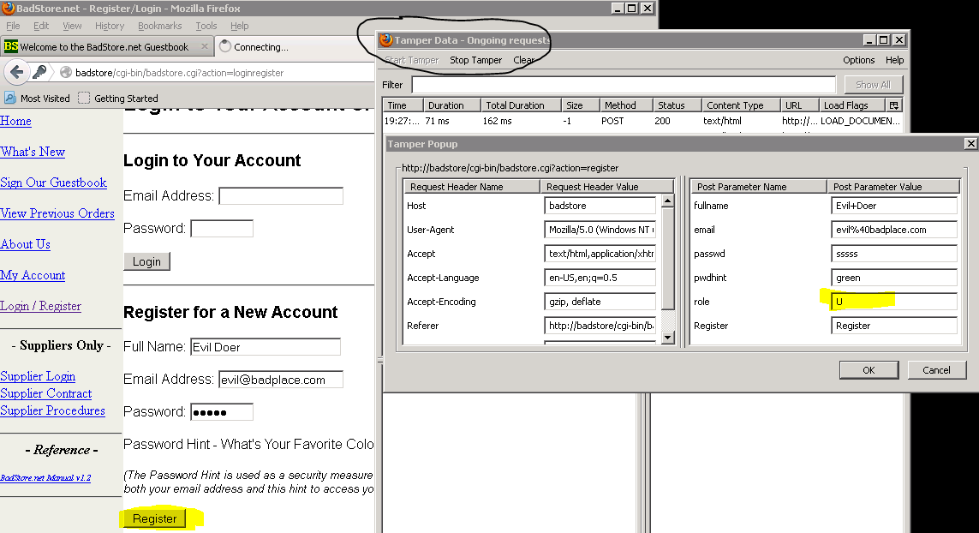
Form Field Inconsistencies
Problem:
Hidden form fields are tampered with
Additional fields are sent by the user
Some fields are NOT sent by the user

Slide 14
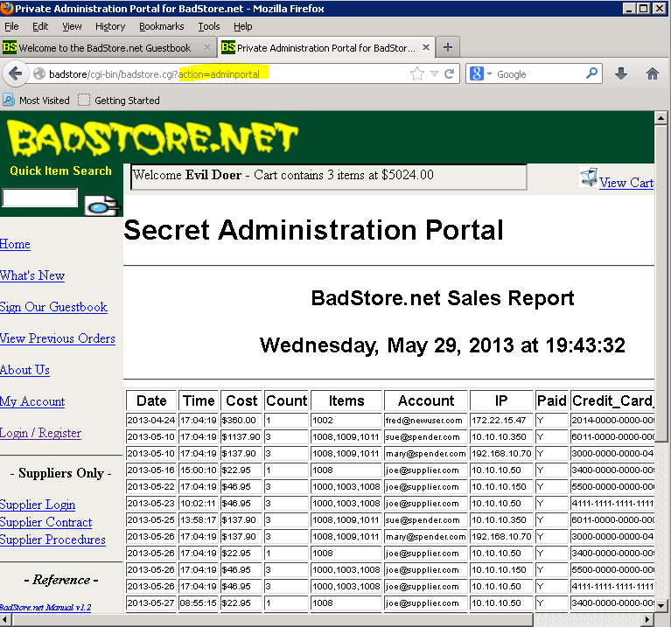
Form Field Inconsistencies
Problem:
Hidden form fields are tampered with
Additional fields are sent by the user
Some fields are NOT sent by the user

Slide 15
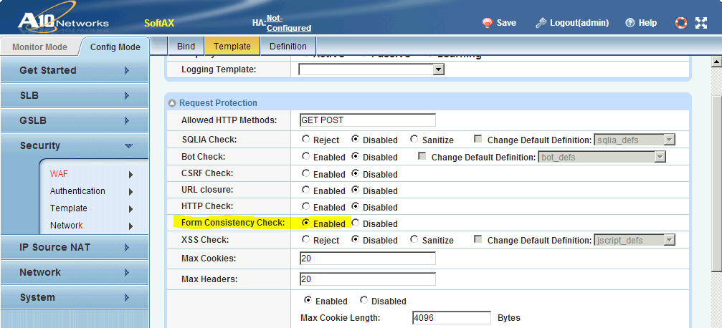
Form Field Inconsistencies - Mitigation
Mitigation:
Enable Form Field Consistency Check to:
Reject forms with modified hidden fields
Reject forms with additional fields
Reject forms with fields removed

Slide 16
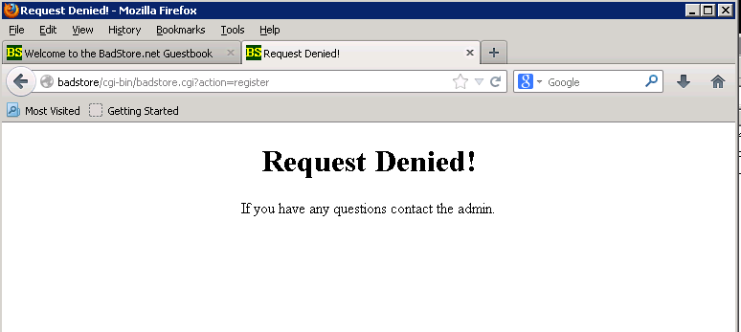
Form Field Inconsistencies - Mitigation
Mitigation:
Enable Form Field Consistency Check to:
Reject forms with modified hidden fields
Reject forms with additional fields
Reject forms with fields removed

Slide 17
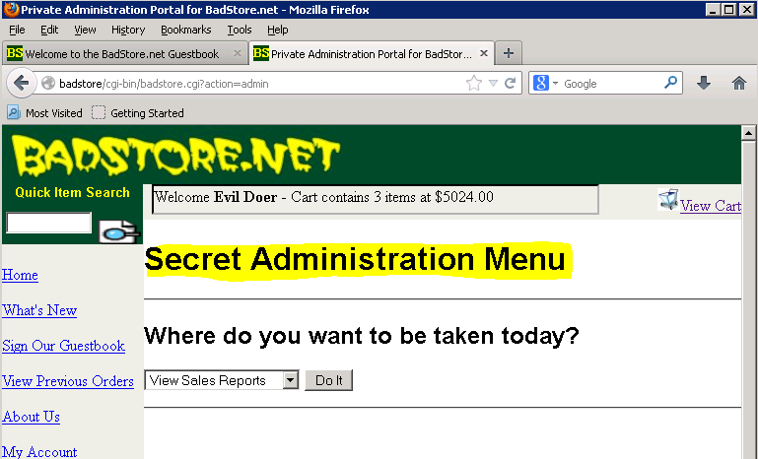
Privileged URL’s
Problem:
Some URL’s should NOT be accessed by users
Example:
Admin Portal

Slide 18
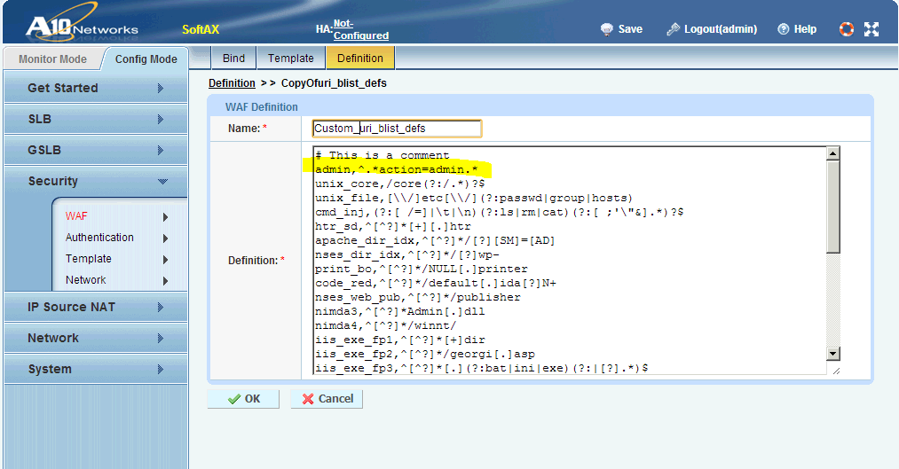
Privileged URL’s - Mitigation
Mitigation:
Block sensitive URL’s using a “blacklist”

Slide 19
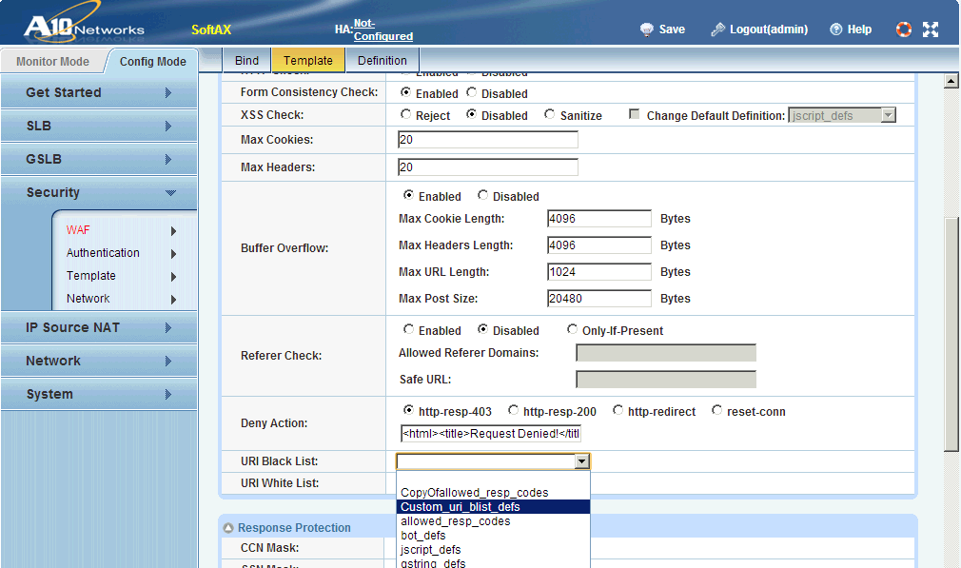
Privileged URL’s - Mitigation
Mitigation:
Block sensitive URL’s using a “blacklist”

Slide 20
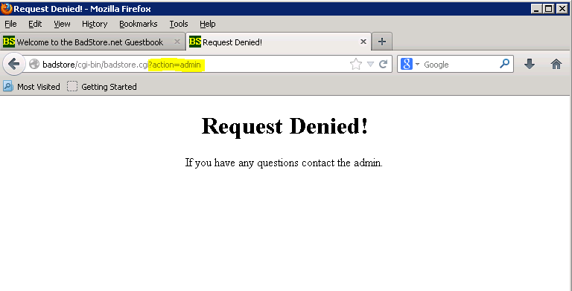
Privileged URL’s - Mitigation
Mitigation:
Block sensitive URL’s using a “blacklist”

Slide 21
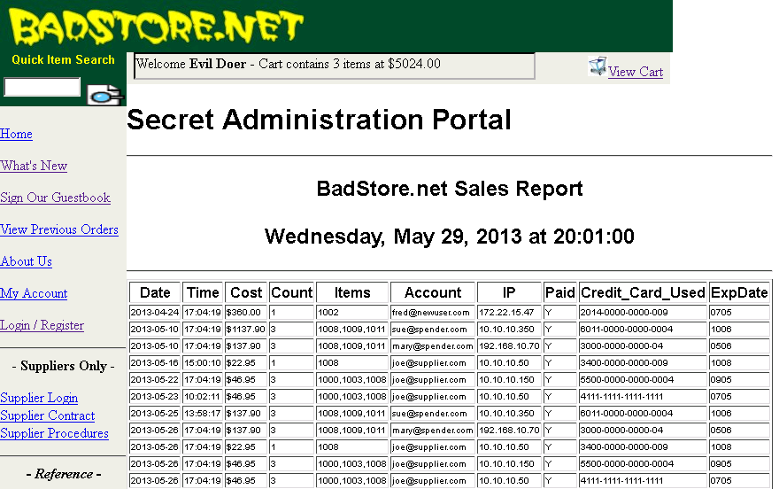
Sensitive Data
Problem
Some Data is too sensitive and should always be blocked
Example:
Credit Card Numbers, SSN Numbers etc

Slide 22
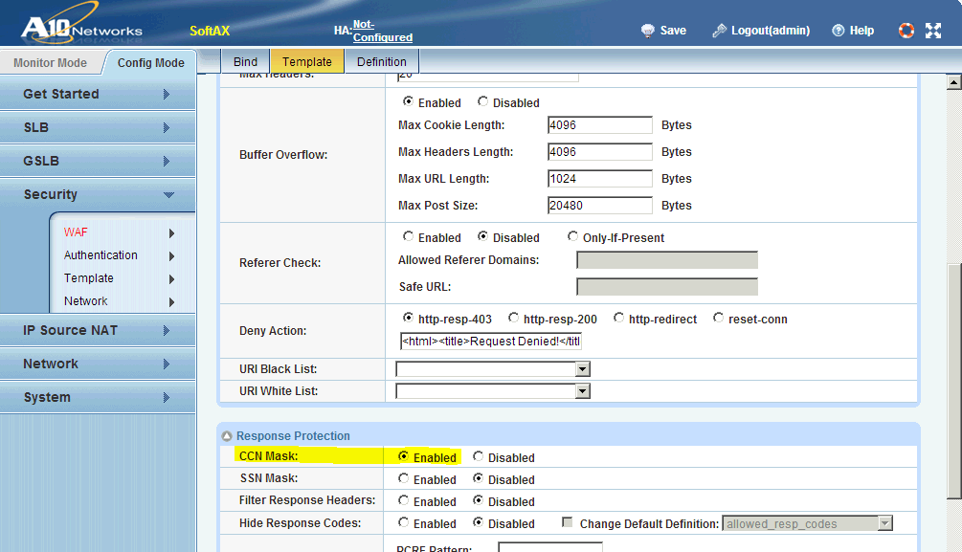
Sensitive Data - Mitigation
Mitigation
Block/Mask data which matches certain Patterns
Built-in Masks for:
Credit Card Numbers
US Social Security Numbers

Slide 23
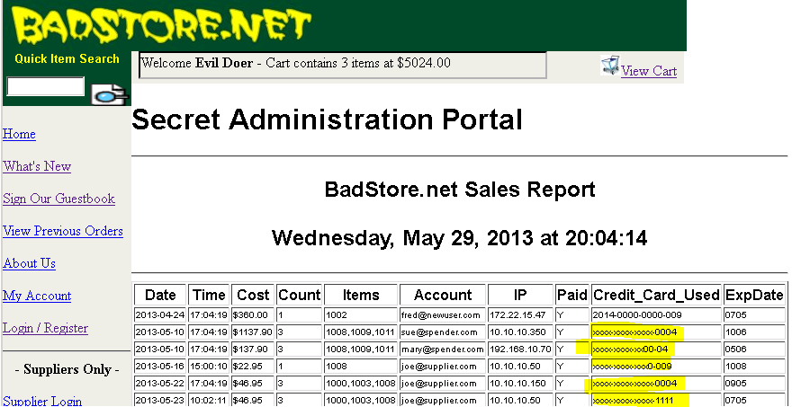
Sensitive Data - Mitigation
Mitigation
Block/Mask data which matches certain Patterns
Built-in Masks for:
Credit Card Numbers
US Social Security Numbers

Slide 24
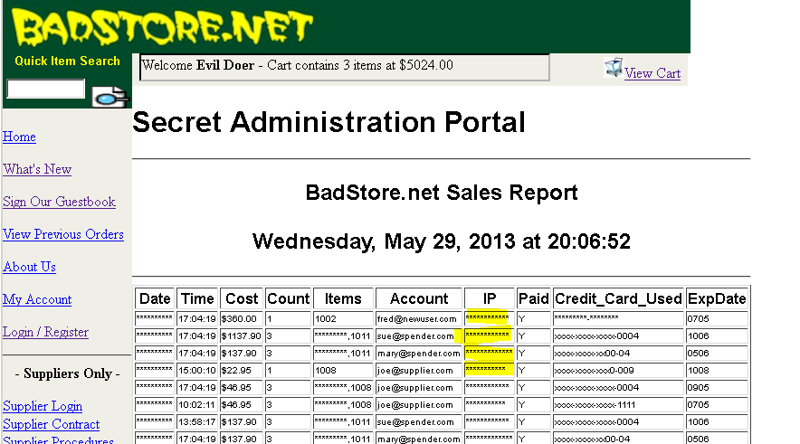
Sensitive Data - Mitigation
Mitigation
Custom Masks can be applied using PCRE
e.g. [0-9]{1,3}.[0-9]{1,3}.[0-9]{1,3}.[0-9]{1,3}

Slide 25
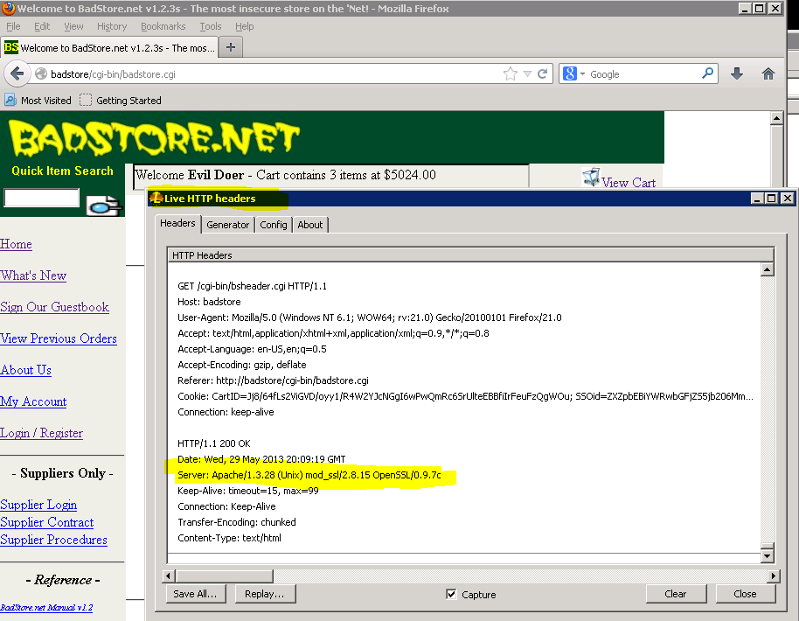
Response Sniffing
Problem
Certain Headers in Responses divulge too much information
Example:
Server, X-Powered-By

Slide 26
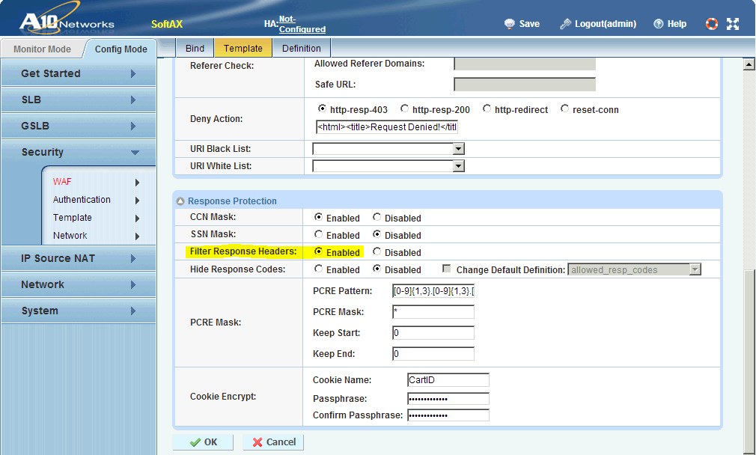
Response Sniffing - Mitigation
Mitigation
Remove Predefined Response Headers e.g. Server

Slide 27
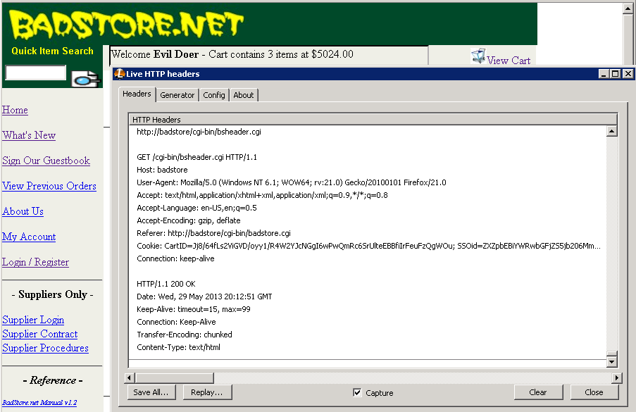
Response Sniffing - Mitigation
Mitigation
Remove Predefined Response Headers e.g. Server

Slide 28

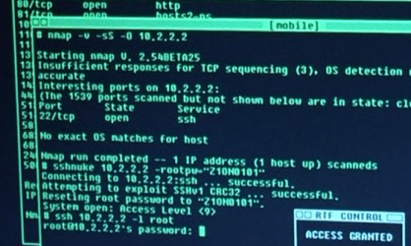
Buffer Overflows
Problem
Buffer overflows are common and can cause severe problems, including root-access, or crashing of servers
Examples
Numerous Examples of Script Kiddies gaining root access

Slide 29
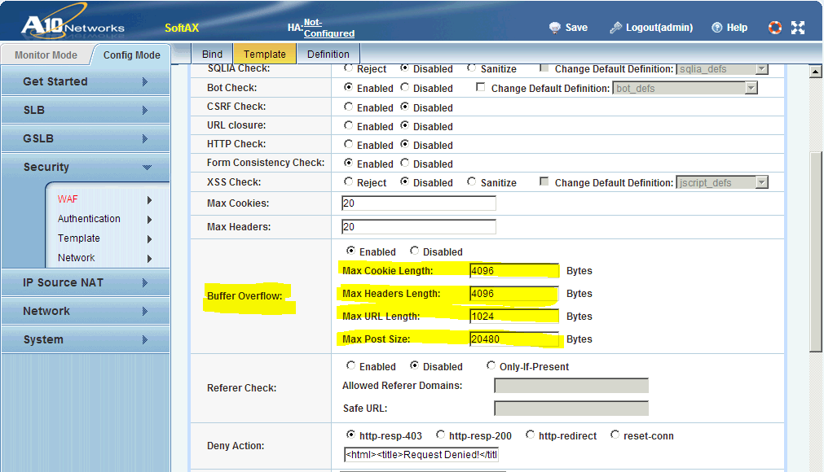
Buffer Overflows - Mitigation
Mitigation
After getting a baseline, change Buffer Overflow Settings

Slide 30
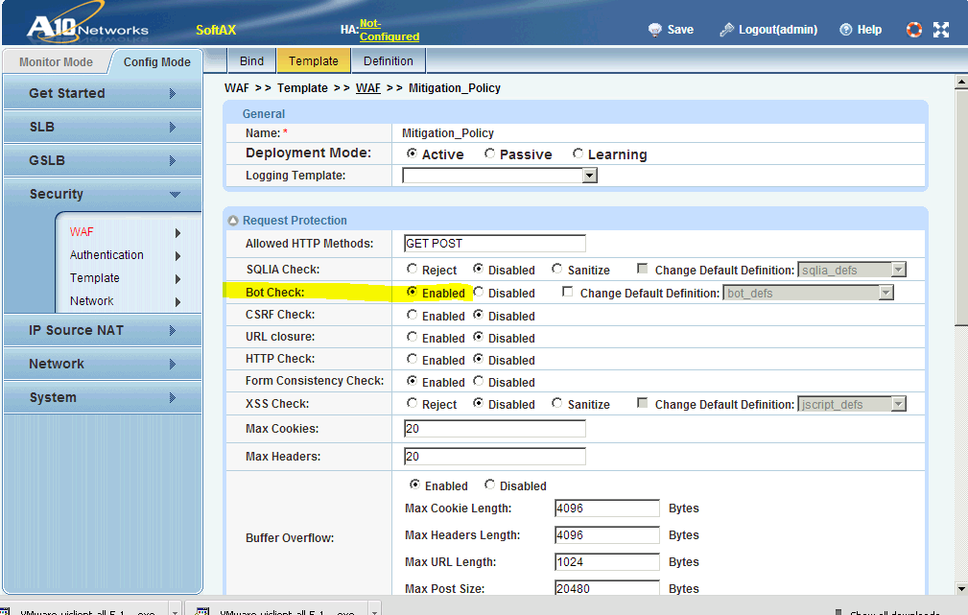
Other Features: Blocking Bot’s
Feature
Known Bot’s can be blocked by checking user-agent. Definitions can be updated

Slide 31
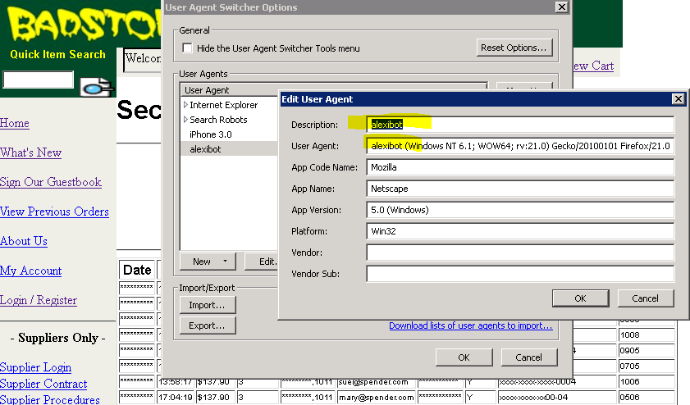
Other Features: Blocking Bot’s
Feature
Known Bot’s can be blocked by checking user-agent. Definitions can be updated

Slide 32
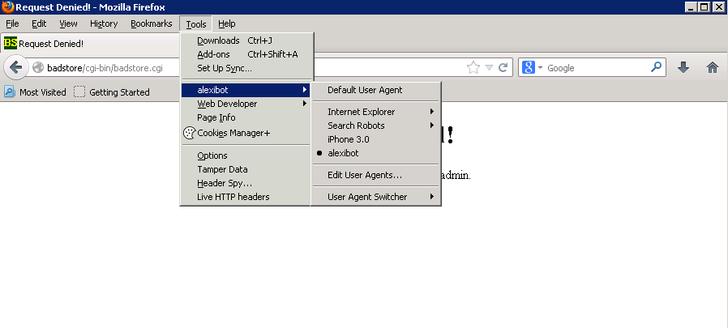
Other Features: Blocking Bot’s
Feature
Known Bot’s can be blocked by checking user-agent. Definitions can be updated

Slide 33
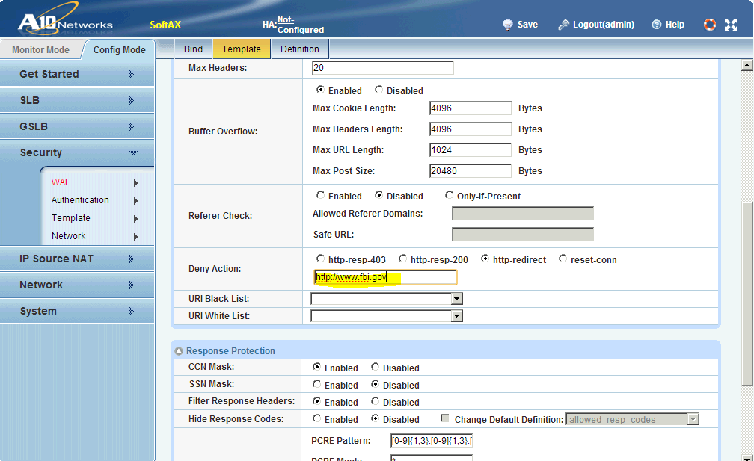
Other Features: Redirecting
Feature
Instead of blocking, a hacker can be redirected to a different page e.g. a honeypot

