Slide 1
A10 Networks ADC Training

Slide 2






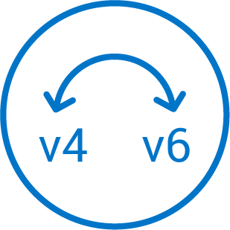





Secure Application Services
aGalaxy
(TPS Mgmt.)
Harmony Controller
(Multi Cloud, Multi Service Mgmt.)
SECURITY
APPLICATION DELIVERY
TPS
SSLi
CFW
ADC
CGN
Automation
Policy
Detection
Automation
Self Service
Analytics

Slide 3
Agenda
ADC Platform
ADC Concept
L4-L7 Load-balancing
Application Acceleration
WAF
DDOS
VRRP
Troubleshooting

Slide 4
ADC Platform

Slide 5


Thunder ADC Product Overview
All inclusive ADC features license
Availability, Acceleration and Security
Per-app analytics and visibility
With Harmony Controller
Ultra high density partitioning
Up to 1,023
Superior hardware model designs
Up to 36 CPU cores (Intel Xeon)
Field upgradable SSL option
SSD for added reliability
Multiple form factors
Physical, Bare Metal, Hybrid, Virtual/Cloud
Internet
Security:
DDoS Mitigation
WAF
DAF
AAM
Backup Data Center
Availability:
GSLB
High-availability
Health-checks
THUNDER ADC
Acceleration:
SSL Offload
TCP Reuse
RAM Caching
Compression
HARMONY
CONTROLLER
Central Mgmt.
Analytics
Automation
Web App
DNS
Other App

Slide 6


ACOS: Best-in-Class Performance Scalability
Efficient and Flexible Form Factors
Physical, virtual and hybrid
SDN/NFV ready
Small 1-3 U appliances
All inclusive license
Efficient &
Accurate Memory Architecture
Shared Memory Architecture
64-Bit Multi-Core Optimized
CPU
1
CPU
2
CPU
3
CPU
N
High performance
256+ million concurrent sessions
220+ Gbps throughput
Cluster to over 1 Tbps
Purpose built appliances
Optimized
Flow Distribution
Flexible Traffic Accelerator
Comprehensive Feature Set
Standardized ADC
Application security features
Integrated DDoS feature
High availability
Switching and Routing
Notes:
Scalable Symmetric Multi-Core Processing (SMMP)
Designed to Optimize Resource Utilization & Efficiency
Shared-Memory Architecture (SMA)
Architected for 64-bit Multi-Core, Multi-Threaded Operations
Fundamental Benefits: Memory, Processor & I/O Efficiency
Linear Performance Scalability with x86 Trajectory
Flexible Traffic Accelerator (FTA)
Multi-Processor Flow Distribution
Symmetric Distribution of Load Across Cores

Slide 7
Thunder ADC Hardware Appliances
THUNDER ADC HARDWARE APPLIANCES
Entry to Lower Mid Range
PRICE
THUNDER 4440(S)
THUNDER 3430(S)
80 Gbps (L4&L7)
2.9 Million L4 CPS
15M RPS (HTTP)
Optional SSL Processor
THUNDER 3230(S)
42 Gbps (L4/L7)
2.5 M L4 CPS
12 M RPS (HTTP)
SSL Processor
Hardware FTA
THUNDER 3040S
30 Gbps (L4/L7)
1.5 M L4 CPS
7.5 M RPS (HTTP)
SSL Processor
Hardware FTA
THUNDER 1030S
30 Gbps (L4&L7)
750k L4 CPS
3 M RPS (HTTP)
SSL Processor
THUNDER 840
10 Gbps (L4&L7)
450k L4 CPS
2 M RPS (HTTP)
SSL Processor
5 Gbps (L4&L7)
200k L4 CPS
1 M RPS (HTTP)
PERFORMANCE
See datasheet for complete range
Notes:
Mid-range enterprise

Slide 8
Thunder ADC Hardware Appliances
Upper Mid Range to High End
THUNDER 7440-11(S)
PRICE
THUNDER 6630(S)
100 GbE Ports
220/200 Gbps (L4&L7)
10.5 Million L4 CPS
44 Million (HTTP)
SSL Processor
THUNDER 6440(S)
150/145 Gbps (L4/L7)
7.1 M L4 CPS
38 M RPS (HTTP)
THUNDER 5840-11(S)
160/150 Gbps (L4/L7)
5.5 M L4 CPS
31 M RPS (HTTP)
SSL Processor
Hardware FTA
THUNDER 5440(S)
100 GbE Ports
115/113 Gbps (L4/L7)
6.2 M L4 CPS
31 M RPS (HTTP)
SSL Processor
Hardware FTA
100/100 Gbps (L4&L7)
4 Million L4 CPS
22 M RPS (HTTP)
SSL Processor
THUNDER 5330(S)
78 Gbps (L4&L7)
3.1 Million L4 CPS
15 M RPS (HTTP)
PERFORMANCE
See datasheet for complete range
Notes:
Mid-range enterprise

Slide 9

Thunder ADC Hardware Appliances
SPE* Models
PRICE
THUNDER 6635 SPE (100GbE)
THUNDER 6435 SPE
150/145 Gbps (L4&L7)
7.1 Million L4 CPS
38 M RPS (HTTP)
Hardware FTA, SPE
THUNDER 5435 SPE
78/77 Gbps (L4&L7)
3.7 Million L4 CPS
20 M RPS (HTTP)
Hardware FTA, SPE
THUNDER 4435 SPE
38/38 Gbps (L4&L7)
3.1 Million L4 CPS
12 M RPS (HTTP)
Hardware FTA, SPE
PERFORMANCE
* SPE (Security Policy Engine) acceleration included

Slide 10

vThunder Software Appliances
vThunder
200 Mbps to 100 Gbps
Hypervisors: ESXi, KVM, Hyper-V
Cloud: AWS and Azure
Dynamic provisioning, faster roll out
Scale up or down on-demand
PRICE
100 Gbps
ESXi
KVM
40 Gbps
20 Gbps
ESXi
KVM
ESXi
KVM
10 Gbps
8 Gbps
ESXi
KVM
4 Gbps
ESXi
KVM
Hyper-V
ESXi
KVM
Hyper-V
1 Gbps
200 Mbps
ESXi
KVM
Hyper-V
LAB EDITION
ESXi
KVM
Hyper-V
ESXi
KVM
Hyper-V
PERFORMANCE
Notes:
Mid-range enterprise

Slide 11

Thunder ADC for Bare Metal Software Appliances
Bare Metal (Perpetual Licensing)
10 Gbps to 60 Gbps
Dynamic provisioning, faster roll out
Scale up or down on-demand
License upgrade option
PRICE
HIGH-PERFORMANCE
HIGH-PERFORMANCE
60 Gbps (24 cores)
40 Gbps (14 cores)
HIGH-PERFORMANCE
20 Gbps (8 cores)
HIGH-PERFORMANCE
10 Gbps (4 cores)
PERFORMANCE
Notes:
Mid-range enterprise

Slide 12
ADC Concept

Slide 13

Interface behavior
interface ethernet 1
ip address 1.1.1.1/24
enable
10.10.10.1/24
192.168.10.1/24
interface ethernet 2
ip address 10.10.10.1/24
enable
interface ethernet 3
ip address 2.2.2.1/24
enable
interface ethernet 4
ip address 192.168.10.1/24
enable
1.1.1.1/24
2.2.2.1/24

Slide 14

Putting interface in same subnet
vlan 10
untagged ethernet 1
untagged ethernet 2
router-interface ve 10
interface ve 10
ip address 1.1.1.1/24
enable
1.1.1.1/24
1.1.1.2/24
1.1.1.3/24

Slide 15

Configuring Trunk
interface ethernet 1
enable
trunk-group 1 lacp
port-priority 100
timeout short
!
interface ethernet 2
enable
trunk-group 1 lacp
port-priority 100
timeout short
!
interface trunk 1
ip address 1.1.1.1 /24
1.1.1.1/24
1.1.1.2/24

Slide 16




Server Load Balancing
Provide high availability of services
Share load among multiple servers (load balancing)

Slide 17



Normal Traffic flow through SLB
IP = SIP
Server 1
Src IP = CIP Dst IP = VIP
Src IP = CIP Dst IP = SIP
Firewall/Router
ADC
IP = CIP
IP = VIP
Server 2

Slide 18
Topology: L3 (routed) mode w/o SNAT
SNAT = 100.0.1.50
VIP = 100.0.0.10
100.0.1.[100-200]
100.0.0.0/24
100.0.1.0/24
200.0.0.1
Source IP | Dest IP
200.0.0.1 | 100.0.0.10
Source IP | Dest IP
200.0.0.1 | 100.0.1.100
Dest IP | Source IP
200.0.0.1 | 100.0.0.10
Dest IP | Source IP
200.0.0.1 | 100.0.1.100

Slide 19
Topology: L2 mode w/o SNAT
VIP = 100.0.0.10
100.0.1.[100-200]
100.0.0.0/24
100.0.1.0/24
200.0.0.1
Source IP | Dest IP
200.0.0.1 | 100.0.0.10
Source IP | Dest IP
200.0.0.1 | 100.0.1.100
Dest IP | Source IP
200.0.0.1 | 100.0.0.10
Dest IP | Source IP
200.0.0.1 | 100.0.1.100

Slide 20
Asymmetric flow Issue
Src IP = SIP1 Dst IP = VIP2
SIP1:-100.0.0.100
Src IP = SIP2 Dst IP = SIP1
Src IP = CIP Dst IP = SIP1
100.0.0.0/24
SIP2:- 100.0.0.200
CIP:-200.0.0.1
Src IP = CIP Dst IP = VIP1
VIP1:-100.0.0.10
VIP2:-100.0.0.20
Src IP = SIP1 Dst IP = SIP2

Slide 21
Topology: L2 mode with SNAT
SNAT = 100.0.0.50
VIP = 100.0.0.10
100.0.0.[100-200]
100.0.0.0/24
200.0.0.1
Source IP | Dest IP
200.0.0.1 | 100.0.0.10
Source IP | Dest IP
100.0.0.50 | 100.0.0.100
Dest IP | Source IP
200.0.0.1 | 100.0.0.10
Dest IP | Source IP
100.0.0.50 | 100.0.0.100

Slide 22

Per session Load-balancing
Server 1
Firewall
ADC
Server 2

Slide 23
Source IP Persistency
Server 1
Creates entry in persistency table
CIP = Server1
CIP
Firewall
ADC
Matching persistency table
CIP = Server1
Server 2

Slide 24

Issue with Source IP persistency
Server 1
Firewall
ADC
Server 2

Slide 25
Cookie Persistency
Load-balancing decision
Server 1
match persistency entry
Cookie1 = Server1
Firewall
ADC
Insert cookie header and create persistency entry
Cookie1 = Server1
Server 2

Slide 26
Cookie Persistency with Load-balancing
Server 1
Persistency match
Load-balancing
Firewall
ADC
Load-balancing
Load-balancing
Server 2

Slide 27
L4 Load-balancing
Server 1
TCP-SYN
TCP-SYN
Firewall
ADC
Server 3
Server 2

Slide 28
L7 Load-balancing
TCP-SYN
Server 1
TCP-SYN
SYN-ACK
ACK
SYN-ACK
ACK
Firewall
ADC
Server 3
HTTP:GET
HTTP:GET
Server 2

Slide 29
Server Load Balancing (SLB)
Thunder SLB configuration has three core elements
Servers, Service Groups, Virtual Servers (VIPs)
Service Group - Web
Web
DNS
Server
SMTP
VIP
Web
DNS
Server
SMTP

Slide 30
Putting the configuration together
slb server S1 192.168.1.10
port 80 tcp
slb server S2 192.168.1.20
port 80 tcp
Service Group - Web
Service Group - Web
Web
Web
Web
slb service-group SG1 tcp
member S1 80
member S2 80
Server
slb virtual-server VIP1 192.168.1.100
port 80 http
service-group SG1
VIP
VIP
VIP
VIP
Web
Web
Server

Slide 31
Default Behaviour
slb server S1 192.168.1.10
ICMP Health checks
port 80 tcp
TCP Health checks
slb service-group SG1 tcp
member S1 80
member S2 80
Round-robin
slb virtual-server VIP1 192.168.1.100
port 80 http
service-group SG1
No Source NAT

Slide 32
Port Template
Connection limit
Connection rate limit
Request Rate limit
Destination NAT
No SSL
Source NAT
Slow Start
slb template port port_80
conn-limit 10000
conn-rate-limit 100
request-rate-limit 500
dest-nat
no-ssl
source-nat nat
slow-start
slb server S1 192.168.1.10
port 80 tcp
slb service-group SG1 tcp
member S1 80
slb service-group SG2 tcp
member S1 80
slb virtual-server VIP1 192.168.1.100
port 80 http
service-group SG1

Slide 33
Server Template
Connection limit
Connection rate limit
Health Check
Spoofing Cache
Slow Start
slb template server server_temp
conn-limit 10000
conn-rate-limit 100
health-check-disable
spoofing-cache
slow-start
slb server S1 192.168.1.10
port 80 tcp
slb service-group SG1 tcp
member S1 80
slb virtual-server VIP1 192.168.1.100
port 80 http
service-group SG1

Slide 34
Http Template
slb server S1 192.168.1.10
port 80 tcp
slb server S2 192.168.1.20
port 80 tcp
slb server S1 192.168.1.30
port 80 tcp
slb server S2 192.168.1.40
port 80 tcp
slb service-group 80 tcp
method least-connection
member S1 80
member S2 80
slb service-group SG1 tcp
member S3 80
member S4 80
slb virtual-server VIP1 192.168.1.100
port 80 http
service-group SG1
template http http_template
Failover URL
Host Switching/URL Switching
Client IP Header Insert
Strict Transaction Switch
Header Erase
Header Insert
Response Content Replace
Compression
Redirect
Redirect Rewrite
slb template http http_template
compression enable
failover-url http://portal.com
insert-client-ip X-Client-IP
strict-transaction-switch
url-switching contains /finance service-group SG1
url-switching contains /tech service-group 80

Slide 35
Failover URL
Server 1
HTTP Request abc.com
Firewall
ADC
Server 3
HTTP Request xyz.com
HTTP Redirect to xyz.com
Server 2

Slide 36
URL Switching
Server 1/SG1
url=/finance
ADC
Server 3
Firewall
url=/tech
Server 2/SG2

Slide 37
Client IP Header Insert
Server 1
X-Client IP :- CIP
HTTP Request
VIP
NAT-IP
Firewall
ADC
Server 3
CIP
Src IP : CIP,Dst IP : VIP
Src IP : NAT-IP,Dst IP : SIP
Server 2

Slide 38
Application Acceleration

Slide 39

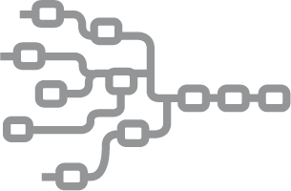



Acceleration
Application acceleration for a faster user experience and optimized utilization
Technology for Application Acceleration
TCP Optimization: Improve application performance
Compression: Optimize any bandwidth level
SSL Acceleration: Secure applications
RAM Caching: Faster page loads equal more revenue

Slide 40
TCP Connection Reuse
Web servers need to manage
New clients (open new sessions)
Clients leaving (close sessions)
Maintain all connected clients sessions
Note: Web browsers keep their TCP connections open - even when all objects have been loaded

Slide 41
Connection Reuse :: Configuration
slb server S1 192.168.1.10
port 80 tcp
slb server S2 192.168.1.20
port 80 tcp
slb service-group SG1 tcp
member S1 80
member S2 80
!
slb template connection-reuse CR1
timeout 1800
keep-alive-conn preopen 10
!
slb virtual-server VIP1 192.168.1.100
port 80 http
service-group SG1
template connection-reuse CR1

Slide 42



SSL Acceleration
SSL Offload relieves the server of SSL tasks
Provides faster server response time and higher server scalability
Thunder receives HTTPS client traffic and sends HTTP traffic to the servers
HTTPS
HTTP

Slide 43
SSL Offloading :: Configuration
Import/Create the certificate and Key to A10 thunder
ADC > SSL Management
slb server S1 192.168.1.10
port 80 tcp
slb server S2 192.168.1.20
port 80 tcp
slb service-group SG1 tcp
member S1 80
member S2 80
!
slb template client-ssl SSL
cert SSL_cert
key SSL_cert
!
slb virtual-server VIP1 192.168.1.100
port 443 https
service-group SG1
template client-ssl CR1

Slide 44
SSL Offloading with backend encryption :: Configuration
Import/Create the certificate and Key to A10 thunder
ADC > SSL Management
slb server S1 192.168.1.10
port 80 tcp
slb server S2 192.168.1.20
port 80 tcp
slb service-group SG1 tcp
member S1 80
member S2 80
!
slb template client-ssl SSL
cert SSL_cert
key SSL_cert
!
slb virtual-server VIP1 192.168.1.100
port 443 https
service-group SG1
template client-ssl CR1
template server-ssl svssl
slb template server-ssl svssl

Slide 45
RAM Caching
RAM caching optimizes network transactions for the user, network and Web servers
Caches HTTP/HTTPS static and dynamic content in Thunder RAM
Delivers cached objects to clients directly from the Thunder ADC cache, offloading servers
Provides faster client download time and higher server scalability

Slide 46
RAM Caching :: Configuration
slb server S1 192.168.1.10
port 80 tcp
slb server S2 192.168.1.20
port 80 tcp
slb service-group SG1 tcp
member S1 80
member S2 80
!
!
slb template cache RAM_CACHE
max-cache-size 5
!
slb virtual-server VIP1 192.168.1.100
port 80 http
service-group SG1
template cache RAM_CACHE

Slide 47
HTTP Compression
Compresses HTTP/HTTPS objects
Uses less bandwidth and provides faster client download time
Thunder ADC HTTP compression
Compresses objects sent to the clients Note: By default, "text" (such as html/css/js) and "application" (such as doc/xls/ppt/pdf)
If HTTP compression is enabled on the servers, Thunder ADC transparently offloads this task from servers

Slide 48
HTTP Compression :: Configuration
slb server S1 192.168.1.10
port 80 tcp
slb server S2 192.168.1.20
port 80 tcp
slb service-group SG1 tcp
member S1 80
member S2 80
!
slb template http HTTP_Compression
compression level 2
!
slb virtual-server VIP1 192.168.1.100
port 80 http
service-group SG1
template http HTTP_Compression

Slide 49
Question
What is health check ACOS does when you add server port to a server ?
ACOS completes TCP handshake with Server
ACOS send RST instead of sending first ACK
ACOS sends ICMP packets to Server
ACOS waits for 500 ms for server’s heartbeat

Slide 50
Question
Select two methods to prevent ACOS from caching a small ‘contact.html’ file ?
Use URL Hash
Increase ‘min content size’ in RAM Caching Template
Specify ‘policy uri /contact.html nocache’ in RAM Caching Template
Set a different ‘Replacement Policy’ on RAM Caching Template
Apply ACL
Use Strict Transaction Switching

Slide 51
Question
What Role ACOS plays between Client and ACOS device when you configure SSL Offload ?
Client
Server
Relay
Bridge

Slide 52
Question
The Don’t Honor Conn Rule option under source-ip persistence template refres to which of the following ?
Ignore connection limits defined on Source-nat pool
Ignore connection limits defined on Virtual-Server
Ignore connection limits defined on Service-Group
Ignore connection limits defined on Server

Slide 53
Question
Select three object types that the HTTP Compression feature compresses by default.(choose three)
HTML
XML
JPEG
MPEG
TXT

Slide 54
Question
Which HTTP response does ACOS cache when the RAM caching template is applied to a vport?
301 Moved Permanently
200 OK
404 Not Found
403 Forbidden
206 Partial content
None of the above is true

Slide 55
Question
Which condition causes a UDP heath check to fail ?
Port replies with a packet
Port does not reply
Port reply with RST/FIN
Port replies with ICMP error message

Slide 56
Global Server Load-balancing

Slide 57

GSLB Flow
Client
DNS Redirect
DNS Redirect
DNS Response
ISP DNS
ISP
Root DNS
Authorative DNS
VIP-2
VIP-1
ADC
ADC
Server-farm
Firewall
Firewall
Server-farm

Slide 58
Inbound LLB
Client
ISP DNS
ISP
Root DNS
Authorative DNS
VIP-2
VIP-1
ADC
ADC
Server-farm
Firewall
Firewall
Server-farm

Slide 59
Inbound LLB
Client
DNS Redirect
DNS Response
DNS Redirect
ISP DNS
ISP
Root DNS
Authorative DNS
ISP-A
ISP-B

Slide 60
Putting the Configuration Together :-GSLB
Site-A
Site-B
slb virtual-server DNS_SrvA 192.168.1.51
port 53 udp
gslb-enable
gslb service-ip servicevipA 192.168.1.46
port 80 tcp
gslb service-ip servicevipB 192.168.2.46
port 80 tcp
!
gslb site SiteA
slb-dev acos-a 192.168.1.1
vip-server servicevipA
gslb policy test
no geographic
metric-order health-check weighted-ip
dns logging none
dns server any authoritative
gslb zone dabur.com
policy test
service 80 pulse
dns-a-record servicevipA ttl 0 static
dns-a-record servicevipB ttl 0 static
!
gslb protocol enable controller
!
gslb protocol enable device
!
slb virtual-server DNS_SrvA 192.168.2.51
port 53 udp
gslb-enable
gslb service-ip servicevipB 192.168.2.46
port 80 tcp
gslb service-ip servicevipA 192.168.2.46
port 80 tcp
!
gslb site SiteB
slb-dev acos-a 192.168.2.1
vip-server servicevipB
gslb policy test
no geographic
metric-order health-check weighted-ip
dns logging none
dns server any authoritative
gslb zone dabur.com
policy test
service 80 pulse
dns-a-record servicevip1 ttl 0 static
dns-a-record servicevip2 ttl 0 static
!
gslb protocol enable controller
!
gslb protocol enable device
!

Slide 61
Putting the Configuration Together :- LLB
slb virtual-server DNS_SrvA 192.168.1.51
port 53 udp
gslb-enable
gslb service-ip servicevipA 192.168.1.46
port 80 tcp
gslb service-ip servicevipB 192.168.2.46
port 80 tcp
!
gslb site SiteA
slb-dev acos-a 127.0.0.1
vip-server servicevipA
gslb policy test
no geographic
metric-order health-check weighted-ip
dns logging none
dns server any authoritative
gslb zone dabur.com
policy test
service 80 pulse
dns-a-record servicevipA ttl 0 static
dns-a-record servicevipB ttl 0 static
!
gslb protocol enable controller
!
gslb protocol enable device
!
slb virtual-server DNS_SrvA 192.168.2.51
port 53 udp
gslb-enable
gslb site SiteB
slb-dev acos-a 127.0.0.2
vip-server servicevipB

Slide 62
Web Application Firewall

Slide 63
Section objectives
WAF Overview
Common Application Security Threats
WAF Deployment Modes
WAF Configuration and Threat Mitigation
WAF Logging

Slide 64


Attackers Don’t Care About Your Firewall
75% of Internet Vulnerabilities are at the Application Layer -- Source: owasp.org

Slide 65
WAF Overview
Filters communications between users and web applications
Adds a security layer for examining
inbound user requests
output from web servers
Malicious request
Drop
WAF
Client
WAF
Client
Strip-off sensitive information
Sensitive information

Slide 66
WAF Operational Modes
WAF supports three Operational Modes
Learning
Used for setting initial thresholds for WAF checks based on known, valid traffic patterns
Should NEVER be used in production environments
Passive
Passive WAF operation that is suitable for production environments
Applies enabled WAF checks without performing WAF actions filtered traffic
Useful for identifying false positives for filtering.
Active
Standard operational mode.
WAF drops or sanitizes traffic based on configured policies
Switching an Active mode template to Learning mode removes all template settings. Best practice is to configure a new template in Learning mode while establishing a baseline for new applications that require testing.

Slide 67
WAF Learning Mode
Setting | Value
buf-ovf-max-url-len | 0
buf-ovf-max-cookie-len | 0
buf-ovf-max-hdrs-len | 0
buf-ovf-max-post-size | 0
max-cookies | 0
max-hdrs | 0
Allowed-http-methods | Null
Setting | Value
buf-ovf-max-url-len | 15
buf-ovf-max-cookie-len | 0
buf-ovf-max-hdrs-len | 23
buf-ovf-max-post-size | 0
max-cookies | 0
max-hdrs | 7
Allowed-http-methods | GET
Get /HTML1.1
Host: www.example.com
Connection: close
User-Agent: Mozilla/5.0
Accept-Encoding: gzip
Accept: text/html
Cache-Control: no-cache

Slide 68


Typical Deployment Scenario
Learning mode
Set the thresh for certain WAF option by sending known valid traffic to thunder using staging environment
LOG SERVER
Passive mode
Place the Thunder in production environment, WAF logs the traffic but does not block it, this mode helps in identifying false positive
LOG SERVER
Active mode
WAF is configured to take action on traffic violating WAF policies and thresholds
LOG SERVER

Slide 69
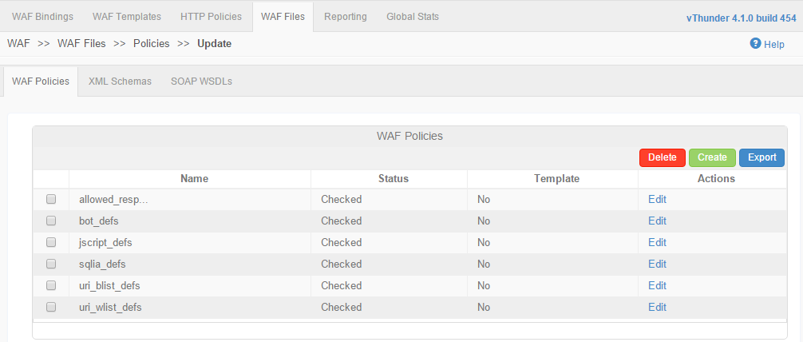
Mitigation – Definition Files
Pre-loaded files for SQL injection, XSS, Response Codes, Bots and URI Black/Whitelists allow immediate protection against these common threats when checks are enabled
Notes – Default definition files cannot be deleted, edited or re-named. To create custom definitions, use the clone feature and edit as needed. WAF features which require definition files will use these defaults, unless custom files are specified

Slide 70
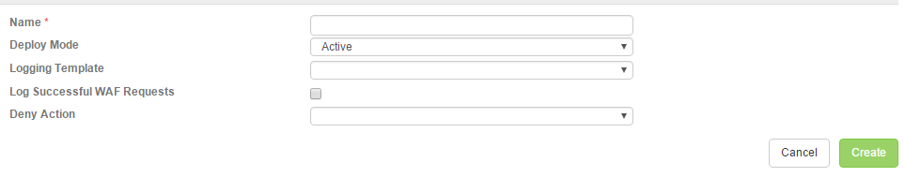
Threat Mitigation Configuration – Templates
To configure WAF, navigate to Config Mode > Security > WAF > Template > WAF
Click Add and Enter a Name
Select Deploy Mode
Choose a Logging Template (optional – but needed for accessing WAF data plane log messages)
Enable desired security checks for client requests
Bind Template to Virtual Port

Slide 71
WAF Template CLI Configuration Examples
Creating the template
A1(config)#slb template waf <template name>
Configuring Deployment Mode
A1(config-waf)#deploy-mode ?
active Deploy WAF in active (blocking) mode
learning Deploy WAF in learning mode
passive Deploy WAF in passive (log-only) mode
Applying logging template
A1(config-waf)#template logging <template name>

Slide 72
WAF Template CLI Configuration Examples
Configuring WAF Settings (SQL Injection example)
A1(config-waf)# sqlia-check reject ?
WORD Name of WAF policy list file
<cr>
Hitting return will apply the default SQL definition file. If a custom file has been created, enter the name
Configuring WAF Settings (Credit Card Masking example)
A1(config-waf)#ccn-mask ?
<cr>
See the WAF configuration guide for the full list of template options and features

Slide 73
Allowed HTTP
waf template waf1
allowed-http-methods "GET POST HEAD“
slb virtual-server VIP1 20.20.20.1
port 80 http
template waf waf1
service-group SG1
Https:GET
WAF
Client
Method
GET
POST
HEAD
Https:DELETE
Supported Http methods on A10 WAF
DROP
• GET
• POST
• HEAD
• PUT
• OPTIONS
• DELETE
• TRACE
• CONNECT
• PURGE

Slide 74
SQL Injection
SQL Query=1001' or 1=1#
WAF
rule1,(?:\%27)|(?:\')|(?:\-\-)|(?:\%23)|(?:#)
rule2,(?:(?:\%3D)|(?:=))[^\n]*(?:(?:\%27)|(?:\')|(?:\-\-)|(?:\%3B)|(?:;))
rule3,\*/from/\*|\*/insert/\*|\+into\+|\%20into\%20|\*/into/\*| into |into|\*/limit/\*|not123exists\*|\*/radminsuper/\*|\*/select/\*|\+select\+|\%20select\%20| select | \+union\+|\%20union\%20|\*/union/\*| union |\*/update/\*|\*/where/\*
DROP

Slide 75
Cross-Site Scripting
<script> alert (‘Attacked’) </script>
WAF
------------
o77,onstop
o78,onsubmit
o79,onunload
s1,script
s2,styl
-----------------------
DROP

Slide 76
Bot Check
User_Agent = alexibot
WAF
------------
a4,adsarobot
a5,ah-ha
a6,aktuelles
a7,alexibot
a8,almaden ------------
DROP

Slide 77


CSRF :- Example
<img src ="http://bank.com/transfer.cgi?amt=9999&to=attacker">
attacker.com
<img src ="http://bank.com/transfer.cgi?amt=9999&to=attacker">
bank.com

Slide 78
CSRF Protection :- Referer Check
GET / transfer.cgi?amt=9999&to=attacker HTTP/1.1
Host: bank.com
User-Agent: Mozilla/5.0 (Windows; U; Windows NT 5.1; en-US; rv:1.6) Gecko/20040113
Accept: text/xml,application/xml,application/xhtml+xml,text/html;q=0.9,text/plain;q=0.8,image/png,image/jpeg,image/gif;q=0.2,*/*;q=0.1
Accept-Language: en-us,en;q=0.5
Accept-Encoding: gzip,deflate
Accept-Charset: ISO-8859-1,utf-8;q=0.7,*;q=0.7
Keep-Alive: 300
Connection: keep-alive
Referer: http://attacker.com/image.html
waf template waf1
referer-check enable bank.com,partner.bank.com www.bank.com/homepage
WAF
bank.com
Referer = attacker.com
DROP

Slide 79
CSRF Protection :- CSRF Form Tagging
Referer header is optional there could be scenario where there might be no referer header
Tag each form sent in response with a unique and unpredictable ID (nonce), and then examine the forms returned by users to ensure that the supplied ID is correct.
waf template waf1
csrf-check

Slide 80
Form Consistency Check
If a field is sent to the user, ensure that it is returned by the user.
If a field is not sent to the user, do not allow the user to add that field and return data in it.
If a field is a read-only or hidden field, verify that the data has not changed.
If a field is a list box or radio button field, verify that the data in the response corresponds to one or more of the values in that field.
Enforce HTML field types and lengths.
waf template waf1
form-consistency-check

Slide 81
URL Black/White List
“/site_images.jpg”
“/datab.html/passwd.cgi”
“/privatepage”
static,^[^?]+[.](?:
?|shtml|js|gif|
html
jpg
|jpeg|png|swf|pif|pdf|css|csv|ico)$
cgi
dynamic,^[^?]+[.](?:
|aspx?|jsp|php|pl)(?:[?].*)?$
The WAF examines incoming user requests against the URI White Lists and Black Lists.
These lists define rules to explicitly allow or deny traffic:
passwd
pwd_file,^[^?]*(?:
|passwords?)(?:[.][^/?]*)?(?:[?].*)?$
Next WAF Feature Check

Slide 82
URL Check
URL2
DROP
WAF
URL1
URL2
URL3
URL4
URL5
URL9

Slide 83
HTTP Check
Regardless of deployment mode, the WAF template automatically enforces a basic, default set of HTTP protocol checks. Following suite of additional checks are available in HTTP compliance check
POST request with Content-Length: 0
Header name with no header value
Several Content-Length headers
Chunked request with Content-Length header
Body in GET or HEAD requests
No Host header in HTTP/1.1 request
Host header contains IP address
Content length should be a positive number
Bad HTTP version
Maximum number of headers
Bad host header value
Maximum number of cookies
Invalid character in Host header
Header contains NULL character
Header contains high-ASCII character
POST with invalid Content-Length header
waf template waf1
http-check

Slide 84
Buffer Overflow
Cookie count = 2
DROP
WAF
Setting | Value
buf-ovf-max-url-len | 25
buf-ovf-max-cookie-len | 15
buf-ovf-max-hdrs-len | 18
buf-ovf-max-post-size | 20
max-cookies | 4
max-hdrs | 10
Allowed-http-methods | GET,POST
Setting | Value
buf-ovf-max-url-len | 30
buf-ovf-max-cookie-len | 15
buf-ovf-max-hdrs-len | 20
buf-ovf-max-post-size | 30
max-cookies | 4
max-hdrs | 10
Allowed-http-methods | GET,POST
Setting | Value
buf-ovf-max-url-len | 0
buf-ovf-max-cookie-len | 0
buf-ovf-max-hdrs-len | 0
buf-ovf-max-post-size | 0
max-cookies | 0
max-hdrs | 0
Allowed-http-methods | NULL
Setting | Value
buf-ovf-max-url-len | 20
buf-ovf-max-cookie-len | 12
buf-ovf-max-hdrs-len | 15
buf-ovf-max-post-size | 0
max-cookies | 2
max-hdrs | 9
Allowed-http-methods | GET
Setting | Value
buf-ovf-max-url-len | 10
buf-ovf-max-cookie-len | 12
buf-ovf-max-hdrs-len | 15
buf-ovf-max-post-size | 0
max-cookies | 0
max-hdrs | 8
Allowed-http-methods | GET
Cookie count = 5

Slide 85
URL Options
URL = %2Fpasswd%2Ftest
WAF
URL=/passwd/test
WAF Policy check
decode-entities Decode entities in internal url
decode-escaped-chars Decode escaped characters such as \r \n \" \xXX \u00YY in internal url
decode-hex-chars Decode hex chars such as \%xx and \%u00yy in internal url
remove-comments Remove comments from internal url
remove-selfref Remove self-references such as /./ and /path/../ from internal url
remove-spaces Remove spaces from internal url

Slide 86
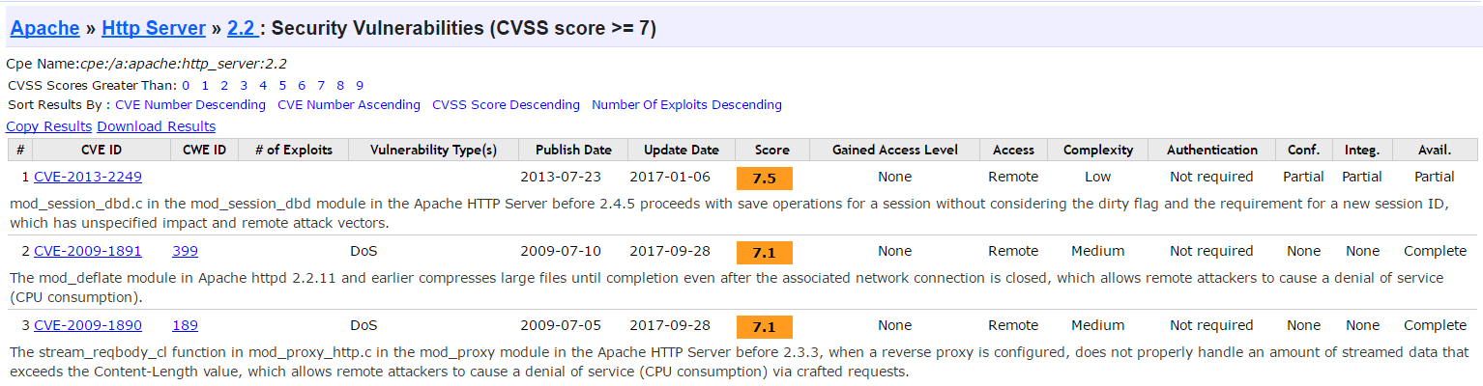
Hide-Response Headers
HTTP/1.1 200 OK
Content-Type: text/html; charset=ISO-8859-1
Content-Encoding: gzip
Server:
Cache-control: private, x-gzip-ok=""
Content-length: 1272
Date: Thu, 13 May 2004 10:17:14 GMT
APACHE/2.2
WAF

Slide 87
Hide-Response Headers
HTTP/1.1 200 OK
Content-Type: text/html; charset=ISO-8859-1
Content-Encoding: gzip
Server: APACHE/2.2
Cache-control: private, x-gzip-ok=""
Content-length: 1272
Date: Thu, 13 May 2004 10:17:14 GMT
WAF
HTTP/1.1 200 OK
Content-Type: text/html; charset=ISO-8859-1
Content-Encoding: gzip
Cache-control: private, x-gzip-ok=""
Content-length: 1272
Date: Thu, 13 May 2004 10:17:14 GMT
waf template waf1
filter-resp-hdrs

Slide 88
Hide-Response Code
505 error code
WAF
waf template waf1
hide-resp-codes allowed_resp_codes
Default allow_resp_codes
(?:1|2|3)\d{2}|40(?:0|1|4|7)|417|503

Slide 89
CCN/SSN Masking
-----------------------------------------------------------------------------------------------------------------------------------------------------------5555-4444-3333-2222---------------------------------------------------------------------------------------------
WAF
waf template waf1
ccn-mask
ssn-mask
-----------------------------------------------------------------------------------------------------------------------------------------------------------XXXX-XXXX-XXXX-2222-------------------------------------------------------------------------------------------

Slide 90
WAF Event Logging
WAFs logs two forms of messages:
Configuration events
Indicate that a configuration change has occurred
Data events
Indicate that traffic has matched a WAF template check
By default, only configuration events are logged to the local logging buffer.
Due to a potential high volume of data event messages, external logging must be configured to view events
WAF logging uses standard ACOS external Syslog template configuration
Logging is activated by binding a logging template to the WAF template on a virtual port

Slide 91
Understanding WAF Messages
WAF log messages can contain the following fields
Timestamp CEF:version|device-vendor|device-product|
device-version|module|event-type|severity|CEF-extension
Sample WAF log message
2013-11-01 18:01:46 local0.info A1 a10logd: [WAF]<6> CEF:0|A10|SoftAX|2.7.1 P2 |WAF|config|2|msg="Template badstoretest: cookie-encrypt ON, cookie-name=CartID, secret=<encrypted>"

Slide 92
Best Practices
Use Learning Mode in a lab/non-production environment with simulated traffic
Use Passive Mode in production to validate learned traffic profiles or make adjustments
Use Active Mode when satisfied with Passive adjustment result
SQLIA and XSS checks have a “sanitize” option
Scrubs potentially malicious code and forwards request to web server.
Uses more processor cycles than the preferred option of “drop”

Slide 93
SSLi

Slide 94





What is the Problem ?
Clear-text Traffic
Infected Clear-text Traffic
Security Devices can inspect HTTP Traffic
Client
Firewall/IPS
Infected Server
Encrypted Traffic
Infected Encrypted Traffic
But blind to SSL traffic
Client
Firewall/IPS
Infected Server

Slide 95
SSL Performance Impact on Next Gen Firewalls
Performance Impact with 2048-bit SSL Ciphers
81%: The average of performance loss across 7 NG Firewalls
Source: “SSL Performance Problems,” NSS Labs

Slide 96

Solution: SSL Insight (SSLi)
Encrypted Traffic
Clear-text Traffic
Infected, Encrypted Traffic
Infected, Clear-text Traffic
Firewall/IPS
Client
Infected Server

Slide 97

SSL Insight Overview
Mitigation against intrusion attacks using SSL
SSli solution built on ACOS
Decrypts outbound SSL traffic for inspection
Re-encrypts and forwards traffic to destination
Mechanisms to bypass personal, private connections (banks, health care)
IPv4 and IPv6 supported
Secure Server
SSL Encrypted connection
A10 Outside Device/partition
Unencrypted traffic flow
A10 Inside Device/partition
SSL Encrypted connection
Client

Slide 98



SSL Insight Certificates
Secure Server
Internal CA
Root/Sub-CA Certificate with Key
A10 Outside Device/partition
A10 Inside Device/partition
Root/Sub-CA Certificate
Client

Slide 99


SSLi Ladder Diagram: wo/ Cached Certificate
Client |  | SSLi_in |  | Clear-text Zone |  | SSLi_out |  | Server
443
8080
8080
443
https://example.com
Client Hello
Client Hello
Server Hello[Server Cert + Public Key, Signed by well-known CA]
SSL Handshake completed
RST
Cache
Proxied Server Hello
[Proxied Server Cert + Local Public Key, Signed by local CA]
SSL Handshake completed
Encrypted Request
Clear-text Request
Client Hello
Server Hello
SSL Handshake completed
Encrypted Request
Encrypted Response
Clear-text Response
Encrypted Response
Notes:
Establish SSL connection with the remote server and get the certificate from the remote server
Extract header information from server certificate.
Change the Issuer and the Public Key as defined in Client-SSL-Template.
Re-sign the new certificate using the CA-Certificate as specified in Client-SSL-Template.
Send the reconstructed Server-Hello to client.
Data decrypted and sent in clear-text through the security device.
New SSL session initiated with remote server.
Data encrypted and sent to remote server.
Response is decrypted and sent through the security device.
Response is encrypted again and sent to the client.

Slide 100
SSLi Ladder Diagram: w/ Cached Certificate
Client |  | SSLi_in |  | Clear-text Zone |  | SSLi_out |  | Server
443
8080
8080
443
https://example.com
Cache
Client Hello
Proxied Server Hello
[Proxied Server Cert + Local Public Key, Signed by local CA]
SSL Handshake completed
Encrypted Request
Clear-text Request
Client Hello
Server Hello
SSL Handshake completed
Encrypted Request
Encrypted Response
Clear-text Response
Encrypted Response
Notes:
Establish SSL connection with the remote server and get the certificate from the remote server
Extract header information from server certificate.
Change the Issuer and the Public Key as defined in Client-SSL-Template.
Re-sign the new certificate using the CA-Certificate as specified in Client-SSL-Template.
Send the reconstructed Server-Hello to client.
Data decrypted and sent in clear-text through the security device.
New SSL session initiated with remote server.
Data encrypted and sent to remote server.
Response is decrypted and sent through the security device.
Response is encrypted again and sent to the client.

Slide 101
Layer-2 Topology with 2 Partition
10.10.10.10
10.10.10.20
10.10.10.1
IP:- 10.10.10.50
Subnet :- 255.255.255.0
Gateway :-10.10.10.1
Decrypted traffic
https traffic

Slide 102
Layer-3 Topology with 2 Partition
10.10.10.1
10.10.20.1
10.10.20.10
IP:- 10.10.10.50
Subnet :- 255.255.255.0
Gateway :-10.10.10.1
Decrypted traffic
https traffic

Slide 103
Layer-3 Topology with 2 Devices
10.10.10.1
10.10.20.1
10.10.20.10
IP:- 10.10.10.50
Subnet :- 255.255.255.0
Gateway :-10.10.10.1
Decrypted traffic
https traffic

Slide 104
Layer-3 Topology with Multiple Security devices
10.10.10.1
10.10.20.1
10.10.20.10
IP:- 10.10.10.50
Subnet :- 255.255.255.0
Gateway :-10.10.10.1
Decrypted traffic
https traffic

Slide 105
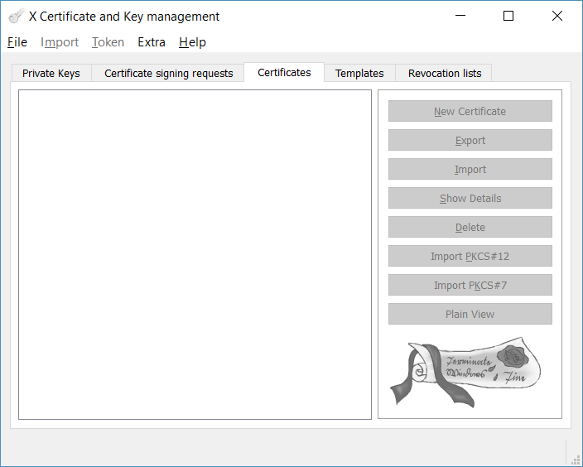
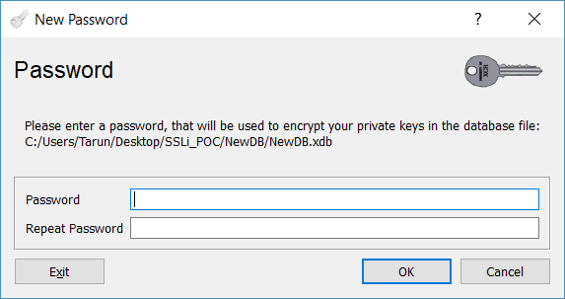
SSL Certificate
Go to File and create new Database

Slide 106
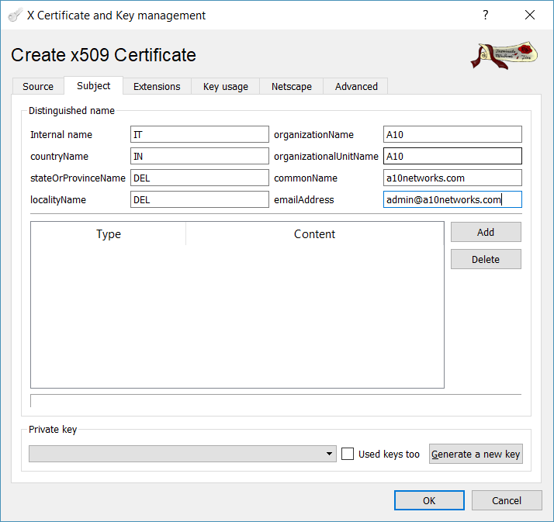
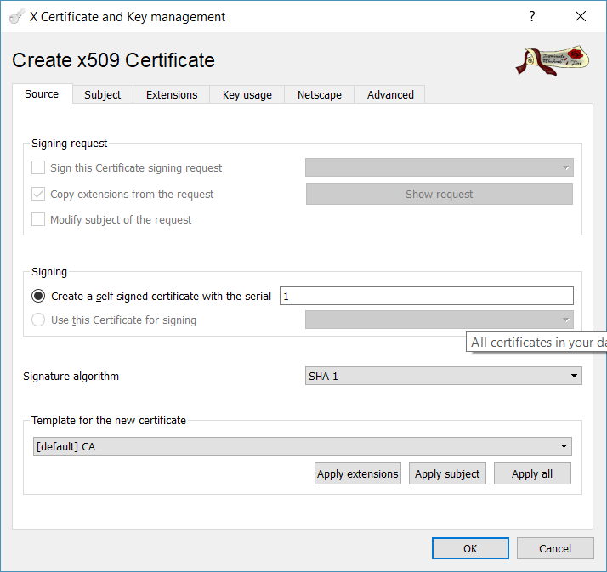
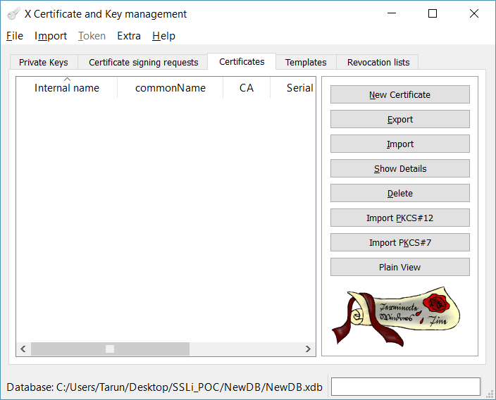
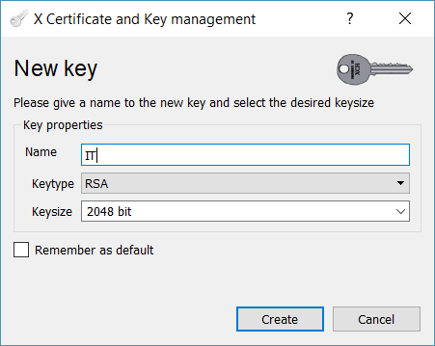
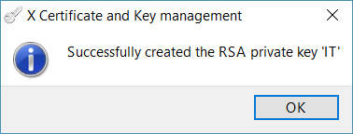
SSL Certificate
Go to Certificate and click on new Certificate
Go to Subject and Fill the details
Click on Generate new Key

Slide 107
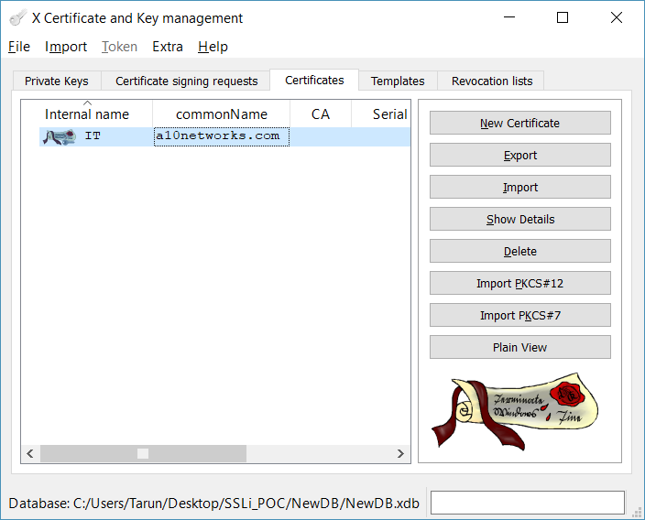
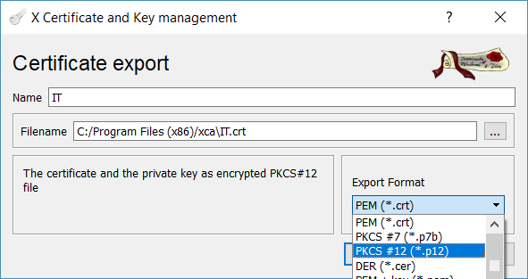
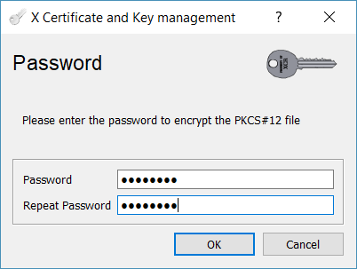
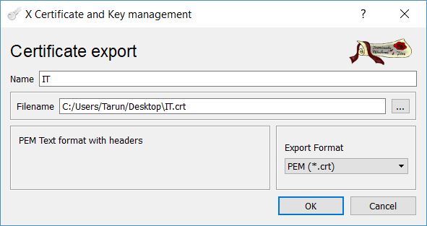
SSL Certificate
Go to Certificate export the certificate in PKCS#12 format
Fill the export format
Export certificate in PEM format

Slide 108
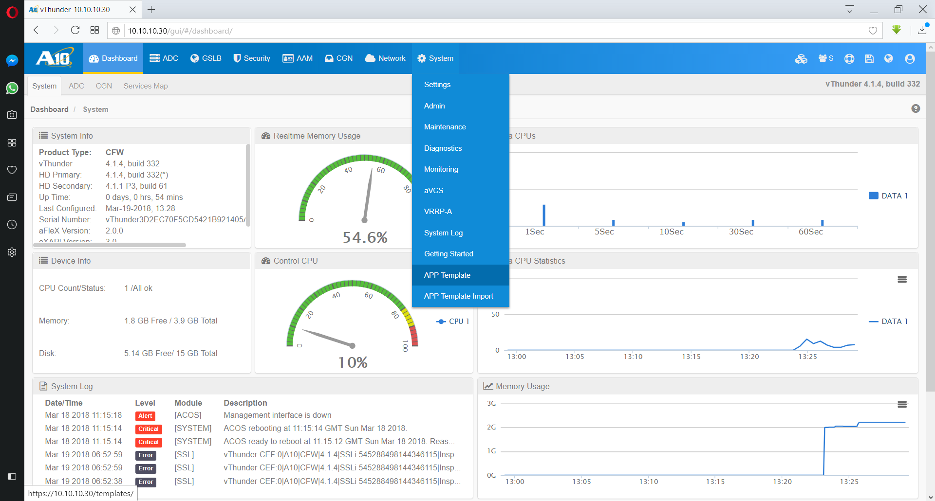
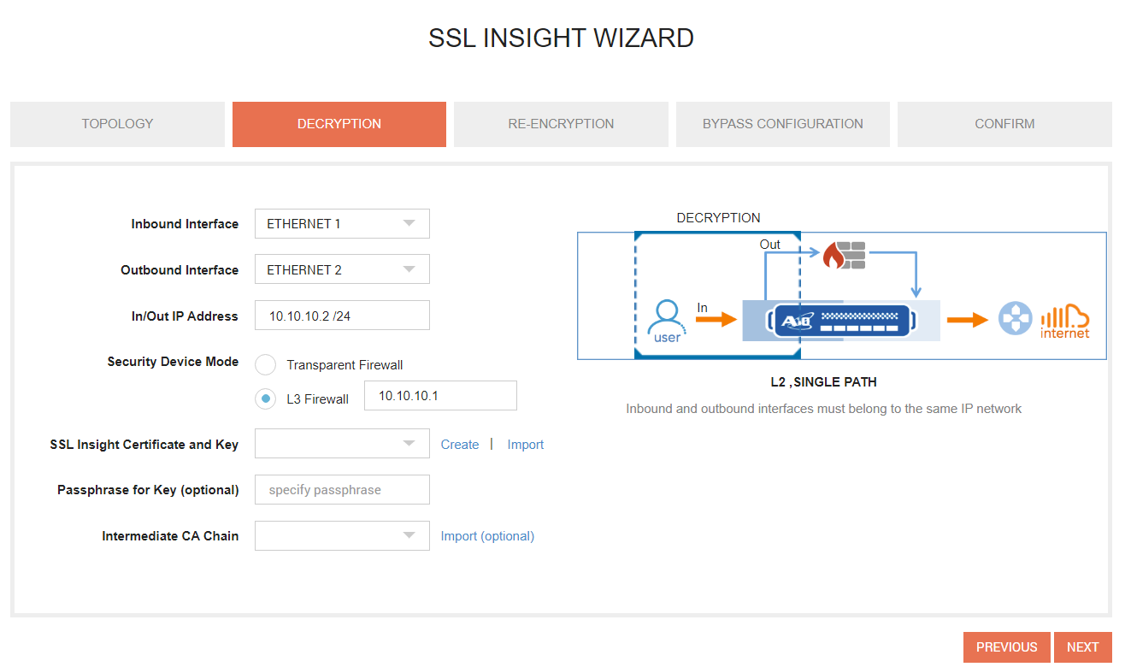
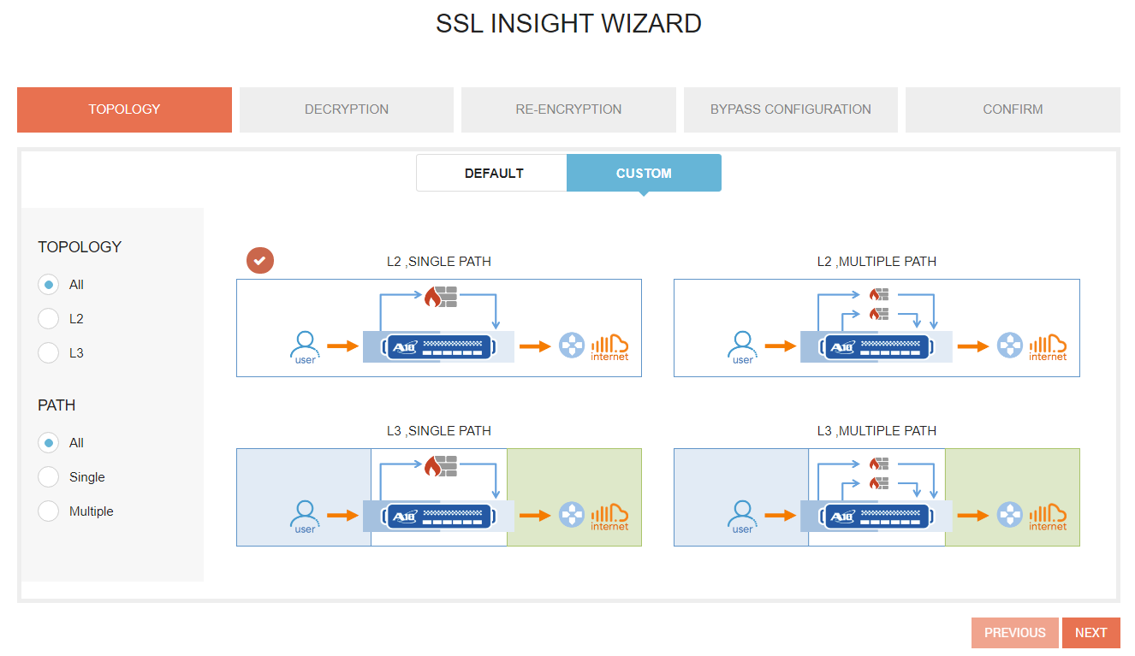
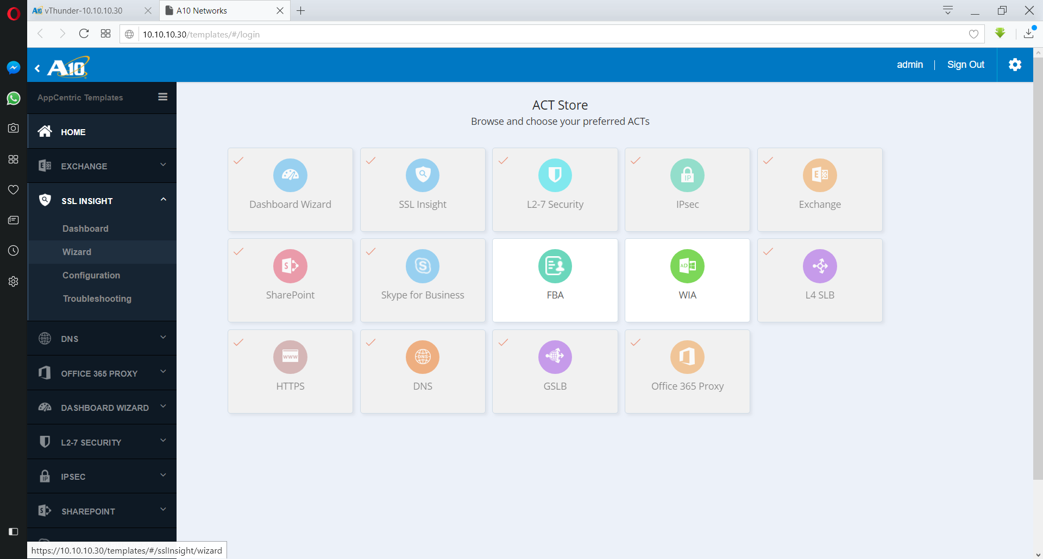
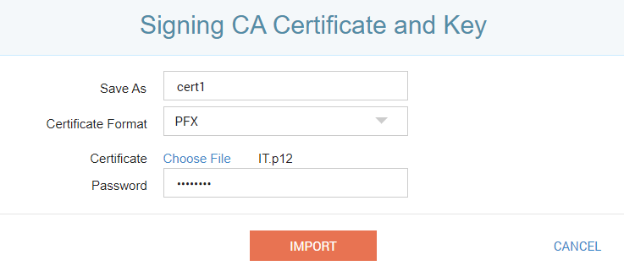
SSLi Wizard

Slide 109
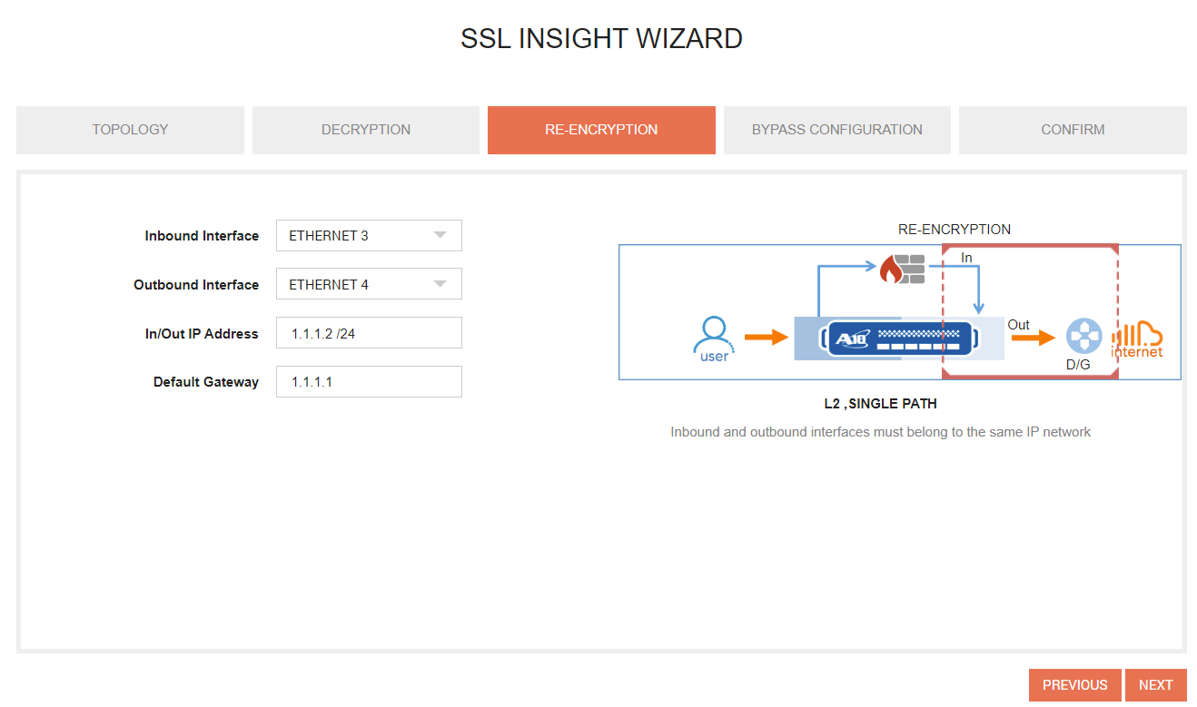
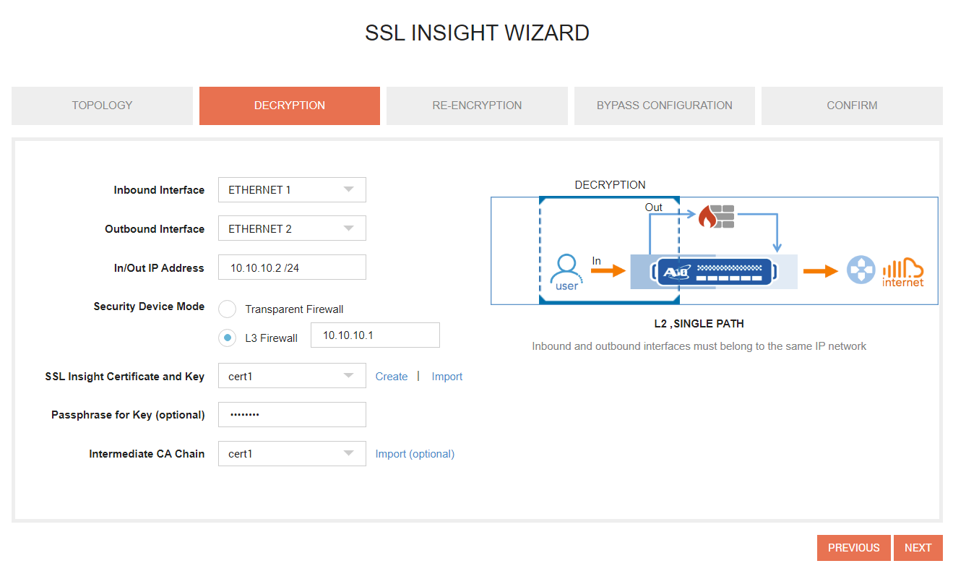
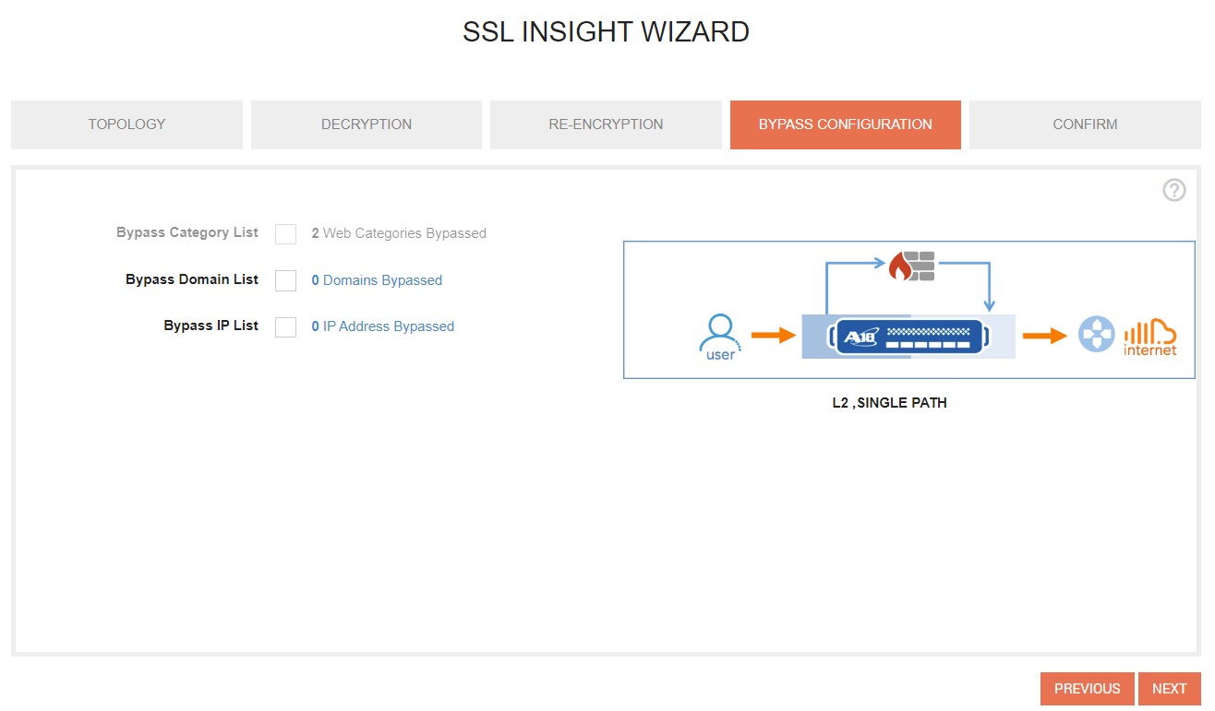
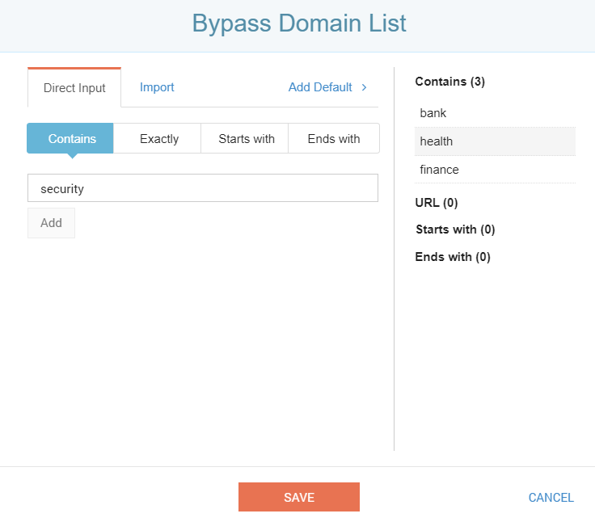
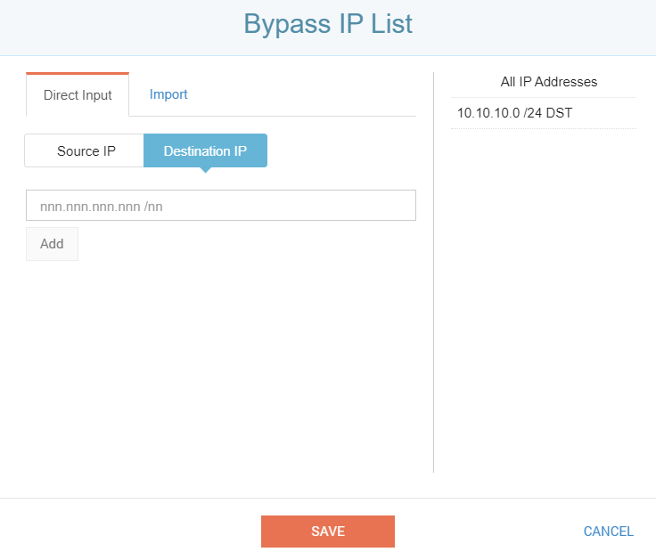
SSLi Wizard

Slide 110
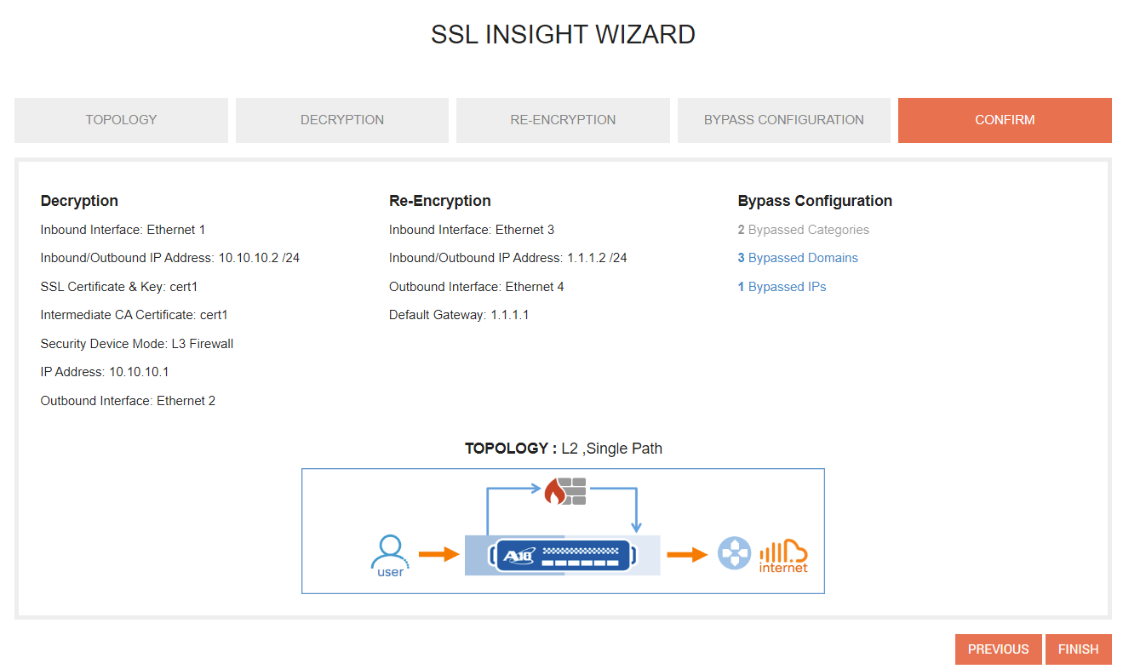
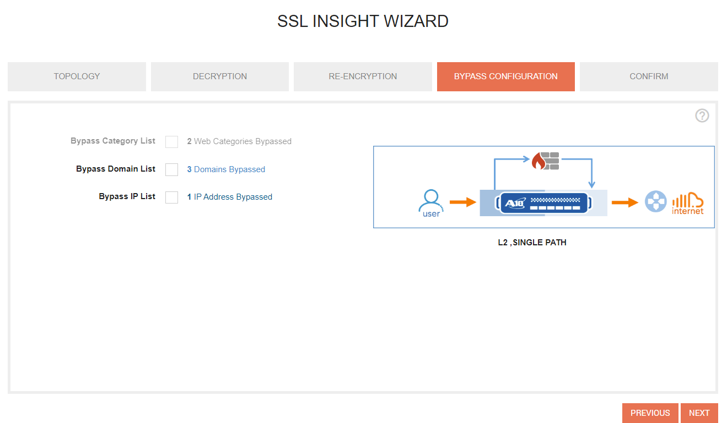
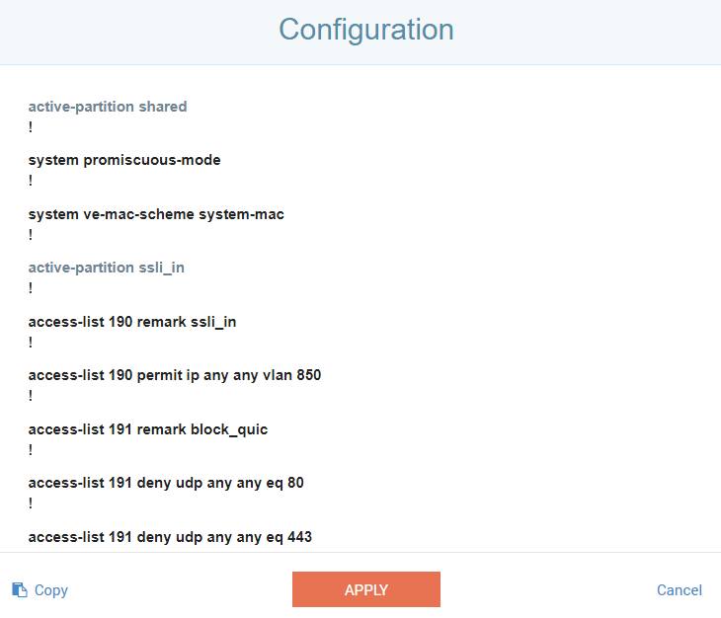
SSLi Wizard

Slide 111
Aflex

Slide 112
Overview:
What is an aFlex?
TCL based script which is applied under a vPort associated with a Virtual-IP
gives you flexibility in doing things that you may not be able to achieve using CLI.
What are some scenarios where we use an aFlex?
Custom App Traffic Handling
Application Enhancements
Traffic Steering
Security
Rate-limiting
System based Logging ……etc……

Slide 113
5 Basic Parts of an Aflex
Events:
Triggered based on client/server packet and/or connection flow.
Operators:
A descriptive string representing a rational or logical operation to be executed.
Commands:
Used on elements within the packet flow headers in order to gather data and provide aFleX functionality
Variables:
Used to store information to memory to be recalled when needed.
Conditionals:
Control structure in programming that allows you to create a logical flow within your code

Slide 114
aFlex Example for ‘Event’
# rewrites relative and absolute redirects to absolute HTTPS redirects
when HTTP_REQUEST {
set host [HTTP::host]
}
Http request event
when HTTP_RESPONSE {
if { [HTTP::is_redirect] } {
if { [HTTP::header Location] starts_with "/" } {
HTTP::header replace Location "https://$host[HTTP::header Location]"
} else {
HTTP::header replace Location "[string map {"http://" "https://"} [HTTP::header Location]]"
}
}
}
Http response event

Slide 115
Events triggered on TCP vPort
Client
Thunder
Server
SYN
CLIENT_ACCEPTED
SYN
LB_SELECTED
SYN-ACK
SERVER_CONNECTED

Slide 116
Events triggered on TCP-Proxy vPort
Client
Thunder
Server
SYN
SYN-ACK
CLIENT_ACCEPTED
ACK
SYN
LB_SELECTED
SYN-ACK
SERVER_CONNECTED

Slide 117
Events triggered on HTTP vPort
Client
Thunder
Server
SYN
CLIENT_ACCEPTED
SYN-ACK
ACK
HTTP_REQUEST
HTTP-Req
LB_SELECTED
SYN
SYN-ACK
SERVER_CONNECTED
ACK
HTTP-Req
HTTP_REQUEST_SEND
HTTP-Respose
HTTP_RESPONSE

Slide 118
Events triggered on HTTPS vPort
Client
Thunder
Server
SYN
CLIENT_ACCEPTED
SYN-ACK
ACK
CLIENT-HELLO
CLIENTSSL_CLIENTCERT
SERVER-HELLO
CLIENTSSL_HANDSHAKE
HTTP_REQUEST
CCS FINISH
LB_SELECTED
SERVER_CONNECTED
HTTP-Req
SYN
SYN-ACK
HTTP_REQUEST_SEND
ACK
HTTP_RESPONSE
HTTP-Req
HTTP-Respose

Slide 119
Events triggered on UDP/DNS vPort
Client
Thunder
Server
CLIENT_ACCEPTED
UDP/DNS Request
DNS_REQUEST
LB_SELECTED
UDP/DNS Request
CLIENT_DATA
UDP/DNS Response
DNS_RESPONSE
UDP/DNS Response

Slide 120
aFlex Example for ‘Operator’
when HTTP_REQUEST {
if { [string tolower [HTTP::uri]] ends_with "cgi" } {
pool cgi_pool
} elseif {[string tolower [HTTP::uri]] starts_with "/abc" } {
pool abc_servers
}
}
aFleX Operators

Slide 121
aFlex Operator Types:
Relational operators
contains, matches, equals (eq, ==), starts_with, ends_with
Logical operators
not (!), and (&&), or (II)
Regular expressions
matches_regex, regexp, regsub, ...etc…

Slide 122
aFlex example for ‘Command’ (2 types)
when HTTP_REQUEST {
if {[HTTP::host] equals www.a10.com} {
snatpool snat_1
pool web_sg1
}
else{
snatpool snat_2
pool other-sg
}
}
aFleX Namespace Command
aFleX Global Command

Slide 123
5 Basic Parts of an Aflex
Events:
Triggered based on client/server packet and/or connection flow.
Operators:
A descriptive string representing a rational or logical operation to be executed.
Commands:
Used on elements within the packet flow headers in order to gather data and provide aFleX functionality
Variables:
Used to store information to memory to be recalled when needed.
Conditionals:
Control structure in programming that allows you to create a logical flow within your code

Slide 124
aFlex example for ‘Variable’
String
set var2 “ATen”
log “What company Rocks? $var2 !!!”
Integer (Note: TCL will initiate a numeric variable as a string and translate it to an integer if needed by the context of usage)
set var 9
set ten [expr $var + 1]
Log “What company Rocks? A$ten !!!”
aFleX Variable
aFleX Variable

Slide 125
aFlex example for ‘Conditionals’
if { [LB::status node $server port $::PORT tcp] equals "up“ } {
log “the server $server is up”
} else {
log “the server $server is down”
}
switch [LB::status node $server port $::PORT tcp] {
"up" { log " the server $server is up" }
"down" { log "the server $server is down" }
}

Slide 126
How is an aFlex executed?
when HTTP_REQUEST {
set host [HTTP::host]
if { [info exists ::SG_ARRAY($host)] } {
log "host $host -> pool $::SG_ARRAY($host)"
pool $::SG_ARRAY($host)
}
}
Commands within the same event are executed in a sequential fashion.

Slide 127
Can I bind more than one aFlex under the same vPort?
When multiple aflex’s are bound to the same vPort as seen below, what specifies the order of execution –
what message below will be logged first?
slb virtual-server aflexlog 192.168.44.107
port 80 http
aflex testing2
aflex testing1
Aflex Testing 1:
when CLIENT_ACCEPTED {
set ip [IP::client_addr]
Log " aflex1 client IP = $ip"
}
Aflex Testing 2:
when CLIENT_ACCEPTED {
set ip [IP::client_addr]
Log " aflex2 client IP = $ip"
}

Slide 128
ADC-DDOS Feature

Slide 129
IP anomaly
• Frag – Drops all IP fragments, which can be used to attack hosts that run IP stacks with known vulnerabilities in
their fragment reassembly code
• IP-option – Drops all packets with IP options
• Land-attack – Drops spoofed SYN packets that contain the same IP address as the source and destination. These
packets can be used to launch an “IP land attack”.
• Zero-length TCP window
• Out-of-sequence packet
• Ping-of-death – Drops all jumbo ICMP packets, which are also known as “ping of death” packets
• TCP-no-flag – Drops all TCP packets that have no TCP flags set
• TCP-SYN-FIN – Drops all TCP packets in which both the SYN and FIN flags are set
• TCP-SYN-frag – Drops incomplete (fragmented) TCP Syn packets, which can be used to launch TCP Syn flood
attacks

Slide 130
IP anomaly Configuration
vThunder(config)# ip anomaly-drop ?
bad-content bad content threshold
drop-all drop all IP anomaly packets
frag drop all fragmented packets
ip-option drop packets with IP options
land-attack drop IP packets with the same source and destination addresses
out-of-sequence out of sequence packet threshold
packet-deformity drop packets with deformity
ping-of-death drop oversize ICMP packets
sampling-enable Enable baselining
security-attack drop packets causing security attack
tcp-no-flag drop TCP packets with no flag
tcp-syn-fin drop TCP packets with both syn and fin flags set
tcp-syn-frag drop fragmented TCP packets with syn flag set
zero-window zero window size threshold

Slide 131


Policy Based Server Load Balancing (PBSLB)
SG1
Select service-group SG2
Select service-group SG1
1.1.1.0/24
2.2.2.0/24
SG2
3.3.3.0/24
Drop the request

Slide 132
PBSLB Configuration
Create a BW list (ADC>BW-List>Create)
1.1.1.0/24 2 ;
2.2.2.0/24 4 ;
3.3.3.0/24 6 ;
Create Policy template
ACOS(config)# slb template policy bw1
ACOS(config-policy)# bw-list name bw1
ACOS(config-policy)# bw-list id 2 service-group SG1
ACOS(config-policy)# bw-list id 4 service-group SG2
ACOS(config-policy)# bw-list id 6 drop
Bind the template with Virtual Service
ACOS(config)# slb virtual-server PBSLB_VS1 10.10.10.10
ACOS(config-slb vserver)# port 80 http
ACOS(config-slb vserver-vport)# template policy bw1

Slide 133

SYN-Cookie
SYN
SYN-ack(with SYN-cookie)
SYN
ACK
Client
Thunder
Server
SYN
SYN-ack(with SYN-cookie)
SYN
SYN-ack(with SYN-cookie)
SYN
Server
Attacker
SYN-ack(with SYN-cookie)
Thunder
ACOS(config)# slb virtual-server vip1
ACOS(config-slb vserver)# port 80 tcp
ACOS(config-slb vserver-vport)# syn-cookie

Slide 134




DNS Application Firewall (DAF) Overview
Reduce load for protected servers (~70%)
Legitimate DNS traffic allowed only
Predictable load
Increases capacity while freeing resources to address increased load
DNS Pre-fetching (or Pre-Resolving) prepared
Increased security for backend servers
Quarantine malicious traffic for inspection (or denial)
Guarantee uptime regardless of DDoS attacks
Target: Customers running a large DNS infrastructure
Good Target: Typically Service Providers
Bad Target: Enterprise with outsourced DNS infrastructure
Regular Clients Perform as Expected
“Zombies”
Infected Clients
Generating Requests
Malicious and
Invalid Non-DNS
Traffic on Port 53
Denied
Surge Protection
Allowed
Standard CPU Usage
Optional Malicious and Invalid Traffic Redirection

Slide 135
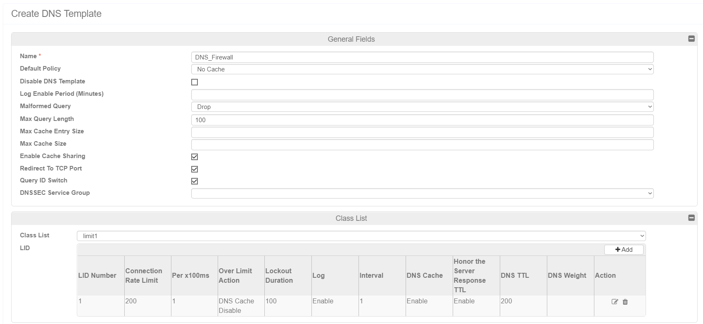
DNS Application Firewall Function
Performs sanity checks on DNS client queries
In some cases of DNS Flood, DNS queries are sent to UDP port 53 without containing a valid DNS Request header. This type of attack is known as a DNS UDP Flood attack. The Thunder ADC can discard the invalid requests.
Also provides connection-rate limiting for "look-alike" valid DNS requests flooded by a botnet.
This protection helps the target DNS server avoid overload

Slide 136
Debugging

Slide 137
AXDEBUG
AX equivalent of the open source “tcpdump”. Captures packets, ready to view in Wireshark.
Only captures packets that come to the CPU, packets sent from the ASIC/FPGA are not captured; e.g. HW SYN COOKIE.
Number of files captured == number of data CPU’s. Control CPU traffic is not captured.
Supports brief mode, detail mode and save mode.
“Brief and save” (capture brief save <FILENAME>) mode as well as “detail and save” (capture detail save <FILENAME>)mode are supported.

Slide 138
AXDEBUG (cont.)
Filter content:
Layer 3 Protocol: IP/ARP/IPv6
Layer 4 Protocol: TCP/UDP/ICMP
Source/Destination: IP/PORT/MAC
IP Protocol based filtering is also supported.
E.g. IP Protocol 89 for OSPF

Slide 139
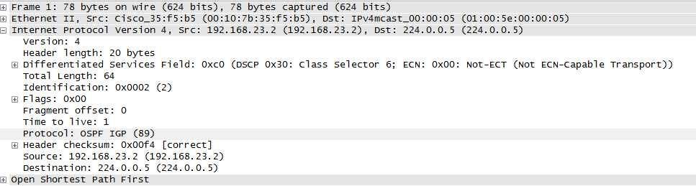
AXDEBUG (cont.)

Slide 140
AXDEBUG Commands (cont.)
Example:
AX# axdebug
AX(axdebug)#filter 1 // Define a filter
AX(axdebug-filter:1)# ip 10.60.60.60 /32
AX(axdebug-filter:1)# exit
AX(axdebug)# count 0 // Capture unlimited # of packets
AX(axdebug)# timeout 0 // No timeout, By default timeout is 5 min.
AX(axdebug)# incoming // Capture incoming traffic
AX(axdebug)# outgoing // Capture outgoing traffic
AX(axdebug)# capture save <FILENAME> // Capture the output to a file
See the filter:
AX(axdebug)# show axdebug filter
axdebug filter 1
ip 10.60.60.60 /32

Slide 141
AXDEBUG Commands (cont.)
Status of the capture:
AX(axdebug)#show axdebug status
axdebug is enabled
unlimited seconds left
debug incoming interface all
debug outgoing interface all
unlimited packets left
Captured packet length 1518
cpu#1 captured 0 packets.
cpu#2 captured 0 packets.
cpu#3 captured 0 packets.
cpu#4 captured 0 packets.
cpu#5 captured 0 packets.
cpu#6 captured 0 packets.

Slide 142
AXDEBUG Commands (cont.)
Size and details of the capture:
AX(axdebug)#show axdebug file
-----------------------------------------------------------------------------------------------------------------------------------------------
Filename | Size(Byte) | Date
-----------------------------------------------------------------------------------------------------------------------------------------------
VRRP | 300144 | Tue Aug 2 10:30:10 2011
AXDEBUG | 1996534 | Fri Apr 13 13:12:25 2012
TACACS_CAPTURE | 192 | Sun May 22 22:08:45 2011
LACP | 41808 | Fri Jan 13 12:37:38 2012
OSPF_CAPTURE | 3958 | Mon Mar 19 14:45:12 2012
ISIS | 145906 | Thu Mar 29 12:04:37 2012
-----------------------------------------------------------------------------------------------------------------------------------------------

Slide 143
AXDEBUG Commands (cont.)
Stop the axdebug capture:
AX# no axdebug
Export the file:
AX# export axdebug <FILENAME> use-mgmt-port scp://<IP><PATH>

Slide 144
DEBUG Packet
Flow/Session based debugging. Both Brief and detail mode are available.
Detail mode dumps out the packet in Hex.
Has the option to filter packets based on L3 IP and L4 protocol/port, CPU #, Interface.
Can save the output of debug packet to a file.
Count 0 is used to capture unlimited packets.
Note: Don’t forget “no debug packet” after you are done with the Debugging session.

Slide 145
TCS

Slide 146
Course Overview
Why TCS?
Typical topology and traffic flow
Network subnets
Configs: SLB, Routing, Spoofing
Show session output
Layer 7 TCS

Slide 147
Why is there a need for TCS?
Improve response time
Cached response returns to client quicker
No need to send the request to the real server every request
Reduce bandwidth demand
Ultimately, improve client experience

Slide 148
Typical Topology and Traffic Flow
Client
Server
Server
Client
Cache Server
Hit the cache!
Server
Client

Slide 149
Typical Topology and Traffic Flow
Client
Cache Server
Cache Server
Server
Server
Cache Server
Cache Server
Client
Miss the cache!

Slide 150
How does it work…
From Client to Cache Server:
SLB traffic
Thunder operating as a Load Balancer
From Cache Server to Real Server:
Routing traffic
Thunder operating as a Router

Slide 151
Typical Topology and Traffic Flow
2.2.2.2
2.2.2.1
1.1.1.2
1.1.1.1
3.3.3.1
3.3.3.2
Client

Slide 152
SLB Config
access-list 100 permit ip any 1.1.1.0 0.0.0.255
interface ethernet 1
ip allow-promiscuous-vip
slb server cache_server 2.2.2.2
no health-check
port 80 tcp
no health-check
!
slb service-group sg tcp
member cache_server:80
!
!
slb virtual-server wildcard 0.0.0.0 acl 100
port 80 tcp
name _wildcard_v4_100_TCP_80
service-group sg
no-dest-nat

Slide 153
Spoofing Cache
Use Client IP 1.1.1.2 instead of Cache Server IP 2.2.2.2 as source IP when forward request to the real server
2.2.2.2
2.2.2.1
1.1.1.2
1.1.1.1
3.3.3.1
3.3.3.2
Client

Slide 154
Two additional steps to enable Spoofing
Enable cache spoofing on the AX interface connected to the cache server
interface ethernet 2
ip address 2.2.2.1 255.255.255.0
ip cache-spoofing-port
The real server configuration for the cache server, enable spoofing cache support
slb server cache_server 2.2.2.2
no health-check
spoofing-cache
port 80 tcp
no health-check

Slide 155
Show session output
Prot Forward Source Forward Dest Reverse Source Reverse Dest Age Hash Flags Type
------------------------------------------------------------------------------------------
Tcp 15.15.15.15:49011 51.51.51.100:80 51.51.51.100:80 15.15.15.15:49011 0 2 NSe0 TCS
Tcp 15.15.15.15:49011 51.51.51.100:80 51.51.51.100:80 15.15.15.15:49011 0 2 NSe0 SLB-L4

Slide 156
Layer 7 TCS
Send requests for particular url to cache server, other requests to edge router
The idea is to control the traffic flow based on L7 url
VIP config is the same except for vport
slb virtual-server wildcard 0.0.0.0 acl 100
port 80 http
name _wildcard_v4_100_TCP_80
service-group sg
no-dest-nat

Slide 157
L7 TCS Config
Two service groups: one for the cache server, the other for the edge router
slb server cache_server 2.2.2.2
no health-check
spoofing-cache
port 80 tcp
no health-check
!
!
slb service-group sg tcp
member cache_server:80
slb server default_gateway 3.3.3.2
no health-check
port 80 tcp
no health-check
!
slb service-group sg2 tcp
member default_gateway:80

Slide 158
L7 TCS Config
HTTP template with url-switching, implementing the L7 control
slb template http http_tmp
url-switching starts-with /tours service-group sg
!
!
slb virtual-server wildcard 0.0.0.0 acl 100
port 80 http
name _wildcard_v4_100_HTTP_80
service-group sg2
template http http_tmp
no-dest-nat

Slide 159
L3V Virtualization

Slide 160
Partitioning and Layer 3 Virtualization (L3V)
The AX can be separated, or “partitioned”, allowing it to run different configurations at the same time, say for various companies, or for different departments within an organization.
L3V is a feature you can enable on each individual partition, allowing each partition to have its own network resources

Slide 161
Why L3V?
By enabling L3V on a partition, each partition is completely isolated from the others.
Resources used/created in one partition does not conflict with resources in a different partition.
Each partition that has L3V enabled can own the following resources for itself:
Layer 2 Resources:
Static MAC entries
Layer 3 Resources:
IP addresses
ARP entries
Routing table
SLB Resources:
Real servers
Virtual-servers
Service groups
Templates
Health monitors
Cert and keys
aFlex scripts

Slide 162
Types of Partitions
Shared
This is the default partition. There is only one shared partition.
Private
You can create multiple private partitions, as needed.
Shared partition
Partition A | Partition B | Partition C

Slide 163
Types of Partitions
Shared partition (default)
By default, all configuration is created under this shared partition
If no partitions are created, you are in the shared partition.
Only admins with read-write privilege can make changes in the shared partition. All admin have the ability to view the shared partition’s configuration.

Slide 164
Types of Partitions
Private partitions
There are no private partitions by default.
A read-write admin must create them, as needed.
Private partitions can only be accessed by partition admins assigned to it, and by admins with read-write or read-only privileges.

Slide 165
VRRP

Slide 166
HA VRRP-A: Overview
VRRP-A is virtual mac based redundancy protocol for thunder devices
VRRP-A can provide redundancy for the following IP resources:
Virtual server IP addresses (VIPs)
Floating IP addresses used as default gateways by downstream devices
IPv6 NAT pools
IPv4 NAT pools
IPv4 static range lists and individual mappings for inside source NAT
Partition Support – only with L3V enabled

Slide 167
Hello Messages
VRRP-A Hello Messages
By default, the active device sends hello messages every 200 milliseconds (ms). Standby devices, by default, wait a maximum of 1 second for a hello message. If no hello message is received within 1 second, failover occurs.
Hello Message Destination Addresses
VRRP-A sends hello messages to the following addresses:
IPv4 multicast address 224.0.0.210, MAC address 01:00:5e:00:00:D2
IPv6 link-local multicast address FF02::D2, MAC address 33:33:00:00:00:D2
Dynamic Priority Reduction

Slide 168
Failover Triggers
Failover Triggers
Standby stop receiving hello message
VRRP-A priority on active device is manually reduced below the standby priority, and pre-emption is enabled
VRRP-A priority on active device is dynamically reduced below the standby priority
Force-self-standby

Slide 169
High Availability – VRRP-A
Standby->Active new Active Thunder sends gratuitous ARPS for IP addresses under VRID Control
VIPs that are assigned to an VRID
Floating IP address, if configured
NAT pools assigned to an VRID
Devices that receive the ARPs learn MAC address and update their forwarding tables
Basically, Thunder sends ARPs immediately
Then, Thunder sends gratuitous ARPs every 30 seconds

Slide 170
Active Device selection
Device Boot
Preemption disable?
Weights equal ?
Device are all active and the first device that receives the heartbeat packet from other active device becomes the standby
Yes
Yes
No
No
Device with highest weight is selected as Active
Device with highest priority is selected as Active

Slide 171
VRRP-A Configuration
Enable VRRP-A
vrrp-a common
device-id 1
set-id 1
enable
Enable VRRP-A on interface
vrrp-a interface ethernet 1
vrrp-a interface ethernet 2
Configure VRID
vrrp-a vrid 0
floating-ip 1.1.1.3
blade-parameters
priority 250
tracking-options
interface ethernet 1 priority-cost 100
interface ethernet 2 priority-cost 100
vrrp-a common
device-id 2
set-id 1
enable
vrrp-a interface ethernet 1
vrrp-a interface ethernet 2
vrrp-a vrid 0
floating-ip 1.1.1.3
blade-parameters
priority 200
tracking-options
interface ethernet 1 priority-cost 100
interface ethernet 2 priority-cost 100

Slide 172
Tracking Options
vThunder-Active(config-vrid:0-blade-parameters-track...)#?
bgp Bgp tracking
gateway VRRP-A tracking gateway
interface Interface tracking
route Route tracking
trunk trunk tracking
vlan VLAN tracking

Slide 173
Thank-You

Slide 174
A10 icon library
Updated February 2018

Slide 175










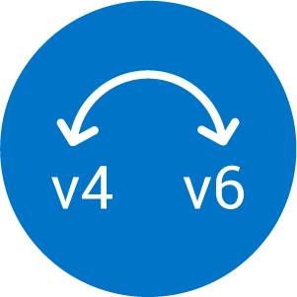








Thunder Hardware
Thunder HVA
Thunder SPE
Bare Metal
vThunder - virtual
vThunder - cloud
ADC
TPS
CGN
SSLi
CFW
HVA
aGalaxy
Lightning
aCloud
Harmony
Controller
Server
Virtual Server

Slide 176
Thunder Hardware
Thunder HVA
Thunder SPE
Bare Metal
vThunder - virtual
vThunder - cloud
ADC
TPS
CGN
SSLi
CFW
HVA
aGalaxy
Lightning
aCloud
Harmony
Controller
Server
Virtual Server

Slide 177

















Automobile
Corporate / Enterprise
Digital Advertising
Education
Education / Online Education
Finance / Banking
Government
Health Care
Insurance
Hosting
Manufacturing
Online Gaming
Retail
School
Mobile
Service Provider
Service
Provider
Web Giants

Slide 178







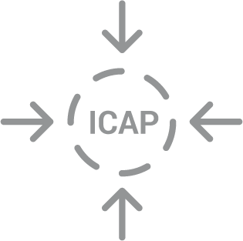




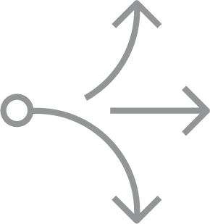



AAM
ALG Support
Analytic
DevOps Ready
Gateway
GSLB
High-Density Partition
ICAP
IPv4<->IPv6
Multi-Tenancy
Open API Integration
Single Sign-On
SLB
Intelligent Threat Protection
IPsec VPN
Traffic Mirroring

Slide 179








Data Base
Router
Switch
Firewall
Desktop
Laptop
Tablet
Mobile
Signal Tower
CPU
Home Router
Deploy

Slide 180











Data Base
Key Storage
Cloud Storage
Router
Switch
Firewall
Firewall - Breached
DNS Firewall
High-Performance Firewall
Firewall LB
WAF / Web Application Firewall
Data Center Firewall
Desktop
Laptop
Tablet
Mobile
Secured Laptop
Webinar
Entertainment Devices
Interactive Service Map

Slide 181
























Lock On / Secured
Lock Off / Non Secured
Security / Openness
High-Performance Security
Secured ADC
Extend Life Security
High-Performance SSL Security
SSL Encrypted
SSL Decrypted
Cloud
Internet
IPv4 Cloud
IPv6 Cloud
Cloud Scalability
Secured Cloud
Non Secure Cloud
Cloud Automation / Agility
Cloud Ready
Cloud Controller
Hybrid Cloud
Threat Intelligent Cloud
Real-Time Analytic Via SaaS
Container Cloud
Private Cloud
Public Cloud
Cloud Deployment
COTS
Traditional Deployment

Slide 182























APP
Application Management
Application Server
Application Server
Application Analytic
Infected Application
eMail
Window
Management Orchestration
Cloud Orchestration
SDN Controller
Scripting
Advanced Logging
Browser Window
Admin Portal
Feature Licensing
Software
Easy to Manage
SQL Injection
Third-Party Integration
White Paper
Folder
Open Folder
Infected Folder

Slide 183


















Document / Data
Infected Doc
Patent
All Inclusive Licensing
Certificate
Policy Enforcement / Service Reporting
Policy Management
Download
Central Policy Management
Medical Data
Flexible License
Encrypted Data
Attachment
Infected Attachment
Programmatic Policy Engine
Incident Response
High-Speed Logging
Log / Clipboard

Slide 184














User
Secured User
Non Secured User
Customized
Support
24-7 Support
Professional
Good/Clean User
Access Denied
Cloud User
Customer
Happy Customer
Police
Student
Engineer / IT
Infected User
Infected User
Group Experts
Group of Users
Group of Users
Parental Control

Slide 185












Hacker
Hacker
Prankster
Hacktivists
Bug
DDoS Attack
Anti-Virus
Trojan
ID Breached
Botnet
Hacker
Threats
Infected APP
Infected Laptop
Botnet Attack
Infected App

Slide 186




























Check
X
Denied
Denied
Question
Synchronizing
Refresh
Performance High
Performance Low
Target
Targeted Bug
Problem
Detection / Inspection
Extend Life
Full Visibility
Visibility
No Visibility
Key
Search
Solution
ID
Gear
Gear - Round
Gears
Gears
Data Filtering
Data Filtering
Always On

Slide 187




























Profit-Lose
Profit-Gain
Large Earning
Saving
Price Down / Cost Down
Customizing
Tool
Media-Image
Media-Film
Media-Play
Media-Web
Media-Music
Media-Headset
Media-Video
Chat
Group Chat
Positive Reputation
Partnership
Easy Access
Connectivity
Contact
Consolidate
Billboard
retargeting
Share Intelligence
Loading-Slow
Responsive
Superior

Slide 188
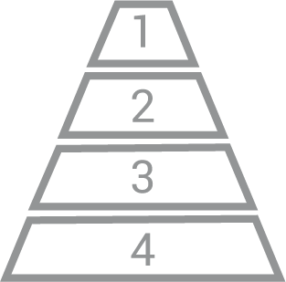



























Priority Pyramid
Priority 1
Priority 2
Priority 3
Priority 4
Money
Location
Massive Performance and Scale
Increase Appliance Capacity
Scalability
High-Performance Software
Increase Appliance Capacity
Feature
News
Dynamic Traffic Management
Symmetric
Proactive
Reactive
TAP (Out Of Band)
Intelligence Service
Performance with Precision
Multi-Vector DDoS Protection
Powerful & Efficient
DDoS Protection
Enable BI-Model IT
Full Spectrum Protection
Threat Intelligence Protection
Customize and Integrate

Slide 189




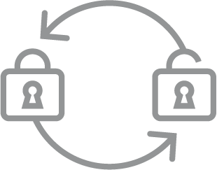











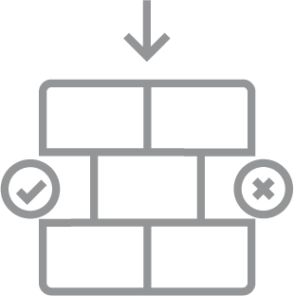








Integrated Protection
Mitigation
Flexible High- Performance Visibility
Traffic Mirroring Support
SSL
URL Category
Decrypt SSL Once Inspect Multiple Times
SSL Decryption
Explicit Proxy Support
Multiple Ciphers
Secure HSM
Data Acceleration and SSL Offload
ALGs
Advanced CGNAT
Extend Life of IPv4
CGNAT
Flexible Deployment (Cross Platform)
Protection & Performance
Stateful L4 FW
Connection Rate Limit
URL Filtering
Security Device Scaling
Centralized Cloud Management
Hybrid Service
Enhance CI/CD
Elastic and Secure
Elastically Scale
Optimize and Accelerate Traffic

Slide 190














Access Control
Agility
Application
Acceleration
Application
Availability
aXAPI REST-based Programmability
Compression
Connection Rate Protection
Data Acceleration
Defeat Cyber Attacks
Elastic WAF
Eliminate 3rd-Party Costs
High Capacity
HTTP/2
In-Memory Caching
Layer 4-7
Multi-Dimensional Security
Optimize and Accelerate
SDN / NFV Ready

