Slide 1
A10 Load Balancer installation & configuration

Slide 2
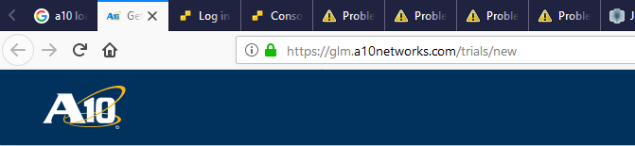
Download A10
Goto below URL & fill the required detail to download A10 trial .ova image & license

Slide 3
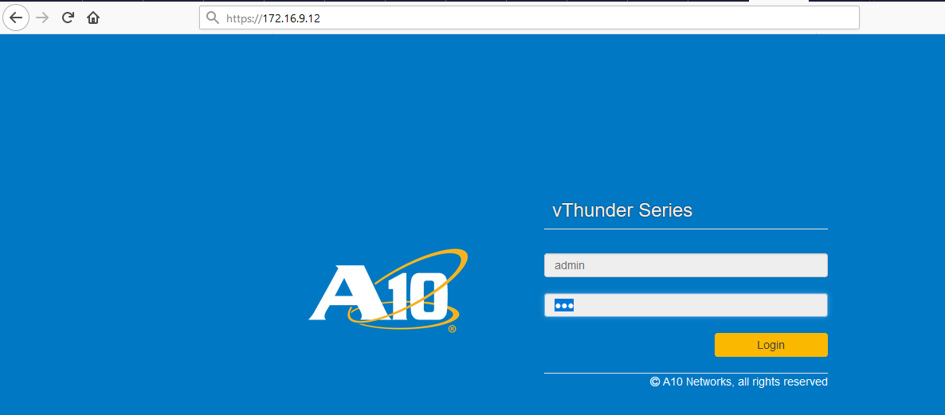
Activating License
Login to A10 via GUI username is admin & password is a10

Slide 4
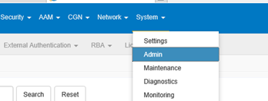
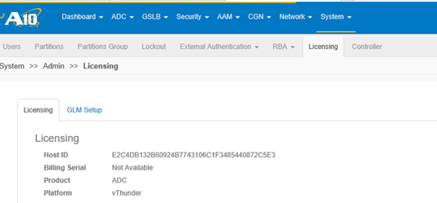
Activating License
Goto System → Admin → Licensing
Copy Host ID

Slide 5
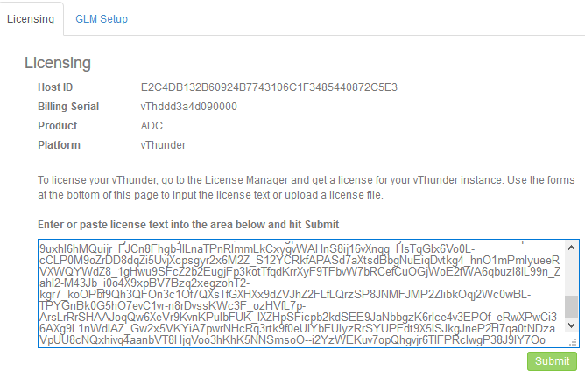
Activating License
Now Goto A10 website & request trial license
Fill the Email-id, Host ID when asked for it.
Now we will receive an email with trial license key
Paste these keys in box as shown below.
Click submit

Slide 6
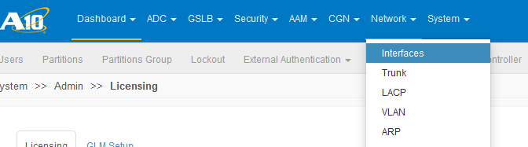
Configuring A10
Goto Network → Interface

Slide 7
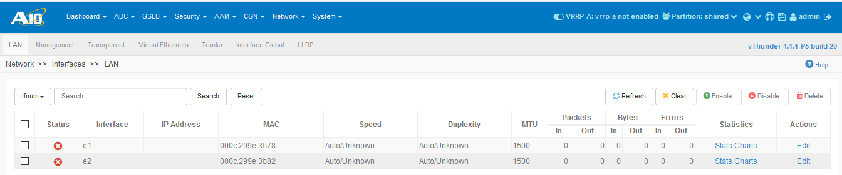
Configuring A10
Click edit

Slide 8
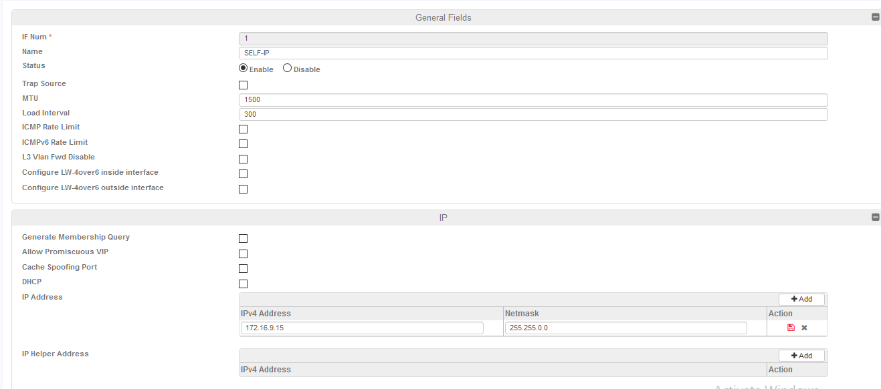
Configuring A10
Enable the interface , assign IP address & click update

Slide 9
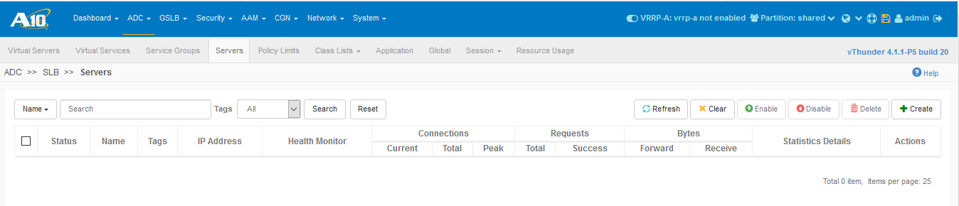
Adding Real Server
Goto ADC → Servers tab → click create

Slide 10
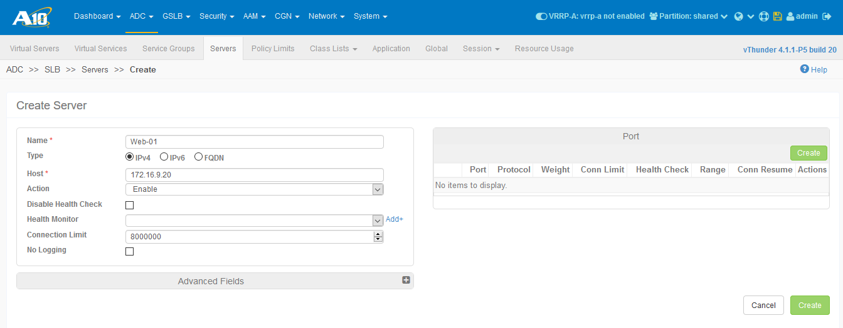
Adding Real Server
Fill the details as shown below

Slide 11
Adding Real Server
Now click create

Slide 12
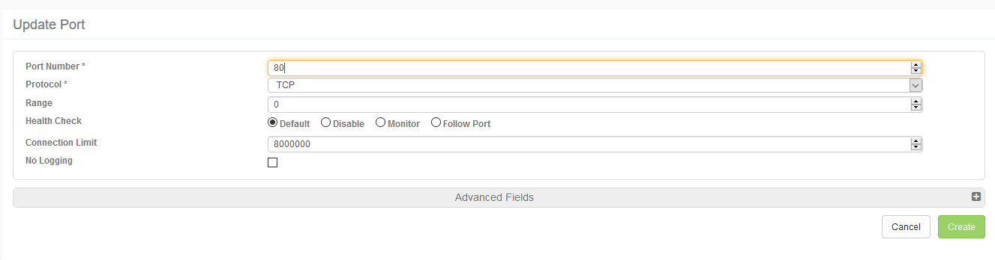
Adding Real Server
Type port no. & click create

Slide 13
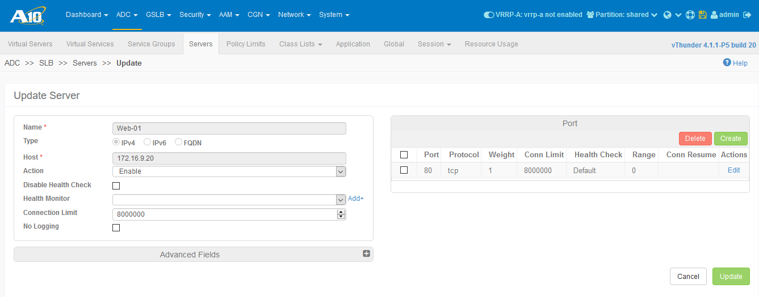
Adding Real Server
Now click update
Similarly add the other servers.

Slide 14
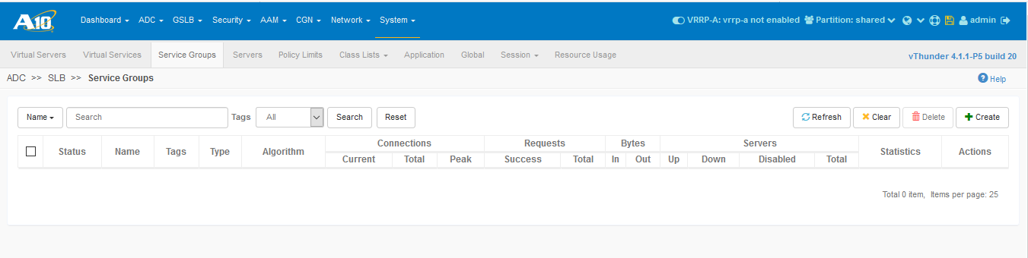
Configuring Server Group
Goto ADC → Service Groups → click create

Slide 15
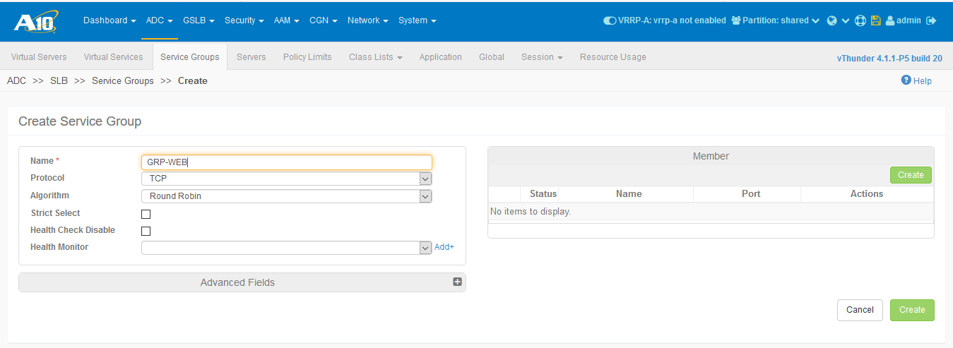
Configuring Server Group
Type name choose protocol & Load Balancing algorithm.
Then click create

Slide 16
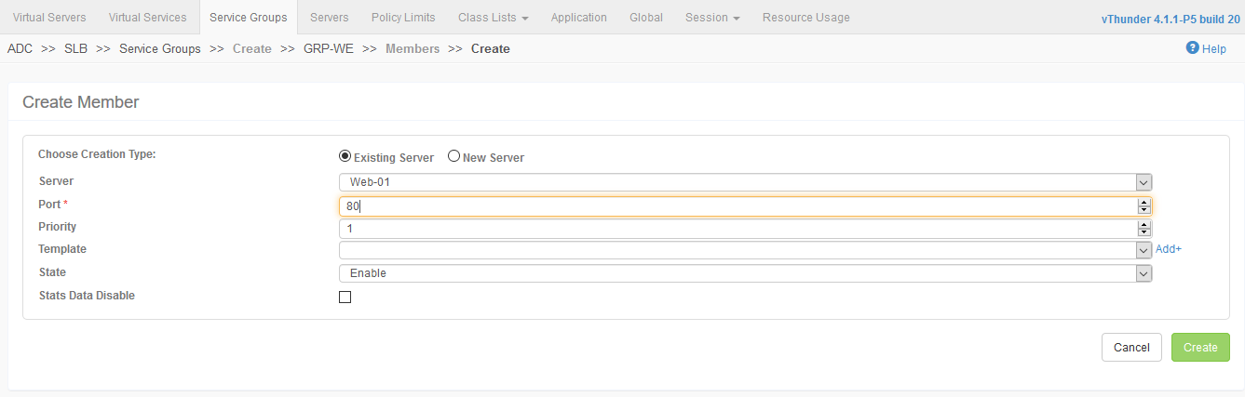
Configuring Server Group
Now add members to this Server group as shown.
Then click create

Slide 17
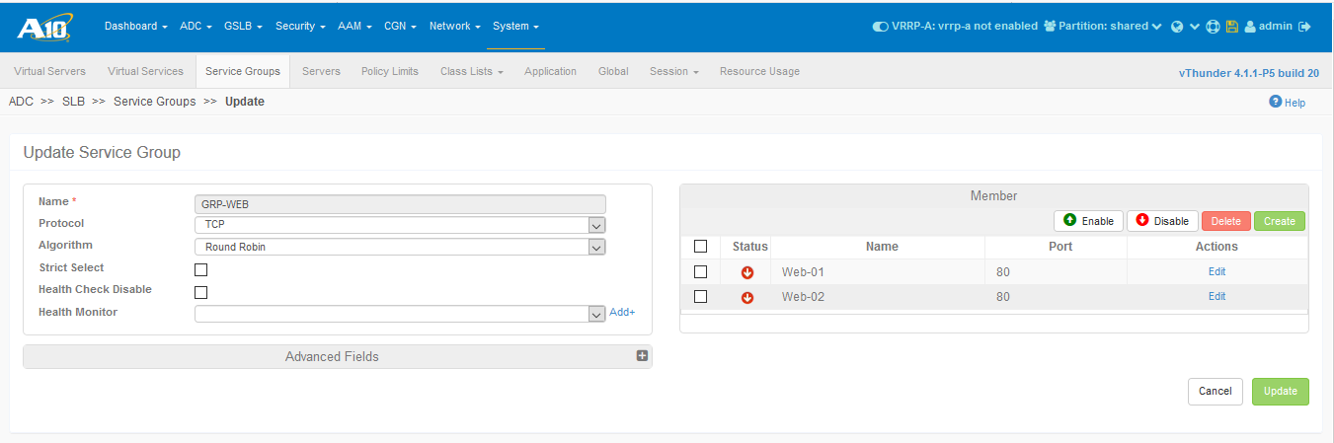
Configuring Server Group
Similarly add other members to this group & click update

Slide 18
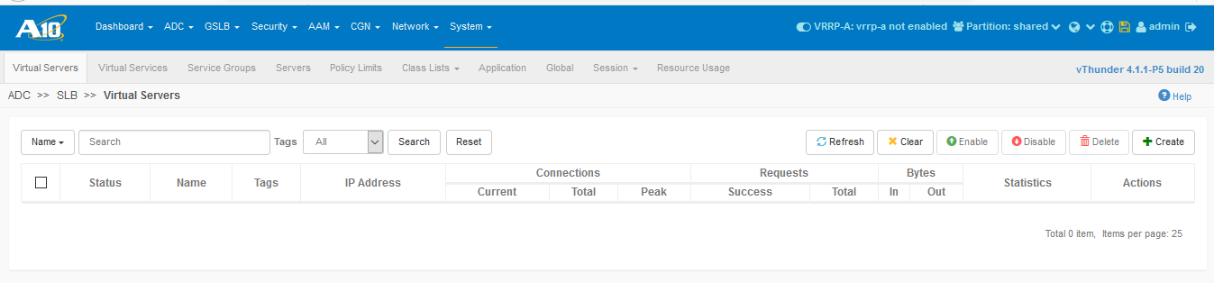
Configuring Virtual Server
Goto Virtual Servers → click create

Slide 19
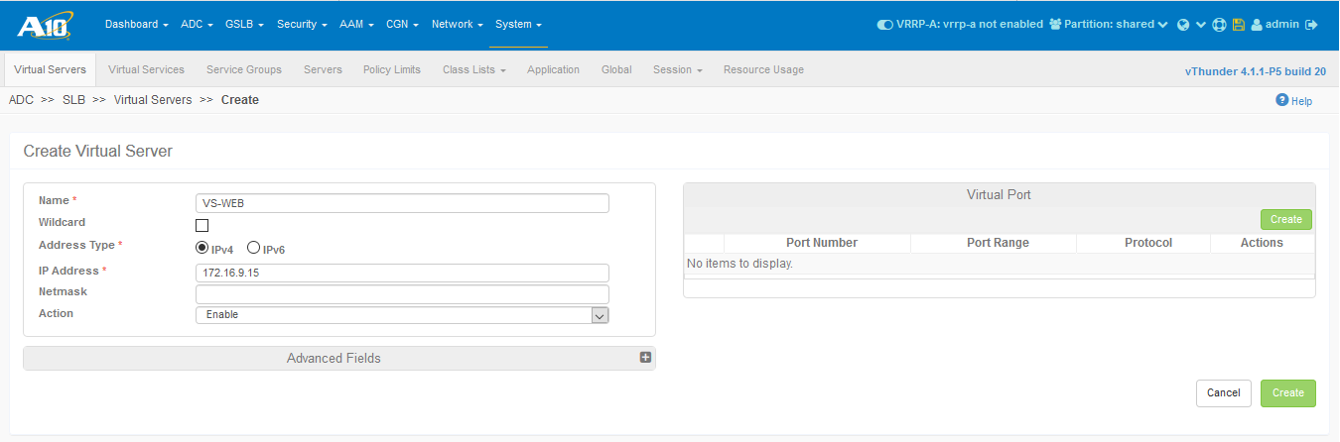
Configuring Virtual Server
Give a name & assign IP as shown below
Then click create

Slide 20
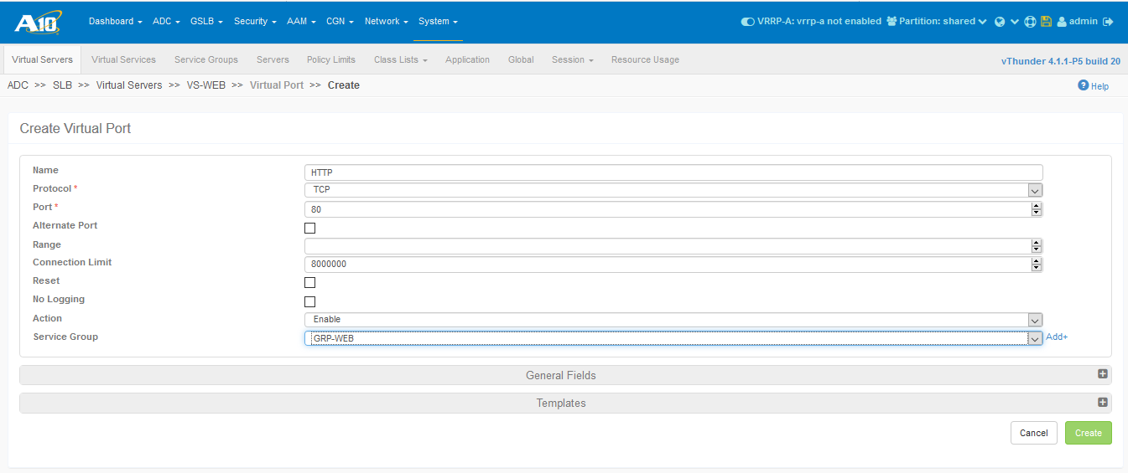
Configuring Virtual Server
Give name, select protocol & port no.
Choose server group

Slide 21
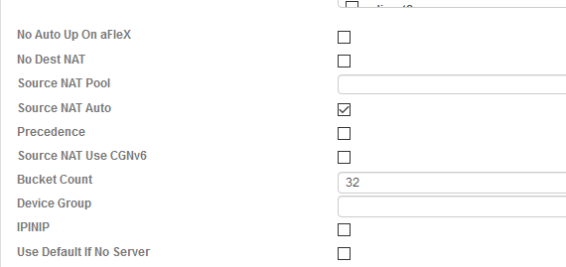
Configuring Virtual Server
Enabling SNAT:
Expand the general fields & check the Source NAT Auto checkbox & click update

Slide 22
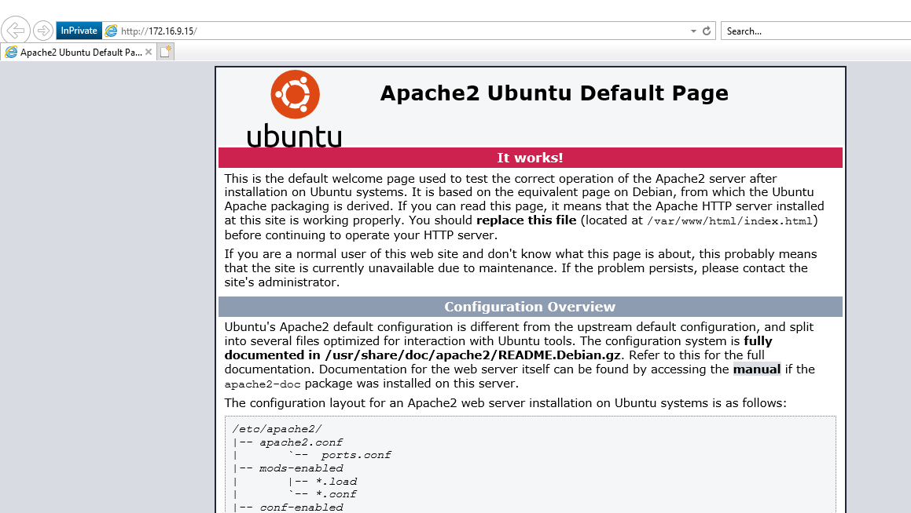
Accessing Web Service
Type the VS ip address in URL bar to access webpage

Slide 23
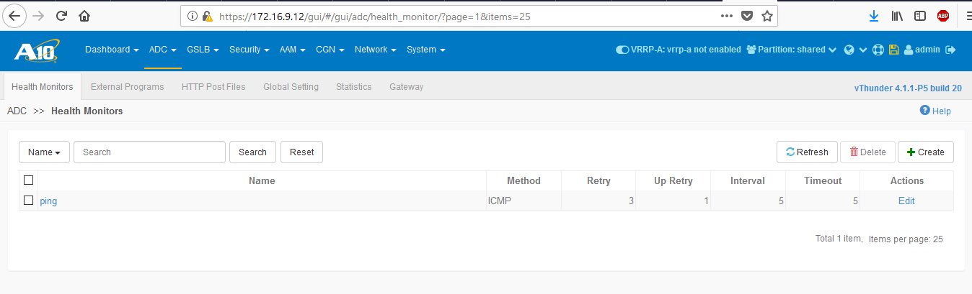
Configuring Health Monitor
Goto ADC → Health Monitor → click create

Slide 24
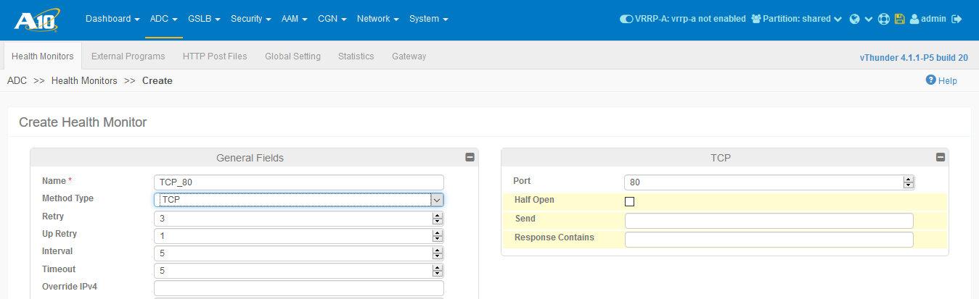
Configuring Health Monitor
Type name, select method type & choose port to monitor.
Click create

Slide 25
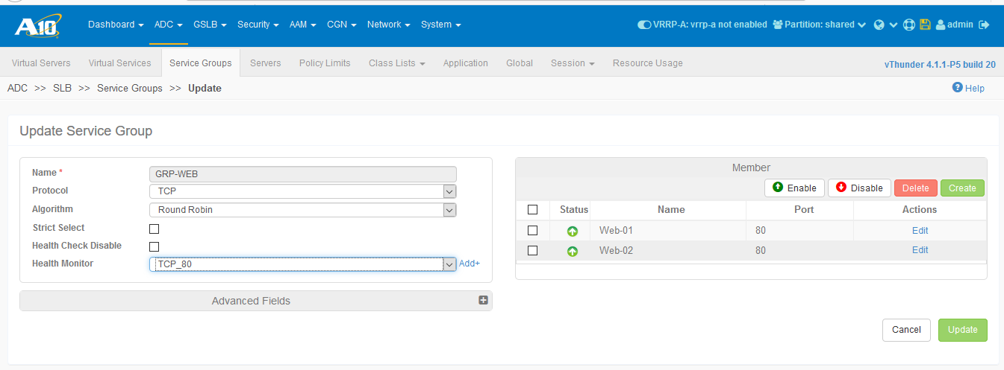
Assigning Health Monitor
Goto Server Groups → click edit
Choose health monitor & click update.

Slide 26
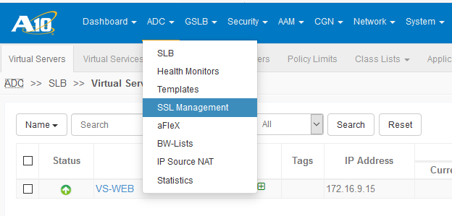
Generating SSL Certificate
Goto ADC SSL Management & click create

Slide 27
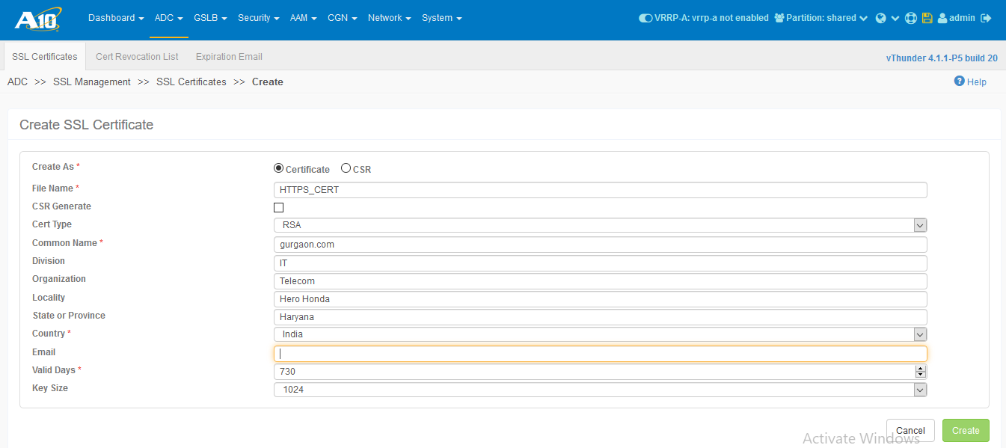
Generating SSL Certificate
Fill the details & click create

Slide 28
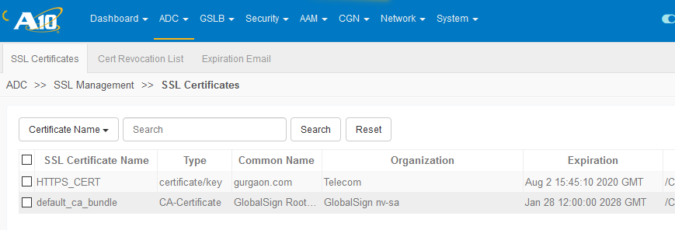
Generating SSL Certificate

Slide 29
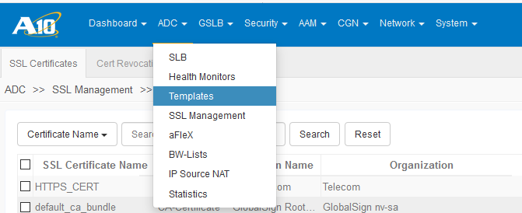
Configuring Template
Goto ADC → Template.

Slide 30
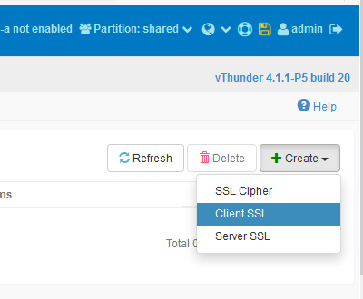
Configuring Template
Click create & choose client ssl.

Slide 31
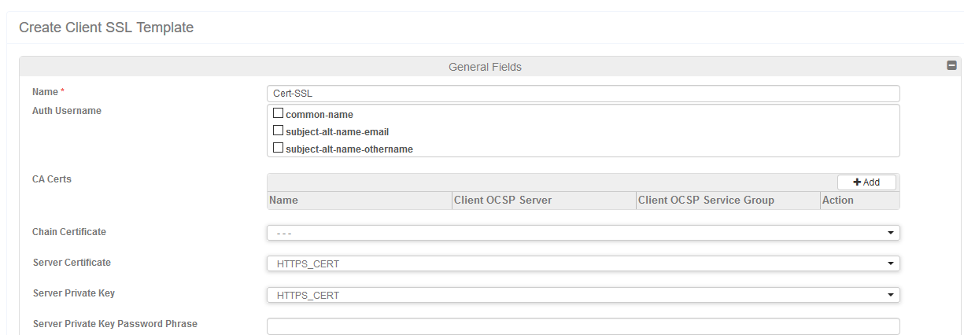
Configuring Template
Choose certificate & key that we created.
Then click ok.

Slide 32
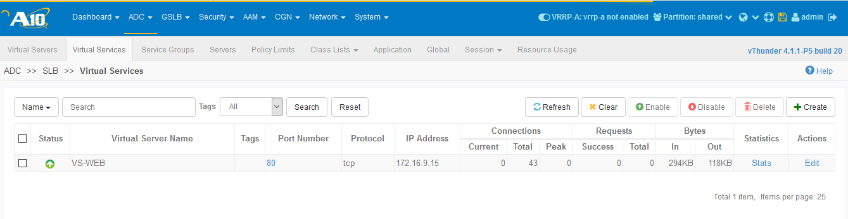
Binding SSL Certificate with virtual service
Goto virtual services, choose virtual service for which ssl certificates are required & click edit

Slide 33
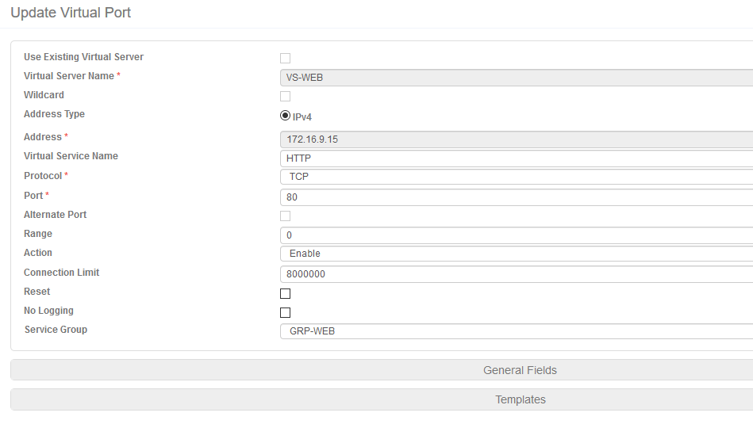
Binding SSL Certificate with virtual service
Click Template in bottom

Slide 34
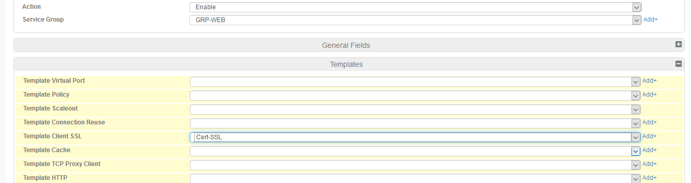
Binding SSL Certificate with virtual service
Select template that we created for client ssl.

Slide 35
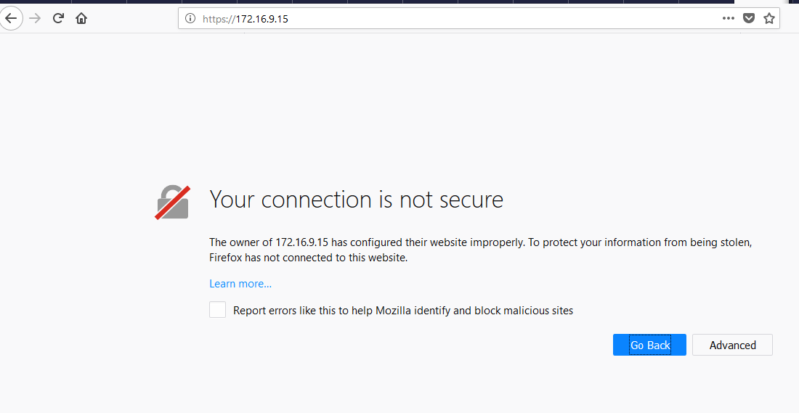
Testing SSL Certificates
Type https://VS-IP-Address in url bar

Slide 36
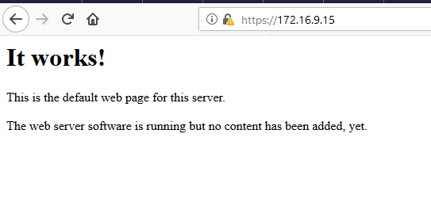
Testing SSL Certificates
Accept these certificate & we will access the web page

Slide 37
Thank You
192.168.1.100

