Slide 1
Introduction to Mobile Security

Slide 2
Goals
What’s different about mobile security?
Non-homogeneous hardware architecture
Device capabilities
Attacker goals
Software ecosystems

Slide 3
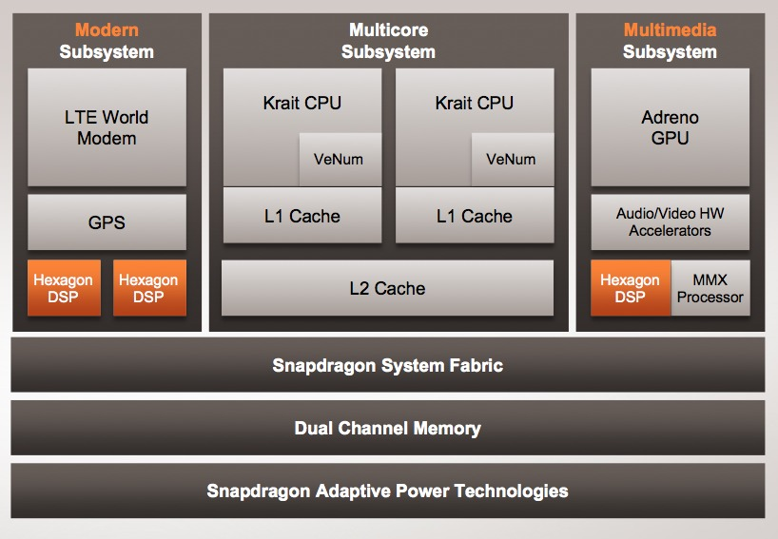
Processor Architecture
Notes:
http://www.bdti.com/InsideDSP/2012/06/21/Qualcomm

Slide 4
Device Capabilities
Connectivity
GPS
Cellular Network (GSM/CDMA)
WiFi
NFC
Sensors
Accelerometer
Gyroscope
Ambient Light
Compass
Barometer
Fingerprint sensor
Battery-powered

Slide 5
Malware Types
Notes:
http://media.kaspersky.com/pdf/Kaspersky-Lab-KSN-Report-mobile-cyberthreats-web.pdf

Slide 6
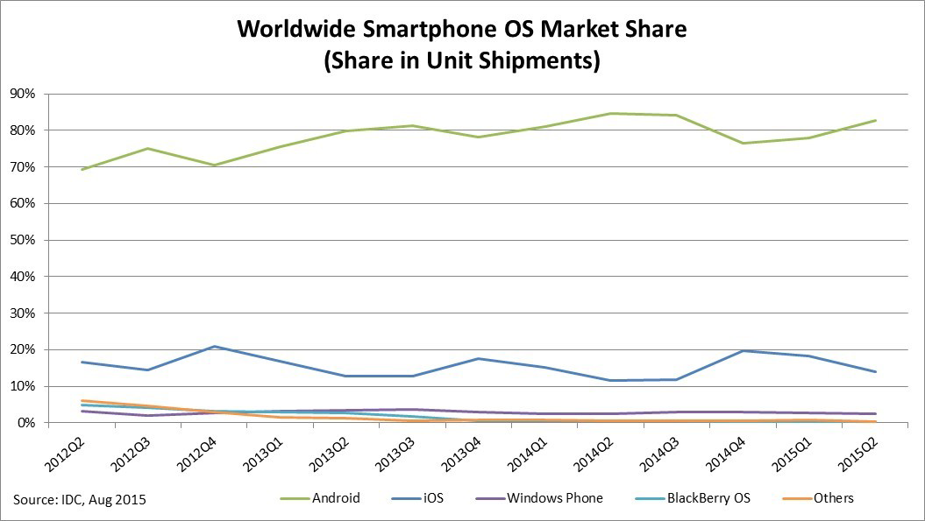
Operating Systems
Notes:
https://www.idc.com/prodserv/smartphone-os-market-share.jsp

Slide 7
Software Ecosystem
Resource-limited devices
Compute
Power
Event-driven programming
No main() method
State transitions via callbacks
Well-defined interfaces
Application lifecycle
Access to user data
Centralized software distribution
Can only download applications from a single source
Vendor takes responsibility for filtering content
Notes:
https://www.idc.com/prodserv/smartphone-os-market-share.jsp

Slide 8
Overview
Architectural complexity
New attack vectors
Mobile operating systems
Operating system safety protections
Software development and distribution model
Common problems with real-world software
Cryptographic misuse
Personal information leakage
Current research techniques

Slide 9
Block Diagram (Nexus 5)
Notes:
https://docs.google.com/file/d/0B7VNhP6LbXNmdl9wZG1OSTBnVUE/edit?pli=1

Slide 10
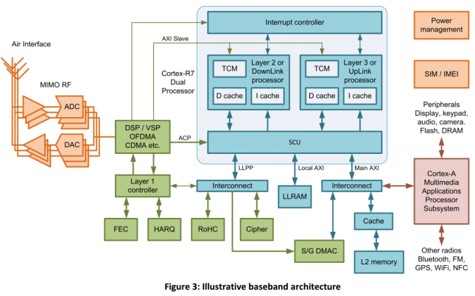
Block Diagram (Baseband)
Notes:
http://www.androidauthority.com/smartphones-have-a-second-os-317800/

Slide 11
Baseband Processor
Separate processor or core that manages radio functionality (why?)
Typically runs a proprietary real-time operating system
Apple iPhone: Nucleus RTOS, ThreadX
Qualcomm: Advanced Mobile Subscriber Software (AMSS/REX OS)
L4A Pistachio microkernel
Notes:
Reasons: Timing-dependent, certification of entire radio software stack

Slide 12
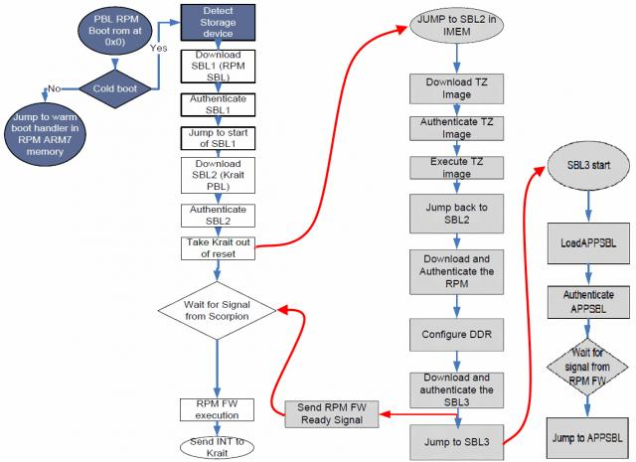
Boot Process
Notes:
http://forum.xda-developers.com/showpost.php?p=30055671
http://forum.xda-developers.com/showpost.php?p=63862650&postcount=158

Slide 13
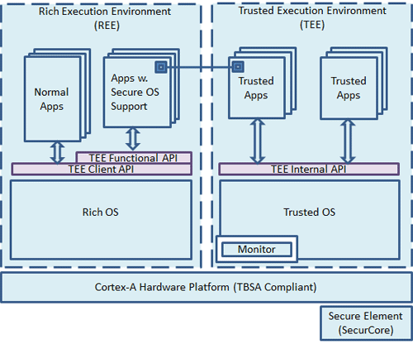
ARM TrustZone
Notes:
http://www.arm.com/products/processors/technologies/trustzone/tee-smc.php

Slide 14
ARM TrustZone
Provides a separate hardware-enforced execution environment
x86 protection rings (0, 3)
Applications
Digital rights management
Secure key storage
Mobile payments
Secure boot management (Q-Fuses)
Kernel integrity monitoring

Slide 15
ARM TrustZone
Qualcomm Secure Execution Environment (QSEE)
Contains separate kernel with separate memory space
Has privileged access to all hardware and the non-secure world
Interfaces with the non-secure world via the privileged Secure Monitor Call (SMC) instruction
Notes:
https://www.blackhat.com/docs/us-14/materials/us-14-Rosenberg-Reflections-On-Trusting-TrustZone-WP.pdf

Slide 16
Case Studies
Baseband Attacks: Remote Exploitation of Memory Corruptions in Cellular Protocol Stacks, Ralf-Philpp Weinmann (WOOT 2012)
Memory corruption in various baseband stacks led to injection/execution of arbitrary code
Reflections on Trusting TrustZone, Dan Rosenberg (BlackHat 2014)
Integer overflow vulnerability led to arbitrary write of secure memory
TrustNone, Sean Beaupre (11/28/15)
Signed comparison on unsigned user input led to arbitrary read/write of secure memory
Notes:
https://www.usenix.org/system/files/conference/woot12/woot12-final24.pdf
https://www.blackhat.com/docs/us-14/materials/us-14-Rosenberg-Reflections-on-Trusting-TrustZone.pdf
http://theroot.ninja/disclosures/TRUSTNONE_1.0-11282015.pdf

Slide 17
Overview
Architectural complexity
New attack vectors
Mobile operating systems
Operating system safety protections
Software development and distribution model
Common problems with real-world software
Cryptographic misuse
Personal information leakage
Current research techniques

Slide 18
Introduction: Android
Originally developed by startup in 2003
Bought out by Google in 2005
Publicly released in 2007
Mostly released under open source license
Proprietary device-specific drivers distributed in binary form
Access to Play Store and Google applications requires licensing agreement
Fire OS, Baidu, Yandex.Store, etc

Slide 19
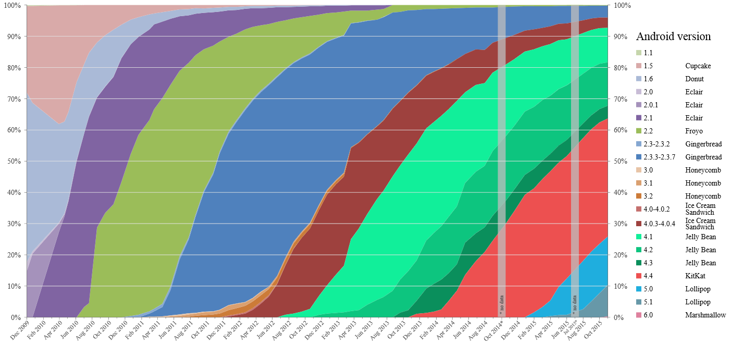
Version History
Notes:
https://commons.wikimedia.org/wiki/File:Android_historical_version_distribution_-_vector.svg

Slide 20
Security Model
Utilizes a modified version of the Linux kernel
Changes are slowly being merged back upstream
UNIX permission model for applications
Mandatory sandbox as separate users (distinct UID)
Limited interface for inter-process communication
Applications are cryptographically signed and verified
Notes:
https://source.android.com/security/overview/kernel-security.html

Slide 21
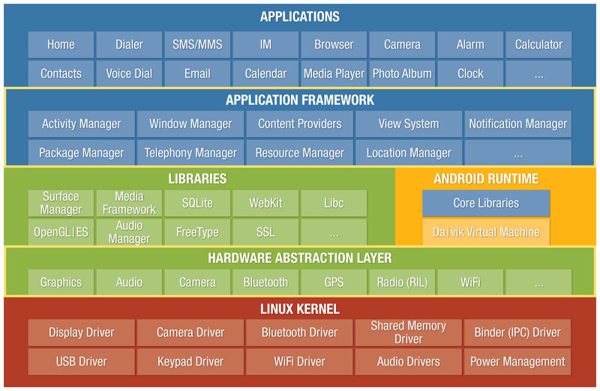
Architecture: Android
Notes:
http://androidteam.googlecode.com/files/Anatomy-Physiology-of-an-Android.pdf

Slide 22
Safety Enhancements
Android 1.5+
Stack overflow protection (-fstack-protector)
Safe integer operations (-lsafe_iop)
Double free protection
Memory allocation integer overflow protection
Android 2.3+
Format-string protections (-Wformat-security)
Data execution protection (DEP)
NULL pointer dereference protection (vm.mmap_min_addr)
Android 4.0+
Address Space Layout Randomization (ASLR)
Notes:
https://www.duosecurity.com/blog/exploit-mitigations-in-android-jelly-bean-4-1
https://source.android.com/security/enhancements/enhancements50.html
https://source.android.com/security/enhancements/enhancements60.html

Slide 23
Safety Enhancements
Android 4.1+
Position Independent Executables (PIE)
Read-only relocations (-Wl,-z,relro –Wl,-z,now)
Android 5.0+
Default full disk encryption
Mandatory PIE
SELinux
Android 6.0+
Verified boot
USB access control
Monthly security patches
Notes:
https://www.duosecurity.com/blog/exploit-mitigations-in-android-jelly-bean-4-1

Slide 24
Permission Model
Capability-based access control model
Categorized into various functional groups
Bluetooth
Camera
Location (fine/coarse-grained)
Network/data connection
SMS/MMS
Telephony
User receives permission prompt at install-time
All-or-nothing

Slide 25
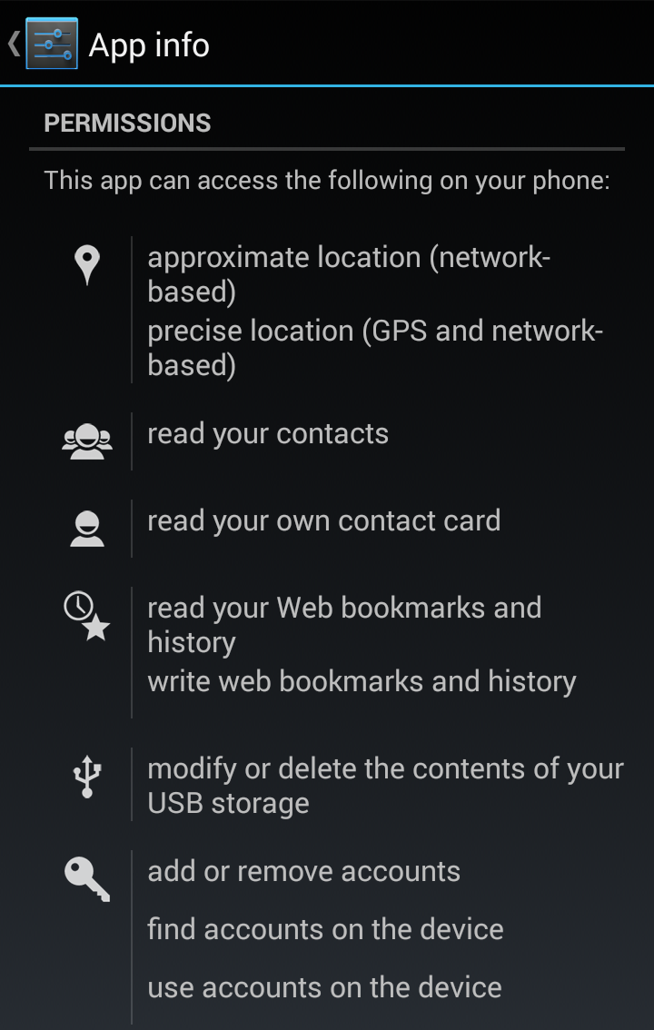
Permission Model
Notes:
https://www.internetsafetyproject.org/wiki/android-permissions

Slide 26
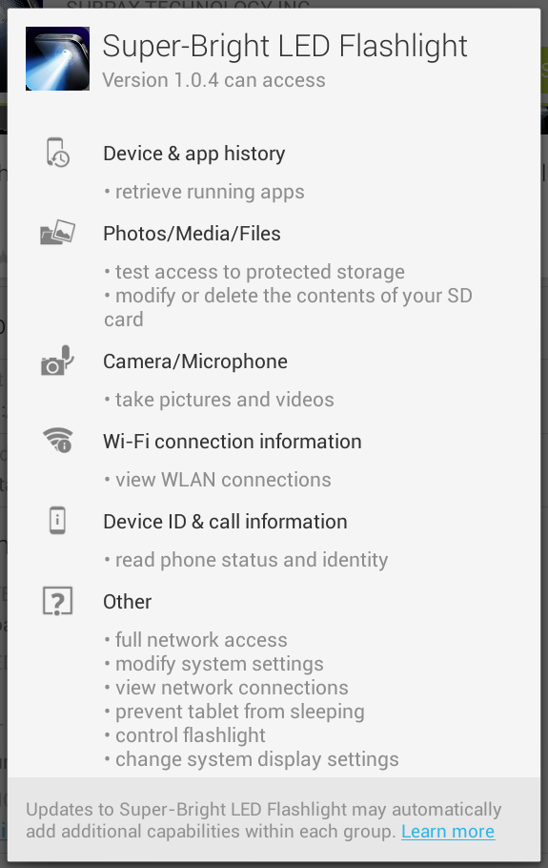
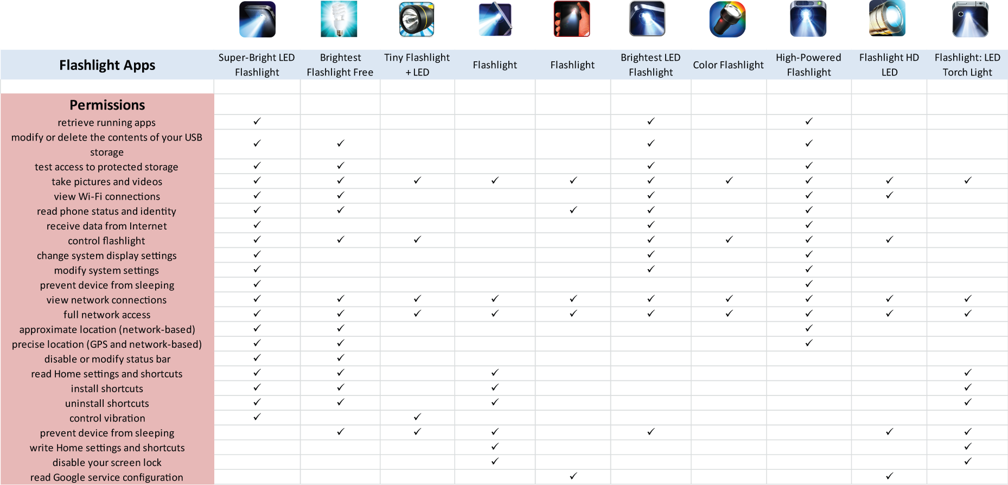
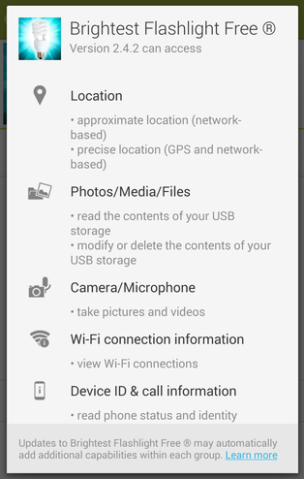
Permission Model
Notes:
http://www.snoopwall.com/threat-reports-10-01-2014/

Slide 27
Permission Model
Starting with Android 6.0 (Marshmallow), permissions are queried at run-time
Allows users to deny individual permissions
Was briefly available for Android 4.4.0 – 4.4.2
3rd party solutions
Xposed Framework (requires root)

Slide 28
Application Structure
Written in Java
Interpreted by Dalvik bytecode virtual machine
Uses just-in-time (JIT) techniques to compile native code
Replaced with Android Runtime (ART) in 5.0+
Introduces ahead-of-time (AOT) compilation instead of JIT
Can also call into native code
Uses Java Native Interface (JNI) to interface with C/C++ libraries
Notes:
http://ieeexplore.ieee.org/xpl/login.jsp?tp=&arnumber=4768655

Slide 29
Application Structure
Activity
Portions of the application’s user interface
Login window, registration interface, etc.
Service
Performs background processing
Download a file, play music, etc.
Broadcast Receiver
Handlers for global messages
Boot completed, power disconnected, etc.
Content Provider
Manages access to structured data
User calendar, contacts, etc.
Notes:
http://ieeexplore.ieee.org/xpl/login.jsp?tp=&arnumber=4768655

Slide 30
Case Studies
Stagefright, Zimperium (2015)
Integer overflow vulnerabilities in system multimedia library leads to remote code execution
Fixed in November monthly security patch
Master Key, Bluebox Security (2013)
Structure of Android application packages allows manipulation of contents without invalidating digital signatures

Slide 31
Introduction: iOS
Originally developed in 2005
Publicly released in 2007
Based off of the Macintosh XNU kernel
Supports memory-protection features
ASLR, DEP, etc.
UNIX-like

Slide 32
Security Model
All applications must be signed by Apple
Unless system is jailbroken to remove checks
Individual applications are encrypted and sandboxed from one another
Code integrity is verified during execution
Makes injection of shellcode difficult

Slide 33
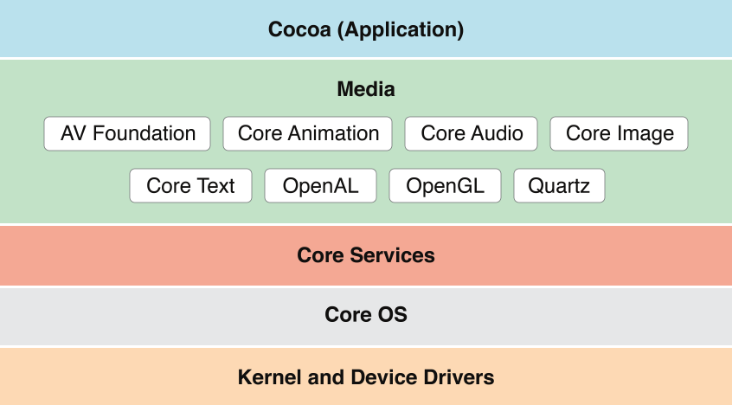
Architecture: iOS
Notes:
https://developer.apple.com/library/mac/documentation/MacOSX/Conceptual/OSX_Technology_Overview/MediaLayer/MediaLayer.html

Slide 34
Application Structure
Written in Objective-C or Swift
Compiled by Clang/LLVM into native code
Adds automatic reference counting for garbage collection in Swift
Transitioning to open source later this year
Uses Model-View-Controller (MVC) design paradigm
Applications objects are model, view, or controller
Abstracts data from logic and presentation
Notes:
https://developer.apple.com/library/ios/documentation/General/Conceptual/DevPedia-CocoaCore/MVC.html

Slide 35
Application Approvals
Applications are typically submitted by developers to App Store for inclusion
These undergo a review process for unwanted behavior or policy violations
Objectionable content
Game emulators
Internal API’s
Techniques
Static analysis
Manual review

Slide 36
Enterprise Provisioning
Enterprise developer certificates allow bypass of the App Store
Designed for deployment of internal applications to employees
Historically, have also been used to bypass platform security
Game emulators
Jailbreaking
Malware

Slide 37
Case Studies
XcodeGhost, Alibaba (2015)
Modified version of Xcode uploaded to a Chinese file sharing service inserted malicious code into binaries
Pangu8, Pangu Team (2015)
Heap overflow in kernel battery gauge service for iOS 8 led to arbitrary writes of kernel memory
limera1n, George Hotz (2010)
Heap overflow in bootloader USB protocol implementation led to arbitrary writes of memory

Slide 38
Overview
Architectural complexity
New attack vectors
Mobile operating systems
Operating system safety protections
Software development and distribution model
Common problems with real-world software
Cryptographic misuse
Personal information leakage
Current research techniques

Slide 39
Common Problems
Developers are not experts in implementing or using cryptography
Tendency to copy-paste “template” code
Need to disable certain cryptographic features for ease of debugging
Developers tend to inadvertently or maliciously request extraneous permissions
Can use user information for advertising or analytics

Slide 40
Cryptographic Misuse
Usage of ECB mode for encryption
Usage of static IV’s in CBC mode
Usage of hardcoded symmetric encryption keys
Usage of low iterations for password-based encryption
Bad seeding of random-number generators

Slide 41
Cryptographic Misuse
CryptoLint, Manuel Egele et al. (CCS 2013)
Extract a control flow graph of an application
Identify calls to sensitive cryptographic API’s
Perform static backward slicing to evaluate security rules
Allows for automatic detection of cryptographic misuse

Slide 42
Case Study

Slide 43
Password Manager (2010)
private String encrypt(byte [] key, String clear) {
byte [] encrypted;
byte [] salt = new byte[2];
...
Random rnd = new Random();
//Cipher cipher = Cipher.getInstance("AES");
Cipher cipher =
Cipher.getInstance("AES/ECB/PKCS7Padding", "BC");
cipher.init(Cipher.ENCRYPT_MODE, skeySpec);
rnd.nextBytes(salt);
cipher.update(salt);
encrypted = cipher.doFinal(clear.getBytes());

Slide 44
Password Manager (+6 days)
private String encrypt(byte [] key, String clear) {
byte [] encrypted;
byte [] salt = new byte[2];
...
Random rnd = new Random();
Cipher cipher =
Cipher.getInstance("AES/CBC/PKCS7Padding", "BC");
byte [] iv = {0,0,0,0,0,0,0,0,0,0,0,0,0,0,0,0};
IvParameterSpec ivSpec = new IvParameterSpec(iv);
cipher.init(Cipher.ENCRYPT_MODE, skeySpec, ivSpec);
rnd.nextBytes(salt);
cipher.update(salt);
encrypted = cipher.doFinal(clear.getBytes());

Slide 45
Password Manager (+2yrs, 5mo)
private String encrypt(byte [] key, String clear) {
...
Random rnd = new Random();
Cipher cipher =
Cipher.getInstance("AES/CBC/PKCS7Padding", "BC");
byte [] iv = new byte[16];
rnd.nextBytes(iv);
IvParameterSpec ivSpec = new IvParameterSpec(iv);
cipher.init(Cipher.ENCRYPT_MODE,skeySpec,ivSpec);
encrypted = cipher.doFinal(clear.getBytes());
...

Slide 46
Password Manager (key)
public static byte []
hmacFromPassword(String password) {
byte [] key = null;
...
Mac hmac = Mac.getInstance("HmacSHA256");
hmac.init (new SecretKeySpec
("notverysecretiv".getBytes("UTF-8"), "RAW"));
hmac.update(password.getBytes("UTF-8"));
key = hmac.doFinal();
...
return key;

Slide 47

Developer Education

Slide 48

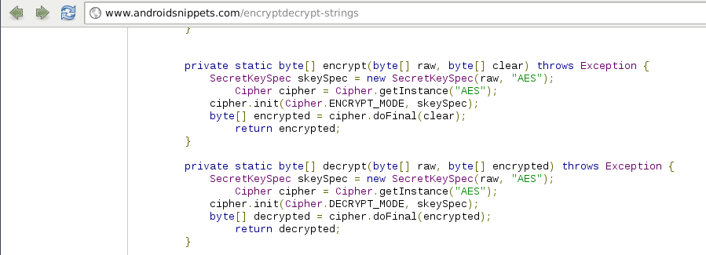
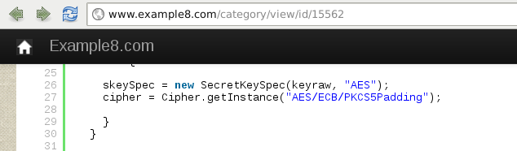
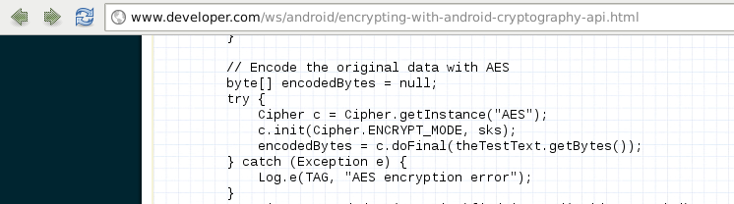
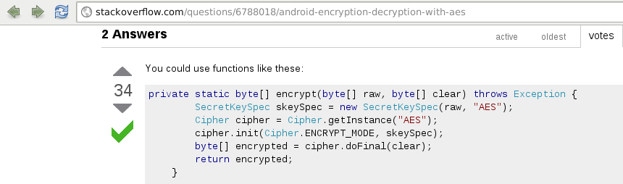
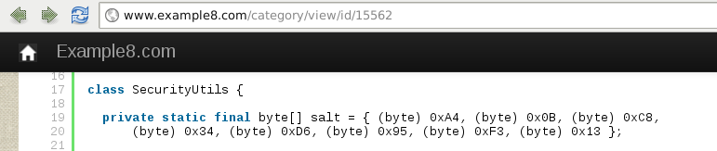


Slide 49
Case Study
TaintDroid, William Enck et al. (OSDI 2010)
Dataset of 30 randomly selected popular applications
Flagged 105 TCP connections for containing tainted privacy-sensitive information
Leakage of device IMEI
Leakage of device location

Slide 50
Overview
Architectural complexity
New attack vectors
Mobile operating systems
Operating system safety protections
Software development and distribution model
Common problems with real-world software
Cryptographic misuse
Personal information leakage
Current research techniques

Slide 51
Program Analysis
Taint Analysis
Mechanism for identifying data flows in an application
Concepts:
Basic Blocks
Control Flow Graphs
Call Graphs

Slide 52
Basic Block
Sequence of instructions executed consecutively
Only the first instruction can be reached from outside the block
Only the last instruction may transition outside the block

Slide 53
Basic Block
x = y + z
z = t + i
x = y + z
z = t + i
jmp 1
jmp 3
3 basic blocks

Slide 54
Control Flow Graph
Each vertex is a basic block
There is an edge between two vertexes if there may be a transfer of control between the blocks
Typically limited to a single function or procedure (intraprocedural)

Slide 55
Control Flow Graph
a = readline()
x = 0
if (a > 5) {
t = “gt”
x = 42
} else {
t = “lte”
x = 7
}
print(“input was ” +
t + “ 5”)
a = readline();
x = 0
if (a > 5)
t = “gt”
x = 42
t = “lte”
x = 7
print( … )

Slide 56
Call Graph
Each node is a function
There is an edge between nodes if a function calls another

Slide 57
Call Graph
void orange()
{
green();
red(); }
void red()
{
...
}
void green()
{
green();
orange();
}
orange
red
green

Slide 58
Taint Analysis
Technique or identifying movement of data in an application
Sources: Originations of privacy sensitive information, e.g. address book API
Sinks: Destinations of network communication, e.g. socket API
Determine what flows occur between sources and sinks

Slide 59
Challenges
Object-oriented languages encapsulate data as objects in memory
Callbacks and local functions are used to transfer data
Need to perform and propagate type recovery
Class hierarchy
Determine relationships between parent and child classes
Identify overridden and virtual functions
Handle dynamic object introspection
e.g. Reflection

Slide 60
Backward/Forward Slicing
Identify all instructions that may influence a given variable
Program point
Variable
Can be performed in both directions

Slide 61
Backward/Forward Slicing
int main() {
int x, y, z;
x = 5 + 2 * 6;
y = getchar();
z = 8 + 10 % 3;
y = x + z * 5;
if (z > 9) {
x = 2 * z + 1;
} else {
x = 4 * z - 1;
}
y = 10 * y + 3;
return foo(x);
}
61

Slide 62
Usage
Identify sources of data that is used in cryptographic API’s
Constant values
Uninitialized data
Identify sinks of data that originate from user data
Address book
Calendar
IMEI

Slide 63
Conclusion
Architectural complexity
New attack vectors
Mobile operating systems
Operating system safety protections
Software development and distribution model
Common problems with real-world software
Cryptographic misuse
Personal information leakage
Current research techniques

Slide 64

Questions?

Slide 65
END

