Slide 1
VAS security Architecture

Slide 2
GNOC Kenya

Slide 3
GNOC Kenya Rack Layout

Slide 4
GNOC Kenya – Logical Connectivity

Slide 5
GNOC Kenya – Physical connectivity

Slide 6
PDC A - Nigeria

Slide 7
PDC-A Nigeria Rack Layout

Slide 8
PDC-A Logical Connectivity

Slide 9
PDC-A Physical Connectivity

Slide 10
6 PDC-A (DRC, Uganda, Zambia, Tanzania, Ghana, Gabon)

Slide 11
6 PDC-A Rack layout (DRC, Uganda, Zambia, Tanzania, Ghana, Gabon)

Slide 12
PDC-A Logical connectivity(DRC, Uganda, Zambia, Tanzania, Ghana, Gabon)

Slide 13
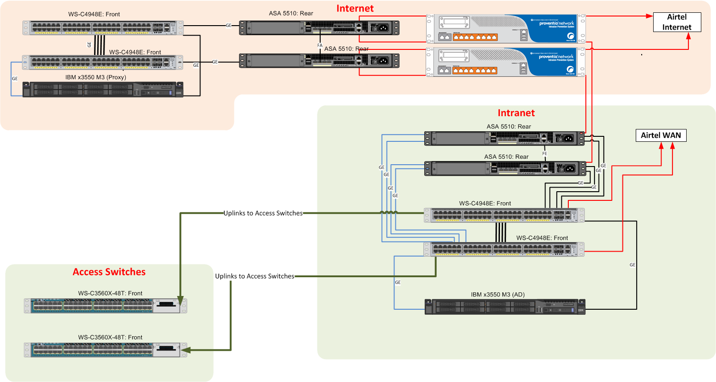
PDC-A Physical connectivity(DRC, Uganda, Zambia, Tanzania, Ghana, Gabon)

Slide 14
9 PDC-B (Congo, Niger, Malawi, Madagascar, Chad, Seychelles, Burkina Faso, Sierra Leone, Rwanda)

Slide 15
9 PDC-B (Congo, Niger, Malawi, Madagascar, Chad, Seychelles, Burkina Faso, Sierra Leone, Rwanda) Rack Layout

Slide 16
9 PDC-B (Congo, Niger, Malawi, Madagascar, Chad, Seychelles, Burkina Faso, Sierra Leone, Rwanda) - Logical

Slide 17
9 PDC-B (Congo, Niger, Malawi, Madagascar, Chad, Seychelles, Burkina Faso, Sierra Leone, Rwanda) – Physical Connectivity

Slide 18
11 SDC (Nigeria [5 sites],Ghana,Zambia, Uganda,DRC, Congo,Niger)

Slide 19
5 SDC (Nigeria)

Slide 20
11 SDC – Rack layout (Nigeria [5 sites],Ghana,Zambia, Uganda,DRC, Congo,Niger)

Slide 21
11 SDC – Rack layout (Nigeria [5 sites],Ghana,Zambia, Uganda,DRC, Congo,Niger)

Slide 22
11 SDC – Rack layout (Nigeria [5 sites],Ghana,Zambia, Uganda,DRC, Congo,Niger)

Slide 23
Thank You

