Slide 1
Vulnerability Assessment
&
Penetration Testing
-
Global Projects Delivery

Slide 2
Agenda
What is VAPT?
Difference Between VA & PT.
Vulnerability Assessment process
Penetration Testing Process
Phases of VAPT
      Discovery Phase of VAPT
Vulnerability Scanning tools
Attack Phase of VAPT
Types of Penetration Testing
Execution of VAPT
Risks involved in VAPT

Slide 3
What is VAPT?
VAPT Stands for Vulnerability Assessment & Penetration Testing.
VAPT proves to be an assured assessment tool to ensure the Cyber Security arrangements of an Organization.
The Technique has become a widely used and integral part of Quality Assurance Techniques for the systems used by various financial organizations.
VAPT is done by simulating an unauthorized user (attacker) attacking the system using either Automated Tools or Manual Excellence or a combination of both.
Hence the process of VAPT is sometimes also referred as Ethical Hacking.

Slide 4
Difference Between VA & PT
Vulnerability Assessment (VA):
      Aims at discovering the possible threats and subset of input space with which a malicious user can exploit logical errors in a system to gain profit or drive the system into an insecure state
Penetration Testing (PT):
      Aims at assessing the difficulty level for someone (basically an attacker/hacker) to penetrate an Organization's Cyber security controls against unauthorized access to its information and information systems.

Slide 5
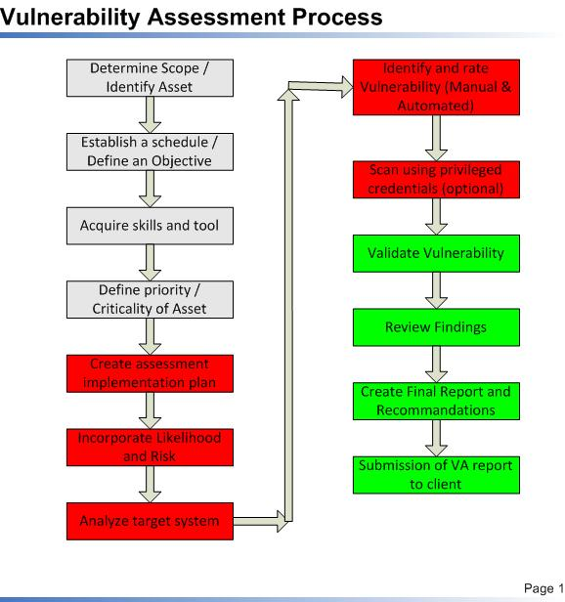

Slide 6
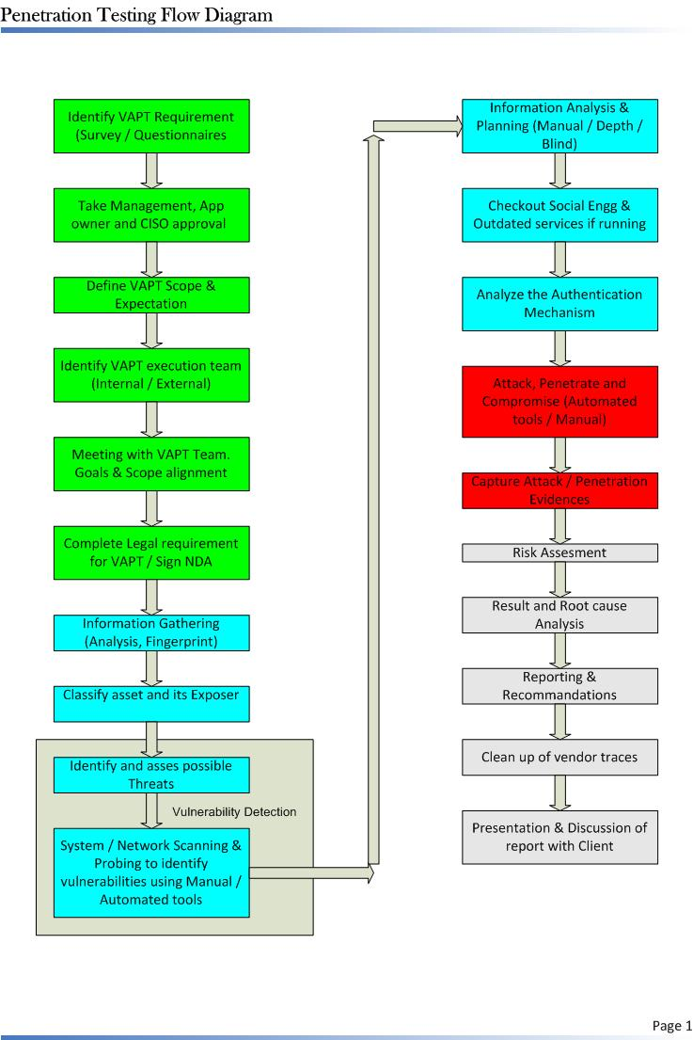

Slide 7
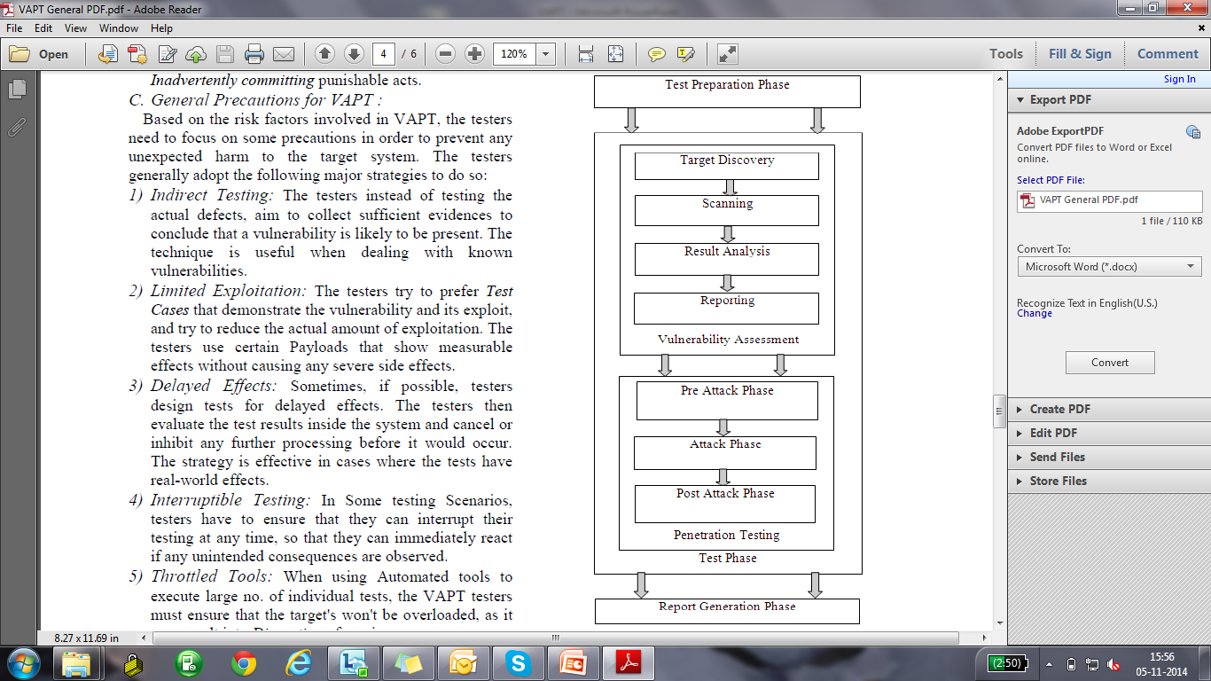
Phases of VAPT

Slide 8
Phases of VAPT Cont..
Reconnaissance
Scanning
Enumerating
Additional Discovery
Planning
Discovery
Attack
Reporting
Gaining Access
Escalating Privilege
System Browsing
Lack of Security Policy
Poorly Enforced Policy
Misconfiguration
Software reliability
Failure to apply patches
Actions

Slide 9
Discovery Phase of VAPT
Footprinting
Port Scanning
Gather Initial
Information
NMap
Ping
Traceroute
Superscan
Enumerating
Netcat
NeoTrace
Visual Route
Determine the
Network Range
Identify
Active Machines
Whois
SmartWhois
NsLookup
Sam Spade
Discover Open Ports
and Access Points
Fingerprint the
Operating System
Uncover
Services on Ports
Map the
Network

Slide 10
Vulnerability Scanning tools
Network Security Assessment tools:
      Nessus
      NMAP
      Open VAS
      GFI LAN Guard
      Qualys Guard
      Nipper
Web Security Assessment tools:
      Nikto
      Samurai
      Safe3
      Websecurity
      SQL Map

Slide 11
Attack Phase of VAPT
Discovery
Phase
Gaining
Access
Escalating
Privilege
System
Browsing
Install
Add. Test
Software
Enough data has been gathered in the discovery phase to make an informed attempt to access the target
If only user-level access was obtained in the last step, the tester will now seek to gain complete control of the system
The information-gathering process begins again to identify mechanisms to gain access to trusted systems

Slide 12
Types of Penetration Testing
Black Box
White Box
Gray Box
External
Test
Penetration
Test
Curious Employee
Disgruntled End User
Disgruntled Administrator
Internal
Test

Slide 13
Black Box Testing:
      In this approach the testers have no prior knowledge of the test target. They are supposed to figure out all the loopholes of the system based on there experience and individual expertise. The tester basically aims at auditing the External Security boundary of the test target hence the tester simulates the actions and procedures of a real attacker who may be present at some other place outside the boundary of the test target and has no information about the test target.
White Box Testing:
      This approach is contrary to Black Box. In this approach the testers are provided with all the necessary information and credentials regarding the test target, and the VAPT tester audits the Internal security arrangements of the test target hence the test simulates the actions and procedures of a real internal threat like a malicious employee who is present within the boundaries of the target.

Slide 14
Grey Box Testing:
      This approach can be simply understood as the combination of the above two approaches, in this approach the VAPT tester is provided with partial disclosure of information about the test target, hence the tester gathers further information by conducting the test.

Slide 15
Execution of VAPT
  Social Engineering (Phishing, pharming, spearphishing)
  Physical Facilities Audit ( Unlocked terminals, unsecure buildings and labs)
  Phone Network Testing
  Walk-throughs and Dumpster Diving
  Network Vulnerability Testing
      Run sniffers on that network to gather information/credentials/etc
      Install a 'dummy' host in network to download/upload malware.
  Web Vulnerability Testing
  Wireless War Driving
  Vulnerability and real world exploits (Metasploit)

Slide 16
Risks Involved in VAPT
VAPT Security Testing causes risks to the target by its nature. Like an Attacker the VAPT Tester deliberately leaves the relatively safe ground of intended use and expected activities. Security Testing is inherently invasive where it employs techniques similar to those used in an attack.
The Specific Risks of VAPT can be categorized as Follows
      Technical Risk
      Organizational / Business Risk
      Legal Risks

Slide 17
Risks Involved in VAPT Cont..
Technical Risk:
      These are the risks caused directly by the Testing Activities or by the System being Tested. Some of the major technical risks are Failure of the target or connected systems, Disruption of service, Reduced Performance, Modification or Contamination of data and Disclosure of data.
Organizational Risks:
      The VAPT testing also involves some Organizational side effects like Unnecessary Triggering of incident handling processes, Disruption of business processes, and Loss of Reputation if third parties are effected.
Legal Risks:
      These kind of risks are encountered due to legal obligations and possible side effects of third parties like Violation of Legal Obligations and Inadvertently committing punishable acts.

Slide 18
Thank You

