Slide 1
Domain 8 – Software Development Security
Notes:
The below and following notes on the template slides are to guide you only. In your final presentation, you may delete these notes and add relevant notes if any.
Title slide:
Title – should not exceed beyond 3 lines, font size 30-34, Arial Headings
(Font size for the title of the PPT can vary between 30-34, Arial Headings, Bold depending on the amount of text, however should not be smaller than 30 font size)
Name should not exceed beyond 1 line, Designation; font size to remain at 18, Arial Headings
Please keep the title slide simple, just the logo, title and name and designation to appear. No other graphic elements or any design, photograph, image can be added to this slide, alignment to remain the same

Slide 2
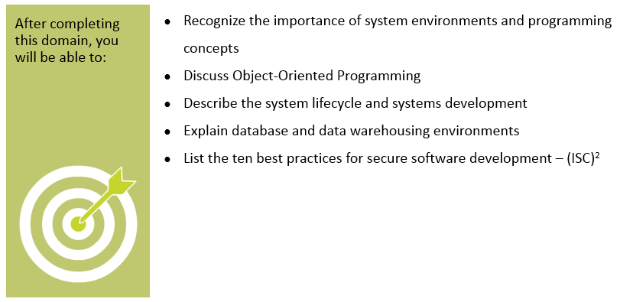
Objectives
Notes:
Section breaker slide with customer logo
Section heading – Arial Headings, 34, Bold
Sub head – Arial Headings, 18, normal
Used for a section heading. You may add a sub heading not exceeding one line also here
Section heading – Arial Headings, bold, 34 font size, should not exceed beyond 1 line
Sub Head – Arial Headings, normal, 18 font size, should not exceed beyond 1 line

Slide 3
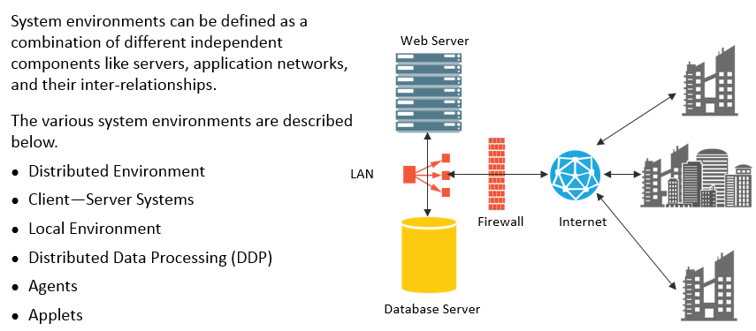
System Enviroments
Notes:
Section breaker slide with customer logo
Section heading – Arial Headings, 34, Bold
Sub head – Arial Headings, 18, normal
Used for a section heading. You may add a sub heading not exceeding one line also here
Section heading – Arial Headings, bold, 34 font size, should not exceed beyond 1 line
Sub Head – Arial Headings, normal, 18 font size, should not exceed beyond 1 line

Slide 4
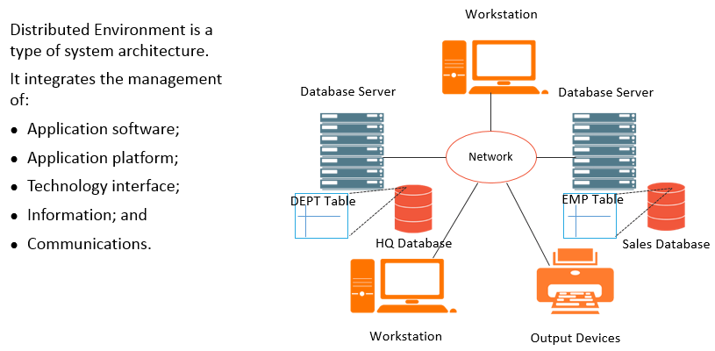
Distributed Environment
Notes:
Section breaker slide with customer logo
Section heading – Arial Headings, 34, Bold
Sub head – Arial Headings, 18, normal
Used for a section heading. You may add a sub heading not exceeding one line also here
Section heading – Arial Headings, bold, 34 font size, should not exceed beyond 1 line
Sub Head – Arial Headings, normal, 18 font size, should not exceed beyond 1 line

Slide 5
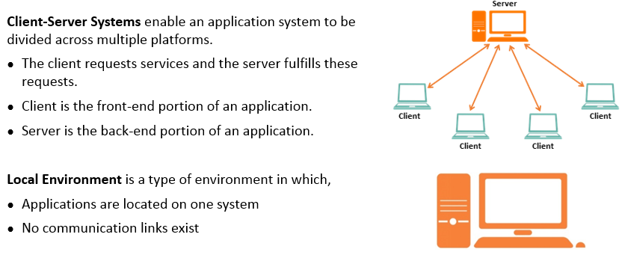
Client/Server Systems and Local Environment
Notes:
Section breaker slide with customer logo
Section heading – Arial Headings, 34, Bold
Sub head – Arial Headings, 18, normal
Used for a section heading. You may add a sub heading not exceeding one line also here
Section heading – Arial Headings, bold, 34 font size, should not exceed beyond 1 line
Sub Head – Arial Headings, normal, 18 font size, should not exceed beyond 1 line

Slide 6
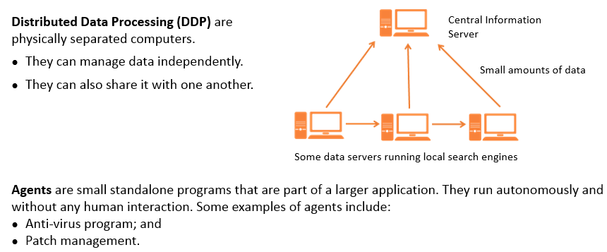
Distributed Data Processing and Agents
Notes:
Section breaker slide with customer logo
Section heading – Arial Headings, 34, Bold
Sub head – Arial Headings, 18, normal
Used for a section heading. You may add a sub heading not exceeding one line also here
Section heading – Arial Headings, bold, 34 font size, should not exceed beyond 1 line
Sub Head – Arial Headings, normal, 18 font size, should not exceed beyond 1 line

Slide 7
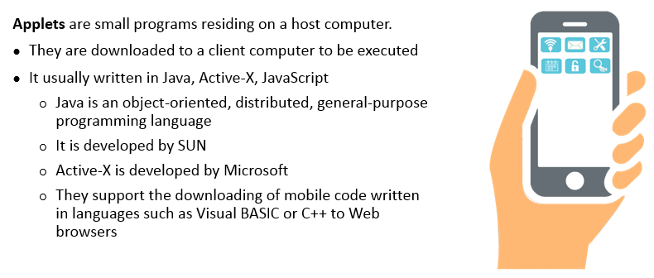
Applets
Notes:
Section breaker slide with customer logo
Section heading – Arial Headings, 34, Bold
Sub head – Arial Headings, 18, normal
Used for a section heading. You may add a sub heading not exceeding one line also here
Section heading – Arial Headings, bold, 34 font size, should not exceed beyond 1 line
Sub Head – Arial Headings, normal, 18 font size, should not exceed beyond 1 line

Slide 8
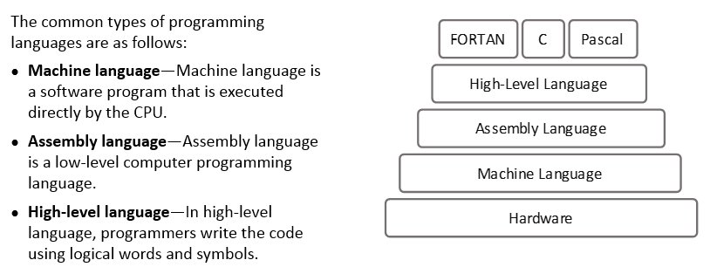
Programming Concepts
Notes:
Section breaker slide with customer logo
Section heading – Arial Headings, 34, Bold
Sub head – Arial Headings, 18, normal
Used for a section heading. You may add a sub heading not exceeding one line also here
Section heading – Arial Headings, bold, 34 font size, should not exceed beyond 1 line
Sub Head – Arial Headings, normal, 18 font size, should not exceed beyond 1 line

Slide 9
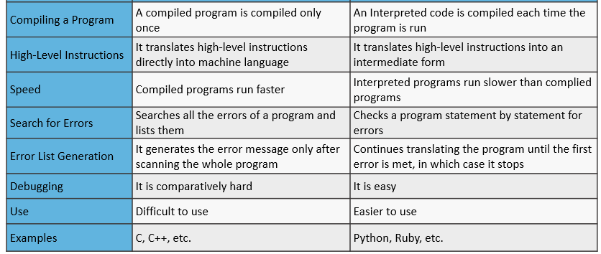
Compiler vs Interpreter
DIfferences
Compiler
Interpreter
Notes:
Section breaker slide with customer logo
Section heading – Arial Headings, 34, Bold
Sub head – Arial Headings, 18, normal
Used for a section heading. You may add a sub heading not exceeding one line also here
Section heading – Arial Headings, bold, 34 font size, should not exceed beyond 1 line
Sub Head – Arial Headings, normal, 18 font size, should not exceed beyond 1 line

Slide 10
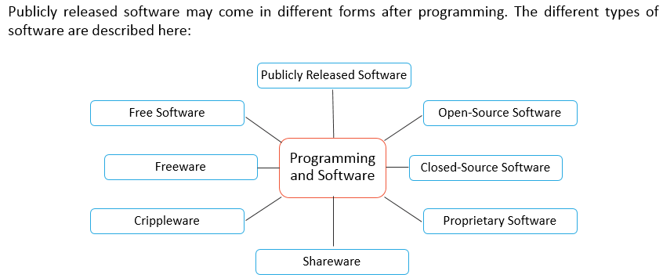
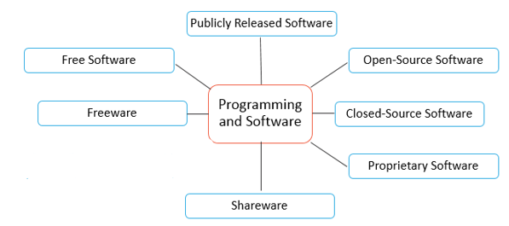
Programming and Software
Notes:
Section breaker slide with customer logo
Section heading – Arial Headings, 34, Bold
Sub head – Arial Headings, 18, normal
Used for a section heading. You may add a sub heading not exceeding one line also here
Section heading – Arial Headings, bold, 34 font size, should not exceed beyond 1 line
Sub Head – Arial Headings, normal, 18 font size, should not exceed beyond 1 line

Slide 11
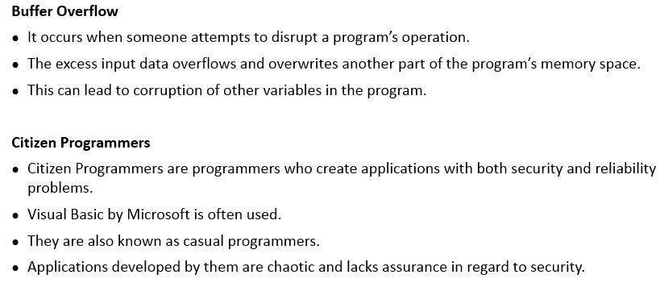
Threats in the Software Environment
Notes:
Section breaker slide with customer logo
Section heading – Arial Headings, 34, Bold
Sub head – Arial Headings, 18, normal
Used for a section heading. You may add a sub heading not exceeding one line also here
Section heading – Arial Headings, bold, 34 font size, should not exceed beyond 1 line
Sub Head – Arial Headings, normal, 18 font size, should not exceed beyond 1 line

Slide 12
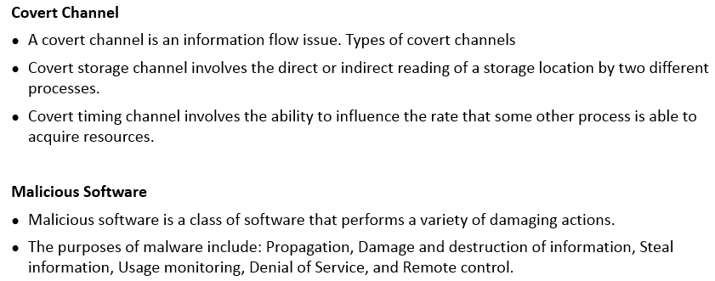
Threats in the Software Environment (contd)
Notes:
Section breaker slide with customer logo
Section heading – Arial Headings, 34, Bold
Sub head – Arial Headings, 18, normal
Used for a section heading. You may add a sub heading not exceeding one line also here
Section heading – Arial Headings, bold, 34 font size, should not exceed beyond 1 line
Sub Head – Arial Headings, normal, 18 font size, should not exceed beyond 1 line

Slide 13
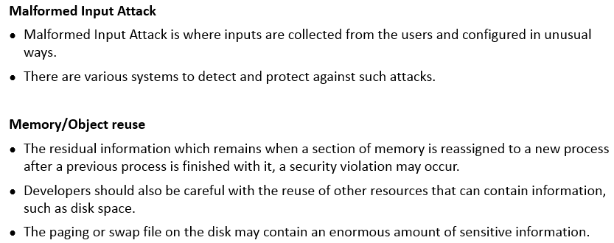
Threats in the Software Environment (contd)
Notes:
Section breaker slide with customer logo
Section heading – Arial Headings, 34, Bold
Sub head – Arial Headings, 18, normal
Used for a section heading. You may add a sub heading not exceeding one line also here
Section heading – Arial Headings, bold, 34 font size, should not exceed beyond 1 line
Sub Head – Arial Headings, normal, 18 font size, should not exceed beyond 1 line

Slide 14
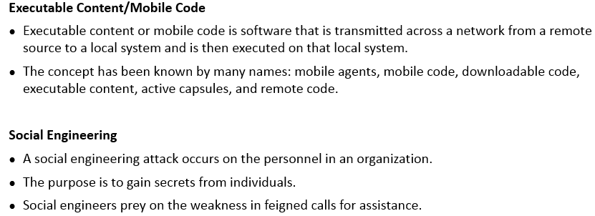
Threats in the Software Environment (contd)
Notes:
Section breaker slide with customer logo
Section heading – Arial Headings, 34, Bold
Sub head – Arial Headings, 18, normal
Used for a section heading. You may add a sub heading not exceeding one line also here
Section heading – Arial Headings, bold, 34 font size, should not exceed beyond 1 line
Sub Head – Arial Headings, normal, 18 font size, should not exceed beyond 1 line

Slide 15
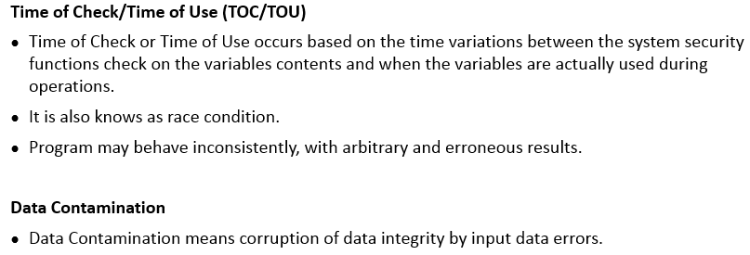
Threats in the Software Environment (contd)
Notes:
Section breaker slide with customer logo
Section heading – Arial Headings, 34, Bold
Sub head – Arial Headings, 18, normal
Used for a section heading. You may add a sub heading not exceeding one line also here
Section heading – Arial Headings, bold, 34 font size, should not exceed beyond 1 line
Sub Head – Arial Headings, normal, 18 font size, should not exceed beyond 1 line

Slide 16
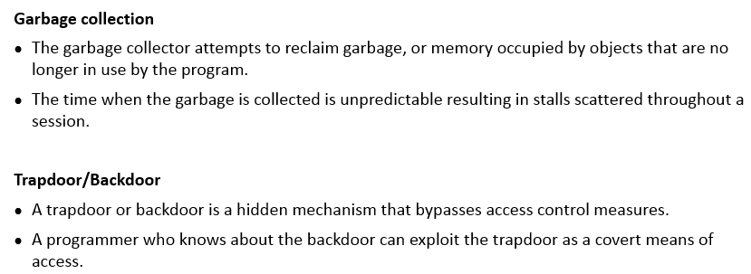
Threats in the Software Environment (contd)
Notes:
Section breaker slide with customer logo
Section heading – Arial Headings, 34, Bold
Sub head – Arial Headings, 18, normal
Used for a section heading. You may add a sub heading not exceeding one line also here
Section heading – Arial Headings, bold, 34 font size, should not exceed beyond 1 line
Sub Head – Arial Headings, normal, 18 font size, should not exceed beyond 1 line

Slide 17
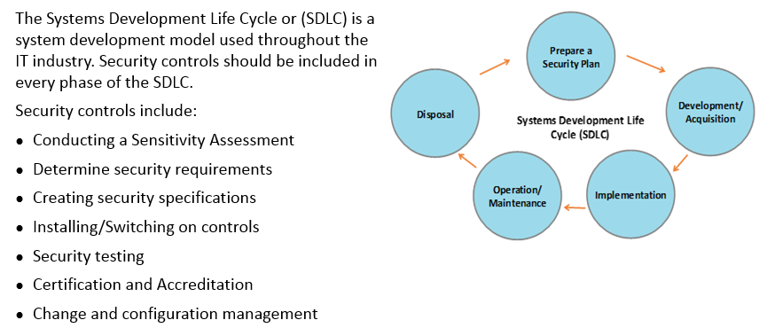
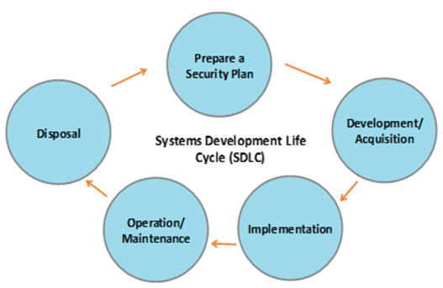
Systems Development Life Cycle
Notes:
Section breaker slide with customer logo
Section heading – Arial Headings, 34, Bold
Sub head – Arial Headings, 18, normal
Used for a section heading. You may add a sub heading not exceeding one line also here
Section heading – Arial Headings, bold, 34 font size, should not exceed beyond 1 line
Sub Head – Arial Headings, normal, 18 font size, should not exceed beyond 1 line

Slide 18
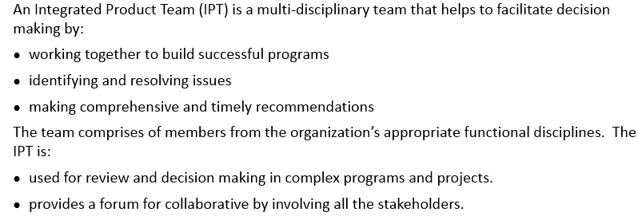
Integrated Product Team (IPT)
Notes:
Section breaker slide with customer logo
Section heading – Arial Headings, 34, Bold
Sub head – Arial Headings, 18, normal
Used for a section heading. You may add a sub heading not exceeding one line also here
Section heading – Arial Headings, bold, 34 font size, should not exceed beyond 1 line
Sub Head – Arial Headings, normal, 18 font size, should not exceed beyond 1 line

Slide 19
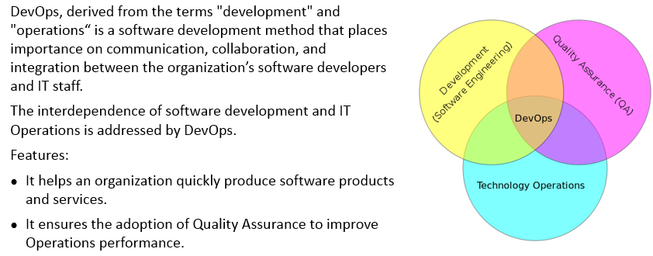
DevOps
Notes:
Section breaker slide with customer logo
Section heading – Arial Headings, 34, Bold
Sub head – Arial Headings, 18, normal
Used for a section heading. You may add a sub heading not exceeding one line also here
Section heading – Arial Headings, bold, 34 font size, should not exceed beyond 1 line
Sub Head – Arial Headings, normal, 18 font size, should not exceed beyond 1 line

Slide 20
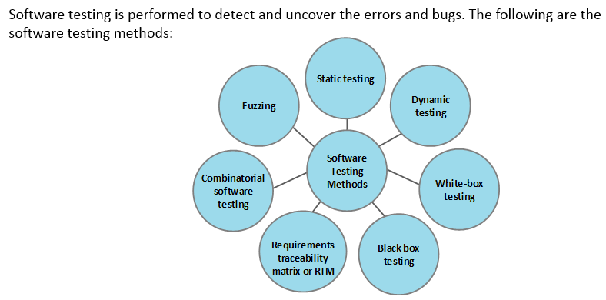
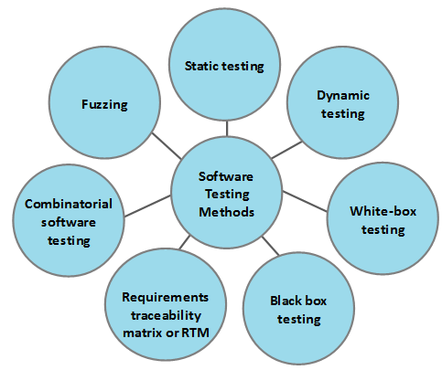
Software Testing Methods
Notes:
Section breaker slide with customer logo
Section heading – Arial Headings, 34, Bold
Sub head – Arial Headings, 18, normal
Used for a section heading. You may add a sub heading not exceeding one line also here
Section heading – Arial Headings, bold, 34 font size, should not exceed beyond 1 line
Sub Head – Arial Headings, normal, 18 font size, should not exceed beyond 1 line

Slide 21
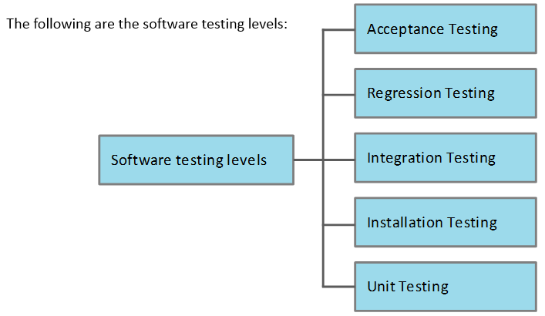
Software Testing Levels
Notes:
Section breaker slide with customer logo
Section heading – Arial Headings, 34, Bold
Sub head – Arial Headings, 18, normal
Used for a section heading. You may add a sub heading not exceeding one line also here
Section heading – Arial Headings, bold, 34 font size, should not exceed beyond 1 line
Sub Head – Arial Headings, normal, 18 font size, should not exceed beyond 1 line

Slide 22
Types of Testing
Unit Testing – Low level tests of software components, such as functions, procedures
or objects
Installation Testing – Testing software as it is installed and first operated
Integration Testing – Testing multiple software components as they are combined into
a working system; subsets may be tested, or “big bang integration testing” tests all the
integrated software components
Regression Testing – Testing software after updates, modifications or patches
Acceptance Testing – Testing to ensure the software meets the customer’s operational
Requirements. This testing is done directly by the customer
Notes:
Section breaker slide with customer logo
Section heading – Arial Headings, 34, Bold
Sub head – Arial Headings, 18, normal
Used for a section heading. You may add a sub heading not exceeding one line also here
Section heading – Arial Headings, bold, 34 font size, should not exceed beyond 1 line
Sub Head – Arial Headings, normal, 18 font size, should not exceed beyond 1 line

Slide 23
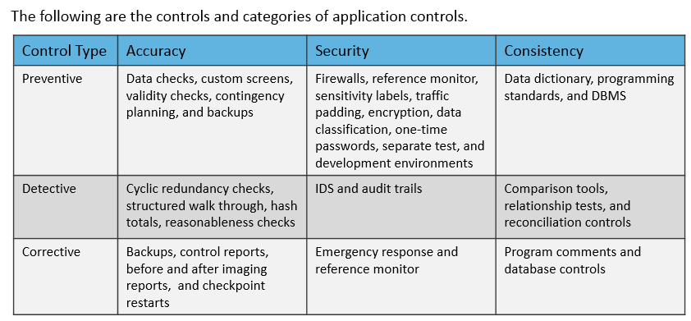
Application Controls
Notes:
Section breaker slide with customer logo
Section heading – Arial Headings, 34, Bold
Sub head – Arial Headings, 18, normal
Used for a section heading. You may add a sub heading not exceeding one line also here
Section heading – Arial Headings, bold, 34 font size, should not exceed beyond 1 line
Sub Head – Arial Headings, normal, 18 font size, should not exceed beyond 1 line

Slide 24
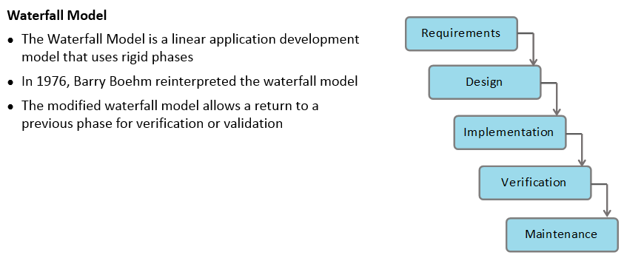
Software Development Methods
Notes:
Section breaker slide with customer logo
Section heading – Arial Headings, 34, Bold
Sub head – Arial Headings, 18, normal
Used for a section heading. You may add a sub heading not exceeding one line also here
Section heading – Arial Headings, bold, 34 font size, should not exceed beyond 1 line
Sub Head – Arial Headings, normal, 18 font size, should not exceed beyond 1 line

Slide 25
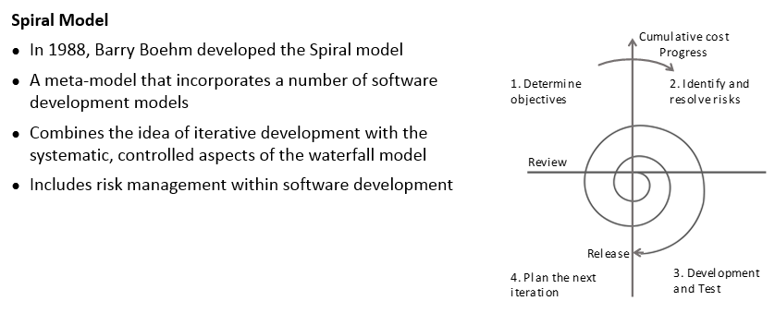
Software Development Methods (contd)
Notes:
Section breaker slide with customer logo
Section heading – Arial Headings, 34, Bold
Sub head – Arial Headings, 18, normal
Used for a section heading. You may add a sub heading not exceeding one line also here
Section heading – Arial Headings, bold, 34 font size, should not exceed beyond 1 line
Sub Head – Arial Headings, normal, 18 font size, should not exceed beyond 1 line

Slide 26
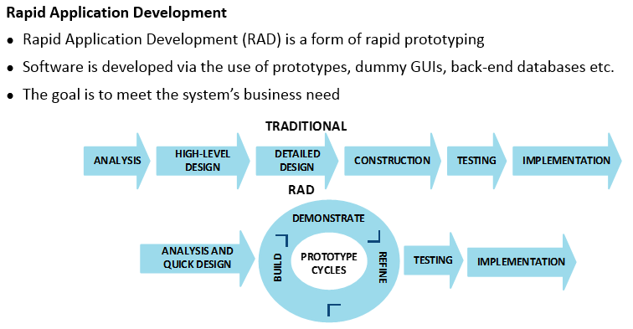
Software Development Methods (contd)
Notes:
Section breaker slide with customer logo
Section heading – Arial Headings, 34, Bold
Sub head – Arial Headings, 18, normal
Used for a section heading. You may add a sub heading not exceeding one line also here
Section heading – Arial Headings, bold, 34 font size, should not exceed beyond 1 line
Sub Head – Arial Headings, normal, 18 font size, should not exceed beyond 1 line

Slide 27
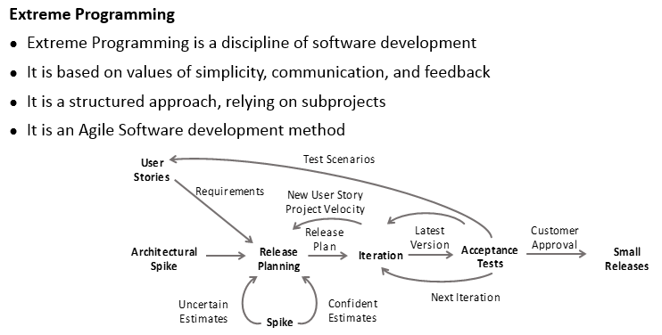
Software Development Methods (contd)
Notes:
Section breaker slide with customer logo
Section heading – Arial Headings, 34, Bold
Sub head – Arial Headings, 18, normal
Used for a section heading. You may add a sub heading not exceeding one line also here
Section heading – Arial Headings, bold, 34 font size, should not exceed beyond 1 line
Sub Head – Arial Headings, normal, 18 font size, should not exceed beyond 1 line

Slide 28
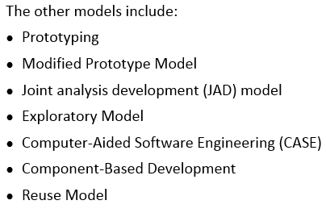
Software Development Methods (contd)
Notes:
Section breaker slide with customer logo
Section heading – Arial Headings, 34, Bold
Sub head – Arial Headings, 18, normal
Used for a section heading. You may add a sub heading not exceeding one line also here
Section heading – Arial Headings, bold, 34 font size, should not exceed beyond 1 line
Sub Head – Arial Headings, normal, 18 font size, should not exceed beyond 1 line

Slide 29
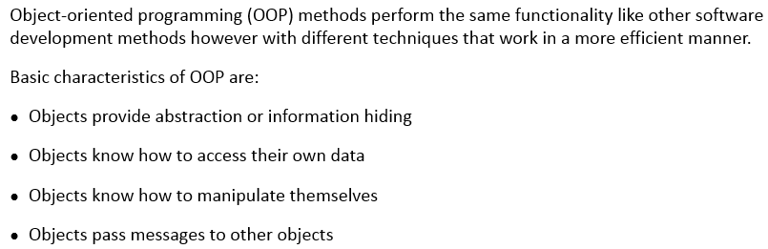
Object Oriented Programming - Definitions
Notes:
Section breaker slide with customer logo
Section heading – Arial Headings, 34, Bold
Sub head – Arial Headings, 18, normal
Used for a section heading. You may add a sub heading not exceeding one line also here
Section heading – Arial Headings, bold, 34 font size, should not exceed beyond 1 line
Sub Head – Arial Headings, normal, 18 font size, should not exceed beyond 1 line

Slide 30
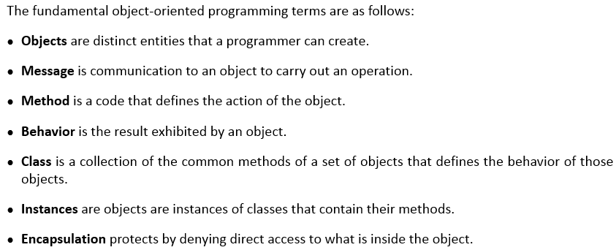
Object Oriented Programming Terms
Notes:
Section breaker slide with customer logo
Section heading – Arial Headings, 34, Bold
Sub head – Arial Headings, 18, normal
Used for a section heading. You may add a sub heading not exceeding one line also here
Section heading – Arial Headings, bold, 34 font size, should not exceed beyond 1 line
Sub Head – Arial Headings, normal, 18 font size, should not exceed beyond 1 line

Slide 31
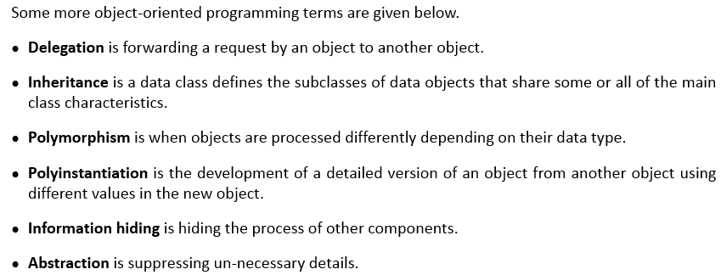
Object Oriented Programming Terms (contd)
Notes:
Section breaker slide with customer logo
Section heading – Arial Headings, 34, Bold
Sub head – Arial Headings, 18, normal
Used for a section heading. You may add a sub heading not exceeding one line also here
Section heading – Arial Headings, bold, 34 font size, should not exceed beyond 1 line
Sub Head – Arial Headings, normal, 18 font size, should not exceed beyond 1 line

Slide 32
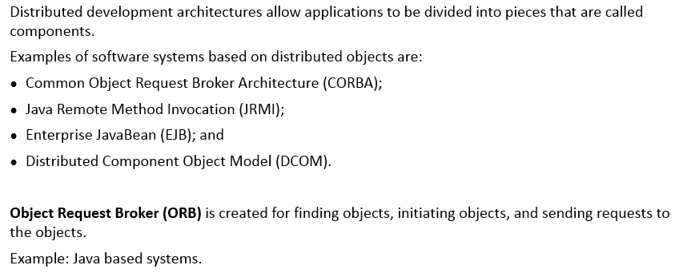
Distributed Object Oriented Systems
Notes:
Section breaker slide with customer logo
Section heading – Arial Headings, 34, Bold
Sub head – Arial Headings, 18, normal
Used for a section heading. You may add a sub heading not exceeding one line also here
Section heading – Arial Headings, bold, 34 font size, should not exceed beyond 1 line
Sub Head – Arial Headings, normal, 18 font size, should not exceed beyond 1 line

Slide 33
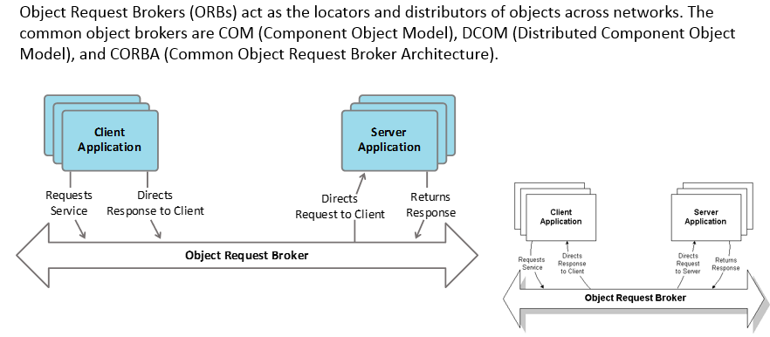
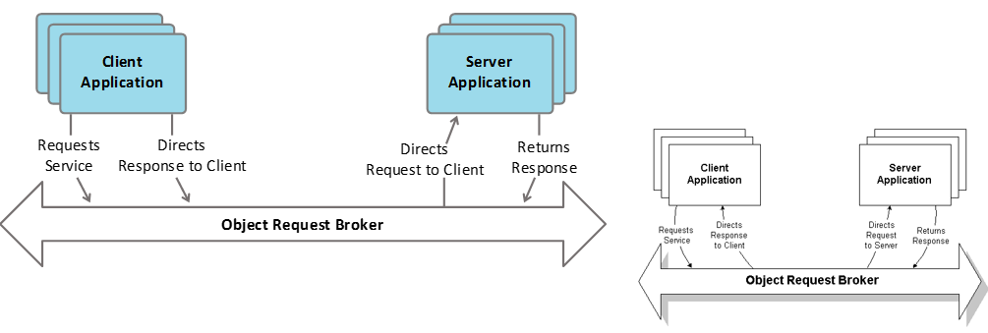
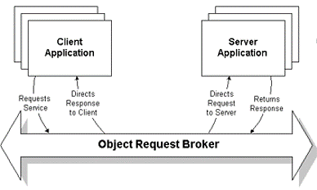
Object Request Brokers (ORBs)
Notes:
Section breaker slide with customer logo
Section heading – Arial Headings, 34, Bold
Sub head – Arial Headings, 18, normal
Used for a section heading. You may add a sub heading not exceeding one line also here
Section heading – Arial Headings, bold, 34 font size, should not exceed beyond 1 line
Sub Head – Arial Headings, normal, 18 font size, should not exceed beyond 1 line

Slide 34
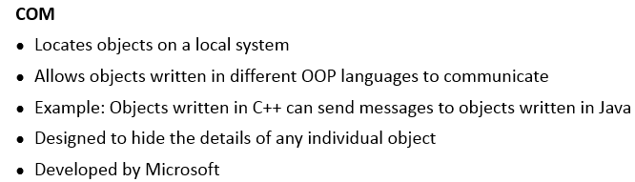
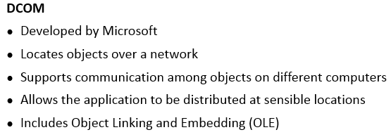
Component Object Model (COM) vs Distributed Component Object Model (DCOM)
Notes:
Section breaker slide with customer logo
Section heading – Arial Headings, 34, Bold
Sub head – Arial Headings, 18, normal
Used for a section heading. You may add a sub heading not exceeding one line also here
Section heading – Arial Headings, bold, 34 font size, should not exceed beyond 1 line
Sub Head – Arial Headings, normal, 18 font size, should not exceed beyond 1 line

Slide 35
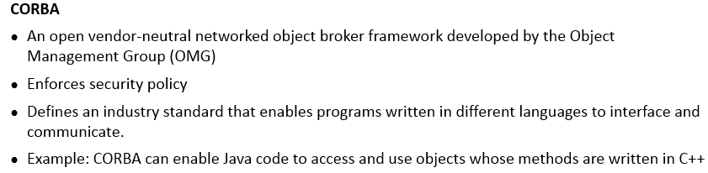
Common Object Request Broker Architecture (CORBA)
Notes:
Section breaker slide with customer logo
Section heading – Arial Headings, 34, Bold
Sub head – Arial Headings, 18, normal
Used for a section heading. You may add a sub heading not exceeding one line also here
Section heading – Arial Headings, bold, 34 font size, should not exceed beyond 1 line
Sub Head – Arial Headings, normal, 18 font size, should not exceed beyond 1 line

Slide 36
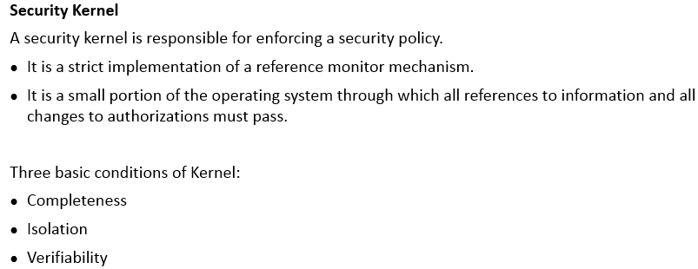
Software Security and Assurance
Notes:
Section breaker slide with customer logo
Section heading – Arial Headings, 34, Bold
Sub head – Arial Headings, 18, normal
Used for a section heading. You may add a sub heading not exceeding one line also here
Section heading – Arial Headings, bold, 34 font size, should not exceed beyond 1 line
Sub Head – Arial Headings, normal, 18 font size, should not exceed beyond 1 line

Slide 37
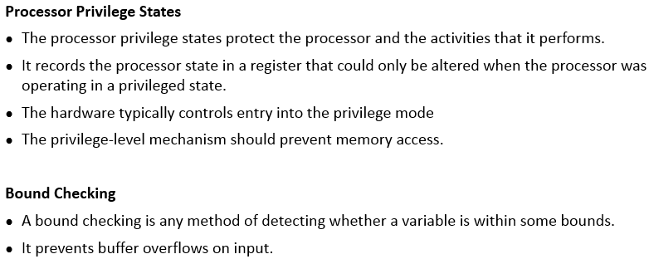
Software Security and Assurance (contd)
Notes:
Section breaker slide with customer logo
Section heading – Arial Headings, 34, Bold
Sub head – Arial Headings, 18, normal
Used for a section heading. You may add a sub heading not exceeding one line also here
Section heading – Arial Headings, bold, 34 font size, should not exceed beyond 1 line
Sub Head – Arial Headings, normal, 18 font size, should not exceed beyond 1 line

Slide 38
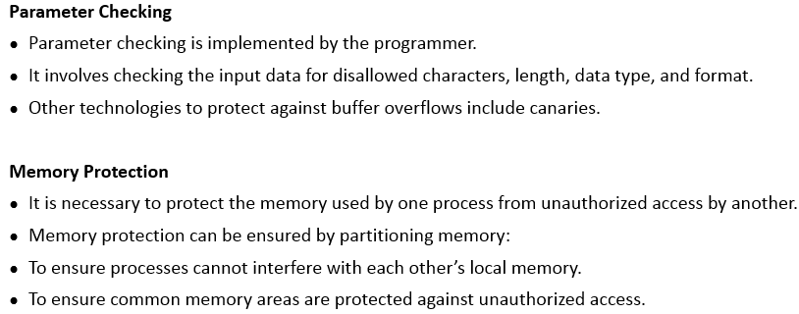
Software Security and Assurance (contd)
Notes:
Section breaker slide with customer logo
Section heading – Arial Headings, 34, Bold
Sub head – Arial Headings, 18, normal
Used for a section heading. You may add a sub heading not exceeding one line also here
Section heading – Arial Headings, bold, 34 font size, should not exceed beyond 1 line
Sub Head – Arial Headings, normal, 18 font size, should not exceed beyond 1 line

Slide 39
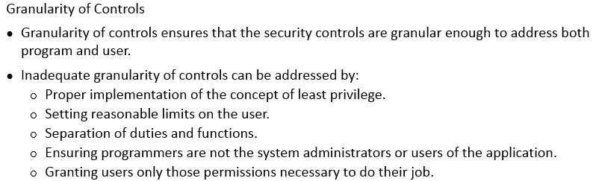
Software Security and Assurance (contd)
Notes:
Section breaker slide with customer logo
Section heading – Arial Headings, 34, Bold
Sub head – Arial Headings, 18, normal
Used for a section heading. You may add a sub heading not exceeding one line also here
Section heading – Arial Headings, bold, 34 font size, should not exceed beyond 1 line
Sub Head – Arial Headings, normal, 18 font size, should not exceed beyond 1 line

Slide 40
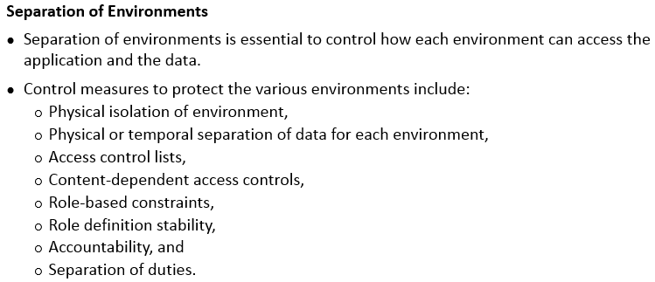
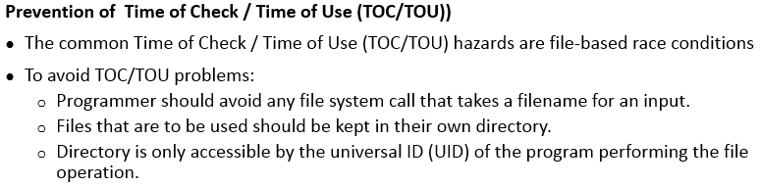
Software Security and Assurance (contd)
Notes:
Section breaker slide with customer logo
Section heading – Arial Headings, 34, Bold
Sub head – Arial Headings, 18, normal
Used for a section heading. You may add a sub heading not exceeding one line also here
Section heading – Arial Headings, bold, 34 font size, should not exceed beyond 1 line
Sub Head – Arial Headings, normal, 18 font size, should not exceed beyond 1 line

Slide 41
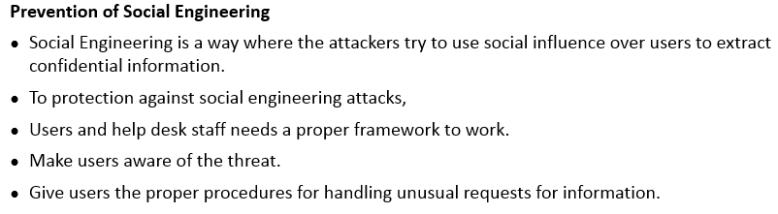
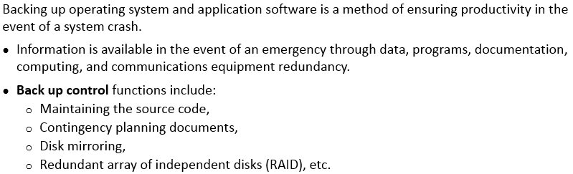
Software Security and Assurance (contd)
Notes:
Section breaker slide with customer logo
Section heading – Arial Headings, 34, Bold
Sub head – Arial Headings, 18, normal
Used for a section heading. You may add a sub heading not exceeding one line also here
Section heading – Arial Headings, bold, 34 font size, should not exceed beyond 1 line
Sub Head – Arial Headings, normal, 18 font size, should not exceed beyond 1 line

Slide 42
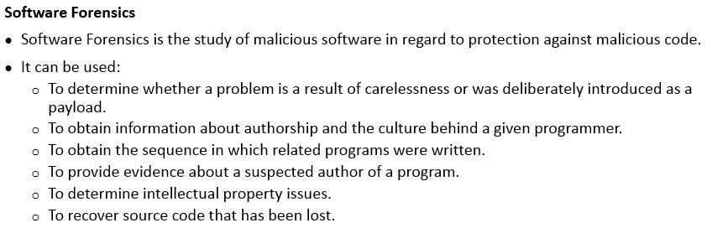
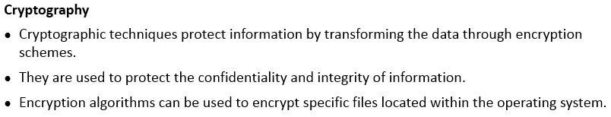
Software Security and Assurance (contd)
Notes:
Section breaker slide with customer logo
Section heading – Arial Headings, 34, Bold
Sub head – Arial Headings, 18, normal
Used for a section heading. You may add a sub heading not exceeding one line also here
Section heading – Arial Headings, bold, 34 font size, should not exceed beyond 1 line
Sub Head – Arial Headings, normal, 18 font size, should not exceed beyond 1 line

Slide 43
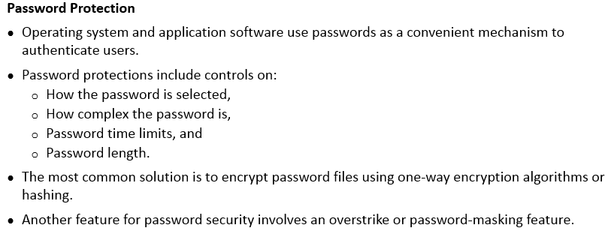
Software Security and Assurance (contd)
Notes:
Section breaker slide with customer logo
Section heading – Arial Headings, 34, Bold
Sub head – Arial Headings, 18, normal
Used for a section heading. You may add a sub heading not exceeding one line also here
Section heading – Arial Headings, bold, 34 font size, should not exceed beyond 1 line
Sub Head – Arial Headings, normal, 18 font size, should not exceed beyond 1 line

Slide 44


Software Security and Assurance (contd)
Notes:
Section breaker slide with customer logo
Section heading – Arial Headings, 34, Bold
Sub head – Arial Headings, 18, normal
Used for a section heading. You may add a sub heading not exceeding one line also here
Section heading – Arial Headings, bold, 34 font size, should not exceed beyond 1 line
Sub Head – Arial Headings, normal, 18 font size, should not exceed beyond 1 line

Slide 45

Service Oriented Architecture (SOA)
Notes:
Section breaker slide with customer logo
Section heading – Arial Headings, 34, Bold
Sub head – Arial Headings, 18, normal
Used for a section heading. You may add a sub heading not exceeding one line also here
Section heading – Arial Headings, bold, 34 font size, should not exceed beyond 1 line
Sub Head – Arial Headings, normal, 18 font size, should not exceed beyond 1 line

Slide 46

Audit and Assurance Mechanisms
Notes:
Section breaker slide with customer logo
Section heading – Arial Headings, 34, Bold
Sub head – Arial Headings, 18, normal
Used for a section heading. You may add a sub heading not exceeding one line also here
Section heading – Arial Headings, bold, 34 font size, should not exceed beyond 1 line
Sub Head – Arial Headings, normal, 18 font size, should not exceed beyond 1 line

Slide 47

Assessing the effectiveness of software security
Notes:
Section breaker slide with customer logo
Section heading – Arial Headings, 34, Bold
Sub head – Arial Headings, 18, normal
Used for a section heading. You may add a sub heading not exceeding one line also here
Section heading – Arial Headings, bold, 34 font size, should not exceed beyond 1 line
Sub Head – Arial Headings, normal, 18 font size, should not exceed beyond 1 line

Slide 48

Assessing the effectiveness of software security (contd)
Notes:
Section breaker slide with customer logo
Section heading – Arial Headings, 34, Bold
Sub head – Arial Headings, 18, normal
Used for a section heading. You may add a sub heading not exceeding one line also here
Section heading – Arial Headings, bold, 34 font size, should not exceed beyond 1 line
Sub Head – Arial Headings, normal, 18 font size, should not exceed beyond 1 line

Slide 49

Assessing the Security Impact of Acquired Software
Notes:
Section breaker slide with customer logo
Section heading – Arial Headings, 34, Bold
Sub head – Arial Headings, 18, normal
Used for a section heading. You may add a sub heading not exceeding one line also here
Section heading – Arial Headings, bold, 34 font size, should not exceed beyond 1 line
Sub Head – Arial Headings, normal, 18 font size, should not exceed beyond 1 line

Slide 50

Code Repositories and Application Programming Interfaces (APIs)
Notes:
Section breaker slide with customer logo
Section heading – Arial Headings, 34, Bold
Sub head – Arial Headings, 18, normal
Used for a section heading. You may add a sub heading not exceeding one line also here
Section heading – Arial Headings, bold, 34 font size, should not exceed beyond 1 line
Sub Head – Arial Headings, normal, 18 font size, should not exceed beyond 1 line

Slide 51

Database and Data Warehousing Environments
Notes:
Section breaker slide with customer logo
Section heading – Arial Headings, 34, Bold
Sub head – Arial Headings, 18, normal
Used for a section heading. You may add a sub heading not exceeding one line also here
Section heading – Arial Headings, bold, 34 font size, should not exceed beyond 1 line
Sub Head – Arial Headings, normal, 18 font size, should not exceed beyond 1 line

Slide 52

Types of Databases
Notes:
Section breaker slide with customer logo
Section heading – Arial Headings, 34, Bold
Sub head – Arial Headings, 18, normal
Used for a section heading. You may add a sub heading not exceeding one line also here
Section heading – Arial Headings, bold, 34 font size, should not exceed beyond 1 line
Sub Head – Arial Headings, normal, 18 font size, should not exceed beyond 1 line

Slide 53

Types of Databases (contd)
Notes:
Section breaker slide with customer logo
Section heading – Arial Headings, 34, Bold
Sub head – Arial Headings, 18, normal
Used for a section heading. You may add a sub heading not exceeding one line also here
Section heading – Arial Headings, bold, 34 font size, should not exceed beyond 1 line
Sub Head – Arial Headings, normal, 18 font size, should not exceed beyond 1 line

Slide 54

Types of Databases (contd)
Notes:
Section breaker slide with customer logo
Section heading – Arial Headings, 34, Bold
Sub head – Arial Headings, 18, normal
Used for a section heading. You may add a sub heading not exceeding one line also here
Section heading – Arial Headings, bold, 34 font size, should not exceed beyond 1 line
Sub Head – Arial Headings, normal, 18 font size, should not exceed beyond 1 line

Slide 55

Types of Databases (contd)
Notes:
Section breaker slide with customer logo
Section heading – Arial Headings, 34, Bold
Sub head – Arial Headings, 18, normal
Used for a section heading. You may add a sub heading not exceeding one line also here
Section heading – Arial Headings, bold, 34 font size, should not exceed beyond 1 line
Sub Head – Arial Headings, normal, 18 font size, should not exceed beyond 1 line

Slide 56

Types of Databases (contd)
Notes:
Section breaker slide with customer logo
Section heading – Arial Headings, 34, Bold
Sub head – Arial Headings, 18, normal
Used for a section heading. You may add a sub heading not exceeding one line also here
Section heading – Arial Headings, bold, 34 font size, should not exceed beyond 1 line
Sub Head – Arial Headings, normal, 18 font size, should not exceed beyond 1 line

Slide 57


Introduction to Data Warehousing
Notes:
Section breaker slide with customer logo
Section heading – Arial Headings, 34, Bold
Sub head – Arial Headings, 18, normal
Used for a section heading. You may add a sub heading not exceeding one line also here
Section heading – Arial Headings, bold, 34 font size, should not exceed beyond 1 line
Sub Head – Arial Headings, normal, 18 font size, should not exceed beyond 1 line

Slide 58

Database Normalization
Notes:
Section breaker slide with customer logo
Section heading – Arial Headings, 34, Bold
Sub head – Arial Headings, 18, normal
Used for a section heading. You may add a sub heading not exceeding one line also here
Section heading – Arial Headings, bold, 34 font size, should not exceed beyond 1 line
Sub Head – Arial Headings, normal, 18 font size, should not exceed beyond 1 line

Slide 59

DBMS Controls
Notes:
Section breaker slide with customer logo
Section heading – Arial Headings, 34, Bold
Sub head – Arial Headings, 18, normal
Used for a section heading. You may add a sub heading not exceeding one line also here
Section heading – Arial Headings, bold, 34 font size, should not exceed beyond 1 line
Sub Head – Arial Headings, normal, 18 font size, should not exceed beyond 1 line

Slide 60

Malware - Types
Notes:
Section breaker slide with customer logo
Section heading – Arial Headings, 34, Bold
Sub head – Arial Headings, 18, normal
Used for a section heading. You may add a sub heading not exceeding one line also here
Section heading – Arial Headings, bold, 34 font size, should not exceed beyond 1 line
Sub Head – Arial Headings, normal, 18 font size, should not exceed beyond 1 line

Slide 61

Protection against Malware
Notes:
Section breaker slide with customer logo
Section heading – Arial Headings, 34, Bold
Sub head – Arial Headings, 18, normal
Used for a section heading. You may add a sub heading not exceeding one line also here
Section heading – Arial Headings, bold, 34 font size, should not exceed beyond 1 line
Sub Head – Arial Headings, normal, 18 font size, should not exceed beyond 1 line

Slide 62

Importance of Knowledge Management
Notes:
Section breaker slide with customer logo
Section heading – Arial Headings, 34, Bold
Sub head – Arial Headings, 18, normal
Used for a section heading. You may add a sub heading not exceeding one line also here
Section heading – Arial Headings, bold, 34 font size, should not exceed beyond 1 line
Sub Head – Arial Headings, normal, 18 font size, should not exceed beyond 1 line

Slide 63

Knowledge Based System (Atificial Intelligence)
Notes:
Section breaker slide with customer logo
Section heading – Arial Headings, 34, Bold
Sub head – Arial Headings, 18, normal
Used for a section heading. You may add a sub heading not exceeding one line also here
Section heading – Arial Headings, bold, 34 font size, should not exceed beyond 1 line
Sub Head – Arial Headings, normal, 18 font size, should not exceed beyond 1 line

Slide 64

Knowledge Based System – Expert System
Notes:
Section breaker slide with customer logo
Section heading – Arial Headings, 34, Bold
Sub head – Arial Headings, 18, normal
Used for a section heading. You may add a sub heading not exceeding one line also here
Section heading – Arial Headings, bold, 34 font size, should not exceed beyond 1 line
Sub Head – Arial Headings, normal, 18 font size, should not exceed beyond 1 line

Slide 65

Knowledge Based System – Neural Network
Notes:
Section breaker slide with customer logo
Section heading – Arial Headings, 34, Bold
Sub head – Arial Headings, 18, normal
Used for a section heading. You may add a sub heading not exceeding one line also here
Section heading – Arial Headings, bold, 34 font size, should not exceed beyond 1 line
Sub Head – Arial Headings, normal, 18 font size, should not exceed beyond 1 line

Slide 66


Web Application Environment - Threats and Vulnerabilities vs Protection
Notes:
Section breaker slide with customer logo
Section heading – Arial Headings, 34, Bold
Sub head – Arial Headings, 18, normal
Used for a section heading. You may add a sub heading not exceeding one line also here
Section heading – Arial Headings, bold, 34 font size, should not exceed beyond 1 line
Sub Head – Arial Headings, normal, 18 font size, should not exceed beyond 1 line

Slide 67


Web Application Environment - Security
Notes:
Section breaker slide with customer logo
Section heading – Arial Headings, 34, Bold
Sub head – Arial Headings, 18, normal
Used for a section heading. You may add a sub heading not exceeding one line also here
Section heading – Arial Headings, bold, 34 font size, should not exceed beyond 1 line
Sub Head – Arial Headings, normal, 18 font size, should not exceed beyond 1 line

Slide 68


Web Application Environment – Security (contd)
Notes:
Section breaker slide with customer logo
Section heading – Arial Headings, 34, Bold
Sub head – Arial Headings, 18, normal
Used for a section heading. You may add a sub heading not exceeding one line also here
Section heading – Arial Headings, bold, 34 font size, should not exceed beyond 1 line
Sub Head – Arial Headings, normal, 18 font size, should not exceed beyond 1 line

Slide 69

Ten Best Practices for Secure Software Development
Notes:
Section breaker slide with customer logo
Section heading – Arial Headings, 34, Bold
Sub head – Arial Headings, 18, normal
Used for a section heading. You may add a sub heading not exceeding one line also here
Section heading – Arial Headings, bold, 34 font size, should not exceed beyond 1 line
Sub Head – Arial Headings, normal, 18 font size, should not exceed beyond 1 line

Slide 70

Notes:
Section breaker slide with customer logo
Section heading – Arial Headings, 34, Bold
Sub head – Arial Headings, 18, normal
Used for a section heading. You may add a sub heading not exceeding one line also here
Section heading – Arial Headings, bold, 34 font size, should not exceed beyond 1 line
Sub Head – Arial Headings, normal, 18 font size, should not exceed beyond 1 line

Slide 71

Notes:
Section breaker slide with customer logo
Section heading – Arial Headings, 34, Bold
Sub head – Arial Headings, 18, normal
Used for a section heading. You may add a sub heading not exceeding one line also here
Section heading – Arial Headings, bold, 34 font size, should not exceed beyond 1 line
Sub Head – Arial Headings, normal, 18 font size, should not exceed beyond 1 line

Slide 72

Notes:
Section breaker slide with customer logo
Section heading – Arial Headings, 34, Bold
Sub head – Arial Headings, 18, normal
Used for a section heading. You may add a sub heading not exceeding one line also here
Section heading – Arial Headings, bold, 34 font size, should not exceed beyond 1 line
Sub Head – Arial Headings, normal, 18 font size, should not exceed beyond 1 line

Slide 73

Notes:
Section breaker slide with customer logo
Section heading – Arial Headings, 34, Bold
Sub head – Arial Headings, 18, normal
Used for a section heading. You may add a sub heading not exceeding one line also here
Section heading – Arial Headings, bold, 34 font size, should not exceed beyond 1 line
Sub Head – Arial Headings, normal, 18 font size, should not exceed beyond 1 line

Slide 74

Notes:
Section breaker slide with customer logo
Section heading – Arial Headings, 34, Bold
Sub head – Arial Headings, 18, normal
Used for a section heading. You may add a sub heading not exceeding one line also here
Section heading – Arial Headings, bold, 34 font size, should not exceed beyond 1 line
Sub Head – Arial Headings, normal, 18 font size, should not exceed beyond 1 line

Slide 75

Notes:
Section breaker slide with customer logo
Section heading – Arial Headings, 34, Bold
Sub head – Arial Headings, 18, normal
Used for a section heading. You may add a sub heading not exceeding one line also here
Section heading – Arial Headings, bold, 34 font size, should not exceed beyond 1 line
Sub Head – Arial Headings, normal, 18 font size, should not exceed beyond 1 line

Slide 76

Notes:
Section breaker slide with customer logo
Section heading – Arial Headings, 34, Bold
Sub head – Arial Headings, 18, normal
Used for a section heading. You may add a sub heading not exceeding one line also here
Section heading – Arial Headings, bold, 34 font size, should not exceed beyond 1 line
Sub Head – Arial Headings, normal, 18 font size, should not exceed beyond 1 line

Slide 77

Notes:
Section breaker slide with customer logo
Section heading – Arial Headings, 34, Bold
Sub head – Arial Headings, 18, normal
Used for a section heading. You may add a sub heading not exceeding one line also here
Section heading – Arial Headings, bold, 34 font size, should not exceed beyond 1 line
Sub Head – Arial Headings, normal, 18 font size, should not exceed beyond 1 line

Slide 78

Notes:
Section breaker slide with customer logo
Section heading – Arial Headings, 34, Bold
Sub head – Arial Headings, 18, normal
Used for a section heading. You may add a sub heading not exceeding one line also here
Section heading – Arial Headings, bold, 34 font size, should not exceed beyond 1 line
Sub Head – Arial Headings, normal, 18 font size, should not exceed beyond 1 line

Slide 79

Notes:
Section breaker slide with customer logo
Section heading – Arial Headings, 34, Bold
Sub head – Arial Headings, 18, normal
Used for a section heading. You may add a sub heading not exceeding one line also here
Section heading – Arial Headings, bold, 34 font size, should not exceed beyond 1 line
Sub Head – Arial Headings, normal, 18 font size, should not exceed beyond 1 line

Slide 80

Notes:
Section breaker slide with customer logo
Section heading – Arial Headings, 34, Bold
Sub head – Arial Headings, 18, normal
Used for a section heading. You may add a sub heading not exceeding one line also here
Section heading – Arial Headings, bold, 34 font size, should not exceed beyond 1 line
Sub Head – Arial Headings, normal, 18 font size, should not exceed beyond 1 line

Slide 81

Notes:
Section breaker slide with customer logo
Section heading – Arial Headings, 34, Bold
Sub head – Arial Headings, 18, normal
Used for a section heading. You may add a sub heading not exceeding one line also here
Section heading – Arial Headings, bold, 34 font size, should not exceed beyond 1 line
Sub Head – Arial Headings, normal, 18 font size, should not exceed beyond 1 line

Slide 82

Notes:
Section breaker slide with customer logo
Section heading – Arial Headings, 34, Bold
Sub head – Arial Headings, 18, normal
Used for a section heading. You may add a sub heading not exceeding one line also here
Section heading – Arial Headings, bold, 34 font size, should not exceed beyond 1 line
Sub Head – Arial Headings, normal, 18 font size, should not exceed beyond 1 line

Slide 83

Notes:
Section breaker slide with customer logo
Section heading – Arial Headings, 34, Bold
Sub head – Arial Headings, 18, normal
Used for a section heading. You may add a sub heading not exceeding one line also here
Section heading – Arial Headings, bold, 34 font size, should not exceed beyond 1 line
Sub Head – Arial Headings, normal, 18 font size, should not exceed beyond 1 line

Slide 84

Notes:
Section breaker slide with customer logo
Section heading – Arial Headings, 34, Bold
Sub head – Arial Headings, 18, normal
Used for a section heading. You may add a sub heading not exceeding one line also here
Section heading – Arial Headings, bold, 34 font size, should not exceed beyond 1 line
Sub Head – Arial Headings, normal, 18 font size, should not exceed beyond 1 line

Slide 85

Notes:
Section breaker slide with customer logo
Section heading – Arial Headings, 34, Bold
Sub head – Arial Headings, 18, normal
Used for a section heading. You may add a sub heading not exceeding one line also here
Section heading – Arial Headings, bold, 34 font size, should not exceed beyond 1 line
Sub Head – Arial Headings, normal, 18 font size, should not exceed beyond 1 line

Slide 86

Notes:
Section breaker slide with customer logo
Section heading – Arial Headings, 34, Bold
Sub head – Arial Headings, 18, normal
Used for a section heading. You may add a sub heading not exceeding one line also here
Section heading – Arial Headings, bold, 34 font size, should not exceed beyond 1 line
Sub Head – Arial Headings, normal, 18 font size, should not exceed beyond 1 line

Slide 87

Notes:
Section breaker slide with customer logo
Section heading – Arial Headings, 34, Bold
Sub head – Arial Headings, 18, normal
Used for a section heading. You may add a sub heading not exceeding one line also here
Section heading – Arial Headings, bold, 34 font size, should not exceed beyond 1 line
Sub Head – Arial Headings, normal, 18 font size, should not exceed beyond 1 line

Slide 88

Notes:
Section breaker slide with customer logo
Section heading – Arial Headings, 34, Bold
Sub head – Arial Headings, 18, normal
Used for a section heading. You may add a sub heading not exceeding one line also here
Section heading – Arial Headings, bold, 34 font size, should not exceed beyond 1 line
Sub Head – Arial Headings, normal, 18 font size, should not exceed beyond 1 line

Slide 89

Notes:
Section breaker slide with customer logo
Section heading – Arial Headings, 34, Bold
Sub head – Arial Headings, 18, normal
Used for a section heading. You may add a sub heading not exceeding one line also here
Section heading – Arial Headings, bold, 34 font size, should not exceed beyond 1 line
Sub Head – Arial Headings, normal, 18 font size, should not exceed beyond 1 line

Slide 90

Notes:
Section breaker slide with customer logo
Section heading – Arial Headings, 34, Bold
Sub head – Arial Headings, 18, normal
Used for a section heading. You may add a sub heading not exceeding one line also here
Section heading – Arial Headings, bold, 34 font size, should not exceed beyond 1 line
Sub Head – Arial Headings, normal, 18 font size, should not exceed beyond 1 line

Slide 91

Notes:
Section breaker slide with customer logo
Section heading – Arial Headings, 34, Bold
Sub head – Arial Headings, 18, normal
Used for a section heading. You may add a sub heading not exceeding one line also here
Section heading – Arial Headings, bold, 34 font size, should not exceed beyond 1 line
Sub Head – Arial Headings, normal, 18 font size, should not exceed beyond 1 line

Slide 92

Notes:
Section breaker slide with customer logo
Section heading – Arial Headings, 34, Bold
Sub head – Arial Headings, 18, normal
Used for a section heading. You may add a sub heading not exceeding one line also here
Section heading – Arial Headings, bold, 34 font size, should not exceed beyond 1 line
Sub Head – Arial Headings, normal, 18 font size, should not exceed beyond 1 line

Slide 93

Notes:
Section breaker slide with customer logo
Section heading – Arial Headings, 34, Bold
Sub head – Arial Headings, 18, normal
Used for a section heading. You may add a sub heading not exceeding one line also here
Section heading – Arial Headings, bold, 34 font size, should not exceed beyond 1 line
Sub Head – Arial Headings, normal, 18 font size, should not exceed beyond 1 line

Slide 94

Notes:
Section breaker slide with customer logo
Section heading – Arial Headings, 34, Bold
Sub head – Arial Headings, 18, normal
Used for a section heading. You may add a sub heading not exceeding one line also here
Section heading – Arial Headings, bold, 34 font size, should not exceed beyond 1 line
Sub Head – Arial Headings, normal, 18 font size, should not exceed beyond 1 line

Slide 95

Notes:
Section breaker slide with customer logo
Section heading – Arial Headings, 34, Bold
Sub head – Arial Headings, 18, normal
Used for a section heading. You may add a sub heading not exceeding one line also here
Section heading – Arial Headings, bold, 34 font size, should not exceed beyond 1 line
Sub Head – Arial Headings, normal, 18 font size, should not exceed beyond 1 line

Slide 96

Notes:
Section breaker slide with customer logo
Section heading – Arial Headings, 34, Bold
Sub head – Arial Headings, 18, normal
Used for a section heading. You may add a sub heading not exceeding one line also here
Section heading – Arial Headings, bold, 34 font size, should not exceed beyond 1 line
Sub Head – Arial Headings, normal, 18 font size, should not exceed beyond 1 line

Slide 97

Notes:
Section breaker slide with customer logo
Section heading – Arial Headings, 34, Bold
Sub head – Arial Headings, 18, normal
Used for a section heading. You may add a sub heading not exceeding one line also here
Section heading – Arial Headings, bold, 34 font size, should not exceed beyond 1 line
Sub Head – Arial Headings, normal, 18 font size, should not exceed beyond 1 line

Slide 98

Notes:
Section breaker slide with customer logo
Section heading – Arial Headings, 34, Bold
Sub head – Arial Headings, 18, normal
Used for a section heading. You may add a sub heading not exceeding one line also here
Section heading – Arial Headings, bold, 34 font size, should not exceed beyond 1 line
Sub Head – Arial Headings, normal, 18 font size, should not exceed beyond 1 line

Slide 99

Summary
Notes:
Section breaker slide with customer logo
Section heading – Arial Headings, 34, Bold
Sub head – Arial Headings, 18, normal
Used for a section heading. You may add a sub heading not exceeding one line also here
Section heading – Arial Headings, bold, 34 font size, should not exceed beyond 1 line
Sub Head – Arial Headings, normal, 18 font size, should not exceed beyond 1 line

Slide 100

Notes:
Content Slide: This is usually the most frequently used slide in every presentation.
Use this slide for Text heavy slides. Text can only be used in bullet points
Title Heading – font size 30, Arial Heading
Slide Content – Should not reduce beyond Arial body font 16
If you need to use sub bullets please use the indent buttons located next to the bullets buttons in the tool bar and this will automatically provide you with the second, third, fourth & fifth level bullet styles and font sizes
Please note you can also press the tab key to create the different levels of bulleted content

