Slide 1
Domain 7 – Security Operations
Notes:
The below and following notes on the template slides are to guide you only. In your final presentation, you may delete these notes and add relevant notes if any.
Title slide:
Title – should not exceed beyond 3 lines, font size 30-34, Arial Headings
(Font size for the title of the PPT can vary between 30-34, Arial Headings, Bold depending on the amount of text, however should not be smaller than 30 font size)
Name should not exceed beyond 1 line, Designation; font size to remain at 18, Arial Headings
Please keep the title slide simple, just the logo, title and name and designation to appear. No other graphic elements or any design, photograph, image can be added to this slide, alignment to remain the same

Slide 2
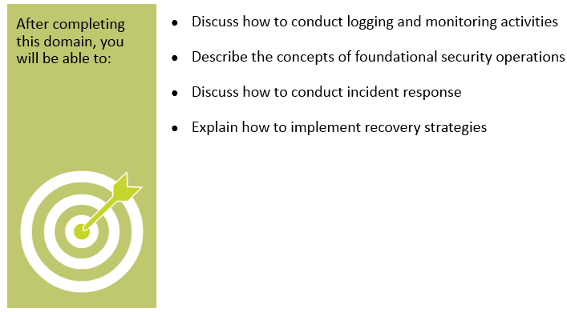
Objectives
Notes:
Section breaker slide with customer logo
Section heading – Arial Headings, 34, Bold
Sub head – Arial Headings, 18, normal
Used for a section heading. You may add a sub heading not exceeding one line also here
Section heading – Arial Headings, bold, 34 font size, should not exceed beyond 1 line
Sub Head – Arial Headings, normal, 18 font size, should not exceed beyond 1 line

Slide 3

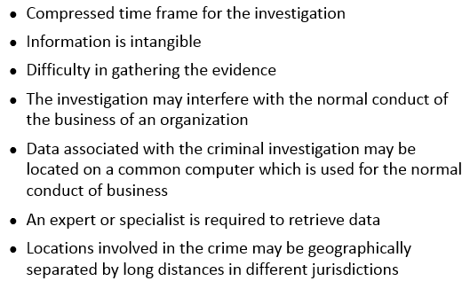
Investigations – Introduction and Challenges
Notes:
Section breaker slide with customer logo
Section heading – Arial Headings, 34, Bold
Sub head – Arial Headings, 18, normal
Used for a section heading. You may add a sub heading not exceeding one line also here
Section heading – Arial Headings, bold, 34 font size, should not exceed beyond 1 line
Sub Head – Arial Headings, normal, 18 font size, should not exceed beyond 1 line

Slide 4
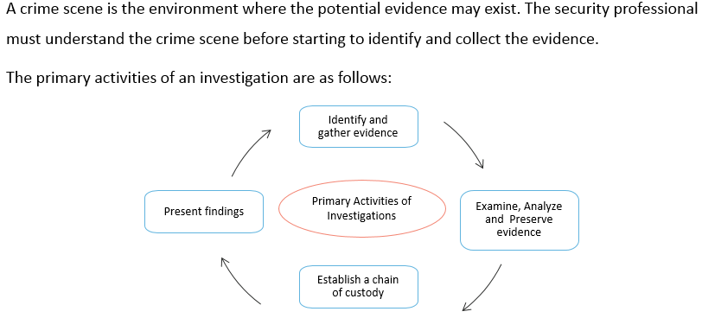
Investigations – Primary Activities
Notes:
Section breaker slide with customer logo
Section heading – Arial Headings, 34, Bold
Sub head – Arial Headings, 18, normal
Used for a section heading. You may add a sub heading not exceeding one line also here
Section heading – Arial Headings, bold, 34 font size, should not exceed beyond 1 line
Sub Head – Arial Headings, normal, 18 font size, should not exceed beyond 1 line

Slide 5
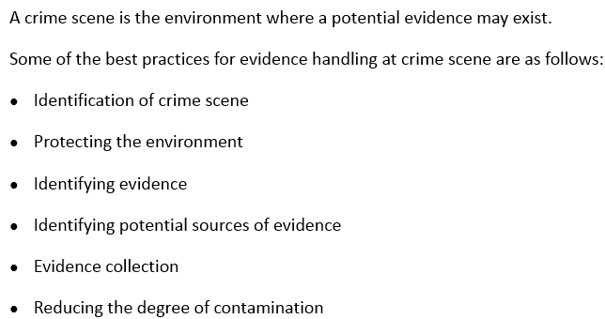
Crime Scene
Notes:
Section breaker slide with customer logo
Section heading – Arial Headings, 34, Bold
Sub head – Arial Headings, 18, normal
Used for a section heading. You may add a sub heading not exceeding one line also here
Section heading – Arial Headings, bold, 34 font size, should not exceed beyond 1 line
Sub Head – Arial Headings, normal, 18 font size, should not exceed beyond 1 line

Slide 6
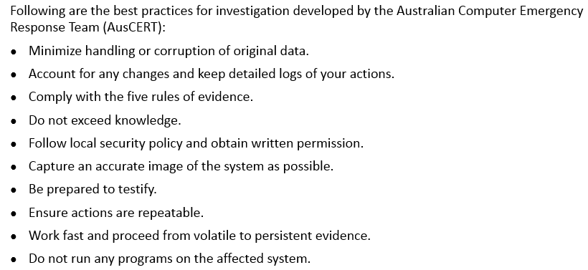
Forensic Investigation - Guidelines
Notes:
Section breaker slide with customer logo
Section heading – Arial Headings, 34, Bold
Sub head – Arial Headings, 18, normal
Used for a section heading. You may add a sub heading not exceeding one line also here
Section heading – Arial Headings, bold, 34 font size, should not exceed beyond 1 line
Sub Head – Arial Headings, normal, 18 font size, should not exceed beyond 1 line

Slide 7
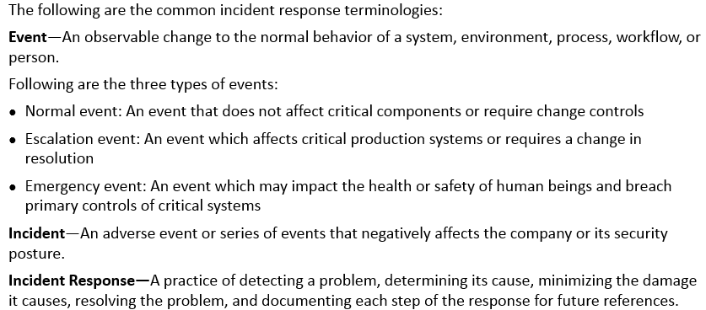
Incident Response - Terminologies
Notes:
Section breaker slide with customer logo
Section heading – Arial Headings, 34, Bold
Sub head – Arial Headings, 18, normal
Used for a section heading. You may add a sub heading not exceeding one line also here
Section heading – Arial Headings, bold, 34 font size, should not exceed beyond 1 line
Sub Head – Arial Headings, normal, 18 font size, should not exceed beyond 1 line

Slide 8
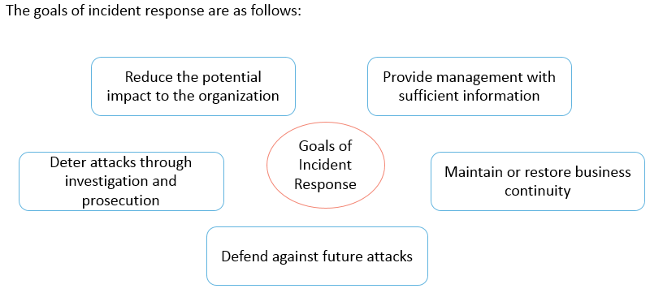
Incident Response - Goals
Notes:
Section breaker slide with customer logo
Section heading – Arial Headings, 34, Bold
Sub head – Arial Headings, 18, normal
Used for a section heading. You may add a sub heading not exceeding one line also here
Section heading – Arial Headings, bold, 34 font size, should not exceed beyond 1 line
Sub Head – Arial Headings, normal, 18 font size, should not exceed beyond 1 line

Slide 9
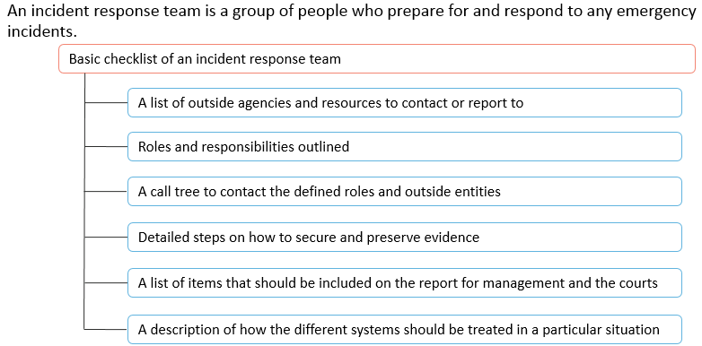
Incident Response Team
Notes:
Section breaker slide with customer logo
Section heading – Arial Headings, 34, Bold
Sub head – Arial Headings, 18, normal
Used for a section heading. You may add a sub heading not exceeding one line also here
Section heading – Arial Headings, bold, 34 font size, should not exceed beyond 1 line
Sub Head – Arial Headings, normal, 18 font size, should not exceed beyond 1 line

Slide 10
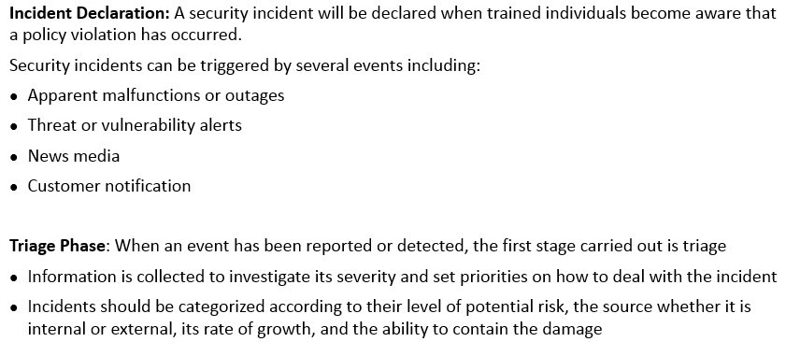
Incident Response - Procedure
Notes:
Section breaker slide with customer logo
Section heading – Arial Headings, 34, Bold
Sub head – Arial Headings, 18, normal
Used for a section heading. You may add a sub heading not exceeding one line also here
Section heading – Arial Headings, bold, 34 font size, should not exceed beyond 1 line
Sub Head – Arial Headings, normal, 18 font size, should not exceed beyond 1 line

Slide 11
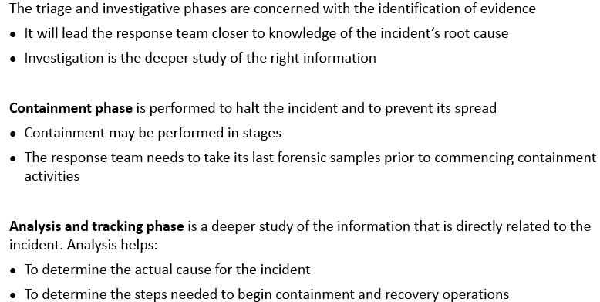
Incident Response – Procedure (contd)
Notes:
Section breaker slide with customer logo
Section heading – Arial Headings, 34, Bold
Sub head – Arial Headings, 18, normal
Used for a section heading. You may add a sub heading not exceeding one line also here
Section heading – Arial Headings, bold, 34 font size, should not exceed beyond 1 line
Sub Head – Arial Headings, normal, 18 font size, should not exceed beyond 1 line

Slide 12
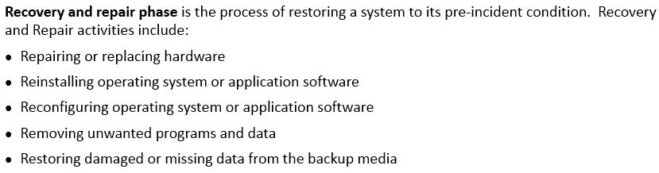
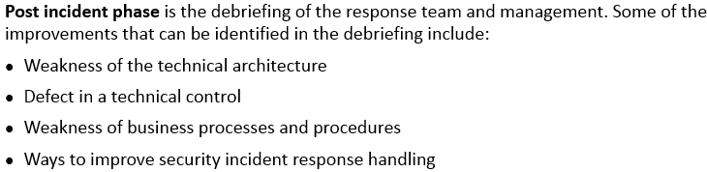
Incident Response – Procedure (contd)
Notes:
Section breaker slide with customer logo
Section heading – Arial Headings, 34, Bold
Sub head – Arial Headings, 18, normal
Used for a section heading. You may add a sub heading not exceeding one line also here
Section heading – Arial Headings, bold, 34 font size, should not exceed beyond 1 line
Sub Head – Arial Headings, normal, 18 font size, should not exceed beyond 1 line

Slide 13
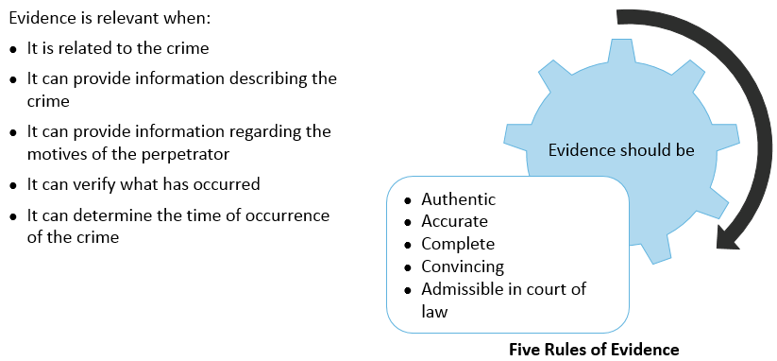
Evidence
Notes:
Section breaker slide with customer logo
Section heading – Arial Headings, 34, Bold
Sub head – Arial Headings, 18, normal
Used for a section heading. You may add a sub heading not exceeding one line also here
Section heading – Arial Headings, bold, 34 font size, should not exceed beyond 1 line
Sub Head – Arial Headings, normal, 18 font size, should not exceed beyond 1 line

Slide 14
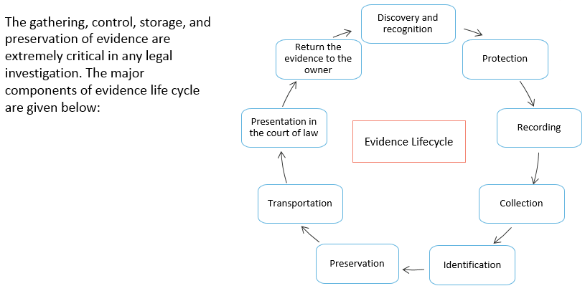
Evidence - Lifecycle
Notes:
Section breaker slide with customer logo
Section heading – Arial Headings, 34, Bold
Sub head – Arial Headings, 18, normal
Used for a section heading. You may add a sub heading not exceeding one line also here
Section heading – Arial Headings, bold, 34 font size, should not exceed beyond 1 line
Sub Head – Arial Headings, normal, 18 font size, should not exceed beyond 1 line

Slide 15
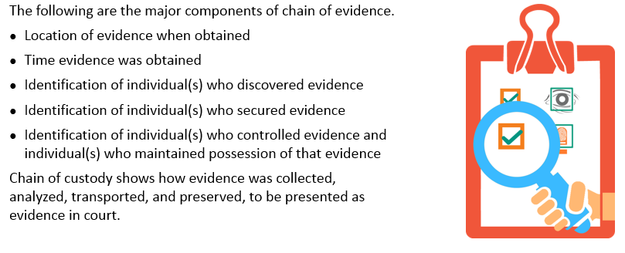
Chain of Evidence
Notes:
Section breaker slide with customer logo
Section heading – Arial Headings, 34, Bold
Sub head – Arial Headings, 18, normal
Used for a section heading. You may add a sub heading not exceeding one line also here
Section heading – Arial Headings, bold, 34 font size, should not exceed beyond 1 line
Sub Head – Arial Headings, normal, 18 font size, should not exceed beyond 1 line

Slide 16
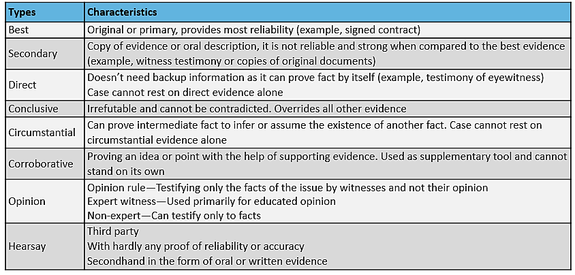
Evidences - Types
Notes:
Section breaker slide with customer logo
Section heading – Arial Headings, 34, Bold
Sub head – Arial Headings, 18, normal
Used for a section heading. You may add a sub heading not exceeding one line also here
Section heading – Arial Headings, bold, 34 font size, should not exceed beyond 1 line
Sub Head – Arial Headings, normal, 18 font size, should not exceed beyond 1 line

Slide 17

Procedure of Computer Forensics
Notes:
Section breaker slide with customer logo
Section heading – Arial Headings, 34, Bold
Sub head – Arial Headings, 18, normal
Used for a section heading. You may add a sub heading not exceeding one line also here
Section heading – Arial Headings, bold, 34 font size, should not exceed beyond 1 line
Sub Head – Arial Headings, normal, 18 font size, should not exceed beyond 1 line

Slide 18
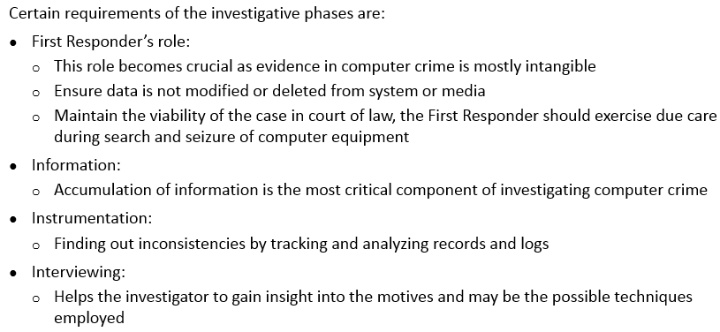
Investigation Related Terms and Activities
Notes:
Section breaker slide with customer logo
Section heading – Arial Headings, 34, Bold
Sub head – Arial Headings, 18, normal
Used for a section heading. You may add a sub heading not exceeding one line also here
Section heading – Arial Headings, bold, 34 font size, should not exceed beyond 1 line
Sub Head – Arial Headings, normal, 18 font size, should not exceed beyond 1 line

Slide 19
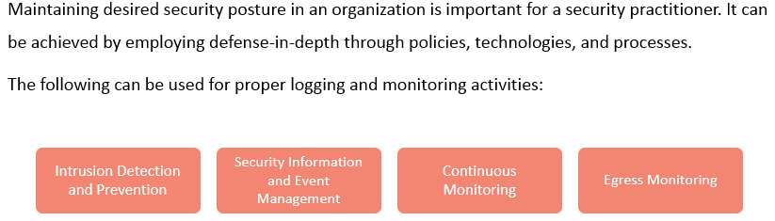
Logging and Monitoring Activities
Notes:
Section breaker slide with customer logo
Section heading – Arial Headings, 34, Bold
Sub head – Arial Headings, 18, normal
Used for a section heading. You may add a sub heading not exceeding one line also here
Section heading – Arial Headings, bold, 34 font size, should not exceed beyond 1 line
Sub Head – Arial Headings, normal, 18 font size, should not exceed beyond 1 line

Slide 20
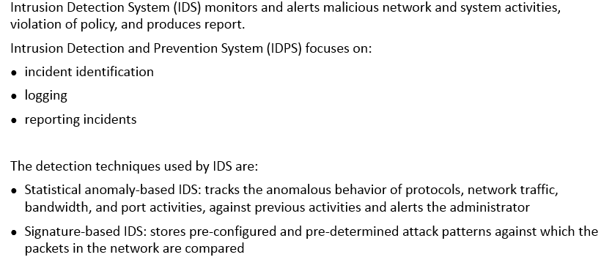
Intrusion Detection System (IDS)
Notes:
Section breaker slide with customer logo
Section heading – Arial Headings, 34, Bold
Sub head – Arial Headings, 18, normal
Used for a section heading. You may add a sub heading not exceeding one line also here
Section heading – Arial Headings, bold, 34 font size, should not exceed beyond 1 line
Sub Head – Arial Headings, normal, 18 font size, should not exceed beyond 1 line

Slide 21
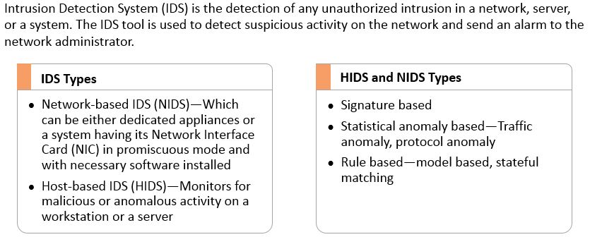
Intrusion Detection System (IDS) (contd)
Notes:
Section breaker slide with customer logo
Section heading – Arial Headings, 34, Bold
Sub head – Arial Headings, 18, normal
Used for a section heading. You may add a sub heading not exceeding one line also here
Section heading – Arial Headings, bold, 34 font size, should not exceed beyond 1 line
Sub Head – Arial Headings, normal, 18 font size, should not exceed beyond 1 line

Slide 22
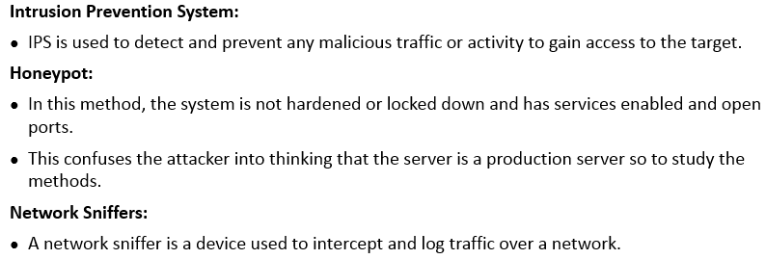
Intrusion Prevention System (IPS)
Notes:
Section breaker slide with customer logo
Section heading – Arial Headings, 34, Bold
Sub head – Arial Headings, 18, normal
Used for a section heading. You may add a sub heading not exceeding one line also here
Section heading – Arial Headings, bold, 34 font size, should not exceed beyond 1 line
Sub Head – Arial Headings, normal, 18 font size, should not exceed beyond 1 line

Slide 23
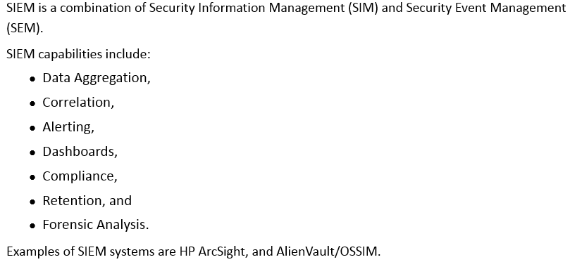
Security Information and Event Management (SIEM)
Notes:
Section breaker slide with customer logo
Section heading – Arial Headings, 34, Bold
Sub head – Arial Headings, 18, normal
Used for a section heading. You may add a sub heading not exceeding one line also here
Section heading – Arial Headings, bold, 34 font size, should not exceed beyond 1 line
Sub Head – Arial Headings, normal, 18 font size, should not exceed beyond 1 line

Slide 24
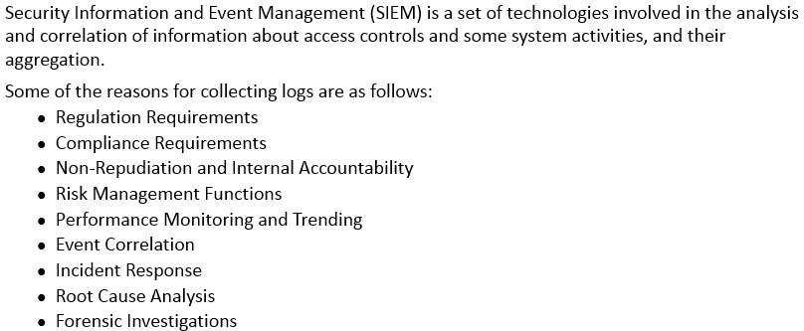
Security Information and Event Management (SIEM) (contd)
Notes:
Section breaker slide with customer logo
Section heading – Arial Headings, 34, Bold
Sub head – Arial Headings, 18, normal
Used for a section heading. You may add a sub heading not exceeding one line also here
Section heading – Arial Headings, bold, 34 font size, should not exceed beyond 1 line
Sub Head – Arial Headings, normal, 18 font size, should not exceed beyond 1 line

Slide 25
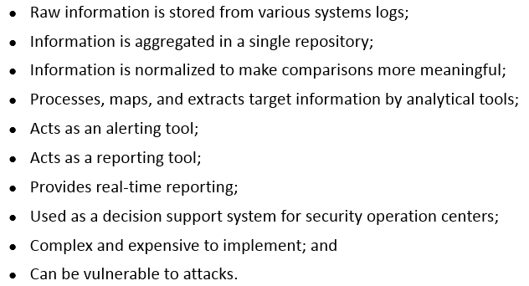
Security Information and Event Management (SIEM) - Characteristics
Notes:
Section breaker slide with customer logo
Section heading – Arial Headings, 34, Bold
Sub head – Arial Headings, 18, normal
Used for a section heading. You may add a sub heading not exceeding one line also here
Section heading – Arial Headings, bold, 34 font size, should not exceed beyond 1 line
Sub Head – Arial Headings, normal, 18 font size, should not exceed beyond 1 line

Slide 26
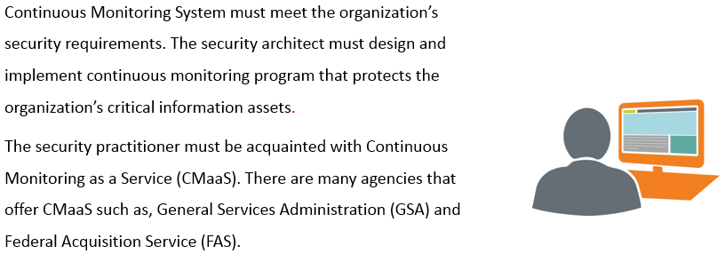
Continuous Monitoring
Notes:
Section breaker slide with customer logo
Section heading – Arial Headings, 34, Bold
Sub head – Arial Headings, 18, normal
Used for a section heading. You may add a sub heading not exceeding one line also here
Section heading – Arial Headings, bold, 34 font size, should not exceed beyond 1 line
Sub Head – Arial Headings, normal, 18 font size, should not exceed beyond 1 line

Slide 27
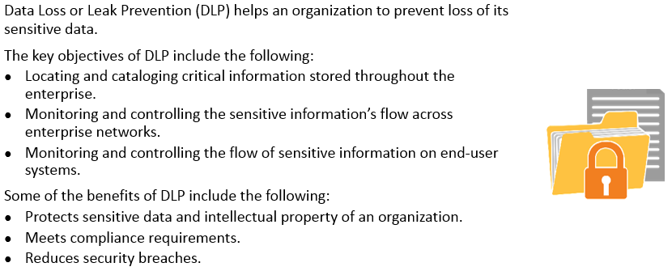
Data Loss Prevention (DLP)
Notes:
Section breaker slide with customer logo
Section heading – Arial Headings, 34, Bold
Sub head – Arial Headings, 18, normal
Used for a section heading. You may add a sub heading not exceeding one line also here
Section heading – Arial Headings, bold, 34 font size, should not exceed beyond 1 line
Sub Head – Arial Headings, normal, 18 font size, should not exceed beyond 1 line

Slide 28
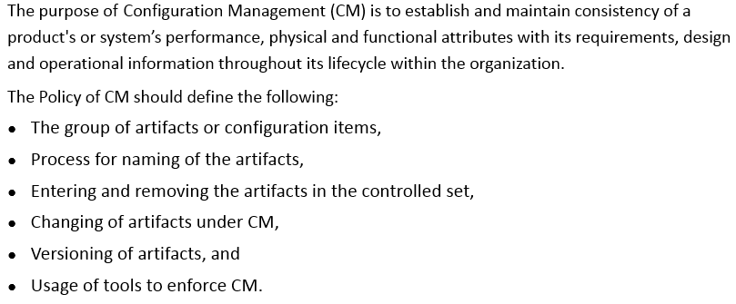
Secure Provisioning of Resources through Configuration Management
Notes:
Section breaker slide with customer logo
Section heading – Arial Headings, 34, Bold
Sub head – Arial Headings, 18, normal
Used for a section heading. You may add a sub heading not exceeding one line also here
Section heading – Arial Headings, bold, 34 font size, should not exceed beyond 1 line
Sub Head – Arial Headings, normal, 18 font size, should not exceed beyond 1 line

Slide 29
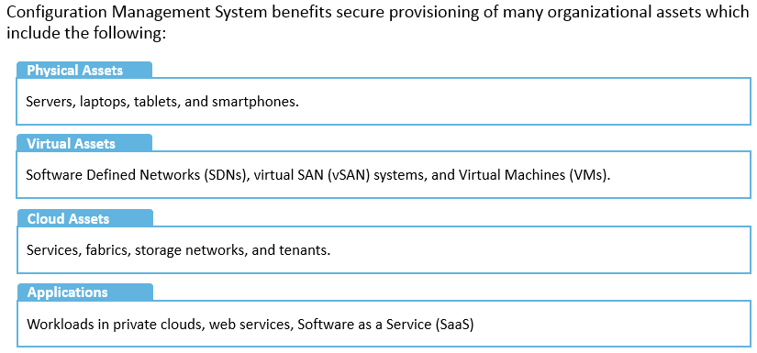
Secure Provisioning of Resources through Configuration Management (contd)
Notes:
Section breaker slide with customer logo
Section heading – Arial Headings, 34, Bold
Sub head – Arial Headings, 18, normal
Used for a section heading. You may add a sub heading not exceeding one line also here
Section heading – Arial Headings, bold, 34 font size, should not exceed beyond 1 line
Sub Head – Arial Headings, normal, 18 font size, should not exceed beyond 1 line

Slide 30
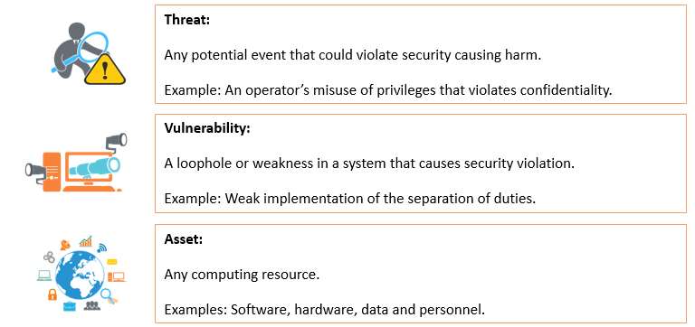
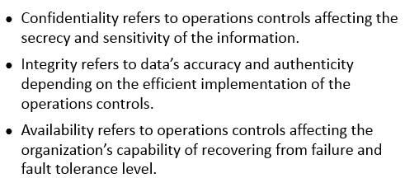
Security Operations - Concepts
Notes:
Section breaker slide with customer logo
Section heading – Arial Headings, 34, Bold
Sub head – Arial Headings, 18, normal
Used for a section heading. You may add a sub heading not exceeding one line also here
Section heading – Arial Headings, bold, 34 font size, should not exceed beyond 1 line
Sub Head – Arial Headings, normal, 18 font size, should not exceed beyond 1 line

Slide 31
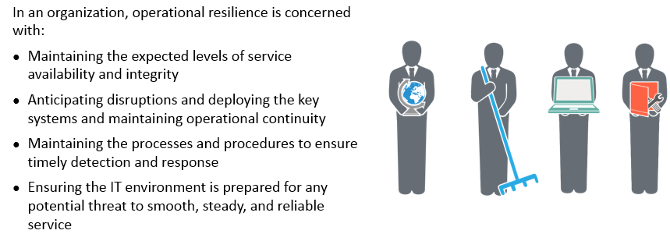
Operational Resilience
Notes:
Section breaker slide with customer logo
Section heading – Arial Headings, 34, Bold
Sub head – Arial Headings, 18, normal
Used for a section heading. You may add a sub heading not exceeding one line also here
Section heading – Arial Headings, bold, 34 font size, should not exceed beyond 1 line
Sub Head – Arial Headings, normal, 18 font size, should not exceed beyond 1 line

Slide 32
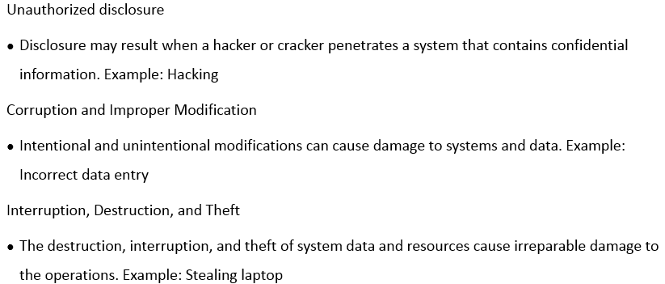
Threats to Operations
Notes:
Section breaker slide with customer logo
Section heading – Arial Headings, 34, Bold
Sub head – Arial Headings, 18, normal
Used for a section heading. You may add a sub heading not exceeding one line also here
Section heading – Arial Headings, bold, 34 font size, should not exceed beyond 1 line
Sub Head – Arial Headings, normal, 18 font size, should not exceed beyond 1 line

Slide 33
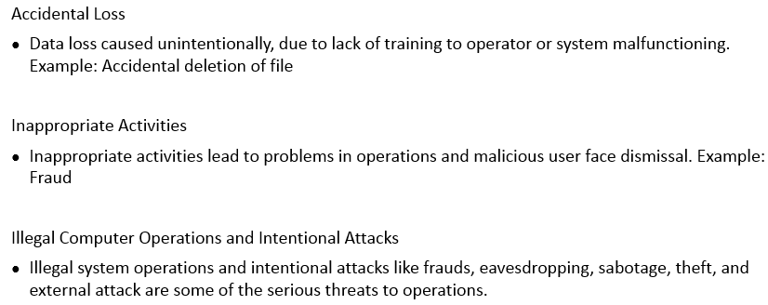
Threats to Operations (contd)
Notes:
Section breaker slide with customer logo
Section heading – Arial Headings, 34, Bold
Sub head – Arial Headings, 18, normal
Used for a section heading. You may add a sub heading not exceeding one line also here
Section heading – Arial Headings, bold, 34 font size, should not exceed beyond 1 line
Sub Head – Arial Headings, normal, 18 font size, should not exceed beyond 1 line

Slide 34
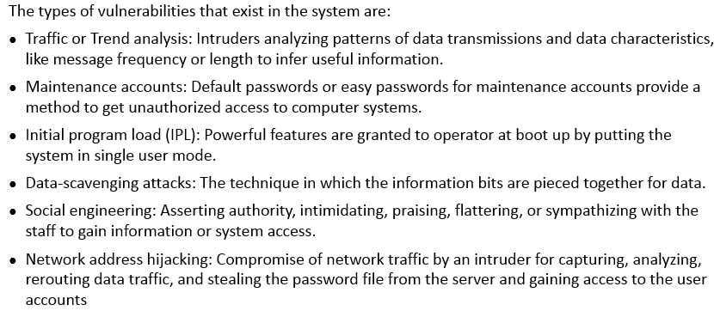
Vulnerabilities
Notes:
Section breaker slide with customer logo
Section heading – Arial Headings, 34, Bold
Sub head – Arial Headings, 18, normal
Used for a section heading. You may add a sub heading not exceeding one line also here
Section heading – Arial Headings, bold, 34 font size, should not exceed beyond 1 line
Sub Head – Arial Headings, normal, 18 font size, should not exceed beyond 1 line

Slide 35
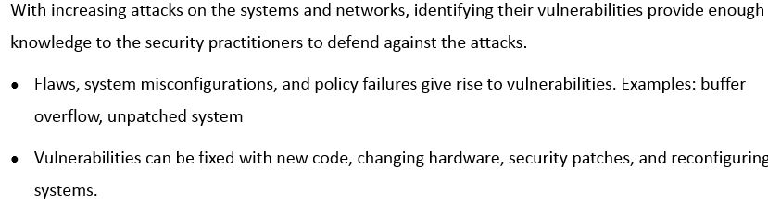
Vulnerability Management
Notes:
Section breaker slide with customer logo
Section heading – Arial Headings, 34, Bold
Sub head – Arial Headings, 18, normal
Used for a section heading. You may add a sub heading not exceeding one line also here
Section heading – Arial Headings, bold, 34 font size, should not exceed beyond 1 line
Sub Head – Arial Headings, normal, 18 font size, should not exceed beyond 1 line

Slide 36
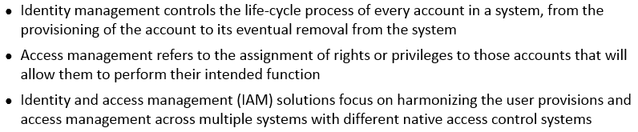
Identity and Access Management
Notes:
Section breaker slide with customer logo
Section heading – Arial Headings, 34, Bold
Sub head – Arial Headings, 18, normal
Used for a section heading. You may add a sub heading not exceeding one line also here
Section heading – Arial Headings, bold, 34 font size, should not exceed beyond 1 line
Sub Head – Arial Headings, normal, 18 font size, should not exceed beyond 1 line

Slide 37
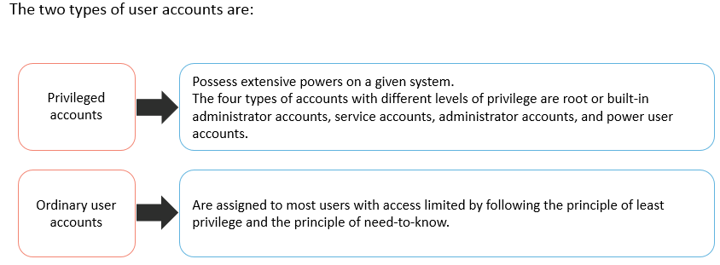
Types of Accounts
Notes:
Section breaker slide with customer logo
Section heading – Arial Headings, 34, Bold
Sub head – Arial Headings, 18, normal
Used for a section heading. You may add a sub heading not exceeding one line also here
Section heading – Arial Headings, bold, 34 font size, should not exceed beyond 1 line
Sub Head – Arial Headings, normal, 18 font size, should not exceed beyond 1 line

Slide 38
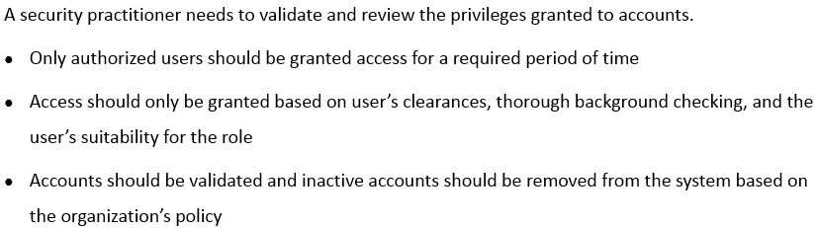
Monitoring Special Priviledges
Notes:
Section breaker slide with customer logo
Section heading – Arial Headings, 34, Bold
Sub head – Arial Headings, 18, normal
Used for a section heading. You may add a sub heading not exceeding one line also here
Section heading – Arial Headings, bold, 34 font size, should not exceed beyond 1 line
Sub Head – Arial Headings, normal, 18 font size, should not exceed beyond 1 line

Slide 39
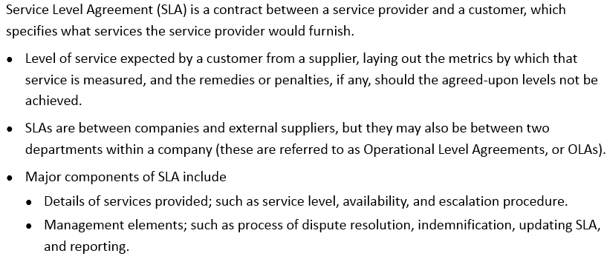
Service Level Agreement (SLA)
Notes:
Section breaker slide with customer logo
Section heading – Arial Headings, 34, Bold
Sub head – Arial Headings, 18, normal
Used for a section heading. You may add a sub heading not exceeding one line also here
Section heading – Arial Headings, bold, 34 font size, should not exceed beyond 1 line
Sub Head – Arial Headings, normal, 18 font size, should not exceed beyond 1 line

Slide 40
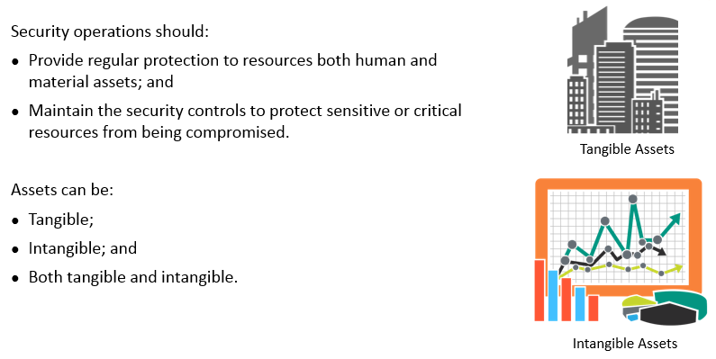
Protect Valuable Assets
Notes:
Section breaker slide with customer logo
Section heading – Arial Headings, 34, Bold
Sub head – Arial Headings, 18, normal
Used for a section heading. You may add a sub heading not exceeding one line also here
Section heading – Arial Headings, bold, 34 font size, should not exceed beyond 1 line
Sub Head – Arial Headings, normal, 18 font size, should not exceed beyond 1 line

Slide 41
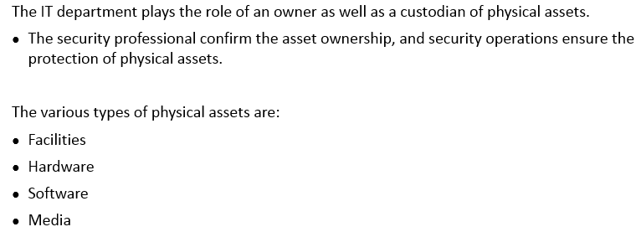
Protecting Physical Assets
Notes:
Section breaker slide with customer logo
Section heading – Arial Headings, 34, Bold
Sub head – Arial Headings, 18, normal
Used for a section heading. You may add a sub heading not exceeding one line also here
Section heading – Arial Headings, bold, 34 font size, should not exceed beyond 1 line
Sub Head – Arial Headings, normal, 18 font size, should not exceed beyond 1 line

Slide 42
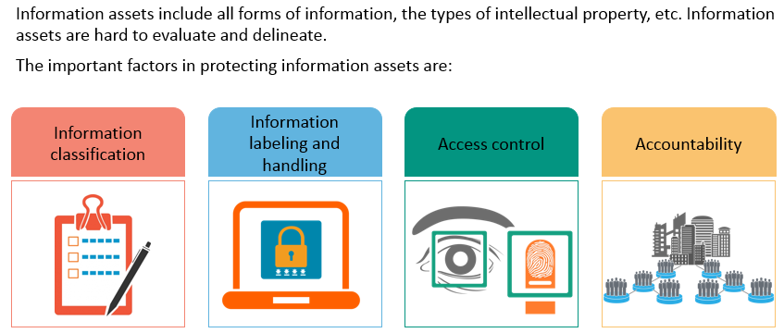
Protecting Information Assets
Notes:
Section breaker slide with customer logo
Section heading – Arial Headings, 34, Bold
Sub head – Arial Headings, 18, normal
Used for a section heading. You may add a sub heading not exceeding one line also here
Section heading – Arial Headings, bold, 34 font size, should not exceed beyond 1 line
Sub Head – Arial Headings, normal, 18 font size, should not exceed beyond 1 line

Slide 43
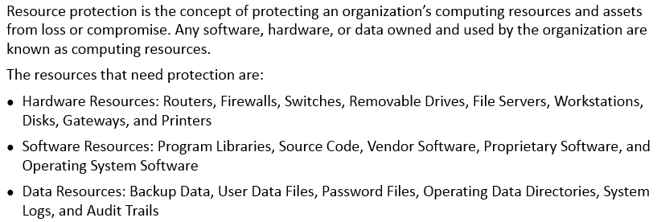
Protecting Resources
Notes:
Section breaker slide with customer logo
Section heading – Arial Headings, 34, Bold
Sub head – Arial Headings, 18, normal
Used for a section heading. You may add a sub heading not exceeding one line also here
Section heading – Arial Headings, bold, 34 font size, should not exceed beyond 1 line
Sub Head – Arial Headings, normal, 18 font size, should not exceed beyond 1 line

Slide 44
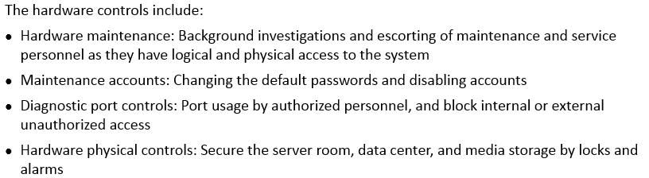
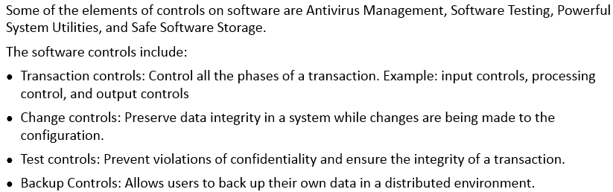
Controls for Protecting Assets – Hardware Controls and Software Controls
Notes:
Section breaker slide with customer logo
Section heading – Arial Headings, 34, Bold
Sub head – Arial Headings, 18, normal
Used for a section heading. You may add a sub heading not exceeding one line also here
Section heading – Arial Headings, bold, 34 font size, should not exceed beyond 1 line
Sub Head – Arial Headings, normal, 18 font size, should not exceed beyond 1 line

Slide 45
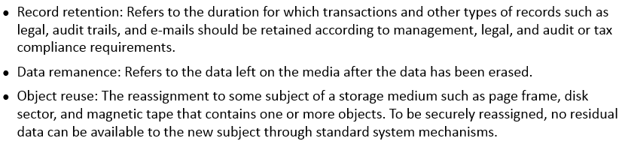
Controls for Protecting Assets – Media Controls
Notes:
Section breaker slide with customer logo
Section heading – Arial Headings, 34, Bold
Sub head – Arial Headings, 18, normal
Used for a section heading. You may add a sub heading not exceeding one line also here
Section heading – Arial Headings, bold, 34 font size, should not exceed beyond 1 line
Sub Head – Arial Headings, normal, 18 font size, should not exceed beyond 1 line

Slide 46
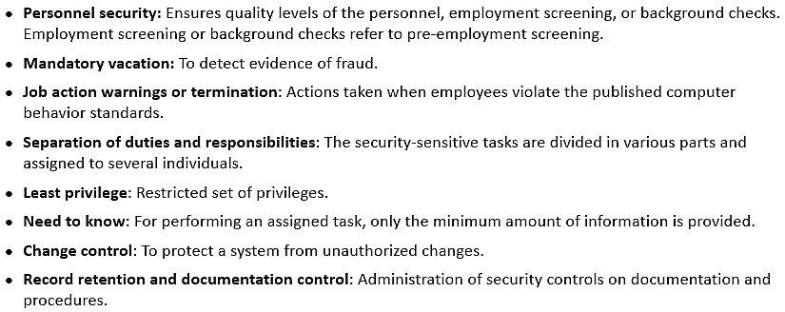
Controls for Protecting Assets – Administrative controls
Notes:
Section breaker slide with customer logo
Section heading – Arial Headings, 34, Bold
Sub head – Arial Headings, 18, normal
Used for a section heading. You may add a sub heading not exceeding one line also here
Section heading – Arial Headings, bold, 34 font size, should not exceed beyond 1 line
Sub Head – Arial Headings, normal, 18 font size, should not exceed beyond 1 line

Slide 47
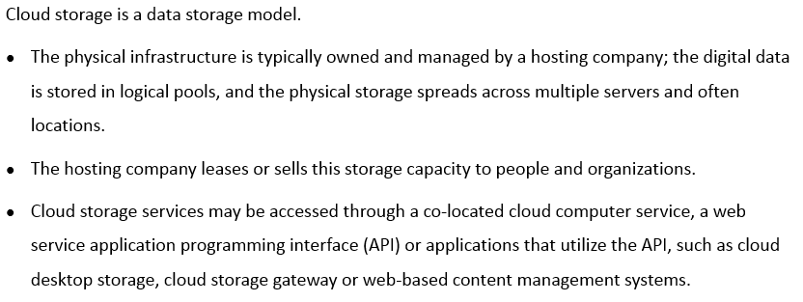
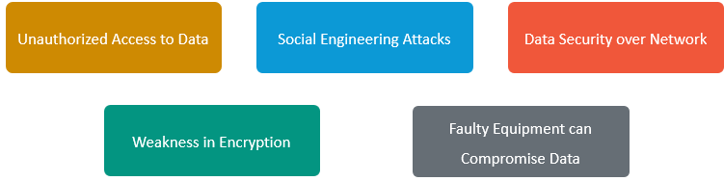
Cloud and Virtual Storage
Cloud and Virtual Storage – Security Issues
Notes:
Section breaker slide with customer logo
Section heading – Arial Headings, 34, Bold
Sub head – Arial Headings, 18, normal
Used for a section heading. You may add a sub heading not exceeding one line also here
Section heading – Arial Headings, bold, 34 font size, should not exceed beyond 1 line
Sub Head – Arial Headings, normal, 18 font size, should not exceed beyond 1 line

Slide 48
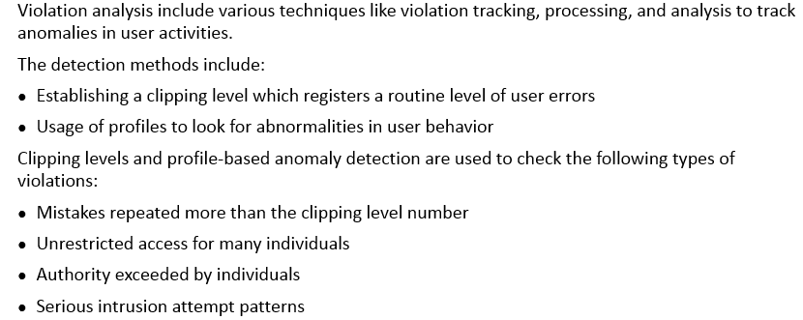
Monitoring Techniques – Violation Analysis
Notes:
Section breaker slide with customer logo
Section heading – Arial Headings, 34, Bold
Sub head – Arial Headings, 18, normal
Used for a section heading. You may add a sub heading not exceeding one line also here
Section heading – Arial Headings, bold, 34 font size, should not exceed beyond 1 line
Sub Head – Arial Headings, normal, 18 font size, should not exceed beyond 1 line

Slide 49

Incident Management
Notes:
Section breaker slide with customer logo
Section heading – Arial Headings, 34, Bold
Sub head – Arial Headings, 18, normal
Used for a section heading. You may add a sub heading not exceeding one line also here
Section heading – Arial Headings, bold, 34 font size, should not exceed beyond 1 line
Sub Head – Arial Headings, normal, 18 font size, should not exceed beyond 1 line

Slide 50

Incident Management (contd)
Notes:
Section breaker slide with customer logo
Section heading – Arial Headings, 34, Bold
Sub head – Arial Headings, 18, normal
Used for a section heading. You may add a sub heading not exceeding one line also here
Section heading – Arial Headings, bold, 34 font size, should not exceed beyond 1 line
Sub Head – Arial Headings, normal, 18 font size, should not exceed beyond 1 line

Slide 51

Trusted Recovery and System Recovery
Notes:
Section breaker slide with customer logo
Section heading – Arial Headings, 34, Bold
Sub head – Arial Headings, 18, normal
Used for a section heading. You may add a sub heading not exceeding one line also here
Section heading – Arial Headings, bold, 34 font size, should not exceed beyond 1 line
Sub Head – Arial Headings, normal, 18 font size, should not exceed beyond 1 line

Slide 52

Problem Management
Notes:
Section breaker slide with customer logo
Section heading – Arial Headings, 34, Bold
Sub head – Arial Headings, 18, normal
Used for a section heading. You may add a sub heading not exceeding one line also here
Section heading – Arial Headings, bold, 34 font size, should not exceed beyond 1 line
Sub Head – Arial Headings, normal, 18 font size, should not exceed beyond 1 line

Slide 53

Operating and Maintaining Preventing Measures
Notes:
Section breaker slide with customer logo
Section heading – Arial Headings, 34, Bold
Sub head – Arial Headings, 18, normal
Used for a section heading. You may add a sub heading not exceeding one line also here
Section heading – Arial Headings, bold, 34 font size, should not exceed beyond 1 line
Sub Head – Arial Headings, normal, 18 font size, should not exceed beyond 1 line

Slide 54

Patch Management
Notes:
Section breaker slide with customer logo
Section heading – Arial Headings, 34, Bold
Sub head – Arial Headings, 18, normal
Used for a section heading. You may add a sub heading not exceeding one line also here
Section heading – Arial Headings, bold, 34 font size, should not exceed beyond 1 line
Sub Head – Arial Headings, normal, 18 font size, should not exceed beyond 1 line

Slide 55

Change Control Process
Notes:
Section breaker slide with customer logo
Section heading – Arial Headings, 34, Bold
Sub head – Arial Headings, 18, normal
Used for a section heading. You may add a sub heading not exceeding one line also here
Section heading – Arial Headings, bold, 34 font size, should not exceed beyond 1 line
Sub Head – Arial Headings, normal, 18 font size, should not exceed beyond 1 line

Slide 56


Configuration Management
Notes:
Section breaker slide with customer logo
Section heading – Arial Headings, 34, Bold
Sub head – Arial Headings, 18, normal
Used for a section heading. You may add a sub heading not exceeding one line also here
Section heading – Arial Headings, bold, 34 font size, should not exceed beyond 1 line
Sub Head – Arial Headings, normal, 18 font size, should not exceed beyond 1 line

Slide 57

Develop a Recovery Strategy
Notes:
Section breaker slide with customer logo
Section heading – Arial Headings, 34, Bold
Sub head – Arial Headings, 18, normal
Used for a section heading. You may add a sub heading not exceeding one line also here
Section heading – Arial Headings, bold, 34 font size, should not exceed beyond 1 line
Sub Head – Arial Headings, normal, 18 font size, should not exceed beyond 1 line

Slide 58

Types of Recovery – Business, Facility and Supply Recovery
Notes:
Section breaker slide with customer logo
Section heading – Arial Headings, 34, Bold
Sub head – Arial Headings, 18, normal
Used for a section heading. You may add a sub heading not exceeding one line also here
Section heading – Arial Headings, bold, 34 font size, should not exceed beyond 1 line
Sub Head – Arial Headings, normal, 18 font size, should not exceed beyond 1 line

Slide 59

Types of Recovery – User Recovery
Notes:
Section breaker slide with customer logo
Section heading – Arial Headings, 34, Bold
Sub head – Arial Headings, 18, normal
Used for a section heading. You may add a sub heading not exceeding one line also here
Section heading – Arial Headings, bold, 34 font size, should not exceed beyond 1 line
Sub Head – Arial Headings, normal, 18 font size, should not exceed beyond 1 line

Slide 60

Recovery Partners - Strategy
Notes:
Section breaker slide with customer logo
Section heading – Arial Headings, 34, Bold
Sub head – Arial Headings, 18, normal
Used for a section heading. You may add a sub heading not exceeding one line also here
Section heading – Arial Headings, bold, 34 font size, should not exceed beyond 1 line
Sub Head – Arial Headings, normal, 18 font size, should not exceed beyond 1 line

Slide 61

Backup Sites
Notes:
Section breaker slide with customer logo
Section heading – Arial Headings, 34, Bold
Sub head – Arial Headings, 18, normal
Used for a section heading. You may add a sub heading not exceeding one line also here
Section heading – Arial Headings, bold, 34 font size, should not exceed beyond 1 line
Sub Head – Arial Headings, normal, 18 font size, should not exceed beyond 1 line

Slide 62

Backup Sites (contd)
Notes:
Section breaker slide with customer logo
Section heading – Arial Headings, 34, Bold
Sub head – Arial Headings, 18, normal
Used for a section heading. You may add a sub heading not exceeding one line also here
Section heading – Arial Headings, bold, 34 font size, should not exceed beyond 1 line
Sub Head – Arial Headings, normal, 18 font size, should not exceed beyond 1 line

Slide 63

Backup Sites (contd)
Notes:
Section breaker slide with customer logo
Section heading – Arial Headings, 34, Bold
Sub head – Arial Headings, 18, normal
Used for a section heading. You may add a sub heading not exceeding one line also here
Section heading – Arial Headings, bold, 34 font size, should not exceed beyond 1 line
Sub Head – Arial Headings, normal, 18 font size, should not exceed beyond 1 line

Slide 64

Backup Methods
Notes:
Section breaker slide with customer logo
Section heading – Arial Headings, 34, Bold
Sub head – Arial Headings, 18, normal
Used for a section heading. You may add a sub heading not exceeding one line also here
Section heading – Arial Headings, bold, 34 font size, should not exceed beyond 1 line
Sub Head – Arial Headings, normal, 18 font size, should not exceed beyond 1 line

Slide 65

Importance of Maintaining Resilient Systems
Notes:
Section breaker slide with customer logo
Section heading – Arial Headings, 34, Bold
Sub head – Arial Headings, 18, normal
Used for a section heading. You may add a sub heading not exceeding one line also here
Section heading – Arial Headings, bold, 34 font size, should not exceed beyond 1 line
Sub Head – Arial Headings, normal, 18 font size, should not exceed beyond 1 line

Slide 66

Redundancy and Fault Tolerance - Methods
Notes:
Section breaker slide with customer logo
Section heading – Arial Headings, 34, Bold
Sub head – Arial Headings, 18, normal
Used for a section heading. You may add a sub heading not exceeding one line also here
Section heading – Arial Headings, bold, 34 font size, should not exceed beyond 1 line
Sub Head – Arial Headings, normal, 18 font size, should not exceed beyond 1 line

Slide 67

Redundancy and Fault Tolerance - Methods (contd)
Notes:
Section breaker slide with customer logo
Section heading – Arial Headings, 34, Bold
Sub head – Arial Headings, 18, normal
Used for a section heading. You may add a sub heading not exceeding one line also here
Section heading – Arial Headings, bold, 34 font size, should not exceed beyond 1 line
Sub Head – Arial Headings, normal, 18 font size, should not exceed beyond 1 line

Slide 68

Backup and Recovery – Best Practices
Notes:
Section breaker slide with customer logo
Section heading – Arial Headings, 34, Bold
Sub head – Arial Headings, 18, normal
Used for a section heading. You may add a sub heading not exceeding one line also here
Section heading – Arial Headings, bold, 34 font size, should not exceed beyond 1 line
Sub Head – Arial Headings, normal, 18 font size, should not exceed beyond 1 line

Slide 69



Disaster Recovery – Planning Design and Development
Notes:
Section breaker slide with customer logo
Section heading – Arial Headings, 34, Bold
Sub head – Arial Headings, 18, normal
Used for a section heading. You may add a sub heading not exceeding one line also here
Section heading – Arial Headings, bold, 34 font size, should not exceed beyond 1 line
Sub Head – Arial Headings, normal, 18 font size, should not exceed beyond 1 line

Slide 70

Disaster Recovery – Planning Design and Development (contd)
Notes:
Section breaker slide with customer logo
Section heading – Arial Headings, 34, Bold
Sub head – Arial Headings, 18, normal
Used for a section heading. You may add a sub heading not exceeding one line also here
Section heading – Arial Headings, bold, 34 font size, should not exceed beyond 1 line
Sub Head – Arial Headings, normal, 18 font size, should not exceed beyond 1 line

Slide 71


Disaster Recovery Phases – Implementation, Testing and Training
Notes:
Section breaker slide with customer logo
Section heading – Arial Headings, 34, Bold
Sub head – Arial Headings, 18, normal
Used for a section heading. You may add a sub heading not exceeding one line also here
Section heading – Arial Headings, bold, 34 font size, should not exceed beyond 1 line
Sub Head – Arial Headings, normal, 18 font size, should not exceed beyond 1 line

Slide 72


Types of Testing
Notes:
Section breaker slide with customer logo
Section heading – Arial Headings, 34, Bold
Sub head – Arial Headings, 18, normal
Used for a section heading. You may add a sub heading not exceeding one line also here
Section heading – Arial Headings, bold, 34 font size, should not exceed beyond 1 line
Sub Head – Arial Headings, normal, 18 font size, should not exceed beyond 1 line

Slide 73

Types of Testing (contd)
Notes:
Section breaker slide with customer logo
Section heading – Arial Headings, 34, Bold
Sub head – Arial Headings, 18, normal
Used for a section heading. You may add a sub heading not exceeding one line also here
Section heading – Arial Headings, bold, 34 font size, should not exceed beyond 1 line
Sub Head – Arial Headings, normal, 18 font size, should not exceed beyond 1 line

Slide 74


Training
Notes:
Section breaker slide with customer logo
Section heading – Arial Headings, 34, Bold
Sub head – Arial Headings, 18, normal
Used for a section heading. You may add a sub heading not exceeding one line also here
Section heading – Arial Headings, bold, 34 font size, should not exceed beyond 1 line
Sub Head – Arial Headings, normal, 18 font size, should not exceed beyond 1 line

Slide 75


Perimeter Security
Notes:
Section breaker slide with customer logo
Section heading – Arial Headings, 34, Bold
Sub head – Arial Headings, 18, normal
Used for a section heading. You may add a sub heading not exceeding one line also here
Section heading – Arial Headings, bold, 34 font size, should not exceed beyond 1 line
Sub Head – Arial Headings, normal, 18 font size, should not exceed beyond 1 line

Slide 76

Barriers
Notes:
Section breaker slide with customer logo
Section heading – Arial Headings, 34, Bold
Sub head – Arial Headings, 18, normal
Used for a section heading. You may add a sub heading not exceeding one line also here
Section heading – Arial Headings, bold, 34 font size, should not exceed beyond 1 line
Sub Head – Arial Headings, normal, 18 font size, should not exceed beyond 1 line

Slide 77

Fences
Notes:
Section breaker slide with customer logo
Section heading – Arial Headings, 34, Bold
Sub head – Arial Headings, 18, normal
Used for a section heading. You may add a sub heading not exceeding one line also here
Section heading – Arial Headings, bold, 34 font size, should not exceed beyond 1 line
Sub Head – Arial Headings, normal, 18 font size, should not exceed beyond 1 line

Slide 78

Gates
Notes:
Section breaker slide with customer logo
Section heading – Arial Headings, 34, Bold
Sub head – Arial Headings, 18, normal
Used for a section heading. You may add a sub heading not exceeding one line also here
Section heading – Arial Headings, bold, 34 font size, should not exceed beyond 1 line
Sub Head – Arial Headings, normal, 18 font size, should not exceed beyond 1 line

Slide 79

Walls and Bollards
Notes:
Section breaker slide with customer logo
Section heading – Arial Headings, 34, Bold
Sub head – Arial Headings, 18, normal
Used for a section heading. You may add a sub heading not exceeding one line also here
Section heading – Arial Headings, bold, 34 font size, should not exceed beyond 1 line
Sub Head – Arial Headings, normal, 18 font size, should not exceed beyond 1 line

Slide 80

Lighting Systems - Types
Notes:
Section breaker slide with customer logo
Section heading – Arial Headings, 34, Bold
Sub head – Arial Headings, 18, normal
Used for a section heading. You may add a sub heading not exceeding one line also here
Section heading – Arial Headings, bold, 34 font size, should not exceed beyond 1 line
Sub Head – Arial Headings, normal, 18 font size, should not exceed beyond 1 line

Slide 81

Types of Lights
Notes:
Section breaker slide with customer logo
Section heading – Arial Headings, 34, Bold
Sub head – Arial Headings, 18, normal
Used for a section heading. You may add a sub heading not exceeding one line also here
Section heading – Arial Headings, bold, 34 font size, should not exceed beyond 1 line
Sub Head – Arial Headings, normal, 18 font size, should not exceed beyond 1 line

Slide 82

Building and Inside Security
Notes:
Section breaker slide with customer logo
Section heading – Arial Headings, 34, Bold
Sub head – Arial Headings, 18, normal
Used for a section heading. You may add a sub heading not exceeding one line also here
Section heading – Arial Headings, bold, 34 font size, should not exceed beyond 1 line
Sub Head – Arial Headings, normal, 18 font size, should not exceed beyond 1 line

Slide 83

Notes:
Section breaker slide with customer logo
Section heading – Arial Headings, 34, Bold
Sub head – Arial Headings, 18, normal
Used for a section heading. You may add a sub heading not exceeding one line also here
Section heading – Arial Headings, bold, 34 font size, should not exceed beyond 1 line
Sub Head – Arial Headings, normal, 18 font size, should not exceed beyond 1 line

Slide 84

Notes:
Section breaker slide with customer logo
Section heading – Arial Headings, 34, Bold
Sub head – Arial Headings, 18, normal
Used for a section heading. You may add a sub heading not exceeding one line also here
Section heading – Arial Headings, bold, 34 font size, should not exceed beyond 1 line
Sub Head – Arial Headings, normal, 18 font size, should not exceed beyond 1 line

Slide 85

Notes:
Section breaker slide with customer logo
Section heading – Arial Headings, 34, Bold
Sub head – Arial Headings, 18, normal
Used for a section heading. You may add a sub heading not exceeding one line also here
Section heading – Arial Headings, bold, 34 font size, should not exceed beyond 1 line
Sub Head – Arial Headings, normal, 18 font size, should not exceed beyond 1 line

Slide 86

Notes:
Section breaker slide with customer logo
Section heading – Arial Headings, 34, Bold
Sub head – Arial Headings, 18, normal
Used for a section heading. You may add a sub heading not exceeding one line also here
Section heading – Arial Headings, bold, 34 font size, should not exceed beyond 1 line
Sub Head – Arial Headings, normal, 18 font size, should not exceed beyond 1 line

Slide 87

Notes:
Section breaker slide with customer logo
Section heading – Arial Headings, 34, Bold
Sub head – Arial Headings, 18, normal
Used for a section heading. You may add a sub heading not exceeding one line also here
Section heading – Arial Headings, bold, 34 font size, should not exceed beyond 1 line
Sub Head – Arial Headings, normal, 18 font size, should not exceed beyond 1 line

Slide 88

Notes:
Section breaker slide with customer logo
Section heading – Arial Headings, 34, Bold
Sub head – Arial Headings, 18, normal
Used for a section heading. You may add a sub heading not exceeding one line also here
Section heading – Arial Headings, bold, 34 font size, should not exceed beyond 1 line
Sub Head – Arial Headings, normal, 18 font size, should not exceed beyond 1 line

Slide 89

Notes:
Section breaker slide with customer logo
Section heading – Arial Headings, 34, Bold
Sub head – Arial Headings, 18, normal
Used for a section heading. You may add a sub heading not exceeding one line also here
Section heading – Arial Headings, bold, 34 font size, should not exceed beyond 1 line
Sub Head – Arial Headings, normal, 18 font size, should not exceed beyond 1 line

Slide 90

Notes:
Section breaker slide with customer logo
Section heading – Arial Headings, 34, Bold
Sub head – Arial Headings, 18, normal
Used for a section heading. You may add a sub heading not exceeding one line also here
Section heading – Arial Headings, bold, 34 font size, should not exceed beyond 1 line
Sub Head – Arial Headings, normal, 18 font size, should not exceed beyond 1 line

Slide 91

Notes:
Section breaker slide with customer logo
Section heading – Arial Headings, 34, Bold
Sub head – Arial Headings, 18, normal
Used for a section heading. You may add a sub heading not exceeding one line also here
Section heading – Arial Headings, bold, 34 font size, should not exceed beyond 1 line
Sub Head – Arial Headings, normal, 18 font size, should not exceed beyond 1 line

Slide 92

Notes:
Section breaker slide with customer logo
Section heading – Arial Headings, 34, Bold
Sub head – Arial Headings, 18, normal
Used for a section heading. You may add a sub heading not exceeding one line also here
Section heading – Arial Headings, bold, 34 font size, should not exceed beyond 1 line
Sub Head – Arial Headings, normal, 18 font size, should not exceed beyond 1 line

Slide 93

Notes:
Section breaker slide with customer logo
Section heading – Arial Headings, 34, Bold
Sub head – Arial Headings, 18, normal
Used for a section heading. You may add a sub heading not exceeding one line also here
Section heading – Arial Headings, bold, 34 font size, should not exceed beyond 1 line
Sub Head – Arial Headings, normal, 18 font size, should not exceed beyond 1 line

Slide 94

Notes:
Section breaker slide with customer logo
Section heading – Arial Headings, 34, Bold
Sub head – Arial Headings, 18, normal
Used for a section heading. You may add a sub heading not exceeding one line also here
Section heading – Arial Headings, bold, 34 font size, should not exceed beyond 1 line
Sub Head – Arial Headings, normal, 18 font size, should not exceed beyond 1 line

Slide 95

Notes:
Section breaker slide with customer logo
Section heading – Arial Headings, 34, Bold
Sub head – Arial Headings, 18, normal
Used for a section heading. You may add a sub heading not exceeding one line also here
Section heading – Arial Headings, bold, 34 font size, should not exceed beyond 1 line
Sub Head – Arial Headings, normal, 18 font size, should not exceed beyond 1 line

Slide 96

Notes:
Section breaker slide with customer logo
Section heading – Arial Headings, 34, Bold
Sub head – Arial Headings, 18, normal
Used for a section heading. You may add a sub heading not exceeding one line also here
Section heading – Arial Headings, bold, 34 font size, should not exceed beyond 1 line
Sub Head – Arial Headings, normal, 18 font size, should not exceed beyond 1 line

Slide 97

Notes:
Section breaker slide with customer logo
Section heading – Arial Headings, 34, Bold
Sub head – Arial Headings, 18, normal
Used for a section heading. You may add a sub heading not exceeding one line also here
Section heading – Arial Headings, bold, 34 font size, should not exceed beyond 1 line
Sub Head – Arial Headings, normal, 18 font size, should not exceed beyond 1 line

Slide 98

Notes:
Section breaker slide with customer logo
Section heading – Arial Headings, 34, Bold
Sub head – Arial Headings, 18, normal
Used for a section heading. You may add a sub heading not exceeding one line also here
Section heading – Arial Headings, bold, 34 font size, should not exceed beyond 1 line
Sub Head – Arial Headings, normal, 18 font size, should not exceed beyond 1 line

Slide 99

Notes:
Section breaker slide with customer logo
Section heading – Arial Headings, 34, Bold
Sub head – Arial Headings, 18, normal
Used for a section heading. You may add a sub heading not exceeding one line also here
Section heading – Arial Headings, bold, 34 font size, should not exceed beyond 1 line
Sub Head – Arial Headings, normal, 18 font size, should not exceed beyond 1 line

Slide 100

Notes:
Section breaker slide with customer logo
Section heading – Arial Headings, 34, Bold
Sub head – Arial Headings, 18, normal
Used for a section heading. You may add a sub heading not exceeding one line also here
Section heading – Arial Headings, bold, 34 font size, should not exceed beyond 1 line
Sub Head – Arial Headings, normal, 18 font size, should not exceed beyond 1 line

Slide 101

Notes:
Section breaker slide with customer logo
Section heading – Arial Headings, 34, Bold
Sub head – Arial Headings, 18, normal
Used for a section heading. You may add a sub heading not exceeding one line also here
Section heading – Arial Headings, bold, 34 font size, should not exceed beyond 1 line
Sub Head – Arial Headings, normal, 18 font size, should not exceed beyond 1 line

Slide 102

Notes:
Section breaker slide with customer logo
Section heading – Arial Headings, 34, Bold
Sub head – Arial Headings, 18, normal
Used for a section heading. You may add a sub heading not exceeding one line also here
Section heading – Arial Headings, bold, 34 font size, should not exceed beyond 1 line
Sub Head – Arial Headings, normal, 18 font size, should not exceed beyond 1 line

Slide 103

Notes:
Section breaker slide with customer logo
Section heading – Arial Headings, 34, Bold
Sub head – Arial Headings, 18, normal
Used for a section heading. You may add a sub heading not exceeding one line also here
Section heading – Arial Headings, bold, 34 font size, should not exceed beyond 1 line
Sub Head – Arial Headings, normal, 18 font size, should not exceed beyond 1 line

Slide 104

Notes:
Section breaker slide with customer logo
Section heading – Arial Headings, 34, Bold
Sub head – Arial Headings, 18, normal
Used for a section heading. You may add a sub heading not exceeding one line also here
Section heading – Arial Headings, bold, 34 font size, should not exceed beyond 1 line
Sub Head – Arial Headings, normal, 18 font size, should not exceed beyond 1 line

Slide 105

Notes:
Section breaker slide with customer logo
Section heading – Arial Headings, 34, Bold
Sub head – Arial Headings, 18, normal
Used for a section heading. You may add a sub heading not exceeding one line also here
Section heading – Arial Headings, bold, 34 font size, should not exceed beyond 1 line
Sub Head – Arial Headings, normal, 18 font size, should not exceed beyond 1 line

Slide 106

Notes:
Section breaker slide with customer logo
Section heading – Arial Headings, 34, Bold
Sub head – Arial Headings, 18, normal
Used for a section heading. You may add a sub heading not exceeding one line also here
Section heading – Arial Headings, bold, 34 font size, should not exceed beyond 1 line
Sub Head – Arial Headings, normal, 18 font size, should not exceed beyond 1 line

Slide 107

Notes:
Section breaker slide with customer logo
Section heading – Arial Headings, 34, Bold
Sub head – Arial Headings, 18, normal
Used for a section heading. You may add a sub heading not exceeding one line also here
Section heading – Arial Headings, bold, 34 font size, should not exceed beyond 1 line
Sub Head – Arial Headings, normal, 18 font size, should not exceed beyond 1 line

Slide 108

Notes:
Section breaker slide with customer logo
Section heading – Arial Headings, 34, Bold
Sub head – Arial Headings, 18, normal
Used for a section heading. You may add a sub heading not exceeding one line also here
Section heading – Arial Headings, bold, 34 font size, should not exceed beyond 1 line
Sub Head – Arial Headings, normal, 18 font size, should not exceed beyond 1 line

Slide 109

Notes:
Section breaker slide with customer logo
Section heading – Arial Headings, 34, Bold
Sub head – Arial Headings, 18, normal
Used for a section heading. You may add a sub heading not exceeding one line also here
Section heading – Arial Headings, bold, 34 font size, should not exceed beyond 1 line
Sub Head – Arial Headings, normal, 18 font size, should not exceed beyond 1 line

Slide 110

Notes:
Section breaker slide with customer logo
Section heading – Arial Headings, 34, Bold
Sub head – Arial Headings, 18, normal
Used for a section heading. You may add a sub heading not exceeding one line also here
Section heading – Arial Headings, bold, 34 font size, should not exceed beyond 1 line
Sub Head – Arial Headings, normal, 18 font size, should not exceed beyond 1 line

Slide 111

Notes:
Section breaker slide with customer logo
Section heading – Arial Headings, 34, Bold
Sub head – Arial Headings, 18, normal
Used for a section heading. You may add a sub heading not exceeding one line also here
Section heading – Arial Headings, bold, 34 font size, should not exceed beyond 1 line
Sub Head – Arial Headings, normal, 18 font size, should not exceed beyond 1 line

Slide 112

Notes:
Section breaker slide with customer logo
Section heading – Arial Headings, 34, Bold
Sub head – Arial Headings, 18, normal
Used for a section heading. You may add a sub heading not exceeding one line also here
Section heading – Arial Headings, bold, 34 font size, should not exceed beyond 1 line
Sub Head – Arial Headings, normal, 18 font size, should not exceed beyond 1 line

Slide 113

Notes:
Section breaker slide with customer logo
Section heading – Arial Headings, 34, Bold
Sub head – Arial Headings, 18, normal
Used for a section heading. You may add a sub heading not exceeding one line also here
Section heading – Arial Headings, bold, 34 font size, should not exceed beyond 1 line
Sub Head – Arial Headings, normal, 18 font size, should not exceed beyond 1 line

Slide 114

Notes:
Section breaker slide with customer logo
Section heading – Arial Headings, 34, Bold
Sub head – Arial Headings, 18, normal
Used for a section heading. You may add a sub heading not exceeding one line also here
Section heading – Arial Headings, bold, 34 font size, should not exceed beyond 1 line
Sub Head – Arial Headings, normal, 18 font size, should not exceed beyond 1 line

Slide 115

Notes:
Section breaker slide with customer logo
Section heading – Arial Headings, 34, Bold
Sub head – Arial Headings, 18, normal
Used for a section heading. You may add a sub heading not exceeding one line also here
Section heading – Arial Headings, bold, 34 font size, should not exceed beyond 1 line
Sub Head – Arial Headings, normal, 18 font size, should not exceed beyond 1 line

Slide 116

Notes:
Section breaker slide with customer logo
Section heading – Arial Headings, 34, Bold
Sub head – Arial Headings, 18, normal
Used for a section heading. You may add a sub heading not exceeding one line also here
Section heading – Arial Headings, bold, 34 font size, should not exceed beyond 1 line
Sub Head – Arial Headings, normal, 18 font size, should not exceed beyond 1 line

Slide 117

Notes:
Section breaker slide with customer logo
Section heading – Arial Headings, 34, Bold
Sub head – Arial Headings, 18, normal
Used for a section heading. You may add a sub heading not exceeding one line also here
Section heading – Arial Headings, bold, 34 font size, should not exceed beyond 1 line
Sub Head – Arial Headings, normal, 18 font size, should not exceed beyond 1 line

Slide 118

Notes:
Section breaker slide with customer logo
Section heading – Arial Headings, 34, Bold
Sub head – Arial Headings, 18, normal
Used for a section heading. You may add a sub heading not exceeding one line also here
Section heading – Arial Headings, bold, 34 font size, should not exceed beyond 1 line
Sub Head – Arial Headings, normal, 18 font size, should not exceed beyond 1 line

Slide 119

Notes:
Section breaker slide with customer logo
Section heading – Arial Headings, 34, Bold
Sub head – Arial Headings, 18, normal
Used for a section heading. You may add a sub heading not exceeding one line also here
Section heading – Arial Headings, bold, 34 font size, should not exceed beyond 1 line
Sub Head – Arial Headings, normal, 18 font size, should not exceed beyond 1 line

Slide 120

Notes:
Section breaker slide with customer logo
Section heading – Arial Headings, 34, Bold
Sub head – Arial Headings, 18, normal
Used for a section heading. You may add a sub heading not exceeding one line also here
Section heading – Arial Headings, bold, 34 font size, should not exceed beyond 1 line
Sub Head – Arial Headings, normal, 18 font size, should not exceed beyond 1 line

Slide 121

Notes:
Section breaker slide with customer logo
Section heading – Arial Headings, 34, Bold
Sub head – Arial Headings, 18, normal
Used for a section heading. You may add a sub heading not exceeding one line also here
Section heading – Arial Headings, bold, 34 font size, should not exceed beyond 1 line
Sub Head – Arial Headings, normal, 18 font size, should not exceed beyond 1 line

Slide 122

Notes:
Section breaker slide with customer logo
Section heading – Arial Headings, 34, Bold
Sub head – Arial Headings, 18, normal
Used for a section heading. You may add a sub heading not exceeding one line also here
Section heading – Arial Headings, bold, 34 font size, should not exceed beyond 1 line
Sub Head – Arial Headings, normal, 18 font size, should not exceed beyond 1 line

Slide 123

Notes:
Section breaker slide with customer logo
Section heading – Arial Headings, 34, Bold
Sub head – Arial Headings, 18, normal
Used for a section heading. You may add a sub heading not exceeding one line also here
Section heading – Arial Headings, bold, 34 font size, should not exceed beyond 1 line
Sub Head – Arial Headings, normal, 18 font size, should not exceed beyond 1 line

Slide 124

Notes:
Section breaker slide with customer logo
Section heading – Arial Headings, 34, Bold
Sub head – Arial Headings, 18, normal
Used for a section heading. You may add a sub heading not exceeding one line also here
Section heading – Arial Headings, bold, 34 font size, should not exceed beyond 1 line
Sub Head – Arial Headings, normal, 18 font size, should not exceed beyond 1 line

Slide 125

Notes:
Section breaker slide with customer logo
Section heading – Arial Headings, 34, Bold
Sub head – Arial Headings, 18, normal
Used for a section heading. You may add a sub heading not exceeding one line also here
Section heading – Arial Headings, bold, 34 font size, should not exceed beyond 1 line
Sub Head – Arial Headings, normal, 18 font size, should not exceed beyond 1 line

Slide 126

Notes:
Section breaker slide with customer logo
Section heading – Arial Headings, 34, Bold
Sub head – Arial Headings, 18, normal
Used for a section heading. You may add a sub heading not exceeding one line also here
Section heading – Arial Headings, bold, 34 font size, should not exceed beyond 1 line
Sub Head – Arial Headings, normal, 18 font size, should not exceed beyond 1 line

Slide 127

Notes:
Section breaker slide with customer logo
Section heading – Arial Headings, 34, Bold
Sub head – Arial Headings, 18, normal
Used for a section heading. You may add a sub heading not exceeding one line also here
Section heading – Arial Headings, bold, 34 font size, should not exceed beyond 1 line
Sub Head – Arial Headings, normal, 18 font size, should not exceed beyond 1 line

Slide 128

Notes:
Section breaker slide with customer logo
Section heading – Arial Headings, 34, Bold
Sub head – Arial Headings, 18, normal
Used for a section heading. You may add a sub heading not exceeding one line also here
Section heading – Arial Headings, bold, 34 font size, should not exceed beyond 1 line
Sub Head – Arial Headings, normal, 18 font size, should not exceed beyond 1 line

Slide 129

Notes:
Section breaker slide with customer logo
Section heading – Arial Headings, 34, Bold
Sub head – Arial Headings, 18, normal
Used for a section heading. You may add a sub heading not exceeding one line also here
Section heading – Arial Headings, bold, 34 font size, should not exceed beyond 1 line
Sub Head – Arial Headings, normal, 18 font size, should not exceed beyond 1 line

Slide 130

Notes:
Section breaker slide with customer logo
Section heading – Arial Headings, 34, Bold
Sub head – Arial Headings, 18, normal
Used for a section heading. You may add a sub heading not exceeding one line also here
Section heading – Arial Headings, bold, 34 font size, should not exceed beyond 1 line
Sub Head – Arial Headings, normal, 18 font size, should not exceed beyond 1 line

Slide 131

Notes:
Section breaker slide with customer logo
Section heading – Arial Headings, 34, Bold
Sub head – Arial Headings, 18, normal
Used for a section heading. You may add a sub heading not exceeding one line also here
Section heading – Arial Headings, bold, 34 font size, should not exceed beyond 1 line
Sub Head – Arial Headings, normal, 18 font size, should not exceed beyond 1 line

Slide 132

Notes:
Section breaker slide with customer logo
Section heading – Arial Headings, 34, Bold
Sub head – Arial Headings, 18, normal
Used for a section heading. You may add a sub heading not exceeding one line also here
Section heading – Arial Headings, bold, 34 font size, should not exceed beyond 1 line
Sub Head – Arial Headings, normal, 18 font size, should not exceed beyond 1 line

Slide 133

Notes:
Section breaker slide with customer logo
Section heading – Arial Headings, 34, Bold
Sub head – Arial Headings, 18, normal
Used for a section heading. You may add a sub heading not exceeding one line also here
Section heading – Arial Headings, bold, 34 font size, should not exceed beyond 1 line
Sub Head – Arial Headings, normal, 18 font size, should not exceed beyond 1 line

Slide 134

Notes:
Section breaker slide with customer logo
Section heading – Arial Headings, 34, Bold
Sub head – Arial Headings, 18, normal
Used for a section heading. You may add a sub heading not exceeding one line also here
Section heading – Arial Headings, bold, 34 font size, should not exceed beyond 1 line
Sub Head – Arial Headings, normal, 18 font size, should not exceed beyond 1 line

Slide 135

Notes:
Section breaker slide with customer logo
Section heading – Arial Headings, 34, Bold
Sub head – Arial Headings, 18, normal
Used for a section heading. You may add a sub heading not exceeding one line also here
Section heading – Arial Headings, bold, 34 font size, should not exceed beyond 1 line
Sub Head – Arial Headings, normal, 18 font size, should not exceed beyond 1 line

Slide 136

Notes:
Section breaker slide with customer logo
Section heading – Arial Headings, 34, Bold
Sub head – Arial Headings, 18, normal
Used for a section heading. You may add a sub heading not exceeding one line also here
Section heading – Arial Headings, bold, 34 font size, should not exceed beyond 1 line
Sub Head – Arial Headings, normal, 18 font size, should not exceed beyond 1 line

Slide 137

Notes:
Section breaker slide with customer logo
Section heading – Arial Headings, 34, Bold
Sub head – Arial Headings, 18, normal
Used for a section heading. You may add a sub heading not exceeding one line also here
Section heading – Arial Headings, bold, 34 font size, should not exceed beyond 1 line
Sub Head – Arial Headings, normal, 18 font size, should not exceed beyond 1 line

Slide 138

Notes:
Section breaker slide with customer logo
Section heading – Arial Headings, 34, Bold
Sub head – Arial Headings, 18, normal
Used for a section heading. You may add a sub heading not exceeding one line also here
Section heading – Arial Headings, bold, 34 font size, should not exceed beyond 1 line
Sub Head – Arial Headings, normal, 18 font size, should not exceed beyond 1 line

Slide 139

Notes:
Section breaker slide with customer logo
Section heading – Arial Headings, 34, Bold
Sub head – Arial Headings, 18, normal
Used for a section heading. You may add a sub heading not exceeding one line also here
Section heading – Arial Headings, bold, 34 font size, should not exceed beyond 1 line
Sub Head – Arial Headings, normal, 18 font size, should not exceed beyond 1 line

Slide 140

Summary
Notes:
Section breaker slide with customer logo
Section heading – Arial Headings, 34, Bold
Sub head – Arial Headings, 18, normal
Used for a section heading. You may add a sub heading not exceeding one line also here
Section heading – Arial Headings, bold, 34 font size, should not exceed beyond 1 line
Sub Head – Arial Headings, normal, 18 font size, should not exceed beyond 1 line

Slide 141
This concludes “Security Operations”
The next domain is “Software Development Security”
Notes:
Content Slide: This is usually the most frequently used slide in every presentation.
Use this slide for Text heavy slides. Text can only be used in bullet points
Title Heading – font size 30, Arial Heading
Slide Content – Should not reduce beyond Arial body font 16
If you need to use sub bullets please use the indent buttons located next to the bullets buttons in the tool bar and this will automatically provide you with the second, third, fourth & fifth level bullet styles and font sizes
Please note you can also press the tab key to create the different levels of bulleted content

