Slide 1
Domain 6 – Security Assessment and Testing
Notes:
The below and following notes on the template slides are to guide you only. In your final presentation, you may delete these notes and add relevant notes if any.
Title slide:
Title – should not exceed beyond 3 lines, font size 30-34, Arial Headings
(Font size for the title of the PPT can vary between 30-34, Arial Headings, Bold depending on the amount of text, however should not be smaller than 30 font size)
Name should not exceed beyond 1 line, Designation; font size to remain at 18, Arial Headings
Please keep the title slide simple, just the logo, title and name and designation to appear. No other graphic elements or any design, photograph, image can be added to this slide, alignment to remain the same

Slide 2
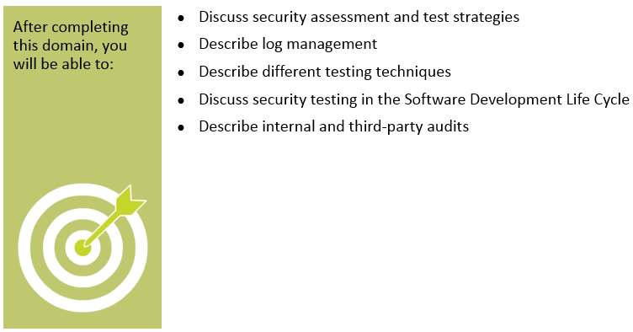
Objectives
Notes:
Section breaker slide with customer logo
Section heading – Arial Headings, 34, Bold
Sub head – Arial Headings, 18, normal
Used for a section heading. You may add a sub heading not exceeding one line also here
Section heading – Arial Headings, bold, 34 font size, should not exceed beyond 1 line
Sub Head – Arial Headings, normal, 18 font size, should not exceed beyond 1 line

Slide 3
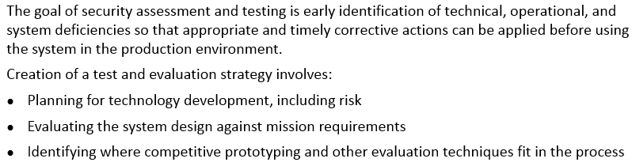
Security Assessment and Testing - Introduction
Notes:
Section breaker slide with customer logo
Section heading – Arial Headings, 34, Bold
Sub head – Arial Headings, 18, normal
Used for a section heading. You may add a sub heading not exceeding one line also here
Section heading – Arial Headings, bold, 34 font size, should not exceed beyond 1 line
Sub Head – Arial Headings, normal, 18 font size, should not exceed beyond 1 line

Slide 4
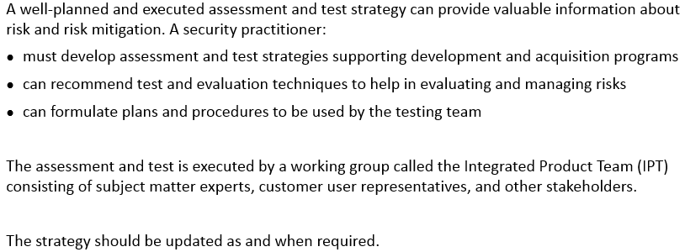
Assessment and Test Strategies
Notes:
Section breaker slide with customer logo
Section heading – Arial Headings, 34, Bold
Sub head – Arial Headings, 18, normal
Used for a section heading. You may add a sub heading not exceeding one line also here
Section heading – Arial Headings, bold, 34 font size, should not exceed beyond 1 line
Sub Head – Arial Headings, normal, 18 font size, should not exceed beyond 1 line

Slide 5
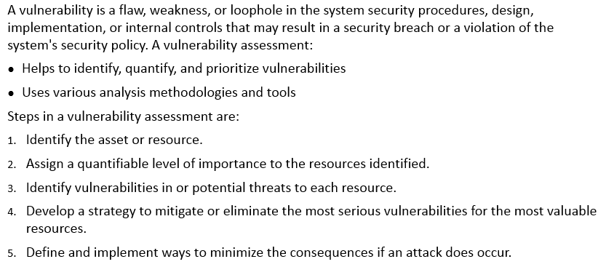
Vulnerabiliy Assessment
Notes:
Section breaker slide with customer logo
Section heading – Arial Headings, 34, Bold
Sub head – Arial Headings, 18, normal
Used for a section heading. You may add a sub heading not exceeding one line also here
Section heading – Arial Headings, bold, 34 font size, should not exceed beyond 1 line
Sub Head – Arial Headings, normal, 18 font size, should not exceed beyond 1 line

Slide 6
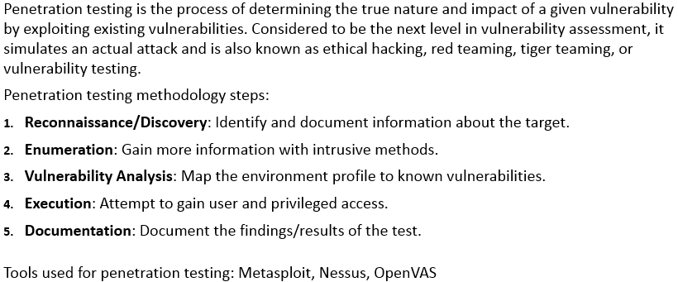
Penetration Testing
Notes:
Section breaker slide with customer logo
Section heading – Arial Headings, 34, Bold
Sub head – Arial Headings, 18, normal
Used for a section heading. You may add a sub heading not exceeding one line also here
Section heading – Arial Headings, bold, 34 font size, should not exceed beyond 1 line
Sub Head – Arial Headings, normal, 18 font size, should not exceed beyond 1 line

Slide 7
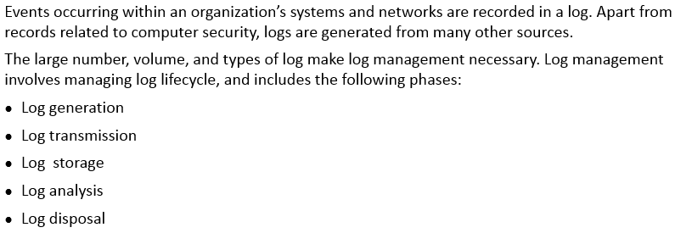
Log Management
Notes:
Section breaker slide with customer logo
Section heading – Arial Headings, 34, Bold
Sub head – Arial Headings, 18, normal
Used for a section heading. You may add a sub heading not exceeding one line also here
Section heading – Arial Headings, bold, 34 font size, should not exceed beyond 1 line
Sub Head – Arial Headings, normal, 18 font size, should not exceed beyond 1 line

Slide 8
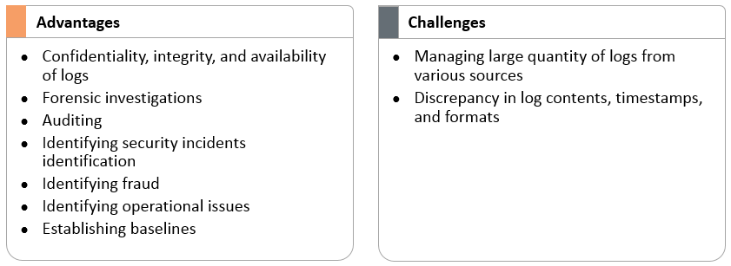
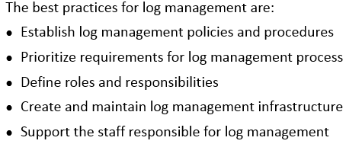
Log Management – Best Practices, Challenges and Advantages
Notes:
Section breaker slide with customer logo
Section heading – Arial Headings, 34, Bold
Sub head – Arial Headings, 18, normal
Used for a section heading. You may add a sub heading not exceeding one line also here
Section heading – Arial Headings, bold, 34 font size, should not exceed beyond 1 line
Sub Head – Arial Headings, normal, 18 font size, should not exceed beyond 1 line

Slide 9
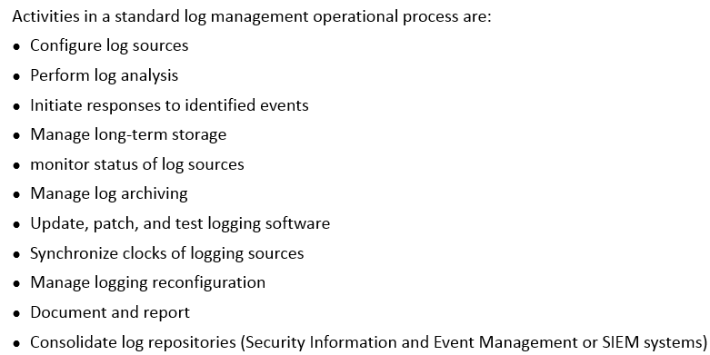
Log Management – Operational process
Notes:
Section breaker slide with customer logo
Section heading – Arial Headings, 34, Bold
Sub head – Arial Headings, 18, normal
Used for a section heading. You may add a sub heading not exceeding one line also here
Section heading – Arial Headings, bold, 34 font size, should not exceed beyond 1 line
Sub Head – Arial Headings, normal, 18 font size, should not exceed beyond 1 line

Slide 10
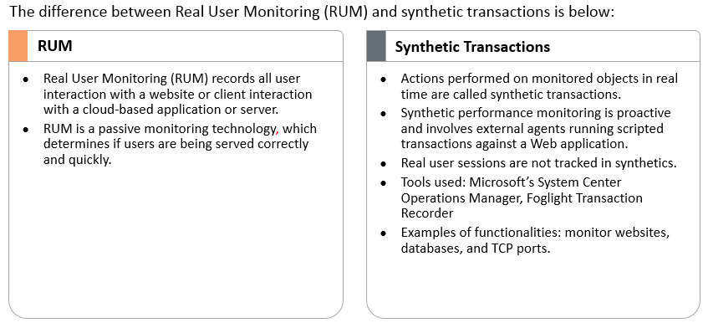
Synthentic Transactions and RUM
Notes:
Section breaker slide with customer logo
Section heading – Arial Headings, 34, Bold
Sub head – Arial Headings, 18, normal
Used for a section heading. You may add a sub heading not exceeding one line also here
Section heading – Arial Headings, bold, 34 font size, should not exceed beyond 1 line
Sub Head – Arial Headings, normal, 18 font size, should not exceed beyond 1 line

Slide 11
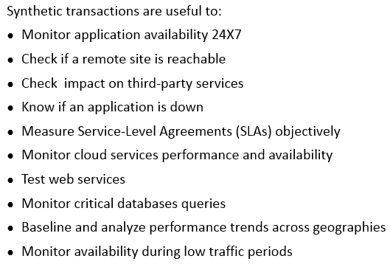
Reasons to use Synthetic Transactions
Notes:
Section breaker slide with customer logo
Section heading – Arial Headings, 34, Bold
Sub head – Arial Headings, 18, normal
Used for a section heading. You may add a sub heading not exceeding one line also here
Section heading – Arial Headings, bold, 34 font size, should not exceed beyond 1 line
Sub Head – Arial Headings, normal, 18 font size, should not exceed beyond 1 line

Slide 12
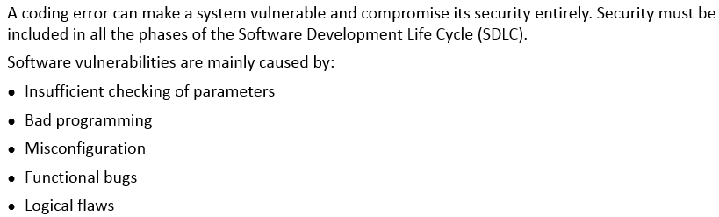
Code Review and Testing
Notes:
Section breaker slide with customer logo
Section heading – Arial Headings, 34, Bold
Sub head – Arial Headings, 18, normal
Used for a section heading. You may add a sub heading not exceeding one line also here
Section heading – Arial Headings, bold, 34 font size, should not exceed beyond 1 line
Sub Head – Arial Headings, normal, 18 font size, should not exceed beyond 1 line

Slide 13
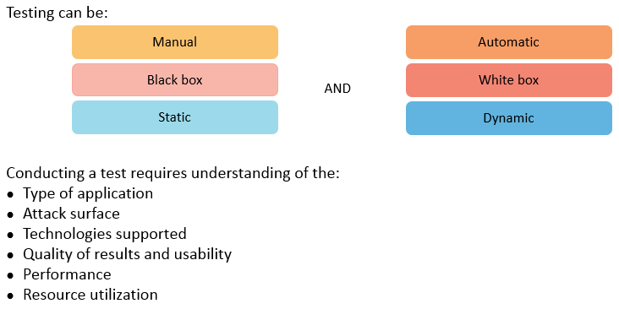
Testing Techniques
Notes:
Section breaker slide with customer logo
Section heading – Arial Headings, 34, Bold
Sub head – Arial Headings, 18, normal
Used for a section heading. You may add a sub heading not exceeding one line also here
Section heading – Arial Headings, bold, 34 font size, should not exceed beyond 1 line
Sub Head – Arial Headings, normal, 18 font size, should not exceed beyond 1 line

Slide 14
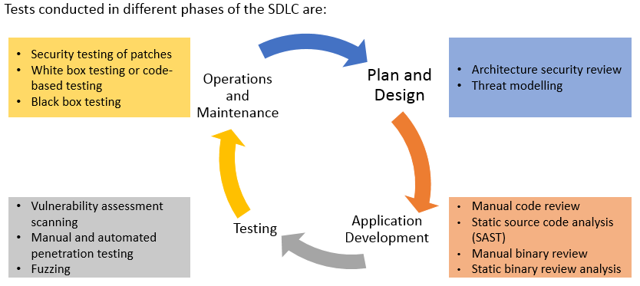
Security Testing in the SDLC
Notes:
Section breaker slide with customer logo
Section heading – Arial Headings, 34, Bold
Sub head – Arial Headings, 18, normal
Used for a section heading. You may add a sub heading not exceeding one line also here
Section heading – Arial Headings, bold, 34 font size, should not exceed beyond 1 line
Sub Head – Arial Headings, normal, 18 font size, should not exceed beyond 1 line

Slide 15
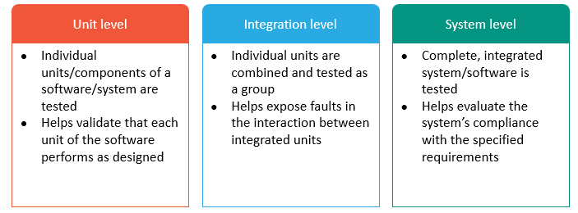
Software Product Testing Levels
Notes:
Section breaker slide with customer logo
Section heading – Arial Headings, 34, Bold
Sub head – Arial Headings, 18, normal
Used for a section heading. You may add a sub heading not exceeding one line also here
Section heading – Arial Headings, bold, 34 font size, should not exceed beyond 1 line
Sub Head – Arial Headings, normal, 18 font size, should not exceed beyond 1 line

Slide 16
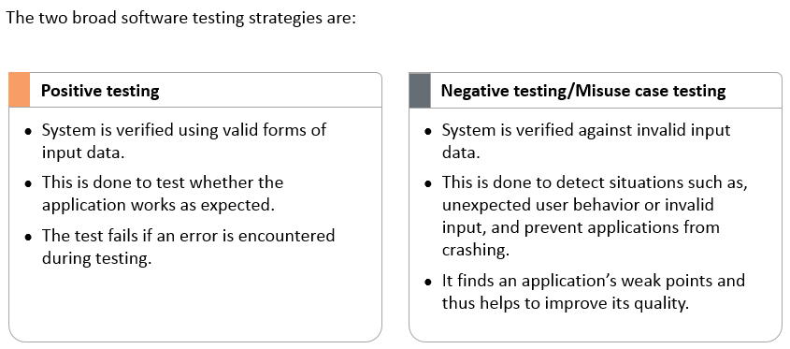
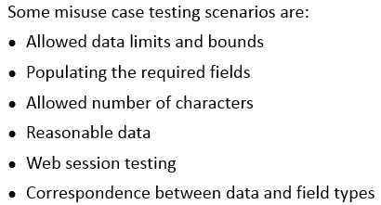
Misuse Case Testing
Notes:
Section breaker slide with customer logo
Section heading – Arial Headings, 34, Bold
Sub head – Arial Headings, 18, normal
Used for a section heading. You may add a sub heading not exceeding one line also here
Section heading – Arial Headings, bold, 34 font size, should not exceed beyond 1 line
Sub Head – Arial Headings, normal, 18 font size, should not exceed beyond 1 line

Slide 17
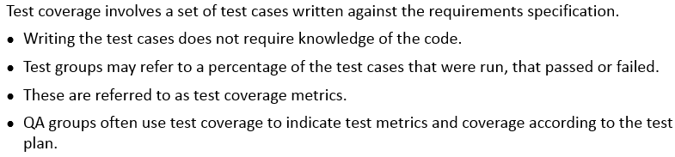
Test Coverage - Analysis
Notes:
Section breaker slide with customer logo
Section heading – Arial Headings, 34, Bold
Sub head – Arial Headings, 18, normal
Used for a section heading. You may add a sub heading not exceeding one line also here
Section heading – Arial Headings, bold, 34 font size, should not exceed beyond 1 line
Sub Head – Arial Headings, normal, 18 font size, should not exceed beyond 1 line

Slide 18
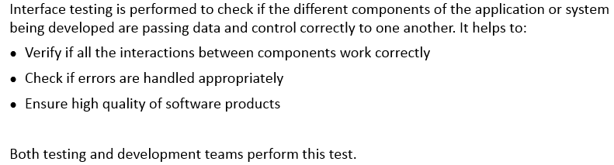
Interface Testing
Notes:
Section breaker slide with customer logo
Section heading – Arial Headings, 34, Bold
Sub head – Arial Headings, 18, normal
Used for a section heading. You may add a sub heading not exceeding one line also here
Section heading – Arial Headings, bold, 34 font size, should not exceed beyond 1 line
Sub Head – Arial Headings, normal, 18 font size, should not exceed beyond 1 line

Slide 19
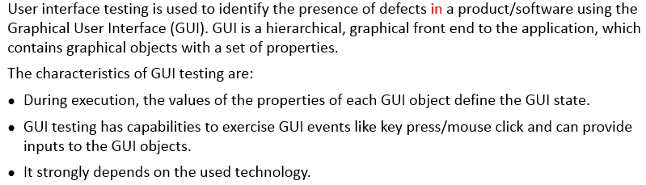
GUI Testing
Notes:
Section breaker slide with customer logo
Section heading – Arial Headings, 34, Bold
Sub head – Arial Headings, 18, normal
Used for a section heading. You may add a sub heading not exceeding one line also here
Section heading – Arial Headings, bold, 34 font size, should not exceed beyond 1 line
Sub Head – Arial Headings, normal, 18 font size, should not exceed beyond 1 line

Slide 20
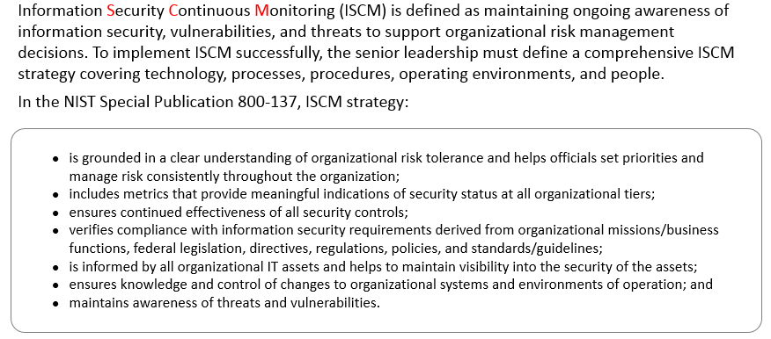
Information Security Continuous Monitoring (ISCM)
Notes:
Section breaker slide with customer logo
Section heading – Arial Headings, 34, Bold
Sub head – Arial Headings, 18, normal
Used for a section heading. You may add a sub heading not exceeding one line also here
Section heading – Arial Headings, bold, 34 font size, should not exceed beyond 1 line
Sub Head – Arial Headings, normal, 18 font size, should not exceed beyond 1 line

Slide 21
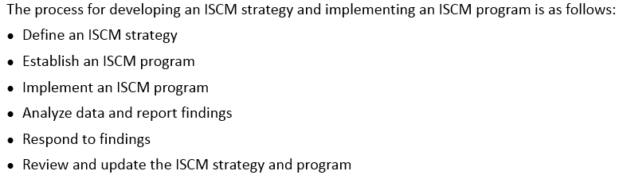
Information Security Continuous Monitoring (ISCM) – Strategy and Process
Notes:
Section breaker slide with customer logo
Section heading – Arial Headings, 34, Bold
Sub head – Arial Headings, 18, normal
Used for a section heading. You may add a sub heading not exceeding one line also here
Section heading – Arial Headings, bold, 34 font size, should not exceed beyond 1 line
Sub Head – Arial Headings, normal, 18 font size, should not exceed beyond 1 line

Slide 22
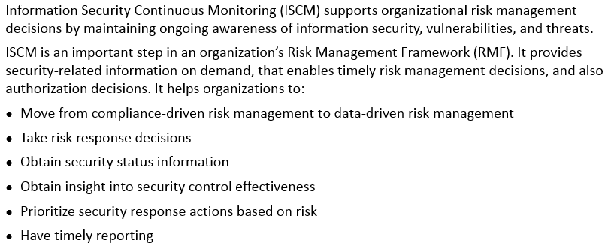
Information Security Continuous Monitoring (ISCM) – Benefits
Notes:
Section breaker slide with customer logo
Section heading – Arial Headings, 34, Bold
Sub head – Arial Headings, 18, normal
Used for a section heading. You may add a sub heading not exceeding one line also here
Section heading – Arial Headings, bold, 34 font size, should not exceed beyond 1 line
Sub Head – Arial Headings, normal, 18 font size, should not exceed beyond 1 line

Slide 23
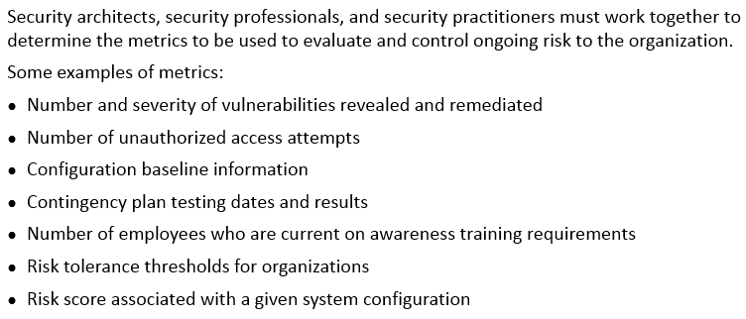
Risk Evaluation and Control - Metrics
Notes:
Section breaker slide with customer logo
Section heading – Arial Headings, 34, Bold
Sub head – Arial Headings, 18, normal
Used for a section heading. You may add a sub heading not exceeding one line also here
Section heading – Arial Headings, bold, 34 font size, should not exceed beyond 1 line
Sub Head – Arial Headings, normal, 18 font size, should not exceed beyond 1 line

Slide 24
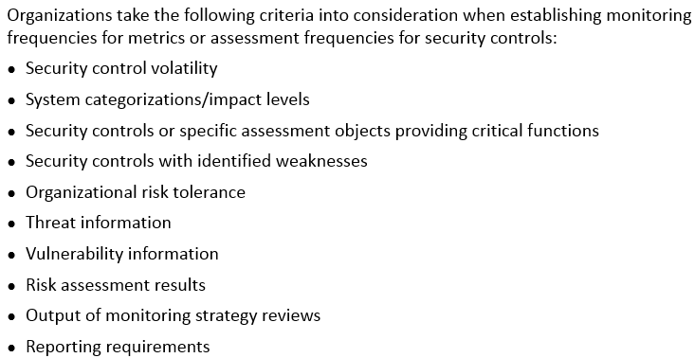
Security Controls Monitoring Frequencies
Notes:
Section breaker slide with customer logo
Section heading – Arial Headings, 34, Bold
Sub head – Arial Headings, 18, normal
Used for a section heading. You may add a sub heading not exceeding one line also here
Section heading – Arial Headings, bold, 34 font size, should not exceed beyond 1 line
Sub Head – Arial Headings, normal, 18 font size, should not exceed beyond 1 line

Slide 25
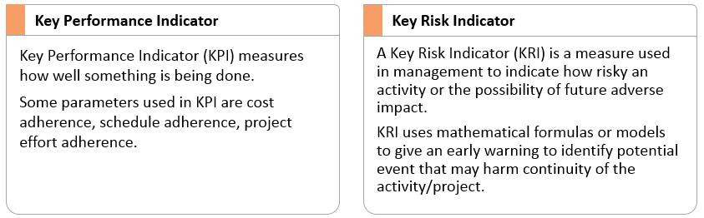
Key Performance Indicator (KPI) and Key Risk Indicator (KRI)
Notes:
Section breaker slide with customer logo
Section heading – Arial Headings, 34, Bold
Sub head – Arial Headings, 18, normal
Used for a section heading. You may add a sub heading not exceeding one line also here
Section heading – Arial Headings, bold, 34 font size, should not exceed beyond 1 line
Sub Head – Arial Headings, normal, 18 font size, should not exceed beyond 1 line

Slide 26
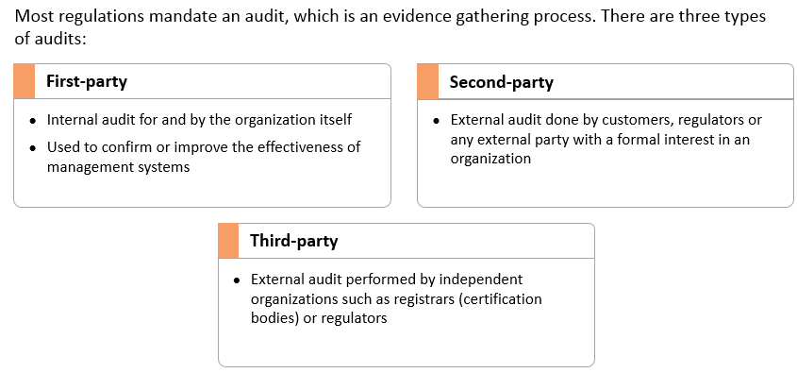
Internal and Third Party Audits
Notes:
Section breaker slide with customer logo
Section heading – Arial Headings, 34, Bold
Sub head – Arial Headings, 18, normal
Used for a section heading. You may add a sub heading not exceeding one line also here
Section heading – Arial Headings, bold, 34 font size, should not exceed beyond 1 line
Sub Head – Arial Headings, normal, 18 font size, should not exceed beyond 1 line

Slide 27
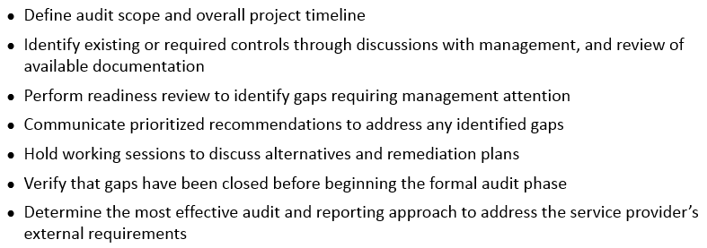
Audit Preparation Steps
Notes:
Section breaker slide with customer logo
Section heading – Arial Headings, 34, Bold
Sub head – Arial Headings, 18, normal
Used for a section heading. You may add a sub heading not exceeding one line also here
Section heading – Arial Headings, bold, 34 font size, should not exceed beyond 1 line
Sub Head – Arial Headings, normal, 18 font size, should not exceed beyond 1 line

Slide 28
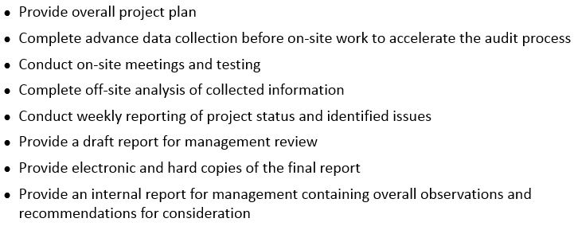
Overall Audit Process
Notes:
Section breaker slide with customer logo
Section heading – Arial Headings, 34, Bold
Sub head – Arial Headings, 18, normal
Used for a section heading. You may add a sub heading not exceeding one line also here
Section heading – Arial Headings, bold, 34 font size, should not exceed beyond 1 line
Sub Head – Arial Headings, normal, 18 font size, should not exceed beyond 1 line

Slide 29

Notes:
Section breaker slide with customer logo
Section heading – Arial Headings, 34, Bold
Sub head – Arial Headings, 18, normal
Used for a section heading. You may add a sub heading not exceeding one line also here
Section heading – Arial Headings, bold, 34 font size, should not exceed beyond 1 line
Sub Head – Arial Headings, normal, 18 font size, should not exceed beyond 1 line

Slide 30
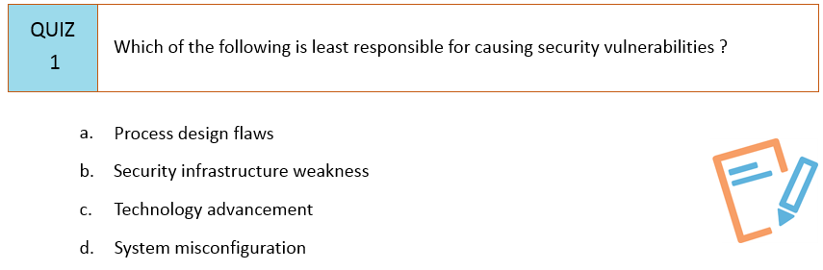
Notes:
Section breaker slide with customer logo
Section heading – Arial Headings, 34, Bold
Sub head – Arial Headings, 18, normal
Used for a section heading. You may add a sub heading not exceeding one line also here
Section heading – Arial Headings, bold, 34 font size, should not exceed beyond 1 line
Sub Head – Arial Headings, normal, 18 font size, should not exceed beyond 1 line

Slide 31
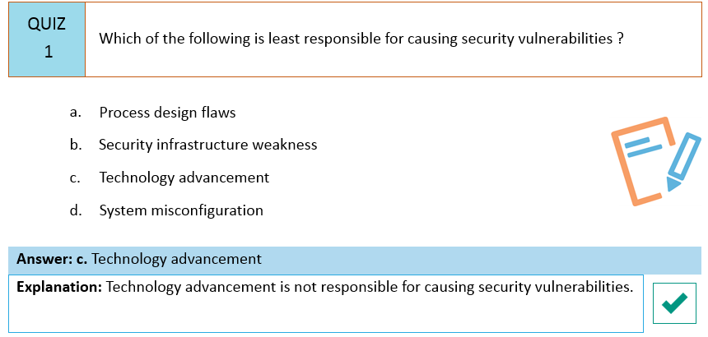
Notes:
Section breaker slide with customer logo
Section heading – Arial Headings, 34, Bold
Sub head – Arial Headings, 18, normal
Used for a section heading. You may add a sub heading not exceeding one line also here
Section heading – Arial Headings, bold, 34 font size, should not exceed beyond 1 line
Sub Head – Arial Headings, normal, 18 font size, should not exceed beyond 1 line

Slide 32
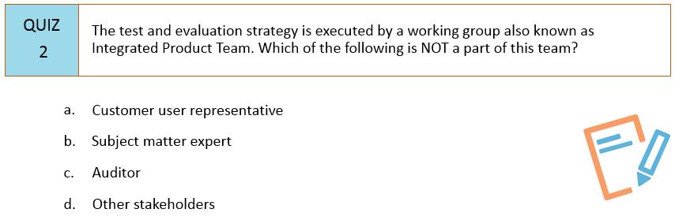
Notes:
Section breaker slide with customer logo
Section heading – Arial Headings, 34, Bold
Sub head – Arial Headings, 18, normal
Used for a section heading. You may add a sub heading not exceeding one line also here
Section heading – Arial Headings, bold, 34 font size, should not exceed beyond 1 line
Sub Head – Arial Headings, normal, 18 font size, should not exceed beyond 1 line

Slide 33
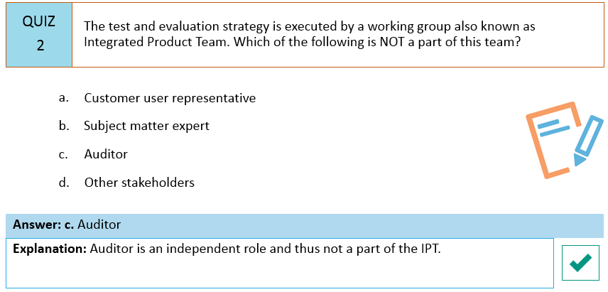
Notes:
Section breaker slide with customer logo
Section heading – Arial Headings, 34, Bold
Sub head – Arial Headings, 18, normal
Used for a section heading. You may add a sub heading not exceeding one line also here
Section heading – Arial Headings, bold, 34 font size, should not exceed beyond 1 line
Sub Head – Arial Headings, normal, 18 font size, should not exceed beyond 1 line

Slide 34
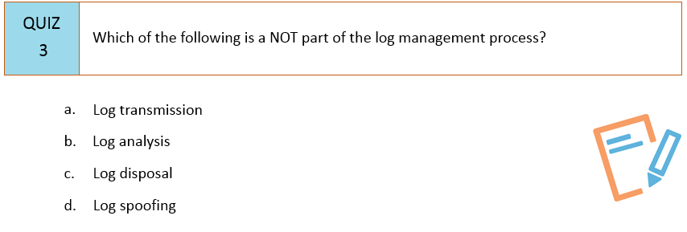
Notes:
Section breaker slide with customer logo
Section heading – Arial Headings, 34, Bold
Sub head – Arial Headings, 18, normal
Used for a section heading. You may add a sub heading not exceeding one line also here
Section heading – Arial Headings, bold, 34 font size, should not exceed beyond 1 line
Sub Head – Arial Headings, normal, 18 font size, should not exceed beyond 1 line

Slide 35
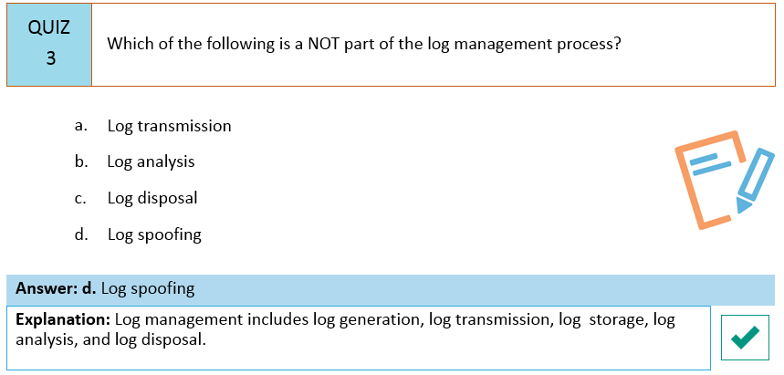
Notes:
Section breaker slide with customer logo
Section heading – Arial Headings, 34, Bold
Sub head – Arial Headings, 18, normal
Used for a section heading. You may add a sub heading not exceeding one line also here
Section heading – Arial Headings, bold, 34 font size, should not exceed beyond 1 line
Sub Head – Arial Headings, normal, 18 font size, should not exceed beyond 1 line

Slide 36
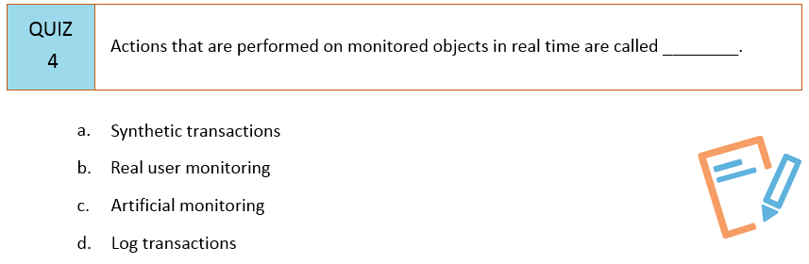
Notes:
Section breaker slide with customer logo
Section heading – Arial Headings, 34, Bold
Sub head – Arial Headings, 18, normal
Used for a section heading. You may add a sub heading not exceeding one line also here
Section heading – Arial Headings, bold, 34 font size, should not exceed beyond 1 line
Sub Head – Arial Headings, normal, 18 font size, should not exceed beyond 1 line

Slide 37
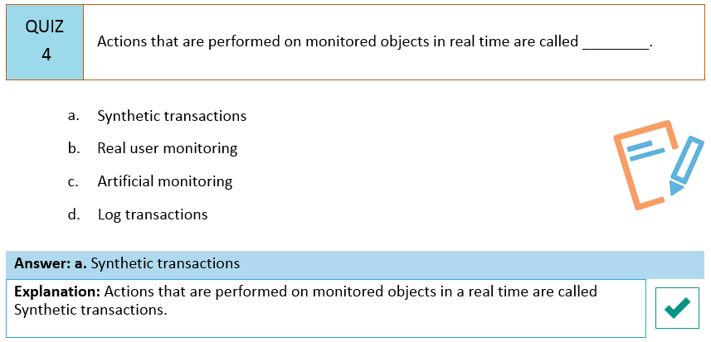
Notes:
Section breaker slide with customer logo
Section heading – Arial Headings, 34, Bold
Sub head – Arial Headings, 18, normal
Used for a section heading. You may add a sub heading not exceeding one line also here
Section heading – Arial Headings, bold, 34 font size, should not exceed beyond 1 line
Sub Head – Arial Headings, normal, 18 font size, should not exceed beyond 1 line

Slide 38
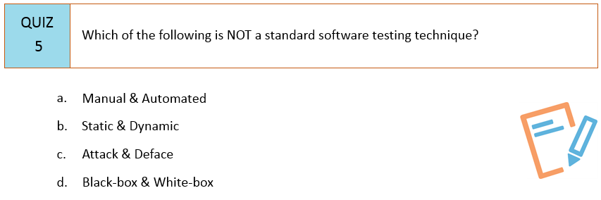
Notes:
Section breaker slide with customer logo
Section heading – Arial Headings, 34, Bold
Sub head – Arial Headings, 18, normal
Used for a section heading. You may add a sub heading not exceeding one line also here
Section heading – Arial Headings, bold, 34 font size, should not exceed beyond 1 line
Sub Head – Arial Headings, normal, 18 font size, should not exceed beyond 1 line

Slide 39
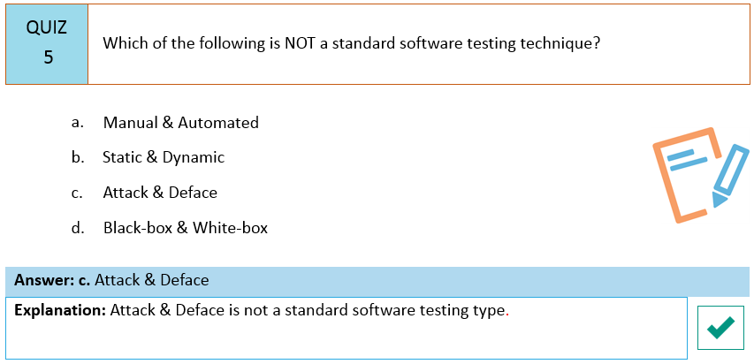
Notes:
Section breaker slide with customer logo
Section heading – Arial Headings, 34, Bold
Sub head – Arial Headings, 18, normal
Used for a section heading. You may add a sub heading not exceeding one line also here
Section heading – Arial Headings, bold, 34 font size, should not exceed beyond 1 line
Sub Head – Arial Headings, normal, 18 font size, should not exceed beyond 1 line

Slide 40
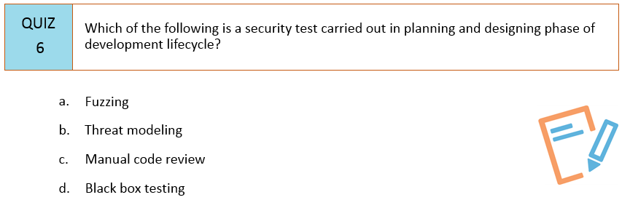
Notes:
Section breaker slide with customer logo
Section heading – Arial Headings, 34, Bold
Sub head – Arial Headings, 18, normal
Used for a section heading. You may add a sub heading not exceeding one line also here
Section heading – Arial Headings, bold, 34 font size, should not exceed beyond 1 line
Sub Head – Arial Headings, normal, 18 font size, should not exceed beyond 1 line

Slide 41
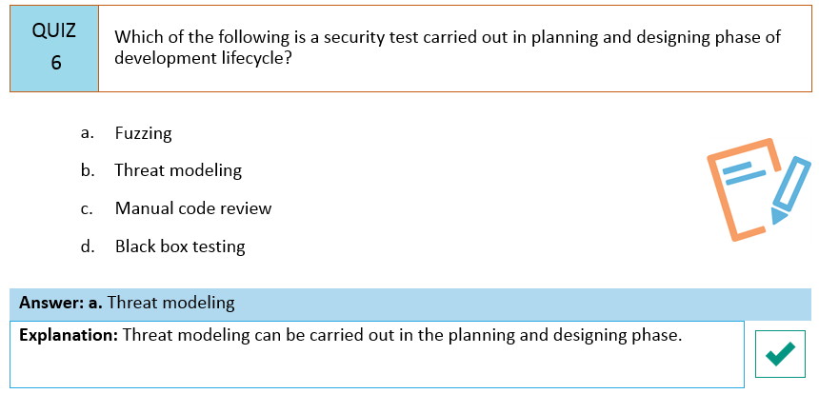
Notes:
Section breaker slide with customer logo
Section heading – Arial Headings, 34, Bold
Sub head – Arial Headings, 18, normal
Used for a section heading. You may add a sub heading not exceeding one line also here
Section heading – Arial Headings, bold, 34 font size, should not exceed beyond 1 line
Sub Head – Arial Headings, normal, 18 font size, should not exceed beyond 1 line

Slide 42
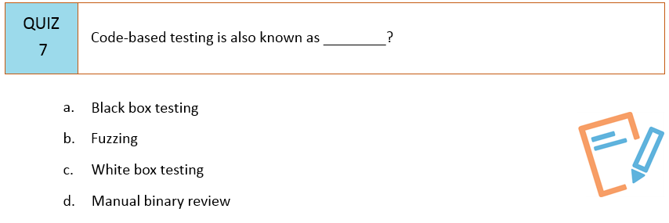
Notes:
Section breaker slide with customer logo
Section heading – Arial Headings, 34, Bold
Sub head – Arial Headings, 18, normal
Used for a section heading. You may add a sub heading not exceeding one line also here
Section heading – Arial Headings, bold, 34 font size, should not exceed beyond 1 line
Sub Head – Arial Headings, normal, 18 font size, should not exceed beyond 1 line

Slide 43
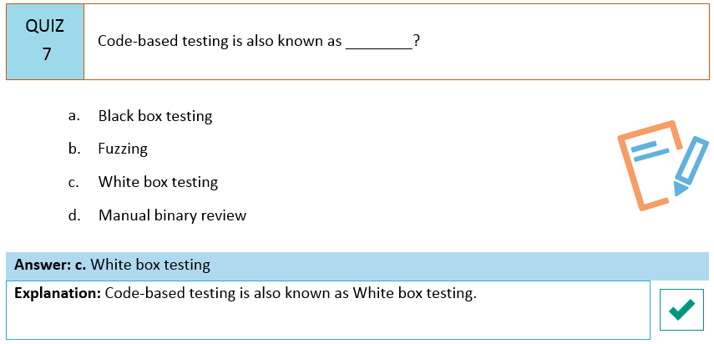
Notes:
Section breaker slide with customer logo
Section heading – Arial Headings, 34, Bold
Sub head – Arial Headings, 18, normal
Used for a section heading. You may add a sub heading not exceeding one line also here
Section heading – Arial Headings, bold, 34 font size, should not exceed beyond 1 line
Sub Head – Arial Headings, normal, 18 font size, should not exceed beyond 1 line

Slide 44
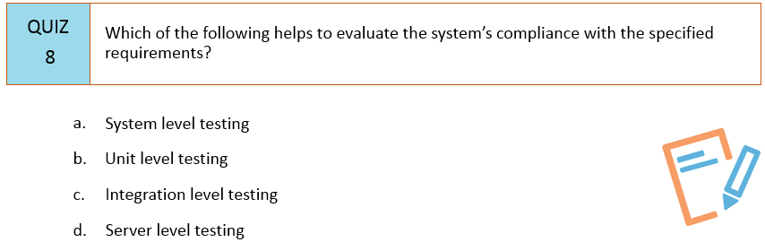
Notes:
Section breaker slide with customer logo
Section heading – Arial Headings, 34, Bold
Sub head – Arial Headings, 18, normal
Used for a section heading. You may add a sub heading not exceeding one line also here
Section heading – Arial Headings, bold, 34 font size, should not exceed beyond 1 line
Sub Head – Arial Headings, normal, 18 font size, should not exceed beyond 1 line

Slide 45
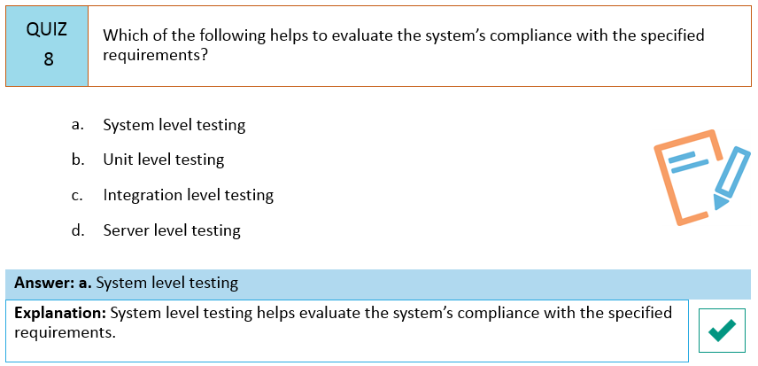
Notes:
Section breaker slide with customer logo
Section heading – Arial Headings, 34, Bold
Sub head – Arial Headings, 18, normal
Used for a section heading. You may add a sub heading not exceeding one line also here
Section heading – Arial Headings, bold, 34 font size, should not exceed beyond 1 line
Sub Head – Arial Headings, normal, 18 font size, should not exceed beyond 1 line

Slide 46
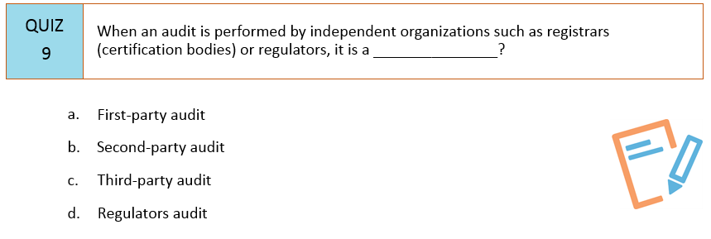
Notes:
Section breaker slide with customer logo
Section heading – Arial Headings, 34, Bold
Sub head – Arial Headings, 18, normal
Used for a section heading. You may add a sub heading not exceeding one line also here
Section heading – Arial Headings, bold, 34 font size, should not exceed beyond 1 line
Sub Head – Arial Headings, normal, 18 font size, should not exceed beyond 1 line

Slide 47
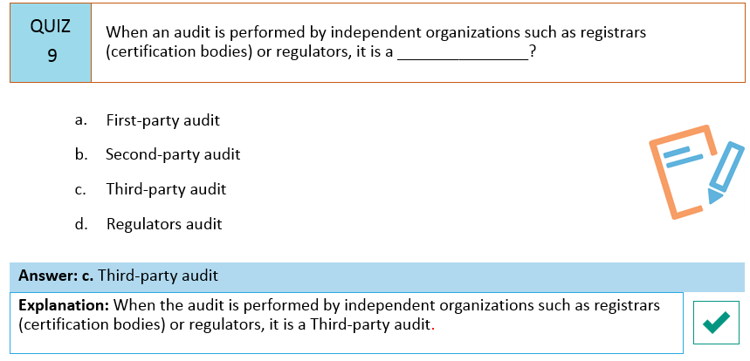
Notes:
Section breaker slide with customer logo
Section heading – Arial Headings, 34, Bold
Sub head – Arial Headings, 18, normal
Used for a section heading. You may add a sub heading not exceeding one line also here
Section heading – Arial Headings, bold, 34 font size, should not exceed beyond 1 line
Sub Head – Arial Headings, normal, 18 font size, should not exceed beyond 1 line

Slide 48
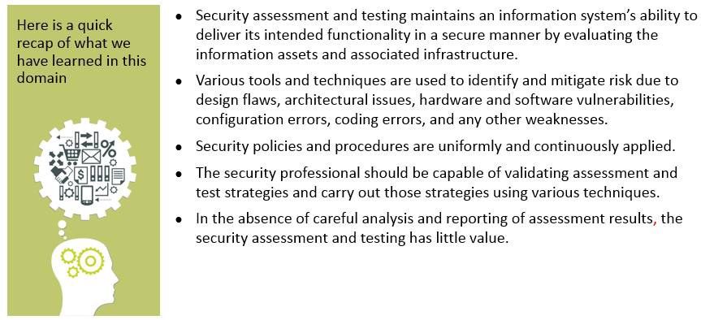
Summary
Notes:
Section breaker slide with customer logo
Section heading – Arial Headings, 34, Bold
Sub head – Arial Headings, 18, normal
Used for a section heading. You may add a sub heading not exceeding one line also here
Section heading – Arial Headings, bold, 34 font size, should not exceed beyond 1 line
Sub Head – Arial Headings, normal, 18 font size, should not exceed beyond 1 line

Slide 49
This concludes “Security Assessment and Testing”
The next domain is “Security Operations”
Notes:
Content Slide: This is usually the most frequently used slide in every presentation.
Use this slide for Text heavy slides. Text can only be used in bullet points
Title Heading – font size 30, Arial Heading
Slide Content – Should not reduce beyond Arial body font 16
If you need to use sub bullets please use the indent buttons located next to the bullets buttons in the tool bar and this will automatically provide you with the second, third, fourth & fifth level bullet styles and font sizes
Please note you can also press the tab key to create the different levels of bulleted content

