Slide 1
Domain 5 – Identity and Access Management
Notes:
The below and following notes on the template slides are to guide you only. In your final presentation, you may delete these notes and add relevant notes if any.
Title slide:
Title – should not exceed beyond 3 lines, font size 30-34, Arial Headings
(Font size for the title of the PPT can vary between 30-34, Arial Headings, Bold depending on the amount of text, however should not be smaller than 30 font size)
Name should not exceed beyond 1 line, Designation; font size to remain at 18, Arial Headings
Please keep the title slide simple, just the logo, title and name and designation to appear. No other graphic elements or any design, photograph, image can be added to this slide, alignment to remain the same

Slide 2
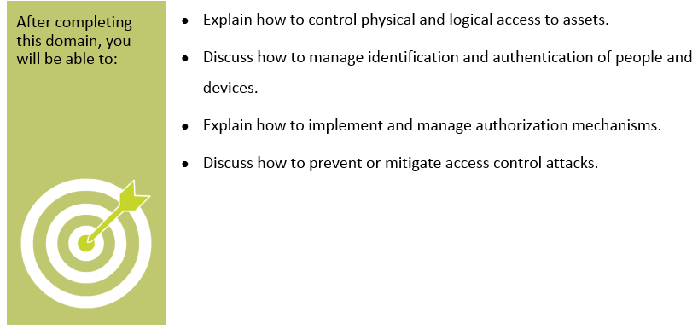
Objectives
Notes:
Section breaker slide with customer logo
Section heading – Arial Headings, 34, Bold
Sub head – Arial Headings, 18, normal
Used for a section heading. You may add a sub heading not exceeding one line also here
Section heading – Arial Headings, bold, 34 font size, should not exceed beyond 1 line
Sub Head – Arial Headings, normal, 18 font size, should not exceed beyond 1 line

Slide 3
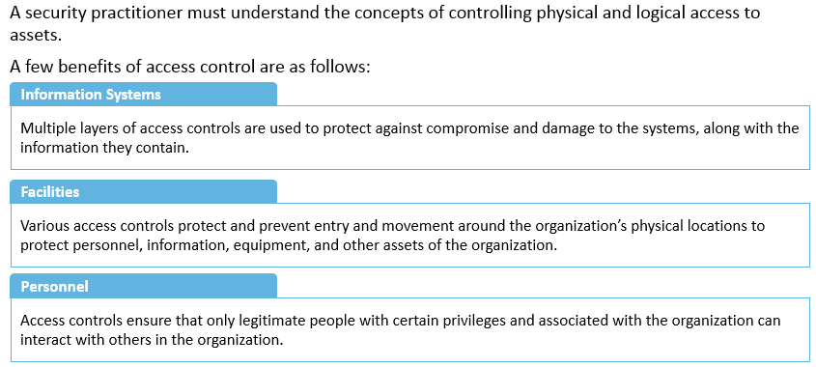
Controlling Physical and Logical Access to Assets
Notes:
Section breaker slide with customer logo
Section heading – Arial Headings, 34, Bold
Sub head – Arial Headings, 18, normal
Used for a section heading. You may add a sub heading not exceeding one line also here
Section heading – Arial Headings, bold, 34 font size, should not exceed beyond 1 line
Sub Head – Arial Headings, normal, 18 font size, should not exceed beyond 1 line

Slide 4
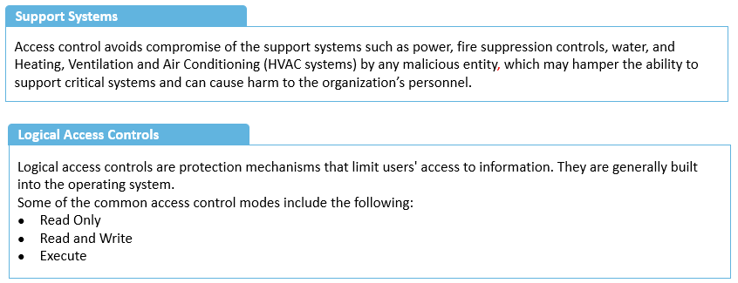
Controlling Physical and Logical Access to Assets (contd)
Notes:
Section breaker slide with customer logo
Section heading – Arial Headings, 34, Bold
Sub head – Arial Headings, 18, normal
Used for a section heading. You may add a sub heading not exceeding one line also here
Section heading – Arial Headings, bold, 34 font size, should not exceed beyond 1 line
Sub Head – Arial Headings, normal, 18 font size, should not exceed beyond 1 line

Slide 5
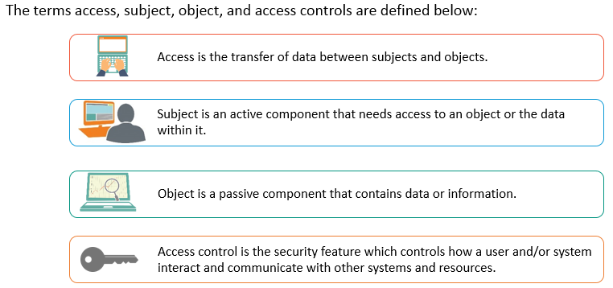
Access, Subject, Object and Accss Control
Notes:
Section breaker slide with customer logo
Section heading – Arial Headings, 34, Bold
Sub head – Arial Headings, 18, normal
Used for a section heading. You may add a sub heading not exceeding one line also here
Section heading – Arial Headings, bold, 34 font size, should not exceed beyond 1 line
Sub Head – Arial Headings, normal, 18 font size, should not exceed beyond 1 line

Slide 6
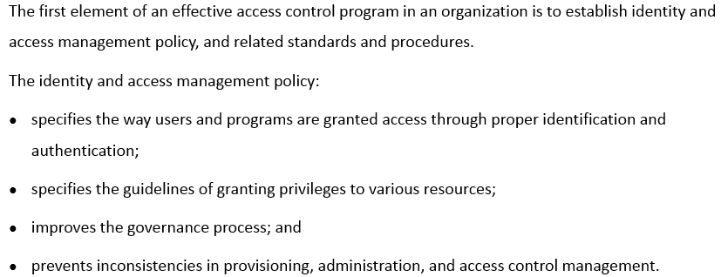
Identity and Access Management - Policy
Notes:
Section breaker slide with customer logo
Section heading – Arial Headings, 34, Bold
Sub head – Arial Headings, 18, normal
Used for a section heading. You may add a sub heading not exceeding one line also here
Section heading – Arial Headings, bold, 34 font size, should not exceed beyond 1 line
Sub Head – Arial Headings, normal, 18 font size, should not exceed beyond 1 line

Slide 7
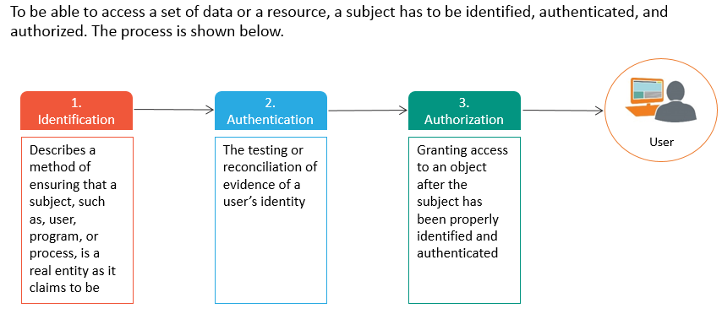
Identification, Authentication and Authorization
Notes:
Section breaker slide with customer logo
Section heading – Arial Headings, 34, Bold
Sub head – Arial Headings, 18, normal
Used for a section heading. You may add a sub heading not exceeding one line also here
Section heading – Arial Headings, bold, 34 font size, should not exceed beyond 1 line
Sub Head – Arial Headings, normal, 18 font size, should not exceed beyond 1 line

Slide 8
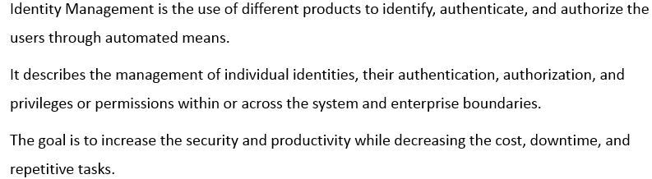
Identity Management
Notes:
Section breaker slide with customer logo
Section heading – Arial Headings, 34, Bold
Sub head – Arial Headings, 18, normal
Used for a section heading. You may add a sub heading not exceeding one line also here
Section heading – Arial Headings, bold, 34 font size, should not exceed beyond 1 line
Sub Head – Arial Headings, normal, 18 font size, should not exceed beyond 1 line

Slide 9
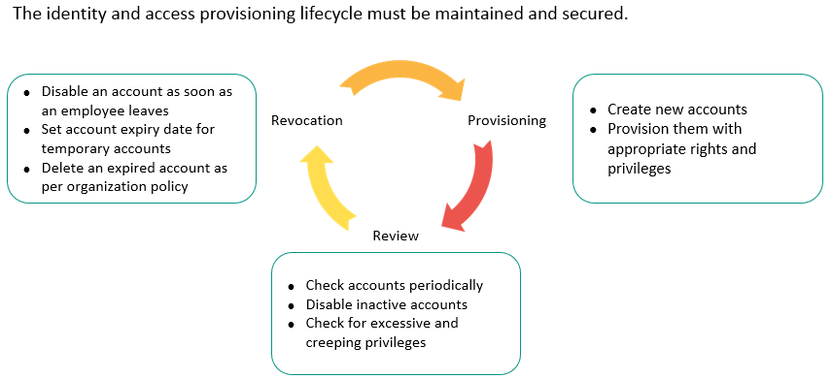
Identity and Access Provisioning Lifecycle
Notes:
Section breaker slide with customer logo
Section heading – Arial Headings, 34, Bold
Sub head – Arial Headings, 18, normal
Used for a section heading. You may add a sub heading not exceeding one line also here
Section heading – Arial Headings, bold, 34 font size, should not exceed beyond 1 line
Sub Head – Arial Headings, normal, 18 font size, should not exceed beyond 1 line

Slide 10
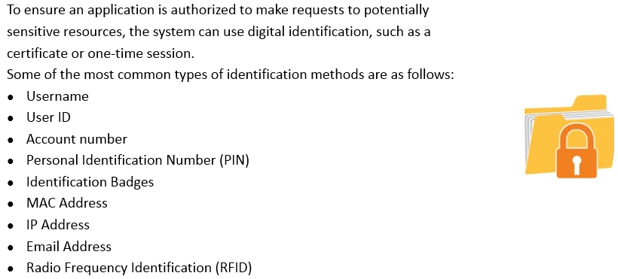
Identification Methods
Notes:
Section breaker slide with customer logo
Section heading – Arial Headings, 34, Bold
Sub head – Arial Headings, 18, normal
Used for a section heading. You may add a sub heading not exceeding one line also here
Section heading – Arial Headings, bold, 34 font size, should not exceed beyond 1 line
Sub Head – Arial Headings, normal, 18 font size, should not exceed beyond 1 line

Slide 11
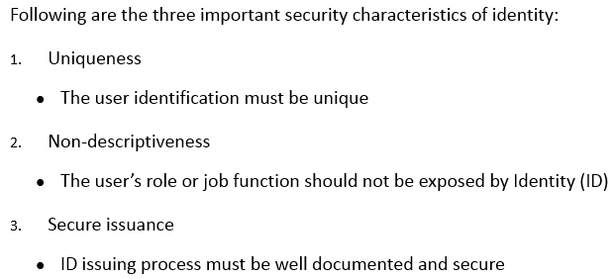
Guidelines for User Identification
Notes:
Section breaker slide with customer logo
Section heading – Arial Headings, 34, Bold
Sub head – Arial Headings, 18, normal
Used for a section heading. You may add a sub heading not exceeding one line also here
Section heading – Arial Headings, bold, 34 font size, should not exceed beyond 1 line
Sub Head – Arial Headings, normal, 18 font size, should not exceed beyond 1 line

Slide 12
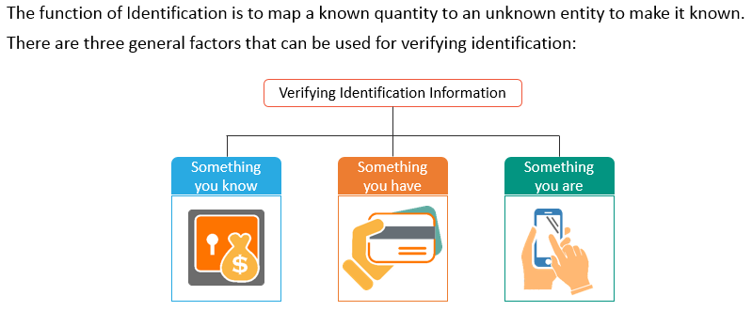
Verifying Identification Information
Notes:
Section breaker slide with customer logo
Section heading – Arial Headings, 34, Bold
Sub head – Arial Headings, 18, normal
Used for a section heading. You may add a sub heading not exceeding one line also here
Section heading – Arial Headings, bold, 34 font size, should not exceed beyond 1 line
Sub Head – Arial Headings, normal, 18 font size, should not exceed beyond 1 line

Slide 13
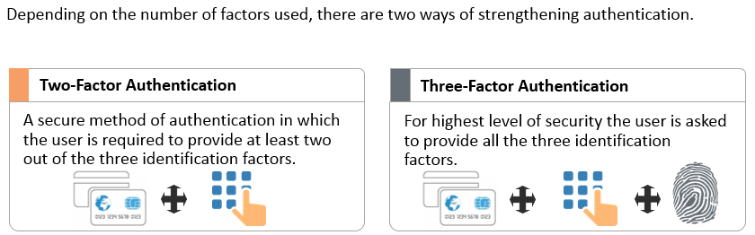
Strong Authentication
Notes:
Section breaker slide with customer logo
Section heading – Arial Headings, 34, Bold
Sub head – Arial Headings, 18, normal
Used for a section heading. You may add a sub heading not exceeding one line also here
Section heading – Arial Headings, bold, 34 font size, should not exceed beyond 1 line
Sub Head – Arial Headings, normal, 18 font size, should not exceed beyond 1 line

Slide 14
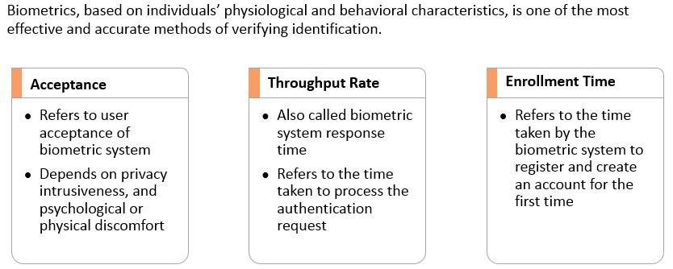
Biometrics – Characteristics
Notes:
Section breaker slide with customer logo
Section heading – Arial Headings, 34, Bold
Sub head – Arial Headings, 18, normal
Used for a section heading. You may add a sub heading not exceeding one line also here
Section heading – Arial Headings, bold, 34 font size, should not exceed beyond 1 line
Sub Head – Arial Headings, normal, 18 font size, should not exceed beyond 1 line

Slide 15
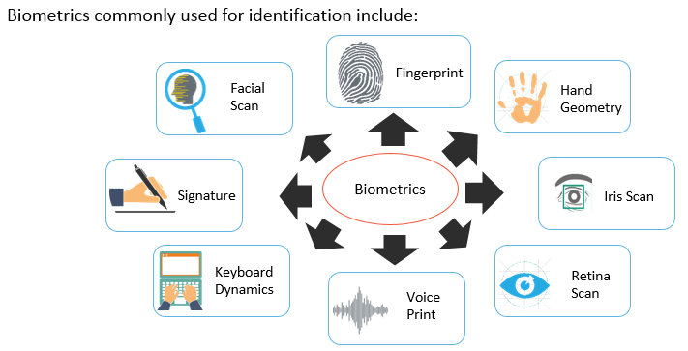
Biometrics - Types
Notes:
Section breaker slide with customer logo
Section heading – Arial Headings, 34, Bold
Sub head – Arial Headings, 18, normal
Used for a section heading. You may add a sub heading not exceeding one line also here
Section heading – Arial Headings, bold, 34 font size, should not exceed beyond 1 line
Sub Head – Arial Headings, normal, 18 font size, should not exceed beyond 1 line

Slide 16
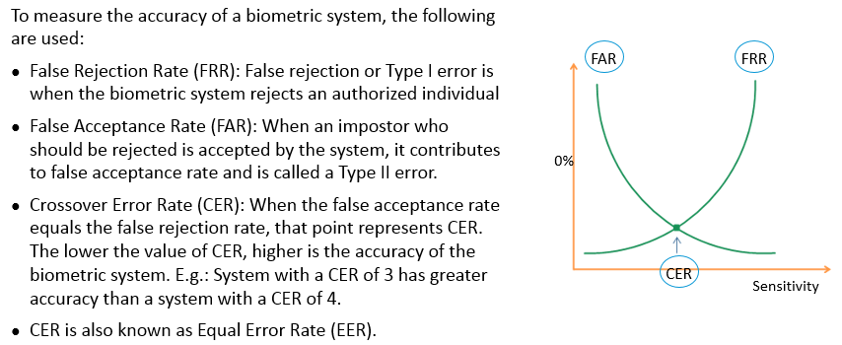
FRR, FAR and CER
Notes:
Section breaker slide with customer logo
Section heading – Arial Headings, 34, Bold
Sub head – Arial Headings, 18, normal
Used for a section heading. You may add a sub heading not exceeding one line also here
Section heading – Arial Headings, bold, 34 font size, should not exceed beyond 1 line
Sub Head – Arial Headings, normal, 18 font size, should not exceed beyond 1 line

Slide 17
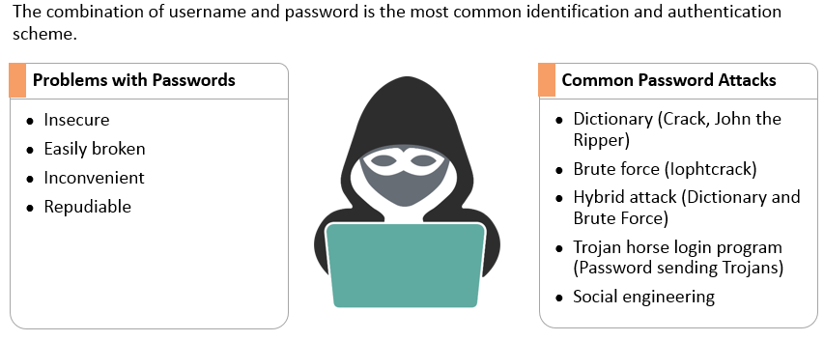
Passwords
Notes:
Section breaker slide with customer logo
Section heading – Arial Headings, 34, Bold
Sub head – Arial Headings, 18, normal
Used for a section heading. You may add a sub heading not exceeding one line also here
Section heading – Arial Headings, bold, 34 font size, should not exceed beyond 1 line
Sub Head – Arial Headings, normal, 18 font size, should not exceed beyond 1 line

Slide 18
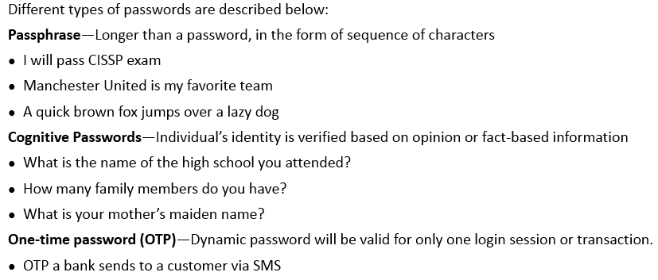
Passwords - Types
Notes:
Section breaker slide with customer logo
Section heading – Arial Headings, 34, Bold
Sub head – Arial Headings, 18, normal
Used for a section heading. You may add a sub heading not exceeding one line also here
Section heading – Arial Headings, bold, 34 font size, should not exceed beyond 1 line
Sub Head – Arial Headings, normal, 18 font size, should not exceed beyond 1 line

Slide 19
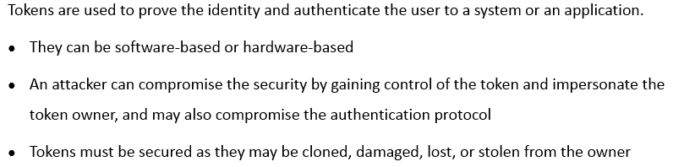
Tokens
Notes:
Section breaker slide with customer logo
Section heading – Arial Headings, 34, Bold
Sub head – Arial Headings, 18, normal
Used for a section heading. You may add a sub heading not exceeding one line also here
Section heading – Arial Headings, bold, 34 font size, should not exceed beyond 1 line
Sub Head – Arial Headings, normal, 18 font size, should not exceed beyond 1 line

Slide 20
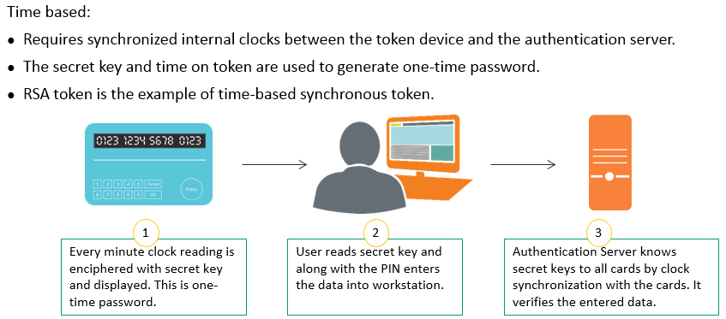
Token Device - Synchronous
Notes:
Section breaker slide with customer logo
Section heading – Arial Headings, 34, Bold
Sub head – Arial Headings, 18, normal
Used for a section heading. You may add a sub heading not exceeding one line also here
Section heading – Arial Headings, bold, 34 font size, should not exceed beyond 1 line
Sub Head – Arial Headings, normal, 18 font size, should not exceed beyond 1 line

Slide 21
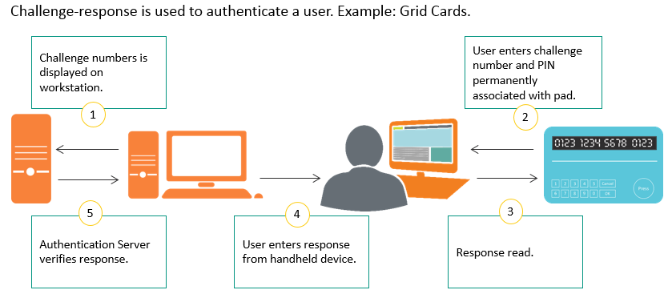
Token Device - Asynchronous
Notes:
Section breaker slide with customer logo
Section heading – Arial Headings, 34, Bold
Sub head – Arial Headings, 18, normal
Used for a section heading. You may add a sub heading not exceeding one line also here
Section heading – Arial Headings, bold, 34 font size, should not exceed beyond 1 line
Sub Head – Arial Headings, normal, 18 font size, should not exceed beyond 1 line

Slide 22
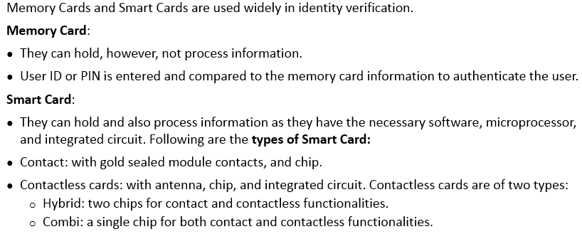
Memory Cards and Smart Cards
Notes:
Section breaker slide with customer logo
Section heading – Arial Headings, 34, Bold
Sub head – Arial Headings, 18, normal
Used for a section heading. You may add a sub heading not exceeding one line also here
Section heading – Arial Headings, bold, 34 font size, should not exceed beyond 1 line
Sub Head – Arial Headings, normal, 18 font size, should not exceed beyond 1 line

Slide 23
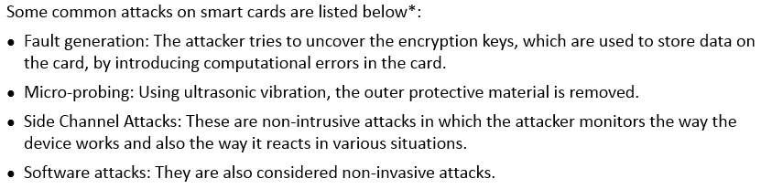
Attacks on Smart Cards
Notes:
Section breaker slide with customer logo
Section heading – Arial Headings, 34, Bold
Sub head – Arial Headings, 18, normal
Used for a section heading. You may add a sub heading not exceeding one line also here
Section heading – Arial Headings, bold, 34 font size, should not exceed beyond 1 line
Sub Head – Arial Headings, normal, 18 font size, should not exceed beyond 1 line

Slide 24
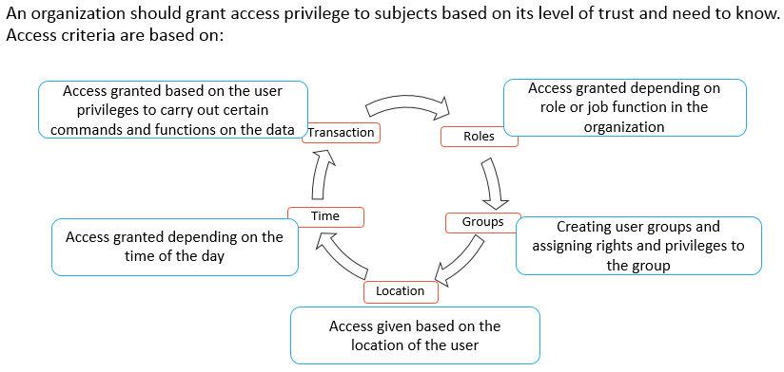
Access Criteria
Notes:
Section breaker slide with customer logo
Section heading – Arial Headings, 34, Bold
Sub head – Arial Headings, 18, normal
Used for a section heading. You may add a sub heading not exceeding one line also here
Section heading – Arial Headings, bold, 34 font size, should not exceed beyond 1 line
Sub Head – Arial Headings, normal, 18 font size, should not exceed beyond 1 line

Slide 25
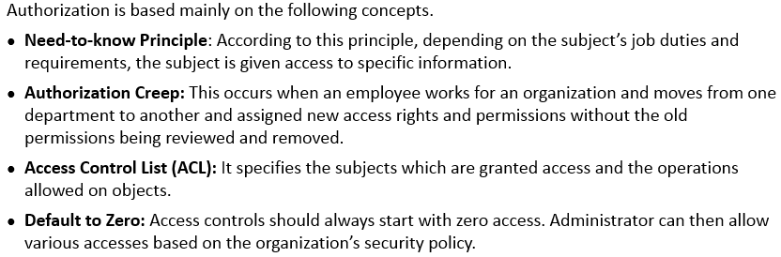
Authorization Concepts
Notes:
Section breaker slide with customer logo
Section heading – Arial Headings, 34, Bold
Sub head – Arial Headings, 18, normal
Used for a section heading. You may add a sub heading not exceeding one line also here
Section heading – Arial Headings, bold, 34 font size, should not exceed beyond 1 line
Sub Head – Arial Headings, normal, 18 font size, should not exceed beyond 1 line

Slide 26
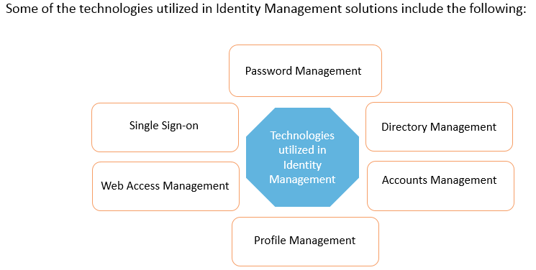
Identity Management - Implementation
Notes:
Section breaker slide with customer logo
Section heading – Arial Headings, 34, Bold
Sub head – Arial Headings, 18, normal
Used for a section heading. You may add a sub heading not exceeding one line also here
Section heading – Arial Headings, bold, 34 font size, should not exceed beyond 1 line
Sub Head – Arial Headings, normal, 18 font size, should not exceed beyond 1 line

Slide 27
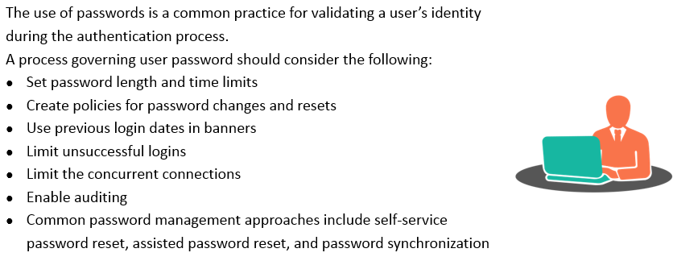
Password Management
Notes:
Section breaker slide with customer logo
Section heading – Arial Headings, 34, Bold
Sub head – Arial Headings, 18, normal
Used for a section heading. You may add a sub heading not exceeding one line also here
Section heading – Arial Headings, bold, 34 font size, should not exceed beyond 1 line
Sub Head – Arial Headings, normal, 18 font size, should not exceed beyond 1 line

Slide 28
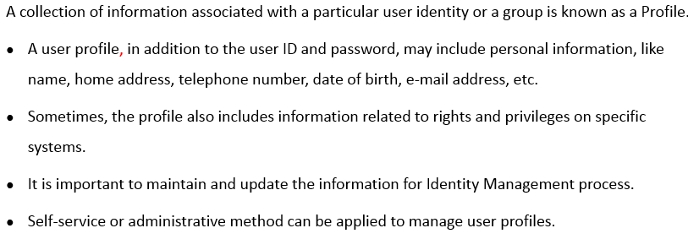
Profile Management
Notes:
Section breaker slide with customer logo
Section heading – Arial Headings, 34, Bold
Sub head – Arial Headings, 18, normal
Used for a section heading. You may add a sub heading not exceeding one line also here
Section heading – Arial Headings, bold, 34 font size, should not exceed beyond 1 line
Sub Head – Arial Headings, normal, 18 font size, should not exceed beyond 1 line

Slide 29
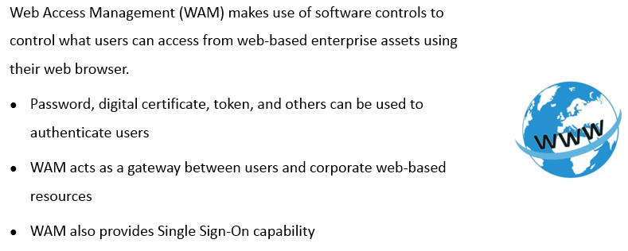
Web Access Management
Notes:
Section breaker slide with customer logo
Section heading – Arial Headings, 34, Bold
Sub head – Arial Headings, 18, normal
Used for a section heading. You may add a sub heading not exceeding one line also here
Section heading – Arial Headings, bold, 34 font size, should not exceed beyond 1 line
Sub Head – Arial Headings, normal, 18 font size, should not exceed beyond 1 line

Slide 30
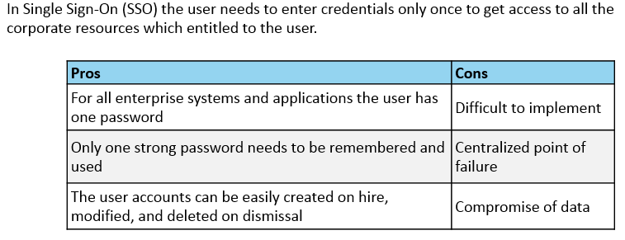
Single Sign On
Notes:
Section breaker slide with customer logo
Section heading – Arial Headings, 34, Bold
Sub head – Arial Headings, 18, normal
Used for a section heading. You may add a sub heading not exceeding one line also here
Section heading – Arial Headings, bold, 34 font size, should not exceed beyond 1 line
Sub Head – Arial Headings, normal, 18 font size, should not exceed beyond 1 line

Slide 31
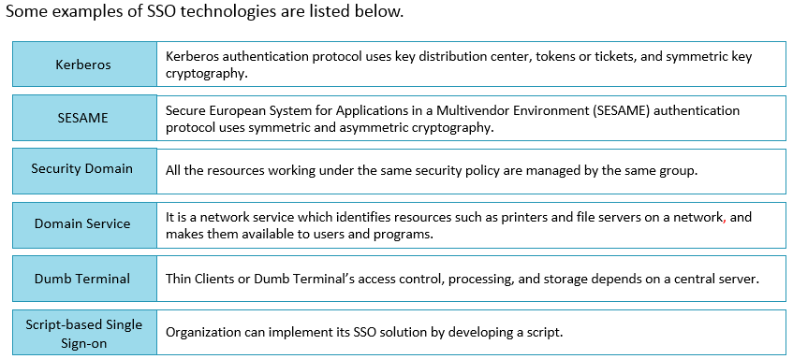
SSO Technologies
Notes:
Section breaker slide with customer logo
Section heading – Arial Headings, 34, Bold
Sub head – Arial Headings, 18, normal
Used for a section heading. You may add a sub heading not exceeding one line also here
Section heading – Arial Headings, bold, 34 font size, should not exceed beyond 1 line
Sub Head – Arial Headings, normal, 18 font size, should not exceed beyond 1 line

Slide 32
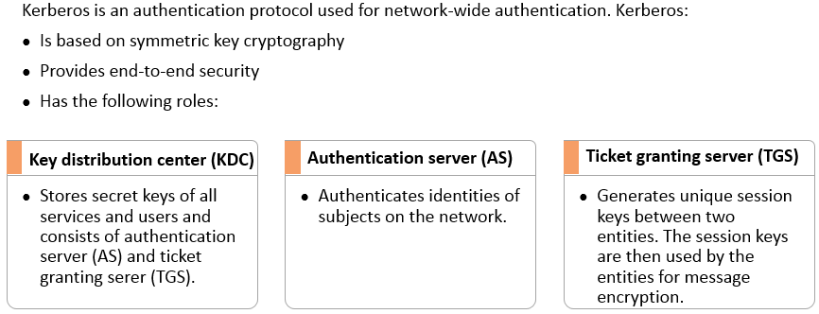
Kerberos
Notes:
Section breaker slide with customer logo
Section heading – Arial Headings, 34, Bold
Sub head – Arial Headings, 18, normal
Used for a section heading. You may add a sub heading not exceeding one line also here
Section heading – Arial Headings, bold, 34 font size, should not exceed beyond 1 line
Sub Head – Arial Headings, normal, 18 font size, should not exceed beyond 1 line

Slide 33

Kerberos - Problems
Notes:
Section breaker slide with customer logo
Section heading – Arial Headings, 34, Bold
Sub head – Arial Headings, 18, normal
Used for a section heading. You may add a sub heading not exceeding one line also here
Section heading – Arial Headings, bold, 34 font size, should not exceed beyond 1 line
Sub Head – Arial Headings, normal, 18 font size, should not exceed beyond 1 line

Slide 34
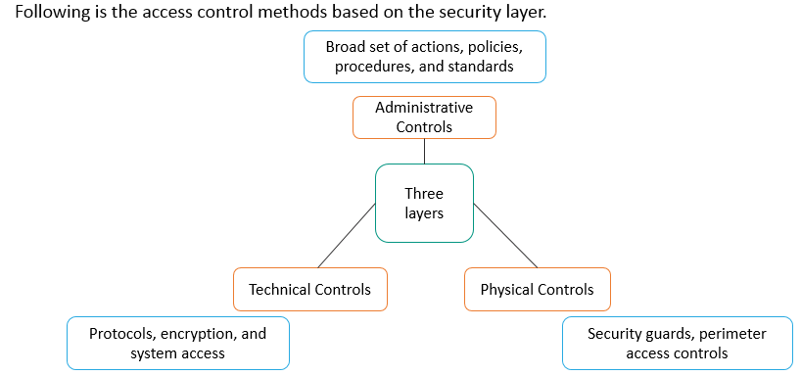
Access Related Controls
Notes:
Section breaker slide with customer logo
Section heading – Arial Headings, 34, Bold
Sub head – Arial Headings, 18, normal
Used for a section heading. You may add a sub heading not exceeding one line also here
Section heading – Arial Headings, bold, 34 font size, should not exceed beyond 1 line
Sub Head – Arial Headings, normal, 18 font size, should not exceed beyond 1 line

Slide 35
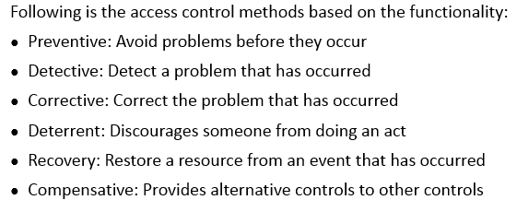
Access Control Method based on Functionality
Notes:
Section breaker slide with customer logo
Section heading – Arial Headings, 34, Bold
Sub head – Arial Headings, 18, normal
Used for a section heading. You may add a sub heading not exceeding one line also here
Section heading – Arial Headings, bold, 34 font size, should not exceed beyond 1 line
Sub Head – Arial Headings, normal, 18 font size, should not exceed beyond 1 line

Slide 36
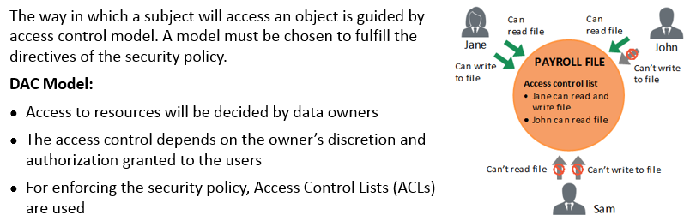
Access Control Models - DAC
Notes:
Section breaker slide with customer logo
Section heading – Arial Headings, 34, Bold
Sub head – Arial Headings, 18, normal
Used for a section heading. You may add a sub heading not exceeding one line also here
Section heading – Arial Headings, bold, 34 font size, should not exceed beyond 1 line
Sub Head – Arial Headings, normal, 18 font size, should not exceed beyond 1 line

Slide 37
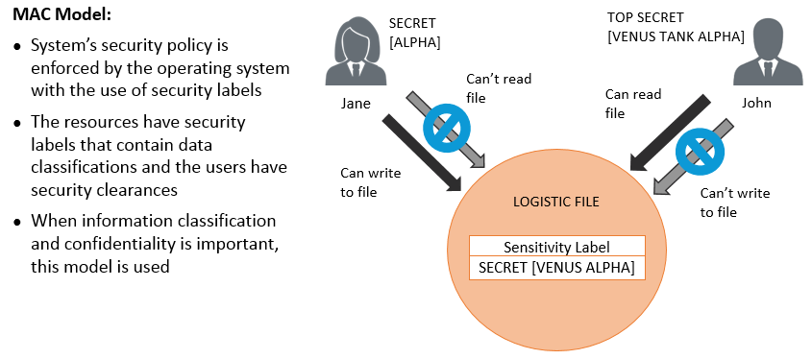
Access Control Models - MAC
Notes:
Section breaker slide with customer logo
Section heading – Arial Headings, 34, Bold
Sub head – Arial Headings, 18, normal
Used for a section heading. You may add a sub heading not exceeding one line also here
Section heading – Arial Headings, bold, 34 font size, should not exceed beyond 1 line
Sub Head – Arial Headings, normal, 18 font size, should not exceed beyond 1 line

Slide 38
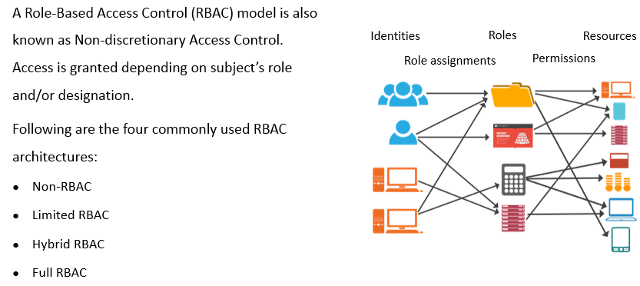
Access Control Models - RBAC
Notes:
Section breaker slide with customer logo
Section heading – Arial Headings, 34, Bold
Sub head – Arial Headings, 18, normal
Used for a section heading. You may add a sub heading not exceeding one line also here
Section heading – Arial Headings, bold, 34 font size, should not exceed beyond 1 line
Sub Head – Arial Headings, normal, 18 font size, should not exceed beyond 1 line

Slide 39
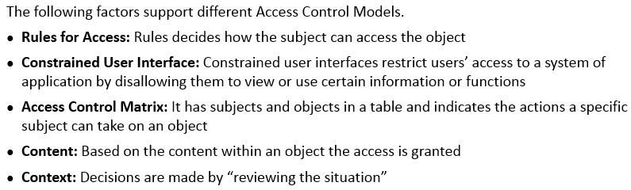
Access Control - Concepts
Notes:
Section breaker slide with customer logo
Section heading – Arial Headings, 34, Bold
Sub head – Arial Headings, 18, normal
Used for a section heading. You may add a sub heading not exceeding one line also here
Section heading – Arial Headings, bold, 34 font size, should not exceed beyond 1 line
Sub Head – Arial Headings, normal, 18 font size, should not exceed beyond 1 line

Slide 40
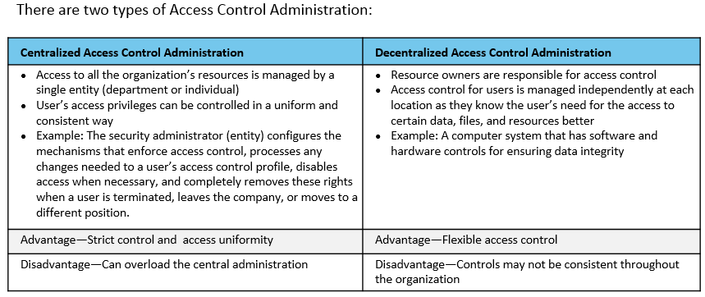
Access Control Administration - Types
Notes:
Section breaker slide with customer logo
Section heading – Arial Headings, 34, Bold
Sub head – Arial Headings, 18, normal
Used for a section heading. You may add a sub heading not exceeding one line also here
Section heading – Arial Headings, bold, 34 font size, should not exceed beyond 1 line
Sub Head – Arial Headings, normal, 18 font size, should not exceed beyond 1 line

Slide 41
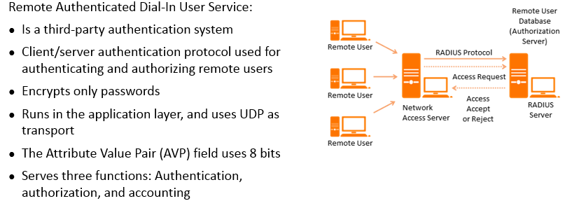
Remote Authentication Dial In User Service (RADIUS)
Notes:
Section breaker slide with customer logo
Section heading – Arial Headings, 34, Bold
Sub head – Arial Headings, 18, normal
Used for a section heading. You may add a sub heading not exceeding one line also here
Section heading – Arial Headings, bold, 34 font size, should not exceed beyond 1 line
Sub Head – Arial Headings, normal, 18 font size, should not exceed beyond 1 line

Slide 42
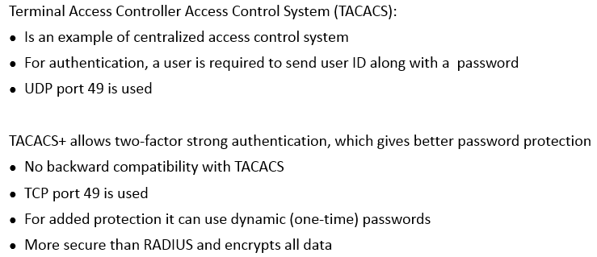
TACACS and TACACS+
Notes:
Section breaker slide with customer logo
Section heading – Arial Headings, 34, Bold
Sub head – Arial Headings, 18, normal
Used for a section heading. You may add a sub heading not exceeding one line also here
Section heading – Arial Headings, bold, 34 font size, should not exceed beyond 1 line
Sub Head – Arial Headings, normal, 18 font size, should not exceed beyond 1 line

Slide 43
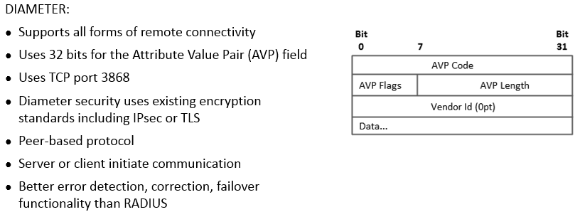
DIAMETER
Notes:
Section breaker slide with customer logo
Section heading – Arial Headings, 34, Bold
Sub head – Arial Headings, 18, normal
Used for a section heading. You may add a sub heading not exceeding one line also here
Section heading – Arial Headings, bold, 34 font size, should not exceed beyond 1 line
Sub Head – Arial Headings, normal, 18 font size, should not exceed beyond 1 line

Slide 44
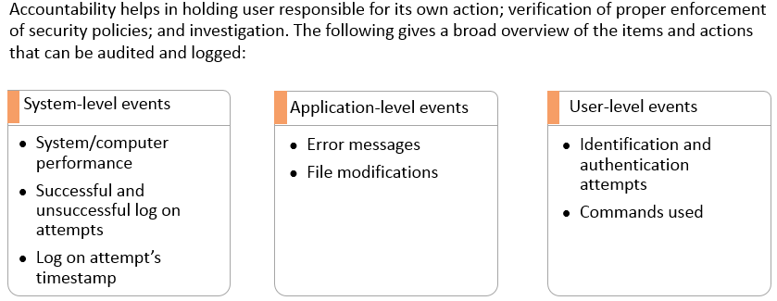
Accountability
Notes:
Section breaker slide with customer logo
Section heading – Arial Headings, 34, Bold
Sub head – Arial Headings, 18, normal
Used for a section heading. You may add a sub heading not exceeding one line also here
Section heading – Arial Headings, bold, 34 font size, should not exceed beyond 1 line
Sub Head – Arial Headings, normal, 18 font size, should not exceed beyond 1 line

Slide 45
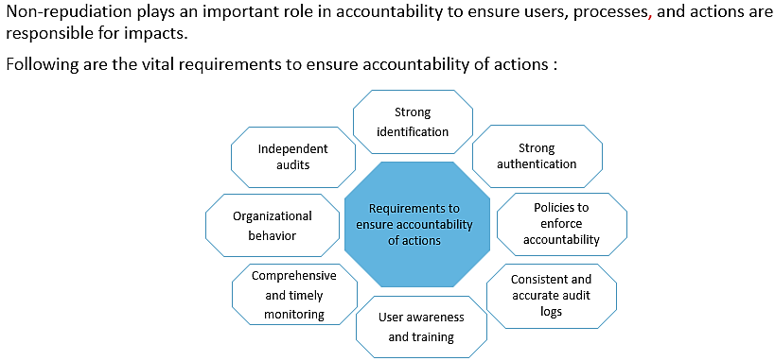
Accountability
Notes:
Section breaker slide with customer logo
Section heading – Arial Headings, 34, Bold
Sub head – Arial Headings, 18, normal
Used for a section heading. You may add a sub heading not exceeding one line also here
Section heading – Arial Headings, bold, 34 font size, should not exceed beyond 1 line
Sub Head – Arial Headings, normal, 18 font size, should not exceed beyond 1 line

Slide 46
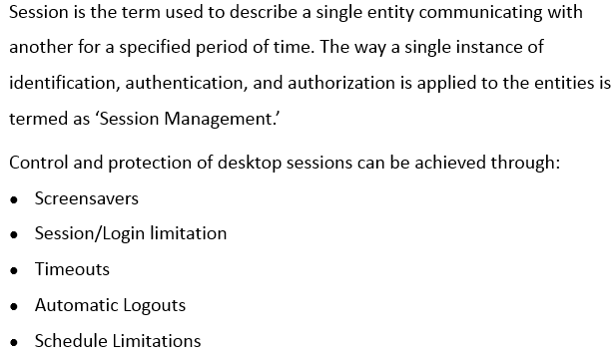
Session Management
Notes:
Section breaker slide with customer logo
Section heading – Arial Headings, 34, Bold
Sub head – Arial Headings, 18, normal
Used for a section heading. You may add a sub heading not exceeding one line also here
Section heading – Arial Headings, bold, 34 font size, should not exceed beyond 1 line
Sub Head – Arial Headings, normal, 18 font size, should not exceed beyond 1 line

Slide 47
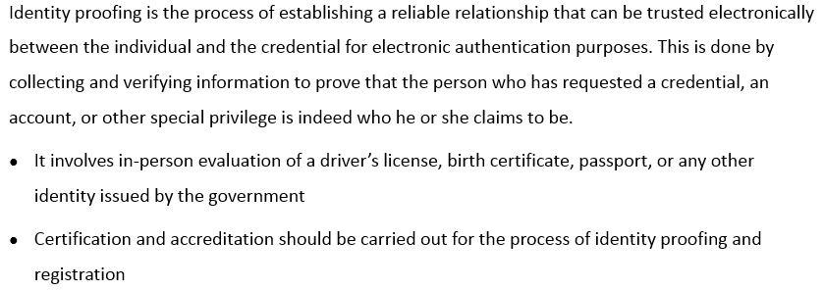
Registration and Proof of Identity
Notes:
Section breaker slide with customer logo
Section heading – Arial Headings, 34, Bold
Sub head – Arial Headings, 18, normal
Used for a section heading. You may add a sub heading not exceeding one line also here
Section heading – Arial Headings, bold, 34 font size, should not exceed beyond 1 line
Sub Head – Arial Headings, normal, 18 font size, should not exceed beyond 1 line

Slide 48
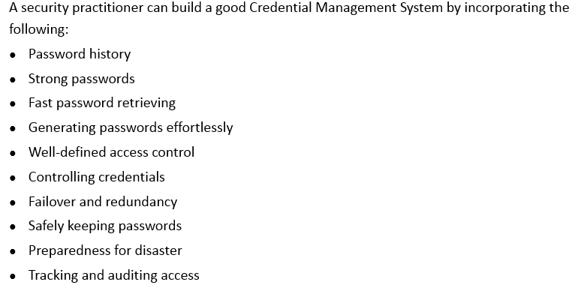
Credential Management Systems (CMS)
Notes:
Section breaker slide with customer logo
Section heading – Arial Headings, 34, Bold
Sub head – Arial Headings, 18, normal
Used for a section heading. You may add a sub heading not exceeding one line also here
Section heading – Arial Headings, bold, 34 font size, should not exceed beyond 1 line
Sub Head – Arial Headings, normal, 18 font size, should not exceed beyond 1 line

Slide 49
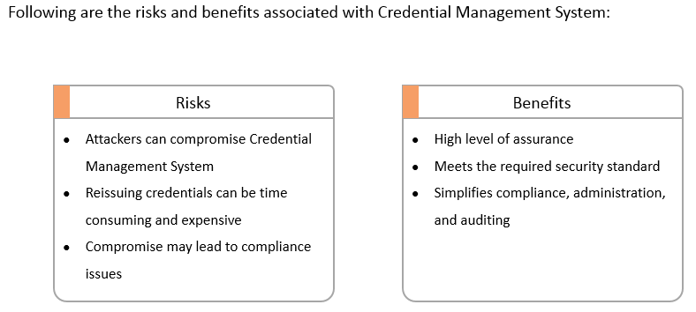
Credential Management Systems (CMS) – Risks vs Benefits
Notes:
Section breaker slide with customer logo
Section heading – Arial Headings, 34, Bold
Sub head – Arial Headings, 18, normal
Used for a section heading. You may add a sub heading not exceeding one line also here
Section heading – Arial Headings, bold, 34 font size, should not exceed beyond 1 line
Sub Head – Arial Headings, normal, 18 font size, should not exceed beyond 1 line

Slide 50
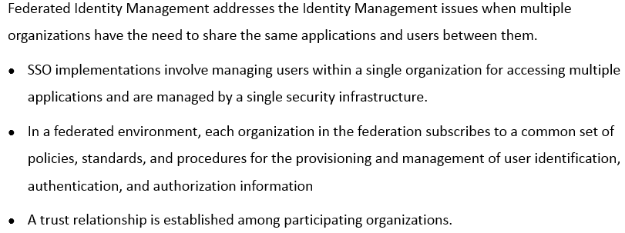
Federated Identity Management
Notes:
Section breaker slide with customer logo
Section heading – Arial Headings, 34, Bold
Sub head – Arial Headings, 18, normal
Used for a section heading. You may add a sub heading not exceeding one line also here
Section heading – Arial Headings, bold, 34 font size, should not exceed beyond 1 line
Sub Head – Arial Headings, normal, 18 font size, should not exceed beyond 1 line

Slide 51
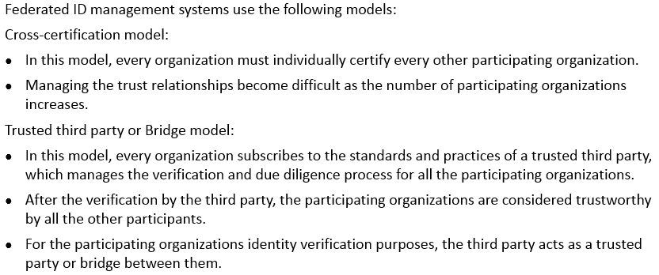
Federated Identity Management - Models
Notes:
Section breaker slide with customer logo
Section heading – Arial Headings, 34, Bold
Sub head – Arial Headings, 18, normal
Used for a section heading. You may add a sub heading not exceeding one line also here
Section heading – Arial Headings, bold, 34 font size, should not exceed beyond 1 line
Sub Head – Arial Headings, normal, 18 font size, should not exceed beyond 1 line

Slide 52
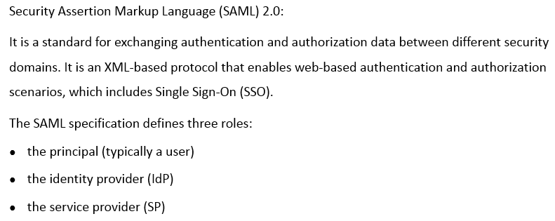
Federated Identity Management – Models (contd)
Notes:
Section breaker slide with customer logo
Section heading – Arial Headings, 34, Bold
Sub head – Arial Headings, 18, normal
Used for a section heading. You may add a sub heading not exceeding one line also here
Section heading – Arial Headings, bold, 34 font size, should not exceed beyond 1 line
Sub Head – Arial Headings, normal, 18 font size, should not exceed beyond 1 line

Slide 53

Federated Identity Management – Models (contd)
Notes:
Section breaker slide with customer logo
Section heading – Arial Headings, 34, Bold
Sub head – Arial Headings, 18, normal
Used for a section heading. You may add a sub heading not exceeding one line also here
Section heading – Arial Headings, bold, 34 font size, should not exceed beyond 1 line
Sub Head – Arial Headings, normal, 18 font size, should not exceed beyond 1 line

Slide 54

Identity As A Service
Notes:
Section breaker slide with customer logo
Section heading – Arial Headings, 34, Bold
Sub head – Arial Headings, 18, normal
Used for a section heading. You may add a sub heading not exceeding one line also here
Section heading – Arial Headings, bold, 34 font size, should not exceed beyond 1 line
Sub Head – Arial Headings, normal, 18 font size, should not exceed beyond 1 line

Slide 55

Identity As A Service - Functionality
Notes:
Section breaker slide with customer logo
Section heading – Arial Headings, 34, Bold
Sub head – Arial Headings, 18, normal
Used for a section heading. You may add a sub heading not exceeding one line also here
Section heading – Arial Headings, bold, 34 font size, should not exceed beyond 1 line
Sub Head – Arial Headings, normal, 18 font size, should not exceed beyond 1 line

Slide 56

Identity As A Service – Possible Issues
Notes:
Section breaker slide with customer logo
Section heading – Arial Headings, 34, Bold
Sub head – Arial Headings, 18, normal
Used for a section heading. You may add a sub heading not exceeding one line also here
Section heading – Arial Headings, bold, 34 font size, should not exceed beyond 1 line
Sub Head – Arial Headings, normal, 18 font size, should not exceed beyond 1 line

Slide 57

Integrate Third Party Identity Services
Notes:
Section breaker slide with customer logo
Section heading – Arial Headings, 34, Bold
Sub head – Arial Headings, 18, normal
Used for a section heading. You may add a sub heading not exceeding one line also here
Section heading – Arial Headings, bold, 34 font size, should not exceed beyond 1 line
Sub Head – Arial Headings, normal, 18 font size, should not exceed beyond 1 line

Slide 58

Unauthorized Disclosure of Information
Notes:
Section breaker slide with customer logo
Section heading – Arial Headings, 34, Bold
Sub head – Arial Headings, 18, normal
Used for a section heading. You may add a sub heading not exceeding one line also here
Section heading – Arial Headings, bold, 34 font size, should not exceed beyond 1 line
Sub Head – Arial Headings, normal, 18 font size, should not exceed beyond 1 line

Slide 59

Access Control - Threats
Notes:
Section breaker slide with customer logo
Section heading – Arial Headings, 34, Bold
Sub head – Arial Headings, 18, normal
Used for a section heading. You may add a sub heading not exceeding one line also here
Section heading – Arial Headings, bold, 34 font size, should not exceed beyond 1 line
Sub Head – Arial Headings, normal, 18 font size, should not exceed beyond 1 line

Slide 60

Protection Against Access Control Attacks
Notes:
Section breaker slide with customer logo
Section heading – Arial Headings, 34, Bold
Sub head – Arial Headings, 18, normal
Used for a section heading. You may add a sub heading not exceeding one line also here
Section heading – Arial Headings, bold, 34 font size, should not exceed beyond 1 line
Sub Head – Arial Headings, normal, 18 font size, should not exceed beyond 1 line

Slide 61


Access Control – Best Practices
Notes:
Section breaker slide with customer logo
Section heading – Arial Headings, 34, Bold
Sub head – Arial Headings, 18, normal
Used for a section heading. You may add a sub heading not exceeding one line also here
Section heading – Arial Headings, bold, 34 font size, should not exceed beyond 1 line
Sub Head – Arial Headings, normal, 18 font size, should not exceed beyond 1 line

Slide 62

Notes:
Section breaker slide with customer logo
Section heading – Arial Headings, 34, Bold
Sub head – Arial Headings, 18, normal
Used for a section heading. You may add a sub heading not exceeding one line also here
Section heading – Arial Headings, bold, 34 font size, should not exceed beyond 1 line
Sub Head – Arial Headings, normal, 18 font size, should not exceed beyond 1 line

Slide 63

Notes:
Section breaker slide with customer logo
Section heading – Arial Headings, 34, Bold
Sub head – Arial Headings, 18, normal
Used for a section heading. You may add a sub heading not exceeding one line also here
Section heading – Arial Headings, bold, 34 font size, should not exceed beyond 1 line
Sub Head – Arial Headings, normal, 18 font size, should not exceed beyond 1 line

Slide 64

Notes:
Section breaker slide with customer logo
Section heading – Arial Headings, 34, Bold
Sub head – Arial Headings, 18, normal
Used for a section heading. You may add a sub heading not exceeding one line also here
Section heading – Arial Headings, bold, 34 font size, should not exceed beyond 1 line
Sub Head – Arial Headings, normal, 18 font size, should not exceed beyond 1 line

Slide 65

Notes:
Section breaker slide with customer logo
Section heading – Arial Headings, 34, Bold
Sub head – Arial Headings, 18, normal
Used for a section heading. You may add a sub heading not exceeding one line also here
Section heading – Arial Headings, bold, 34 font size, should not exceed beyond 1 line
Sub Head – Arial Headings, normal, 18 font size, should not exceed beyond 1 line

Slide 66

Notes:
Section breaker slide with customer logo
Section heading – Arial Headings, 34, Bold
Sub head – Arial Headings, 18, normal
Used for a section heading. You may add a sub heading not exceeding one line also here
Section heading – Arial Headings, bold, 34 font size, should not exceed beyond 1 line
Sub Head – Arial Headings, normal, 18 font size, should not exceed beyond 1 line

Slide 67

Notes:
Section breaker slide with customer logo
Section heading – Arial Headings, 34, Bold
Sub head – Arial Headings, 18, normal
Used for a section heading. You may add a sub heading not exceeding one line also here
Section heading – Arial Headings, bold, 34 font size, should not exceed beyond 1 line
Sub Head – Arial Headings, normal, 18 font size, should not exceed beyond 1 line

Slide 68

Notes:
Section breaker slide with customer logo
Section heading – Arial Headings, 34, Bold
Sub head – Arial Headings, 18, normal
Used for a section heading. You may add a sub heading not exceeding one line also here
Section heading – Arial Headings, bold, 34 font size, should not exceed beyond 1 line
Sub Head – Arial Headings, normal, 18 font size, should not exceed beyond 1 line

Slide 69

Notes:
Section breaker slide with customer logo
Section heading – Arial Headings, 34, Bold
Sub head – Arial Headings, 18, normal
Used for a section heading. You may add a sub heading not exceeding one line also here
Section heading – Arial Headings, bold, 34 font size, should not exceed beyond 1 line
Sub Head – Arial Headings, normal, 18 font size, should not exceed beyond 1 line

Slide 70

Notes:
Section breaker slide with customer logo
Section heading – Arial Headings, 34, Bold
Sub head – Arial Headings, 18, normal
Used for a section heading. You may add a sub heading not exceeding one line also here
Section heading – Arial Headings, bold, 34 font size, should not exceed beyond 1 line
Sub Head – Arial Headings, normal, 18 font size, should not exceed beyond 1 line

Slide 71

Notes:
Section breaker slide with customer logo
Section heading – Arial Headings, 34, Bold
Sub head – Arial Headings, 18, normal
Used for a section heading. You may add a sub heading not exceeding one line also here
Section heading – Arial Headings, bold, 34 font size, should not exceed beyond 1 line
Sub Head – Arial Headings, normal, 18 font size, should not exceed beyond 1 line

Slide 72

Notes:
Section breaker slide with customer logo
Section heading – Arial Headings, 34, Bold
Sub head – Arial Headings, 18, normal
Used for a section heading. You may add a sub heading not exceeding one line also here
Section heading – Arial Headings, bold, 34 font size, should not exceed beyond 1 line
Sub Head – Arial Headings, normal, 18 font size, should not exceed beyond 1 line

Slide 73

Notes:
Section breaker slide with customer logo
Section heading – Arial Headings, 34, Bold
Sub head – Arial Headings, 18, normal
Used for a section heading. You may add a sub heading not exceeding one line also here
Section heading – Arial Headings, bold, 34 font size, should not exceed beyond 1 line
Sub Head – Arial Headings, normal, 18 font size, should not exceed beyond 1 line

Slide 74

Notes:
Section breaker slide with customer logo
Section heading – Arial Headings, 34, Bold
Sub head – Arial Headings, 18, normal
Used for a section heading. You may add a sub heading not exceeding one line also here
Section heading – Arial Headings, bold, 34 font size, should not exceed beyond 1 line
Sub Head – Arial Headings, normal, 18 font size, should not exceed beyond 1 line

Slide 75

Notes:
Section breaker slide with customer logo
Section heading – Arial Headings, 34, Bold
Sub head – Arial Headings, 18, normal
Used for a section heading. You may add a sub heading not exceeding one line also here
Section heading – Arial Headings, bold, 34 font size, should not exceed beyond 1 line
Sub Head – Arial Headings, normal, 18 font size, should not exceed beyond 1 line

Slide 76

Notes:
Section breaker slide with customer logo
Section heading – Arial Headings, 34, Bold
Sub head – Arial Headings, 18, normal
Used for a section heading. You may add a sub heading not exceeding one line also here
Section heading – Arial Headings, bold, 34 font size, should not exceed beyond 1 line
Sub Head – Arial Headings, normal, 18 font size, should not exceed beyond 1 line

Slide 77

Notes:
Section breaker slide with customer logo
Section heading – Arial Headings, 34, Bold
Sub head – Arial Headings, 18, normal
Used for a section heading. You may add a sub heading not exceeding one line also here
Section heading – Arial Headings, bold, 34 font size, should not exceed beyond 1 line
Sub Head – Arial Headings, normal, 18 font size, should not exceed beyond 1 line

Slide 78

Notes:
Section breaker slide with customer logo
Section heading – Arial Headings, 34, Bold
Sub head – Arial Headings, 18, normal
Used for a section heading. You may add a sub heading not exceeding one line also here
Section heading – Arial Headings, bold, 34 font size, should not exceed beyond 1 line
Sub Head – Arial Headings, normal, 18 font size, should not exceed beyond 1 line

Slide 79

Notes:
Section breaker slide with customer logo
Section heading – Arial Headings, 34, Bold
Sub head – Arial Headings, 18, normal
Used for a section heading. You may add a sub heading not exceeding one line also here
Section heading – Arial Headings, bold, 34 font size, should not exceed beyond 1 line
Sub Head – Arial Headings, normal, 18 font size, should not exceed beyond 1 line

Slide 80

Notes:
Section breaker slide with customer logo
Section heading – Arial Headings, 34, Bold
Sub head – Arial Headings, 18, normal
Used for a section heading. You may add a sub heading not exceeding one line also here
Section heading – Arial Headings, bold, 34 font size, should not exceed beyond 1 line
Sub Head – Arial Headings, normal, 18 font size, should not exceed beyond 1 line

Slide 81

Notes:
Section breaker slide with customer logo
Section heading – Arial Headings, 34, Bold
Sub head – Arial Headings, 18, normal
Used for a section heading. You may add a sub heading not exceeding one line also here
Section heading – Arial Headings, bold, 34 font size, should not exceed beyond 1 line
Sub Head – Arial Headings, normal, 18 font size, should not exceed beyond 1 line

Slide 82

Notes:
Section breaker slide with customer logo
Section heading – Arial Headings, 34, Bold
Sub head – Arial Headings, 18, normal
Used for a section heading. You may add a sub heading not exceeding one line also here
Section heading – Arial Headings, bold, 34 font size, should not exceed beyond 1 line
Sub Head – Arial Headings, normal, 18 font size, should not exceed beyond 1 line

Slide 83

Notes:
Section breaker slide with customer logo
Section heading – Arial Headings, 34, Bold
Sub head – Arial Headings, 18, normal
Used for a section heading. You may add a sub heading not exceeding one line also here
Section heading – Arial Headings, bold, 34 font size, should not exceed beyond 1 line
Sub Head – Arial Headings, normal, 18 font size, should not exceed beyond 1 line

Slide 84

Notes:
Section breaker slide with customer logo
Section heading – Arial Headings, 34, Bold
Sub head – Arial Headings, 18, normal
Used for a section heading. You may add a sub heading not exceeding one line also here
Section heading – Arial Headings, bold, 34 font size, should not exceed beyond 1 line
Sub Head – Arial Headings, normal, 18 font size, should not exceed beyond 1 line

Slide 85

Notes:
Section breaker slide with customer logo
Section heading – Arial Headings, 34, Bold
Sub head – Arial Headings, 18, normal
Used for a section heading. You may add a sub heading not exceeding one line also here
Section heading – Arial Headings, bold, 34 font size, should not exceed beyond 1 line
Sub Head – Arial Headings, normal, 18 font size, should not exceed beyond 1 line

Slide 86

Notes:
Section breaker slide with customer logo
Section heading – Arial Headings, 34, Bold
Sub head – Arial Headings, 18, normal
Used for a section heading. You may add a sub heading not exceeding one line also here
Section heading – Arial Headings, bold, 34 font size, should not exceed beyond 1 line
Sub Head – Arial Headings, normal, 18 font size, should not exceed beyond 1 line

Slide 87

Notes:
Section breaker slide with customer logo
Section heading – Arial Headings, 34, Bold
Sub head – Arial Headings, 18, normal
Used for a section heading. You may add a sub heading not exceeding one line also here
Section heading – Arial Headings, bold, 34 font size, should not exceed beyond 1 line
Sub Head – Arial Headings, normal, 18 font size, should not exceed beyond 1 line

Slide 88

Notes:
Section breaker slide with customer logo
Section heading – Arial Headings, 34, Bold
Sub head – Arial Headings, 18, normal
Used for a section heading. You may add a sub heading not exceeding one line also here
Section heading – Arial Headings, bold, 34 font size, should not exceed beyond 1 line
Sub Head – Arial Headings, normal, 18 font size, should not exceed beyond 1 line

Slide 89

Notes:
Section breaker slide with customer logo
Section heading – Arial Headings, 34, Bold
Sub head – Arial Headings, 18, normal
Used for a section heading. You may add a sub heading not exceeding one line also here
Section heading – Arial Headings, bold, 34 font size, should not exceed beyond 1 line
Sub Head – Arial Headings, normal, 18 font size, should not exceed beyond 1 line

Slide 90

Notes:
Section breaker slide with customer logo
Section heading – Arial Headings, 34, Bold
Sub head – Arial Headings, 18, normal
Used for a section heading. You may add a sub heading not exceeding one line also here
Section heading – Arial Headings, bold, 34 font size, should not exceed beyond 1 line
Sub Head – Arial Headings, normal, 18 font size, should not exceed beyond 1 line

Slide 91

Summary
Notes:
Section breaker slide with customer logo
Section heading – Arial Headings, 34, Bold
Sub head – Arial Headings, 18, normal
Used for a section heading. You may add a sub heading not exceeding one line also here
Section heading – Arial Headings, bold, 34 font size, should not exceed beyond 1 line
Sub Head – Arial Headings, normal, 18 font size, should not exceed beyond 1 line

Slide 92
This concludes “Identity and Access Management”
The next domain is “Security Assessment and Testing”
Notes:
Content Slide: This is usually the most frequently used slide in every presentation.
Use this slide for Text heavy slides. Text can only be used in bullet points
Title Heading – font size 30, Arial Heading
Slide Content – Should not reduce beyond Arial body font 16
If you need to use sub bullets please use the indent buttons located next to the bullets buttons in the tool bar and this will automatically provide you with the second, third, fourth & fifth level bullet styles and font sizes
Please note you can also press the tab key to create the different levels of bulleted content

