Slide 1
Domain 4 – Communications and Network Security
Notes:
The below and following notes on the template slides are to guide you only. In your final presentation, you may delete these notes and add relevant notes if any.
Title slide:
Title – should not exceed beyond 3 lines, font size 30-34, Arial Headings
(Font size for the title of the PPT can vary between 30-34, Arial Headings, Bold depending on the amount of text, however should not be smaller than 30 font size)
Name should not exceed beyond 1 line, Designation; font size to remain at 18, Arial Headings
Please keep the title slide simple, just the logo, title and name and designation to appear. No other graphic elements or any design, photograph, image can be added to this slide, alignment to remain the same

Slide 2
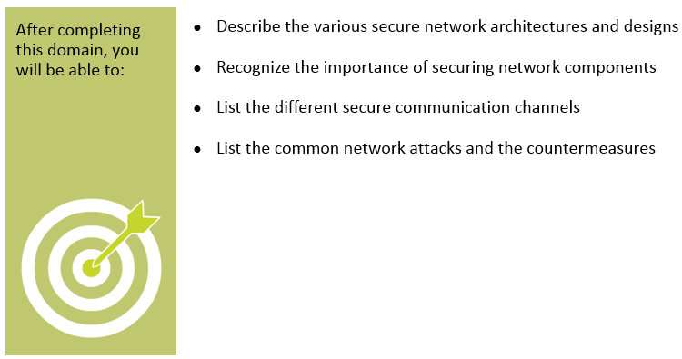
Objectives
Notes:
Section breaker slide with customer logo
Section heading – Arial Headings, 34, Bold
Sub head – Arial Headings, 18, normal
Used for a section heading. You may add a sub heading not exceeding one line also here
Section heading – Arial Headings, bold, 34 font size, should not exceed beyond 1 line
Sub Head – Arial Headings, normal, 18 font size, should not exceed beyond 1 line

Slide 3
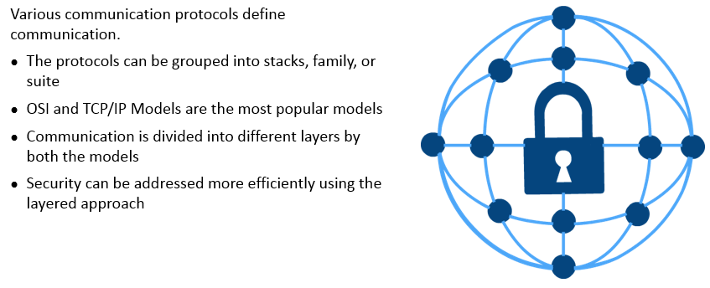
Introduction to Secure Network Architecture and Design
Notes:
Section breaker slide with customer logo
Section heading – Arial Headings, 34, Bold
Sub head – Arial Headings, 18, normal
Used for a section heading. You may add a sub heading not exceeding one line also here
Section heading – Arial Headings, bold, 34 font size, should not exceed beyond 1 line
Sub Head – Arial Headings, normal, 18 font size, should not exceed beyond 1 line

Slide 4
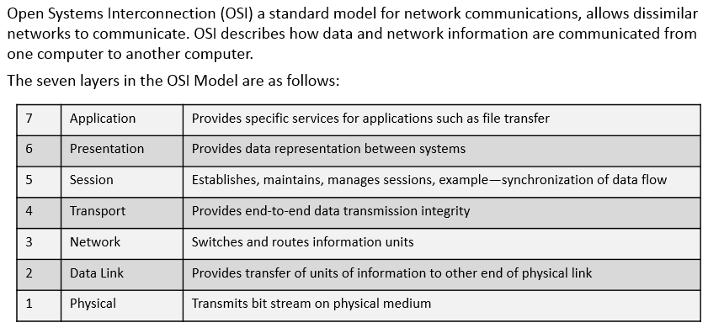
Open Systems Interconnection (OSI)
Notes:
Section breaker slide with customer logo
Section heading – Arial Headings, 34, Bold
Sub head – Arial Headings, 18, normal
Used for a section heading. You may add a sub heading not exceeding one line also here
Section heading – Arial Headings, bold, 34 font size, should not exceed beyond 1 line
Sub Head – Arial Headings, normal, 18 font size, should not exceed beyond 1 line

Slide 5
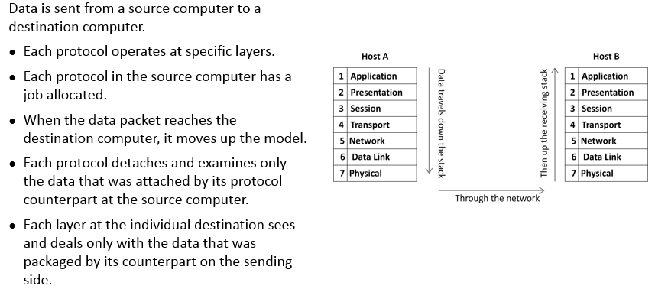
Working of the OSI Model
Notes:
Section breaker slide with customer logo
Section heading – Arial Headings, 34, Bold
Sub head – Arial Headings, 18, normal
Used for a section heading. You may add a sub heading not exceeding one line also here
Section heading – Arial Headings, bold, 34 font size, should not exceed beyond 1 line
Sub Head – Arial Headings, normal, 18 font size, should not exceed beyond 1 line

Slide 6
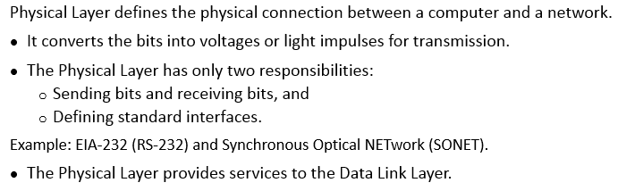
Physical Layer
Notes:
Section breaker slide with customer logo
Section heading – Arial Headings, 34, Bold
Sub head – Arial Headings, 18, normal
Used for a section heading. You may add a sub heading not exceeding one line also here
Section heading – Arial Headings, bold, 34 font size, should not exceed beyond 1 line
Sub Head – Arial Headings, normal, 18 font size, should not exceed beyond 1 line

Slide 7
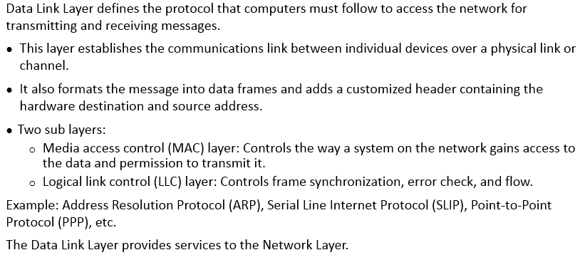
Data Link Layer
Notes:
Section breaker slide with customer logo
Section heading – Arial Headings, 34, Bold
Sub head – Arial Headings, 18, normal
Used for a section heading. You may add a sub heading not exceeding one line also here
Section heading – Arial Headings, bold, 34 font size, should not exceed beyond 1 line
Sub Head – Arial Headings, normal, 18 font size, should not exceed beyond 1 line

Slide 8
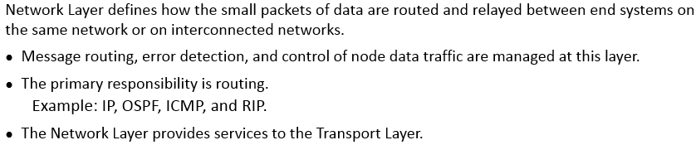
Network Layer
Notes:
Section breaker slide with customer logo
Section heading – Arial Headings, 34, Bold
Sub head – Arial Headings, 18, normal
Used for a section heading. You may add a sub heading not exceeding one line also here
Section heading – Arial Headings, bold, 34 font size, should not exceed beyond 1 line
Sub Head – Arial Headings, normal, 18 font size, should not exceed beyond 1 line

Slide 9
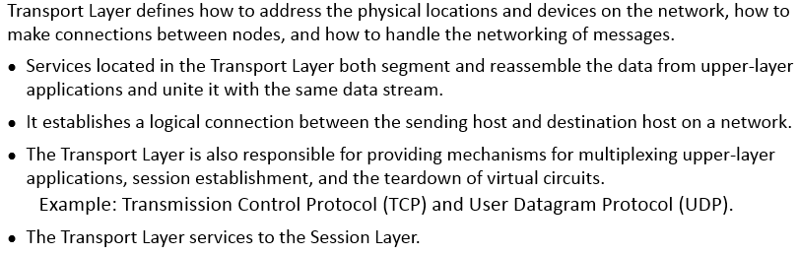
Transport Layer
Notes:
Section breaker slide with customer logo
Section heading – Arial Headings, 34, Bold
Sub head – Arial Headings, 18, normal
Used for a section heading. You may add a sub heading not exceeding one line also here
Section heading – Arial Headings, bold, 34 font size, should not exceed beyond 1 line
Sub Head – Arial Headings, normal, 18 font size, should not exceed beyond 1 line

Slide 10
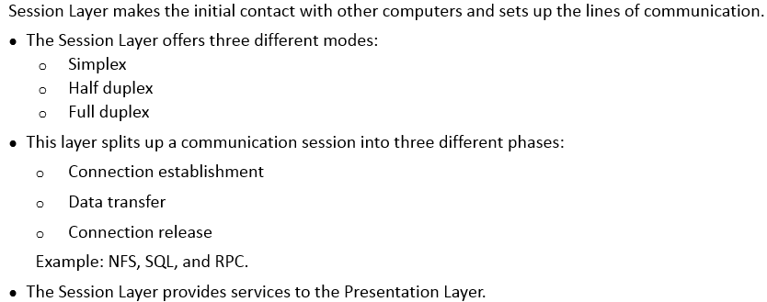
Session Layer
Notes:
Section breaker slide with customer logo
Section heading – Arial Headings, 34, Bold
Sub head – Arial Headings, 18, normal
Used for a section heading. You may add a sub heading not exceeding one line also here
Section heading – Arial Headings, bold, 34 font size, should not exceed beyond 1 line
Sub Head – Arial Headings, normal, 18 font size, should not exceed beyond 1 line

Slide 11
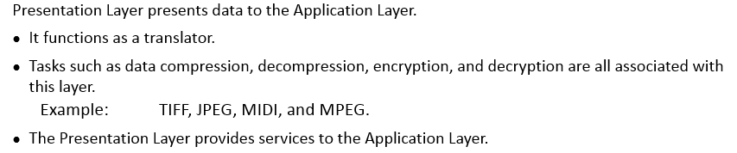
Presentation Layer
Notes:
Section breaker slide with customer logo
Section heading – Arial Headings, 34, Bold
Sub head – Arial Headings, 18, normal
Used for a section heading. You may add a sub heading not exceeding one line also here
Section heading – Arial Headings, bold, 34 font size, should not exceed beyond 1 line
Sub Head – Arial Headings, normal, 18 font size, should not exceed beyond 1 line

Slide 12
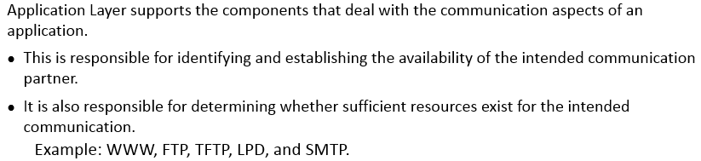
Application Layer
Notes:
Section breaker slide with customer logo
Section heading – Arial Headings, 34, Bold
Sub head – Arial Headings, 18, normal
Used for a section heading. You may add a sub heading not exceeding one line also here
Section heading – Arial Headings, bold, 34 font size, should not exceed beyond 1 line
Sub Head – Arial Headings, normal, 18 font size, should not exceed beyond 1 line

Slide 13
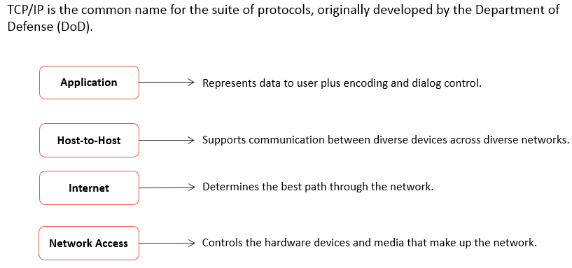
Transmission Control Protocol/ Internet Protocol (TCP/IP) Model
Notes:
Section breaker slide with customer logo
Section heading – Arial Headings, 34, Bold
Sub head – Arial Headings, 18, normal
Used for a section heading. You may add a sub heading not exceeding one line also here
Section heading – Arial Headings, bold, 34 font size, should not exceed beyond 1 line
Sub Head – Arial Headings, normal, 18 font size, should not exceed beyond 1 line

Slide 14
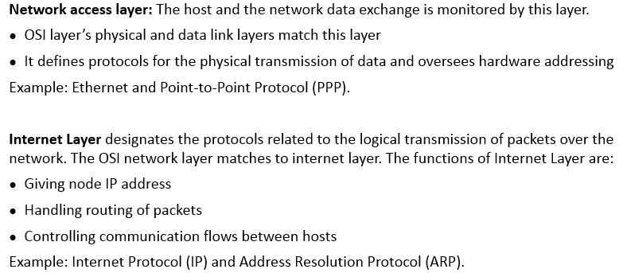
Network Access Layer and Internet Layer
Notes:
Section breaker slide with customer logo
Section heading – Arial Headings, 34, Bold
Sub head – Arial Headings, 18, normal
Used for a section heading. You may add a sub heading not exceeding one line also here
Section heading – Arial Headings, bold, 34 font size, should not exceed beyond 1 line
Sub Head – Arial Headings, normal, 18 font size, should not exceed beyond 1 line

Slide 15
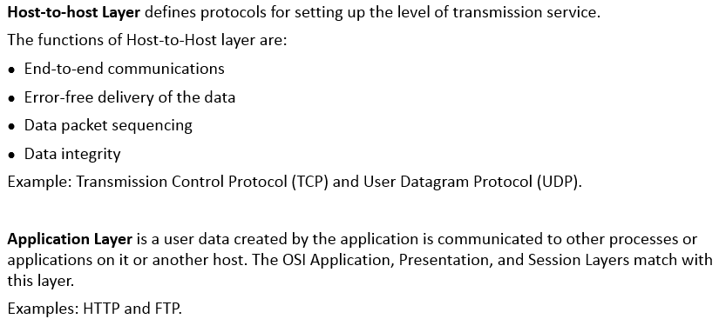
Host to Host Layer and Application Layer
Notes:
Section breaker slide with customer logo
Section heading – Arial Headings, 34, Bold
Sub head – Arial Headings, 18, normal
Used for a section heading. You may add a sub heading not exceeding one line also here
Section heading – Arial Headings, bold, 34 font size, should not exceed beyond 1 line
Sub Head – Arial Headings, normal, 18 font size, should not exceed beyond 1 line

Slide 16
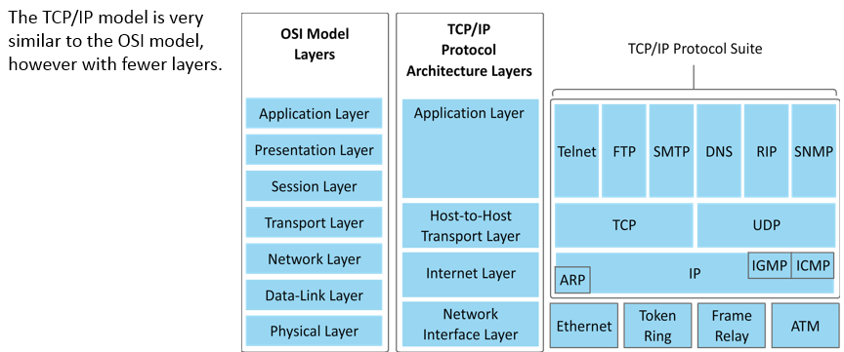
Comparison of OSI and TCP/IP Models
Notes:
Section breaker slide with customer logo
Section heading – Arial Headings, 34, Bold
Sub head – Arial Headings, 18, normal
Used for a section heading. You may add a sub heading not exceeding one line also here
Section heading – Arial Headings, bold, 34 font size, should not exceed beyond 1 line
Sub Head – Arial Headings, normal, 18 font size, should not exceed beyond 1 line

Slide 17
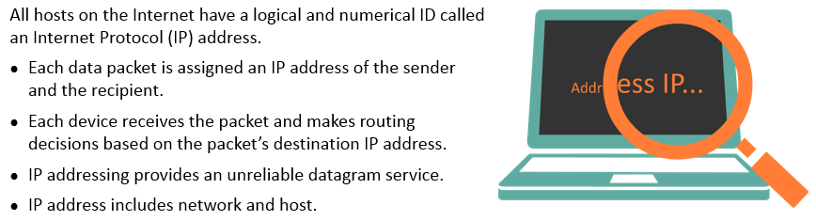
IP Addressing - Introduction
Notes:
Section breaker slide with customer logo
Section heading – Arial Headings, 34, Bold
Sub head – Arial Headings, 18, normal
Used for a section heading. You may add a sub heading not exceeding one line also here
Section heading – Arial Headings, bold, 34 font size, should not exceed beyond 1 line
Sub Head – Arial Headings, normal, 18 font size, should not exceed beyond 1 line

Slide 18
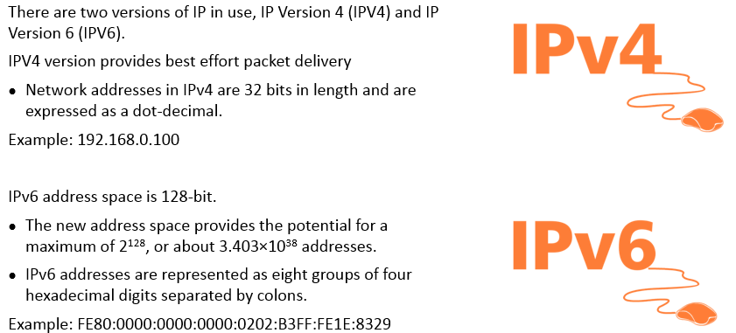
IPv4 and IPv6
Notes:
Section breaker slide with customer logo
Section heading – Arial Headings, 34, Bold
Sub head – Arial Headings, 18, normal
Used for a section heading. You may add a sub heading not exceeding one line also here
Section heading – Arial Headings, bold, 34 font size, should not exceed beyond 1 line
Sub Head – Arial Headings, normal, 18 font size, should not exceed beyond 1 line

Slide 19
Classful IP Addressing
There are five types of classful IP Addressing :
Class | Sunet Mask Decimal | IP Address Range
A | 255.0.0.0 | 0.0.0.0 | 127.255.255.255
B | 233.255.0.0 | 128.0.0.0 | 191.255.255.255
C | 255.255.255.0 | 192.0.0.0 | 223.255.255.255
D | Reserved for Multicast groups | 224.0.0.0 | 239.255.255.255
E | Reserved for R&D and future research | 240.0.0.0 | 255.255.255.255
Notes:
Section breaker slide with customer logo
Section heading – Arial Headings, 34, Bold
Sub head – Arial Headings, 18, normal
Used for a section heading. You may add a sub heading not exceeding one line also here
Section heading – Arial Headings, bold, 34 font size, should not exceed beyond 1 line
Sub Head – Arial Headings, normal, 18 font size, should not exceed beyond 1 line

Slide 20
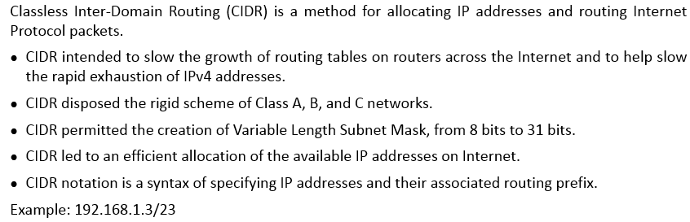
Classless Inter Domain Routing (CIDR)
Notes:
Section breaker slide with customer logo
Section heading – Arial Headings, 34, Bold
Sub head – Arial Headings, 18, normal
Used for a section heading. You may add a sub heading not exceeding one line also here
Section heading – Arial Headings, bold, 34 font size, should not exceed beyond 1 line
Sub Head – Arial Headings, normal, 18 font size, should not exceed beyond 1 line

Slide 21
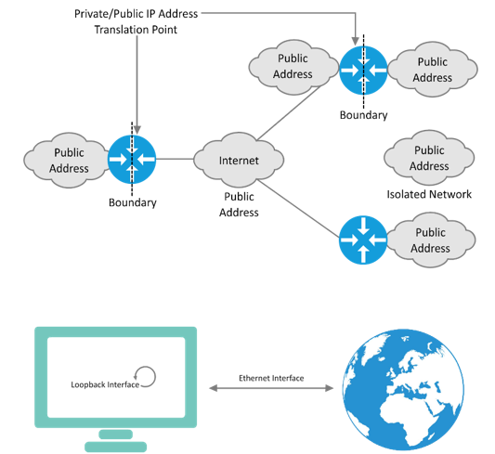
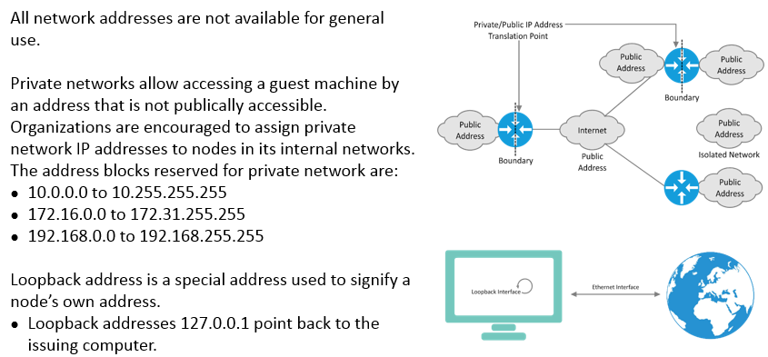
Private Networks and Loopback Address
Notes:
Section breaker slide with customer logo
Section heading – Arial Headings, 34, Bold
Sub head – Arial Headings, 18, normal
Used for a section heading. You may add a sub heading not exceeding one line also here
Section heading – Arial Headings, bold, 34 font size, should not exceed beyond 1 line
Sub Head – Arial Headings, normal, 18 font size, should not exceed beyond 1 line

Slide 22
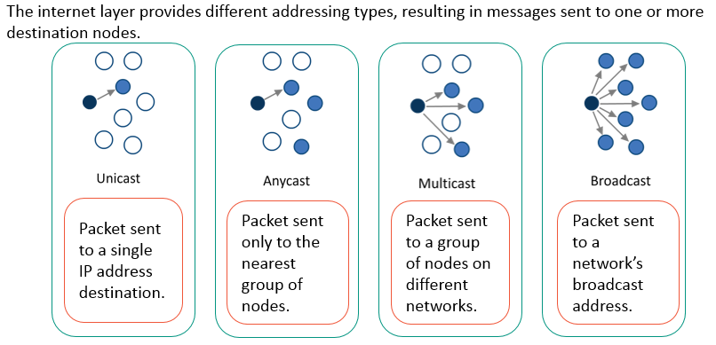
Types of IP Addressing
Notes:
Section breaker slide with customer logo
Section heading – Arial Headings, 34, Bold
Sub head – Arial Headings, 18, normal
Used for a section heading. You may add a sub heading not exceeding one line also here
Section heading – Arial Headings, bold, 34 font size, should not exceed beyond 1 line
Sub Head – Arial Headings, normal, 18 font size, should not exceed beyond 1 line

Slide 23
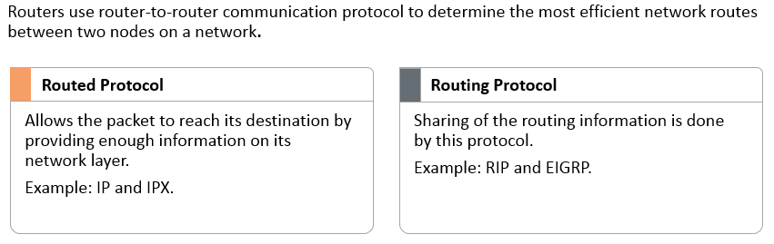
Routed and Routing Protocols
Notes:
Section breaker slide with customer logo
Section heading – Arial Headings, 34, Bold
Sub head – Arial Headings, 18, normal
Used for a section heading. You may add a sub heading not exceeding one line also here
Section heading – Arial Headings, bold, 34 font size, should not exceed beyond 1 line
Sub Head – Arial Headings, normal, 18 font size, should not exceed beyond 1 line

Slide 24
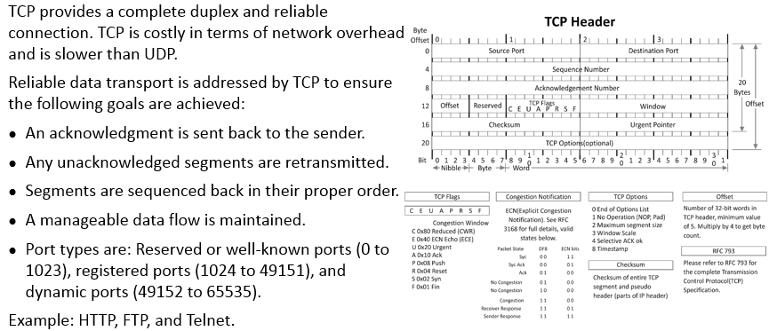
Transmission Control Protocol (TCP)
Notes:
Section breaker slide with customer logo
Section heading – Arial Headings, 34, Bold
Sub head – Arial Headings, 18, normal
Used for a section heading. You may add a sub heading not exceeding one line also here
Section heading – Arial Headings, bold, 34 font size, should not exceed beyond 1 line
Sub Head – Arial Headings, normal, 18 font size, should not exceed beyond 1 line

Slide 25
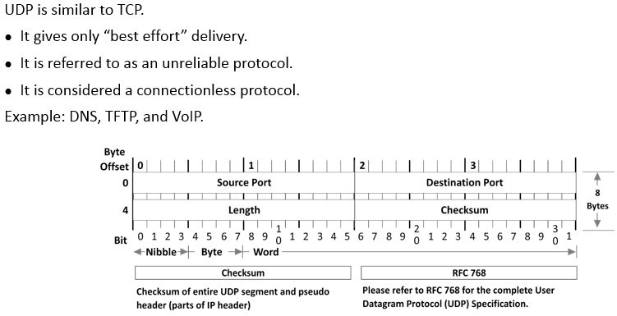
User Datagram Protocol (UDP)
Notes:
Section breaker slide with customer logo
Section heading – Arial Headings, 34, Bold
Sub head – Arial Headings, 18, normal
Used for a section heading. You may add a sub heading not exceeding one line also here
Section heading – Arial Headings, bold, 34 font size, should not exceed beyond 1 line
Sub Head – Arial Headings, normal, 18 font size, should not exceed beyond 1 line

Slide 26
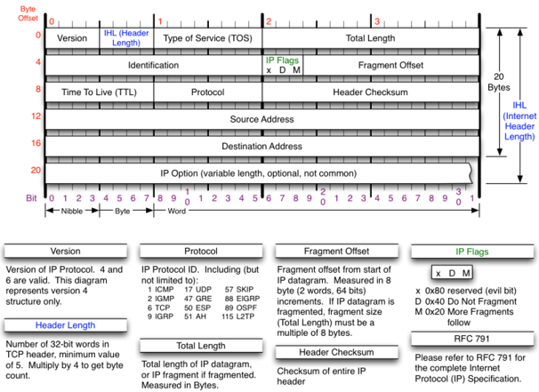
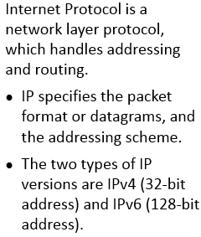
Internet Protocol
Notes:
Section breaker slide with customer logo
Section heading – Arial Headings, 34, Bold
Sub head – Arial Headings, 18, normal
Used for a section heading. You may add a sub heading not exceeding one line also here
Section heading – Arial Headings, bold, 34 font size, should not exceed beyond 1 line
Sub Head – Arial Headings, normal, 18 font size, should not exceed beyond 1 line

Slide 27
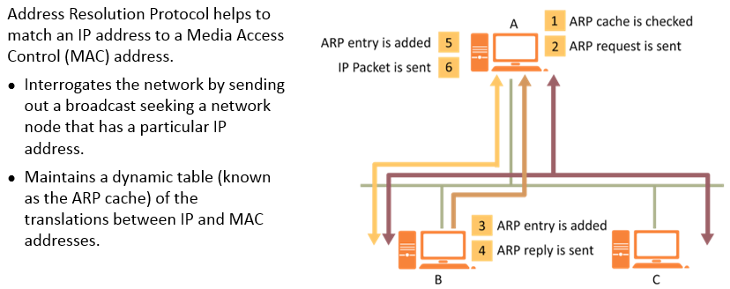
Address Resolution Protocol
Notes:
Section breaker slide with customer logo
Section heading – Arial Headings, 34, Bold
Sub head – Arial Headings, 18, normal
Used for a section heading. You may add a sub heading not exceeding one line also here
Section heading – Arial Headings, bold, 34 font size, should not exceed beyond 1 line
Sub Head – Arial Headings, normal, 18 font size, should not exceed beyond 1 line

Slide 28
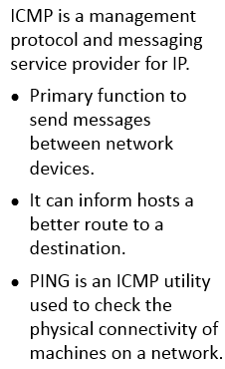
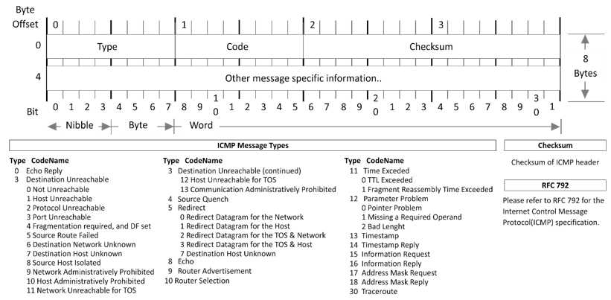
Internet Control Message Protocol (ICMP)
Notes:
Section breaker slide with customer logo
Section heading – Arial Headings, 34, Bold
Sub head – Arial Headings, 18, normal
Used for a section heading. You may add a sub heading not exceeding one line also here
Section heading – Arial Headings, bold, 34 font size, should not exceed beyond 1 line
Sub Head – Arial Headings, normal, 18 font size, should not exceed beyond 1 line

Slide 29
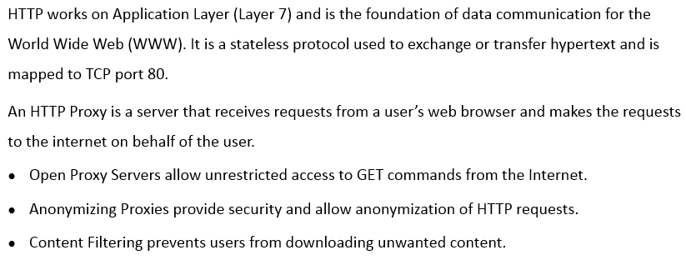
Hyper Text Transfer Protocol (HTTP)
Notes:
Section breaker slide with customer logo
Section heading – Arial Headings, 34, Bold
Sub head – Arial Headings, 18, normal
Used for a section heading. You may add a sub heading not exceeding one line also here
Section heading – Arial Headings, bold, 34 font size, should not exceed beyond 1 line
Sub Head – Arial Headings, normal, 18 font size, should not exceed beyond 1 line

Slide 30
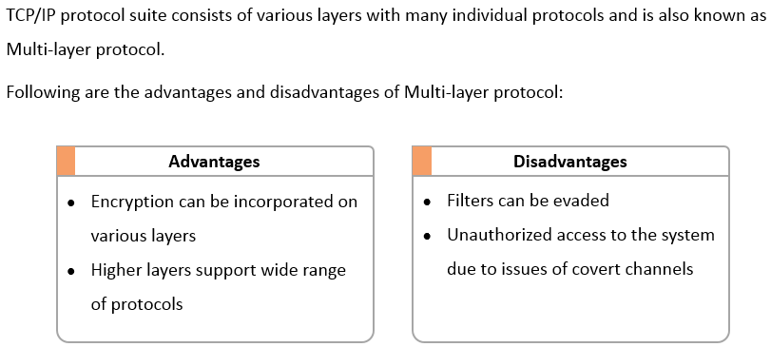
Implications of Multi Layer Protocols
Notes:
Section breaker slide with customer logo
Section heading – Arial Headings, 34, Bold
Sub head – Arial Headings, 18, normal
Used for a section heading. You may add a sub heading not exceeding one line also here
Section heading – Arial Headings, bold, 34 font size, should not exceed beyond 1 line
Sub Head – Arial Headings, normal, 18 font size, should not exceed beyond 1 line

Slide 31
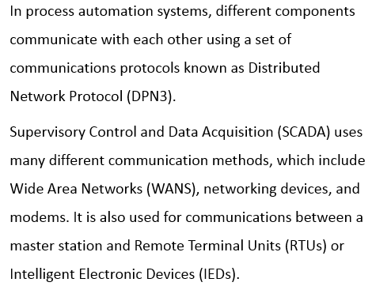
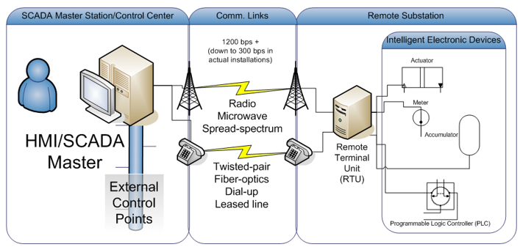
Distributed Network Protocol
Notes:
Section breaker slide with customer logo
Section heading – Arial Headings, 34, Bold
Sub head – Arial Headings, 18, normal
Used for a section heading. You may add a sub heading not exceeding one line also here
Section heading – Arial Headings, bold, 34 font size, should not exceed beyond 1 line
Sub Head – Arial Headings, normal, 18 font size, should not exceed beyond 1 line

Slide 32
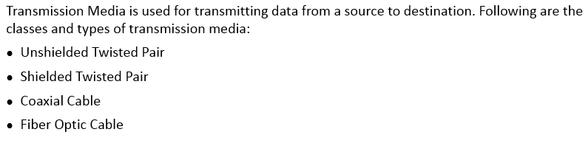
Transmission Media
Notes:
Section breaker slide with customer logo
Section heading – Arial Headings, 34, Bold
Sub head – Arial Headings, 18, normal
Used for a section heading. You may add a sub heading not exceeding one line also here
Section heading – Arial Headings, bold, 34 font size, should not exceed beyond 1 line
Sub Head – Arial Headings, normal, 18 font size, should not exceed beyond 1 line

Slide 33
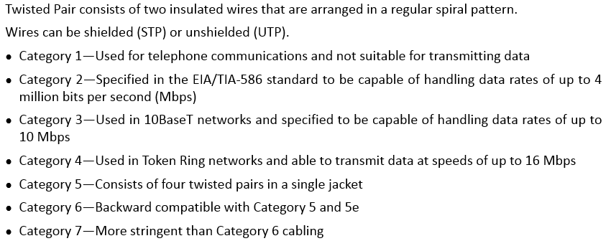
Twisted Pair
Notes:
Section breaker slide with customer logo
Section heading – Arial Headings, 34, Bold
Sub head – Arial Headings, 18, normal
Used for a section heading. You may add a sub heading not exceeding one line also here
Section heading – Arial Headings, bold, 34 font size, should not exceed beyond 1 line
Sub Head – Arial Headings, normal, 18 font size, should not exceed beyond 1 line

Slide 34
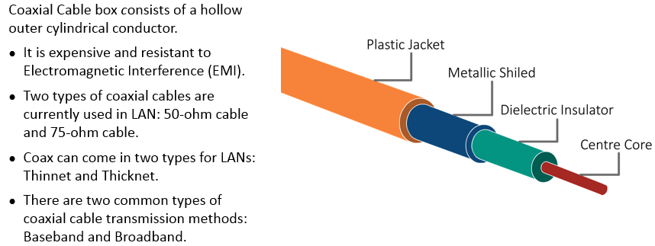
Coaxial Cable box
Notes:
Section breaker slide with customer logo
Section heading – Arial Headings, 34, Bold
Sub head – Arial Headings, 18, normal
Used for a section heading. You may add a sub heading not exceeding one line also here
Section heading – Arial Headings, bold, 34 font size, should not exceed beyond 1 line
Sub Head – Arial Headings, normal, 18 font size, should not exceed beyond 1 line

Slide 35
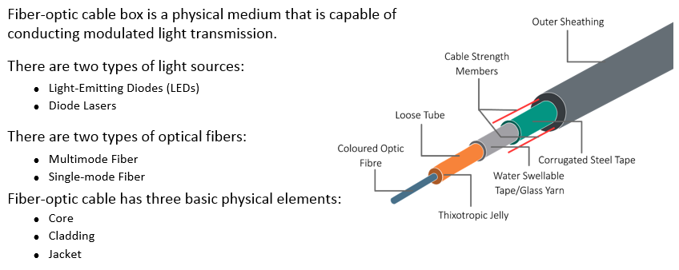
Fibre Optic Cable box
Notes:
Section breaker slide with customer logo
Section heading – Arial Headings, 34, Bold
Sub head – Arial Headings, 18, normal
Used for a section heading. You may add a sub heading not exceeding one line also here
Section heading – Arial Headings, bold, 34 font size, should not exceed beyond 1 line
Sub Head – Arial Headings, normal, 18 font size, should not exceed beyond 1 line

Slide 36
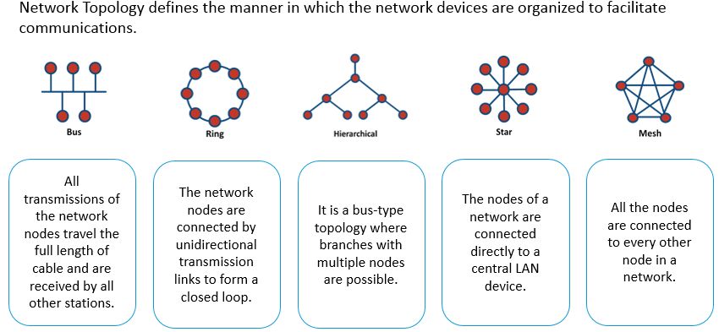
Network Topologies
Notes:
Section breaker slide with customer logo
Section heading – Arial Headings, 34, Bold
Sub head – Arial Headings, 18, normal
Used for a section heading. You may add a sub heading not exceeding one line also here
Section heading – Arial Headings, bold, 34 font size, should not exceed beyond 1 line
Sub Head – Arial Headings, normal, 18 font size, should not exceed beyond 1 line

Slide 37
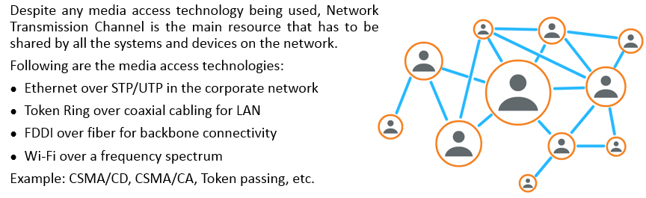
Network Transmission Channel
Notes:
Section breaker slide with customer logo
Section heading – Arial Headings, 34, Bold
Sub head – Arial Headings, 18, normal
Used for a section heading. You may add a sub heading not exceeding one line also here
Section heading – Arial Headings, bold, 34 font size, should not exceed beyond 1 line
Sub Head – Arial Headings, normal, 18 font size, should not exceed beyond 1 line

Slide 38
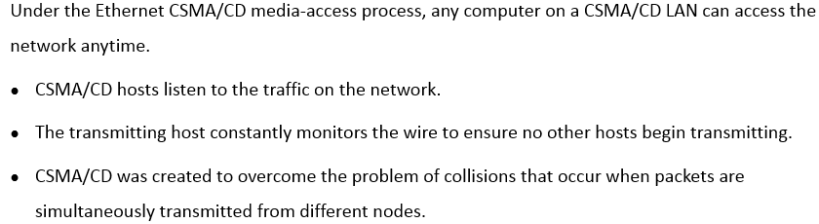
Carrier-Sense Multiple Access with Collision Detection
Notes:
Section breaker slide with customer logo
Section heading – Arial Headings, 34, Bold
Sub head – Arial Headings, 18, normal
Used for a section heading. You may add a sub heading not exceeding one line also here
Section heading – Arial Headings, bold, 34 font size, should not exceed beyond 1 line
Sub Head – Arial Headings, normal, 18 font size, should not exceed beyond 1 line

Slide 39
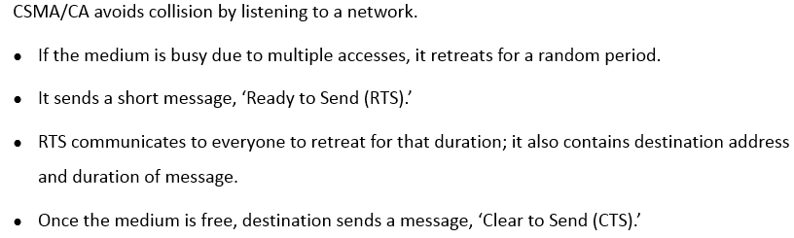
Carrier-Sense Multiple Access with Collision Avoidance
Notes:
Section breaker slide with customer logo
Section heading – Arial Headings, 34, Bold
Sub head – Arial Headings, 18, normal
Used for a section heading. You may add a sub heading not exceeding one line also here
Section heading – Arial Headings, bold, 34 font size, should not exceed beyond 1 line
Sub Head – Arial Headings, normal, 18 font size, should not exceed beyond 1 line

Slide 40
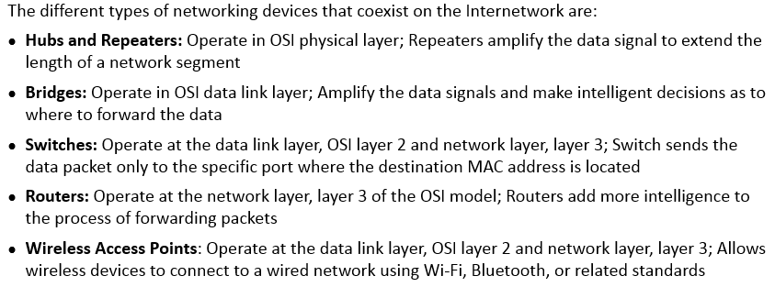
List of Networking Devices
Notes:
Section breaker slide with customer logo
Section heading – Arial Headings, 34, Bold
Sub head – Arial Headings, 18, normal
Used for a section heading. You may add a sub heading not exceeding one line also here
Section heading – Arial Headings, bold, 34 font size, should not exceed beyond 1 line
Sub Head – Arial Headings, normal, 18 font size, should not exceed beyond 1 line

Slide 41
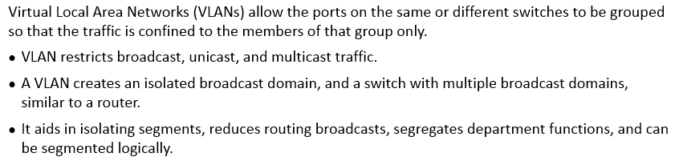
VLANs
Notes:
Section breaker slide with customer logo
Section heading – Arial Headings, 34, Bold
Sub head – Arial Headings, 18, normal
Used for a section heading. You may add a sub heading not exceeding one line also here
Section heading – Arial Headings, bold, 34 font size, should not exceed beyond 1 line
Sub Head – Arial Headings, normal, 18 font size, should not exceed beyond 1 line

Slide 42
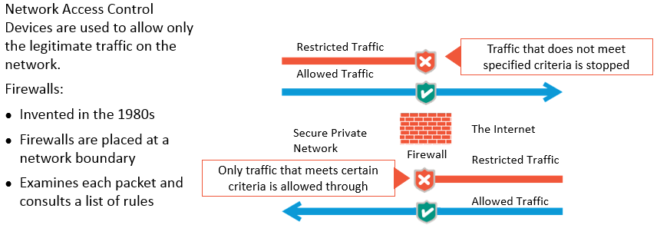
Network Access Control Devices
Notes:
Section breaker slide with customer logo
Section heading – Arial Headings, 34, Bold
Sub head – Arial Headings, 18, normal
Used for a section heading. You may add a sub heading not exceeding one line also here
Section heading – Arial Headings, bold, 34 font size, should not exceed beyond 1 line
Sub Head – Arial Headings, normal, 18 font size, should not exceed beyond 1 line

Slide 43
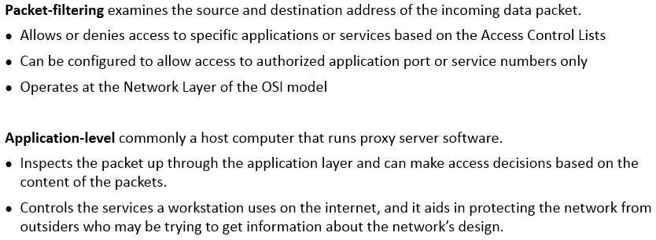
Packet Filtering and Application Level
Notes:
Section breaker slide with customer logo
Section heading – Arial Headings, 34, Bold
Sub head – Arial Headings, 18, normal
Used for a section heading. You may add a sub heading not exceeding one line also here
Section heading – Arial Headings, bold, 34 font size, should not exceed beyond 1 line
Sub Head – Arial Headings, normal, 18 font size, should not exceed beyond 1 line

Slide 44
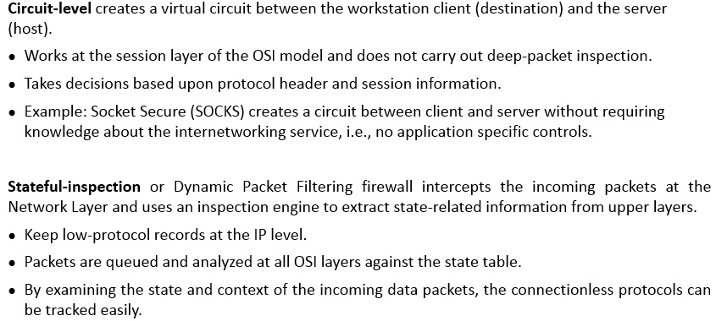
Circuit Level and Stateful Inspection
Notes:
Section breaker slide with customer logo
Section heading – Arial Headings, 34, Bold
Sub head – Arial Headings, 18, normal
Used for a section heading. You may add a sub heading not exceeding one line also here
Section heading – Arial Headings, bold, 34 font size, should not exceed beyond 1 line
Sub Head – Arial Headings, normal, 18 font size, should not exceed beyond 1 line

Slide 45
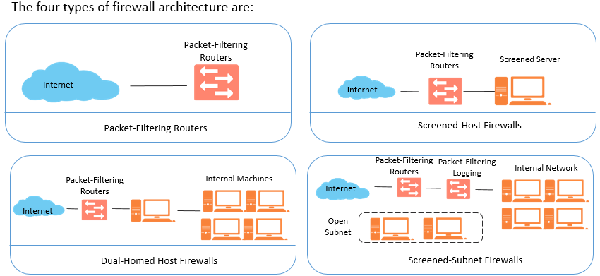
Firewall Architectures
Notes:
Section breaker slide with customer logo
Section heading – Arial Headings, 34, Bold
Sub head – Arial Headings, 18, normal
Used for a section heading. You may add a sub heading not exceeding one line also here
Section heading – Arial Headings, bold, 34 font size, should not exceed beyond 1 line
Sub Head – Arial Headings, normal, 18 font size, should not exceed beyond 1 line

Slide 46
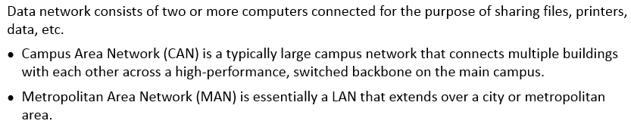
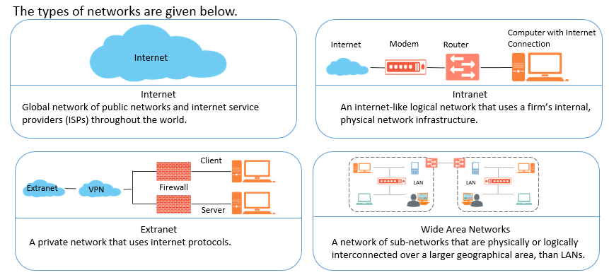
Networks and Types of Networks
Notes:
Section breaker slide with customer logo
Section heading – Arial Headings, 34, Bold
Sub head – Arial Headings, 18, normal
Used for a section heading. You may add a sub heading not exceeding one line also here
Section heading – Arial Headings, bold, 34 font size, should not exceed beyond 1 line
Sub Head – Arial Headings, normal, 18 font size, should not exceed beyond 1 line

Slide 47
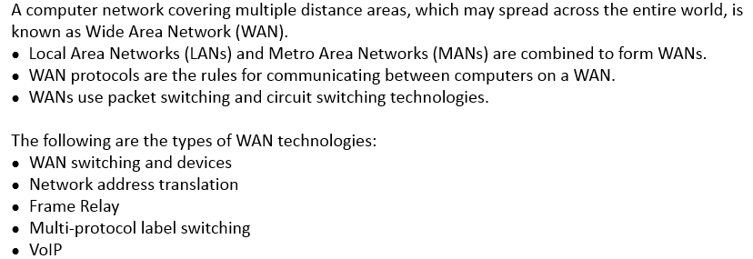
WAN Technologies
Notes:
Section breaker slide with customer logo
Section heading – Arial Headings, 34, Bold
Sub head – Arial Headings, 18, normal
Used for a section heading. You may add a sub heading not exceeding one line also here
Section heading – Arial Headings, bold, 34 font size, should not exceed beyond 1 line
Sub Head – Arial Headings, normal, 18 font size, should not exceed beyond 1 line

Slide 48

WAN Switching and Devices
Notes:
Section breaker slide with customer logo
Section heading – Arial Headings, 34, Bold
Sub head – Arial Headings, 18, normal
Used for a section heading. You may add a sub heading not exceeding one line also here
Section heading – Arial Headings, bold, 34 font size, should not exceed beyond 1 line
Sub Head – Arial Headings, normal, 18 font size, should not exceed beyond 1 line

Slide 49

Network Address Translation and Frame Relay
Notes:
Section breaker slide with customer logo
Section heading – Arial Headings, 34, Bold
Sub head – Arial Headings, 18, normal
Used for a section heading. You may add a sub heading not exceeding one line also here
Section heading – Arial Headings, bold, 34 font size, should not exceed beyond 1 line
Sub Head – Arial Headings, normal, 18 font size, should not exceed beyond 1 line

Slide 50

Multi-Protocol Label Switching and VoIP
Notes:
Section breaker slide with customer logo
Section heading – Arial Headings, 34, Bold
Sub head – Arial Headings, 18, normal
Used for a section heading. You may add a sub heading not exceeding one line also here
Section heading – Arial Headings, bold, 34 font size, should not exceed beyond 1 line
Sub Head – Arial Headings, normal, 18 font size, should not exceed beyond 1 line

Slide 51

Virtual Networks
Notes:
Section breaker slide with customer logo
Section heading – Arial Headings, 34, Bold
Sub head – Arial Headings, 18, normal
Used for a section heading. You may add a sub heading not exceeding one line also here
Section heading – Arial Headings, bold, 34 font size, should not exceed beyond 1 line
Sub Head – Arial Headings, normal, 18 font size, should not exceed beyond 1 line

Slide 52

Remote Access - Introduction
Notes:
Section breaker slide with customer logo
Section heading – Arial Headings, 34, Bold
Sub head – Arial Headings, 18, normal
Used for a section heading. You may add a sub heading not exceeding one line also here
Section heading – Arial Headings, bold, 34 font size, should not exceed beyond 1 line
Sub Head – Arial Headings, normal, 18 font size, should not exceed beyond 1 line

Slide 53

VPN using PPTP and L2TP
Notes:
Section breaker slide with customer logo
Section heading – Arial Headings, 34, Bold
Sub head – Arial Headings, 18, normal
Used for a section heading. You may add a sub heading not exceeding one line also here
Section heading – Arial Headings, bold, 34 font size, should not exceed beyond 1 line
Sub Head – Arial Headings, normal, 18 font size, should not exceed beyond 1 line

Slide 54

Internet Security Protocol (IPsec)
Notes:
Section breaker slide with customer logo
Section heading – Arial Headings, 34, Bold
Sub head – Arial Headings, 18, normal
Used for a section heading. You may add a sub heading not exceeding one line also here
Section heading – Arial Headings, bold, 34 font size, should not exceed beyond 1 line
Sub Head – Arial Headings, normal, 18 font size, should not exceed beyond 1 line

Slide 55

IPsec - Modes of operation
Notes:
Section breaker slide with customer logo
Section heading – Arial Headings, 34, Bold
Sub head – Arial Headings, 18, normal
Used for a section heading. You may add a sub heading not exceeding one line also here
Section heading – Arial Headings, bold, 34 font size, should not exceed beyond 1 line
Sub Head – Arial Headings, normal, 18 font size, should not exceed beyond 1 line

Slide 56

IPsec Security Protocols – Authentication Header (AH)
Notes:
Section breaker slide with customer logo
Section heading – Arial Headings, 34, Bold
Sub head – Arial Headings, 18, normal
Used for a section heading. You may add a sub heading not exceeding one line also here
Section heading – Arial Headings, bold, 34 font size, should not exceed beyond 1 line
Sub Head – Arial Headings, normal, 18 font size, should not exceed beyond 1 line

Slide 57

IPsec Security Protocols – Encapsulating Security Payload (ESP)
Notes:
Section breaker slide with customer logo
Section heading – Arial Headings, 34, Bold
Sub head – Arial Headings, 18, normal
Used for a section heading. You may add a sub heading not exceeding one line also here
Section heading – Arial Headings, bold, 34 font size, should not exceed beyond 1 line
Sub Head – Arial Headings, normal, 18 font size, should not exceed beyond 1 line

Slide 58


IPsec process - Components
Notes:
Section breaker slide with customer logo
Section heading – Arial Headings, 34, Bold
Sub head – Arial Headings, 18, normal
Used for a section heading. You may add a sub heading not exceeding one line also here
Section heading – Arial Headings, bold, 34 font size, should not exceed beyond 1 line
Sub Head – Arial Headings, normal, 18 font size, should not exceed beyond 1 line

Slide 59

Secure Access Protocols
Notes:
Section breaker slide with customer logo
Section heading – Arial Headings, 34, Bold
Sub head – Arial Headings, 18, normal
Used for a section heading. You may add a sub heading not exceeding one line also here
Section heading – Arial Headings, bold, 34 font size, should not exceed beyond 1 line
Sub Head – Arial Headings, normal, 18 font size, should not exceed beyond 1 line

Slide 60


Secure Access Protocols (contd)
Notes:
Section breaker slide with customer logo
Section heading – Arial Headings, 34, Bold
Sub head – Arial Headings, 18, normal
Used for a section heading. You may add a sub heading not exceeding one line also here
Section heading – Arial Headings, bold, 34 font size, should not exceed beyond 1 line
Sub Head – Arial Headings, normal, 18 font size, should not exceed beyond 1 line

Slide 61

Remote Access Security Methods
Notes:
Section breaker slide with customer logo
Section heading – Arial Headings, 34, Bold
Sub head – Arial Headings, 18, normal
Used for a section heading. You may add a sub heading not exceeding one line also here
Section heading – Arial Headings, bold, 34 font size, should not exceed beyond 1 line
Sub Head – Arial Headings, normal, 18 font size, should not exceed beyond 1 line

Slide 62

Multimedia Collaboration
Notes:
Section breaker slide with customer logo
Section heading – Arial Headings, 34, Bold
Sub head – Arial Headings, 18, normal
Used for a section heading. You may add a sub heading not exceeding one line also here
Section heading – Arial Headings, bold, 34 font size, should not exceed beyond 1 line
Sub Head – Arial Headings, normal, 18 font size, should not exceed beyond 1 line

Slide 63

Wireless Technologies
Notes:
Section breaker slide with customer logo
Section heading – Arial Headings, 34, Bold
Sub head – Arial Headings, 18, normal
Used for a section heading. You may add a sub heading not exceeding one line also here
Section heading – Arial Headings, bold, 34 font size, should not exceed beyond 1 line
Sub Head – Arial Headings, normal, 18 font size, should not exceed beyond 1 line

Slide 64

IEEE Wireless Standards and Spread Spectrum Technologies
Notes:
Section breaker slide with customer logo
Section heading – Arial Headings, 34, Bold
Sub head – Arial Headings, 18, normal
Used for a section heading. You may add a sub heading not exceeding one line also here
Section heading – Arial Headings, bold, 34 font size, should not exceed beyond 1 line
Sub Head – Arial Headings, normal, 18 font size, should not exceed beyond 1 line

Slide 65

Direct Sequence Spread Spectrum and Frequency Hopping Spread Spectrum
Notes:
Section breaker slide with customer logo
Section heading – Arial Headings, 34, Bold
Sub head – Arial Headings, 18, normal
Used for a section heading. You may add a sub heading not exceeding one line also here
Section heading – Arial Headings, bold, 34 font size, should not exceed beyond 1 line
Sub Head – Arial Headings, normal, 18 font size, should not exceed beyond 1 line

Slide 66

WLAN Operational Modes
Notes:
Section breaker slide with customer logo
Section heading – Arial Headings, 34, Bold
Sub head – Arial Headings, 18, normal
Used for a section heading. You may add a sub heading not exceeding one line also here
Section heading – Arial Headings, bold, 34 font size, should not exceed beyond 1 line
Sub Head – Arial Headings, normal, 18 font size, should not exceed beyond 1 line

Slide 67

Bluetooth
Notes:
Section breaker slide with customer logo
Section heading – Arial Headings, 34, Bold
Sub head – Arial Headings, 18, normal
Used for a section heading. You may add a sub heading not exceeding one line also here
Section heading – Arial Headings, bold, 34 font size, should not exceed beyond 1 line
Sub Head – Arial Headings, normal, 18 font size, should not exceed beyond 1 line

Slide 68


Bluetooth Attack
Notes:
Section breaker slide with customer logo
Section heading – Arial Headings, 34, Bold
Sub head – Arial Headings, 18, normal
Used for a section heading. You may add a sub heading not exceeding one line also here
Section heading – Arial Headings, bold, 34 font size, should not exceed beyond 1 line
Sub Head – Arial Headings, normal, 18 font size, should not exceed beyond 1 line

Slide 69

Bluetooth Attack (contd)
Notes:
Section breaker slide with customer logo
Section heading – Arial Headings, 34, Bold
Sub head – Arial Headings, 18, normal
Used for a section heading. You may add a sub heading not exceeding one line also here
Section heading – Arial Headings, bold, 34 font size, should not exceed beyond 1 line
Sub Head – Arial Headings, normal, 18 font size, should not exceed beyond 1 line

Slide 70

Network Attacks
Notes:
Section breaker slide with customer logo
Section heading – Arial Headings, 34, Bold
Sub head – Arial Headings, 18, normal
Used for a section heading. You may add a sub heading not exceeding one line also here
Section heading – Arial Headings, bold, 34 font size, should not exceed beyond 1 line
Sub Head – Arial Headings, normal, 18 font size, should not exceed beyond 1 line

Slide 71

Network Attacks (contd)
Notes:
Section breaker slide with customer logo
Section heading – Arial Headings, 34, Bold
Sub head – Arial Headings, 18, normal
Used for a section heading. You may add a sub heading not exceeding one line also here
Section heading – Arial Headings, bold, 34 font size, should not exceed beyond 1 line
Sub Head – Arial Headings, normal, 18 font size, should not exceed beyond 1 line

Slide 72

Network Attacks - Countermeasures
Notes:
Section breaker slide with customer logo
Section heading – Arial Headings, 34, Bold
Sub head – Arial Headings, 18, normal
Used for a section heading. You may add a sub heading not exceeding one line also here
Section heading – Arial Headings, bold, 34 font size, should not exceed beyond 1 line
Sub Head – Arial Headings, normal, 18 font size, should not exceed beyond 1 line

Slide 73

Notes:
Section breaker slide with customer logo
Section heading – Arial Headings, 34, Bold
Sub head – Arial Headings, 18, normal
Used for a section heading. You may add a sub heading not exceeding one line also here
Section heading – Arial Headings, bold, 34 font size, should not exceed beyond 1 line
Sub Head – Arial Headings, normal, 18 font size, should not exceed beyond 1 line

Slide 74

Notes:
Section breaker slide with customer logo
Section heading – Arial Headings, 34, Bold
Sub head – Arial Headings, 18, normal
Used for a section heading. You may add a sub heading not exceeding one line also here
Section heading – Arial Headings, bold, 34 font size, should not exceed beyond 1 line
Sub Head – Arial Headings, normal, 18 font size, should not exceed beyond 1 line

Slide 75

Notes:
Section breaker slide with customer logo
Section heading – Arial Headings, 34, Bold
Sub head – Arial Headings, 18, normal
Used for a section heading. You may add a sub heading not exceeding one line also here
Section heading – Arial Headings, bold, 34 font size, should not exceed beyond 1 line
Sub Head – Arial Headings, normal, 18 font size, should not exceed beyond 1 line

Slide 76

Notes:
Section breaker slide with customer logo
Section heading – Arial Headings, 34, Bold
Sub head – Arial Headings, 18, normal
Used for a section heading. You may add a sub heading not exceeding one line also here
Section heading – Arial Headings, bold, 34 font size, should not exceed beyond 1 line
Sub Head – Arial Headings, normal, 18 font size, should not exceed beyond 1 line

Slide 77

Notes:
Section breaker slide with customer logo
Section heading – Arial Headings, 34, Bold
Sub head – Arial Headings, 18, normal
Used for a section heading. You may add a sub heading not exceeding one line also here
Section heading – Arial Headings, bold, 34 font size, should not exceed beyond 1 line
Sub Head – Arial Headings, normal, 18 font size, should not exceed beyond 1 line

Slide 78

Notes:
Section breaker slide with customer logo
Section heading – Arial Headings, 34, Bold
Sub head – Arial Headings, 18, normal
Used for a section heading. You may add a sub heading not exceeding one line also here
Section heading – Arial Headings, bold, 34 font size, should not exceed beyond 1 line
Sub Head – Arial Headings, normal, 18 font size, should not exceed beyond 1 line

Slide 79

Notes:
Section breaker slide with customer logo
Section heading – Arial Headings, 34, Bold
Sub head – Arial Headings, 18, normal
Used for a section heading. You may add a sub heading not exceeding one line also here
Section heading – Arial Headings, bold, 34 font size, should not exceed beyond 1 line
Sub Head – Arial Headings, normal, 18 font size, should not exceed beyond 1 line

Slide 80

Notes:
Section breaker slide with customer logo
Section heading – Arial Headings, 34, Bold
Sub head – Arial Headings, 18, normal
Used for a section heading. You may add a sub heading not exceeding one line also here
Section heading – Arial Headings, bold, 34 font size, should not exceed beyond 1 line
Sub Head – Arial Headings, normal, 18 font size, should not exceed beyond 1 line

Slide 81

Notes:
Section breaker slide with customer logo
Section heading – Arial Headings, 34, Bold
Sub head – Arial Headings, 18, normal
Used for a section heading. You may add a sub heading not exceeding one line also here
Section heading – Arial Headings, bold, 34 font size, should not exceed beyond 1 line
Sub Head – Arial Headings, normal, 18 font size, should not exceed beyond 1 line

Slide 82

Notes:
Section breaker slide with customer logo
Section heading – Arial Headings, 34, Bold
Sub head – Arial Headings, 18, normal
Used for a section heading. You may add a sub heading not exceeding one line also here
Section heading – Arial Headings, bold, 34 font size, should not exceed beyond 1 line
Sub Head – Arial Headings, normal, 18 font size, should not exceed beyond 1 line

Slide 83

Notes:
Section breaker slide with customer logo
Section heading – Arial Headings, 34, Bold
Sub head – Arial Headings, 18, normal
Used for a section heading. You may add a sub heading not exceeding one line also here
Section heading – Arial Headings, bold, 34 font size, should not exceed beyond 1 line
Sub Head – Arial Headings, normal, 18 font size, should not exceed beyond 1 line

Slide 84

Notes:
Section breaker slide with customer logo
Section heading – Arial Headings, 34, Bold
Sub head – Arial Headings, 18, normal
Used for a section heading. You may add a sub heading not exceeding one line also here
Section heading – Arial Headings, bold, 34 font size, should not exceed beyond 1 line
Sub Head – Arial Headings, normal, 18 font size, should not exceed beyond 1 line

Slide 85

Notes:
Section breaker slide with customer logo
Section heading – Arial Headings, 34, Bold
Sub head – Arial Headings, 18, normal
Used for a section heading. You may add a sub heading not exceeding one line also here
Section heading – Arial Headings, bold, 34 font size, should not exceed beyond 1 line
Sub Head – Arial Headings, normal, 18 font size, should not exceed beyond 1 line

Slide 86

Notes:
Section breaker slide with customer logo
Section heading – Arial Headings, 34, Bold
Sub head – Arial Headings, 18, normal
Used for a section heading. You may add a sub heading not exceeding one line also here
Section heading – Arial Headings, bold, 34 font size, should not exceed beyond 1 line
Sub Head – Arial Headings, normal, 18 font size, should not exceed beyond 1 line

Slide 87

Notes:
Section breaker slide with customer logo
Section heading – Arial Headings, 34, Bold
Sub head – Arial Headings, 18, normal
Used for a section heading. You may add a sub heading not exceeding one line also here
Section heading – Arial Headings, bold, 34 font size, should not exceed beyond 1 line
Sub Head – Arial Headings, normal, 18 font size, should not exceed beyond 1 line

Slide 88

Notes:
Section breaker slide with customer logo
Section heading – Arial Headings, 34, Bold
Sub head – Arial Headings, 18, normal
Used for a section heading. You may add a sub heading not exceeding one line also here
Section heading – Arial Headings, bold, 34 font size, should not exceed beyond 1 line
Sub Head – Arial Headings, normal, 18 font size, should not exceed beyond 1 line

Slide 89

Notes:
Section breaker slide with customer logo
Section heading – Arial Headings, 34, Bold
Sub head – Arial Headings, 18, normal
Used for a section heading. You may add a sub heading not exceeding one line also here
Section heading – Arial Headings, bold, 34 font size, should not exceed beyond 1 line
Sub Head – Arial Headings, normal, 18 font size, should not exceed beyond 1 line

Slide 90

Summary
Notes:
Section breaker slide with customer logo
Section heading – Arial Headings, 34, Bold
Sub head – Arial Headings, 18, normal
Used for a section heading. You may add a sub heading not exceeding one line also here
Section heading – Arial Headings, bold, 34 font size, should not exceed beyond 1 line
Sub Head – Arial Headings, normal, 18 font size, should not exceed beyond 1 line

Slide 91
This concludes “Communications and Network Security”
The next domain is “Identity and Access Management”
Notes:
Content Slide: This is usually the most frequently used slide in every presentation.
Use this slide for Text heavy slides. Text can only be used in bullet points
Title Heading – font size 30, Arial Heading
Slide Content – Should not reduce beyond Arial body font 16
If you need to use sub bullets please use the indent buttons located next to the bullets buttons in the tool bar and this will automatically provide you with the second, third, fourth & fifth level bullet styles and font sizes
Please note you can also press the tab key to create the different levels of bulleted content

