Slide 1
Domain 3 – Security Engineering
Notes:
The below and following notes on the template slides are to guide you only. In your final presentation, you may delete these notes and add relevant notes if any.
Title slide:
Title – should not exceed beyond 3 lines, font size 30-34, Arial Headings
(Font size for the title of the PPT can vary between 30-34, Arial Headings, Bold depending on the amount of text, however should not be smaller than 30 font size)
Name should not exceed beyond 1 line, Designation; font size to remain at 18, Arial Headings
Please keep the title slide simple, just the logo, title and name and designation to appear. No other graphic elements or any design, photograph, image can be added to this slide, alignment to remain the same

Slide 2
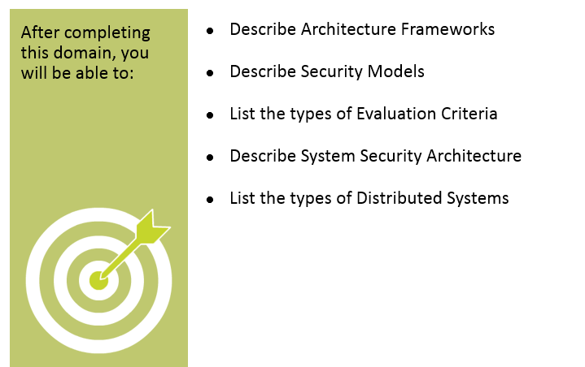
Objectives
Notes:
Section breaker slide with customer logo
Section heading – Arial Headings, 34, Bold
Sub head – Arial Headings, 18, normal
Used for a section heading. You may add a sub heading not exceeding one line also here
Section heading – Arial Headings, bold, 34 font size, should not exceed beyond 1 line
Sub Head – Arial Headings, normal, 18 font size, should not exceed beyond 1 line

Slide 3
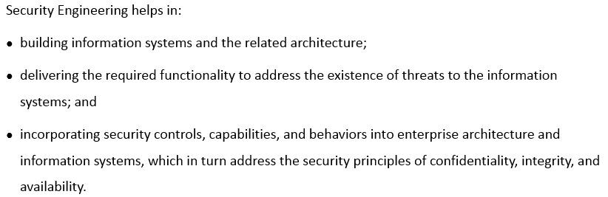
Security Engineering
Notes:
Section breaker slide with customer logo
Section heading – Arial Headings, 34, Bold
Sub head – Arial Headings, 18, normal
Used for a section heading. You may add a sub heading not exceeding one line also here
Section heading – Arial Headings, bold, 34 font size, should not exceed beyond 1 line
Sub Head – Arial Headings, normal, 18 font size, should not exceed beyond 1 line

Slide 4
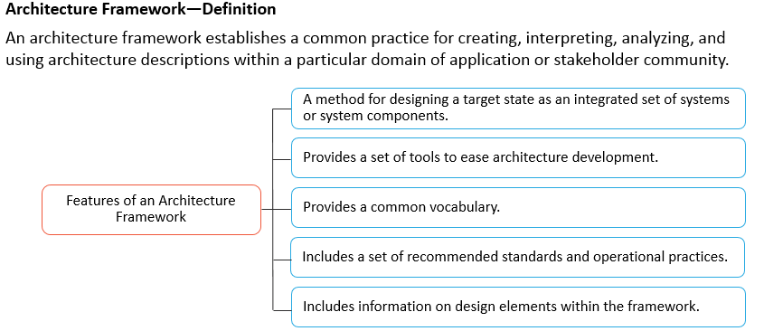
Architecture Framework - Definition
Notes:
Section breaker slide with customer logo
Section heading – Arial Headings, 34, Bold
Sub head – Arial Headings, 18, normal
Used for a section heading. You may add a sub heading not exceeding one line also here
Section heading – Arial Headings, bold, 34 font size, should not exceed beyond 1 line
Sub Head – Arial Headings, normal, 18 font size, should not exceed beyond 1 line

Slide 5
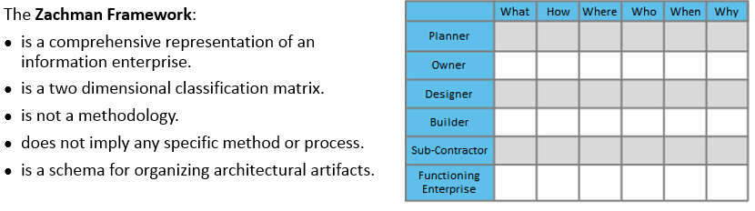
Zachman Framework
Notes:
Section breaker slide with customer logo
Section heading – Arial Headings, 34, Bold
Sub head – Arial Headings, 18, normal
Used for a section heading. You may add a sub heading not exceeding one line also here
Section heading – Arial Headings, bold, 34 font size, should not exceed beyond 1 line
Sub Head – Arial Headings, normal, 18 font size, should not exceed beyond 1 line

Slide 6
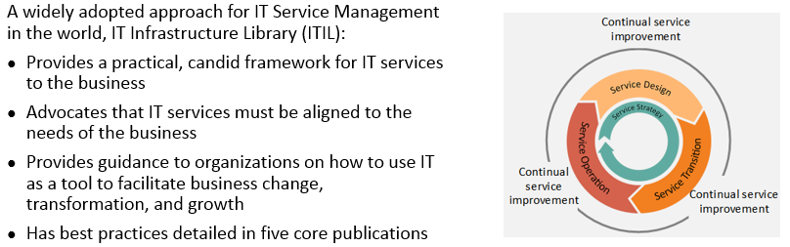
ITIL
Notes:
Section breaker slide with customer logo
Section heading – Arial Headings, 34, Bold
Sub head – Arial Headings, 18, normal
Used for a section heading. You may add a sub heading not exceeding one line also here
Section heading – Arial Headings, bold, 34 font size, should not exceed beyond 1 line
Sub Head – Arial Headings, normal, 18 font size, should not exceed beyond 1 line

Slide 7
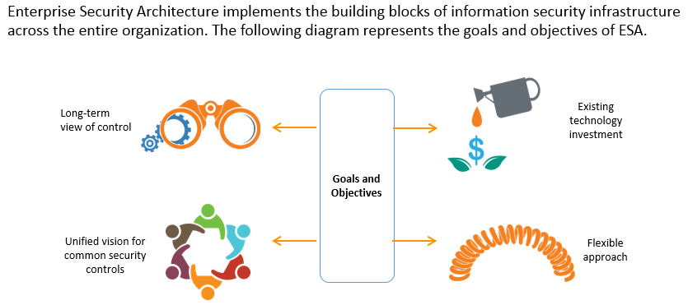
Enterprise Security Architecture
Notes:
Section breaker slide with customer logo
Section heading – Arial Headings, 34, Bold
Sub head – Arial Headings, 18, normal
Used for a section heading. You may add a sub heading not exceeding one line also here
Section heading – Arial Headings, bold, 34 font size, should not exceed beyond 1 line
Sub Head – Arial Headings, normal, 18 font size, should not exceed beyond 1 line

Slide 8
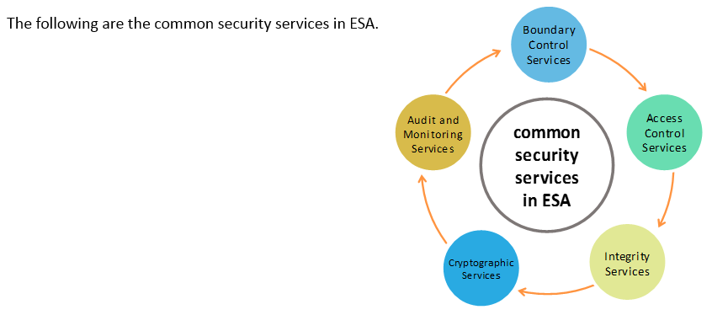
Common Security Services in ESA
Notes:
Section breaker slide with customer logo
Section heading – Arial Headings, 34, Bold
Sub head – Arial Headings, 18, normal
Used for a section heading. You may add a sub heading not exceeding one line also here
Section heading – Arial Headings, bold, 34 font size, should not exceed beyond 1 line
Sub Head – Arial Headings, normal, 18 font size, should not exceed beyond 1 line

Slide 9
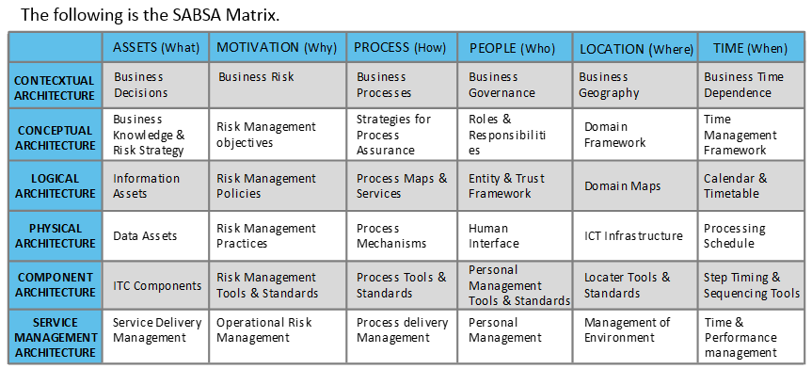
SABSA Matrix
Notes:
Section breaker slide with customer logo
Section heading – Arial Headings, 34, Bold
Sub head – Arial Headings, 18, normal
Used for a section heading. You may add a sub heading not exceeding one line also here
Section heading – Arial Headings, bold, 34 font size, should not exceed beyond 1 line
Sub Head – Arial Headings, normal, 18 font size, should not exceed beyond 1 line

Slide 10
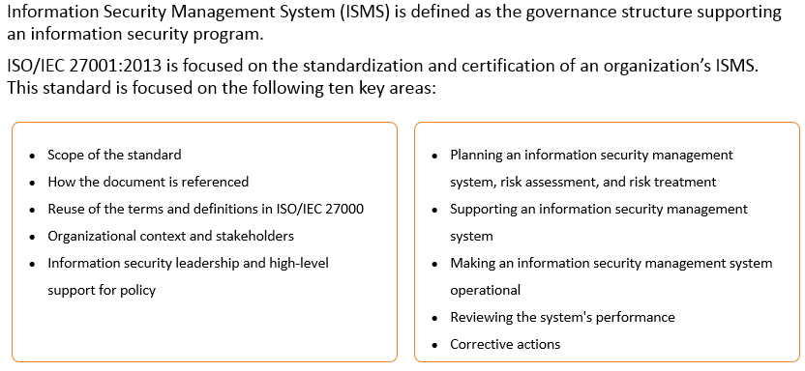
ISO/IEC 27001:2013 Security Standards
Notes:
Section breaker slide with customer logo
Section heading – Arial Headings, 34, Bold
Sub head – Arial Headings, 18, normal
Used for a section heading. You may add a sub heading not exceeding one line also here
Section heading – Arial Headings, bold, 34 font size, should not exceed beyond 1 line
Sub Head – Arial Headings, normal, 18 font size, should not exceed beyond 1 line

Slide 11
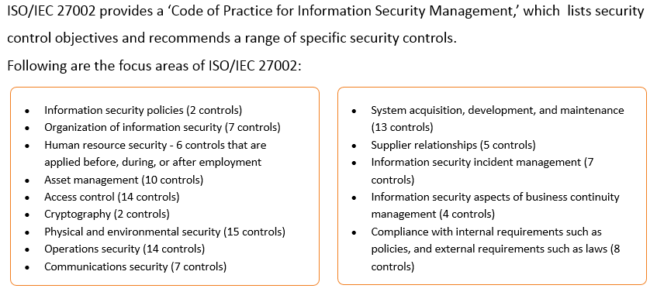
ISO/IEC 27002 – code of practice for Information Security Management
Notes:
Section breaker slide with customer logo
Section heading – Arial Headings, 34, Bold
Sub head – Arial Headings, 18, normal
Used for a section heading. You may add a sub heading not exceeding one line also here
Section heading – Arial Headings, bold, 34 font size, should not exceed beyond 1 line
Sub Head – Arial Headings, normal, 18 font size, should not exceed beyond 1 line

Slide 12
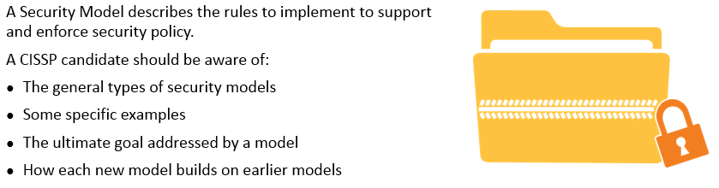
Security Models
Notes:
Section breaker slide with customer logo
Section heading – Arial Headings, 34, Bold
Sub head – Arial Headings, 18, normal
Used for a section heading. You may add a sub heading not exceeding one line also here
Section heading – Arial Headings, bold, 34 font size, should not exceed beyond 1 line
Sub Head – Arial Headings, normal, 18 font size, should not exceed beyond 1 line

Slide 13
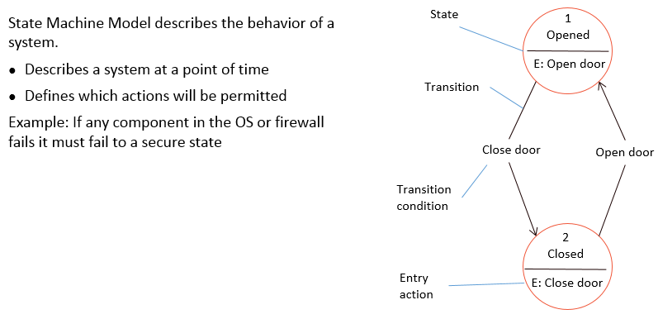
State Machine Model
Notes:
Section breaker slide with customer logo
Section heading – Arial Headings, 34, Bold
Sub head – Arial Headings, 18, normal
Used for a section heading. You may add a sub heading not exceeding one line also here
Section heading – Arial Headings, bold, 34 font size, should not exceed beyond 1 line
Sub Head – Arial Headings, normal, 18 font size, should not exceed beyond 1 line

Slide 14
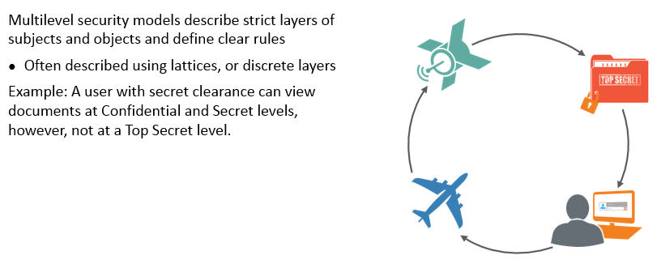
Multilevel Lattice Models
Notes:
Section breaker slide with customer logo
Section heading – Arial Headings, 34, Bold
Sub head – Arial Headings, 18, normal
Used for a section heading. You may add a sub heading not exceeding one line also here
Section heading – Arial Headings, bold, 34 font size, should not exceed beyond 1 line
Sub Head – Arial Headings, normal, 18 font size, should not exceed beyond 1 line

Slide 15
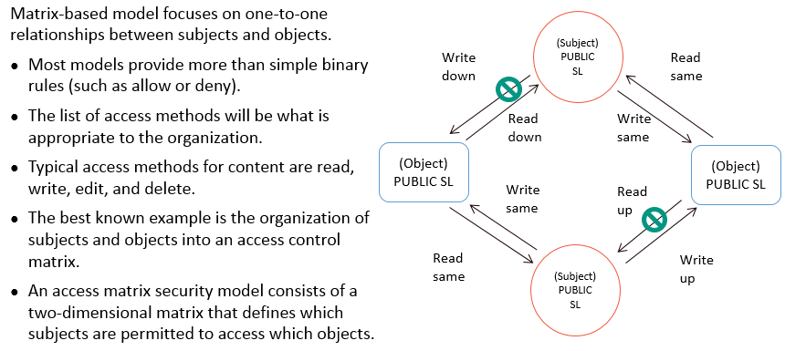
Matrix based model
Notes:
Section breaker slide with customer logo
Section heading – Arial Headings, 34, Bold
Sub head – Arial Headings, 18, normal
Used for a section heading. You may add a sub heading not exceeding one line also here
Section heading – Arial Headings, bold, 34 font size, should not exceed beyond 1 line
Sub Head – Arial Headings, normal, 18 font size, should not exceed beyond 1 line

Slide 16
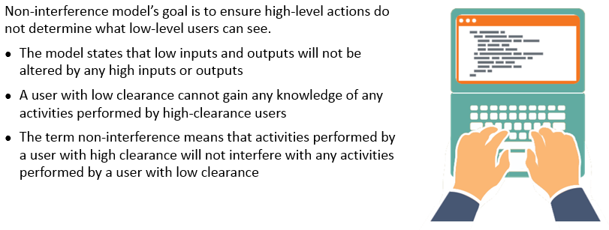
Non Interference Model
Notes:
Section breaker slide with customer logo
Section heading – Arial Headings, 34, Bold
Sub head – Arial Headings, 18, normal
Used for a section heading. You may add a sub heading not exceeding one line also here
Section heading – Arial Headings, bold, 34 font size, should not exceed beyond 1 line
Sub Head – Arial Headings, normal, 18 font size, should not exceed beyond 1 line

Slide 17
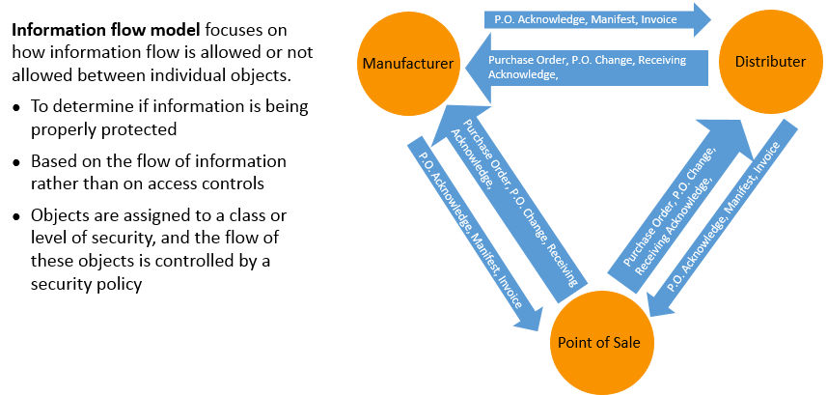
Information Flow Model
Notes:
Section breaker slide with customer logo
Section heading – Arial Headings, 34, Bold
Sub head – Arial Headings, 18, normal
Used for a section heading. You may add a sub heading not exceeding one line also here
Section heading – Arial Headings, bold, 34 font size, should not exceed beyond 1 line
Sub Head – Arial Headings, normal, 18 font size, should not exceed beyond 1 line

Slide 18
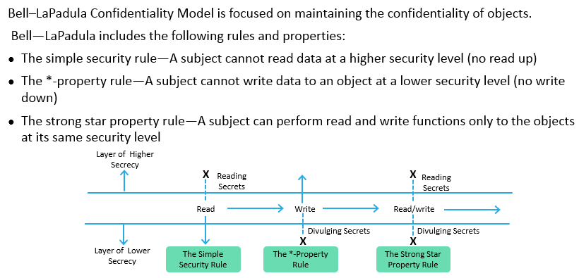
Examples of security models: Bell LaPadula Confidentiality model
Notes:
Section breaker slide with customer logo
Section heading – Arial Headings, 34, Bold
Sub head – Arial Headings, 18, normal
Used for a section heading. You may add a sub heading not exceeding one line also here
Section heading – Arial Headings, bold, 34 font size, should not exceed beyond 1 line
Sub Head – Arial Headings, normal, 18 font size, should not exceed beyond 1 line

Slide 19
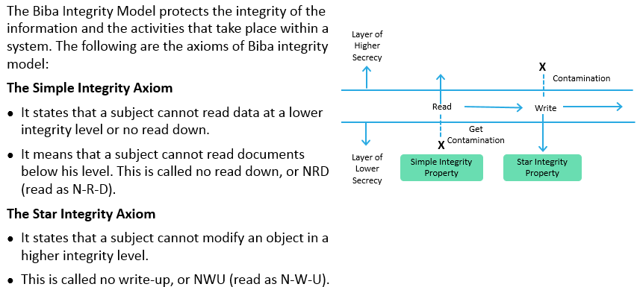
Examples of security models: Biba Integrity model
Notes:
Section breaker slide with customer logo
Section heading – Arial Headings, 34, Bold
Sub head – Arial Headings, 18, normal
Used for a section heading. You may add a sub heading not exceeding one line also here
Section heading – Arial Headings, bold, 34 font size, should not exceed beyond 1 line
Sub Head – Arial Headings, normal, 18 font size, should not exceed beyond 1 line

Slide 20
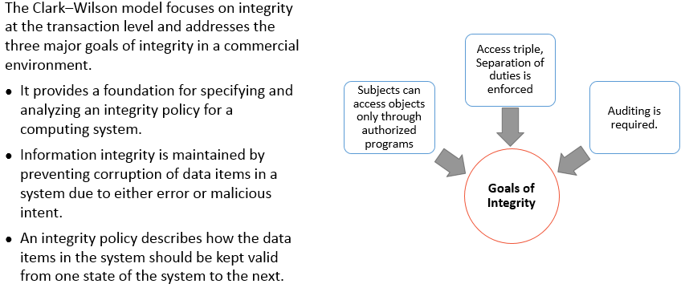
Examples of security models: Clark Wilson Integrity model
Notes:
Section breaker slide with customer logo
Section heading – Arial Headings, 34, Bold
Sub head – Arial Headings, 18, normal
Used for a section heading. You may add a sub heading not exceeding one line also here
Section heading – Arial Headings, bold, 34 font size, should not exceed beyond 1 line
Sub Head – Arial Headings, normal, 18 font size, should not exceed beyond 1 line

Slide 21
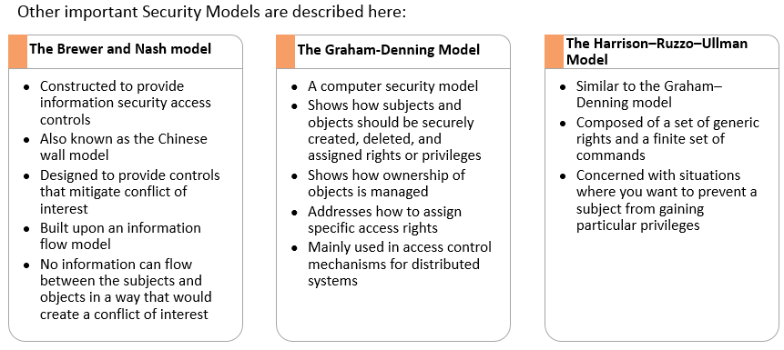
Brewer Nash, Graham Denning, Harrison Ruzzo Ullman models
Notes:
Section breaker slide with customer logo
Section heading – Arial Headings, 34, Bold
Sub head – Arial Headings, 18, normal
Used for a section heading. You may add a sub heading not exceeding one line also here
Section heading – Arial Headings, bold, 34 font size, should not exceed beyond 1 line
Sub Head – Arial Headings, normal, 18 font size, should not exceed beyond 1 line

Slide 22
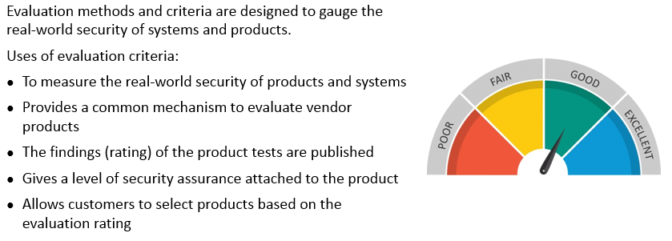
Evaluation Criteria
Notes:
Section breaker slide with customer logo
Section heading – Arial Headings, 34, Bold
Sub head – Arial Headings, 18, normal
Used for a section heading. You may add a sub heading not exceeding one line also here
Section heading – Arial Headings, bold, 34 font size, should not exceed beyond 1 line
Sub Head – Arial Headings, normal, 18 font size, should not exceed beyond 1 line

Slide 23
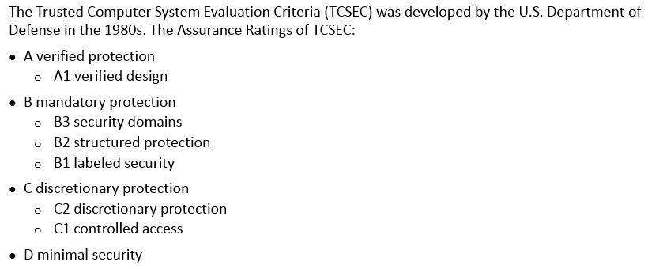
TCSEC
Notes:
Section breaker slide with customer logo
Section heading – Arial Headings, 34, Bold
Sub head – Arial Headings, 18, normal
Used for a section heading. You may add a sub heading not exceeding one line also here
Section heading – Arial Headings, bold, 34 font size, should not exceed beyond 1 line
Sub Head – Arial Headings, normal, 18 font size, should not exceed beyond 1 line

Slide 24
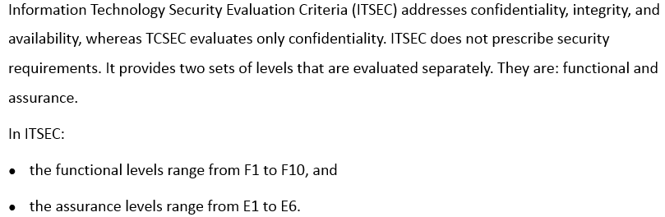
Information Technology Security Evaluation Criteria (ITSEC)
Notes:
Section breaker slide with customer logo
Section heading – Arial Headings, 34, Bold
Sub head – Arial Headings, 18, normal
Used for a section heading. You may add a sub heading not exceeding one line also here
Section heading – Arial Headings, bold, 34 font size, should not exceed beyond 1 line
Sub Head – Arial Headings, normal, 18 font size, should not exceed beyond 1 line

Slide 25
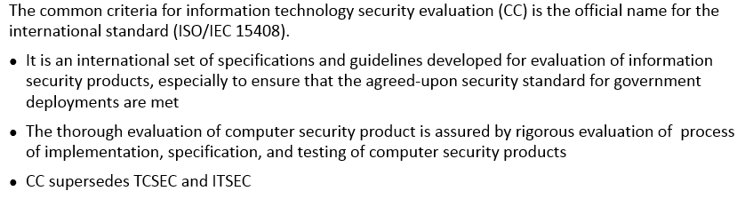
Common Criteria
Notes:
Section breaker slide with customer logo
Section heading – Arial Headings, 34, Bold
Sub head – Arial Headings, 18, normal
Used for a section heading. You may add a sub heading not exceeding one line also here
Section heading – Arial Headings, bold, 34 font size, should not exceed beyond 1 line
Sub Head – Arial Headings, normal, 18 font size, should not exceed beyond 1 line

Slide 26
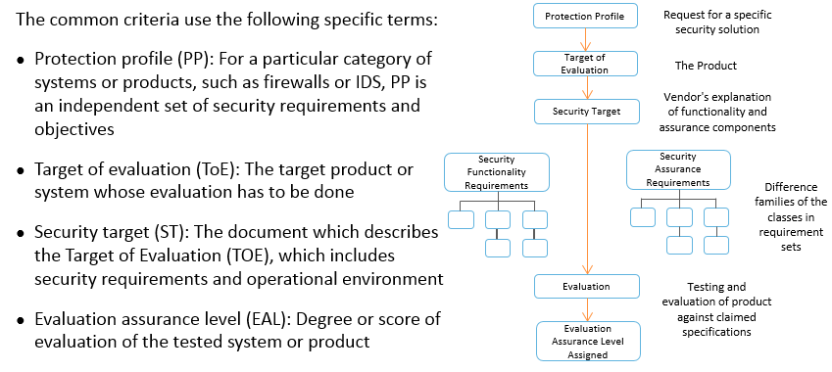
Common Criteria Evaluation Process
Notes:
Section breaker slide with customer logo
Section heading – Arial Headings, 34, Bold
Sub head – Arial Headings, 18, normal
Used for a section heading. You may add a sub heading not exceeding one line also here
Section heading – Arial Headings, bold, 34 font size, should not exceed beyond 1 line
Sub Head – Arial Headings, normal, 18 font size, should not exceed beyond 1 line

Slide 27
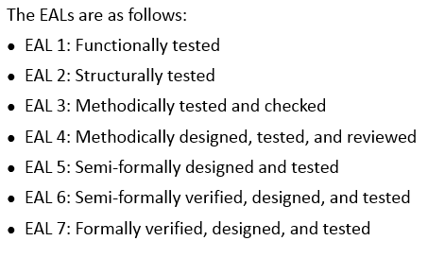
Common Criteria - Levels
Notes:
Section breaker slide with customer logo
Section heading – Arial Headings, 34, Bold
Sub head – Arial Headings, 18, normal
Used for a section heading. You may add a sub heading not exceeding one line also here
Section heading – Arial Headings, bold, 34 font size, should not exceed beyond 1 line
Sub Head – Arial Headings, normal, 18 font size, should not exceed beyond 1 line

Slide 28
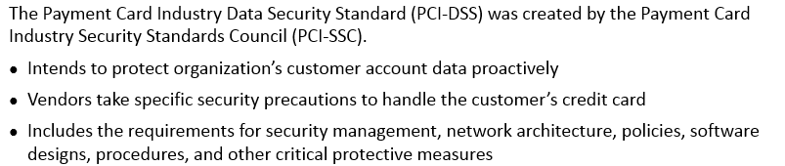
Payment Card Industry Data Security Standard
Notes:
Section breaker slide with customer logo
Section heading – Arial Headings, 34, Bold
Sub head – Arial Headings, 18, normal
Used for a section heading. You may add a sub heading not exceeding one line also here
Section heading – Arial Headings, bold, 34 font size, should not exceed beyond 1 line
Sub Head – Arial Headings, normal, 18 font size, should not exceed beyond 1 line

Slide 29
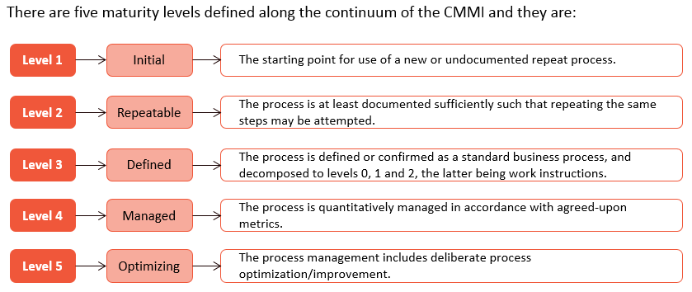
SEI – CMMI Levels
Notes:
Section breaker slide with customer logo
Section heading – Arial Headings, 34, Bold
Sub head – Arial Headings, 18, normal
Used for a section heading. You may add a sub heading not exceeding one line also here
Section heading – Arial Headings, bold, 34 font size, should not exceed beyond 1 line
Sub Head – Arial Headings, normal, 18 font size, should not exceed beyond 1 line

Slide 30
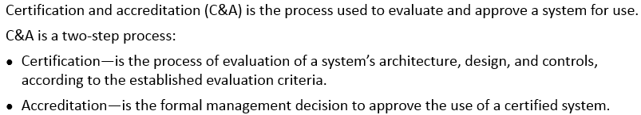
Certification and Accreditation
Notes:
Section breaker slide with customer logo
Section heading – Arial Headings, 34, Bold
Sub head – Arial Headings, 18, normal
Used for a section heading. You may add a sub heading not exceeding one line also here
Section heading – Arial Headings, bold, 34 font size, should not exceed beyond 1 line
Sub Head – Arial Headings, normal, 18 font size, should not exceed beyond 1 line

Slide 31
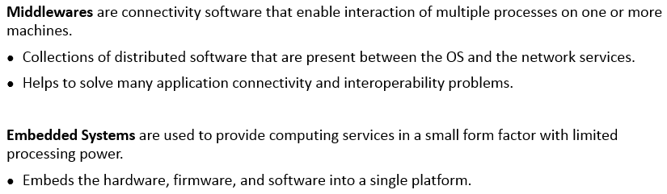
Middleware and Embedded Systems
Notes:
Section breaker slide with customer logo
Section heading – Arial Headings, 34, Bold
Sub head – Arial Headings, 18, normal
Used for a section heading. You may add a sub heading not exceeding one line also here
Section heading – Arial Headings, bold, 34 font size, should not exceed beyond 1 line
Sub Head – Arial Headings, normal, 18 font size, should not exceed beyond 1 line

Slide 32
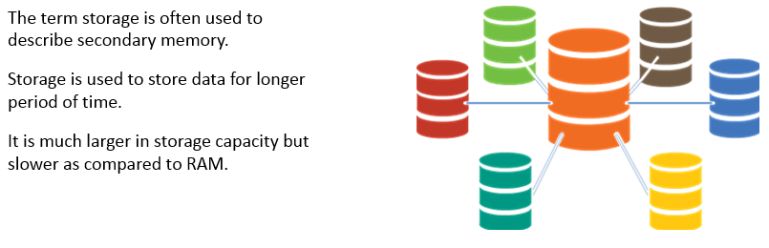
System Components - Storage
Notes:
Section breaker slide with customer logo
Section heading – Arial Headings, 34, Bold
Sub head – Arial Headings, 18, normal
Used for a section heading. You may add a sub heading not exceeding one line also here
Section heading – Arial Headings, bold, 34 font size, should not exceed beyond 1 line
Sub Head – Arial Headings, normal, 18 font size, should not exceed beyond 1 line

Slide 33
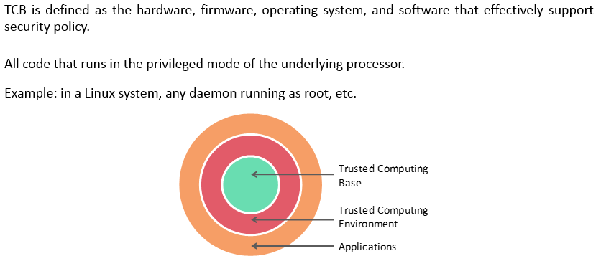
System Components – Trusted Computing Base (TCB)
Notes:
Section breaker slide with customer logo
Section heading – Arial Headings, 34, Bold
Sub head – Arial Headings, 18, normal
Used for a section heading. You may add a sub heading not exceeding one line also here
Section heading – Arial Headings, bold, 34 font size, should not exceed beyond 1 line
Sub Head – Arial Headings, normal, 18 font size, should not exceed beyond 1 line

Slide 34
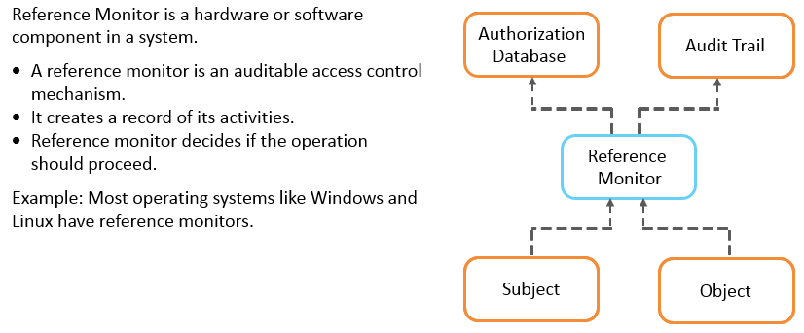
System Components – Reference Monitor
Notes:
Section breaker slide with customer logo
Section heading – Arial Headings, 34, Bold
Sub head – Arial Headings, 18, normal
Used for a section heading. You may add a sub heading not exceeding one line also here
Section heading – Arial Headings, bold, 34 font size, should not exceed beyond 1 line
Sub Head – Arial Headings, normal, 18 font size, should not exceed beyond 1 line

Slide 35
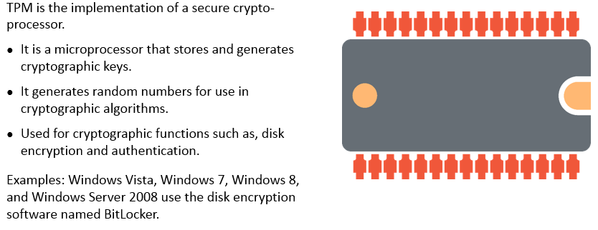
System Components – Trusted Platform Module (TPM)
Notes:
Section breaker slide with customer logo
Section heading – Arial Headings, 34, Bold
Sub head – Arial Headings, 18, normal
Used for a section heading. You may add a sub heading not exceeding one line also here
Section heading – Arial Headings, bold, 34 font size, should not exceed beyond 1 line
Sub Head – Arial Headings, normal, 18 font size, should not exceed beyond 1 line

Slide 36

System Components – Operating System
Notes:
Section breaker slide with customer logo
Section heading – Arial Headings, 34, Bold
Sub head – Arial Headings, 18, normal
Used for a section heading. You may add a sub heading not exceeding one line also here
Section heading – Arial Headings, bold, 34 font size, should not exceed beyond 1 line
Sub Head – Arial Headings, normal, 18 font size, should not exceed beyond 1 line

Slide 37
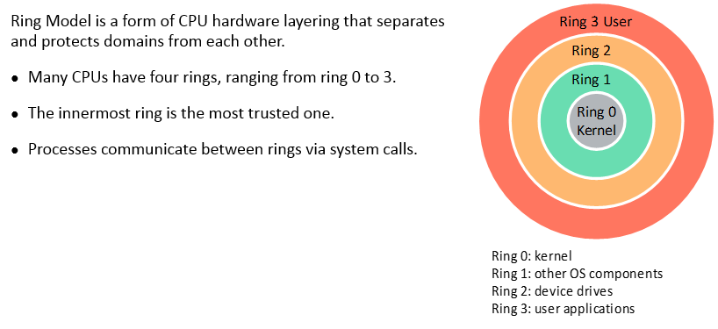
System Components – Ring Model
Notes:
Section breaker slide with customer logo
Section heading – Arial Headings, 34, Bold
Sub head – Arial Headings, 18, normal
Used for a section heading. You may add a sub heading not exceeding one line also here
Section heading – Arial Headings, bold, 34 font size, should not exceed beyond 1 line
Sub Head – Arial Headings, normal, 18 font size, should not exceed beyond 1 line

Slide 38
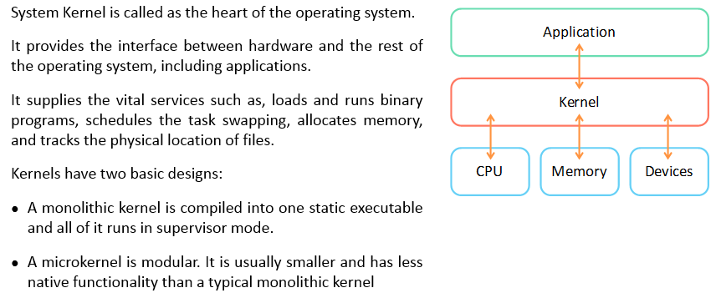
System Components – System Kernel
Notes:
Section breaker slide with customer logo
Section heading – Arial Headings, 34, Bold
Sub head – Arial Headings, 18, normal
Used for a section heading. You may add a sub heading not exceeding one line also here
Section heading – Arial Headings, bold, 34 font size, should not exceed beyond 1 line
Sub Head – Arial Headings, normal, 18 font size, should not exceed beyond 1 line

Slide 39
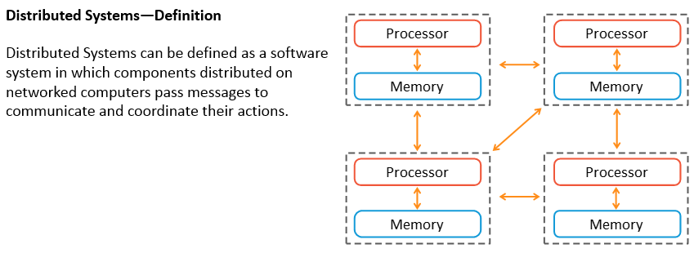
Distributed Systems
Notes:
Section breaker slide with customer logo
Section heading – Arial Headings, 34, Bold
Sub head – Arial Headings, 18, normal
Used for a section heading. You may add a sub heading not exceeding one line also here
Section heading – Arial Headings, bold, 34 font size, should not exceed beyond 1 line
Sub Head – Arial Headings, normal, 18 font size, should not exceed beyond 1 line

Slide 40
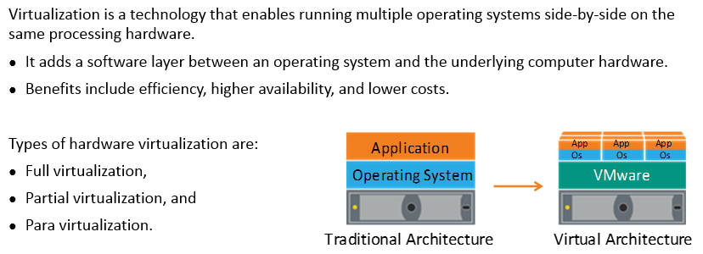
Virtualization
Notes:
Section breaker slide with customer logo
Section heading – Arial Headings, 34, Bold
Sub head – Arial Headings, 18, normal
Used for a section heading. You may add a sub heading not exceeding one line also here
Section heading – Arial Headings, bold, 34 font size, should not exceed beyond 1 line
Sub Head – Arial Headings, normal, 18 font size, should not exceed beyond 1 line

Slide 41
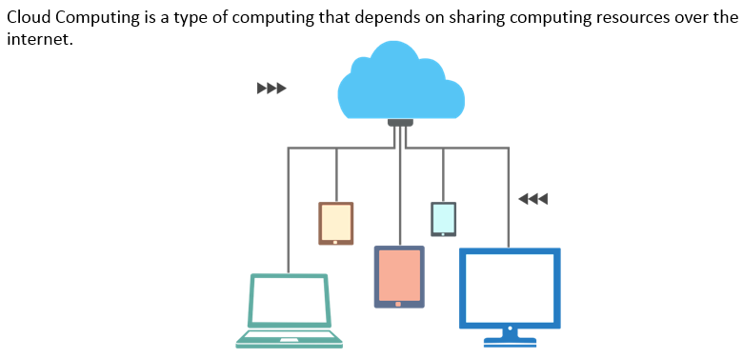
Cloud Computing
Notes:
Section breaker slide with customer logo
Section heading – Arial Headings, 34, Bold
Sub head – Arial Headings, 18, normal
Used for a section heading. You may add a sub heading not exceeding one line also here
Section heading – Arial Headings, bold, 34 font size, should not exceed beyond 1 line
Sub Head – Arial Headings, normal, 18 font size, should not exceed beyond 1 line

Slide 42
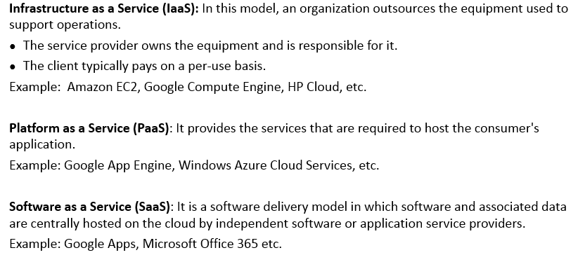
Service Models
Notes:
Section breaker slide with customer logo
Section heading – Arial Headings, 34, Bold
Sub head – Arial Headings, 18, normal
Used for a section heading. You may add a sub heading not exceeding one line also here
Section heading – Arial Headings, bold, 34 font size, should not exceed beyond 1 line
Sub Head – Arial Headings, normal, 18 font size, should not exceed beyond 1 line

Slide 43
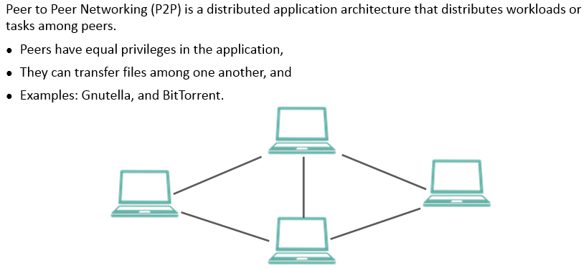
Peer to Peer networking – P2P
Notes:
Section breaker slide with customer logo
Section heading – Arial Headings, 34, Bold
Sub head – Arial Headings, 18, normal
Used for a section heading. You may add a sub heading not exceeding one line also here
Section heading – Arial Headings, bold, 34 font size, should not exceed beyond 1 line
Sub Head – Arial Headings, normal, 18 font size, should not exceed beyond 1 line

Slide 44
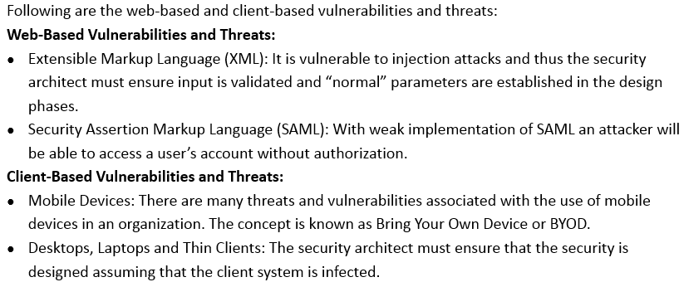
Assessing and mitigating vulnerabilities and threats
Notes:
Section breaker slide with customer logo
Section heading – Arial Headings, 34, Bold
Sub head – Arial Headings, 18, normal
Used for a section heading. You may add a sub heading not exceeding one line also here
Section heading – Arial Headings, bold, 34 font size, should not exceed beyond 1 line
Sub Head – Arial Headings, normal, 18 font size, should not exceed beyond 1 line

Slide 45
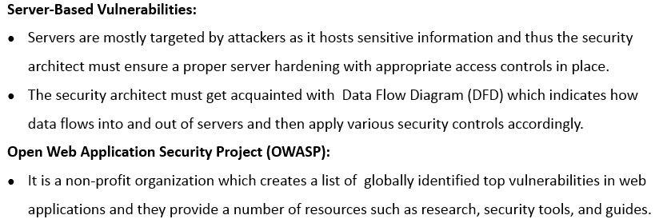
Assessing and mitigating vulnerabilities and threats (contd)
Notes:
Section breaker slide with customer logo
Section heading – Arial Headings, 34, Bold
Sub head – Arial Headings, 18, normal
Used for a section heading. You may add a sub heading not exceeding one line also here
Section heading – Arial Headings, bold, 34 font size, should not exceed beyond 1 line
Sub Head – Arial Headings, normal, 18 font size, should not exceed beyond 1 line

Slide 46
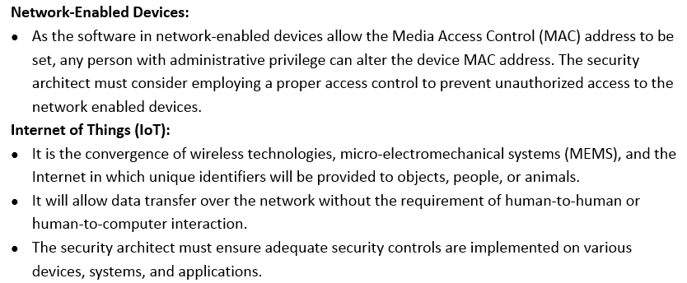
Assessing and mitigating vulnerabilities and threats (contd)
Notes:
Section breaker slide with customer logo
Section heading – Arial Headings, 34, Bold
Sub head – Arial Headings, 18, normal
Used for a section heading. You may add a sub heading not exceeding one line also here
Section heading – Arial Headings, bold, 34 font size, should not exceed beyond 1 line
Sub Head – Arial Headings, normal, 18 font size, should not exceed beyond 1 line

Slide 47
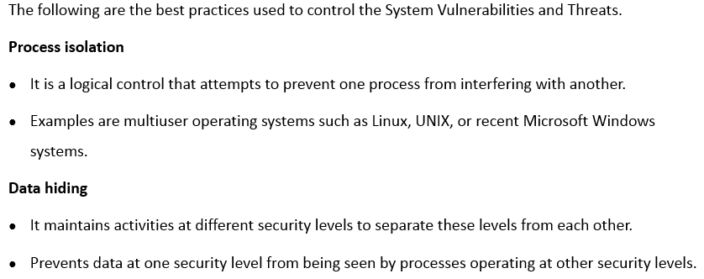
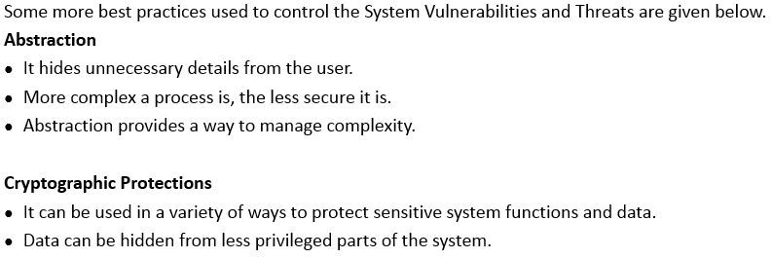
Best Practices
Notes:
Section breaker slide with customer logo
Section heading – Arial Headings, 34, Bold
Sub head – Arial Headings, 18, normal
Used for a section heading. You may add a sub heading not exceeding one line also here
Section heading – Arial Headings, bold, 34 font size, should not exceed beyond 1 line
Sub Head – Arial Headings, normal, 18 font size, should not exceed beyond 1 line

Slide 48
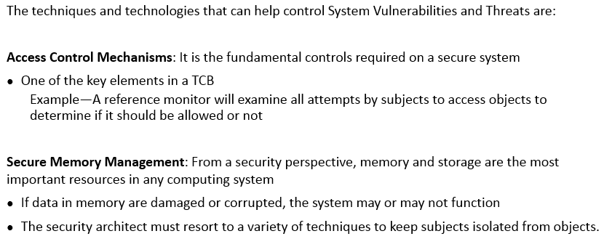
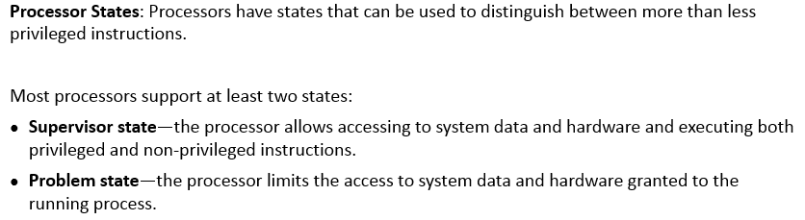
Best Practices – Techniques and Technologies
Notes:
Section breaker slide with customer logo
Section heading – Arial Headings, 34, Bold
Sub head – Arial Headings, 18, normal
Used for a section heading. You may add a sub heading not exceeding one line also here
Section heading – Arial Headings, bold, 34 font size, should not exceed beyond 1 line
Sub Head – Arial Headings, normal, 18 font size, should not exceed beyond 1 line

Slide 49
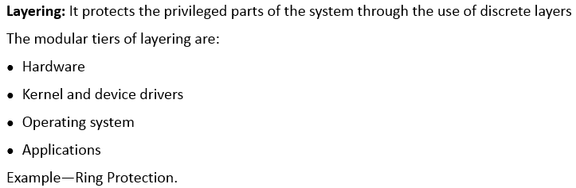
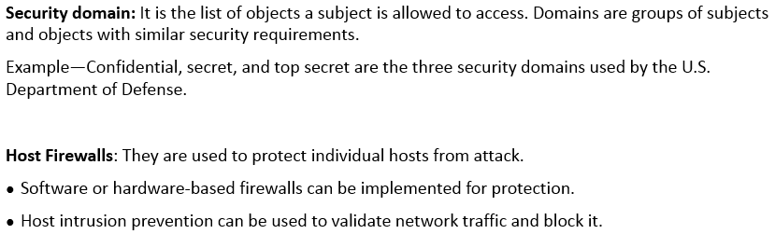
Best Practices – Techniques and Technologies (contd)
Notes:
Section breaker slide with customer logo
Section heading – Arial Headings, 34, Bold
Sub head – Arial Headings, 18, normal
Used for a section heading. You may add a sub heading not exceeding one line also here
Section heading – Arial Headings, bold, 34 font size, should not exceed beyond 1 line
Sub Head – Arial Headings, normal, 18 font size, should not exceed beyond 1 line

Slide 50

Best Practices – Techniques and Technologies (contd)
Notes:
Section breaker slide with customer logo
Section heading – Arial Headings, 34, Bold
Sub head – Arial Headings, 18, normal
Used for a section heading. You may add a sub heading not exceeding one line also here
Section heading – Arial Headings, bold, 34 font size, should not exceed beyond 1 line
Sub Head – Arial Headings, normal, 18 font size, should not exceed beyond 1 line

Slide 51

Cryptography
Notes:
Section breaker slide with customer logo
Section heading – Arial Headings, 34, Bold
Sub head – Arial Headings, 18, normal
Used for a section heading. You may add a sub heading not exceeding one line also here
Section heading – Arial Headings, bold, 34 font size, should not exceed beyond 1 line
Sub Head – Arial Headings, normal, 18 font size, should not exceed beyond 1 line

Slide 52

Cryptographic Lifecycle
Notes:
Section breaker slide with customer logo
Section heading – Arial Headings, 34, Bold
Sub head – Arial Headings, 18, normal
Used for a section heading. You may add a sub heading not exceeding one line also here
Section heading – Arial Headings, bold, 34 font size, should not exceed beyond 1 line
Sub Head – Arial Headings, normal, 18 font size, should not exceed beyond 1 line

Slide 53

Algorithm or Protocol governance
Notes:
Section breaker slide with customer logo
Section heading – Arial Headings, 34, Bold
Sub head – Arial Headings, 18, normal
Used for a section heading. You may add a sub heading not exceeding one line also here
Section heading – Arial Headings, bold, 34 font size, should not exceed beyond 1 line
Sub Head – Arial Headings, normal, 18 font size, should not exceed beyond 1 line

Slide 54

Strength of a cryptosystem
Notes:
Section breaker slide with customer logo
Section heading – Arial Headings, 34, Bold
Sub head – Arial Headings, 18, normal
Used for a section heading. You may add a sub heading not exceeding one line also here
Section heading – Arial Headings, bold, 34 font size, should not exceed beyond 1 line
Sub Head – Arial Headings, normal, 18 font size, should not exceed beyond 1 line

Slide 55

Cryptography Methods – Substitution cipher
Notes:
Section breaker slide with customer logo
Section heading – Arial Headings, 34, Bold
Sub head – Arial Headings, 18, normal
Used for a section heading. You may add a sub heading not exceeding one line also here
Section heading – Arial Headings, bold, 34 font size, should not exceed beyond 1 line
Sub Head – Arial Headings, normal, 18 font size, should not exceed beyond 1 line

Slide 56

Cryptography Methods – Transposition cipher
Notes:
Section breaker slide with customer logo
Section heading – Arial Headings, 34, Bold
Sub head – Arial Headings, 18, normal
Used for a section heading. You may add a sub heading not exceeding one line also here
Section heading – Arial Headings, bold, 34 font size, should not exceed beyond 1 line
Sub Head – Arial Headings, normal, 18 font size, should not exceed beyond 1 line

Slide 57

Cryptography Methods – book or running key cipher
Notes:
Section breaker slide with customer logo
Section heading – Arial Headings, 34, Bold
Sub head – Arial Headings, 18, normal
Used for a section heading. You may add a sub heading not exceeding one line also here
Section heading – Arial Headings, bold, 34 font size, should not exceed beyond 1 line
Sub Head – Arial Headings, normal, 18 font size, should not exceed beyond 1 line

Slide 58

Cryptography Methods – concealment cipher
Notes:
Section breaker slide with customer logo
Section heading – Arial Headings, 34, Bold
Sub head – Arial Headings, 18, normal
Used for a section heading. You may add a sub heading not exceeding one line also here
Section heading – Arial Headings, bold, 34 font size, should not exceed beyond 1 line
Sub Head – Arial Headings, normal, 18 font size, should not exceed beyond 1 line

Slide 59

Cryptography Methods – steganography and DRM
Notes:
Section breaker slide with customer logo
Section heading – Arial Headings, 34, Bold
Sub head – Arial Headings, 18, normal
Used for a section heading. You may add a sub heading not exceeding one line also here
Section heading – Arial Headings, bold, 34 font size, should not exceed beyond 1 line
Sub Head – Arial Headings, normal, 18 font size, should not exceed beyond 1 line

Slide 60

Introduction to Symmetric cryptography
Notes:
Section breaker slide with customer logo
Section heading – Arial Headings, 34, Bold
Sub head – Arial Headings, 18, normal
Used for a section heading. You may add a sub heading not exceeding one line also here
Section heading – Arial Headings, bold, 34 font size, should not exceed beyond 1 line
Sub Head – Arial Headings, normal, 18 font size, should not exceed beyond 1 line

Slide 61

Symmetric key ciphers
Notes:
Section breaker slide with customer logo
Section heading – Arial Headings, 34, Bold
Sub head – Arial Headings, 18, normal
Used for a section heading. You may add a sub heading not exceeding one line also here
Section heading – Arial Headings, bold, 34 font size, should not exceed beyond 1 line
Sub Head – Arial Headings, normal, 18 font size, should not exceed beyond 1 line

Slide 62

Block cipher
Notes:
Section breaker slide with customer logo
Section heading – Arial Headings, 34, Bold
Sub head – Arial Headings, 18, normal
Used for a section heading. You may add a sub heading not exceeding one line also here
Section heading – Arial Headings, bold, 34 font size, should not exceed beyond 1 line
Sub Head – Arial Headings, normal, 18 font size, should not exceed beyond 1 line

Slide 63

Stream cipher
Notes:
Section breaker slide with customer logo
Section heading – Arial Headings, 34, Bold
Sub head – Arial Headings, 18, normal
Used for a section heading. You may add a sub heading not exceeding one line also here
Section heading – Arial Headings, bold, 34 font size, should not exceed beyond 1 line
Sub Head – Arial Headings, normal, 18 font size, should not exceed beyond 1 line

Slide 64

Data Encryption Standard (DES)
Notes:
Section breaker slide with customer logo
Section heading – Arial Headings, 34, Bold
Sub head – Arial Headings, 18, normal
Used for a section heading. You may add a sub heading not exceeding one line also here
Section heading – Arial Headings, bold, 34 font size, should not exceed beyond 1 line
Sub Head – Arial Headings, normal, 18 font size, should not exceed beyond 1 line

Slide 65

DES Algorithm
Notes:
Section breaker slide with customer logo
Section heading – Arial Headings, 34, Bold
Sub head – Arial Headings, 18, normal
Used for a section heading. You may add a sub heading not exceeding one line also here
Section heading – Arial Headings, bold, 34 font size, should not exceed beyond 1 line
Sub Head – Arial Headings, normal, 18 font size, should not exceed beyond 1 line

Slide 66

DES Operation Modes – Electronic Code Book (ECB)
Notes:
Section breaker slide with customer logo
Section heading – Arial Headings, 34, Bold
Sub head – Arial Headings, 18, normal
Used for a section heading. You may add a sub heading not exceeding one line also here
Section heading – Arial Headings, bold, 34 font size, should not exceed beyond 1 line
Sub Head – Arial Headings, normal, 18 font size, should not exceed beyond 1 line

Slide 67

DES Operation Modes – Cipher Block Chaining (CBC)
Notes:
Section breaker slide with customer logo
Section heading – Arial Headings, 34, Bold
Sub head – Arial Headings, 18, normal
Used for a section heading. You may add a sub heading not exceeding one line also here
Section heading – Arial Headings, bold, 34 font size, should not exceed beyond 1 line
Sub Head – Arial Headings, normal, 18 font size, should not exceed beyond 1 line

Slide 68

DES Operation Modes – Cipher Feed Back (CFB)
Notes:
Section breaker slide with customer logo
Section heading – Arial Headings, 34, Bold
Sub head – Arial Headings, 18, normal
Used for a section heading. You may add a sub heading not exceeding one line also here
Section heading – Arial Headings, bold, 34 font size, should not exceed beyond 1 line
Sub Head – Arial Headings, normal, 18 font size, should not exceed beyond 1 line

Slide 69

DES Operation Modes – Output Feed Back (OFB)
Notes:
Section breaker slide with customer logo
Section heading – Arial Headings, 34, Bold
Sub head – Arial Headings, 18, normal
Used for a section heading. You may add a sub heading not exceeding one line also here
Section heading – Arial Headings, bold, 34 font size, should not exceed beyond 1 line
Sub Head – Arial Headings, normal, 18 font size, should not exceed beyond 1 line

Slide 70

DES Operation Modes – Counter
Notes:
Section breaker slide with customer logo
Section heading – Arial Headings, 34, Bold
Sub head – Arial Headings, 18, normal
Used for a section heading. You may add a sub heading not exceeding one line also here
Section heading – Arial Headings, bold, 34 font size, should not exceed beyond 1 line
Sub Head – Arial Headings, normal, 18 font size, should not exceed beyond 1 line

Slide 71

Triple DES
Notes:
Section breaker slide with customer logo
Section heading – Arial Headings, 34, Bold
Sub head – Arial Headings, 18, normal
Used for a section heading. You may add a sub heading not exceeding one line also here
Section heading – Arial Headings, bold, 34 font size, should not exceed beyond 1 line
Sub Head – Arial Headings, normal, 18 font size, should not exceed beyond 1 line

Slide 72

Advanced Encryption Standard (AES)
Notes:
Section breaker slide with customer logo
Section heading – Arial Headings, 34, Bold
Sub head – Arial Headings, 18, normal
Used for a section heading. You may add a sub heading not exceeding one line also here
Section heading – Arial Headings, bold, 34 font size, should not exceed beyond 1 line
Sub Head – Arial Headings, normal, 18 font size, should not exceed beyond 1 line

Slide 73


Other Symmetric Systems
Notes:
Section breaker slide with customer logo
Section heading – Arial Headings, 34, Bold
Sub head – Arial Headings, 18, normal
Used for a section heading. You may add a sub heading not exceeding one line also here
Section heading – Arial Headings, bold, 34 font size, should not exceed beyond 1 line
Sub Head – Arial Headings, normal, 18 font size, should not exceed beyond 1 line

Slide 74

Introduction to Asymmetric Cryptography
Notes:
Section breaker slide with customer logo
Section heading – Arial Headings, 34, Bold
Sub head – Arial Headings, 18, normal
Used for a section heading. You may add a sub heading not exceeding one line also here
Section heading – Arial Headings, bold, 34 font size, should not exceed beyond 1 line
Sub Head – Arial Headings, normal, 18 font size, should not exceed beyond 1 line

Slide 75

Conceptual Diagram
Notes:
Section breaker slide with customer logo
Section heading – Arial Headings, 34, Bold
Sub head – Arial Headings, 18, normal
Used for a section heading. You may add a sub heading not exceeding one line also here
Section heading – Arial Headings, bold, 34 font size, should not exceed beyond 1 line
Sub Head – Arial Headings, normal, 18 font size, should not exceed beyond 1 line

Slide 76

Asymmetric Cryptography - RSA Algorithm
Notes:
Section breaker slide with customer logo
Section heading – Arial Headings, 34, Bold
Sub head – Arial Headings, 18, normal
Used for a section heading. You may add a sub heading not exceeding one line also here
Section heading – Arial Headings, bold, 34 font size, should not exceed beyond 1 line
Sub Head – Arial Headings, normal, 18 font size, should not exceed beyond 1 line

Slide 77

Other types of asymmetric cryptography – Elliptic Curve Cryptosystems (ECC)
Notes:
Section breaker slide with customer logo
Section heading – Arial Headings, 34, Bold
Sub head – Arial Headings, 18, normal
Used for a section heading. You may add a sub heading not exceeding one line also here
Section heading – Arial Headings, bold, 34 font size, should not exceed beyond 1 line
Sub Head – Arial Headings, normal, 18 font size, should not exceed beyond 1 line

Slide 78

Other types of asymmetric cryptography – Diffie hellman key exchange
Notes:
Section breaker slide with customer logo
Section heading – Arial Headings, 34, Bold
Sub head – Arial Headings, 18, normal
Used for a section heading. You may add a sub heading not exceeding one line also here
Section heading – Arial Headings, bold, 34 font size, should not exceed beyond 1 line
Sub Head – Arial Headings, normal, 18 font size, should not exceed beyond 1 line

Slide 79

Public Key Cryptography
Notes:
Section breaker slide with customer logo
Section heading – Arial Headings, 34, Bold
Sub head – Arial Headings, 18, normal
Used for a section heading. You may add a sub heading not exceeding one line also here
Section heading – Arial Headings, bold, 34 font size, should not exceed beyond 1 line
Sub Head – Arial Headings, normal, 18 font size, should not exceed beyond 1 line

Slide 80

Symmetric vs Asymmetric cryptography
Notes:
Section breaker slide with customer logo
Section heading – Arial Headings, 34, Bold
Sub head – Arial Headings, 18, normal
Used for a section heading. You may add a sub heading not exceeding one line also here
Section heading – Arial Headings, bold, 34 font size, should not exceed beyond 1 line
Sub Head – Arial Headings, normal, 18 font size, should not exceed beyond 1 line

Slide 81

Advantages and Disadvantages
Notes:
Section breaker slide with customer logo
Section heading – Arial Headings, 34, Bold
Sub head – Arial Headings, 18, normal
Used for a section heading. You may add a sub heading not exceeding one line also here
Section heading – Arial Headings, bold, 34 font size, should not exceed beyond 1 line
Sub Head – Arial Headings, normal, 18 font size, should not exceed beyond 1 line

Slide 82

Public Key Infrastructure - Introduction
Notes:
Section breaker slide with customer logo
Section heading – Arial Headings, 34, Bold
Sub head – Arial Headings, 18, normal
Used for a section heading. You may add a sub heading not exceeding one line also here
Section heading – Arial Headings, bold, 34 font size, should not exceed beyond 1 line
Sub Head – Arial Headings, normal, 18 font size, should not exceed beyond 1 line

Slide 83


PKI Certification
Notes:
Section breaker slide with customer logo
Section heading – Arial Headings, 34, Bold
Sub head – Arial Headings, 18, normal
Used for a section heading. You may add a sub heading not exceeding one line also here
Section heading – Arial Headings, bold, 34 font size, should not exceed beyond 1 line
Sub Head – Arial Headings, normal, 18 font size, should not exceed beyond 1 line

Slide 84

PKI (contd)
Notes:
Section breaker slide with customer logo
Section heading – Arial Headings, 34, Bold
Sub head – Arial Headings, 18, normal
Used for a section heading. You may add a sub heading not exceeding one line also here
Section heading – Arial Headings, bold, 34 font size, should not exceed beyond 1 line
Sub Head – Arial Headings, normal, 18 font size, should not exceed beyond 1 line

Slide 85

One Way Hash
Notes:
Section breaker slide with customer logo
Section heading – Arial Headings, 34, Bold
Sub head – Arial Headings, 18, normal
Used for a section heading. You may add a sub heading not exceeding one line also here
Section heading – Arial Headings, bold, 34 font size, should not exceed beyond 1 line
Sub Head – Arial Headings, normal, 18 font size, should not exceed beyond 1 line

Slide 86


Hashing Algorithms
Notes:
Section breaker slide with customer logo
Section heading – Arial Headings, 34, Bold
Sub head – Arial Headings, 18, normal
Used for a section heading. You may add a sub heading not exceeding one line also here
Section heading – Arial Headings, bold, 34 font size, should not exceed beyond 1 line
Sub Head – Arial Headings, normal, 18 font size, should not exceed beyond 1 line

Slide 87

Message Authentication Code
Notes:
Section breaker slide with customer logo
Section heading – Arial Headings, 34, Bold
Sub head – Arial Headings, 18, normal
Used for a section heading. You may add a sub heading not exceeding one line also here
Section heading – Arial Headings, bold, 34 font size, should not exceed beyond 1 line
Sub Head – Arial Headings, normal, 18 font size, should not exceed beyond 1 line

Slide 88

Digital Signatures
Notes:
Section breaker slide with customer logo
Section heading – Arial Headings, 34, Bold
Sub head – Arial Headings, 18, normal
Used for a section heading. You may add a sub heading not exceeding one line also here
Section heading – Arial Headings, bold, 34 font size, should not exceed beyond 1 line
Sub Head – Arial Headings, normal, 18 font size, should not exceed beyond 1 line

Slide 89

Key Management
Notes:
Section breaker slide with customer logo
Section heading – Arial Headings, 34, Bold
Sub head – Arial Headings, 18, normal
Used for a section heading. You may add a sub heading not exceeding one line also here
Section heading – Arial Headings, bold, 34 font size, should not exceed beyond 1 line
Sub Head – Arial Headings, normal, 18 font size, should not exceed beyond 1 line

Slide 90

Key Management Principles
Notes:
Section breaker slide with customer logo
Section heading – Arial Headings, 34, Bold
Sub head – Arial Headings, 18, normal
Used for a section heading. You may add a sub heading not exceeding one line also here
Section heading – Arial Headings, bold, 34 font size, should not exceed beyond 1 line
Sub Head – Arial Headings, normal, 18 font size, should not exceed beyond 1 line

Slide 91

Need for Physical and Environmental Security
Notes:
Section breaker slide with customer logo
Section heading – Arial Headings, 34, Bold
Sub head – Arial Headings, 18, normal
Used for a section heading. You may add a sub heading not exceeding one line also here
Section heading – Arial Headings, bold, 34 font size, should not exceed beyond 1 line
Sub Head – Arial Headings, normal, 18 font size, should not exceed beyond 1 line

Slide 92

Site and Facility Design Criteria
Notes:
Section breaker slide with customer logo
Section heading – Arial Headings, 34, Bold
Sub head – Arial Headings, 18, normal
Used for a section heading. You may add a sub heading not exceeding one line also here
Section heading – Arial Headings, bold, 34 font size, should not exceed beyond 1 line
Sub Head – Arial Headings, normal, 18 font size, should not exceed beyond 1 line

Slide 93

Information Protection Environment
Notes:
Section breaker slide with customer logo
Section heading – Arial Headings, 34, Bold
Sub head – Arial Headings, 18, normal
Used for a section heading. You may add a sub heading not exceeding one line also here
Section heading – Arial Headings, bold, 34 font size, should not exceed beyond 1 line
Sub Head – Arial Headings, normal, 18 font size, should not exceed beyond 1 line

Slide 94

Crime Prevention Through Environmental Design (CPTED)
Notes:
Section breaker slide with customer logo
Section heading – Arial Headings, 34, Bold
Sub head – Arial Headings, 18, normal
Used for a section heading. You may add a sub heading not exceeding one line also here
Section heading – Arial Headings, bold, 34 font size, should not exceed beyond 1 line
Sub Head – Arial Headings, normal, 18 font size, should not exceed beyond 1 line

Slide 95

Site Location
Notes:
Section breaker slide with customer logo
Section heading – Arial Headings, 34, Bold
Sub head – Arial Headings, 18, normal
Used for a section heading. You may add a sub heading not exceeding one line also here
Section heading – Arial Headings, bold, 34 font size, should not exceed beyond 1 line
Sub Head – Arial Headings, normal, 18 font size, should not exceed beyond 1 line

Slide 96

Construction
Notes:
Section breaker slide with customer logo
Section heading – Arial Headings, 34, Bold
Sub head – Arial Headings, 18, normal
Used for a section heading. You may add a sub heading not exceeding one line also here
Section heading – Arial Headings, bold, 34 font size, should not exceed beyond 1 line
Sub Head – Arial Headings, normal, 18 font size, should not exceed beyond 1 line

Slide 97

Support Facilities
Notes:
Section breaker slide with customer logo
Section heading – Arial Headings, 34, Bold
Sub head – Arial Headings, 18, normal
Used for a section heading. You may add a sub heading not exceeding one line also here
Section heading – Arial Headings, bold, 34 font size, should not exceed beyond 1 line
Sub Head – Arial Headings, normal, 18 font size, should not exceed beyond 1 line

Slide 98

Environmental Controls
Notes:
Section breaker slide with customer logo
Section heading – Arial Headings, 34, Bold
Sub head – Arial Headings, 18, normal
Used for a section heading. You may add a sub heading not exceeding one line also here
Section heading – Arial Headings, bold, 34 font size, should not exceed beyond 1 line
Sub Head – Arial Headings, normal, 18 font size, should not exceed beyond 1 line

Slide 99

Fire Detection and Suppression
Notes:
Section breaker slide with customer logo
Section heading – Arial Headings, 34, Bold
Sub head – Arial Headings, 18, normal
Used for a section heading. You may add a sub heading not exceeding one line also here
Section heading – Arial Headings, bold, 34 font size, should not exceed beyond 1 line
Sub Head – Arial Headings, normal, 18 font size, should not exceed beyond 1 line

Slide 100

Power Supply
Notes:
Section breaker slide with customer logo
Section heading – Arial Headings, 34, Bold
Sub head – Arial Headings, 18, normal
Used for a section heading. You may add a sub heading not exceeding one line also here
Section heading – Arial Headings, bold, 34 font size, should not exceed beyond 1 line
Sub Head – Arial Headings, normal, 18 font size, should not exceed beyond 1 line

Slide 101

HVAC
Notes:
Section breaker slide with customer logo
Section heading – Arial Headings, 34, Bold
Sub head – Arial Headings, 18, normal
Used for a section heading. You may add a sub heading not exceeding one line also here
Section heading – Arial Headings, bold, 34 font size, should not exceed beyond 1 line
Sub Head – Arial Headings, normal, 18 font size, should not exceed beyond 1 line

Slide 102

Training and Awareness
Notes:
Section breaker slide with customer logo
Section heading – Arial Headings, 34, Bold
Sub head – Arial Headings, 18, normal
Used for a section heading. You may add a sub heading not exceeding one line also here
Section heading – Arial Headings, bold, 34 font size, should not exceed beyond 1 line
Sub Head – Arial Headings, normal, 18 font size, should not exceed beyond 1 line

Slide 103

Notes:
Section breaker slide with customer logo
Section heading – Arial Headings, 34, Bold
Sub head – Arial Headings, 18, normal
Used for a section heading. You may add a sub heading not exceeding one line also here
Section heading – Arial Headings, bold, 34 font size, should not exceed beyond 1 line
Sub Head – Arial Headings, normal, 18 font size, should not exceed beyond 1 line

Slide 104

Notes:
Section breaker slide with customer logo
Section heading – Arial Headings, 34, Bold
Sub head – Arial Headings, 18, normal
Used for a section heading. You may add a sub heading not exceeding one line also here
Section heading – Arial Headings, bold, 34 font size, should not exceed beyond 1 line
Sub Head – Arial Headings, normal, 18 font size, should not exceed beyond 1 line

Slide 105

Notes:
Section breaker slide with customer logo
Section heading – Arial Headings, 34, Bold
Sub head – Arial Headings, 18, normal
Used for a section heading. You may add a sub heading not exceeding one line also here
Section heading – Arial Headings, bold, 34 font size, should not exceed beyond 1 line
Sub Head – Arial Headings, normal, 18 font size, should not exceed beyond 1 line

Slide 106

Notes:
Section breaker slide with customer logo
Section heading – Arial Headings, 34, Bold
Sub head – Arial Headings, 18, normal
Used for a section heading. You may add a sub heading not exceeding one line also here
Section heading – Arial Headings, bold, 34 font size, should not exceed beyond 1 line
Sub Head – Arial Headings, normal, 18 font size, should not exceed beyond 1 line

Slide 107

Notes:
Section breaker slide with customer logo
Section heading – Arial Headings, 34, Bold
Sub head – Arial Headings, 18, normal
Used for a section heading. You may add a sub heading not exceeding one line also here
Section heading – Arial Headings, bold, 34 font size, should not exceed beyond 1 line
Sub Head – Arial Headings, normal, 18 font size, should not exceed beyond 1 line

Slide 108

Notes:
Section breaker slide with customer logo
Section heading – Arial Headings, 34, Bold
Sub head – Arial Headings, 18, normal
Used for a section heading. You may add a sub heading not exceeding one line also here
Section heading – Arial Headings, bold, 34 font size, should not exceed beyond 1 line
Sub Head – Arial Headings, normal, 18 font size, should not exceed beyond 1 line

Slide 109

Notes:
Section breaker slide with customer logo
Section heading – Arial Headings, 34, Bold
Sub head – Arial Headings, 18, normal
Used for a section heading. You may add a sub heading not exceeding one line also here
Section heading – Arial Headings, bold, 34 font size, should not exceed beyond 1 line
Sub Head – Arial Headings, normal, 18 font size, should not exceed beyond 1 line

Slide 110

Notes:
Section breaker slide with customer logo
Section heading – Arial Headings, 34, Bold
Sub head – Arial Headings, 18, normal
Used for a section heading. You may add a sub heading not exceeding one line also here
Section heading – Arial Headings, bold, 34 font size, should not exceed beyond 1 line
Sub Head – Arial Headings, normal, 18 font size, should not exceed beyond 1 line

Slide 111

Notes:
Section breaker slide with customer logo
Section heading – Arial Headings, 34, Bold
Sub head – Arial Headings, 18, normal
Used for a section heading. You may add a sub heading not exceeding one line also here
Section heading – Arial Headings, bold, 34 font size, should not exceed beyond 1 line
Sub Head – Arial Headings, normal, 18 font size, should not exceed beyond 1 line

Slide 112

Notes:
Section breaker slide with customer logo
Section heading – Arial Headings, 34, Bold
Sub head – Arial Headings, 18, normal
Used for a section heading. You may add a sub heading not exceeding one line also here
Section heading – Arial Headings, bold, 34 font size, should not exceed beyond 1 line
Sub Head – Arial Headings, normal, 18 font size, should not exceed beyond 1 line

Slide 113

Notes:
Section breaker slide with customer logo
Section heading – Arial Headings, 34, Bold
Sub head – Arial Headings, 18, normal
Used for a section heading. You may add a sub heading not exceeding one line also here
Section heading – Arial Headings, bold, 34 font size, should not exceed beyond 1 line
Sub Head – Arial Headings, normal, 18 font size, should not exceed beyond 1 line

Slide 114

Notes:
Section breaker slide with customer logo
Section heading – Arial Headings, 34, Bold
Sub head – Arial Headings, 18, normal
Used for a section heading. You may add a sub heading not exceeding one line also here
Section heading – Arial Headings, bold, 34 font size, should not exceed beyond 1 line
Sub Head – Arial Headings, normal, 18 font size, should not exceed beyond 1 line

Slide 115

Notes:
Section breaker slide with customer logo
Section heading – Arial Headings, 34, Bold
Sub head – Arial Headings, 18, normal
Used for a section heading. You may add a sub heading not exceeding one line also here
Section heading – Arial Headings, bold, 34 font size, should not exceed beyond 1 line
Sub Head – Arial Headings, normal, 18 font size, should not exceed beyond 1 line

Slide 116

Notes:
Section breaker slide with customer logo
Section heading – Arial Headings, 34, Bold
Sub head – Arial Headings, 18, normal
Used for a section heading. You may add a sub heading not exceeding one line also here
Section heading – Arial Headings, bold, 34 font size, should not exceed beyond 1 line
Sub Head – Arial Headings, normal, 18 font size, should not exceed beyond 1 line

Slide 117

Notes:
Section breaker slide with customer logo
Section heading – Arial Headings, 34, Bold
Sub head – Arial Headings, 18, normal
Used for a section heading. You may add a sub heading not exceeding one line also here
Section heading – Arial Headings, bold, 34 font size, should not exceed beyond 1 line
Sub Head – Arial Headings, normal, 18 font size, should not exceed beyond 1 line

Slide 118

Notes:
Section breaker slide with customer logo
Section heading – Arial Headings, 34, Bold
Sub head – Arial Headings, 18, normal
Used for a section heading. You may add a sub heading not exceeding one line also here
Section heading – Arial Headings, bold, 34 font size, should not exceed beyond 1 line
Sub Head – Arial Headings, normal, 18 font size, should not exceed beyond 1 line

Slide 119

Notes:
Section breaker slide with customer logo
Section heading – Arial Headings, 34, Bold
Sub head – Arial Headings, 18, normal
Used for a section heading. You may add a sub heading not exceeding one line also here
Section heading – Arial Headings, bold, 34 font size, should not exceed beyond 1 line
Sub Head – Arial Headings, normal, 18 font size, should not exceed beyond 1 line

Slide 120

Notes:
Section breaker slide with customer logo
Section heading – Arial Headings, 34, Bold
Sub head – Arial Headings, 18, normal
Used for a section heading. You may add a sub heading not exceeding one line also here
Section heading – Arial Headings, bold, 34 font size, should not exceed beyond 1 line
Sub Head – Arial Headings, normal, 18 font size, should not exceed beyond 1 line

Slide 121

Notes:
Section breaker slide with customer logo
Section heading – Arial Headings, 34, Bold
Sub head – Arial Headings, 18, normal
Used for a section heading. You may add a sub heading not exceeding one line also here
Section heading – Arial Headings, bold, 34 font size, should not exceed beyond 1 line
Sub Head – Arial Headings, normal, 18 font size, should not exceed beyond 1 line

Slide 122

Notes:
Section breaker slide with customer logo
Section heading – Arial Headings, 34, Bold
Sub head – Arial Headings, 18, normal
Used for a section heading. You may add a sub heading not exceeding one line also here
Section heading – Arial Headings, bold, 34 font size, should not exceed beyond 1 line
Sub Head – Arial Headings, normal, 18 font size, should not exceed beyond 1 line

Slide 123

Notes:
Section breaker slide with customer logo
Section heading – Arial Headings, 34, Bold
Sub head – Arial Headings, 18, normal
Used for a section heading. You may add a sub heading not exceeding one line also here
Section heading – Arial Headings, bold, 34 font size, should not exceed beyond 1 line
Sub Head – Arial Headings, normal, 18 font size, should not exceed beyond 1 line

Slide 124

Notes:
Section breaker slide with customer logo
Section heading – Arial Headings, 34, Bold
Sub head – Arial Headings, 18, normal
Used for a section heading. You may add a sub heading not exceeding one line also here
Section heading – Arial Headings, bold, 34 font size, should not exceed beyond 1 line
Sub Head – Arial Headings, normal, 18 font size, should not exceed beyond 1 line

Slide 125

Notes:
Section breaker slide with customer logo
Section heading – Arial Headings, 34, Bold
Sub head – Arial Headings, 18, normal
Used for a section heading. You may add a sub heading not exceeding one line also here
Section heading – Arial Headings, bold, 34 font size, should not exceed beyond 1 line
Sub Head – Arial Headings, normal, 18 font size, should not exceed beyond 1 line

Slide 126

Notes:
Section breaker slide with customer logo
Section heading – Arial Headings, 34, Bold
Sub head – Arial Headings, 18, normal
Used for a section heading. You may add a sub heading not exceeding one line also here
Section heading – Arial Headings, bold, 34 font size, should not exceed beyond 1 line
Sub Head – Arial Headings, normal, 18 font size, should not exceed beyond 1 line

Slide 127

Notes:
Section breaker slide with customer logo
Section heading – Arial Headings, 34, Bold
Sub head – Arial Headings, 18, normal
Used for a section heading. You may add a sub heading not exceeding one line also here
Section heading – Arial Headings, bold, 34 font size, should not exceed beyond 1 line
Sub Head – Arial Headings, normal, 18 font size, should not exceed beyond 1 line

Slide 128

Notes:
Section breaker slide with customer logo
Section heading – Arial Headings, 34, Bold
Sub head – Arial Headings, 18, normal
Used for a section heading. You may add a sub heading not exceeding one line also here
Section heading – Arial Headings, bold, 34 font size, should not exceed beyond 1 line
Sub Head – Arial Headings, normal, 18 font size, should not exceed beyond 1 line

Slide 129

Notes:
Section breaker slide with customer logo
Section heading – Arial Headings, 34, Bold
Sub head – Arial Headings, 18, normal
Used for a section heading. You may add a sub heading not exceeding one line also here
Section heading – Arial Headings, bold, 34 font size, should not exceed beyond 1 line
Sub Head – Arial Headings, normal, 18 font size, should not exceed beyond 1 line

Slide 130

Notes:
Section breaker slide with customer logo
Section heading – Arial Headings, 34, Bold
Sub head – Arial Headings, 18, normal
Used for a section heading. You may add a sub heading not exceeding one line also here
Section heading – Arial Headings, bold, 34 font size, should not exceed beyond 1 line
Sub Head – Arial Headings, normal, 18 font size, should not exceed beyond 1 line

Slide 131

Notes:
Section breaker slide with customer logo
Section heading – Arial Headings, 34, Bold
Sub head – Arial Headings, 18, normal
Used for a section heading. You may add a sub heading not exceeding one line also here
Section heading – Arial Headings, bold, 34 font size, should not exceed beyond 1 line
Sub Head – Arial Headings, normal, 18 font size, should not exceed beyond 1 line

Slide 132

Notes:
Section breaker slide with customer logo
Section heading – Arial Headings, 34, Bold
Sub head – Arial Headings, 18, normal
Used for a section heading. You may add a sub heading not exceeding one line also here
Section heading – Arial Headings, bold, 34 font size, should not exceed beyond 1 line
Sub Head – Arial Headings, normal, 18 font size, should not exceed beyond 1 line

Slide 133

Notes:
Section breaker slide with customer logo
Section heading – Arial Headings, 34, Bold
Sub head – Arial Headings, 18, normal
Used for a section heading. You may add a sub heading not exceeding one line also here
Section heading – Arial Headings, bold, 34 font size, should not exceed beyond 1 line
Sub Head – Arial Headings, normal, 18 font size, should not exceed beyond 1 line

Slide 134

Notes:
Section breaker slide with customer logo
Section heading – Arial Headings, 34, Bold
Sub head – Arial Headings, 18, normal
Used for a section heading. You may add a sub heading not exceeding one line also here
Section heading – Arial Headings, bold, 34 font size, should not exceed beyond 1 line
Sub Head – Arial Headings, normal, 18 font size, should not exceed beyond 1 line

Slide 135

Notes:
Section breaker slide with customer logo
Section heading – Arial Headings, 34, Bold
Sub head – Arial Headings, 18, normal
Used for a section heading. You may add a sub heading not exceeding one line also here
Section heading – Arial Headings, bold, 34 font size, should not exceed beyond 1 line
Sub Head – Arial Headings, normal, 18 font size, should not exceed beyond 1 line

Slide 136

Notes:
Section breaker slide with customer logo
Section heading – Arial Headings, 34, Bold
Sub head – Arial Headings, 18, normal
Used for a section heading. You may add a sub heading not exceeding one line also here
Section heading – Arial Headings, bold, 34 font size, should not exceed beyond 1 line
Sub Head – Arial Headings, normal, 18 font size, should not exceed beyond 1 line

Slide 137

Notes:
Section breaker slide with customer logo
Section heading – Arial Headings, 34, Bold
Sub head – Arial Headings, 18, normal
Used for a section heading. You may add a sub heading not exceeding one line also here
Section heading – Arial Headings, bold, 34 font size, should not exceed beyond 1 line
Sub Head – Arial Headings, normal, 18 font size, should not exceed beyond 1 line

Slide 138

Notes:
Section breaker slide with customer logo
Section heading – Arial Headings, 34, Bold
Sub head – Arial Headings, 18, normal
Used for a section heading. You may add a sub heading not exceeding one line also here
Section heading – Arial Headings, bold, 34 font size, should not exceed beyond 1 line
Sub Head – Arial Headings, normal, 18 font size, should not exceed beyond 1 line

Slide 139

Notes:
Section breaker slide with customer logo
Section heading – Arial Headings, 34, Bold
Sub head – Arial Headings, 18, normal
Used for a section heading. You may add a sub heading not exceeding one line also here
Section heading – Arial Headings, bold, 34 font size, should not exceed beyond 1 line
Sub Head – Arial Headings, normal, 18 font size, should not exceed beyond 1 line

Slide 140

Notes:
Section breaker slide with customer logo
Section heading – Arial Headings, 34, Bold
Sub head – Arial Headings, 18, normal
Used for a section heading. You may add a sub heading not exceeding one line also here
Section heading – Arial Headings, bold, 34 font size, should not exceed beyond 1 line
Sub Head – Arial Headings, normal, 18 font size, should not exceed beyond 1 line

Slide 141

Notes:
Section breaker slide with customer logo
Section heading – Arial Headings, 34, Bold
Sub head – Arial Headings, 18, normal
Used for a section heading. You may add a sub heading not exceeding one line also here
Section heading – Arial Headings, bold, 34 font size, should not exceed beyond 1 line
Sub Head – Arial Headings, normal, 18 font size, should not exceed beyond 1 line

Slide 142

Notes:
Section breaker slide with customer logo
Section heading – Arial Headings, 34, Bold
Sub head – Arial Headings, 18, normal
Used for a section heading. You may add a sub heading not exceeding one line also here
Section heading – Arial Headings, bold, 34 font size, should not exceed beyond 1 line
Sub Head – Arial Headings, normal, 18 font size, should not exceed beyond 1 line

Slide 143

Notes:
Section breaker slide with customer logo
Section heading – Arial Headings, 34, Bold
Sub head – Arial Headings, 18, normal
Used for a section heading. You may add a sub heading not exceeding one line also here
Section heading – Arial Headings, bold, 34 font size, should not exceed beyond 1 line
Sub Head – Arial Headings, normal, 18 font size, should not exceed beyond 1 line

Slide 144

Notes:
Section breaker slide with customer logo
Section heading – Arial Headings, 34, Bold
Sub head – Arial Headings, 18, normal
Used for a section heading. You may add a sub heading not exceeding one line also here
Section heading – Arial Headings, bold, 34 font size, should not exceed beyond 1 line
Sub Head – Arial Headings, normal, 18 font size, should not exceed beyond 1 line

Slide 145

Notes:
Section breaker slide with customer logo
Section heading – Arial Headings, 34, Bold
Sub head – Arial Headings, 18, normal
Used for a section heading. You may add a sub heading not exceeding one line also here
Section heading – Arial Headings, bold, 34 font size, should not exceed beyond 1 line
Sub Head – Arial Headings, normal, 18 font size, should not exceed beyond 1 line

Slide 146

Notes:
Section breaker slide with customer logo
Section heading – Arial Headings, 34, Bold
Sub head – Arial Headings, 18, normal
Used for a section heading. You may add a sub heading not exceeding one line also here
Section heading – Arial Headings, bold, 34 font size, should not exceed beyond 1 line
Sub Head – Arial Headings, normal, 18 font size, should not exceed beyond 1 line

Slide 147

Notes:
Section breaker slide with customer logo
Section heading – Arial Headings, 34, Bold
Sub head – Arial Headings, 18, normal
Used for a section heading. You may add a sub heading not exceeding one line also here
Section heading – Arial Headings, bold, 34 font size, should not exceed beyond 1 line
Sub Head – Arial Headings, normal, 18 font size, should not exceed beyond 1 line

Slide 148

Notes:
Section breaker slide with customer logo
Section heading – Arial Headings, 34, Bold
Sub head – Arial Headings, 18, normal
Used for a section heading. You may add a sub heading not exceeding one line also here
Section heading – Arial Headings, bold, 34 font size, should not exceed beyond 1 line
Sub Head – Arial Headings, normal, 18 font size, should not exceed beyond 1 line

Slide 149

Notes:
Section breaker slide with customer logo
Section heading – Arial Headings, 34, Bold
Sub head – Arial Headings, 18, normal
Used for a section heading. You may add a sub heading not exceeding one line also here
Section heading – Arial Headings, bold, 34 font size, should not exceed beyond 1 line
Sub Head – Arial Headings, normal, 18 font size, should not exceed beyond 1 line

Slide 150

Notes:
Section breaker slide with customer logo
Section heading – Arial Headings, 34, Bold
Sub head – Arial Headings, 18, normal
Used for a section heading. You may add a sub heading not exceeding one line also here
Section heading – Arial Headings, bold, 34 font size, should not exceed beyond 1 line
Sub Head – Arial Headings, normal, 18 font size, should not exceed beyond 1 line

Slide 151

Notes:
Section breaker slide with customer logo
Section heading – Arial Headings, 34, Bold
Sub head – Arial Headings, 18, normal
Used for a section heading. You may add a sub heading not exceeding one line also here
Section heading – Arial Headings, bold, 34 font size, should not exceed beyond 1 line
Sub Head – Arial Headings, normal, 18 font size, should not exceed beyond 1 line

Slide 152

Notes:
Section breaker slide with customer logo
Section heading – Arial Headings, 34, Bold
Sub head – Arial Headings, 18, normal
Used for a section heading. You may add a sub heading not exceeding one line also here
Section heading – Arial Headings, bold, 34 font size, should not exceed beyond 1 line
Sub Head – Arial Headings, normal, 18 font size, should not exceed beyond 1 line

Slide 153

Notes:
Section breaker slide with customer logo
Section heading – Arial Headings, 34, Bold
Sub head – Arial Headings, 18, normal
Used for a section heading. You may add a sub heading not exceeding one line also here
Section heading – Arial Headings, bold, 34 font size, should not exceed beyond 1 line
Sub Head – Arial Headings, normal, 18 font size, should not exceed beyond 1 line

Slide 154

Notes:
Section breaker slide with customer logo
Section heading – Arial Headings, 34, Bold
Sub head – Arial Headings, 18, normal
Used for a section heading. You may add a sub heading not exceeding one line also here
Section heading – Arial Headings, bold, 34 font size, should not exceed beyond 1 line
Sub Head – Arial Headings, normal, 18 font size, should not exceed beyond 1 line

Slide 155

Notes:
Section breaker slide with customer logo
Section heading – Arial Headings, 34, Bold
Sub head – Arial Headings, 18, normal
Used for a section heading. You may add a sub heading not exceeding one line also here
Section heading – Arial Headings, bold, 34 font size, should not exceed beyond 1 line
Sub Head – Arial Headings, normal, 18 font size, should not exceed beyond 1 line

Slide 156

Summary
Notes:
Section breaker slide with customer logo
Section heading – Arial Headings, 34, Bold
Sub head – Arial Headings, 18, normal
Used for a section heading. You may add a sub heading not exceeding one line also here
Section heading – Arial Headings, bold, 34 font size, should not exceed beyond 1 line
Sub Head – Arial Headings, normal, 18 font size, should not exceed beyond 1 line

Slide 157
This concludes “Security Engineering”
The next domain is “Communications and Network Security”
Notes:
Content Slide: This is usually the most frequently used slide in every presentation.
Use this slide for Text heavy slides. Text can only be used in bullet points
Title Heading – font size 30, Arial Heading
Slide Content – Should not reduce beyond Arial body font 16
If you need to use sub bullets please use the indent buttons located next to the bullets buttons in the tool bar and this will automatically provide you with the second, third, fourth & fifth level bullet styles and font sizes
Please note you can also press the tab key to create the different levels of bulleted content

