Slide 1
Domain 2 – Asset Security
Notes:
The below and following notes on the template slides are to guide you only. In your final presentation, you may delete these notes and add relevant notes if any.
Title slide:
Title – should not exceed beyond 3 lines, font size 30-34, Arial Headings
(Font size for the title of the PPT can vary between 30-34, Arial Headings, Bold depending on the amount of text, however should not be smaller than 30 font size)
Name should not exceed beyond 1 line, Designation; font size to remain at 18, Arial Headings
Please keep the title slide simple, just the logo, title and name and designation to appear. No other graphic elements or any design, photograph, image can be added to this slide, alignment to remain the same

Slide 2
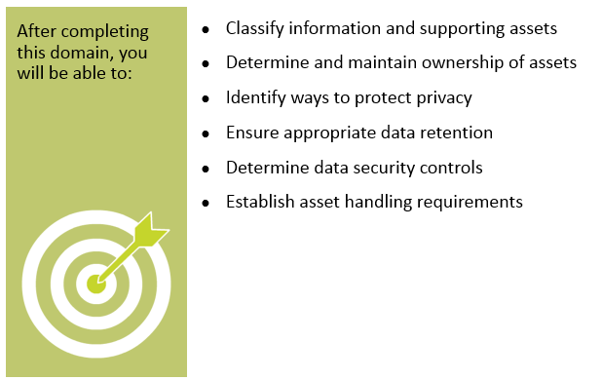
Objectives
Notes:
Section breaker slide with customer logo
Section heading – Arial Headings, 34, Bold
Sub head – Arial Headings, 18, normal
Used for a section heading. You may add a sub heading not exceeding one line also here
Section heading – Arial Headings, bold, 34 font size, should not exceed beyond 1 line
Sub Head – Arial Headings, normal, 18 font size, should not exceed beyond 1 line

Slide 3
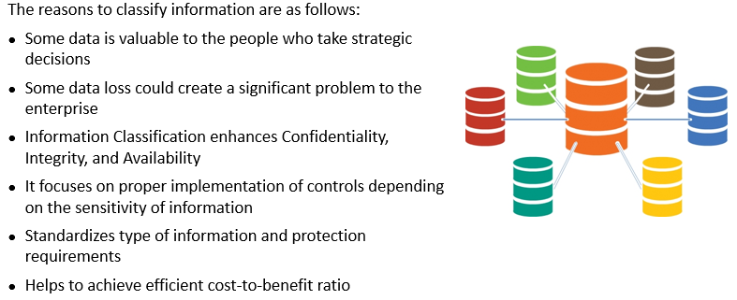
Need for Information Classification
Notes:
Section breaker slide with customer logo
Section heading – Arial Headings, 34, Bold
Sub head – Arial Headings, 18, normal
Used for a section heading. You may add a sub heading not exceeding one line also here
Section heading – Arial Headings, bold, 34 font size, should not exceed beyond 1 line
Sub Head – Arial Headings, normal, 18 font size, should not exceed beyond 1 line

Slide 4
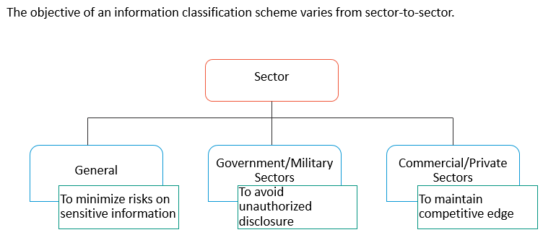
Information Classification - Objectives
Notes:
Section breaker slide with customer logo
Section heading – Arial Headings, 34, Bold
Sub head – Arial Headings, 18, normal
Used for a section heading. You may add a sub heading not exceeding one line also here
Section heading – Arial Headings, bold, 34 font size, should not exceed beyond 1 line
Sub Head – Arial Headings, normal, 18 font size, should not exceed beyond 1 line

Slide 5
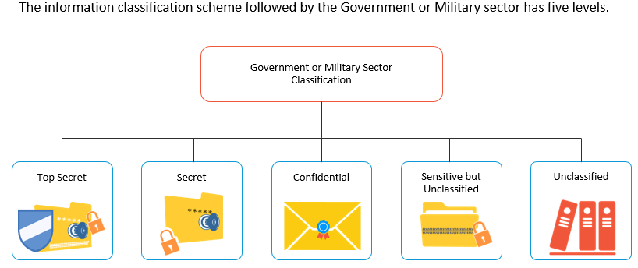
Government or Military Sector Classification
Notes:
Section breaker slide with customer logo
Section heading – Arial Headings, 34, Bold
Sub head – Arial Headings, 18, normal
Used for a section heading. You may add a sub heading not exceeding one line also here
Section heading – Arial Headings, bold, 34 font size, should not exceed beyond 1 line
Sub Head – Arial Headings, normal, 18 font size, should not exceed beyond 1 line

Slide 6
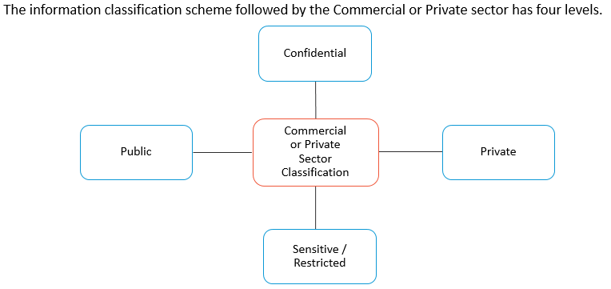
Commercial or Private Sector Classification
Notes:
Section breaker slide with customer logo
Section heading – Arial Headings, 34, Bold
Sub head – Arial Headings, 18, normal
Used for a section heading. You may add a sub heading not exceeding one line also here
Section heading – Arial Headings, bold, 34 font size, should not exceed beyond 1 line
Sub Head – Arial Headings, normal, 18 font size, should not exceed beyond 1 line

Slide 7
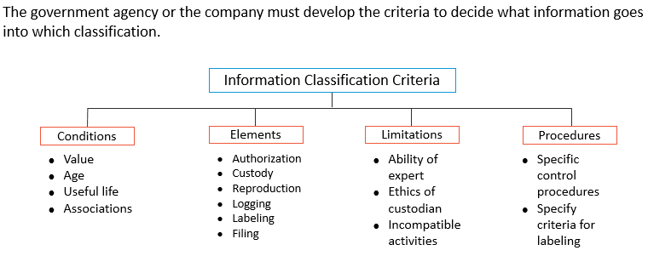
Information Classification - Criteria
Notes:
Section breaker slide with customer logo
Section heading – Arial Headings, 34, Bold
Sub head – Arial Headings, 18, normal
Used for a section heading. You may add a sub heading not exceeding one line also here
Section heading – Arial Headings, bold, 34 font size, should not exceed beyond 1 line
Sub Head – Arial Headings, normal, 18 font size, should not exceed beyond 1 line

Slide 8
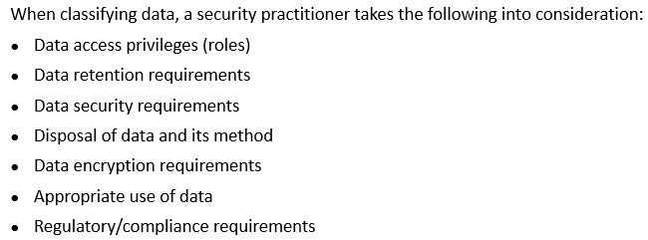
Data Classification Considerations
Notes:
Section breaker slide with customer logo
Section heading – Arial Headings, 34, Bold
Sub head – Arial Headings, 18, normal
Used for a section heading. You may add a sub heading not exceeding one line also here
Section heading – Arial Headings, bold, 34 font size, should not exceed beyond 1 line
Sub Head – Arial Headings, normal, 18 font size, should not exceed beyond 1 line

Slide 9
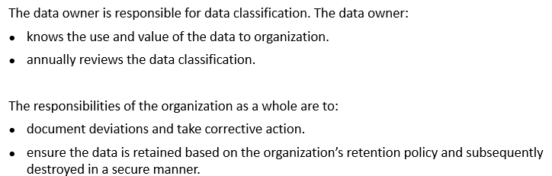
Role Responsible for Data Classification
Notes:
Section breaker slide with customer logo
Section heading – Arial Headings, 34, Bold
Sub head – Arial Headings, 18, normal
Used for a section heading. You may add a sub heading not exceeding one line also here
Section heading – Arial Headings, bold, 34 font size, should not exceed beyond 1 line
Sub Head – Arial Headings, normal, 18 font size, should not exceed beyond 1 line

Slide 10
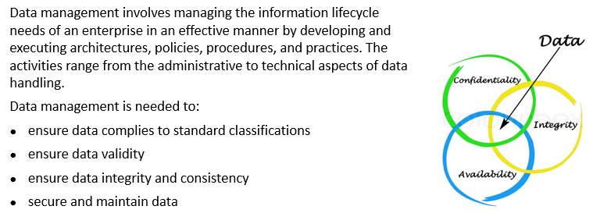
Data Management
Notes:
Section breaker slide with customer logo
Section heading – Arial Headings, 34, Bold
Sub head – Arial Headings, 18, normal
Used for a section heading. You may add a sub heading not exceeding one line also here
Section heading – Arial Headings, bold, 34 font size, should not exceed beyond 1 line
Sub Head – Arial Headings, normal, 18 font size, should not exceed beyond 1 line

Slide 11
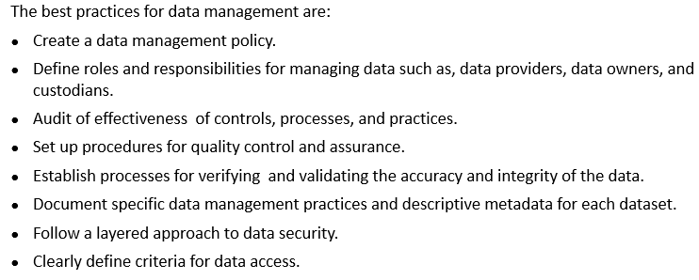
Best Practices for Data Management
Notes:
Section breaker slide with customer logo
Section heading – Arial Headings, 34, Bold
Sub head – Arial Headings, 18, normal
Used for a section heading. You may add a sub heading not exceeding one line also here
Section heading – Arial Headings, bold, 34 font size, should not exceed beyond 1 line
Sub Head – Arial Headings, normal, 18 font size, should not exceed beyond 1 line

Slide 12
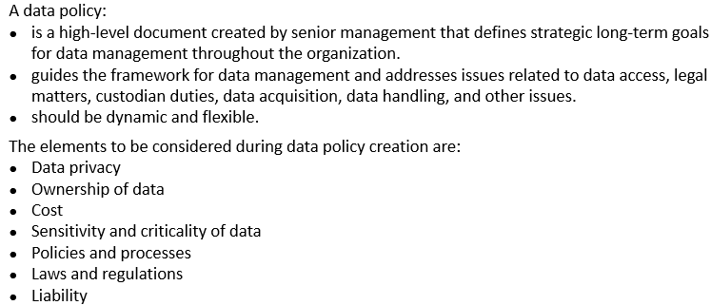
Data Policy
Notes:
Section breaker slide with customer logo
Section heading – Arial Headings, 34, Bold
Sub head – Arial Headings, 18, normal
Used for a section heading. You may add a sub heading not exceeding one line also here
Section heading – Arial Headings, bold, 34 font size, should not exceed beyond 1 line
Sub Head – Arial Headings, normal, 18 font size, should not exceed beyond 1 line

Slide 13
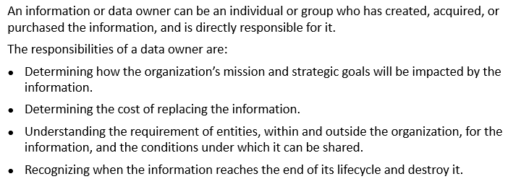
Data Owner
Notes:
Section breaker slide with customer logo
Section heading – Arial Headings, 34, Bold
Sub head – Arial Headings, 18, normal
Used for a section heading. You may add a sub heading not exceeding one line also here
Section heading – Arial Headings, bold, 34 font size, should not exceed beyond 1 line
Sub Head – Arial Headings, normal, 18 font size, should not exceed beyond 1 line

Slide 14
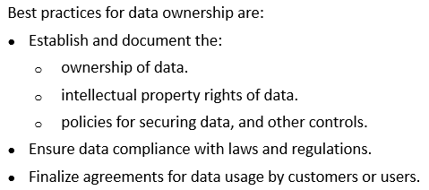
Data Owner – Best Practices
Notes:
Section breaker slide with customer logo
Section heading – Arial Headings, 34, Bold
Sub head – Arial Headings, 18, normal
Used for a section heading. You may add a sub heading not exceeding one line also here
Section heading – Arial Headings, bold, 34 font size, should not exceed beyond 1 line
Sub Head – Arial Headings, normal, 18 font size, should not exceed beyond 1 line

Slide 15
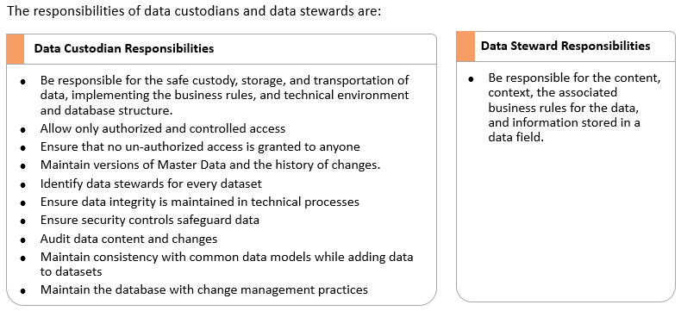
Data Custodians
Notes:
Section breaker slide with customer logo
Section heading – Arial Headings, 34, Bold
Sub head – Arial Headings, 18, normal
Used for a section heading. You may add a sub heading not exceeding one line also here
Section heading – Arial Headings, bold, 34 font size, should not exceed beyond 1 line
Sub Head – Arial Headings, normal, 18 font size, should not exceed beyond 1 line

Slide 16
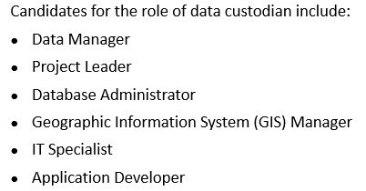
Data Custodians
Notes:
Section breaker slide with customer logo
Section heading – Arial Headings, 34, Bold
Sub head – Arial Headings, 18, normal
Used for a section heading. You may add a sub heading not exceeding one line also here
Section heading – Arial Headings, bold, 34 font size, should not exceed beyond 1 line
Sub Head – Arial Headings, normal, 18 font size, should not exceed beyond 1 line

Slide 17
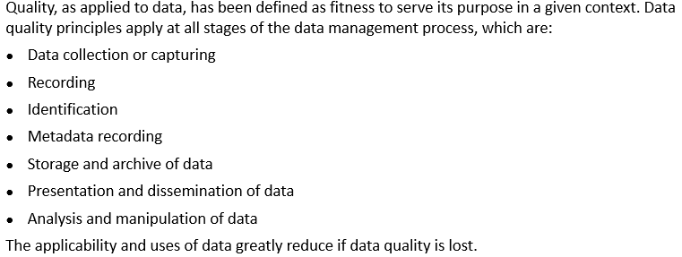
Data Quality
Notes:
Section breaker slide with customer logo
Section heading – Arial Headings, 34, Bold
Sub head – Arial Headings, 18, normal
Used for a section heading. You may add a sub heading not exceeding one line also here
Section heading – Arial Headings, bold, 34 font size, should not exceed beyond 1 line
Sub Head – Arial Headings, normal, 18 font size, should not exceed beyond 1 line

Slide 18
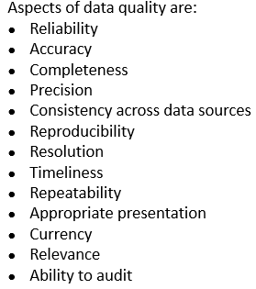
Data Quality - Aspects
Notes:
Section breaker slide with customer logo
Section heading – Arial Headings, 34, Bold
Sub head – Arial Headings, 18, normal
Used for a section heading. You may add a sub heading not exceeding one line also here
Section heading – Arial Headings, bold, 34 font size, should not exceed beyond 1 line
Sub Head – Arial Headings, normal, 18 font size, should not exceed beyond 1 line

Slide 19
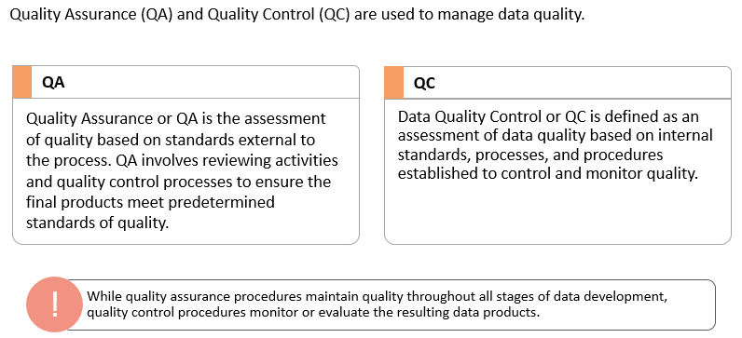
Data Quality Assurance and Quality Control
Notes:
Section breaker slide with customer logo
Section heading – Arial Headings, 34, Bold
Sub head – Arial Headings, 18, normal
Used for a section heading. You may add a sub heading not exceeding one line also here
Section heading – Arial Headings, bold, 34 font size, should not exceed beyond 1 line
Sub Head – Arial Headings, normal, 18 font size, should not exceed beyond 1 line

Slide 20
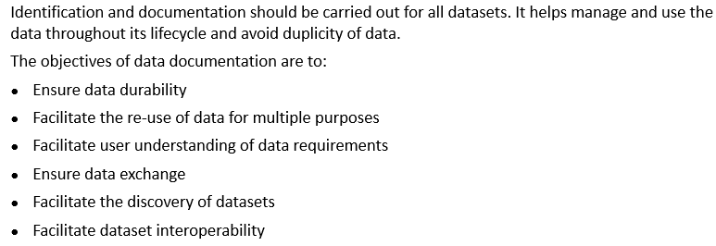
Data Documentation
Notes:
Section breaker slide with customer logo
Section heading – Arial Headings, 34, Bold
Sub head – Arial Headings, 18, normal
Used for a section heading. You may add a sub heading not exceeding one line also here
Section heading – Arial Headings, bold, 34 font size, should not exceed beyond 1 line
Sub Head – Arial Headings, normal, 18 font size, should not exceed beyond 1 line

Slide 21
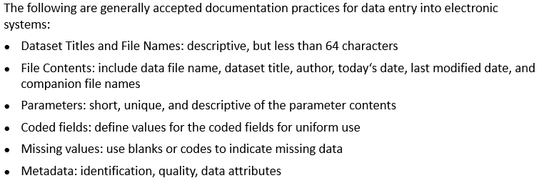
Data Documentation Practices
Notes:
Section breaker slide with customer logo
Section heading – Arial Headings, 34, Bold
Sub head – Arial Headings, 18, normal
Used for a section heading. You may add a sub heading not exceeding one line also here
Section heading – Arial Headings, bold, 34 font size, should not exceed beyond 1 line
Sub Head – Arial Headings, normal, 18 font size, should not exceed beyond 1 line

Slide 22
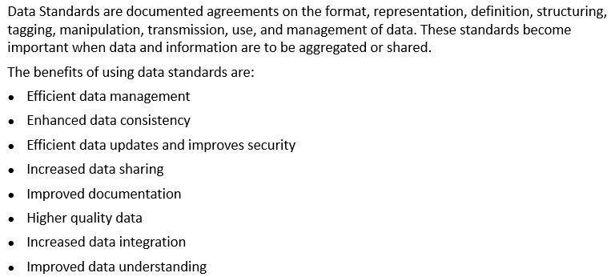
Data Standards
Notes:
Section breaker slide with customer logo
Section heading – Arial Headings, 34, Bold
Sub head – Arial Headings, 18, normal
Used for a section heading. You may add a sub heading not exceeding one line also here
Section heading – Arial Headings, bold, 34 font size, should not exceed beyond 1 line
Sub Head – Arial Headings, normal, 18 font size, should not exceed beyond 1 line

Slide 23
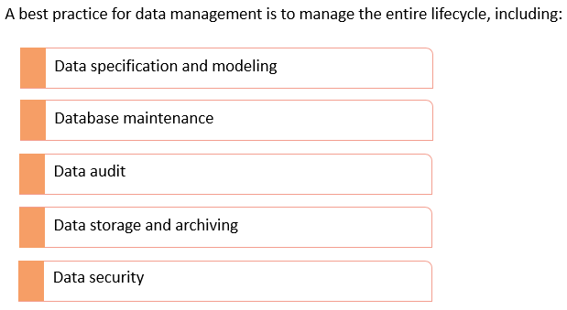
Data Control Lifecycle
Notes:
Section breaker slide with customer logo
Section heading – Arial Headings, 34, Bold
Sub head – Arial Headings, 18, normal
Used for a section heading. You may add a sub heading not exceeding one line also here
Section heading – Arial Headings, bold, 34 font size, should not exceed beyond 1 line
Sub Head – Arial Headings, normal, 18 font size, should not exceed beyond 1 line

Slide 24
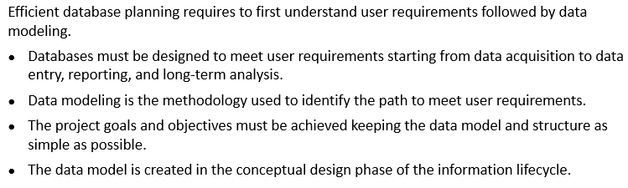
Data Specification and Modeling
Notes:
Section breaker slide with customer logo
Section heading – Arial Headings, 34, Bold
Sub head – Arial Headings, 18, normal
Used for a section heading. You may add a sub heading not exceeding one line also here
Section heading – Arial Headings, bold, 34 font size, should not exceed beyond 1 line
Sub Head – Arial Headings, normal, 18 font size, should not exceed beyond 1 line

Slide 25
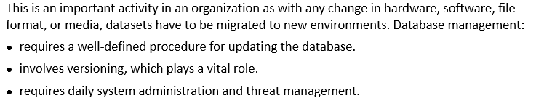
Database Maintenance
Notes:
Section breaker slide with customer logo
Section heading – Arial Headings, 34, Bold
Sub head – Arial Headings, 18, normal
Used for a section heading. You may add a sub heading not exceeding one line also here
Section heading – Arial Headings, bold, 34 font size, should not exceed beyond 1 line
Sub Head – Arial Headings, normal, 18 font size, should not exceed beyond 1 line

Slide 26
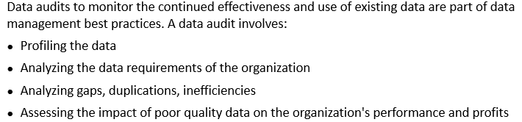
Data Audit
Notes:
Section breaker slide with customer logo
Section heading – Arial Headings, 34, Bold
Sub head – Arial Headings, 18, normal
Used for a section heading. You may add a sub heading not exceeding one line also here
Section heading – Arial Headings, bold, 34 font size, should not exceed beyond 1 line
Sub Head – Arial Headings, normal, 18 font size, should not exceed beyond 1 line

Slide 27
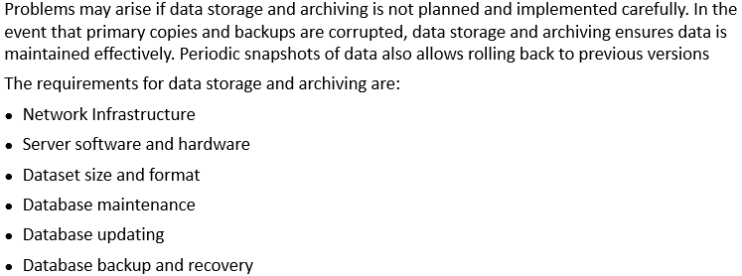
Data Storage and Archiving
Notes:
Section breaker slide with customer logo
Section heading – Arial Headings, 34, Bold
Sub head – Arial Headings, 18, normal
Used for a section heading. You may add a sub heading not exceeding one line also here
Section heading – Arial Headings, bold, 34 font size, should not exceed beyond 1 line
Sub Head – Arial Headings, normal, 18 font size, should not exceed beyond 1 line

Slide 28
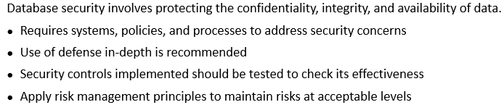
Data Security
Notes:
Section breaker slide with customer logo
Section heading – Arial Headings, 34, Bold
Sub head – Arial Headings, 18, normal
Used for a section heading. You may add a sub heading not exceeding one line also here
Section heading – Arial Headings, bold, 34 font size, should not exceed beyond 1 line
Sub Head – Arial Headings, normal, 18 font size, should not exceed beyond 1 line

Slide 29
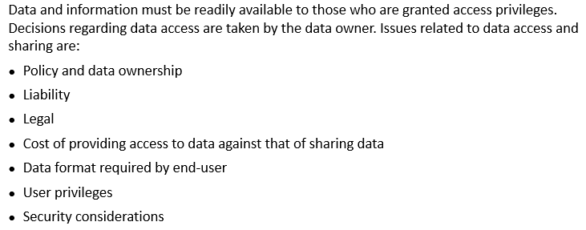
Data Access, Sharing, and Dissemination
Notes:
Section breaker slide with customer logo
Section heading – Arial Headings, 34, Bold
Sub head – Arial Headings, 18, normal
Used for a section heading. You may add a sub heading not exceeding one line also here
Section heading – Arial Headings, bold, 34 font size, should not exceed beyond 1 line
Sub Head – Arial Headings, normal, 18 font size, should not exceed beyond 1 line

Slide 30
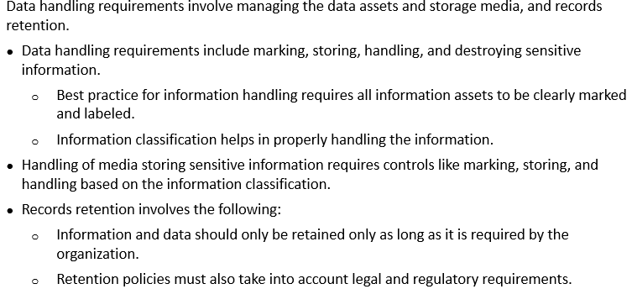
Data Handling Requirements
Notes:
Section breaker slide with customer logo
Section heading – Arial Headings, 34, Bold
Sub head – Arial Headings, 18, normal
Used for a section heading. You may add a sub heading not exceeding one line also here
Section heading – Arial Headings, bold, 34 font size, should not exceed beyond 1 line
Sub Head – Arial Headings, normal, 18 font size, should not exceed beyond 1 line

Slide 31
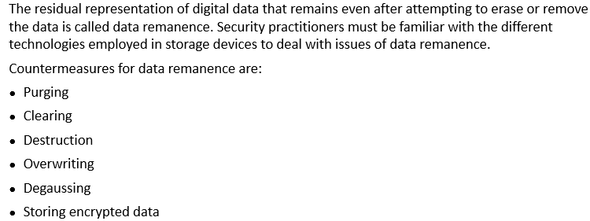
Data Remanence
Notes:
Section breaker slide with customer logo
Section heading – Arial Headings, 34, Bold
Sub head – Arial Headings, 18, normal
Used for a section heading. You may add a sub heading not exceeding one line also here
Section heading – Arial Headings, bold, 34 font size, should not exceed beyond 1 line
Sub Head – Arial Headings, normal, 18 font size, should not exceed beyond 1 line

Slide 32
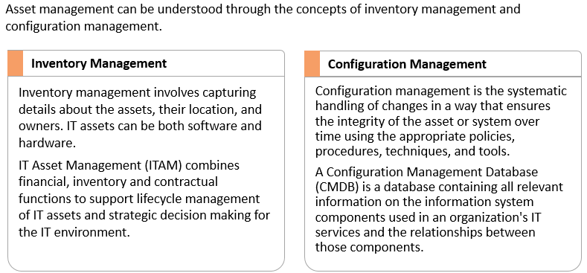
Asset Management
Notes:
Section breaker slide with customer logo
Section heading – Arial Headings, 34, Bold
Sub head – Arial Headings, 18, normal
Used for a section heading. You may add a sub heading not exceeding one line also here
Section heading – Arial Headings, bold, 34 font size, should not exceed beyond 1 line
Sub Head – Arial Headings, normal, 18 font size, should not exceed beyond 1 line

Slide 33
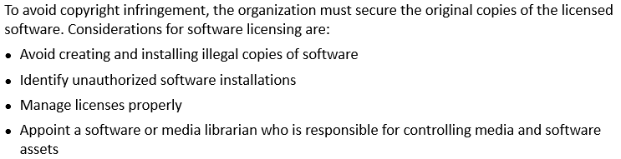
Software Licenses
Notes:
Section breaker slide with customer logo
Section heading – Arial Headings, 34, Bold
Sub head – Arial Headings, 18, normal
Used for a section heading. You may add a sub heading not exceeding one line also here
Section heading – Arial Headings, bold, 34 font size, should not exceed beyond 1 line
Sub Head – Arial Headings, normal, 18 font size, should not exceed beyond 1 line

Slide 34
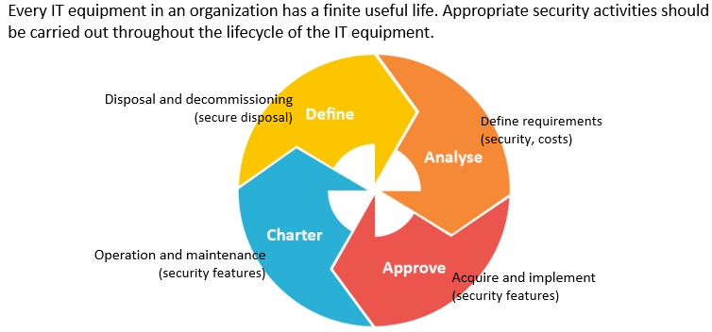
Equipment Lifecycle
Notes:
Section breaker slide with customer logo
Section heading – Arial Headings, 34, Bold
Sub head – Arial Headings, 18, normal
Used for a section heading. You may add a sub heading not exceeding one line also here
Section heading – Arial Headings, bold, 34 font size, should not exceed beyond 1 line
Sub Head – Arial Headings, normal, 18 font size, should not exceed beyond 1 line

Slide 35
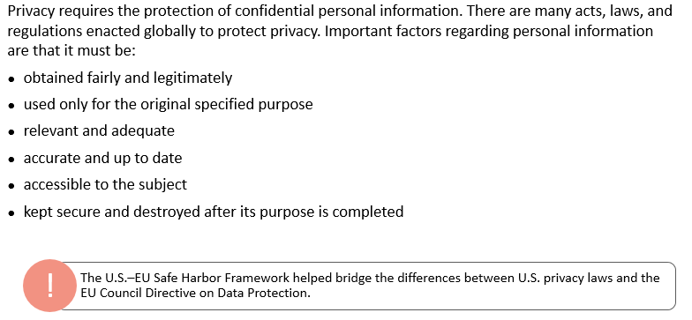
Protecting Privacy
Notes:
Section breaker slide with customer logo
Section heading – Arial Headings, 34, Bold
Sub head – Arial Headings, 18, normal
Used for a section heading. You may add a sub heading not exceeding one line also here
Section heading – Arial Headings, bold, 34 font size, should not exceed beyond 1 line
Sub Head – Arial Headings, normal, 18 font size, should not exceed beyond 1 line

Slide 36
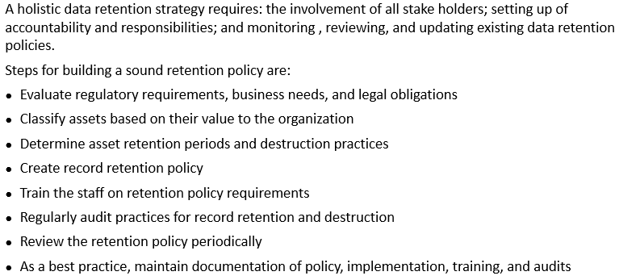
Ensuring Appropriate Data Retention
Notes:
Section breaker slide with customer logo
Section heading – Arial Headings, 34, Bold
Sub head – Arial Headings, 18, normal
Used for a section heading. You may add a sub heading not exceeding one line also here
Section heading – Arial Headings, bold, 34 font size, should not exceed beyond 1 line
Sub Head – Arial Headings, normal, 18 font size, should not exceed beyond 1 line

Slide 37
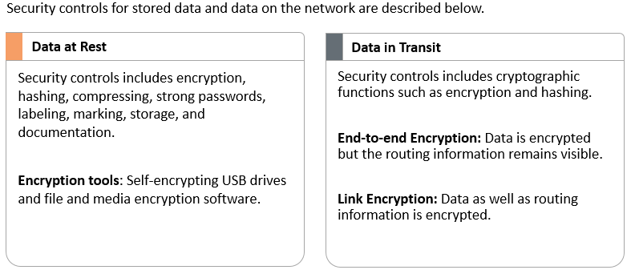
Data Security Controls
Notes:
Section breaker slide with customer logo
Section heading – Arial Headings, 34, Bold
Sub head – Arial Headings, 18, normal
Used for a section heading. You may add a sub heading not exceeding one line also here
Section heading – Arial Headings, bold, 34 font size, should not exceed beyond 1 line
Sub Head – Arial Headings, normal, 18 font size, should not exceed beyond 1 line

Slide 38
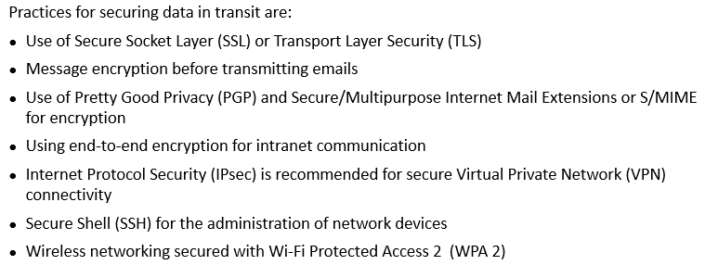
Data In Transit – Best Practices
Notes:
Section breaker slide with customer logo
Section heading – Arial Headings, 34, Bold
Sub head – Arial Headings, 18, normal
Used for a section heading. You may add a sub heading not exceeding one line also here
Section heading – Arial Headings, bold, 34 font size, should not exceed beyond 1 line
Sub Head – Arial Headings, normal, 18 font size, should not exceed beyond 1 line

Slide 39
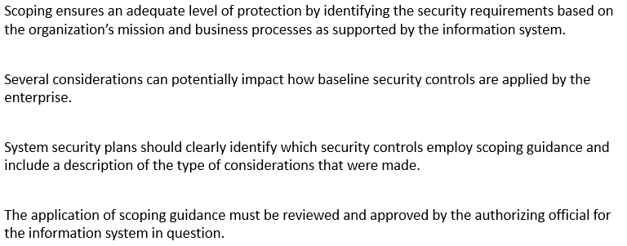
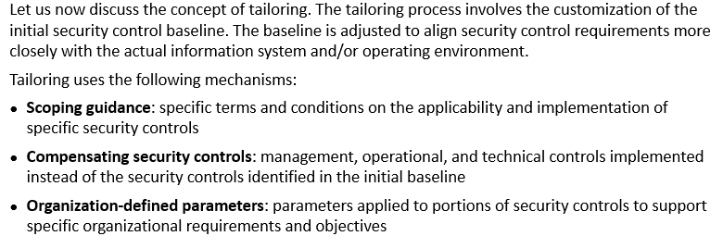
Scoping, Tailoring
Notes:
Section breaker slide with customer logo
Section heading – Arial Headings, 34, Bold
Sub head – Arial Headings, 18, normal
Used for a section heading. You may add a sub heading not exceeding one line also here
Section heading – Arial Headings, bold, 34 font size, should not exceed beyond 1 line
Sub Head – Arial Headings, normal, 18 font size, should not exceed beyond 1 line

Slide 40
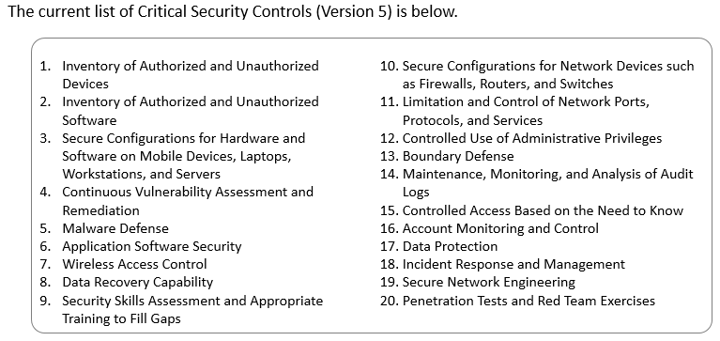
Standards Selection – Critical Security Controls
Notes:
Section breaker slide with customer logo
Section heading – Arial Headings, 34, Bold
Sub head – Arial Headings, 18, normal
Used for a section heading. You may add a sub heading not exceeding one line also here
Section heading – Arial Headings, bold, 34 font size, should not exceed beyond 1 line
Sub Head – Arial Headings, normal, 18 font size, should not exceed beyond 1 line

Slide 41

Notes:
Section breaker slide with customer logo
Section heading – Arial Headings, 34, Bold
Sub head – Arial Headings, 18, normal
Used for a section heading. You may add a sub heading not exceeding one line also here
Section heading – Arial Headings, bold, 34 font size, should not exceed beyond 1 line
Sub Head – Arial Headings, normal, 18 font size, should not exceed beyond 1 line

Slide 42
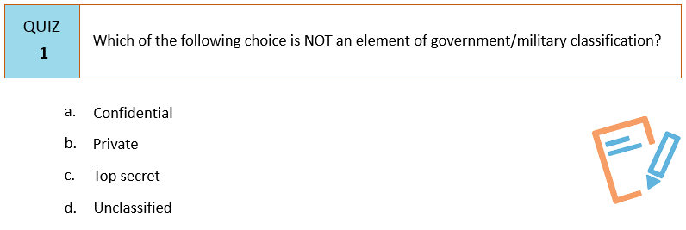
Notes:
Section breaker slide with customer logo
Section heading – Arial Headings, 34, Bold
Sub head – Arial Headings, 18, normal
Used for a section heading. You may add a sub heading not exceeding one line also here
Section heading – Arial Headings, bold, 34 font size, should not exceed beyond 1 line
Sub Head – Arial Headings, normal, 18 font size, should not exceed beyond 1 line

Slide 43
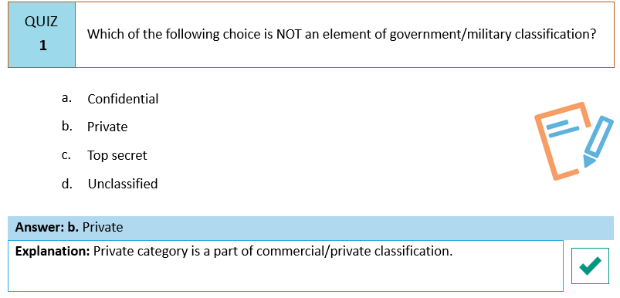
Notes:
Section breaker slide with customer logo
Section heading – Arial Headings, 34, Bold
Sub head – Arial Headings, 18, normal
Used for a section heading. You may add a sub heading not exceeding one line also here
Section heading – Arial Headings, bold, 34 font size, should not exceed beyond 1 line
Sub Head – Arial Headings, normal, 18 font size, should not exceed beyond 1 line

Slide 44
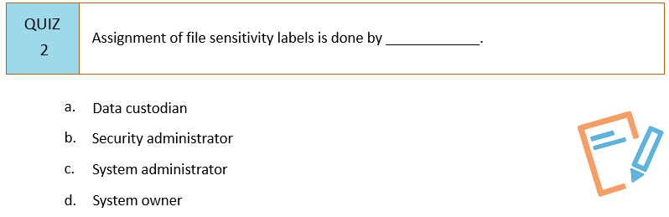
Notes:
Section breaker slide with customer logo
Section heading – Arial Headings, 34, Bold
Sub head – Arial Headings, 18, normal
Used for a section heading. You may add a sub heading not exceeding one line also here
Section heading – Arial Headings, bold, 34 font size, should not exceed beyond 1 line
Sub Head – Arial Headings, normal, 18 font size, should not exceed beyond 1 line

Slide 45
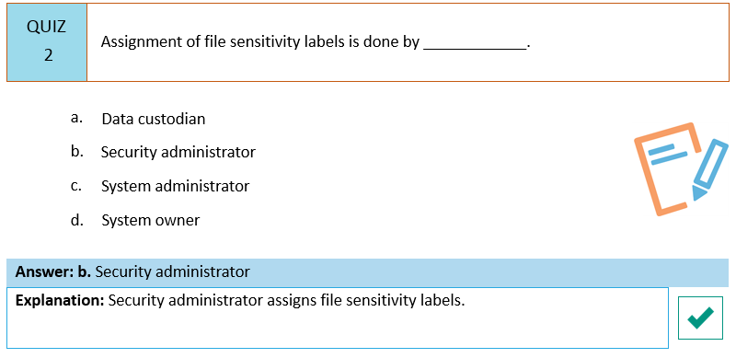
Notes:
Section breaker slide with customer logo
Section heading – Arial Headings, 34, Bold
Sub head – Arial Headings, 18, normal
Used for a section heading. You may add a sub heading not exceeding one line also here
Section heading – Arial Headings, bold, 34 font size, should not exceed beyond 1 line
Sub Head – Arial Headings, normal, 18 font size, should not exceed beyond 1 line

Slide 46
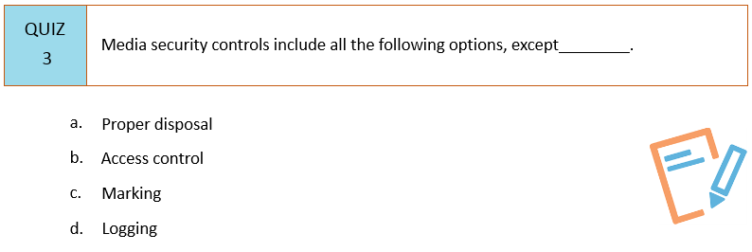
Notes:
Section breaker slide with customer logo
Section heading – Arial Headings, 34, Bold
Sub head – Arial Headings, 18, normal
Used for a section heading. You may add a sub heading not exceeding one line also here
Section heading – Arial Headings, bold, 34 font size, should not exceed beyond 1 line
Sub Head – Arial Headings, normal, 18 font size, should not exceed beyond 1 line

Slide 47
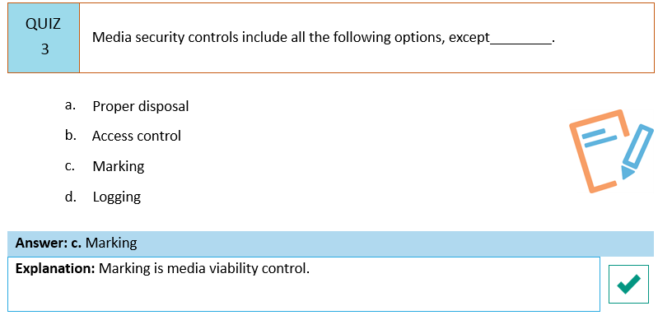
Notes:
Section breaker slide with customer logo
Section heading – Arial Headings, 34, Bold
Sub head – Arial Headings, 18, normal
Used for a section heading. You may add a sub heading not exceeding one line also here
Section heading – Arial Headings, bold, 34 font size, should not exceed beyond 1 line
Sub Head – Arial Headings, normal, 18 font size, should not exceed beyond 1 line

Slide 48
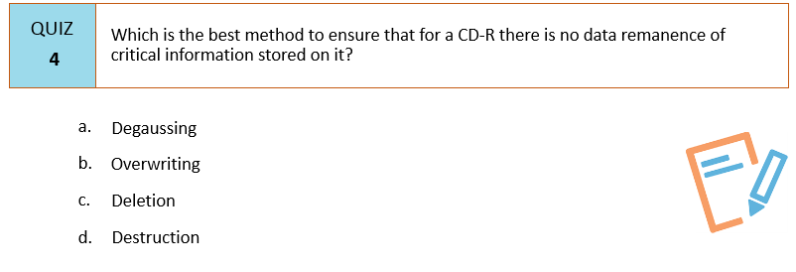
Notes:
Section breaker slide with customer logo
Section heading – Arial Headings, 34, Bold
Sub head – Arial Headings, 18, normal
Used for a section heading. You may add a sub heading not exceeding one line also here
Section heading – Arial Headings, bold, 34 font size, should not exceed beyond 1 line
Sub Head – Arial Headings, normal, 18 font size, should not exceed beyond 1 line

Slide 49
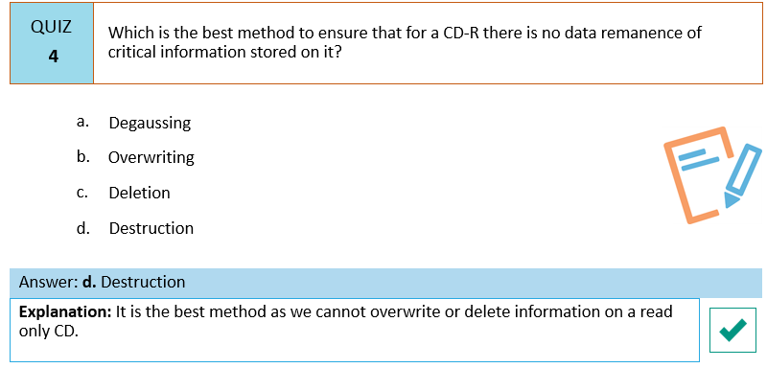
Notes:
Section breaker slide with customer logo
Section heading – Arial Headings, 34, Bold
Sub head – Arial Headings, 18, normal
Used for a section heading. You may add a sub heading not exceeding one line also here
Section heading – Arial Headings, bold, 34 font size, should not exceed beyond 1 line
Sub Head – Arial Headings, normal, 18 font size, should not exceed beyond 1 line

Slide 50
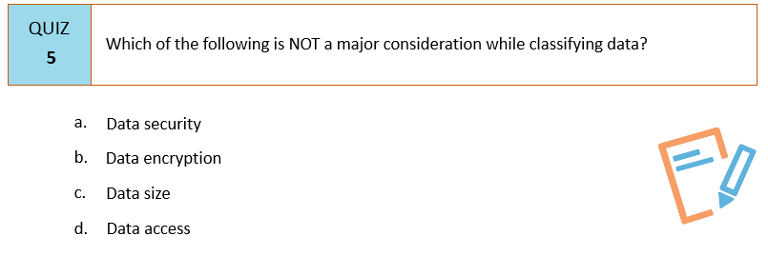
Notes:
Section breaker slide with customer logo
Section heading – Arial Headings, 34, Bold
Sub head – Arial Headings, 18, normal
Used for a section heading. You may add a sub heading not exceeding one line also here
Section heading – Arial Headings, bold, 34 font size, should not exceed beyond 1 line
Sub Head – Arial Headings, normal, 18 font size, should not exceed beyond 1 line

Slide 51
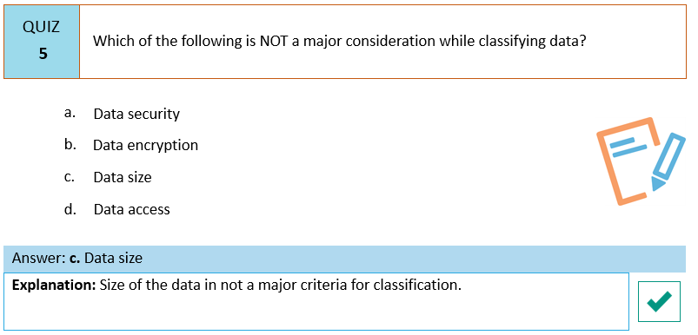
Notes:
Section breaker slide with customer logo
Section heading – Arial Headings, 34, Bold
Sub head – Arial Headings, 18, normal
Used for a section heading. You may add a sub heading not exceeding one line also here
Section heading – Arial Headings, bold, 34 font size, should not exceed beyond 1 line
Sub Head – Arial Headings, normal, 18 font size, should not exceed beyond 1 line

Slide 52

Notes:
Section breaker slide with customer logo
Section heading – Arial Headings, 34, Bold
Sub head – Arial Headings, 18, normal
Used for a section heading. You may add a sub heading not exceeding one line also here
Section heading – Arial Headings, bold, 34 font size, should not exceed beyond 1 line
Sub Head – Arial Headings, normal, 18 font size, should not exceed beyond 1 line

Slide 53

Notes:
Section breaker slide with customer logo
Section heading – Arial Headings, 34, Bold
Sub head – Arial Headings, 18, normal
Used for a section heading. You may add a sub heading not exceeding one line also here
Section heading – Arial Headings, bold, 34 font size, should not exceed beyond 1 line
Sub Head – Arial Headings, normal, 18 font size, should not exceed beyond 1 line

Slide 54

Notes:
Section breaker slide with customer logo
Section heading – Arial Headings, 34, Bold
Sub head – Arial Headings, 18, normal
Used for a section heading. You may add a sub heading not exceeding one line also here
Section heading – Arial Headings, bold, 34 font size, should not exceed beyond 1 line
Sub Head – Arial Headings, normal, 18 font size, should not exceed beyond 1 line

Slide 55

Notes:
Section breaker slide with customer logo
Section heading – Arial Headings, 34, Bold
Sub head – Arial Headings, 18, normal
Used for a section heading. You may add a sub heading not exceeding one line also here
Section heading – Arial Headings, bold, 34 font size, should not exceed beyond 1 line
Sub Head – Arial Headings, normal, 18 font size, should not exceed beyond 1 line

Slide 56

Notes:
Section breaker slide with customer logo
Section heading – Arial Headings, 34, Bold
Sub head – Arial Headings, 18, normal
Used for a section heading. You may add a sub heading not exceeding one line also here
Section heading – Arial Headings, bold, 34 font size, should not exceed beyond 1 line
Sub Head – Arial Headings, normal, 18 font size, should not exceed beyond 1 line

Slide 57

Notes:
Section breaker slide with customer logo
Section heading – Arial Headings, 34, Bold
Sub head – Arial Headings, 18, normal
Used for a section heading. You may add a sub heading not exceeding one line also here
Section heading – Arial Headings, bold, 34 font size, should not exceed beyond 1 line
Sub Head – Arial Headings, normal, 18 font size, should not exceed beyond 1 line

Slide 58

Notes:
Section breaker slide with customer logo
Section heading – Arial Headings, 34, Bold
Sub head – Arial Headings, 18, normal
Used for a section heading. You may add a sub heading not exceeding one line also here
Section heading – Arial Headings, bold, 34 font size, should not exceed beyond 1 line
Sub Head – Arial Headings, normal, 18 font size, should not exceed beyond 1 line

Slide 59

Notes:
Section breaker slide with customer logo
Section heading – Arial Headings, 34, Bold
Sub head – Arial Headings, 18, normal
Used for a section heading. You may add a sub heading not exceeding one line also here
Section heading – Arial Headings, bold, 34 font size, should not exceed beyond 1 line
Sub Head – Arial Headings, normal, 18 font size, should not exceed beyond 1 line

Slide 60

Summary
Notes:
Section breaker slide with customer logo
Section heading – Arial Headings, 34, Bold
Sub head – Arial Headings, 18, normal
Used for a section heading. You may add a sub heading not exceeding one line also here
Section heading – Arial Headings, bold, 34 font size, should not exceed beyond 1 line
Sub Head – Arial Headings, normal, 18 font size, should not exceed beyond 1 line

Slide 61
This concludes “Asset Security”
The next domain is “Security Engineering”
Notes:
Content Slide: This is usually the most frequently used slide in every presentation.
Use this slide for Text heavy slides. Text can only be used in bullet points
Title Heading – font size 30, Arial Heading
Slide Content – Should not reduce beyond Arial body font 16
If you need to use sub bullets please use the indent buttons located next to the bullets buttons in the tool bar and this will automatically provide you with the second, third, fourth & fifth level bullet styles and font sizes
Please note you can also press the tab key to create the different levels of bulleted content

