Slide 1
Domain 1 – Security and Risk Management
Notes:
The below and following notes on the template slides are to guide you only. In your final presentation, you may delete these notes and add relevant notes if any.
Title slide:
Title – should not exceed beyond 3 lines, font size 30-34, Arial Headings
(Font size for the title of the PPT can vary between 30-34, Arial Headings, Bold depending on the amount of text, however should not be smaller than 30 font size)
Name should not exceed beyond 1 line, Designation; font size to remain at 18, Arial Headings
Please keep the title slide simple, just the logo, title and name and designation to appear. No other graphic elements or any design, photograph, image can be added to this slide, alignment to remain the same

Slide 2
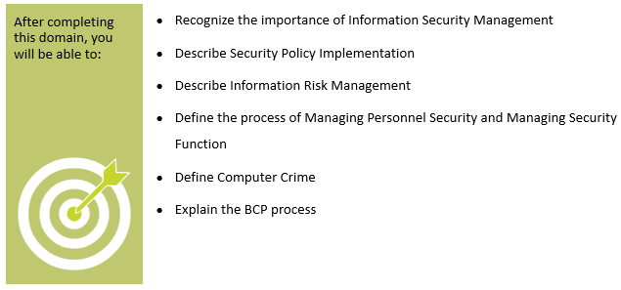
Objectives
Notes:
Section breaker slide with customer logo
Section heading – Arial Headings, 34, Bold
Sub head – Arial Headings, 18, normal
Used for a section heading. You may add a sub heading not exceeding one line also here
Section heading – Arial Headings, bold, 34 font size, should not exceed beyond 1 line
Sub Head – Arial Headings, normal, 18 font size, should not exceed beyond 1 line

Slide 3
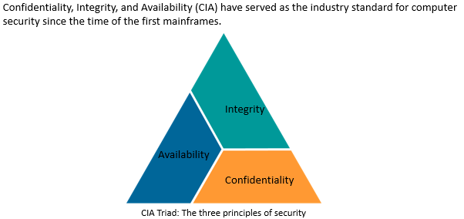
Role and Importance of CIA in ISM
Notes:
Content Slide: This is usually the most frequently used slide in every presentation.
Use this slide for Text heavy slides. Text can only be used in bullet points
Title Heading – font size 30, Arial Heading
Slide Content – Should not reduce beyond Arial body font 16
If you need to use sub bullets please use the indent buttons located next to the bullets buttons in the tool bar and this will automatically provide you with the second, third, fourth & fifth level bullet styles and font sizes
Please note you can also press the tab key to create the different levels of bulleted content

Slide 4
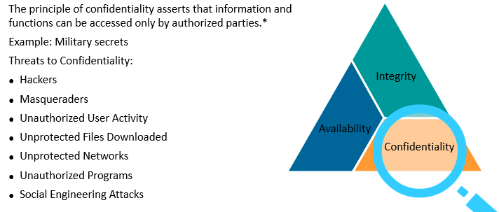
Confidentiality
Notes:
Content Slide: This is usually the most frequently used slide in every presentation.
Use this slide for Text heavy slides. Text can only be used in bullet points
Title Heading – font size 30, Arial Heading
Slide Content – Should not reduce beyond Arial body font 16
If you need to use sub bullets please use the indent buttons located next to the bullets buttons in the tool bar and this will automatically provide you with the second, third, fourth & fifth level bullet styles and font sizes
Please note you can also press the tab key to create the different levels of bulleted content

Slide 5
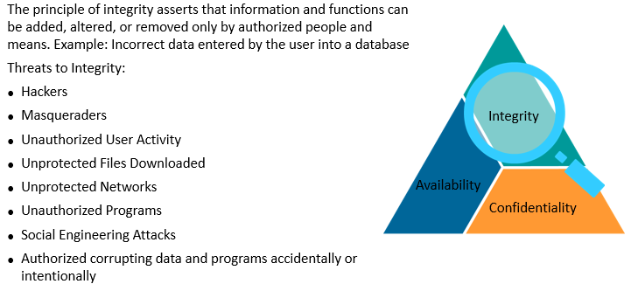
Integrity
Notes:
Content Slide: This is usually the most frequently used slide in every presentation.
Use this slide for Text heavy slides. Text can only be used in bullet points
Title Heading – font size 30, Arial Heading
Slide Content – Should not reduce beyond Arial body font 16
If you need to use sub bullets please use the indent buttons located next to the bullets buttons in the tool bar and this will automatically provide you with the second, third, fourth & fifth level bullet styles and font sizes
Please note you can also press the tab key to create the different levels of bulleted content

Slide 6
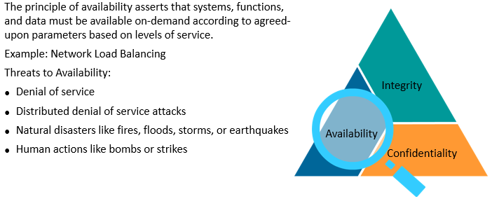
Availability
Notes:
Content Slide: This is usually the most frequently used slide in every presentation.
Use this slide for Text heavy slides. Text can only be used in bullet points
Title Heading – font size 30, Arial Heading
Slide Content – Should not reduce beyond Arial body font 16
If you need to use sub bullets please use the indent buttons located next to the bullets buttons in the tool bar and this will automatically provide you with the second, third, fourth & fifth level bullet styles and font sizes
Please note you can also press the tab key to create the different levels of bulleted content

Slide 7
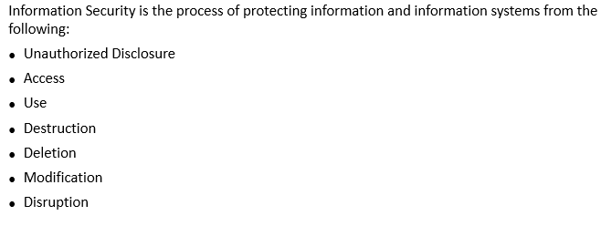
Information Security
Notes:
Content Slide: This is usually the most frequently used slide in every presentation.
Use this slide for Text heavy slides. Text can only be used in bullet points
Title Heading – font size 30, Arial Heading
Slide Content – Should not reduce beyond Arial body font 16
If you need to use sub bullets please use the indent buttons located next to the bullets buttons in the tool bar and this will automatically provide you with the second, third, fourth & fifth level bullet styles and font sizes
Please note you can also press the tab key to create the different levels of bulleted content

Slide 8
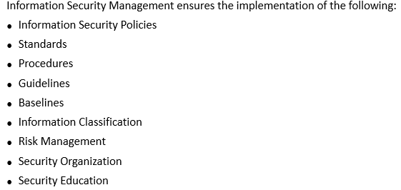
Information Security Management
Notes:
Content Slide: This is usually the most frequently used slide in every presentation.
Use this slide for Text heavy slides. Text can only be used in bullet points
Title Heading – font size 30, Arial Heading
Slide Content – Should not reduce beyond Arial body font 16
If you need to use sub bullets please use the indent buttons located next to the bullets buttons in the tool bar and this will automatically provide you with the second, third, fourth & fifth level bullet styles and font sizes
Please note you can also press the tab key to create the different levels of bulleted content

Slide 9
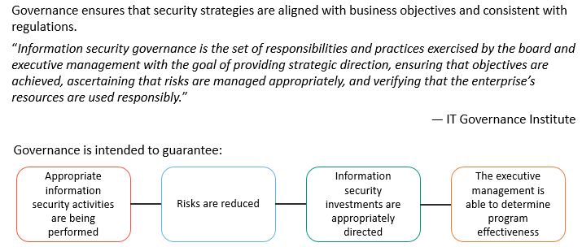
Information Security Governance
Notes:
Content Slide: This is usually the most frequently used slide in every presentation.
Use this slide for Text heavy slides. Text can only be used in bullet points
Title Heading – font size 30, Arial Heading
Slide Content – Should not reduce beyond Arial body font 16
If you need to use sub bullets please use the indent buttons located next to the bullets buttons in the tool bar and this will automatically provide you with the second, third, fourth & fifth level bullet styles and font sizes
Please note you can also press the tab key to create the different levels of bulleted content

Slide 10
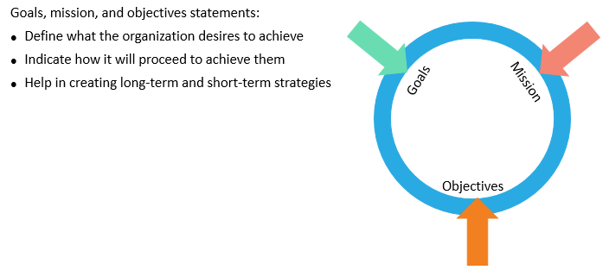
IT Security and Organizational Goals, Mission and Objectives
Notes:
Content Slide: This is usually the most frequently used slide in every presentation.
Use this slide for Text heavy slides. Text can only be used in bullet points
Title Heading – font size 30, Arial Heading
Slide Content – Should not reduce beyond Arial body font 16
If you need to use sub bullets please use the indent buttons located next to the bullets buttons in the tool bar and this will automatically provide you with the second, third, fourth & fifth level bullet styles and font sizes
Please note you can also press the tab key to create the different levels of bulleted content

Slide 11
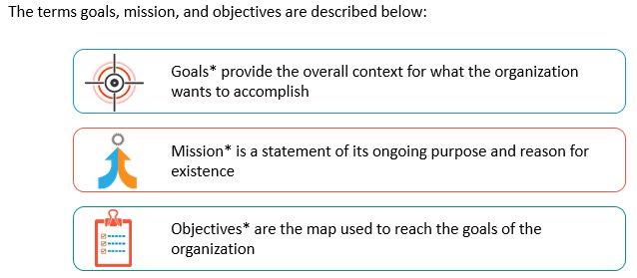
Goals, Mission and Objectives
Notes:
Content Slide: This is usually the most frequently used slide in every presentation.
Use this slide for Text heavy slides. Text can only be used in bullet points
Title Heading – font size 30, Arial Heading
Slide Content – Should not reduce beyond Arial body font 16
If you need to use sub bullets please use the indent buttons located next to the bullets buttons in the tool bar and this will automatically provide you with the second, third, fourth & fifth level bullet styles and font sizes
Please note you can also press the tab key to create the different levels of bulleted content

Slide 12
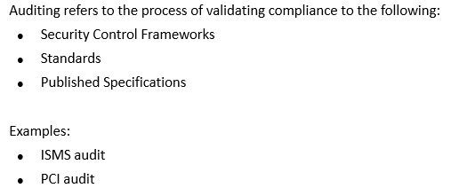
Auditing
Notes:
Content Slide: This is usually the most frequently used slide in every presentation.
Use this slide for Text heavy slides. Text can only be used in bullet points
Title Heading – font size 30, Arial Heading
Slide Content – Should not reduce beyond Arial body font 16
If you need to use sub bullets please use the indent buttons located next to the bullets buttons in the tool bar and this will automatically provide you with the second, third, fourth & fifth level bullet styles and font sizes
Please note you can also press the tab key to create the different levels of bulleted content

Slide 13
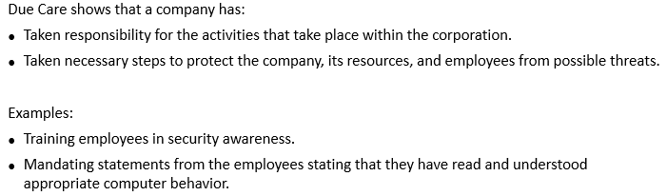
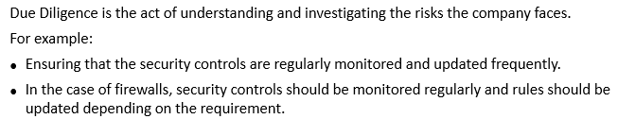
Due Care and Due Diligence
Notes:
Content Slide: This is usually the most frequently used slide in every presentation.
Use this slide for Text heavy slides. Text can only be used in bullet points
Title Heading – font size 30, Arial Heading
Slide Content – Should not reduce beyond Arial body font 16
If you need to use sub bullets please use the indent buttons located next to the bullets buttons in the tool bar and this will automatically provide you with the second, third, fourth & fifth level bullet styles and font sizes
Please note you can also press the tab key to create the different levels of bulleted content

Slide 14
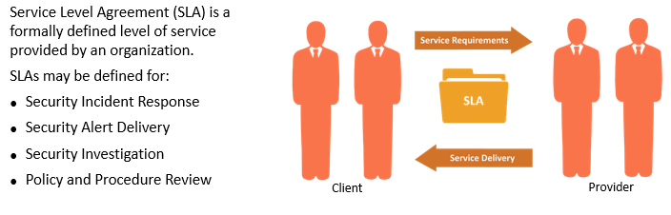
Service Level Agreements (SLA)
Notes:
Content Slide: This is usually the most frequently used slide in every presentation.
Use this slide for Text heavy slides. Text can only be used in bullet points
Title Heading – font size 30, Arial Heading
Slide Content – Should not reduce beyond Arial body font 16
If you need to use sub bullets please use the indent buttons located next to the bullets buttons in the tool bar and this will automatically provide you with the second, third, fourth & fifth level bullet styles and font sizes
Please note you can also press the tab key to create the different levels of bulleted content

Slide 15
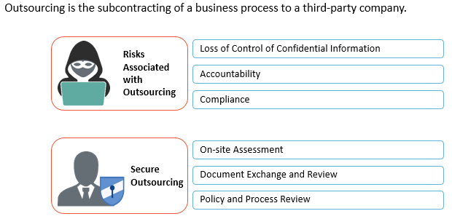
Managing Third Party Governance
Notes:
Content Slide: This is usually the most frequently used slide in every presentation.
Use this slide for Text heavy slides. Text can only be used in bullet points
Title Heading – font size 30, Arial Heading
Slide Content – Should not reduce beyond Arial body font 16
If you need to use sub bullets please use the indent buttons located next to the bullets buttons in the tool bar and this will automatically provide you with the second, third, fourth & fifth level bullet styles and font sizes
Please note you can also press the tab key to create the different levels of bulleted content

Slide 16
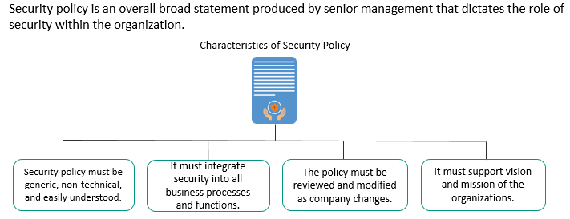
Security Policies
Notes:
Content Slide: This is usually the most frequently used slide in every presentation.
Use this slide for Text heavy slides. Text can only be used in bullet points
Title Heading – font size 30, Arial Heading
Slide Content – Should not reduce beyond Arial body font 16
If you need to use sub bullets please use the indent buttons located next to the bullets buttons in the tool bar and this will automatically provide you with the second, third, fourth & fifth level bullet styles and font sizes
Please note you can also press the tab key to create the different levels of bulleted content

Slide 17
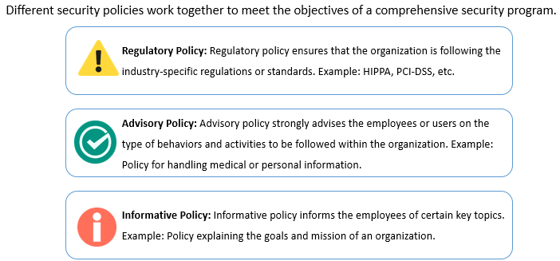
Types of Security Policies
Notes:
Content Slide: This is usually the most frequently used slide in every presentation.
Use this slide for Text heavy slides. Text can only be used in bullet points
Title Heading – font size 30, Arial Heading
Slide Content – Should not reduce beyond Arial body font 16
If you need to use sub bullets please use the indent buttons located next to the bullets buttons in the tool bar and this will automatically provide you with the second, third, fourth & fifth level bullet styles and font sizes
Please note you can also press the tab key to create the different levels of bulleted content

Slide 18
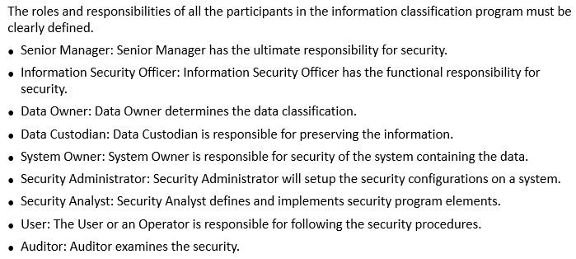
Layers of Responsibility
Notes:
Content Slide: This is usually the most frequently used slide in every presentation.
Use this slide for Text heavy slides. Text can only be used in bullet points
Title Heading – font size 30, Arial Heading
Slide Content – Should not reduce beyond Arial body font 16
If you need to use sub bullets please use the indent buttons located next to the bullets buttons in the tool bar and this will automatically provide you with the second, third, fourth & fifth level bullet styles and font sizes
Please note you can also press the tab key to create the different levels of bulleted content

Slide 19
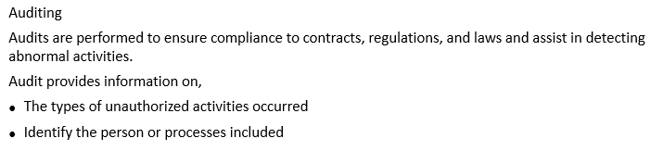
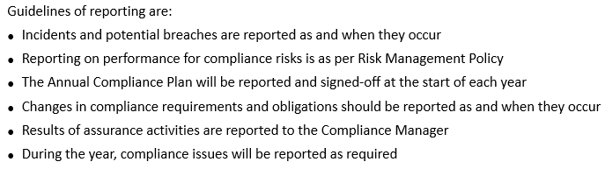
Compliance
Notes:
Content Slide: This is usually the most frequently used slide in every presentation.
Use this slide for Text heavy slides. Text can only be used in bullet points
Title Heading – font size 30, Arial Heading
Slide Content – Should not reduce beyond Arial body font 16
If you need to use sub bullets please use the indent buttons located next to the bullets buttons in the tool bar and this will automatically provide you with the second, third, fourth & fifth level bullet styles and font sizes
Please note you can also press the tab key to create the different levels of bulleted content

Slide 20
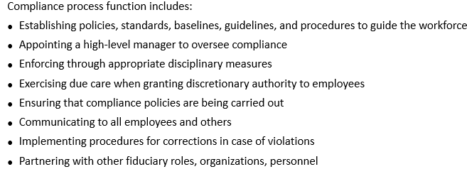
Compliance (contd)
Notes:
Content Slide: This is usually the most frequently used slide in every presentation.
Use this slide for Text heavy slides. Text can only be used in bullet points
Title Heading – font size 30, Arial Heading
Slide Content – Should not reduce beyond Arial body font 16
If you need to use sub bullets please use the indent buttons located next to the bullets buttons in the tool bar and this will automatically provide you with the second, third, fourth & fifth level bullet styles and font sizes
Please note you can also press the tab key to create the different levels of bulleted content

Slide 21


Cyber Crimes
Notes:
Content Slide: This is usually the most frequently used slide in every presentation.
Use this slide for Text heavy slides. Text can only be used in bullet points
Title Heading – font size 30, Arial Heading
Slide Content – Should not reduce beyond Arial body font 16
If you need to use sub bullets please use the indent buttons located next to the bullets buttons in the tool bar and this will automatically provide you with the second, third, fourth & fifth level bullet styles and font sizes
Please note you can also press the tab key to create the different levels of bulleted content

Slide 22
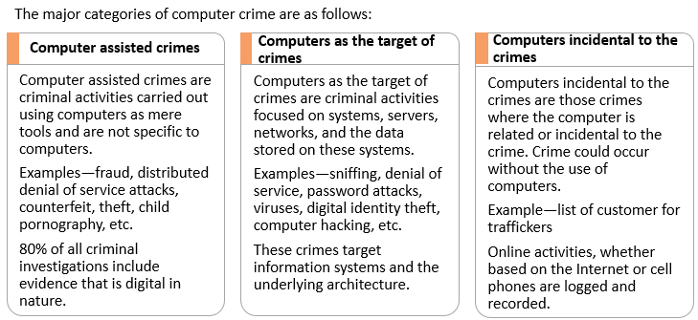
Categories of Computer Crime
Notes:
Content Slide: This is usually the most frequently used slide in every presentation.
Use this slide for Text heavy slides. Text can only be used in bullet points
Title Heading – font size 30, Arial Heading
Slide Content – Should not reduce beyond Arial body font 16
If you need to use sub bullets please use the indent buttons located next to the bullets buttons in the tool bar and this will automatically provide you with the second, third, fourth & fifth level bullet styles and font sizes
Please note you can also press the tab key to create the different levels of bulleted content

Slide 23
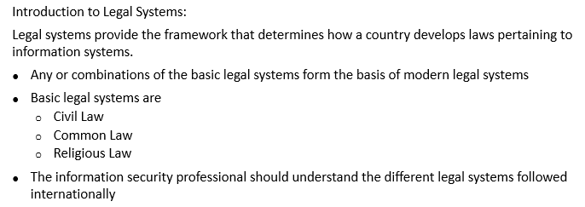
Major Legal Systems
Notes:
Content Slide: This is usually the most frequently used slide in every presentation.
Use this slide for Text heavy slides. Text can only be used in bullet points
Title Heading – font size 30, Arial Heading
Slide Content – Should not reduce beyond Arial body font 16
If you need to use sub bullets please use the indent buttons located next to the bullets buttons in the tool bar and this will automatically provide you with the second, third, fourth & fifth level bullet styles and font sizes
Please note you can also press the tab key to create the different levels of bulleted content

Slide 24
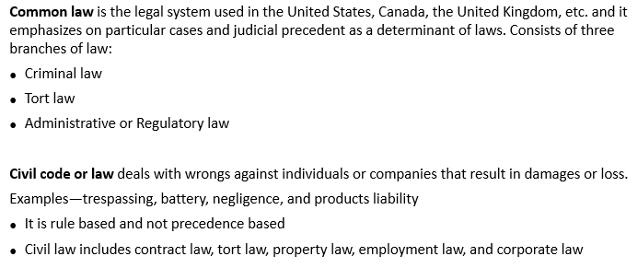
Common Law and Civil Law
Notes:
Content Slide: This is usually the most frequently used slide in every presentation.
Use this slide for Text heavy slides. Text can only be used in bullet points
Title Heading – font size 30, Arial Heading
Slide Content – Should not reduce beyond Arial body font 16
If you need to use sub bullets please use the indent buttons located next to the bullets buttons in the tool bar and this will automatically provide you with the second, third, fourth & fifth level bullet styles and font sizes
Please note you can also press the tab key to create the different levels of bulleted content

Slide 25
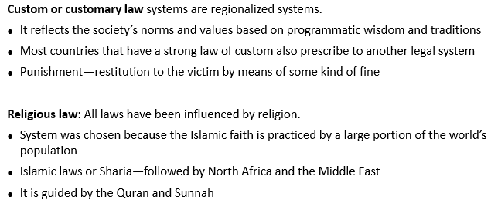
Customary Law and Religious Law
Notes:
Content Slide: This is usually the most frequently used slide in every presentation.
Use this slide for Text heavy slides. Text can only be used in bullet points
Title Heading – font size 30, Arial Heading
Slide Content – Should not reduce beyond Arial body font 16
If you need to use sub bullets please use the indent buttons located next to the bullets buttons in the tool bar and this will automatically provide you with the second, third, fourth & fifth level bullet styles and font sizes
Please note you can also press the tab key to create the different levels of bulleted content

Slide 26

Mixed Law
Notes:
Content Slide: This is usually the most frequently used slide in every presentation.
Use this slide for Text heavy slides. Text can only be used in bullet points
Title Heading – font size 30, Arial Heading
Slide Content – Should not reduce beyond Arial body font 16
If you need to use sub bullets please use the indent buttons located next to the bullets buttons in the tool bar and this will automatically provide you with the second, third, fourth & fifth level bullet styles and font sizes
Please note you can also press the tab key to create the different levels of bulleted content

Slide 27
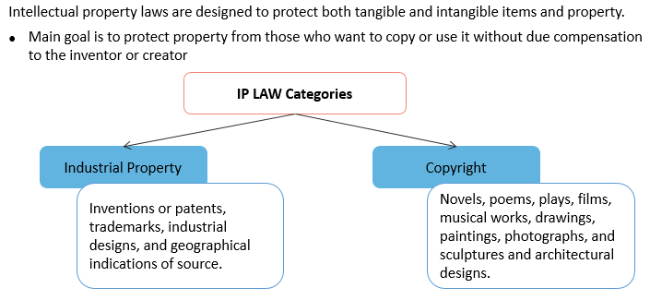
Introduction to Intellectual Property (IP) Law
Notes:
Content Slide: This is usually the most frequently used slide in every presentation.
Use this slide for Text heavy slides. Text can only be used in bullet points
Title Heading – font size 30, Arial Heading
Slide Content – Should not reduce beyond Arial body font 16
If you need to use sub bullets please use the indent buttons located next to the bullets buttons in the tool bar and this will automatically provide you with the second, third, fourth & fifth level bullet styles and font sizes
Please note you can also press the tab key to create the different levels of bulleted content

Slide 28
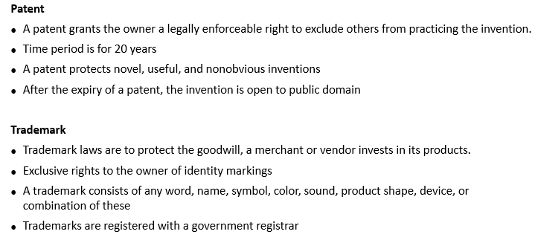
Types of Intellectual Property (IP) Law
Notes:
Content Slide: This is usually the most frequently used slide in every presentation.
Use this slide for Text heavy slides. Text can only be used in bullet points
Title Heading – font size 30, Arial Heading
Slide Content – Should not reduce beyond Arial body font 16
If you need to use sub bullets please use the indent buttons located next to the bullets buttons in the tool bar and this will automatically provide you with the second, third, fourth & fifth level bullet styles and font sizes
Please note you can also press the tab key to create the different levels of bulleted content

Slide 29
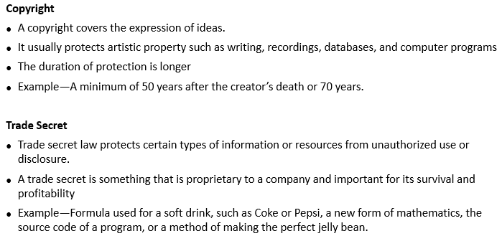
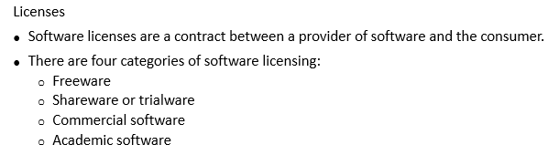
Types of Intellectual Property (IP) Law (contd)
Notes:
Content Slide: This is usually the most frequently used slide in every presentation.
Use this slide for Text heavy slides. Text can only be used in bullet points
Title Heading – font size 30, Arial Heading
Slide Content – Should not reduce beyond Arial body font 16
If you need to use sub bullets please use the indent buttons located next to the bullets buttons in the tool bar and this will automatically provide you with the second, third, fourth & fifth level bullet styles and font sizes
Please note you can also press the tab key to create the different levels of bulleted content

Slide 30
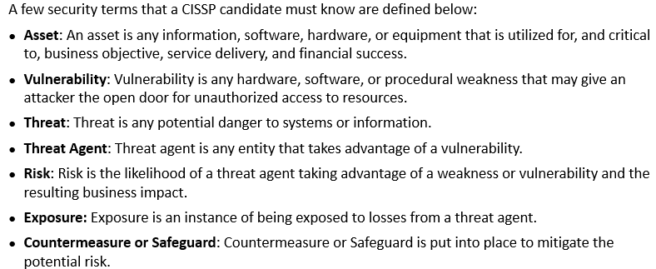
Security Definitions
Notes:
Content Slide: This is usually the most frequently used slide in every presentation.
Use this slide for Text heavy slides. Text can only be used in bullet points
Title Heading – font size 30, Arial Heading
Slide Content – Should not reduce beyond Arial body font 16
If you need to use sub bullets please use the indent buttons located next to the bullets buttons in the tool bar and this will automatically provide you with the second, third, fourth & fifth level bullet styles and font sizes
Please note you can also press the tab key to create the different levels of bulleted content

Slide 31
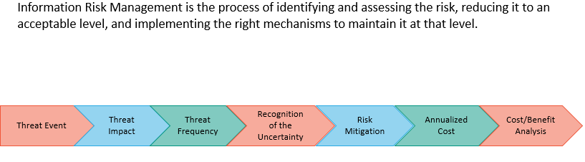
Information Risk Management
Notes:
Content Slide: This is usually the most frequently used slide in every presentation.
Use this slide for Text heavy slides. Text can only be used in bullet points
Title Heading – font size 30, Arial Heading
Slide Content – Should not reduce beyond Arial body font 16
If you need to use sub bullets please use the indent buttons located next to the bullets buttons in the tool bar and this will automatically provide you with the second, third, fourth & fifth level bullet styles and font sizes
Please note you can also press the tab key to create the different levels of bulleted content

Slide 32
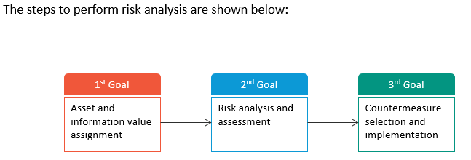
Steps for Risk Analysis
Notes:
Content Slide: This is usually the most frequently used slide in every presentation.
Use this slide for Text heavy slides. Text can only be used in bullet points
Title Heading – font size 30, Arial Heading
Slide Content – Should not reduce beyond Arial body font 16
If you need to use sub bullets please use the indent buttons located next to the bullets buttons in the tool bar and this will automatically provide you with the second, third, fourth & fifth level bullet styles and font sizes
Please note you can also press the tab key to create the different levels of bulleted content

Slide 33
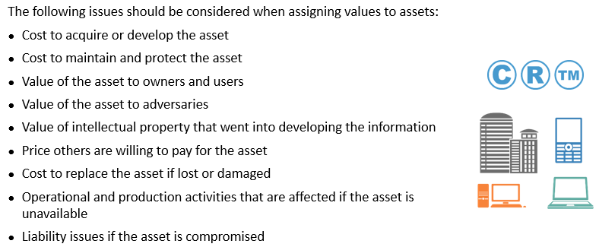
Information and Assets Valuation
Notes:
Content Slide: This is usually the most frequently used slide in every presentation.
Use this slide for Text heavy slides. Text can only be used in bullet points
Title Heading – font size 30, Arial Heading
Slide Content – Should not reduce beyond Arial body font 16
If you need to use sub bullets please use the indent buttons located next to the bullets buttons in the tool bar and this will automatically provide you with the second, third, fourth & fifth level bullet styles and font sizes
Please note you can also press the tab key to create the different levels of bulleted content

Slide 34
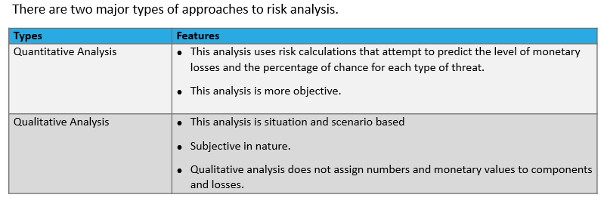
Risk Analysis Types
Notes:
Content Slide: This is usually the most frequently used slide in every presentation.
Use this slide for Text heavy slides. Text can only be used in bullet points
Title Heading – font size 30, Arial Heading
Slide Content – Should not reduce beyond Arial body font 16
If you need to use sub bullets please use the indent buttons located next to the bullets buttons in the tool bar and this will automatically provide you with the second, third, fourth & fifth level bullet styles and font sizes
Please note you can also press the tab key to create the different levels of bulleted content

Slide 35
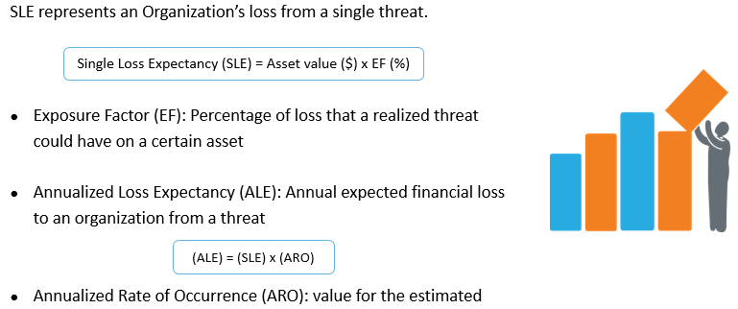
Quantitative Risk Analysis - Steps
Notes:
Content Slide: This is usually the most frequently used slide in every presentation.
Use this slide for Text heavy slides. Text can only be used in bullet points
Title Heading – font size 30, Arial Heading
Slide Content – Should not reduce beyond Arial body font 16
If you need to use sub bullets please use the indent buttons located next to the bullets buttons in the tool bar and this will automatically provide you with the second, third, fourth & fifth level bullet styles and font sizes
Please note you can also press the tab key to create the different levels of bulleted content

Slide 36
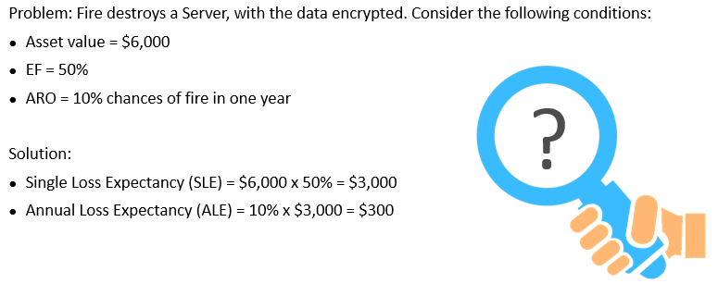
Quantitative Risk Analysis - Problem
Notes:
Content Slide: This is usually the most frequently used slide in every presentation.
Use this slide for Text heavy slides. Text can only be used in bullet points
Title Heading – font size 30, Arial Heading
Slide Content – Should not reduce beyond Arial body font 16
If you need to use sub bullets please use the indent buttons located next to the bullets buttons in the tool bar and this will automatically provide you with the second, third, fourth & fifth level bullet styles and font sizes
Please note you can also press the tab key to create the different levels of bulleted content

Slide 37
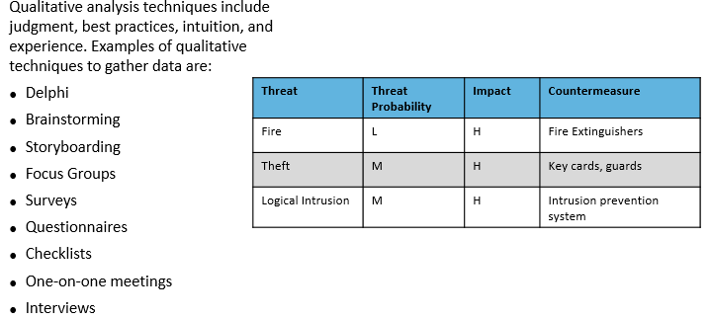
Qualitative Risk Analysis
Notes:
Content Slide: This is usually the most frequently used slide in every presentation.
Use this slide for Text heavy slides. Text can only be used in bullet points
Title Heading – font size 30, Arial Heading
Slide Content – Should not reduce beyond Arial body font 16
If you need to use sub bullets please use the indent buttons located next to the bullets buttons in the tool bar and this will automatically provide you with the second, third, fourth & fifth level bullet styles and font sizes
Please note you can also press the tab key to create the different levels of bulleted content

Slide 38
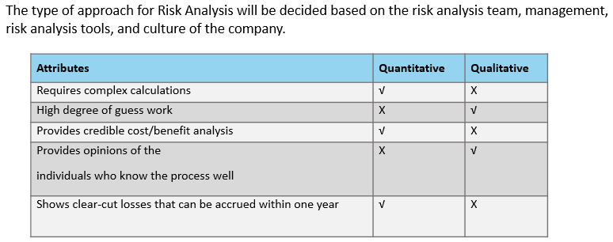
Quantitative vs Qualitative
Notes:
Content Slide: This is usually the most frequently used slide in every presentation.
Use this slide for Text heavy slides. Text can only be used in bullet points
Title Heading – font size 30, Arial Heading
Slide Content – Should not reduce beyond Arial body font 16
If you need to use sub bullets please use the indent buttons located next to the bullets buttons in the tool bar and this will automatically provide you with the second, third, fourth & fifth level bullet styles and font sizes
Please note you can also press the tab key to create the different levels of bulleted content

Slide 39
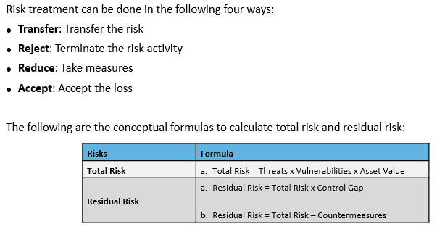
Risk Treatment
Notes:
Content Slide: This is usually the most frequently used slide in every presentation.
Use this slide for Text heavy slides. Text can only be used in bullet points
Title Heading – font size 30, Arial Heading
Slide Content – Should not reduce beyond Arial body font 16
If you need to use sub bullets please use the indent buttons located next to the bullets buttons in the tool bar and this will automatically provide you with the second, third, fourth & fifth level bullet styles and font sizes
Please note you can also press the tab key to create the different levels of bulleted content

Slide 40
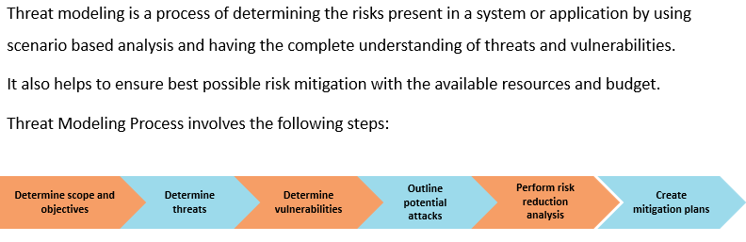
Threat Modeling
Notes:
Content Slide: This is usually the most frequently used slide in every presentation.
Use this slide for Text heavy slides. Text can only be used in bullet points
Title Heading – font size 30, Arial Heading
Slide Content – Should not reduce beyond Arial body font 16
If you need to use sub bullets please use the indent buttons located next to the bullets buttons in the tool bar and this will automatically provide you with the second, third, fourth & fifth level bullet styles and font sizes
Please note you can also press the tab key to create the different levels of bulleted content

Slide 41
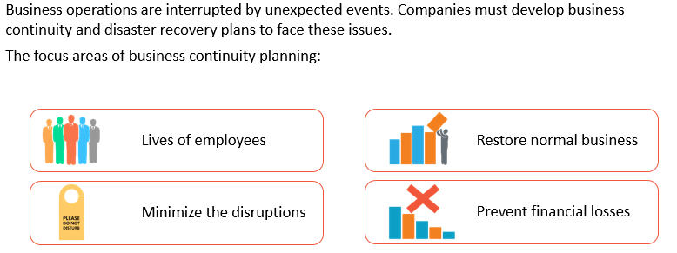
Need for Business Continuity Planning
Notes:
Content Slide: This is usually the most frequently used slide in every presentation.
Use this slide for Text heavy slides. Text can only be used in bullet points
Title Heading – font size 30, Arial Heading
Slide Content – Should not reduce beyond Arial body font 16
If you need to use sub bullets please use the indent buttons located next to the bullets buttons in the tool bar and this will automatically provide you with the second, third, fourth & fifth level bullet styles and font sizes
Please note you can also press the tab key to create the different levels of bulleted content

Slide 42
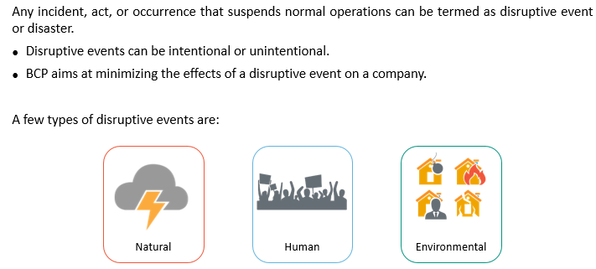
Disruptive Events
Notes:
Content Slide: This is usually the most frequently used slide in every presentation.
Use this slide for Text heavy slides. Text can only be used in bullet points
Title Heading – font size 30, Arial Heading
Slide Content – Should not reduce beyond Arial body font 16
If you need to use sub bullets please use the indent buttons located next to the bullets buttons in the tool bar and this will automatically provide you with the second, third, fourth & fifth level bullet styles and font sizes
Please note you can also press the tab key to create the different levels of bulleted content

Slide 43
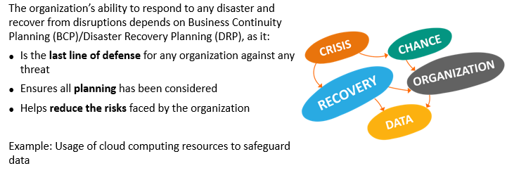
Importance of Business Continuity Planning
Notes:
Content Slide: This is usually the most frequently used slide in every presentation.
Use this slide for Text heavy slides. Text can only be used in bullet points
Title Heading – font size 30, Arial Heading
Slide Content – Should not reduce beyond Arial body font 16
If you need to use sub bullets please use the indent buttons located next to the bullets buttons in the tool bar and this will automatically provide you with the second, third, fourth & fifth level bullet styles and font sizes
Please note you can also press the tab key to create the different levels of bulleted content

Slide 44
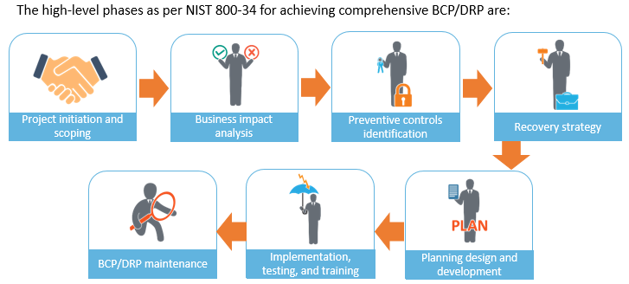
Business Continuity Planning Phases
Notes:
Content Slide: This is usually the most frequently used slide in every presentation.
Use this slide for Text heavy slides. Text can only be used in bullet points
Title Heading – font size 30, Arial Heading
Slide Content – Should not reduce beyond Arial body font 16
If you need to use sub bullets please use the indent buttons located next to the bullets buttons in the tool bar and this will automatically provide you with the second, third, fourth & fifth level bullet styles and font sizes
Please note you can also press the tab key to create the different levels of bulleted content

Slide 45
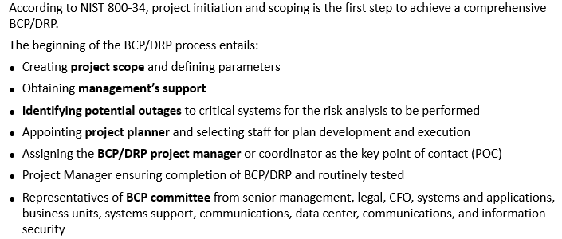
BCP/DRP Phase 1 – project initiation and scoping
Notes:
Content Slide: This is usually the most frequently used slide in every presentation.
Use this slide for Text heavy slides. Text can only be used in bullet points
Title Heading – font size 30, Arial Heading
Slide Content – Should not reduce beyond Arial body font 16
If you need to use sub bullets please use the indent buttons located next to the bullets buttons in the tool bar and this will automatically provide you with the second, third, fourth & fifth level bullet styles and font sizes
Please note you can also press the tab key to create the different levels of bulleted content

Slide 46
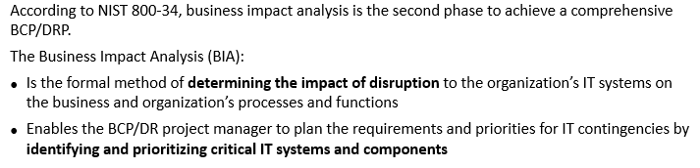
BCP/DRP Phase 2 – business impact analysis (BIA)
Notes:
Content Slide: This is usually the most frequently used slide in every presentation.
Use this slide for Text heavy slides. Text can only be used in bullet points
Title Heading – font size 30, Arial Heading
Slide Content – Should not reduce beyond Arial body font 16
If you need to use sub bullets please use the indent buttons located next to the bullets buttons in the tool bar and this will automatically provide you with the second, third, fourth & fifth level bullet styles and font sizes
Please note you can also press the tab key to create the different levels of bulleted content

Slide 47
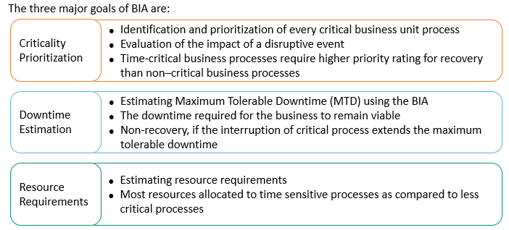
BIA - Goals
Notes:
Content Slide: This is usually the most frequently used slide in every presentation.
Use this slide for Text heavy slides. Text can only be used in bullet points
Title Heading – font size 30, Arial Heading
Slide Content – Should not reduce beyond Arial body font 16
If you need to use sub bullets please use the indent buttons located next to the bullets buttons in the tool bar and this will automatically provide you with the second, third, fourth & fifth level bullet styles and font sizes
Please note you can also press the tab key to create the different levels of bulleted content

Slide 48
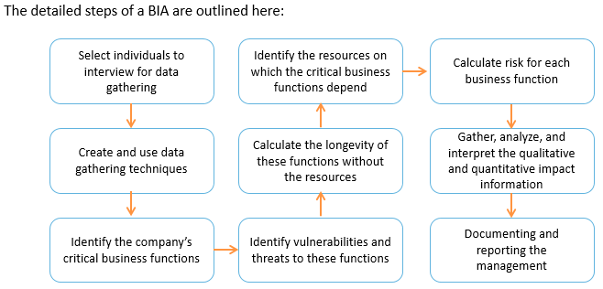
BIA - Steps
Notes:
Content Slide: This is usually the most frequently used slide in every presentation.
Use this slide for Text heavy slides. Text can only be used in bullet points
Title Heading – font size 30, Arial Heading
Slide Content – Should not reduce beyond Arial body font 16
If you need to use sub bullets please use the indent buttons located next to the bullets buttons in the tool bar and this will automatically provide you with the second, third, fourth & fifth level bullet styles and font sizes
Please note you can also press the tab key to create the different levels of bulleted content

Slide 49
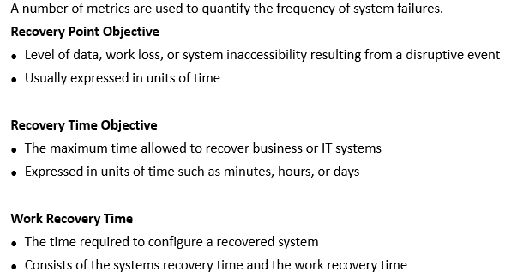
Failure and Recovery Metrics
Notes:
Content Slide: This is usually the most frequently used slide in every presentation.
Use this slide for Text heavy slides. Text can only be used in bullet points
Title Heading – font size 30, Arial Heading
Slide Content – Should not reduce beyond Arial body font 16
If you need to use sub bullets please use the indent buttons located next to the bullets buttons in the tool bar and this will automatically provide you with the second, third, fourth & fifth level bullet styles and font sizes
Please note you can also press the tab key to create the different levels of bulleted content

Slide 50
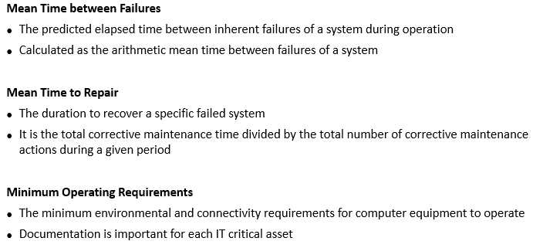
Failure and Recovery Metrics (contd)
Notes:
Content Slide: This is usually the most frequently used slide in every presentation.
Use this slide for Text heavy slides. Text can only be used in bullet points
Title Heading – font size 30, Arial Heading
Slide Content – Should not reduce beyond Arial body font 16
If you need to use sub bullets please use the indent buttons located next to the bullets buttons in the tool bar and this will automatically provide you with the second, third, fourth & fifth level bullet styles and font sizes
Please note you can also press the tab key to create the different levels of bulleted content

Slide 51

BCP/DRP Phase 3 – identify preventive controls
Notes:
Content Slide: This is usually the most frequently used slide in every presentation.
Use this slide for Text heavy slides. Text can only be used in bullet points
Title Heading – font size 30, Arial Heading
Slide Content – Should not reduce beyond Arial body font 16
If you need to use sub bullets please use the indent buttons located next to the bullets buttons in the tool bar and this will automatically provide you with the second, third, fourth & fifth level bullet styles and font sizes
Please note you can also press the tab key to create the different levels of bulleted content

Slide 52

Importance of managing personnel security
Notes:
Content Slide: This is usually the most frequently used slide in every presentation.
Use this slide for Text heavy slides. Text can only be used in bullet points
Title Heading – font size 30, Arial Heading
Slide Content – Should not reduce beyond Arial body font 16
If you need to use sub bullets please use the indent buttons located next to the bullets buttons in the tool bar and this will automatically provide you with the second, third, fourth & fifth level bullet styles and font sizes
Please note you can also press the tab key to create the different levels of bulleted content

Slide 53

Managing personnel security – hiring practices
Notes:
Content Slide: This is usually the most frequently used slide in every presentation.
Use this slide for Text heavy slides. Text can only be used in bullet points
Title Heading – font size 30, Arial Heading
Slide Content – Should not reduce beyond Arial body font 16
If you need to use sub bullets please use the indent buttons located next to the bullets buttons in the tool bar and this will automatically provide you with the second, third, fourth & fifth level bullet styles and font sizes
Please note you can also press the tab key to create the different levels of bulleted content

Slide 54

Managing personnel security – employee termination
Notes:
Content Slide: This is usually the most frequently used slide in every presentation.
Use this slide for Text heavy slides. Text can only be used in bullet points
Title Heading – font size 30, Arial Heading
Slide Content – Should not reduce beyond Arial body font 16
If you need to use sub bullets please use the indent buttons located next to the bullets buttons in the tool bar and this will automatically provide you with the second, third, fourth & fifth level bullet styles and font sizes
Please note you can also press the tab key to create the different levels of bulleted content

Slide 55

Vendors, Contractors and Consultant controls
Notes:
Content Slide: This is usually the most frequently used slide in every presentation.
Use this slide for Text heavy slides. Text can only be used in bullet points
Title Heading – font size 30, Arial Heading
Slide Content – Should not reduce beyond Arial body font 16
If you need to use sub bullets please use the indent buttons located next to the bullets buttons in the tool bar and this will automatically provide you with the second, third, fourth & fifth level bullet styles and font sizes
Please note you can also press the tab key to create the different levels of bulleted content

Slide 56

Best Work Practices
Notes:
Content Slide: This is usually the most frequently used slide in every presentation.
Use this slide for Text heavy slides. Text can only be used in bullet points
Title Heading – font size 30, Arial Heading
Slide Content – Should not reduce beyond Arial body font 16
If you need to use sub bullets please use the indent buttons located next to the bullets buttons in the tool bar and this will automatically provide you with the second, third, fourth & fifth level bullet styles and font sizes
Please note you can also press the tab key to create the different levels of bulleted content

Slide 57

Importance of Security Awareness Training
Notes:
Content Slide: This is usually the most frequently used slide in every presentation.
Use this slide for Text heavy slides. Text can only be used in bullet points
Title Heading – font size 30, Arial Heading
Slide Content – Should not reduce beyond Arial body font 16
If you need to use sub bullets please use the indent buttons located next to the bullets buttons in the tool bar and this will automatically provide you with the second, third, fourth & fifth level bullet styles and font sizes
Please note you can also press the tab key to create the different levels of bulleted content

Slide 58

Awareness, Training and Education
Notes:
Content Slide: This is usually the most frequently used slide in every presentation.
Use this slide for Text heavy slides. Text can only be used in bullet points
Title Heading – font size 30, Arial Heading
Slide Content – Should not reduce beyond Arial body font 16
If you need to use sub bullets please use the indent buttons located next to the bullets buttons in the tool bar and this will automatically provide you with the second, third, fourth & fifth level bullet styles and font sizes
Please note you can also press the tab key to create the different levels of bulleted content

Slide 59

Security Awareness Training Program - Implementation
Notes:
Content Slide: This is usually the most frequently used slide in every presentation.
Use this slide for Text heavy slides. Text can only be used in bullet points
Title Heading – font size 30, Arial Heading
Slide Content – Should not reduce beyond Arial body font 16
If you need to use sub bullets please use the indent buttons located next to the bullets buttons in the tool bar and this will automatically provide you with the second, third, fourth & fifth level bullet styles and font sizes
Please note you can also press the tab key to create the different levels of bulleted content

Slide 60

Importance of Managing the Security Function
Notes:
Content Slide: This is usually the most frequently used slide in every presentation.
Use this slide for Text heavy slides. Text can only be used in bullet points
Title Heading – font size 30, Arial Heading
Slide Content – Should not reduce beyond Arial body font 16
If you need to use sub bullets please use the indent buttons located next to the bullets buttons in the tool bar and this will automatically provide you with the second, third, fourth & fifth level bullet styles and font sizes
Please note you can also press the tab key to create the different levels of bulleted content

Slide 61

Best Practices – Budget and Establish Security Metrics
Notes:
Content Slide: This is usually the most frequently used slide in every presentation.
Use this slide for Text heavy slides. Text can only be used in bullet points
Title Heading – font size 30, Arial Heading
Slide Content – Should not reduce beyond Arial body font 16
If you need to use sub bullets please use the indent buttons located next to the bullets buttons in the tool bar and this will automatically provide you with the second, third, fourth & fifth level bullet styles and font sizes
Please note you can also press the tab key to create the different levels of bulleted content

Slide 62

Best Practices – Resources Develop and Implement Strategies
Notes:
Content Slide: This is usually the most frequently used slide in every presentation.
Use this slide for Text heavy slides. Text can only be used in bullet points
Title Heading – font size 30, Arial Heading
Slide Content – Should not reduce beyond Arial body font 16
If you need to use sub bullets please use the indent buttons located next to the bullets buttons in the tool bar and this will automatically provide you with the second, third, fourth & fifth level bullet styles and font sizes
Please note you can also press the tab key to create the different levels of bulleted content

Slide 63

Best Practices – Completeness and Effectiveness of the Program
Notes:
Content Slide: This is usually the most frequently used slide in every presentation.
Use this slide for Text heavy slides. Text can only be used in bullet points
Title Heading – font size 30, Arial Heading
Slide Content – Should not reduce beyond Arial body font 16
If you need to use sub bullets please use the indent buttons located next to the bullets buttons in the tool bar and this will automatically provide you with the second, third, fourth & fifth level bullet styles and font sizes
Please note you can also press the tab key to create the different levels of bulleted content

Slide 64

Notes:
Content Slide: This is usually the most frequently used slide in every presentation.
Use this slide for Text heavy slides. Text can only be used in bullet points
Title Heading – font size 30, Arial Heading
Slide Content – Should not reduce beyond Arial body font 16
If you need to use sub bullets please use the indent buttons located next to the bullets buttons in the tool bar and this will automatically provide you with the second, third, fourth & fifth level bullet styles and font sizes
Please note you can also press the tab key to create the different levels of bulleted content

Slide 65

Notes:
Content Slide: This is usually the most frequently used slide in every presentation.
Use this slide for Text heavy slides. Text can only be used in bullet points
Title Heading – font size 30, Arial Heading
Slide Content – Should not reduce beyond Arial body font 16
If you need to use sub bullets please use the indent buttons located next to the bullets buttons in the tool bar and this will automatically provide you with the second, third, fourth & fifth level bullet styles and font sizes
Please note you can also press the tab key to create the different levels of bulleted content

Slide 66

Notes:
Content Slide: This is usually the most frequently used slide in every presentation.
Use this slide for Text heavy slides. Text can only be used in bullet points
Title Heading – font size 30, Arial Heading
Slide Content – Should not reduce beyond Arial body font 16
If you need to use sub bullets please use the indent buttons located next to the bullets buttons in the tool bar and this will automatically provide you with the second, third, fourth & fifth level bullet styles and font sizes
Please note you can also press the tab key to create the different levels of bulleted content

Slide 67

Notes:
Content Slide: This is usually the most frequently used slide in every presentation.
Use this slide for Text heavy slides. Text can only be used in bullet points
Title Heading – font size 30, Arial Heading
Slide Content – Should not reduce beyond Arial body font 16
If you need to use sub bullets please use the indent buttons located next to the bullets buttons in the tool bar and this will automatically provide you with the second, third, fourth & fifth level bullet styles and font sizes
Please note you can also press the tab key to create the different levels of bulleted content

Slide 68

Notes:
Content Slide: This is usually the most frequently used slide in every presentation.
Use this slide for Text heavy slides. Text can only be used in bullet points
Title Heading – font size 30, Arial Heading
Slide Content – Should not reduce beyond Arial body font 16
If you need to use sub bullets please use the indent buttons located next to the bullets buttons in the tool bar and this will automatically provide you with the second, third, fourth & fifth level bullet styles and font sizes
Please note you can also press the tab key to create the different levels of bulleted content

Slide 69

Notes:
Content Slide: This is usually the most frequently used slide in every presentation.
Use this slide for Text heavy slides. Text can only be used in bullet points
Title Heading – font size 30, Arial Heading
Slide Content – Should not reduce beyond Arial body font 16
If you need to use sub bullets please use the indent buttons located next to the bullets buttons in the tool bar and this will automatically provide you with the second, third, fourth & fifth level bullet styles and font sizes
Please note you can also press the tab key to create the different levels of bulleted content

Slide 70

Notes:
Content Slide: This is usually the most frequently used slide in every presentation.
Use this slide for Text heavy slides. Text can only be used in bullet points
Title Heading – font size 30, Arial Heading
Slide Content – Should not reduce beyond Arial body font 16
If you need to use sub bullets please use the indent buttons located next to the bullets buttons in the tool bar and this will automatically provide you with the second, third, fourth & fifth level bullet styles and font sizes
Please note you can also press the tab key to create the different levels of bulleted content

Slide 71

Notes:
Content Slide: This is usually the most frequently used slide in every presentation.
Use this slide for Text heavy slides. Text can only be used in bullet points
Title Heading – font size 30, Arial Heading
Slide Content – Should not reduce beyond Arial body font 16
If you need to use sub bullets please use the indent buttons located next to the bullets buttons in the tool bar and this will automatically provide you with the second, third, fourth & fifth level bullet styles and font sizes
Please note you can also press the tab key to create the different levels of bulleted content

Slide 72

Notes:
Content Slide: This is usually the most frequently used slide in every presentation.
Use this slide for Text heavy slides. Text can only be used in bullet points
Title Heading – font size 30, Arial Heading
Slide Content – Should not reduce beyond Arial body font 16
If you need to use sub bullets please use the indent buttons located next to the bullets buttons in the tool bar and this will automatically provide you with the second, third, fourth & fifth level bullet styles and font sizes
Please note you can also press the tab key to create the different levels of bulleted content

Slide 73

Notes:
Content Slide: This is usually the most frequently used slide in every presentation.
Use this slide for Text heavy slides. Text can only be used in bullet points
Title Heading – font size 30, Arial Heading
Slide Content – Should not reduce beyond Arial body font 16
If you need to use sub bullets please use the indent buttons located next to the bullets buttons in the tool bar and this will automatically provide you with the second, third, fourth & fifth level bullet styles and font sizes
Please note you can also press the tab key to create the different levels of bulleted content

Slide 74

Notes:
Content Slide: This is usually the most frequently used slide in every presentation.
Use this slide for Text heavy slides. Text can only be used in bullet points
Title Heading – font size 30, Arial Heading
Slide Content – Should not reduce beyond Arial body font 16
If you need to use sub bullets please use the indent buttons located next to the bullets buttons in the tool bar and this will automatically provide you with the second, third, fourth & fifth level bullet styles and font sizes
Please note you can also press the tab key to create the different levels of bulleted content

Slide 75

Notes:
Content Slide: This is usually the most frequently used slide in every presentation.
Use this slide for Text heavy slides. Text can only be used in bullet points
Title Heading – font size 30, Arial Heading
Slide Content – Should not reduce beyond Arial body font 16
If you need to use sub bullets please use the indent buttons located next to the bullets buttons in the tool bar and this will automatically provide you with the second, third, fourth & fifth level bullet styles and font sizes
Please note you can also press the tab key to create the different levels of bulleted content

Slide 76

Notes:
Content Slide: This is usually the most frequently used slide in every presentation.
Use this slide for Text heavy slides. Text can only be used in bullet points
Title Heading – font size 30, Arial Heading
Slide Content – Should not reduce beyond Arial body font 16
If you need to use sub bullets please use the indent buttons located next to the bullets buttons in the tool bar and this will automatically provide you with the second, third, fourth & fifth level bullet styles and font sizes
Please note you can also press the tab key to create the different levels of bulleted content

Slide 77

Notes:
Content Slide: This is usually the most frequently used slide in every presentation.
Use this slide for Text heavy slides. Text can only be used in bullet points
Title Heading – font size 30, Arial Heading
Slide Content – Should not reduce beyond Arial body font 16
If you need to use sub bullets please use the indent buttons located next to the bullets buttons in the tool bar and this will automatically provide you with the second, third, fourth & fifth level bullet styles and font sizes
Please note you can also press the tab key to create the different levels of bulleted content

Slide 78

Notes:
Content Slide: This is usually the most frequently used slide in every presentation.
Use this slide for Text heavy slides. Text can only be used in bullet points
Title Heading – font size 30, Arial Heading
Slide Content – Should not reduce beyond Arial body font 16
If you need to use sub bullets please use the indent buttons located next to the bullets buttons in the tool bar and this will automatically provide you with the second, third, fourth & fifth level bullet styles and font sizes
Please note you can also press the tab key to create the different levels of bulleted content

Slide 79

Notes:
Content Slide: This is usually the most frequently used slide in every presentation.
Use this slide for Text heavy slides. Text can only be used in bullet points
Title Heading – font size 30, Arial Heading
Slide Content – Should not reduce beyond Arial body font 16
If you need to use sub bullets please use the indent buttons located next to the bullets buttons in the tool bar and this will automatically provide you with the second, third, fourth & fifth level bullet styles and font sizes
Please note you can also press the tab key to create the different levels of bulleted content

Slide 80

Notes:
Content Slide: This is usually the most frequently used slide in every presentation.
Use this slide for Text heavy slides. Text can only be used in bullet points
Title Heading – font size 30, Arial Heading
Slide Content – Should not reduce beyond Arial body font 16
If you need to use sub bullets please use the indent buttons located next to the bullets buttons in the tool bar and this will automatically provide you with the second, third, fourth & fifth level bullet styles and font sizes
Please note you can also press the tab key to create the different levels of bulleted content

Slide 81

Notes:
Content Slide: This is usually the most frequently used slide in every presentation.
Use this slide for Text heavy slides. Text can only be used in bullet points
Title Heading – font size 30, Arial Heading
Slide Content – Should not reduce beyond Arial body font 16
If you need to use sub bullets please use the indent buttons located next to the bullets buttons in the tool bar and this will automatically provide you with the second, third, fourth & fifth level bullet styles and font sizes
Please note you can also press the tab key to create the different levels of bulleted content

Slide 82

Notes:
Content Slide: This is usually the most frequently used slide in every presentation.
Use this slide for Text heavy slides. Text can only be used in bullet points
Title Heading – font size 30, Arial Heading
Slide Content – Should not reduce beyond Arial body font 16
If you need to use sub bullets please use the indent buttons located next to the bullets buttons in the tool bar and this will automatically provide you with the second, third, fourth & fifth level bullet styles and font sizes
Please note you can also press the tab key to create the different levels of bulleted content

Slide 83

Notes:
Content Slide: This is usually the most frequently used slide in every presentation.
Use this slide for Text heavy slides. Text can only be used in bullet points
Title Heading – font size 30, Arial Heading
Slide Content – Should not reduce beyond Arial body font 16
If you need to use sub bullets please use the indent buttons located next to the bullets buttons in the tool bar and this will automatically provide you with the second, third, fourth & fifth level bullet styles and font sizes
Please note you can also press the tab key to create the different levels of bulleted content

Slide 84

Notes:
Content Slide: This is usually the most frequently used slide in every presentation.
Use this slide for Text heavy slides. Text can only be used in bullet points
Title Heading – font size 30, Arial Heading
Slide Content – Should not reduce beyond Arial body font 16
If you need to use sub bullets please use the indent buttons located next to the bullets buttons in the tool bar and this will automatically provide you with the second, third, fourth & fifth level bullet styles and font sizes
Please note you can also press the tab key to create the different levels of bulleted content

Slide 85

Notes:
Content Slide: This is usually the most frequently used slide in every presentation.
Use this slide for Text heavy slides. Text can only be used in bullet points
Title Heading – font size 30, Arial Heading
Slide Content – Should not reduce beyond Arial body font 16
If you need to use sub bullets please use the indent buttons located next to the bullets buttons in the tool bar and this will automatically provide you with the second, third, fourth & fifth level bullet styles and font sizes
Please note you can also press the tab key to create the different levels of bulleted content

Slide 86

Notes:
Content Slide: This is usually the most frequently used slide in every presentation.
Use this slide for Text heavy slides. Text can only be used in bullet points
Title Heading – font size 30, Arial Heading
Slide Content – Should not reduce beyond Arial body font 16
If you need to use sub bullets please use the indent buttons located next to the bullets buttons in the tool bar and this will automatically provide you with the second, third, fourth & fifth level bullet styles and font sizes
Please note you can also press the tab key to create the different levels of bulleted content

Slide 87

Notes:
Content Slide: This is usually the most frequently used slide in every presentation.
Use this slide for Text heavy slides. Text can only be used in bullet points
Title Heading – font size 30, Arial Heading
Slide Content – Should not reduce beyond Arial body font 16
If you need to use sub bullets please use the indent buttons located next to the bullets buttons in the tool bar and this will automatically provide you with the second, third, fourth & fifth level bullet styles and font sizes
Please note you can also press the tab key to create the different levels of bulleted content

Slide 88

Notes:
Content Slide: This is usually the most frequently used slide in every presentation.
Use this slide for Text heavy slides. Text can only be used in bullet points
Title Heading – font size 30, Arial Heading
Slide Content – Should not reduce beyond Arial body font 16
If you need to use sub bullets please use the indent buttons located next to the bullets buttons in the tool bar and this will automatically provide you with the second, third, fourth & fifth level bullet styles and font sizes
Please note you can also press the tab key to create the different levels of bulleted content

Slide 89

Notes:
Content Slide: This is usually the most frequently used slide in every presentation.
Use this slide for Text heavy slides. Text can only be used in bullet points
Title Heading – font size 30, Arial Heading
Slide Content – Should not reduce beyond Arial body font 16
If you need to use sub bullets please use the indent buttons located next to the bullets buttons in the tool bar and this will automatically provide you with the second, third, fourth & fifth level bullet styles and font sizes
Please note you can also press the tab key to create the different levels of bulleted content

Slide 90

Notes:
Content Slide: This is usually the most frequently used slide in every presentation.
Use this slide for Text heavy slides. Text can only be used in bullet points
Title Heading – font size 30, Arial Heading
Slide Content – Should not reduce beyond Arial body font 16
If you need to use sub bullets please use the indent buttons located next to the bullets buttons in the tool bar and this will automatically provide you with the second, third, fourth & fifth level bullet styles and font sizes
Please note you can also press the tab key to create the different levels of bulleted content

Slide 91

Notes:
Content Slide: This is usually the most frequently used slide in every presentation.
Use this slide for Text heavy slides. Text can only be used in bullet points
Title Heading – font size 30, Arial Heading
Slide Content – Should not reduce beyond Arial body font 16
If you need to use sub bullets please use the indent buttons located next to the bullets buttons in the tool bar and this will automatically provide you with the second, third, fourth & fifth level bullet styles and font sizes
Please note you can also press the tab key to create the different levels of bulleted content

Slide 92

Notes:
Content Slide: This is usually the most frequently used slide in every presentation.
Use this slide for Text heavy slides. Text can only be used in bullet points
Title Heading – font size 30, Arial Heading
Slide Content – Should not reduce beyond Arial body font 16
If you need to use sub bullets please use the indent buttons located next to the bullets buttons in the tool bar and this will automatically provide you with the second, third, fourth & fifth level bullet styles and font sizes
Please note you can also press the tab key to create the different levels of bulleted content

Slide 93

Notes:
Content Slide: This is usually the most frequently used slide in every presentation.
Use this slide for Text heavy slides. Text can only be used in bullet points
Title Heading – font size 30, Arial Heading
Slide Content – Should not reduce beyond Arial body font 16
If you need to use sub bullets please use the indent buttons located next to the bullets buttons in the tool bar and this will automatically provide you with the second, third, fourth & fifth level bullet styles and font sizes
Please note you can also press the tab key to create the different levels of bulleted content

Slide 94

Notes:
Content Slide: This is usually the most frequently used slide in every presentation.
Use this slide for Text heavy slides. Text can only be used in bullet points
Title Heading – font size 30, Arial Heading
Slide Content – Should not reduce beyond Arial body font 16
If you need to use sub bullets please use the indent buttons located next to the bullets buttons in the tool bar and this will automatically provide you with the second, third, fourth & fifth level bullet styles and font sizes
Please note you can also press the tab key to create the different levels of bulleted content

Slide 95

Notes:
Content Slide: This is usually the most frequently used slide in every presentation.
Use this slide for Text heavy slides. Text can only be used in bullet points
Title Heading – font size 30, Arial Heading
Slide Content – Should not reduce beyond Arial body font 16
If you need to use sub bullets please use the indent buttons located next to the bullets buttons in the tool bar and this will automatically provide you with the second, third, fourth & fifth level bullet styles and font sizes
Please note you can also press the tab key to create the different levels of bulleted content

Slide 96

Notes:
Content Slide: This is usually the most frequently used slide in every presentation.
Use this slide for Text heavy slides. Text can only be used in bullet points
Title Heading – font size 30, Arial Heading
Slide Content – Should not reduce beyond Arial body font 16
If you need to use sub bullets please use the indent buttons located next to the bullets buttons in the tool bar and this will automatically provide you with the second, third, fourth & fifth level bullet styles and font sizes
Please note you can also press the tab key to create the different levels of bulleted content

Slide 97

Notes:
Content Slide: This is usually the most frequently used slide in every presentation.
Use this slide for Text heavy slides. Text can only be used in bullet points
Title Heading – font size 30, Arial Heading
Slide Content – Should not reduce beyond Arial body font 16
If you need to use sub bullets please use the indent buttons located next to the bullets buttons in the tool bar and this will automatically provide you with the second, third, fourth & fifth level bullet styles and font sizes
Please note you can also press the tab key to create the different levels of bulleted content

Slide 98

Notes:
Content Slide: This is usually the most frequently used slide in every presentation.
Use this slide for Text heavy slides. Text can only be used in bullet points
Title Heading – font size 30, Arial Heading
Slide Content – Should not reduce beyond Arial body font 16
If you need to use sub bullets please use the indent buttons located next to the bullets buttons in the tool bar and this will automatically provide you with the second, third, fourth & fifth level bullet styles and font sizes
Please note you can also press the tab key to create the different levels of bulleted content

Slide 99

Notes:
Content Slide: This is usually the most frequently used slide in every presentation.
Use this slide for Text heavy slides. Text can only be used in bullet points
Title Heading – font size 30, Arial Heading
Slide Content – Should not reduce beyond Arial body font 16
If you need to use sub bullets please use the indent buttons located next to the bullets buttons in the tool bar and this will automatically provide you with the second, third, fourth & fifth level bullet styles and font sizes
Please note you can also press the tab key to create the different levels of bulleted content

Slide 100

Notes:
Content Slide: This is usually the most frequently used slide in every presentation.
Use this slide for Text heavy slides. Text can only be used in bullet points
Title Heading – font size 30, Arial Heading
Slide Content – Should not reduce beyond Arial body font 16
If you need to use sub bullets please use the indent buttons located next to the bullets buttons in the tool bar and this will automatically provide you with the second, third, fourth & fifth level bullet styles and font sizes
Please note you can also press the tab key to create the different levels of bulleted content

Slide 101

Notes:
Content Slide: This is usually the most frequently used slide in every presentation.
Use this slide for Text heavy slides. Text can only be used in bullet points
Title Heading – font size 30, Arial Heading
Slide Content – Should not reduce beyond Arial body font 16
If you need to use sub bullets please use the indent buttons located next to the bullets buttons in the tool bar and this will automatically provide you with the second, third, fourth & fifth level bullet styles and font sizes
Please note you can also press the tab key to create the different levels of bulleted content

Slide 102

Notes:
Content Slide: This is usually the most frequently used slide in every presentation.
Use this slide for Text heavy slides. Text can only be used in bullet points
Title Heading – font size 30, Arial Heading
Slide Content – Should not reduce beyond Arial body font 16
If you need to use sub bullets please use the indent buttons located next to the bullets buttons in the tool bar and this will automatically provide you with the second, third, fourth & fifth level bullet styles and font sizes
Please note you can also press the tab key to create the different levels of bulleted content

Slide 103

Notes:
Content Slide: This is usually the most frequently used slide in every presentation.
Use this slide for Text heavy slides. Text can only be used in bullet points
Title Heading – font size 30, Arial Heading
Slide Content – Should not reduce beyond Arial body font 16
If you need to use sub bullets please use the indent buttons located next to the bullets buttons in the tool bar and this will automatically provide you with the second, third, fourth & fifth level bullet styles and font sizes
Please note you can also press the tab key to create the different levels of bulleted content

Slide 104

Notes:
Content Slide: This is usually the most frequently used slide in every presentation.
Use this slide for Text heavy slides. Text can only be used in bullet points
Title Heading – font size 30, Arial Heading
Slide Content – Should not reduce beyond Arial body font 16
If you need to use sub bullets please use the indent buttons located next to the bullets buttons in the tool bar and this will automatically provide you with the second, third, fourth & fifth level bullet styles and font sizes
Please note you can also press the tab key to create the different levels of bulleted content

Slide 105

Notes:
Content Slide: This is usually the most frequently used slide in every presentation.
Use this slide for Text heavy slides. Text can only be used in bullet points
Title Heading – font size 30, Arial Heading
Slide Content – Should not reduce beyond Arial body font 16
If you need to use sub bullets please use the indent buttons located next to the bullets buttons in the tool bar and this will automatically provide you with the second, third, fourth & fifth level bullet styles and font sizes
Please note you can also press the tab key to create the different levels of bulleted content

Slide 106

Notes:
Content Slide: This is usually the most frequently used slide in every presentation.
Use this slide for Text heavy slides. Text can only be used in bullet points
Title Heading – font size 30, Arial Heading
Slide Content – Should not reduce beyond Arial body font 16
If you need to use sub bullets please use the indent buttons located next to the bullets buttons in the tool bar and this will automatically provide you with the second, third, fourth & fifth level bullet styles and font sizes
Please note you can also press the tab key to create the different levels of bulleted content

Slide 107

Notes:
Content Slide: This is usually the most frequently used slide in every presentation.
Use this slide for Text heavy slides. Text can only be used in bullet points
Title Heading – font size 30, Arial Heading
Slide Content – Should not reduce beyond Arial body font 16
If you need to use sub bullets please use the indent buttons located next to the bullets buttons in the tool bar and this will automatically provide you with the second, third, fourth & fifth level bullet styles and font sizes
Please note you can also press the tab key to create the different levels of bulleted content

Slide 108

Notes:
Content Slide: This is usually the most frequently used slide in every presentation.
Use this slide for Text heavy slides. Text can only be used in bullet points
Title Heading – font size 30, Arial Heading
Slide Content – Should not reduce beyond Arial body font 16
If you need to use sub bullets please use the indent buttons located next to the bullets buttons in the tool bar and this will automatically provide you with the second, third, fourth & fifth level bullet styles and font sizes
Please note you can also press the tab key to create the different levels of bulleted content

Slide 109

Notes:
Content Slide: This is usually the most frequently used slide in every presentation.
Use this slide for Text heavy slides. Text can only be used in bullet points
Title Heading – font size 30, Arial Heading
Slide Content – Should not reduce beyond Arial body font 16
If you need to use sub bullets please use the indent buttons located next to the bullets buttons in the tool bar and this will automatically provide you with the second, third, fourth & fifth level bullet styles and font sizes
Please note you can also press the tab key to create the different levels of bulleted content

Slide 110

Notes:
Content Slide: This is usually the most frequently used slide in every presentation.
Use this slide for Text heavy slides. Text can only be used in bullet points
Title Heading – font size 30, Arial Heading
Slide Content – Should not reduce beyond Arial body font 16
If you need to use sub bullets please use the indent buttons located next to the bullets buttons in the tool bar and this will automatically provide you with the second, third, fourth & fifth level bullet styles and font sizes
Please note you can also press the tab key to create the different levels of bulleted content

Slide 111

Notes:
Content Slide: This is usually the most frequently used slide in every presentation.
Use this slide for Text heavy slides. Text can only be used in bullet points
Title Heading – font size 30, Arial Heading
Slide Content – Should not reduce beyond Arial body font 16
If you need to use sub bullets please use the indent buttons located next to the bullets buttons in the tool bar and this will automatically provide you with the second, third, fourth & fifth level bullet styles and font sizes
Please note you can also press the tab key to create the different levels of bulleted content

Slide 112

Notes:
Content Slide: This is usually the most frequently used slide in every presentation.
Use this slide for Text heavy slides. Text can only be used in bullet points
Title Heading – font size 30, Arial Heading
Slide Content – Should not reduce beyond Arial body font 16
If you need to use sub bullets please use the indent buttons located next to the bullets buttons in the tool bar and this will automatically provide you with the second, third, fourth & fifth level bullet styles and font sizes
Please note you can also press the tab key to create the different levels of bulleted content

Slide 113

Notes:
Content Slide: This is usually the most frequently used slide in every presentation.
Use this slide for Text heavy slides. Text can only be used in bullet points
Title Heading – font size 30, Arial Heading
Slide Content – Should not reduce beyond Arial body font 16
If you need to use sub bullets please use the indent buttons located next to the bullets buttons in the tool bar and this will automatically provide you with the second, third, fourth & fifth level bullet styles and font sizes
Please note you can also press the tab key to create the different levels of bulleted content

Slide 114

Notes:
Content Slide: This is usually the most frequently used slide in every presentation.
Use this slide for Text heavy slides. Text can only be used in bullet points
Title Heading – font size 30, Arial Heading
Slide Content – Should not reduce beyond Arial body font 16
If you need to use sub bullets please use the indent buttons located next to the bullets buttons in the tool bar and this will automatically provide you with the second, third, fourth & fifth level bullet styles and font sizes
Please note you can also press the tab key to create the different levels of bulleted content

Slide 115

Notes:
Content Slide: This is usually the most frequently used slide in every presentation.
Use this slide for Text heavy slides. Text can only be used in bullet points
Title Heading – font size 30, Arial Heading
Slide Content – Should not reduce beyond Arial body font 16
If you need to use sub bullets please use the indent buttons located next to the bullets buttons in the tool bar and this will automatically provide you with the second, third, fourth & fifth level bullet styles and font sizes
Please note you can also press the tab key to create the different levels of bulleted content

Slide 116

Notes:
Content Slide: This is usually the most frequently used slide in every presentation.
Use this slide for Text heavy slides. Text can only be used in bullet points
Title Heading – font size 30, Arial Heading
Slide Content – Should not reduce beyond Arial body font 16
If you need to use sub bullets please use the indent buttons located next to the bullets buttons in the tool bar and this will automatically provide you with the second, third, fourth & fifth level bullet styles and font sizes
Please note you can also press the tab key to create the different levels of bulleted content

Slide 117

Notes:
Content Slide: This is usually the most frequently used slide in every presentation.
Use this slide for Text heavy slides. Text can only be used in bullet points
Title Heading – font size 30, Arial Heading
Slide Content – Should not reduce beyond Arial body font 16
If you need to use sub bullets please use the indent buttons located next to the bullets buttons in the tool bar and this will automatically provide you with the second, third, fourth & fifth level bullet styles and font sizes
Please note you can also press the tab key to create the different levels of bulleted content

Slide 118

Notes:
Content Slide: This is usually the most frequently used slide in every presentation.
Use this slide for Text heavy slides. Text can only be used in bullet points
Title Heading – font size 30, Arial Heading
Slide Content – Should not reduce beyond Arial body font 16
If you need to use sub bullets please use the indent buttons located next to the bullets buttons in the tool bar and this will automatically provide you with the second, third, fourth & fifth level bullet styles and font sizes
Please note you can also press the tab key to create the different levels of bulleted content

Slide 119

Notes:
Content Slide: This is usually the most frequently used slide in every presentation.
Use this slide for Text heavy slides. Text can only be used in bullet points
Title Heading – font size 30, Arial Heading
Slide Content – Should not reduce beyond Arial body font 16
If you need to use sub bullets please use the indent buttons located next to the bullets buttons in the tool bar and this will automatically provide you with the second, third, fourth & fifth level bullet styles and font sizes
Please note you can also press the tab key to create the different levels of bulleted content

Slide 120

Notes:
Content Slide: This is usually the most frequently used slide in every presentation.
Use this slide for Text heavy slides. Text can only be used in bullet points
Title Heading – font size 30, Arial Heading
Slide Content – Should not reduce beyond Arial body font 16
If you need to use sub bullets please use the indent buttons located next to the bullets buttons in the tool bar and this will automatically provide you with the second, third, fourth & fifth level bullet styles and font sizes
Please note you can also press the tab key to create the different levels of bulleted content

Slide 121

Summary
Notes:
Content Slide: This is usually the most frequently used slide in every presentation.
Use this slide for Text heavy slides. Text can only be used in bullet points
Title Heading – font size 30, Arial Heading
Slide Content – Should not reduce beyond Arial body font 16
If you need to use sub bullets please use the indent buttons located next to the bullets buttons in the tool bar and this will automatically provide you with the second, third, fourth & fifth level bullet styles and font sizes
Please note you can also press the tab key to create the different levels of bulleted content

Slide 122
This concludes “Security and Risk Management”
The next domain is “Asset Security”
Notes:
Content Slide: This is usually the most frequently used slide in every presentation.
Use this slide for Text heavy slides. Text can only be used in bullet points
Title Heading – font size 30, Arial Heading
Slide Content – Should not reduce beyond Arial body font 16
If you need to use sub bullets please use the indent buttons located next to the bullets buttons in the tool bar and this will automatically provide you with the second, third, fourth & fifth level bullet styles and font sizes
Please note you can also press the tab key to create the different levels of bulleted content

